Slide 2
Acts 2 Chapter Summary
Coming of the Holy Spirit (1-4)
Holy Spirit’s Impact (5-13)
Peter’s Sermon (14-36)
Sermon’s Impact (37-47)

Slide 3
Coming of the Holy Spirit Acts 2:37-47
Salvation (37-41)
Church (42-47)

Slide 4
Acts 2:42-47 Church
Priorities (42)
Miracles (43)
Unity (44)
Communal living (45)
Lord’s Table (46)
Evangelism (47)

Slide 5
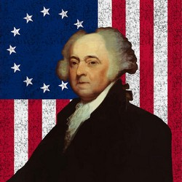
John Adams
John Adams, A Defence of the Constitutions of Government of the United States of America, 3 vols., American Constitutional and Legal History, ed. Leonard W. Levy (London: Dilly, 1787; reprint, NY: Da Capo, 1971), 3:217
“The moment the idea is admitted into society, that property is not as sacred as the laws of God, and that there is not a force of law and public justice to protect it, anarchy and tyranny commence. If ‘Thou Shalt Not Covet,’ and ‘Thou Shalt Not Steal’ were not commandments of Heaven, they must be made inviolable precepts in every society before it can be civilized or made free.”

Slide 6
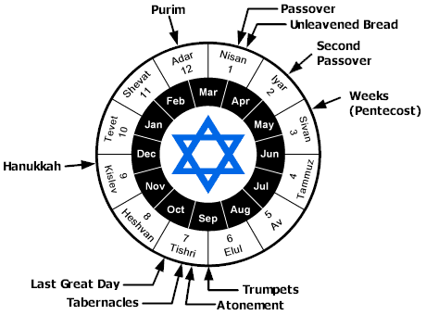

Slide 7
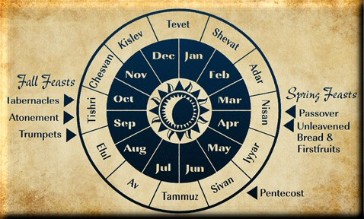

Slide 8
Acts 2:42-47 Church
Priorities (42)
Miracles (43)
Unity (44)
Communal living (45)
Lord’s Table (46)
Evangelism (47)

Slide 9
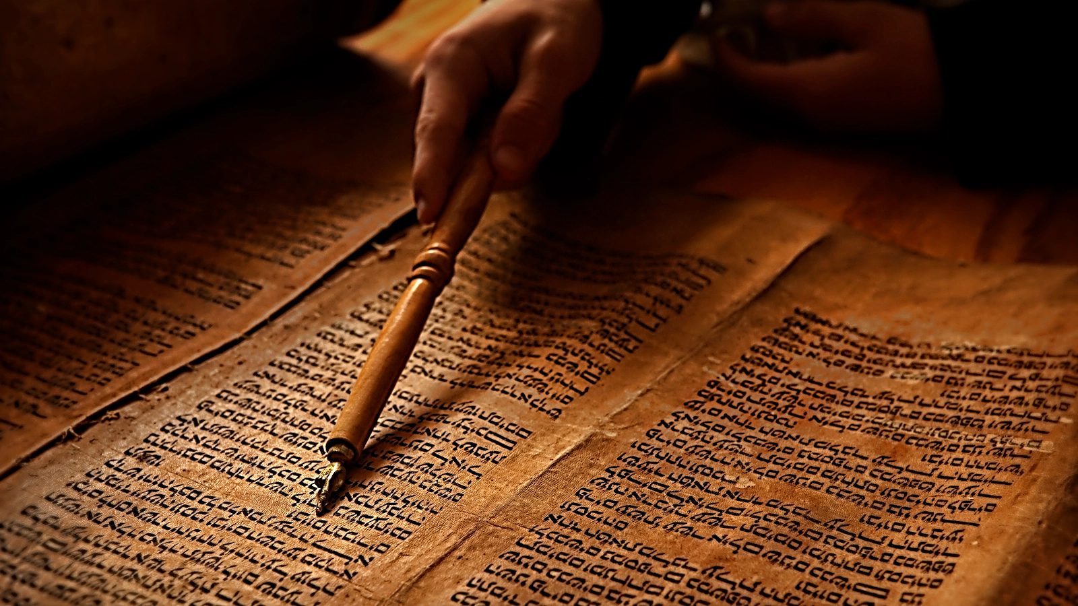
John 5:39, 46
“³⁹ You search the Scriptures because you think that in them you have eternal life; it is these that testify about Me…⁴⁶ For if you believed Moses, you would believe Me, for he wrote about Me.”

Slide 10
Luke 24:27, 44
“²⁷ Then beginning with Moses and with all the prophets, He explained to them the things concerning Himself in all the Scriptures…⁴⁴ Now He said to them, ‘These are My words which I spoke to you while I was still with you, that all things which are written about Me in the Law of Moses and the Prophets and the Psalms must be fulfilled.’”

Slide 11
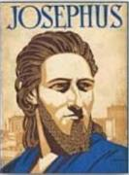
Josephus
Antiquities 18.3.3
“About this time there lived Jesus, a wise man, if indeed one ought to call him a man. For he was one who performed surprising deeds and was a teacher of such people as accept the truth gladly. He won over many Jews and many of the Greeks. He was the Christ. And when, upon the accusation of the principal men among us, Pilate had condemned him to a cross, those who had first come to love him did not cease. He appeared to them spending a third day restored to life, for the prophets of God had foretold these things and a thousand other marvels about him. And the tribe of the Christians, so called after him, has still to this day not disappeared.”

Slide 12
OT Prophecies About Christ
Prophecy | Scripture | Years in Advance
Manner of Birth | Isaiah 7:14 | 700 years
Place of Birth | Micah 5:2 | 700 years
Nationality | Numbers 24:17 | 1400 years
Tribe | Genesis 49:10 | 1800 years
Time of and Response to His Messiahship | Dan. 9:25-26 | 600 years

Slide 13
OT Prophecies About Christ
Prophecy | Scripture | Years in Advance
Crucified Between Thieves | Isaiah 53:9 | 700 years
Pierced | Isaiah 53:5 | 700 years
No Broken Bones | Psalm 22:17 | 1000 years
Gamble for His Clothing | Psalm 22:18 | 1000 years
Buried in Rich Man’s Tomb | Isaiah 53:9 | 700 years
Notes:
109 prophecies…
Peter Stoner – SCIENCE SPEAKS, An Evaluation of Certain Christian Evidences
To fulfill just 8 prophecies =1 X 10 to the twenty-eighth power!
Can we visualize this with an illustration? Suppose we took an atheistic professor, blindfolded him and covered the state of Texas two feet deep with silver dollars. Then we put a check on one of those silver dollars and mixed them up. The odds of one person fulfilling just these eight prophecies would be the same as this atheistic professor selecting the silver dollar upon which we have placed a check, in his first try.
https://www.bereanpublishers.com/the-odds-of-eight-messianic-prophecies-coming-true/

Slide 14
Acts 2:42-47 Church
Priorities (42)
Miracles (43)
Unity (44)
Communal living (45)
Lord’s Table (46)
Evangelism (47)

Slide 15
Matthew 16:18
“I also say to you that you are Peter, and upon this rock I will build [oikodomeō] My church; and the gates of Hades WILL NOT overpower it.”

Slide 16
Message
Birth and growth of the church numerically, geographically, ethnically.
Components
Numerically (progress reports)
Geographically (From Jerusalem to Rome)
Ethnically (From Judaism to Gentile domination)

Slide 17
Progress Reports
Clearest: Acts 2:47; 6:7; 9:31; 12:24; 16:5; 19:20; 28:30-31
Less clear: Acts 1:13, 15; 2:41, 47; 4:4, 31; 5:14, 42; 8:25, 40; 11:21; 13:49; 17:6

Slide 18
Acts 2:47
“praising God and having favor with all the people. And the Lord was adding to their number day by day those who were being saved.” (NASB)
“praising God and having favor with all the people. And the Lord added to the church daily those who were being saved.” (NKJV)

Slide 19
Author | Written | Earliest MSS | Time Span | No. MSS
Cesar | 100 to 44 b.c. | a.d. 900 | 1000 | 10
Plato | 427 to 347 b.c. | a.d. 900 | 1200 | 7
Thucydides | 460 to 400 b.c. | a.d. 900 | 1300 | 8
Tacitus | a.d. 100 | a.d. 1100 | 1000 | 20
Suetonius | a.d. 75 to 160 | a.d. 950 | 800 | 8
Homer (Illiad) | 900 b.c. | a.d. 400 | 500 | 643
New Testament | a.d. 40 to 100 | a.d. 125 | 25 to 50 | 24,000
Cesar | 100 to 44 b.c. | a.d. 900 | 1000 | 10
http://creationrevolution.com/2012/05/should-we-trust-the-bible/

Slide 20
Manuscript Evidence for Ancient Writings
Author | Written | Earliest Fragment/Copy | Time Span in Years | Number of Manuscripts
Cesar | 100 to 44 b.c. | a.d. 900 | 1000 | 10
Plato | 427 to 347 b.c. | a.d. 900 | 1200 | 7
Thucydides | 460 to 400 b.c. | a.d. 900 | 1300 | 8
Tacitus | a.d. 100 | a.d. 1100 | 1000 | 20
Suetonius | a.d. 75 to 160 | a.d. 950 | 800 | 8
Homer (Illiad) | 900 b.c. | a.d. 400 | 500 | 643
New Testament | a.d. 40 to 100 | a.d. 125 | 25 to 50 | 24,000
Information in this chart can be found in various sources. This chart was adapted from: Christian Apologetics, by Norman Geisler, 1976, p. 307; and Evidence That Demands a Verdict, by Josh McDowell, 1979, pp. 42, 43.

Slide 21
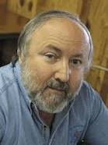
Arnold Fruchtenbaum Arnold G. Fruchtenbaum, “Israel and the Church,” in Issues in Dispensationalism, ed. Wesley R. Willis and John R. Master (Chicago: Moody, 1994), 118.
“In the book of Acts, both Israel and the church exist simultaneously. The term Israel is used twenty times and ekklēsia (church) nineteen times, yet the two groups are always kept distinct.”

Slide 22
Conclusion

Slide 23
Acts 2 Chapter Summary
Coming of the Holy Spirit (1-4)
Holy Spirit’s Impact (5-13)
Peter’s Sermon (14-36)
Sermon’s Impact (37-47)

