Slide 1
Genesis 12‒50
Israel’s Birth & Preservation

Slide 2
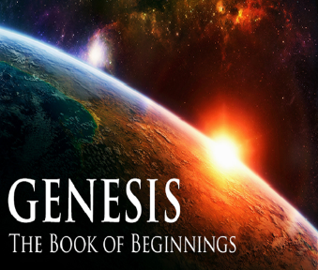
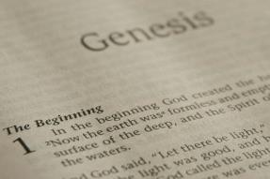
GENESIS STRUCTURE
Genesis 12-50 (four people)
Abraham (12:1–25:11)
Isaac (25:12–26:35)
Jacob (27–36)
Joseph (37–50)

Slide 3
Genesis 29 Chapter Summary
Jacob’s Arrival (1-14)
Jacob’s Marriages (15-30)
Jacob's Sons (31-35)

Slide 4
Genesis 29 Chapter Summary
Jacob’s Arrival (1-14)
Jacob’s Marriages (15-30)
Jacob’s Sons (31-35)

Slide 5
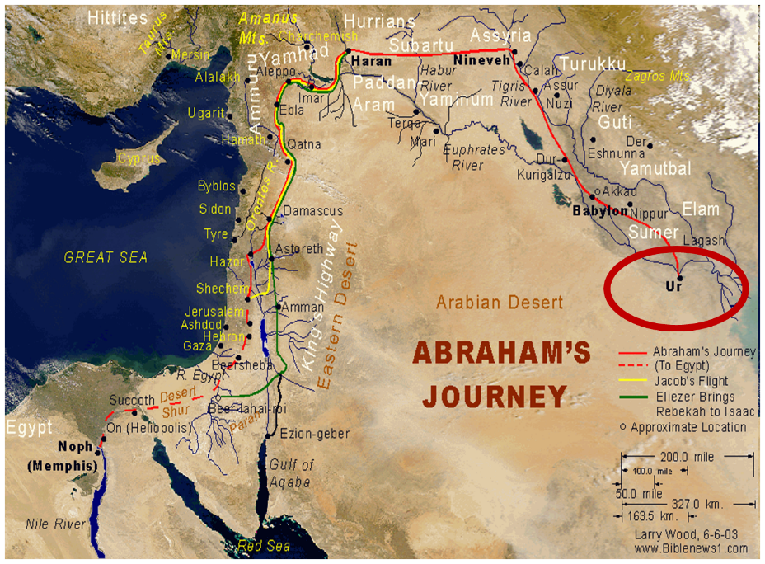

Slide 6
Genesis 29 Chapter Summary
Jacob’s Arrival (1-14)
Jacob’s Marriages (15-30)
Jacob’s Sons (31-35)

Slide 7
II. Genesis 29:15-30 Jacob’s Marriages
Marriage contract (15-19)
Marriages (20-30)

Slide 8
II. Genesis 29:15-30 Jacob’s Marriages
Marriage contract (15-19)
Marriages (20-30)

Slide 9
II. Genesis 29:15-30 Jacob’s Marriages
Marriage contract (15-19)
Marriages (20-30)

Slide 10
Genesis 29:20-30 Jacob’s Marriages
Seven years of labor for Rachel (20)
Marriage to Leah (21-25a)
Marriage to Rachel (25b-30)

Slide 11
Genesis 29:20-30 Jacob’s Marriages
Seven years of labor for Rachel (20)
Marriage to Leah (21-25a)
Marriage to Rachel (25b-30)

Slide 12
Genesis 29:20-30 Jacob’s Marriages
Seven years of labor for Rachel (20)
Marriage to Leah (21-25a)
Marriage to Rachel (25b-30)

Slide 13
Genesis 29:20-30 Jacob’s Marriages
Seven years of labor for Rachel (20)
Marriage to Leah (21-25a)
Marriage to Rachel (25b-30)

Slide 14
Genesis 29:25b-30 Marriage to Rachel
Jacob’s complaint (25b)
Laban’s response (26-27)
Jacob’s agreement (28)
Wedding gift (29)
Consummation (30a)
Second seven years (30b)

Slide 15
Genesis 29:25b-30 Marriage to Rachel
Jacob’s complaint (25b)
Laban’s response (26-27)
Jacob’s agreement (28)
Wedding gift (29)
Consummation (30a)
Second seven years (30b)

Slide 16
Matt 24 / Rev 6 Parallels
Prediction | Birth pangs (Matt 24) | Seal judgments (Rev 6)
1. False Christ | 24:5 | 6:2
2. War | 24:6 | 6:3-4
3. Famine | 24:7 | 6:5-6
4. Death | 24:6-7 | 6:7-8
5. Martyrs | 24:9-13 | 6:9-11
6. Earthquakes | 24:7 | 6:12-17
7. Evangelism | 24:14 | 7:1-9

Slide 17
Genesis 29:25b-30 Marriage to Rachel
Jacob’s complaint (25b)
Laban’s response (26-27)
Jacob’s agreement (28)
Wedding gift (29)
Consummation (30a)
Second seven years (30b)

Slide 18
Genesis 29:26-27 Laban’s Response
Local custom (26)
Laban’s offer (27)

Slide 19
Genesis 29:26-27 Laban’s Response
Local custom (26)
Laban’s offer (27)

Slide 20
Genesis 29:26-27 Laban’s Response
Local custom (26)
Laban’s offer (27)

Slide 22
Messiah must present Himself to Israel on March 30, A.D. 33 (Daniel 9:25)

Slide 23
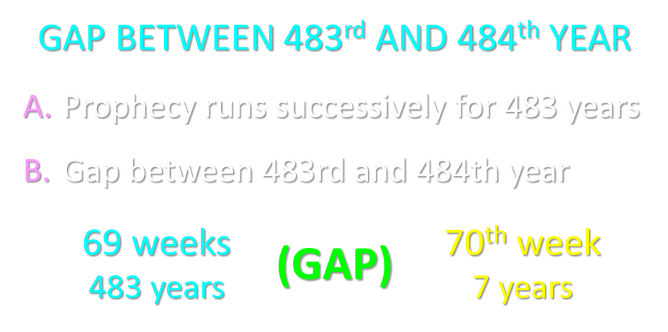

Slide 24
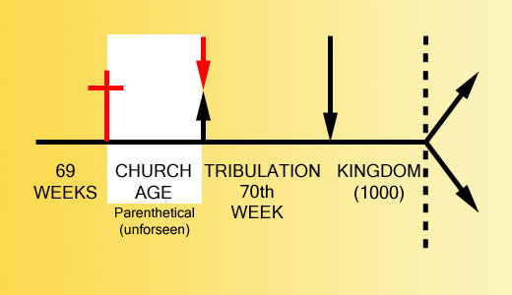

Slide 25
Daniel 9:27
And he will make a firm covenant with the many for one week, but in the middle of the week he will put a stop to sacrifice and grain offering; and on the wing of abominations will come one who makes desolate, even until a complete destruction, one that is decreed, is poured out on the one who makes desolate.

Slide 27
Genesis 29:25b-30 Marriage to Rachel
Jacob’s complaint (25b)
Laban’s response (26-27)
Jacob’s agreement (28)
Wedding gift (29)
Consummation (30a)
Second seven years (30b)

Slide 28
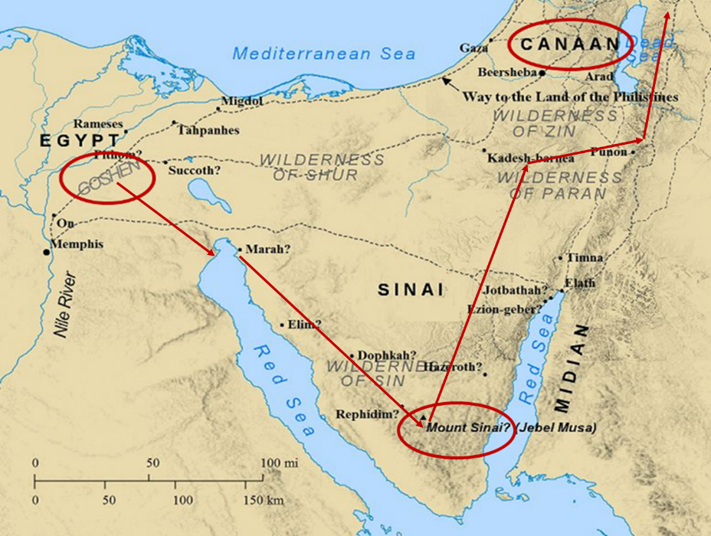

Slide 29
Genesis 29:25b-30 Marriage to Rachel
Jacob’s complaint (25b)
Laban’s response (26-27)
Jacob’s agreement (28)
Wedding gift (29)
Consummation (30a)
Second seven years (30b)

Slide 30
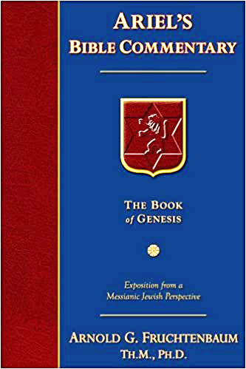
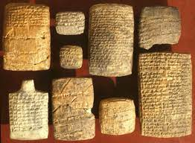
Dr. Arnold G. Fruchtenbaum
The Book of Genesis, 446
“Verse 29 discloses the wedding gift: And Laban gave to Rachel his daughter Bilhah, meaning ‘terror,’ his handmaid to be her handmaid. Again, this is in keeping with the Nuzi Tablets.”

Slide 31
Genesis 29:25b-30 Marriage to Rachel
Jacob’s complaint (25b)
Laban’s response (26-27)
Jacob’s agreement (28)
Wedding gift (29)
Consummation (30a)
Second seven years (30b)

Slide 32
Genesis 29:25b-30 Marriage to Rachel
Jacob’s complaint (25b)
Laban’s response (26-27)
Jacob’s agreement (28)
Wedding gift (29)
Consummation (30a)
Second seven years (30b)

Slide 33
Genesis 29 Chapter Summary
Jacob’s Arrival (1-14)
Jacob’s Marriages (15-30)
Jacob’s Sons (31-35)

Slide 34
Distinctions Between 144,000 & Multitude
144,000 | MULTITUDE
Revelation 7:1-8 | Revelation 7:9-17
Numbered | Innumerable
Jews | All nations
Sealed | Slain
Sealed before the Tribulation | Converted out of the Tribulation
Hitchcock and Ice, The Truth Behind Left Behind, 77

Slide 35
III. Genesis 29:31-35 Jacob’s Sons
God’s providence (31)
Leah’s four sons (32-35a)
Conclusion (35b)

Slide 36
III. Genesis 29:31-35 Jacob’s Sons
God’s providence (31)
Leah’s four sons (32-35a)
Conclusion (35b)

Slide 37
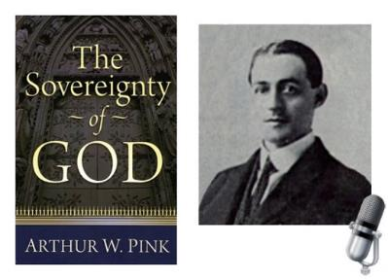
A. W. Pink
Sovereignty of God, p. 160, 163.
“The fact is, that the love of God, is a truth for the Saints only…In like manner, the ‘world’ in John 3:16 must, in the final analysis, refer to the world of God’s people.”

Slide 38
III. Genesis 29:31-35 Jacob’s Sons
God’s providence (31)
Leah’s four sons (32-35a)
Conclusion (35b)

Slide 39
Genesis 29:32-35a Leah’s Four Sons
Reuben’s birth (32)
Simeon’s birth (33)
Levi’s birth (34)
Judah’s birth (35a)

Slide 40
Genesis 29:32-35a Leah’s Four Sons
Reuben’s birth (32)
Simeon’s birth (33)
Levi’s birth (34)
Judah’s birth (35a)

Slide 41
Genesis 29:32-35a Leah’s Four Sons
Reuben’s birth (32)
Simeon’s birth (33)
Levi’s birth (34)
Judah’s birth (35a)

Slide 42
Genesis 29:32-35a Leah’s Four Sons
Reuben’s birth (32)
Simeon’s birth (33)
Levi’s birth (34)
Judah’s birth (35a)

Slide 44
Genesis 29:32-35a Leah’s Four Sons
Reuben’s birth (32)
Simeon’s birth (33)
Levi’s birth (34)
Judah’s birth (35a)

Slide 45
Dr. Arnold G. Fruchtenbaum
The Book of Genesis, 448
“In the naming of the first three sons, Leah named them with a basic hope that Jacob would learn to love her or at least treat her equally. That never happened. By the time she came to her fourth son, she focused on God and not on Jacob, realizing that although not loved by Jacob, she was loved by God. The two key institutions of Israel, priesthood (Levi) and royalty (Judah), came from an unplanned and unwanted marriage.”

Slide 46
Dr. Arnold G. Fruchtenbaum
The Book of Genesis, 448
“In the naming of the first three sons, Leah named them with a basic hope that Jacob would learn to love her or at least treat her equally. That never happened. By the time she came to her fourth son, she focused on God and not on Jacob, realizing that although not loved by Jacob, she was loved by God. The two key institutions of Israel, priesthood (Levi) and royalty (Judah), came from an unplanned and unwanted marriage.”

Slide 47
III. Genesis 29:31-35 Jacob’s Sons
God’s providence (31)
Leah’s four sons (32-35a)
Conclusion (35b)

Slide 48
Conclusion

Slide 49
Genesis 29 Chapter Summary
Jacob’s Arrival (1-14)
Jacob’s Marriages (15-30)
Jacob’s Sons (31-35)

Slide 50
²⁴ The Lord bless you, and keep you; ²⁵ The Lord make His face shine on you, And be gracious to you; ²⁶ The Lord lift up His countenance on you, And give you peace.
Numbers 6:24–26 (NASB95)

