Slide 1


Dr. Andy Woods
Senior Pastor – Sugar Land Bible Church
President – Chafer Theological Seminary

Slide 2

Structure
1 THESSALONIANS 1-3 | 1 THESSALONIANS 4-5
Personal Experience | Practical Exhortation
Looking Back | Looking Forward

Slide 3

Structure
Personal (1–3)
  Genuine conversion (1)
  Impure motives (2:1-16)
  Lack of concern (2:17–3:13)
Practical (4–5)
  Immorality (4:1-8)
  Laziness (4:9-12)
  Eschatology (4:13–5:11)
  Ministry imbalances (5:12-15)
  Progressive sanctification (5:16-28)

Slide 4
Structure
Personal (1–3)
  Genuine conversion (1)
  Impure motives (2:1-16)
  Lack of concern (2:17–3:13)
Practical (4–5)
  Immorality (4:1-8)
  Laziness (4:9-12)
  Eschatology (4:13–5:11)
  Ministry imbalances (5:12-15)
  Progressive sanctification (5:16-28)

Slide 5
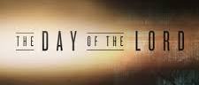
Day of the Lord (5:1-11)
Description (5:1-3)
Application (5:4-11)

Slide 6
Day of the Lord (5:1-11)
Description (5:1-3)
Application (5:4-11)

Slide 7


Slide 8


Slide 9
Day of the Lord (5:1-11)
Description (5:1-3)
Application (5:4-11)

Slide 10

Matthew 24:36-39
³⁶ “But of that day and hour no one knows, not even the angels of heaven, nor the Son, but the Father alone. ³⁷ For the coming of the Son of Man will be just like the days of Noah. ³⁸ For as in those days before the flood they were eating and drinking, marrying and giving in marriage, until the day that Noah entered the ark, ³⁹ and they did not understand until the flood came and took them all away; so will the coming of the Son of Man be.”

Slide 11

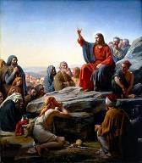
Matt 5:13, 16
“You are the light of the world. A city set on a hill cannot be hidden…Let your light shine before men in such a way that they may see your good works, and glorify your Father who is in heaven.”

Slide 12
Seven “I AM” statements in John
1. I am the Bread of Life | 6:35
2. I am the Light of the world | 8:12
3. I am the Gate for the sheep | 10:7; cf. v.9
4. I am the Good Shepherd | 10:11,14
5. I am the Resurrection and the Life | 11:25
6. I am the Way and the Truth and the Life | 14:6
7. I am the true Vine | 15:1; cf. v.5

Slide 13
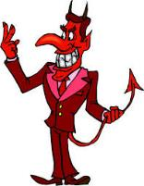
Names & Titles Demonstrating Satan’s
Post-Fall, Earthly Authority
(Job 1:7; 2:2; Luke 4:5-8; Rom. 8:19-22)
Prince of this world (John 12:31; 14:30; 16:11)
God of this age (2 Cor. 4:4)
Prince and power of the air (Eph. 2:2)
Who the believer wrestles with (Eph. 6:12)
Roaring lion (1 Pet. 5:8)
Whole world lies in his power (1 John 5:19)

Slide 14


Acts 2:13, 15
¹³ “But others were mocking and saying, ‘They are full of sweet wine.’… ¹⁵ ‘For these men are not drunk, as you suppose, for it is only the third hour of the day.’”

Slide 15
Ephesians: What Is Inside?
1–3 | 4–6
Relationship | Responsibility
No imperatives | 35 imperatives
Orthodoxy | Orthopraxy
Knowledge | Wisdom
Belief | Behavior
Position | Practice
Privileges | Responsibility

Slide 16
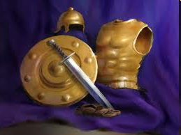
Ephesians
Dressed for Success!

Slide 17

6 Pieces of Armor (Eph 6:14-17)
Belt of truth (14a)
Breastplate of righteousness (14b)
Sandals of peace (15)
Shield of faith (16)
Helmet of salvation (17a)
Sword of the Spirit (17b)
Notes:
17

Slide 18

2 Peter 1:5-7
⁵ Now for this very reason also, applying all diligence, in your faith supply moral excellence, and in your moral excellence, knowledge, ⁶ and in your knowledge, self-control, and in your self-control, perseverance, and in your perseverance, godliness, ⁷ and in your godliness, brotherly kindness, and in your brotherly kindness, love.

Slide 19
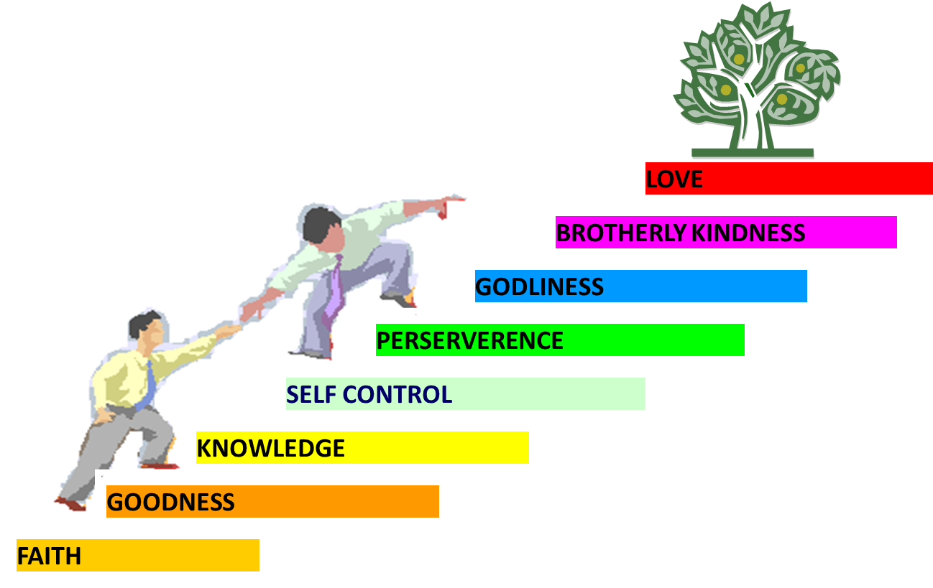
PORTRAIT OF GROWTH
1:5-7

Slide 20
Three Tenses of Salvation
Phase | Justification | Sanctification | Glorification
Tense | Past | Present | Future
Saved from sin’s: | Penalty | Power | Presence
Scripture | Eph 2:8-9; Titus 3:5 | Philip 2:12 | Rom 5:10

Slide 21

Romans 13:11-12
“Do this, knowing the time, that it is already the hour for you to awaken from sleep; for now salvation is nearer to us than when we believed. ¹² The night is almost gone, and the day is near. Therefore, let us lay aside the deeds of darkness and put on the armor of light.”

Slide 22

Romans 8:29-30
²⁹ For those whom He foreknew, He also predestined to become conformed to the image of His Son, so that He would be the firstborn among many brethren; ³⁰ and these whom He predestined, He also called; and these whom He called, He also justified; and these whom He justified, He also glorified.

Slide 23
Three Reasons Believers Will Not Be in the Tribulation
(1 Thess. 4:9-11)
    We are not appointed unto wrath (9)
    We are exempted from wrath whether morally asleep or awake (10)
    Promises of comfort (11)

Slide 24
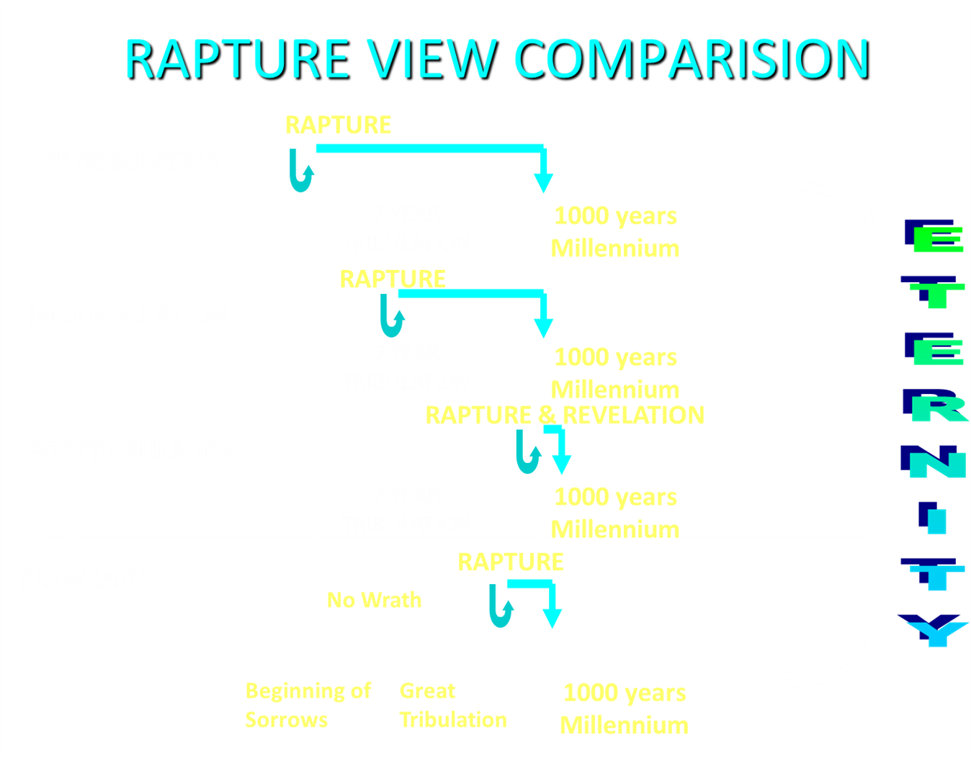

Slide 25
Three Reasons Believers Will Not Be in the Tribulation
(1 Thess. 4:9-11)
    We are not appointed unto wrath (9)
    We are exempted from wrath whether morally asleep or awake (10)
    Promises of comfort (11)

Slide 26

Promised Exemption from Divine Wrath
The promise (1 Thess 1:10; 5:9; Rom 5:9; 8:1; Rev 3:10)
Tribulation = divine wrath/anger (Rev 6:16-17; 11:18; 14:10; 15:1, 7; 16:1, 19; 19:15)

Slide 27


1 Thessalonians 1:10
“and to wait for His Son from heaven, whom He raised from the dead, that is Jesus, who rescues (rhyomai) us from (ek) the wrath (orgē) to come..”

Slide 28



Slide 29
Revelation 6:16-17
^{“16} and they (unbelievers) said to the mountains and to the rocks, ‘Fall on us and hide us from the presence of Him who sits on the throne, and from the wrath [orgḗ] of the Lamb; ¹⁷ for the great day of their wrath [orgḗ] has come, and who is able to stand?’”

Slide 30

Rev. 6:16-17
Robert L. Thomas, Revelation 1–7: An Exegetical Commentary, ed. Kenneth Barker (Chicago: Moody, 1992), 457-58.
"Mankind in his rebellion correctly analyzes the cosmic and terrestrial disturbances as a part of the great end-time day of wrath from the one sitting on the throne and from the Lamb. The verb ēlethen ("has come") is aorist indicative, referring to a previous arrival of wrath, not something that is about to take place. Men see the arrival of this day at least as early as the cosmic upheavals that characterize the sixth seal (6:12-14), but upon reflection they probably recognize that it was already in effect with the death of one-fourth of the population (6:7-8), the worldwide famine (6:5-6), and the global warfare (6:3-4). The rapid sequence of all of these events could not escape notice, but the light of their true explanation does not dawn upon human consciousness until the severe phenomena of the sixth seal arrive."

Slide 31
Three Tenses of Salvation
Phase | Justification | Sanctification | Glorification
Tense | Past | Present | Future
Saved from sin’s: | Penalty | Power | Presence
Scripture | Eph 2:8-9; Titus 3:5 | Philip 2:12 | Rom 5:10

Slide 32

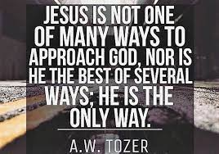
John 14:6
“Jesus said to him, ‘I am the way, and the truth, and the life; no one comes to the Father but through Me.’”

Slide 33
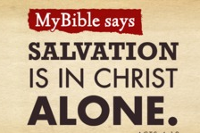
Acts 4:12
“And there is salvation in no one else; for there is no other name under heaven that has been given among men by which we must [dei] be saved.”

Slide 34
Three Reasons Believers Will Not Be in the Tribulation
(1 Thess. 4:9-11)
    We are not appointed unto wrath (9)
    We are exempted from wrath whether morally asleep or awake (10)
    Promises of comfort (11)

Slide 35

1 Thessalonians 4:13-18
¹³ "But we do not want you to be uninformed, brethren, about those who are asleep, so that you will not grieve as do the rest who have no hope. ¹⁴ For if we believe that Jesus died and rose again, even so God will bring with Him those who have fallen asleep in Jesus. ¹⁵ For this we say to you by the word of the Lord, that we who are alive and remain until the coming of the Lord, will not precede those who have fallen asleep. ¹⁶ For the Lord Himself will descend from . . .

Slide 36
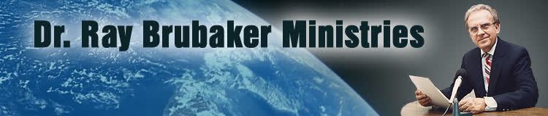
Ray Brubaker
"The Purpose of the Tribulation," Radar News, (December 1968): 6.
“Finally, we should note that the purpose of the tribulation is also to be the testing of lukewarm shallow Laodicean Christians who will be left behind at the coming of Christ. No doubt multitudes who expect to be raptured will be disappointed because like the foolish virgins, they were not watchful. Tribulation is then for the purpose of trying the faith of those who profess to be Christians but who really never repented or are living in disobedience to the will of God.”

Slide 37

G.N.H. Peters
Theocratic Kingdom, 2:332
“It is not simply those who ‘watch’ that shall ‘escape,’ but those, Luke 21:36 who ‘watch and pray always,’ avoiding the corrupting influences around them. The number of translated ones may not be very large (for the number of translated ones given as...types in comparison with the number of those not translated, and with that of the resurrected saints is small so that Dr. Seiss, with whom many concur, is undoubtedly correct in saying: ‘I have no idea that a very large portion of mankind, or even of the professing Church, will be thus taken. The first translation, if I may so speak, will embrace only the select few who watch and pray always,’ etc.””

Slide 38


Slide 39
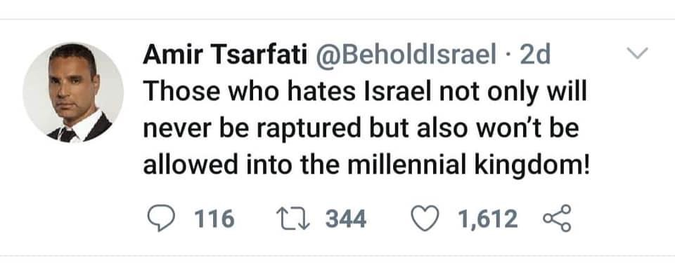

Slide 40
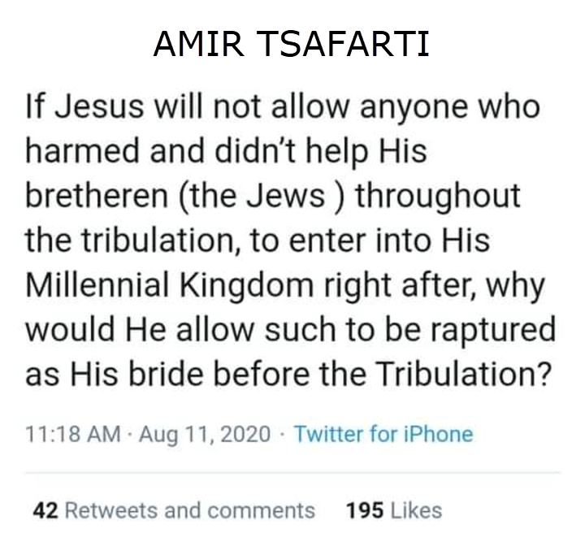

Slide 41
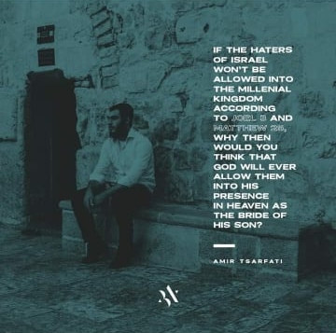

Slide 42
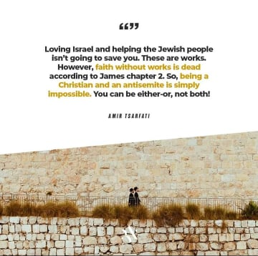

Slide 43


1 Corinthians 15:51
“Behold, I tell you a mystery; we will not all sleep, but we will all be changed.”

Slide 44
Three Reasons Believers Will Not Be in the Tribulation
(1 Thess. 4:9-11)
    We are not appointed unto wrath (9)
    We are exempted from wrath whether morally asleep or awake (10)
    Promises of comfort (11)

Slide 45
2 Peter 3:10-11
“¹⁰ But the day of the Lord will come like a thief, in which the heavens will pass away with a roar and the elements will be destroyed with intense heat, and the earth and its works will be burned up. ¹¹ Since all these things are to be destroyed in this way, what sort of people ought you to be in holy conduct and godliness.”

Slide 46
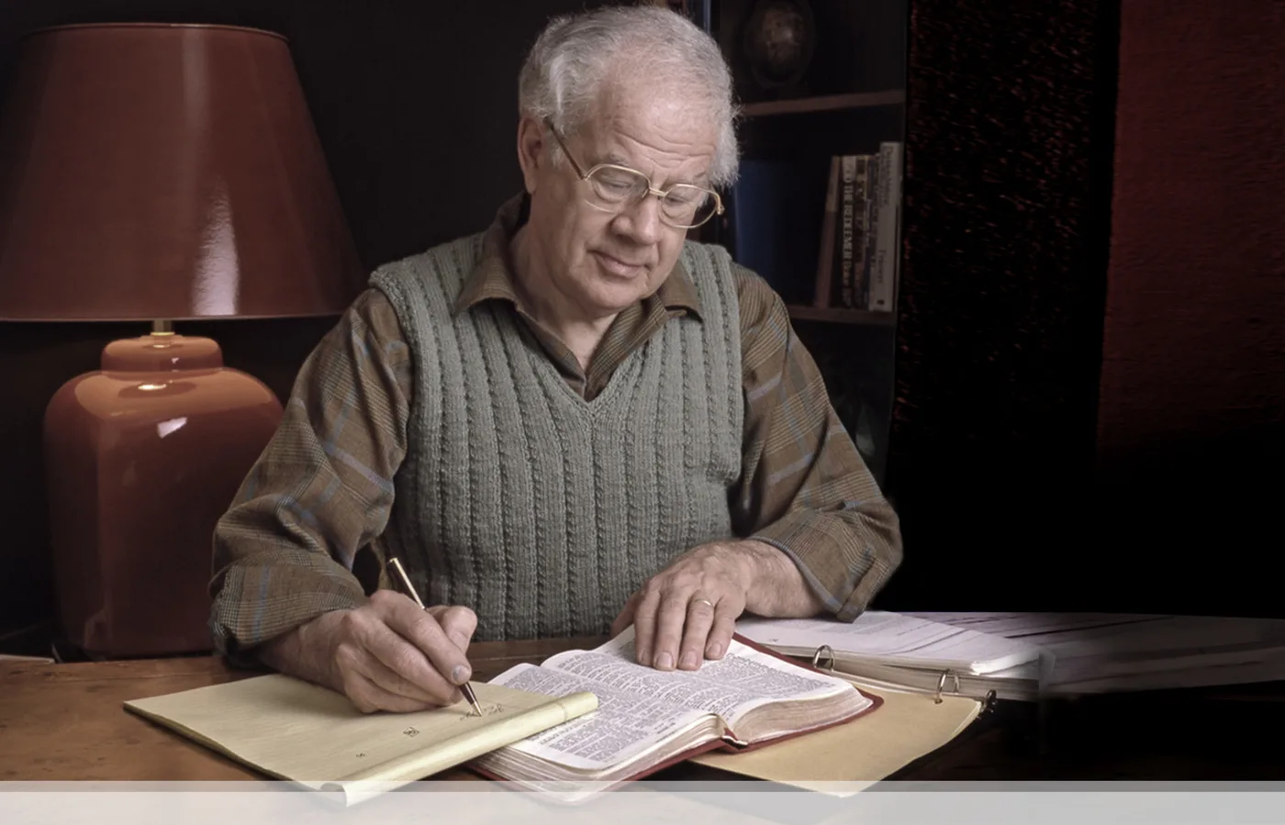
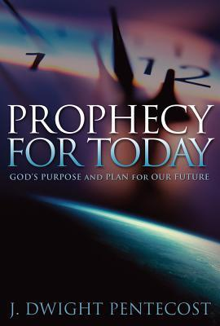
J. Dwight Pentecost
Prophecy For Today, Page 20
“A short time ago, I took occasion to go through the New Testament to mark each reference to the coming of the Lord Jesus Christ and to observe the use made of that teaching about His coming. I was struck a new with the fact that almost without exception, when the coming of Christ is mentioned in the New Testament, it is followed by an exhortation to godliness and holy living.”

Slide 47


John 14:1–4
¹ “Do not let your heart be troubled; believe in God, believe also in Me. ² In My Father’s house are many dwelling places; if it were not so, I would have told you; for I go to prepare a place for you. ³ If I go and prepare a place for you, I will come again and receive you to Myself, that where I am, there you may be also. ⁴ And you know the way where I am going.”

Slide 48
1 Thessalonians 4:13-18
. . .heaven with a shout, with the voice of the archangel and with the trumpet of God, and the dead in Christ will rise first. ¹⁷ Then we who are alive and remain will be caught up together with them in the clouds to meet the Lord in the air, and so we shall always be with the Lord. ¹⁸ Therefore comfort one another with these words."

Slide 49

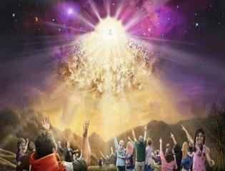

Titus 2:13
“Looking for the blessed hope and the appearing of the glory of our great God and Savior, Christ Jesus.”

Slide 51
Conclusion

Slide 52
Structure
Personal (1–3)
  Genuine conversion (1)
  Impure motives (2:1-16)
  Lack of concern (2:17–3:13)
Practical (4–5)
  Immorality (4:1-8)
  Laziness (4:9-12)
  Eschatology (4:13–5:11)
  Ministry imbalances (5:12-15)
  Progressive sanctification (5:16-28)

Slide 53
Day of the Lord (5:1-11)
Description (5:1-3)
Application (5:4-11)

Slide 54
Structure
Personal (1–3)
  Genuine conversion (1)
  Impure motives (2:1-16)
  Lack of concern (2:17–3:13)
Practical (4–5)
  Immorality (4:1-8)
  Laziness (4:9-12)
  Eschatology (4:13–5:11)
  Ministry imbalances (5:12-15)
  Progressive sanctification (5:16-28)

