Slide 1
Genesis 12‒50
Israel’s Birth & Preservation

Slide 2
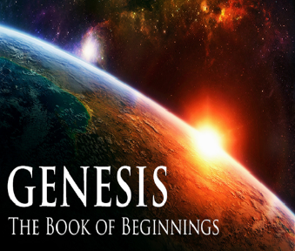
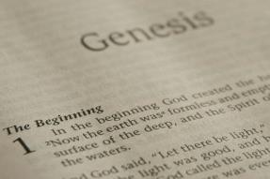
GENESIS STRUCTURE
Genesis 12-50 (four people)
Abraham (12:1–25:11)
Isaac (25:12–26:35)
Jacob (27–36)
Joseph (37–50)

Slide 3
Genesis 29 Chapter Summary
Jacob’s Arrival (1-14)
Jacob’s Marriages (15-30)
Jacob's Sons (31-35)

Slide 4
Genesis 29 Chapter Summary
Jacob’s Arrival (1-14)
Jacob’s Marriages (15-30)
Jacob’s Sons (31-35)

Slide 5
I. Genesis 29:1-14 Jacob’s Arrival
Journey (1)
At the well (2-3)
Conversation with the locals (4-8)
Jacob meets Rachel (9-12)
Jacob in Laban’s home (13-14)

Slide 6
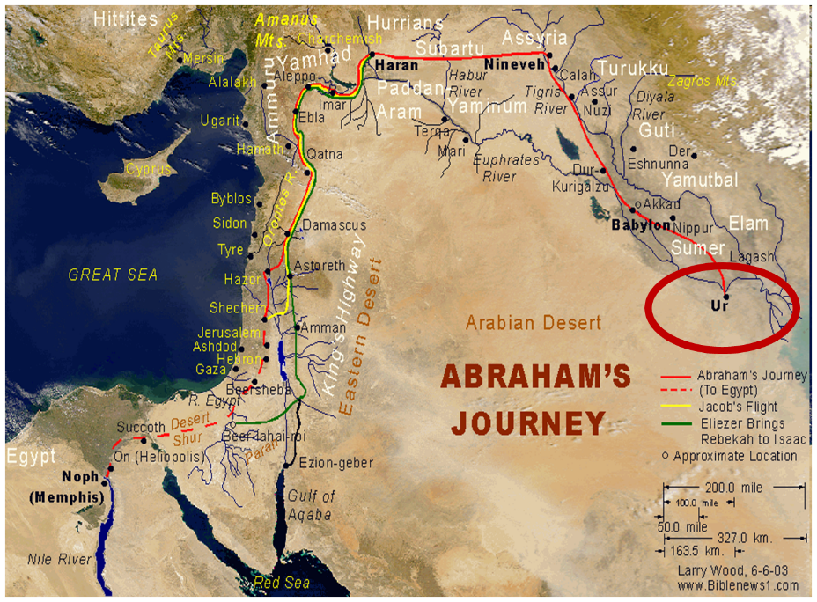

Slide 7
Genesis 29 Chapter Summary
Jacob’s Arrival (1-14)
Jacob’s Marriages (15-30)
Jacob’s Sons (31-35)

Slide 8
II. Genesis 29:15-30 Jacob’s Marriages
Marriage contract (15-19)
Marriages (20-30)

Slide 9
II. Genesis 29:15-30 Jacob’s Marriages
Marriage contract (15-19)
Marriages (20-30)

Slide 10
Genesis 29:15-19 Marriage Contract
Laban’s inquiry (15)
Laban’s daughters (16-17)
Jacob’s wages (18)
Laban’s agreement (19)

Slide 11
Genesis 29:15-19 Marriage Contract
Laban’s inquiry (15)
Laban’s daughters (16-17)
Jacob’s wages (18)
Laban’s agreement (19)

Slide 12
Genesis 29:15-19 Marriage Contract
Laban’s inquiry (15)
Laban’s daughters (16-17)
Jacob’s wages (18)
Laban’s agreement (19)

Slide 13
Genesis 29:16-17 Laban’s Daughters
Names (16)
Distinctives (17)

Slide 14
Genesis 29:16-17 Laban’s Daughters
Names (16)
Distinctives (17)

Slide 15
Genesis 29:16-17 Laban’s Daughters
Names (16)
Distinctives (17)

Slide 16
Genesis 29:15-19 Marriage Contract
Laban’s inquiry (15)
Laban’s daughters (16-17)
Jacob’s wages (18)
Laban’s agreement (19)

Slide 17
Genesis 12‒25 Abraham’s Early Journeys
Unconditional promises (Gen. 12:1-3) From Haran to Canaan (Gen. 12:4-5) In Canaan (Gen. 12:6-9) In Egypt (Gen. 12:10-20) Abram and Lot Separate (Gen. 13:1-13) Reaffirmation of Abram’s promises (Gen. 13:14-18) Abram Rescues Lot (14:1-24) Abrahamic Covenant (15:1-21) Hagar & Ishmael (16:1-16) Circumcision (Gen. 17:1-27) | Sodom & Gomorrah (Gen. 18‒19) Abraham & Abimelech (Gen. 20) Isaac’s birth (Gen. 21:1-7) Ishmael’s expulsion (21:8-21) Abraham & Abimelech’s covenant (21:22-34) Abraham sacrifices Isaac (22) Sarah’s death (23) Isaac’s marriage (24) Abraham & Keturah (25:1-6) Abraham’s death (25:7-11)

Slide 18
Genesis 29:15-19 Marriage Contract
Laban’s inquiry (15)
Laban’s daughters (16-17)
Jacob’s wages (18)
Laban’s agreement (19)

Slide 19
II. Genesis 29:15-30 Jacob’s Marriages
Marriage contract (15-19)
Marriages (20-30)

Slide 20
Genesis 29:20-30 Jacob’s Marriages
Seven years of labor for Rachel (20)
Marriage to Leah (21-25a)
Marriage to Rachel (25b-30)

Slide 21
Genesis 29:20-30 Jacob’s Marriages
Seven years of labor for Rachel (20)
Marriage to Leah (21-25a)
Marriage to Rachel (25b-30)

Slide 22
Genesis 29:20-30 Jacob’s Marriages
Seven years of labor for Rachel (20)
Marriage to Leah (21-25a)
Marriage to Rachel (25b-30)

Slide 23
Genesis 29:21-25a Marriage to Leah
Jacob’s demand (21)
Festivities (22)
Wedding night (23)
Wedding gift (24)
Jacob’s discovery (25a)

Slide 24
Genesis 29:21-25a Marriage to Leah
Jacob’s demand (21)
Festivities (22)
Wedding night (23)
Wedding gift (24)
Jacob’s discovery (25a)

Slide 25
Genesis 29:21-25a Marriage to Leah
Jacob’s demand (21)
Festivities (22)
Wedding night (23)
Wedding gift (24)
Jacob’s discovery (25a)

Slide 26
Genesis 29:21-25a Marriage to Leah
Jacob’s demand (21)
Festivities (22)
Wedding night (23)
Wedding gift (24)
Jacob’s discovery (25a)

Slide 27
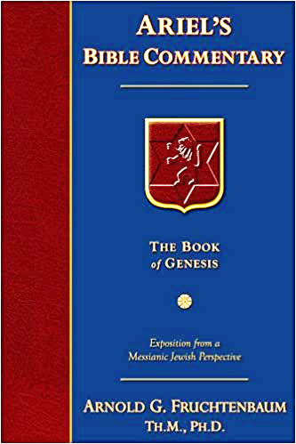
Dr. Arnold G. Fruchtenbaum
The Book of Genesis, 445
“Now the deceiver is deceived, although the motivations differ from good to bad. This is divine retribution in four ways. First, Isaac’s blindness equals the darkness of Jacob’s wedding night, and neither could see well as a result. Second, this Jacob is deceived by being presented the older for the younger, the reversal of Isaac’s presentation of Jacob for Esau. Third, Isaac thought Jacob was Esau and Jacob thought Leah was Rachel. Fourth, Jacob pretended to be his older brother, while Leah pretended to be her younger sister.”

Slide 28
Genesis 29:21-25a Marriage to Leah
Jacob’s demand (21)
Festivities (22)
Wedding night (23)
Wedding gift (24)
Jacob’s discovery (25a)

Slide 29
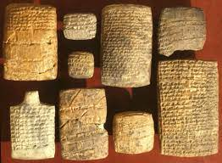
Dr. Arnold G. Fruchtenbaum
The Book of Genesis, 445
“In verse 24 is the wedding gift: And Laban gave Zilpah, meaning ‘nearness’ or ‘intimacy,’ his handmaid unto his daughter Leah for a handmaid. This practice is in keeping with what is known from the Nuzi Tablets.”

Slide 30
Genesis 29:21-25a Marriage to Leah
Jacob’s demand (21)
Festivities (22)
Wedding night (23)
Wedding gift (24)
Jacob’s discovery (25a)

Slide 31
Genesis 29:20-30 Jacob’s Marriages
Seven years of labor for Rachel (20)
Marriage to Leah (21-25a)
Marriage to Rachel (25b-30)

Slide 32
Genesis 29:25b-30 Marriage to Rachel
Jacob’s complaint (25b)
Laban’s response (26-27)
Jacob’s agreement (28)
Wedding gift (29)
Consummation (30a)
Second seven years (30b)

Slide 33
Genesis 29:25b-30 Marriage to Rachel
Jacob’s complaint (25b)
Laban’s response (26-27)
Jacob’s agreement (28)
Wedding gift (29)
Consummation (30a)
Second seven years (30b)

Slide 34
Genesis 29:25b-30 Marriage to Rachel
Jacob’s complaint (25b)
Laban’s response (26-27)
Jacob’s agreement (28)
Wedding gift (29)
Consummation (30a)
Second seven years (30b)

Slide 35
Genesis 29:26-27 Laban’s Response
Local custom (26)
Laban’s offer (27)

Slide 36
Genesis 29:26-27 Laban’s Response
Local custom (26)
Laban’s offer (27)

Slide 37
Genesis 29:26-27 Laban’s Response
Local custom (26)
Laban’s offer (27)

Slide 38
Genesis 29:25b-30 Marriage to Rachel
Jacob’s complaint (25b)
Laban’s response (26-27)
Jacob’s agreement (28)
Wedding gift (29)
Consummation (30a)
Second seven years (30b)

Slide 39
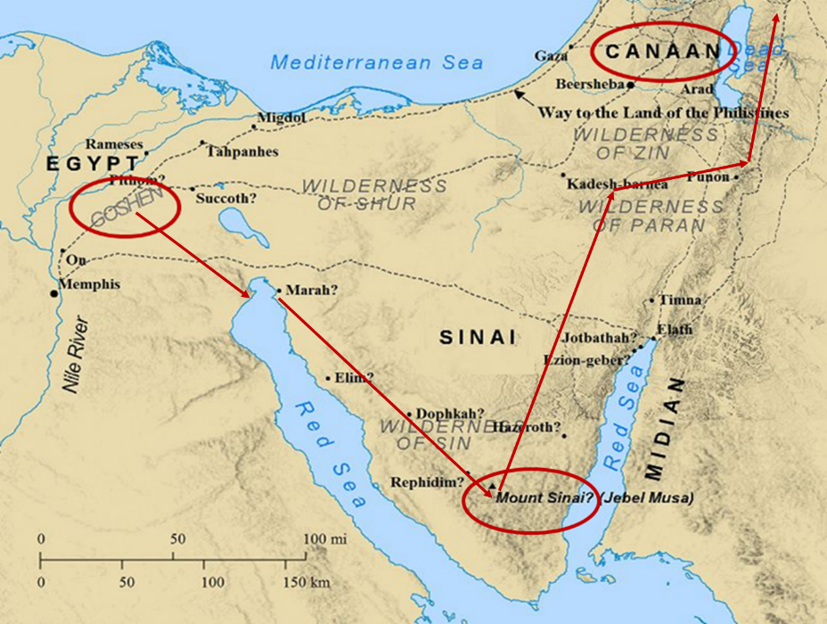

Slide 40
Genesis 29:25b-30 Marriage to Rachel
Jacob’s complaint (25b)
Laban’s response (26-27)
Jacob’s agreement (28)
Wedding gift (29)
Consummation (30a)
Second seven years (30b)

Slide 41
Dr. Arnold G. Fruchtenbaum
The Book of Genesis, 446
“Verse 29 discloses the wedding gift: And Laban gave to Rachel his daughter Bilhah, meaning ‘terror,’ his handmaid to be her handmaid. Again, this is in keeping with the Nuzi Tablets.”

Slide 42
Genesis 29:25b-30 Marriage to Rachel
Jacob’s complaint (25b)
Laban’s response (26-27)
Jacob’s agreement (28)
Wedding gift (29)
Consummation (30a)
Second seven years (30b)

Slide 43
Genesis 29:25b-30 Marriage to Rachel
Jacob’s complaint (25b)
Laban’s response (26-27)
Jacob’s agreement (28)
Wedding gift (29)
Consummation (30a)
Second seven years (30b)

Slide 44
Genesis 29 Chapter Summary
Jacob’s Arrival (1-14)
Jacob’s Marriages (15-30)
Jacob’s Sons (31-35)

Slide 45
Distinctions Between 144,000 & Multitude
144,000 | MULTITUDE
Revelation 7:1-8 | Revelation 7:9-17
Numbered | Innumerable
Jews | All nations
Sealed | Slain
Sealed before the Tribulation | Converted out of the Tribulation
Hitchcock and Ice, The Truth Behind Left Behind, 77

Slide 46
III. Genesis 29:31-35 Jacob’s Sons
God’s providence (31)
Leah’s four sons (32-35a)
Conclusion (35b)

Slide 47
III. Genesis 29:31-35 Jacob’s Sons
God’s providence (31)
Leah’s four sons (32-35a)
Conclusion (35b)

Slide 48
III. Genesis 29:31-35 Jacob’s Sons
God’s providence (31)
Leah’s four sons (32-35a)
Conclusion (35b)

Slide 49
Genesis 29:32-35a Leah’s Four Sons
Reuben’s birth (32)
Simeon’s birth (33)
Levi’s birth (34)
Judah’s birth (35a)

Slide 50
Genesis 29:32-35a Leah’s Four Sons
Reuben’s birth (32)
Simeon’s birth (33)
Levi’s birth (34)
Judah’s birth (35a)

Slide 51
Genesis 29:32-35a Leah’s Four Sons
Reuben’s birth (32)
Simeon’s birth (33)
Levi’s birth (34)
Judah’s birth (35a)

Slide 52
Genesis 29:32-35a Leah’s Four Sons
Reuben’s birth (32)
Simeon’s birth (33)
Levi’s birth (34)
Judah’s birth (35a)

Slide 54
Genesis 29:32-35a Leah’s Four Sons
Reuben’s birth (32)
Simeon’s birth (33)
Levi’s birth (34)
Judah’s birth (35a)

Slide 55
Dr. Arnold G. Fruchtenbaum
The Book of Genesis, 448
“In the naming of the first three sons, Leah named them with a basic hope that Jacob would learn to love her or at least treat her equally. That never happened. By the time she came to her fourth son, she focused on God and not on Jacob, realizing that although not loved by Jacob, she was loved by God. The two key institutions of Israel, priesthood (Levi) and royalty (Judah), came from an unplanned and unwanted marriage.”

Slide 56
III. Genesis 29:31-35 Jacob’s Sons
God’s providence (31)
Leah’s four sons (32-35a)
Conclusion (35b)

Slide 57
Conclusion

Slide 58
Genesis 29 Chapter Summary
Jacob’s Arrival (1-14)
Jacob’s Marriages (15-30)
Jacob’s Sons (31-35)

Slide 59
²⁴ The Lord bless you, and keep you; ²⁵ The Lord make His face shine on you, And be gracious to you; ²⁶ The Lord lift up His countenance on you, And give you peace.
Numbers 6:24–26 (NASB95)

