Slide 1


Dr. Andy Woods
Senior Pastor – Sugar Land Bible Church
President – Chafer Theological Seminary

Slide 2

Structure
1 THESSALONIANS 1-3 | 1 THESSALONIANS 4-5
Personal Experience | Practical Exhortation
Looking Back | Looking Forward

Slide 3

Structure
Personal (1–3)
  Genuine conversion (1)
  Impure motives (2:1-16)
  Lack of concern (2:17–3:13)
Practical (4–5)
  Immorality (4:1-8)
  Laziness (4:9-12)
  Eschatology (4:13–5:11)
  Ministry imbalances (5:12-15)
  Progressive sanctification (5:16-28)

Slide 4
Structure
Personal (1–3)
  Genuine conversion (1)
  Impure motives (2:1-16)
  Lack of concern (2:17–3:13)
Practical (4–5)
  Immorality (4:1-8)
  Laziness (4:9-12)
  Eschatology (4:13–5:11)
  Ministry imbalances (5:12-15)
  Progressive sanctification (5:16-28)

Slide 5
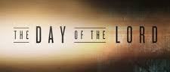
Day of the Lord (5:1-11)
Description (5:1-3)
Application (5:4-11)

Slide 6
Day of the Lord (5:1-11)
Description (5:1-3)
Application (5:4-11)

Slide 7

1 Thessalonians 4:13-18
¹³ "But we do not want you to be uninformed, brethren, about those who are asleep, so that you will not grieve as do the rest who have no hope. ¹⁴ For if we believe that Jesus died and rose again, even so God will bring with Him those who have fallen asleep in Jesus. ¹⁵ For this we say to you by the word of the Lord, that we who are alive and remain until the coming of the Lord, will not precede those who have fallen asleep. ¹⁶ For the Lord Himself will descend from . . .

Slide 8
First Corinthians Structure
Issues reported to Paul (1–6)
  Divisions reported from Chloe’s household (1–4)
  Incest, litigation, and prostitution reported from bearer of former letter (5–6)

Slide 9
First Corinthians Structure
Issues asked of Paul (7–16)
  Marital issues (7:1, 25)
  Liberty (8:1)
  Worship (11:2)
  Spiritual gifts (12:1)
  Resurrection (15:1)
  Money (16:1)
  Apollos (16:12)

Slide 10
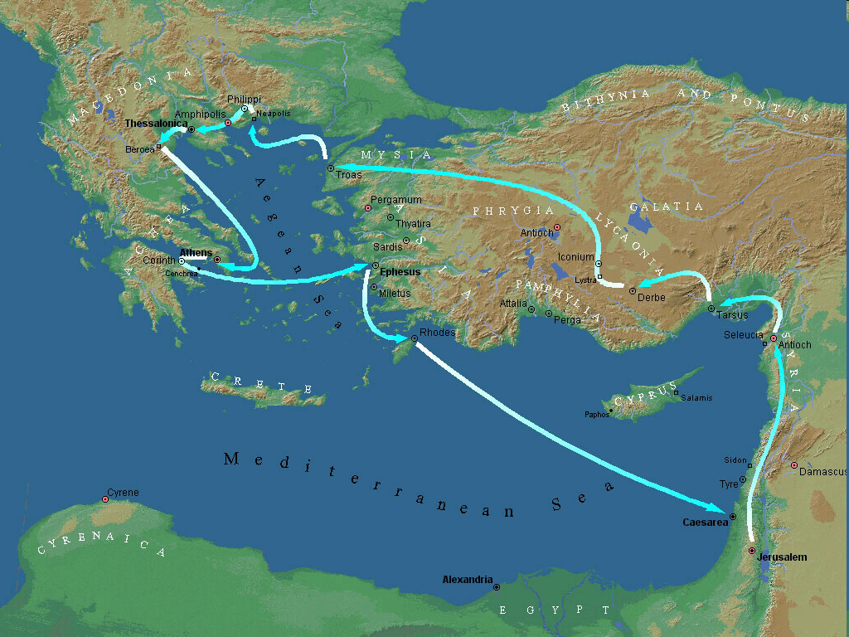

Second Missionary Journey

Slide 11

2 Thessalonians 2:5
“Do you not remember that while I was still with you, I was telling you these things?”

Slide 12


Slide 13

2 Peter 3:10-11
“¹⁰ But the day of the Lord will come like a thief, in which the heavens will pass away with a roar and the elements will be destroyed with intense heat, and the earth and its works will be burned up. ¹¹ Since all these things are to be destroyed in this way, what sort of people ought you to be in holy conduct and godliness.”

Slide 14

Matthew 24:36-39
³⁶ “But of that day and hour no one knows, not even the angels of heaven, nor the Son, but the Father alone. ³⁷ For the coming of the Son of Man will be just like the days of Noah. ³⁸ For as in those days before the flood they were eating and drinking, marrying and giving in marriage, until the day that Noah entered the ark, ³⁹ and they did not understand until the flood came and took them all away; so will the coming of the Son of Man be.”

Slide 15


John 14:1–4
¹ “Do not let your heart be troubled; believe in God, believe also in Me. ² In My Father’s house are many dwelling places; if it were not so, I would have told you; for I go to prepare a place for you. ³ If I go and prepare a place for you, I will come again and receive you to Myself, that where I am, there you may be also. ⁴ And you know the way where I am going.”

Slide 16
1 Thessalonians 4:13-18
. . .heaven with a shout, with the voice of the archangel and with the trumpet of God, and the dead in Christ will rise first. ¹⁷ Then we who are alive and remain will be caught up together with them in the clouds to meet the Lord in the air, and so we shall always be with the Lord. ¹⁸ Therefore comfort one another with these words."

Slide 17

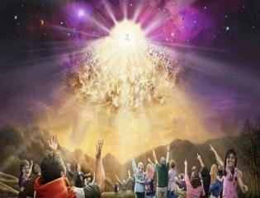

Titus 2:13
“Looking for the blessed hope and the appearing of the glory of our great God and Savior, Christ Jesus.”
17

Slide 18
1 Thessalonians 4:13-18
¹³ "But we do not want you to be uninformed, brethren, about those who are asleep, so that you will not grieve as do the rest who have no hope. ¹⁴ For if we believe that Jesus died and rose again, even so God will bring with Him those who have fallen asleep in Jesus. ¹⁵ For this we say to you by the word of the Lord, that we who are alive and remain until the coming of the Lord, will not precede those who have fallen asleep. ¹⁶ For the Lord Himself will descend from . . .

Slide 19


1 Corinthians 15:51
“Behold, I tell you a mystery; we will not all sleep, but we will all be changed.”

Slide 20

Isaiah 9:6-7
^{6 “}For a child will be born to us, a son will be given to us; And the government will rest on His shoulders; And His name will be called Wonderful Counselor, Mighty God, Eternal Father, Prince of Peace.⁷ There will be no end to the increase of His government or of peace, The zeal of the Lord of hosts will accomplish this. On the throne of David and over his kingdom, To establish it and to uphold it with justice and righteousness From then on and forevermore.”

Slide 21

Daniel 9:27
“And he will make a firm covenant with the many for one week, but in the middle of the week he will put a stop to sacrifice and grain offering; and on the wing of abominations will come one who makes desolate, even until a complete destruction, one that is decreed, is poured out on the one who makes desolate.”
21

Slide 22


Slide 23


Slide 24

1st Six Seals (Revelation 6)
SEAL 1 – 6:1-2 – Advent of antichrist
SEAL 2 – 6:3-4 – War
SEAL 3 – 6:5-6 – Famine
SEAL 4 – 6:7-8 – Death
SEAL 5 – 6:9-11 – Martyrdoms
SEAL 6 – 6:12-17 – Cosmic disturbances

Slide 25

Ezekiel 38:8, 11
“⁸ After many days you will be summoned; in the latter years you will come into the land that is restored from the sword, whose inhabitants have been gathered from many nations to the mountains of Israel which had been a continual waste; but its people were brought out from the nations, and they are living securely [batach], all of them….¹¹ and you will say, ‘I will go up against the land of unwalled villages. I will go against those who are at rest [shacat], that live securely [batach], all of them living without walls and having no bars or gates.”

Slide 26
Isaiah 9:6-7
^{6 “}For a child will be born to us, a son will be given to us; And the government will rest on His shoulders; And His name will be called Wonderful Counselor, Mighty God, Eternal Father, Prince of Peace.⁷ There will be no end to the increase of His government or of peace, The zeal of the Lord of hosts will accomplish this. On the throne of David and over his kingdom, To establish it and to uphold it with justice and righteousness From then on and forevermore.”

Slide 28
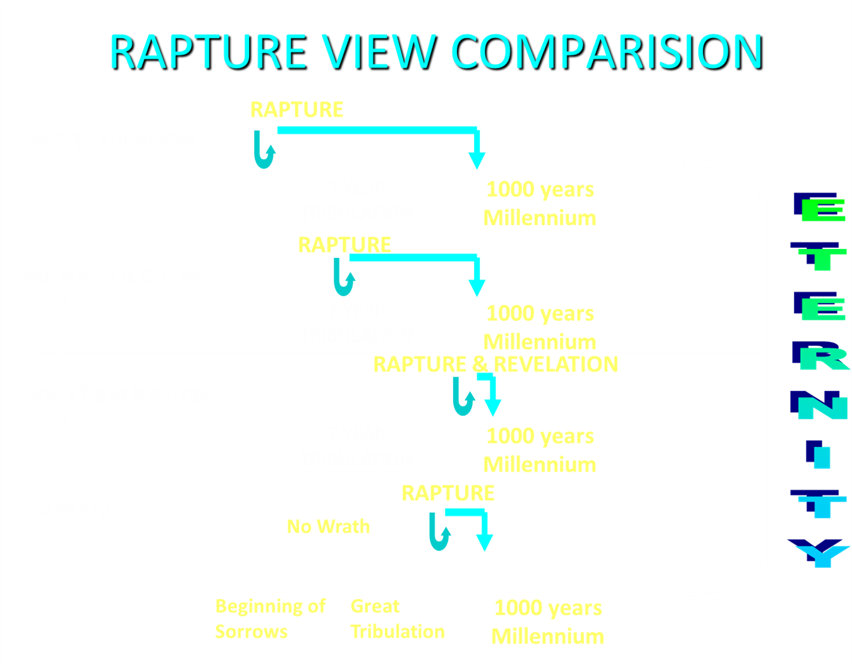

Slide 29
Matt 24 / Rev 6 Parallels
Prediction | Birth pangs (Matt 24) | Seal judgments (Rev 6)
1. False Christ | 24:5 | 6:2
2. War | 24:6 | 6:3-4
3. Famine | 24:7 | 6:5-6
4. Death | 24:6-7 | 6:7-8
5. Martyrs | 24:9-13 | 6:9-11
6. Earthquakes | 24:7 | 6:12-17
7. Evangelism | 24:14 | 7:1-9

Slide 30
1 Thessalonians 4:13-18
¹³ "But we do not want you to be uninformed, brethren, about those who are asleep, so that you will not grieve as do the rest who have no hope. ¹⁴ For if we believe that Jesus died and rose again, even so God will bring with Him those who have fallen asleep in Jesus. ¹⁵ For this we say to you by the word of the Lord, that we who are alive and remain until the coming of the Lord, will not precede those who have fallen asleep. ¹⁶ For the Lord Himself will descend from . . .

Slide 31
1 Corinthians 15:51
“Behold, I tell you a mystery; we will not all sleep, but we will all be changed.”

Slide 32
Day of the Lord (5:1-11)
Description (5:1-3)
Application (5:4-11)

Slide 33
Matthew 24:36-39
³⁶ “But of that day and hour no one knows, not even the angels of heaven, nor the Son, but the Father alone. ³⁷ For the coming of the Son of Man will be just like the days of Noah. ³⁸ For as in those days before the flood they were eating and drinking, marrying and giving in marriage, until the day that Noah entered the ark, ³⁹ and they did not understand until the flood came and took them all away; so will the coming of the Son of Man be.”

Slide 34

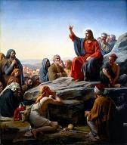
Matt 5:13, 16
“You are the light of the world. A city set on a hill cannot be hidden…Let your light shine before men in such a way that they may see your good works, and glorify your Father who is in heaven.”

Slide 35
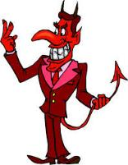
Names & Titles Demonstrating Satan’s
Post-Fall, Earthly Authority
(Job 1:7; 2:2; Luke 4:5-8; Rom. 8:19-22)
Prince of this world (John 12:31; 14:30; 16:11)
God of this age (2 Cor. 4:4)
Prince and power of the air (Eph. 2:2)
Who the believer wrestles with (Eph. 6:12)
Roaring lion (1 Pet. 5:8)
Whole world lies in his power (1 John 5:19)

Slide 36

Acts 2:13, 15
¹³ “But others were mocking and saying, ‘They are full of sweet wine.’… ¹⁵ ‘For these men are not drunk, as you suppose, for it is only the third hour of the day.’”

Slide 37
Ephesians: What Is Inside?
1–3 | 4–6
Relationship | Responsibility
No imperatives | 35 imperatives
Orthodoxy | Orthopraxy
Knowledge | Wisdom
Belief | Behavior
Position | Practice
Privileges | Responsibility

Slide 38
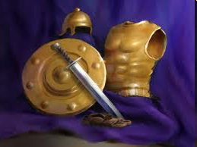
Ephesians
Dressed for Success!

Slide 39

6 Pieces of Armor (Eph 6:14-17)
Belt of truth (14a)
Breastplate of righteousness (14b)
Sandals of peace (15)
Shield of faith (16)
Helmet of salvation (17a)
Sword of the Spirit (17b)
Notes:
39

Slide 40

2 Peter 1:5-7
⁵ Now for this very reason also, applying all diligence, in your faith supply moral excellence, and in your moral excellence, knowledge, ⁶ and in your knowledge, self-control, and in your self-control, perseverance, and in your perseverance, godliness, ⁷ and in your godliness, brotherly kindness, and in your brotherly kindness, love.

Slide 41
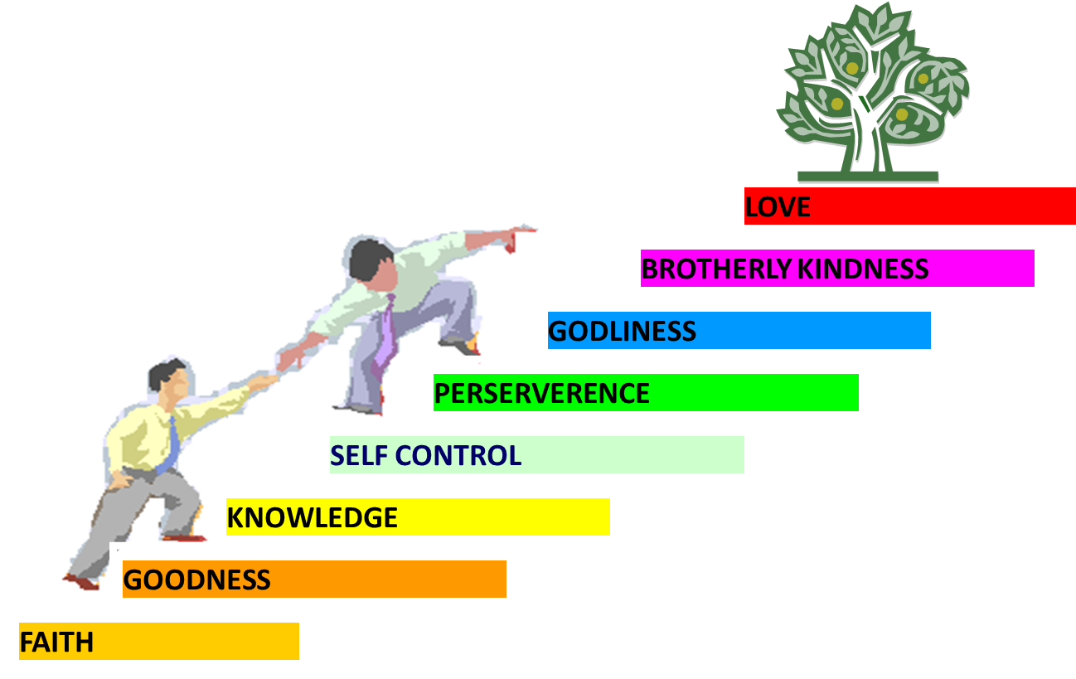
PORTRAIT OF GROWTH
1:5-7

Slide 42
Three Tenses of Salvation
Phase | Justification | Sanctification | Glorification
Tense | Past | Present | Future
Saved from sin’s: | Penalty | Power | Presence
Scripture | Eph 2:8-9; Titus 3:5 | Philip 2:12 | Rom 5:10

Slide 43

Romans 13:11-12
“Do this, knowing the time, that it is already the hour for you to awaken from sleep; for now salvation is nearer to us than when we believed. ¹² The night is almost gone, and the day is near. Therefore, let us lay aside the deeds of darkness and put on the armor of light.”

Slide 44
Three Reasons Believers Will Not Be in the Tribulation
(1 Thess. 4:9-11)
    We are not appointed unto wrath (9)
    We are exempted from wrath whether morally asleep or awake (10)
    Promises of comfort (11)

Slide 46
Three Reasons Believers Will Not Be in the Tribulation
(1 Thess. 4:9-11)
    We are not appointed unto wrath (9)
    We are exempted from wrath whether morally asleep or awake (10)
    Promises of comfort (11)

Slide 47

Promised Exemption from Divine Wrath
The promise (1 Thess 1:10; 5:9; Rom 5:9; 8:1; Rev 3:10)
Tribulation = divine wrath/anger (Rev 6:16-17; 11:18; 14:10; 15:1, 7; 16:1, 19; 19:15)

Slide 48


1 Thessalonians 1:10
“and to wait for His Son from heaven, whom He raised from the dead, that is Jesus, who rescues (rhyomai) us from (ek) the wrath (orgē) to come..”

Slide 49



Slide 50
Revelation 6:16-17
^{“16} and they (unbelievers) said to the mountains and to the rocks, “Fall on us and hide us from the presence of Him who sits on the throne, and from the wrath [orgḗ] of the Lamb; ¹⁷ for the great day of their wrath [orgḗ] has come, and who is able to stand?”

Slide 51
Three Tenses of Salvation
Phase | Justification | Sanctification | Glorification
Tense | Past | Present | Future
Saved from sin’s: | Penalty | Power | Presence
Scripture | Eph 2:8-9; Titus 3:5 | Philip 2:12 | Rom 5:10

Slide 52

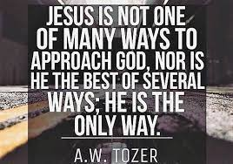
John 14:6
“Jesus said to him, ‘I am the way, and the truth, and the life; no one comes to the Father but through Me.’”

Slide 53
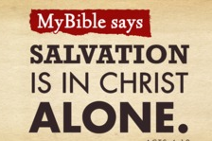
Acts 4:12
“And there is salvation in no one else; for there is no other name under heaven that has been given among men by which we must [dei] be saved.”

Slide 54
Three Reasons Believers Will Not Be in the Tribulation
(1 Thess. 4:9-11)
    We are not appointed unto wrath (9)
    We are exempted from wrath whether morally asleep or awake (10)
    Promises of comfort (11)

Slide 55
1 Thessalonians 4:13-18
¹³ "But we do not want you to be uninformed, brethren, about those who are asleep, so that you will not grieve as do the rest who have no hope. ¹⁴ For if we believe that Jesus died and rose again, even so God will bring with Him those who have fallen asleep in Jesus. ¹⁵ For this we say to you by the word of the Lord, that we who are alive and remain until the coming of the Lord, will not precede those who have fallen asleep. ¹⁶ For the Lord Himself will descend from . . .

Slide 56
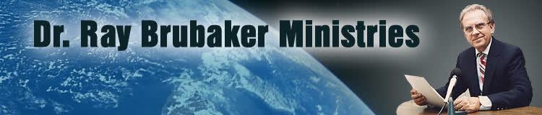
Ray Brubaker
"The Purpose of the Tribulation," Radar News, (December 1968): 6.
“Finally, we should note that the purpose of the tribulation is also to be the testing of lukewarm shallow Laodicean Christians who will be left behind at the coming of Christ. No doubt multitudes who expect to be raptured will be disappointed because like the foolish virgins, they were not watchful. Tribulation is then for the purpose of trying the faith of those who profess to be Christians but who really never repented or are living in disobedience to the will of God.”

Slide 57

G.N.H. Peters
Theocratic Kingdom, 2:332
“It is not simply those who ‘watch’ that shall ‘escape,’ but those, Luke 21:36 who ‘watch and pray always,’ avoiding the corrupting influences around them. The number of translated ones may not be very large (for the number of translated ones given as...types in comparison with the number of those not translated, and with that of the resurrected saints is small so that Dr. Seiss, with whom many concur, is undoubtedly correct in saying: ‘I have no idea that a very large portion of mankind, or even of the professing Church, will be thus taken. The first translation, if I may so speak, will embrace only the select few who watch and pray always,’ etc.””

Slide 58


Slide 59
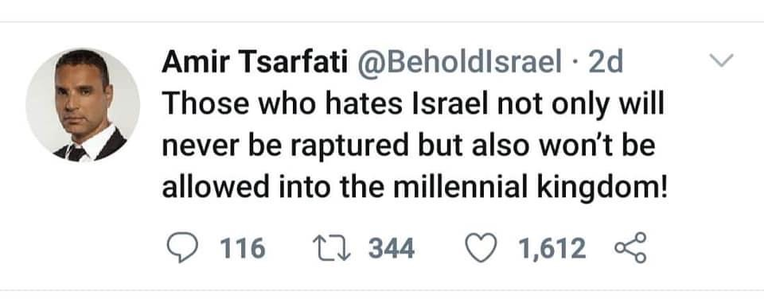

Slide 60
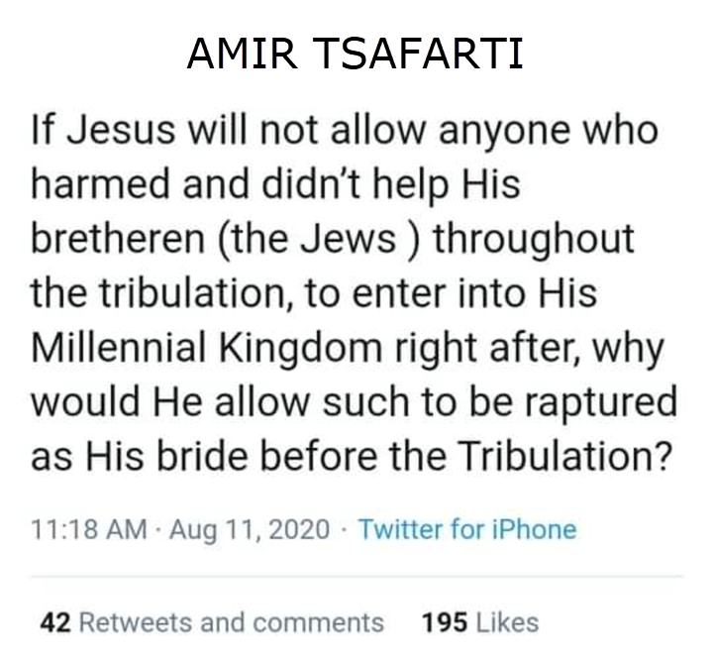

Slide 61
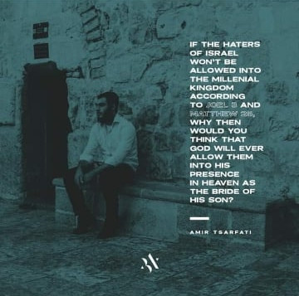

Slide 62
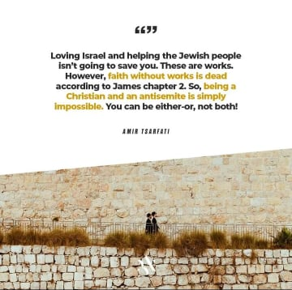

Slide 63
1 Corinthians 15:51
“Behold, I tell you a mystery; we will not all sleep, but we will all be changed.”

Slide 64
Three Reasons Believers Will Not Be in the Tribulation
(1 Thess. 4:9-11)
    We are not appointed unto wrath (9)
    We are exempted from wrath whether morally asleep or awake (10)
    Promises of comfort (11)

Slide 65
2 Peter 3:10-11
“¹⁰ But the day of the Lord will come like a thief, in which the heavens will pass away with a roar and the elements will be destroyed with intense heat, and the earth and its works will be burned up. ¹¹ Since all these things are to be destroyed in this way, what sort of people ought you to be in holy conduct and godliness.”

Slide 66
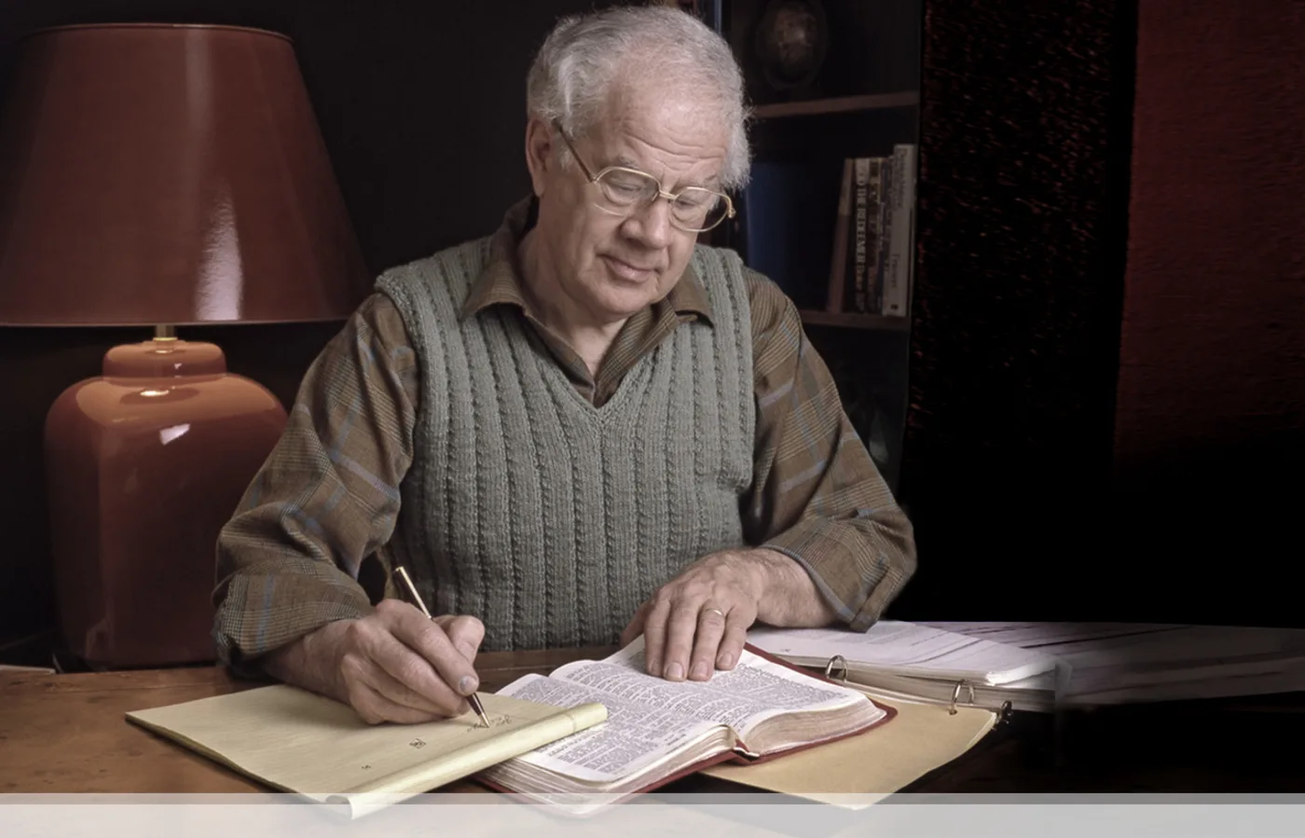

J. Dwight Pentecost
Prophecy For Today, Page 20
“A short time ago, I took occasion to go through the New Testament to mark each reference to the coming of the Lord Jesus Christ and to observe the use made of that teaching about His coming. I was struck a new with the fact that almost without exception, when the coming of Christ is mentioned in the New Testament, it is followed by an exhortation to godliness and holy living.”

Slide 67
John 14:1–4
¹ “Do not let your heart be troubled; believe in God, believe also in Me. ² In My Father’s house are many dwelling places; if it were not so, I would have told you; for I go to prepare a place for you. ³ If I go and prepare a place for you, I will come again and receive you to Myself, that where I am, there you may be also. ⁴ And you know the way where I am going.”

Slide 68
1 Thessalonians 4:13-18
. . .heaven with a shout, with the voice of the archangel and with the trumpet of God, and the dead in Christ will rise first. ¹⁷ Then we who are alive and remain will be caught up together with them in the clouds to meet the Lord in the air, and so we shall always be with the Lord. ¹⁸ Therefore comfort one another with these words."

Slide 69
Titus 2:13
“Looking for the blessed hope and the appearing of the glory of our great God and Savior, Christ Jesus.”
69

Slide 71
Conclusion

Slide 72
Structure
Personal (1–3)
  Genuine conversion (1)
  Impure motives (2:1-16)
  Lack of concern (2:17–3:13)
Practical (4–5)
  Immorality (4:1-8)
  Laziness (4:9-12)
  Eschatology (4:13–5:11)
  Ministry imbalances (5:12-15)
  Progressive sanctification (5:16-28)

Slide 73
Day of the Lord (5:1-11)
Description (5:1-3)
Application (5:4-11)

