Slide 1


Dr. Andy Woods
Senior Pastor – Sugar Land Bible Church
President – Chafer Theological Seminary

Slide 2

Structure
1 THESSALONIANS 1-3 | 1 THESSALONIANS 4-5
Personal Experience | Practical Exhortation
Looking Back | Looking Forward

Slide 3

Structure
Personal (1–3)
  Genuine conversion (1)
  Impure motives (2:1-16)
  Lack of concern (2:17–3:13)
Practical (4–5)
  Immorality (4:1-8)
  Laziness (4:9-12)
  Eschatology (4:13–5:11)
  Ministry imbalances (5:12-15)
  Progressive sanctification (5:16-28)

Slide 4
Christian Living (4:1-12)
General conduct (4:1-2)
Negative command: sexual sin (4:3-8)
Positive command: brotherly love (4:9-12)

Slide 5
Structure
Personal (1–3)
  Genuine conversion (1)
  Impure motives (2:1-16)
  Lack of concern (2:17–3:13)
Practical (4–5)
  Immorality (4:1-8)
  Laziness (4:9-12)
  Eschatology (4:13–5:11)
  Ministry imbalances (5:12-15)
  Progressive sanctification (5:16-28)

Slide 6

1 Thessalonians 4:13-18
¹³ "But we do not want you to be uninformed, brethren, about those who are asleep, so that you will not grieve as do the rest who have no hope. ¹⁴ For if we believe that Jesus died and rose again, even so God will bring with Him those who have fallen asleep in Jesus. ¹⁵ For this we say to you by the word of the Lord, that we who are alive and remain until the coming of the Lord, will not precede those who have fallen asleep. ¹⁶ For the Lord Himself will descend from . . .

Slide 7
1 Thessalonians 4:13-18
. . .heaven with a shout, with the voice of the archangel and with the trumpet of God, and the dead in Christ will rise first. ¹⁷ Then we who are alive and remain will be caught up together with them in the clouds to meet the Lord in the air, and so we shall always be with the Lord. ¹⁸ Therefore comfort one another with these words."

Slide 8
Unique Characteristics
Every chapter ends with a reference to the Second Advent
Small amount of time in between planting of the church and the first letter to the church

Slide 9

2 Thessalonians 2:5
“Do you not remember that while I was still with you, I was telling you these things?”

Slide 10
1 Thessalonians 4:13-18
¹³ "But we do not want you to be uninformed, brethren, about those who are asleep, so that you will not grieve as do the rest who have no hope. ¹⁴ For if we believe that Jesus died and rose again, even so God will bring with Him those who have fallen asleep in Jesus. ¹⁵ For this we say to you by the word of the Lord, that we who are alive and remain until the coming of the Lord, will not precede those who have fallen asleep. ¹⁶ For the Lord Himself will descend from . . .

Slide 11
Order of Paul’s Letters
Galatians (A.D. 49)
1‒2 Thessalonians (A.D. 51)
1‒2 Corinthians (A.D. 56)
Romans (A.D. 57)
Ephesians, Colossians, Philemon, Philippians (A.D. 60‒62)
1 Timothy, Titus (A.D. 62‒66)
2 Timothy (A.D. 67)

Slide 12
Five General Comments
(1 Thess. 4:13-18)
Not the first mention of The Rapture
“Rapture” comes from the Latin
The Rapture is distinct from the Second Advent
Only for the Church Age believer
Pre-tribulationalism is the correct view
Notes:
Outline

Slide 13
Five General Comments
(1 Thess. 4:13-18)
Not the first mention of The Rapture
“Rapture” comes from the Latin
The Rapture is distinct from the Second Advent
Only for the Church Age believer
Pre-tribulationalism is the correct view
Notes:
Outline

Slide 14


John 14:1–4
¹ “Do not let your heart be troubled; believe in God, believe also in Me. ² In My Father’s house are many dwelling places; if it were not so, I would have told you; for I go to prepare a place for you. ³ If I go and prepare a place for you, I will come again and receive you to Myself, that where I am, there you may be also. ⁴ And you know the way where I am going.”

Slide 15

New Mystery Truth
“But here in John 14 the Lord gives a new and unique revelation; He speaks of something which no prophet had promised, or even could promise. Where is it written that this Messiah would come and instead of gathering His saints into an earthly Jerusalem, would take them to the Father's house, to the very place where He is? It is something new.”
Arno C. Gaebelein, The Gospel of John, 268.

Slide 16

Chafer
Chafer, Systematic Theology, 1:111.
"The Upper Room Discourse, in which the above passage is found, is the seed-plot of that form of doctrine which is later developed in the Epistles. It is not strange, therefore, that the Apostle Paul takes up this great theme for further elucidation."

Slide 17
Parallels
JOHN 14:1-4 | 1 THESS 4:13-18
trouble (1) | sorrow (13)
Believe (1) | believe (14)
God, me (1) | Jesus, God (14)
told you (2) | say to you (15)
come again (3) | coming of the Lord (15)
receive, you (3) | caught up (17)
to myself (3) | to meet the Lord (17)
be where I am (3) | ever be with the Lord (17)
J. B. Smith, A Revelation of Jesus Christ: A Commentary on the Book of Revelation, 311-13

Slide 18
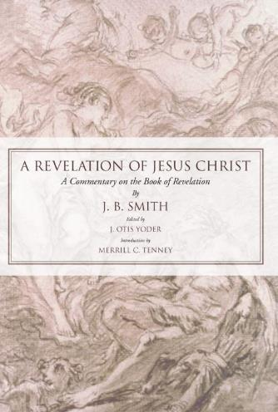
J. B. Smith
A Revelation of Jesus Christ: A Commentary on the Book of Revelation (Scottdale, PA: Herald Press, 1961), pp. 312-13.
“The words or phrases are almost an exact parallel. They follow one another in both passages in exactly the same order. Only the righteous are dealt with in each case. There is not a single irregularity in the progression of words from first to last. Either column takes the believer from the troubles of earth to the glories of heaven.”

Slide 19


Slide 20
J. B. Smith
A Revelation of Jesus Christ: A Commentary on the Book of Revelation (Scottdale, PA: Herald Press, 1961), pp. 312.
“Hence it is impossible that one sentence or even one phrase can be alike in the two lists…And finally not one word in the two lists is used in the same relation or connection...It would be difficult if not impossible to find elsewhere any two important passages of Scripture that are so diverse in the words employed and so opposite in their implications. . . . We believe the comparison of the words of these two passages . . . describe different events.”

Slide 21
1 Thessalonians 4:13-18
¹³ "But we do not want you to be uninformed, brethren, about those who are asleep, so that you will not grieve as do the rest who have no hope. ¹⁴ For if we believe that Jesus died and rose again, even so God will bring with Him those who have fallen asleep in Jesus. ¹⁵ For this we say to you by the word of the Lord, that we who are alive and remain until the coming of the Lord, will not precede those who have fallen asleep. ¹⁶ For the Lord Himself will descend from . . .

Slide 22
Five General Comments
(1 Thess. 4:13-18)
Not the first mention of The Rapture
“Rapture” comes from the Latin
The Rapture is distinct from the Second Advent
Only for the Church Age believer
Pre-tribulationalism is the correct view
Notes:
Outline

Slide 23
1 Thessalonians 4:13-18
. . .heaven with a shout, with the voice of the archangel and with the trumpet of God, and the dead in Christ will rise first. ¹⁷ Then we who are alive and remain will be caught up (harpazō) together with them in the clouds to meet the Lord in the air, and so we shall always be with the Lord. ¹⁸ Therefore comfort one another with these words."

Slide 24

Catching Away of All Living Believers
(1 Thess. 4:17)
Harpazo = seized or caught up by force
Harpazo (Greek) = rapere (Latin) = rapture (English)

Slide 25
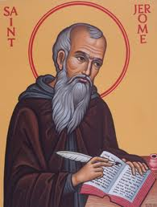
Latin Vulgate Translation
(1 Thess. 4:17)
“Deinde nos, qui vivimus, qui relinquimur, simul rapiemur cum illis in nubibus obviam Christo in aëra, et sic semper cum Domino erimus.”
Andrew Curtis and Isaiah Hoogendyk, The Lexham Latin-English Interlinear Vulgate (Bellingham, WA: Lexham Press, 2016), 1 Th 4:17.

Slide 26


Slide 27
Five General Comments
(1 Thess. 4:13-18)
Not the first mention of The Rapture
“Rapture” comes from the Latin
The Rapture is distinct from the Second Advent
Only for the Church Age believer
Pre-tribulationalism is the correct view
Notes:
Outline

Slide 28
RAPTURE DISTINCT FROM SECOND ADVENT
RAPTURE (1 Thess 4:13-17; 1 Cor 15:51-57) | SECOND COMING (Rev 19:11-16)
Christ comes in the air (1 Thess 4:16) | Christ comes to the earth (Zech 14:4)
For His saints (1 Thess 4:15-17) | With His saints (Rev 19:14)
Blessing (1 Thess 4:18) | Judgment (Rev 19:15)
Effects only believers (1 Thess 4:16) | Effects both believers and unbelievers (Rev 19:15)
Invisible (1 Thess 4:16) | Visible to all (Rev 1:7)
Announced only by an archangel (1 Thess 4:16) | Involves myriads of angels (Jude 14)
Resurrection (1 Cor 15: 51) | No resurrection
Rescue of the church (1 Thess 1:10) | Rescue of Israel (Matt 23:37-39)

Slide 29

Matthew 23:37-39
³⁷ “Jerusalem, Jerusalem, who kills the prophets and stones those who are sent to her! How often I wanted to gather [episynagō] your children together, the way a hen gathers [episynagō] her chicks under her wings, and you were unwilling. ³⁸ Behold, your house is being left to you desolate! ³⁹ For I say to you, from now on you will not see Me until you say, ‘Blessed is He who comes in the name of the Lord!’”

Slide 30


Finis Jennings Dake
What the Bible Says About the Second Coming of Jesus (Lawrenceville, GA: Armor Books, 2003), 171.
“I could never reconcile the conflicting statements—that there should be seven years of tribulation and the reign of Antichrist before the coming of Christ, and yet it could happen ‘tonight.’ What these teachers should have said was that the rapture and the Second Advent were two distinct, unrelated events, and that whereas the rapture could take place ‘tonight,’ the Second Advent could not take place until after the Tribulation and the last seven years of this age which would include the reign of Antichrist.”

Slide 31
Finis Jennings Dake
What the Bible Says About the Second Coming of Jesus (Lawrenceville, GA: Armor Books, 2003), 171.
“It is still truth to teach that the rapture could take place at any moment. The Second Advent, however, cannot take place until after the Tribulation and the reign of Antichrist. In fact, all the prophecies of Mt. 24–25; Mk. 13; Lk. 21:1-11, 25-33; 2 Thess. 2; 1 Thess. 5; Rev. 4:1–19:10 must be fulfilled in detail before the Second Advent of Christ and after the rapture.”

Slide 32
Five General Comments
(1 Thess. 4:13-18)
Not the first mention of The Rapture
“Rapture” comes from the Latin
The Rapture is distinct from the Second Advent
Only for the Church Age believer
Pre-tribulationalism is the correct view
Notes:
Outline

Slide 33
1 Thessalonians 4:13-18
. . .heaven with a shout, with the voice of the archangel and with the trumpet of God, and the dead in Christ will rise first. ¹⁷ Then we who are alive and remain will be caught up together with them in the clouds to meet the Lord in the air, and so we shall always be with the Lord. ¹⁸ Therefore comfort one another with these words."

Slide 35
Revelation 20:4-6
…⁵ The rest of the dead did not come to life [zaō] until the thousand years were completed. This is the first resurrection [anastasis]. ⁶ Blessed and holy is the one who has a part in the first resurrection [anastasis]; over these the second death has no power, but they will be priests of God and of Christ and will reign with Him for a thousand years.”

Slide 36

1 Corinthians 15:20-23
“²⁰ But now Christ has been raised from the dead, the first fruits of those who are asleep. ²¹ For since by a man came death, by a man also came the resurrection of the dead. ²² For as in Adam all die, so also in Christ all will be made alive. ²³ But each in his own order: Christ the first fruits, after that those who are Christ’s at His coming.”

Slide 37
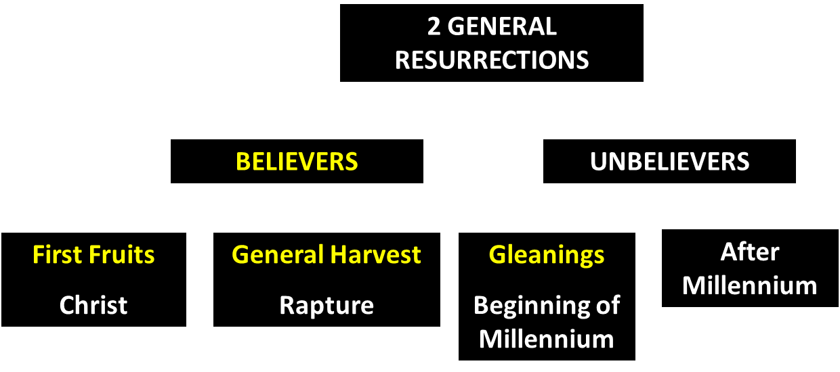
God’s Resurrection Program

Slide 38
1 Corinthians 15:20-23
“²⁰ But now Christ has been raised from the dead, the first fruits of those who are asleep. ²¹ For since by a man came death, by a man also came the resurrection of the dead. ²² For as in Adam all die, so also in Christ all will be made alive. ²³ But each in his own order (tagma): Christ the first fruits, after that those who are Christ’s at His coming.”

Slide 39
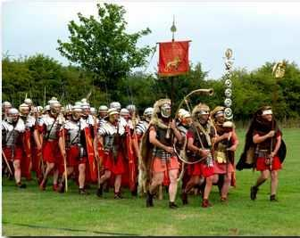
Order or Tagma (1 Cor. 15:23)
General – Christ’s resurrection (1 Cor. 15:23)
Officer – Rapture (1 Thess. 4:13-18)
Soldiers – OT saints & Tribulation martyrs (Rev. 20:4)
Captives – Unsaved of all ages (Rev. 20:5)

Slide 40
Five General Comments
(1 Thess. 4:13-18)
Not the first mention of The Rapture
“Rapture” comes from the Latin
The Rapture is distinct from the Second Advent
Only for the Church Age believer
Pre-tribulationalism is the correct view
Notes:
Outline

Slide 41
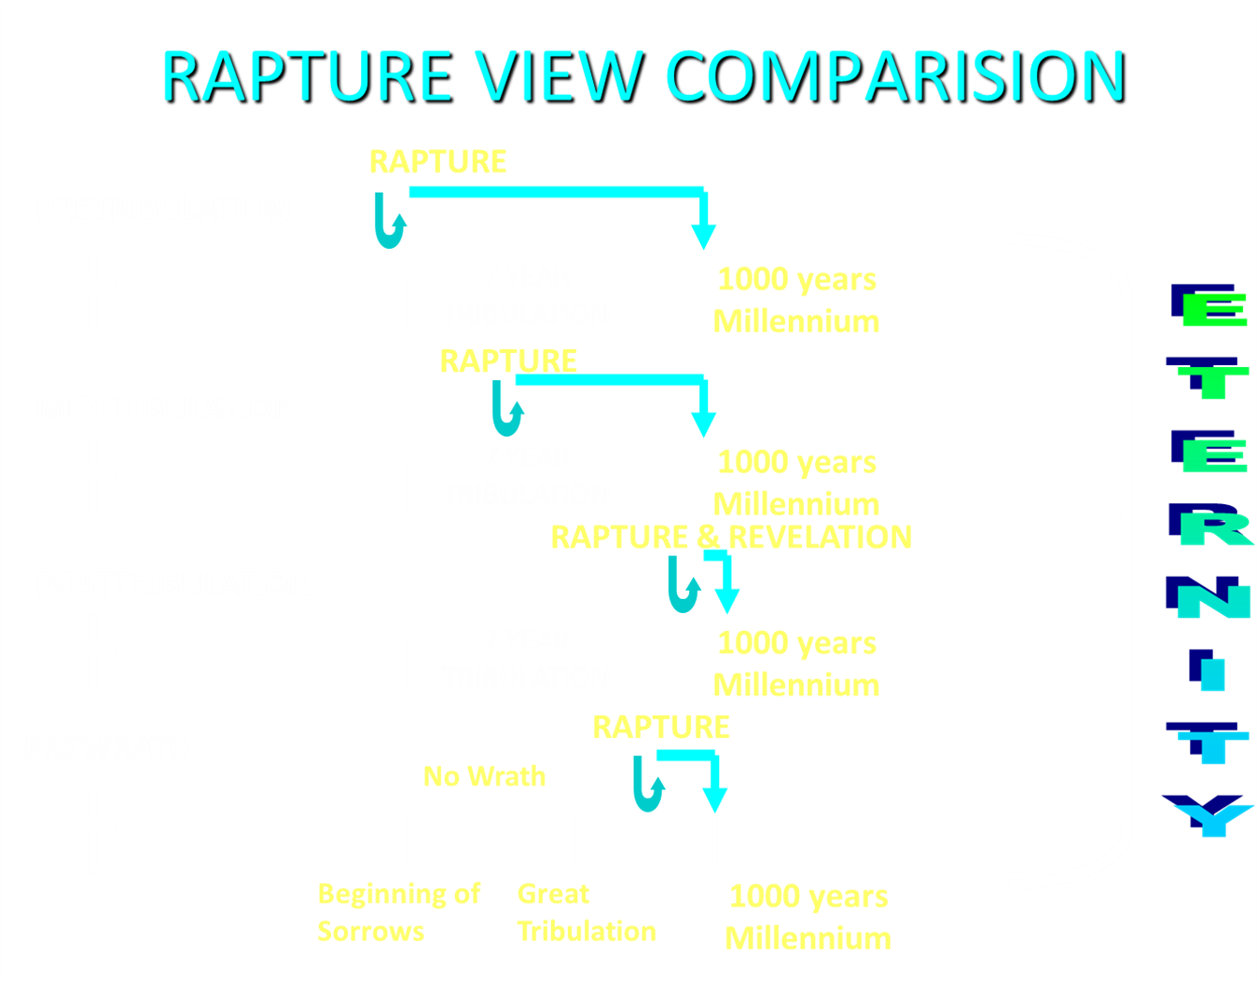

Slide 42
Pre-Tribulationalism is the Correct View
    Imminency (15)
    Comfort (18)
    Exemption from Divine Wrath (1 Thess. 1:10; 5:9)

Slide 43
Pre-Tribulationalism is the Correct View
    Imminency (15)
    Comfort (18)
    Exemption from Divine Wrath (1 Thess. 1:10; 5:9)

Slide 44
1 Thessalonians 4:13-18
¹³ "But we do not want you to be uninformed, brethren, about those who are asleep, so that you will not grieve as do the rest who have no hope. ¹⁴ For if we believe that Jesus died and rose again, even so God will bring with Him those who have fallen asleep in Jesus. ¹⁵ For this we say to you by the word of the Lord, that we who are alive and remain until the coming of the Lord, will not precede those who have fallen asleep. ¹⁶ For the Lord Himself will descend from . . .

Slide 45


1 Corinthians 15:51
“Behold, I tell you a mystery; we will not all sleep, but we will all be changed.”

Slide 46
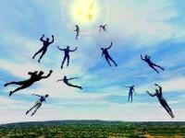
Imminent
(1 Cor 15:51; 1 Thess 4:15)
Imminency definition
James 5:8; 1 Thess 1:10; 1 Cor 1:7; Philip 3:20
We are to be looking for Jesus Christ and not the Antichrist!
Motivator (Holiness, Evangelism)
Feast of Trumpets?

Slide 47
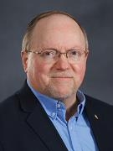
Wayne Brindle
"Biblical Evidence for the Imminence of the Rapture," Bibliotheca Sacra 158, no. 630 (April-June 2001): 138-51.
“Four criteria may be suggested, any one of which indicates imminence:
The passage speaks of Christ’s return as at any moment.
The passage speaks of Christ’s return as ‘near,’ without stating any signs that must precede His coming.
The passage speaks of Christ’s return as something that gives believers hope and encouragement, without indicating that these believers will suffer tribulation.
The passage speaks of Christ’s return as giving hope without relating it to God’s judgment of unbelievers.”

Slide 48
John 14:1–4
¹ “Do not let your heart be troubled; believe in God, believe also in Me. ² In My Father’s house are many dwelling places; if it were not so, I would have told you; for I go to prepare a place for you. ³ If I go and prepare a place for you, I will come again and receive you to Myself, that where I am, there you may be also. ⁴ And you know the way where I am going.”

Slide 49


Slide 50
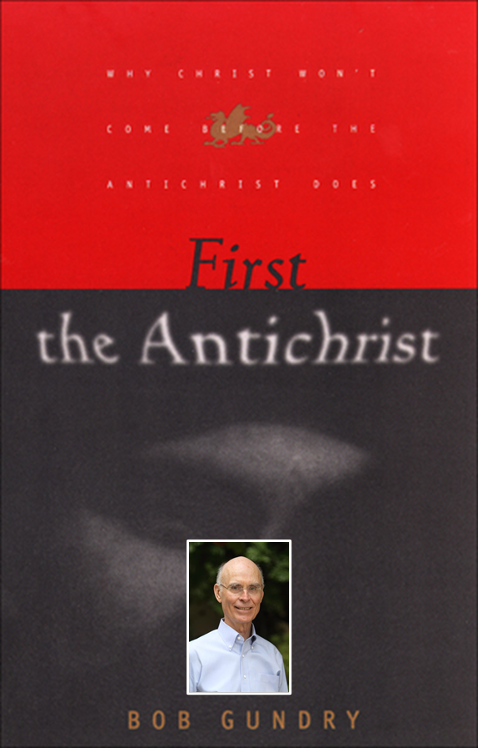
Robert H. Gundry, The Church and the Tribulation: Why Christ Won't Come Before the Antichrist Does (Grand Rapids: Zondervan, 1973).

Slide 51


Slide 52
Pre-Tribulationalism is the Correct View
    Imminency (15)
    Comfort (18)
    Exemption from Divine Wrath (1 Thess. 1:10; 5:9)

Slide 53
1 Thessalonians 4:13-18
. . .heaven with a shout, with the voice of the archangel and with the trumpet of God, and the dead in Christ will rise first. ¹⁷ Then we who are alive and remain will be caught up together with them in the clouds to meet the Lord in the air, and so we shall always be with the Lord. ¹⁸ Therefore comfort one another with these words."

Slide 54
John 14:1–4
¹ “Do not let your heart be troubled; believe in God, believe also in Me. ² In My Father’s house are many dwelling places; if it were not so, I would have told you; for I go to prepare a place for you. ³ If I go and prepare a place for you, I will come again and receive you to Myself, that where I am, there you may be also. ⁴ And you know the way where I am going.”

Slide 55

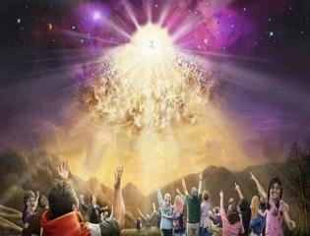

Titus 2:13
“Looking for the blessed hope and the appearing of the glory of our great God and Savior, Christ Jesus.”
55

Slide 56
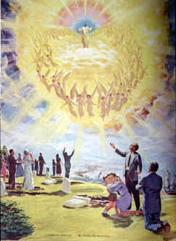
Comfort
John 14:1; 1 Thess 4:18; Titus 2:13
Other rapture views are not comforting since they place the church into divine wrath

Slide 58
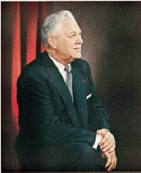
Donald Grey Barnhouse
Cited in Mark Hitchcock, “An Overview of Pretribulational arguments,” online: www.pre-trib.org, accessed 27 August 2013, 29-30.
“Jesus may come today, Glad day! Glad day!
And I would see my friend;
Dangers and troubles would end If Jesus should come today.
Glad day! Glad day! Is it the crowning day?
I’ll live for today, nor anxious be, Jesus, my Lord, I soon shall see;
Glad day! Glad day! Is it the crowning day?”

Slide 59
Donald Grey Barnhouse
Cited in Mark Hitchcock, “An Overview of Pretribulational arguments,” online: www.pre-trib.org, accessed 27 August 2013, 29-30.
By way of parody, Dr. Barnhouse also pointed out that if the midtrib or posttrib advocates sang this song, it would instead have to say:
“Jesus can’t come today, Sad day! Sad day! And I won't see my friend; Dangers and troubles won’t end Because Jesus can’t come today. Sad day! Sad day! Today is not the crowning day? I won’t live for today, and anxious I’ll be, The Beast and the False Prophet I soon shall see, Sad day! Sad day! Today is not the crowning day?”

Slide 60
Pre-Tribulationalism is the Correct View
    Imminency (15)
    Comfort (18)
    Exemption from Divine Wrath (1 Thess. 1:10; 5:9)

Slide 61


1 Thessalonians 1:10
“and to wait for His Son from heaven, whom He raised from the dead, that is Jesus, who rescues (rhyomai) us from (ek) the wrath (orgē) to come..”

Slide 62

Promised Exemption from Divine Wrath
The promise (1 Thess 1:10; 5:9; Rom 5:9; 8:1; Rev 3:10)
Tribulation = divine wrath/anger (Rev 6:16-17; 11:18; 14:10; 15:1, 7; 16:1, 19; 19:15)

Slide 63

1st Six Seals (Revelation 6)
SEAL 1 – 6:1-2 – Advent of antichrist
SEAL 2 – 6:3-4 – War
SEAL 3 – 6:5-6 – Famine
SEAL 4 – 6:7-8 – Death
SEAL 5 – 6:9-11 – Martyrdoms
SEAL 6 – 6:12-17 – Cosmic disturbances

Slide 64


Slide 65
Conclusion

Slide 66
Five General Comments
(1 Thess. 4:13-18)
Not the first mention of The Rapture
“Rapture” comes from the Latin
The Rapture is distinct from the Second Advent
Only for the Church Age believer
Pre-tribulationalism is the correct view
Notes:
Outline

Slide 67
Structure
Personal (1–3)
  Genuine conversion (1)
  Impure motives (2:1-16)
  Lack of concern (2:17–3:13)
Practical (4–5)
  Immorality (4:1-8)
  Laziness (4:9-12)
  Eschatology (4:13–5:11)
  Ministry imbalances (5:12-15)
  Progressive sanctification (5:16-28)

