Slide 1
Genesis 12‒50
Israel’s Birth & Preservation

Slide 2
GENESIS STRUCTURE
Genesis 12-50 (four people)
Abraham (12:1–25:11)
Isaac (25:12–26:35)
Jacob (27–36)
Joseph (37–50)

Slide 3
Genesis 28 Chapter Summary
Jacob’s flight to Haran (1-5)
Esau’s third wife (6-9)
Reconfirmation of the Covenant (10-22)

Slide 4
Genesis 28:10-22 Reconfirmation of the Covenant
Circumstances (10-12)
Covenant reaffirmed (13-15)
Jacob’s recognition (16-17)
Pillar (18-19)
Vow (20-22)

Slide 5
Genesis 28:10-22 Reconfirmation of the Covenant
Circumstances (10-12)
Covenant reaffirmed (13-15)
Jacob’s recognition (16-17)
Pillar (18-19)
Vow (20-22)

Slide 6
Genesis 28:10-12 Circumstances
Journey (10)
Bethel (11)
Dream (12)

Slide 7
Genesis 28:10-12 Circumstances
Journey (10)
Bethel (11)
Dream (12)

Slide 8
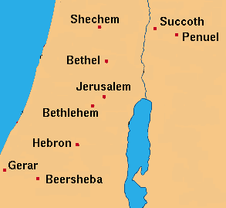

Slide 9
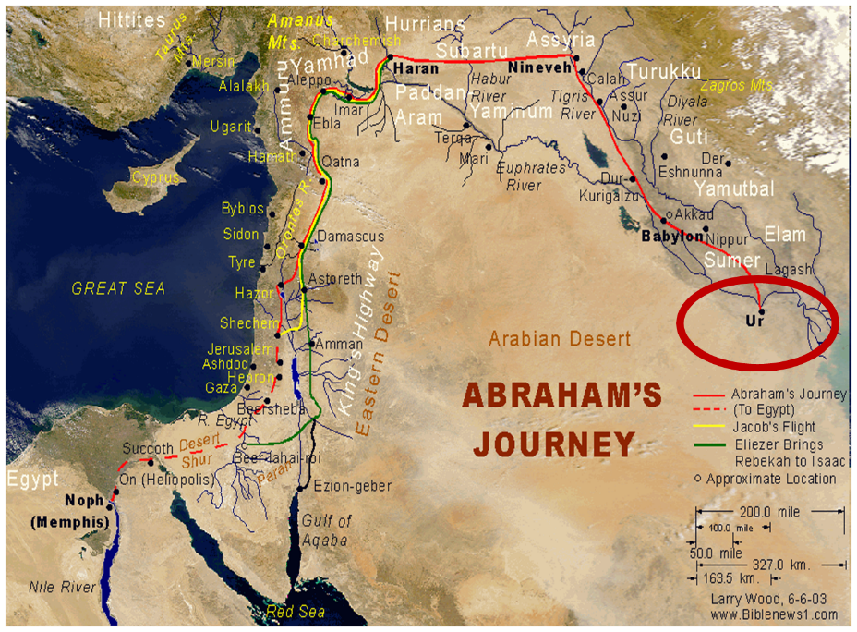

Slide 10
Genesis 28:10-12 Circumstances
Journey (10)
Bethel (11)
Dream (12)

Slide 11
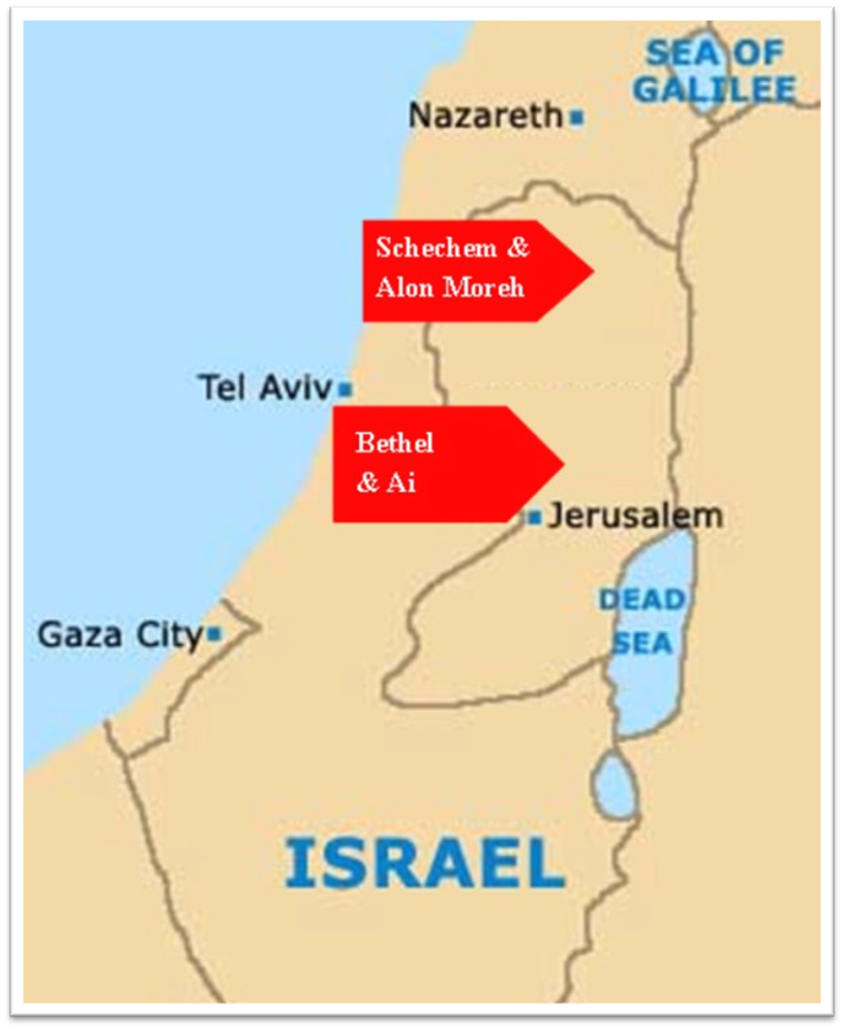

Slide 12
Dr. Arnold G. Fruchtenbaum
The Book of Genesis, 436
“The next thing he did was: And he took one of the stones of the place, and put it under his head, which has been misunderstood to mean that he used it as a pillow, but a stone would make a rather uncomfortable pillow. The Hebrew literally reads, ‘at his head,’ not ‘under his head.’ It means the stone was placed at his head, as was the case with Saul’s spear in I Samuel 26:7, where the same terminology is used. Then: and lay down in that place to sleep.”

Slide 13
Genesis 28:10-12 Circumstances
Journey (10)
Bethel (11)
Dream (12)

Slide 14
Genesis 12‒25 Abraham’s Early Journeys
Unconditional promises (Gen. 12:1-3) From Haran to Canaan (Gen. 12:4-5) In Canaan (Gen. 12:6-9) In Egypt (Gen. 12:10-20) Abram and Lot Separate (Gen. 13:1-13) Reaffirmation of Abram’s promises (Gen. 13:14-18) Abram Rescues Lot (14:1-24) Abrahamic Covenant (15:1-21) Hagar & Ishmael (16:1-16) Circumcision (Gen. 17:1-27) | Sodom & Gomorrah (Gen. 18‒19) Abraham & Abimelech (Gen. 20) Isaac’s birth (Gen. 21:1-7) Ishmael’s expulsion (21:8-21) Abraham & Abimelech’s covenant (21:22-34) Abraham sacrifices Isaac (22) Sarah’s death (23) Isaac’s marriage (24) Abraham & Keturah (25:1-6) Abraham’s death (25:7-11)

Slide 15
Dr. Arnold G. Fruchtenbaum
The Book of Genesis, 436-37
“In the dream Jacob saw something before him: And behold a ladder. The Hebrew word for ladder here is sulam, a hapax-legomenon. It was not a ladder in the modern sense of the term but has the meaning of a ‘stairway,’ indeed a stairway to heaven. It was set upon the earth, which is where Jacob was, and reached to heaven, where God was. The ladder pictured Jacob having access to Heaven.”

Slide 16
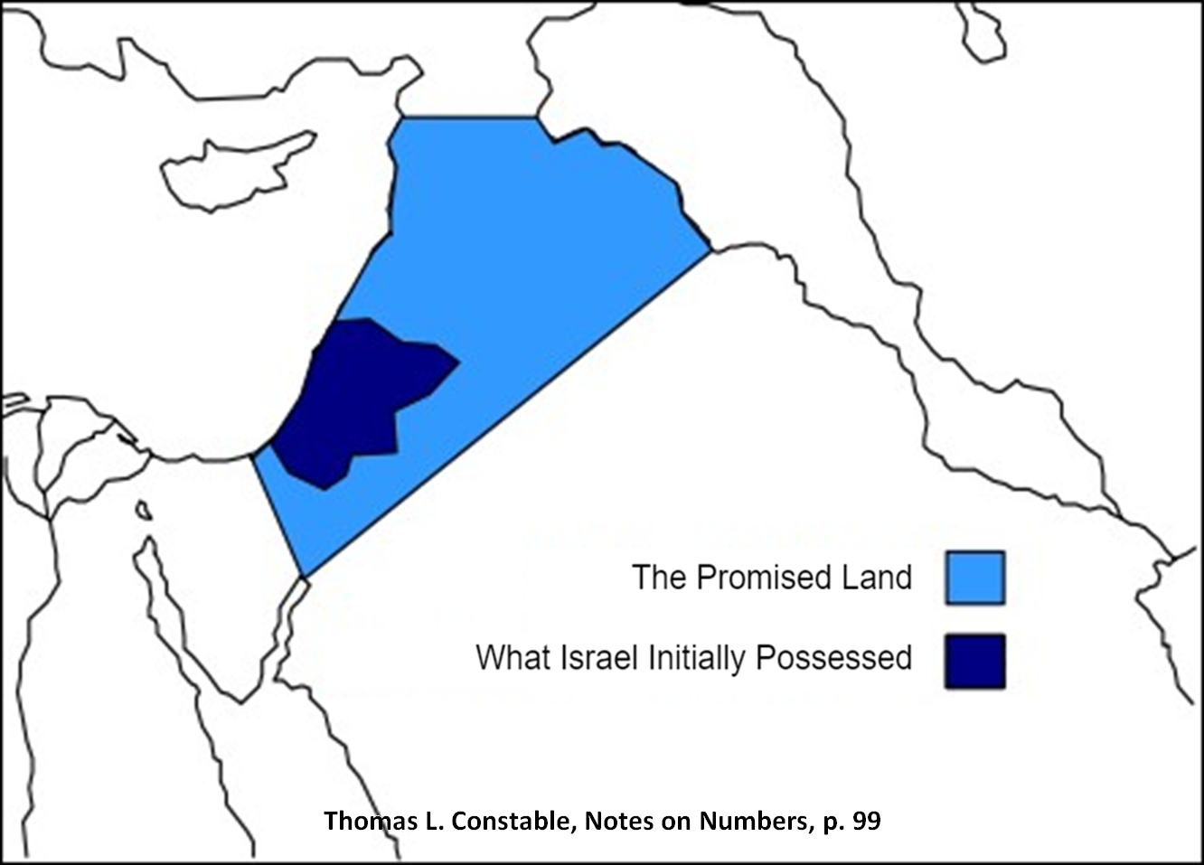

Slide 17
Dr. Arnold G. Fruchtenbaum
The Book of Genesis, 437
“Furthermore: And behold, the angels of God. In the Book of Genesis, the phrase the angels of God is found only twice, here and in 32:1; and it is significant as to the circumstances when it appears. Here in verse 12, the angels of God are mentioned as Jacob departs from the Land. In 32:1, they appear again as Jacob is returning to the Land.”

Slide 18
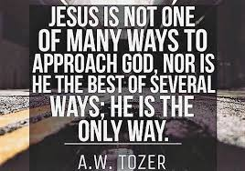
John 14:6
“Jesus said to him, ‘I am the way, and the truth, and the life; no one comes to the Father but through Me.’”

Slide 19
Genesis 28:10-22 Reconfirmation of the Covenant
Circumstances (10-12)
Covenant reaffirmed (13-15)
Jacob’s recognition (16-17)
Pillar (18-19)
Vow (20-22)

Slide 20
Genesis 28:13-15 Covenant Reaffirmed
Divine identification (13a)
Four covenant provisions (13b-15)

Slide 21
Genesis 28:13-15 Covenant Reaffirmed
Divine identification (13a)
Four covenant provisions (13b-15)

Slide 22
Genesis 28:13-15 Covenant Reaffirmed
Divine identification (13a)
Four covenant provisions (13b-15)

Slide 23
Genesis 28:13b-15 Four Covenant Provisions
Land (13b)
Seed (14a)
Blessing to the Gentiles (14b)
Jacob’s Personal Promises (15)

Slide 24
Genesis 28:13b-15 Four Covenant Provisions
Land (13b)
Seed (14a)
Blessing to the Gentiles (14b)
Jacob’s Personal Promises (15)

Slide 27
Ezekiel 36:24-28
²⁴ “For I will take you from the nations, gather you from all the lands and bring you into your own land. ²⁵ Then I will sprinkle clean water on you, and you will be clean; I will cleanse you from all your filthiness and from all your idols. ²⁶ Moreover, I will give you a new heart and put a new spirit within you; and I will remove the heart of stone from your flesh and give you a heart of flesh. ²⁷ I will put My Spirit within you and cause you to walk in My statutes, and you will be careful to observe My ordinances. ²⁸ You will live in the land that I gave to your forefathers; so you will be My people, and I will be your God.”

Slide 28
Genesis 28:13b-15 Four Covenant Provisions
Land (13b)
Seed (14a)
Blessing to the Gentiles (14b)
Jacob’s Personal Promises (15)

Slide 29
Genesis 28:13b-15 Four Covenant Provisions
Land (13b)
Seed (14a)
Blessing to the Gentiles (14b)
Jacob’s Personal Promises (15)

Slide 30
VI. 8 New Promises Genesis 12:1-3
Land (Gen. 12:1b)
Great nation (Gen. 12:2a)
Personal blessing (Gen. 12:2b)
Great name (Gen. 12:2c)
Blessing to others (Gen. 12:2d)
Blessing to blessers (Gen. 12:3a)
Cursing to cursers (Gen. 12:3b)
Blessing to the world (Gen. 12:3c)

Slide 31
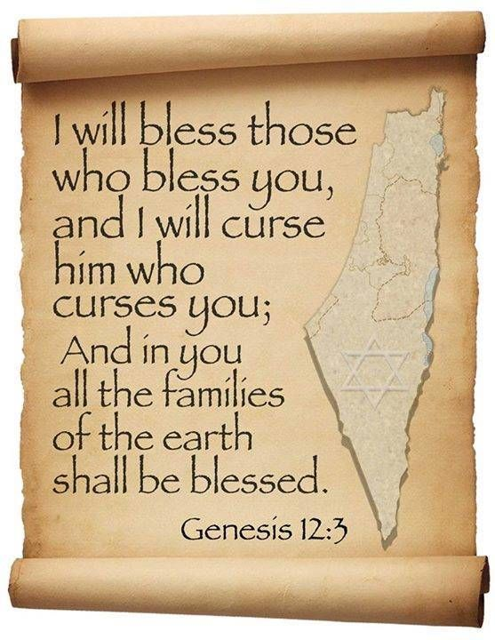
Genesis 12:3
“And I will bless those who bless you, And the one who curses you I will curse. And in you all the families of the earth will be blessed.”

Slide 32
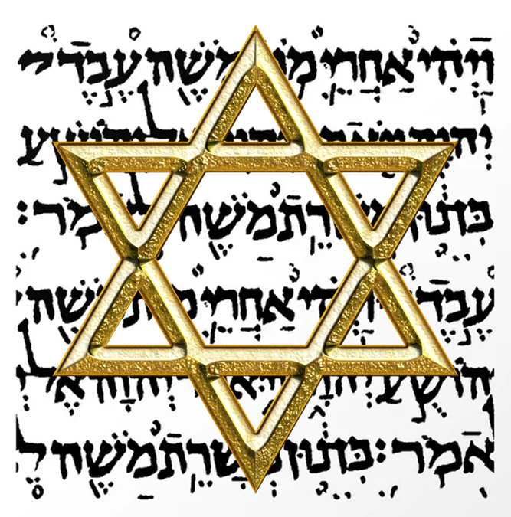
Israel’s Three Blessings to the World (Gen 12:3b)
Scripture (Rom 3:2)
Savior (John 4:22)
Kingdom (Isa 2:2-3)

Slide 33
Genesis 28:13b-15 Four Covenant Provisions
Land (13b)
Seed (14a)
Blessing to the Gentiles (14b)
Jacob’s Personal Promises (15)

Slide 34
Genesis 28:15 Jacob’s Personal Promises
God’s presence (15a)
God’s protection (15b)
Land (15c)
God’s commitment (15d)

Slide 35
Genesis 28:15 Jacob’s Personal Promises
God’s presence (15a)
God’s protection (15b)
Land (15c)
God’s commitment (15d)

Slide 36
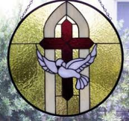
John 14:16-17
¹⁶ I will ask the Father, and He will give you another Helper, that He may be with you forever; ¹⁷ that is the Spirit of truth, whom the world cannot receive, because it does not see Him or know Him, but you know Him because He abides with you and will be in you.

Slide 37
Genesis 28:15 Jacob’s Personal Promises
God’s presence (15a)
God’s protection (15b)
Land (15c)
God’s commitment (15d)

Slide 38
Genesis 28:15 Jacob’s Personal Promises
God’s presence (15a)
God’s protection (15b)
Land (15c)
God’s commitment (15d)

Slide 39
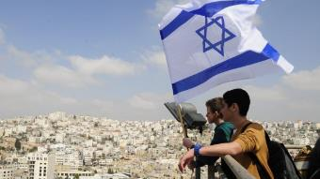
Reliability of the “Divine Regathering” Predictions
 | RETURN | PREDICTED | FULFILLED
1st | From Egypt to Canaan | Gen. 15:13-14 | Joshua 1‒12
2nd | From Babylon to Israel | Jer. 25:11; 29:10 | Ezra & Nehemiah
3rd | From the Diaspora to Israel’s restoration | Ezekiel 36:24-28 | Millennial Kingdom

Slide 40
Genesis 28:15 Jacob’s Personal Promises
God’s presence (15a)
God’s protection (15b)
Land (15c)
God’s commitment (15d)

Slide 41
Evidence of Abrahamic Covenant’s Unconditional Nature
ANE covenant ratification ceremony (Gen 15)
Lack of stated conditions for Israel’s obedience (Gen 15)
Covenant's eternality (Gen 17:7, 13, 19; Ps. 90:2)
Covenant's immutability (Heb 6:13-18; Mal. 3:6)
Trans-generational reaffirmation despite perpetual national disobedience (Jer 31:35-37)
Walvoord, The Millennial Kingdom, 149-52

Slide 42
Genesis 28:10-22 Reconfirmation of the Covenant
Circumstances (10-12)
Covenant reaffirmed (13-15)
Jacob’s recognition (16-17)
Pillar (18-19)
Vow (20-22)

Slide 43
Genesis 28:16-17 Jacob’s Recognition
Recognition (16)
Fear (17a)
Place (17b)
Conclusion (17c)

Slide 44
Genesis 28:16-17 Jacob’s Recognition
Recognition (16)
Fear (17a)
Place (17b)
Conclusion (17c)

Slide 45
Genesis 28:16-17 Jacob’s Recognition
Recognition (16)
Fear (17a)
Place (17b)
Conclusion (17c)

Slide 46
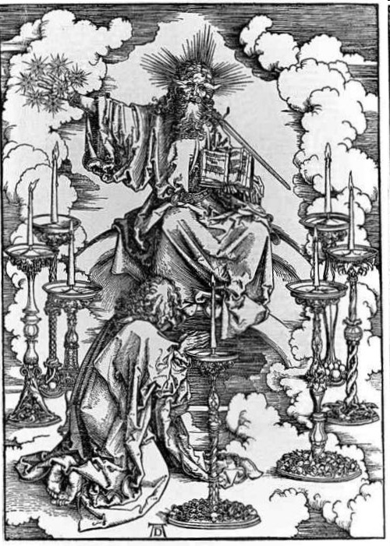

Slide 47
Genesis 28:16-17 Jacob’s Recognition
Recognition (16)
Fear (17a)
Place (17b)
Conclusion (17c)

Slide 48
Genesis 28:16-17 Jacob’s Recognition
Recognition (16)
Fear (17a)
Place (17b)
Conclusion (17c)

Slide 49
John 14:6
“Jesus said to him, ‘I am the way, and the truth, and the life; no one comes to the Father but through Me.’”

Slide 50
Genesis 28:10-22 Reconfirmation of the Covenant
Circumstances (10-12)
Covenant reaffirmed (13-15)
Jacob’s recognition (16-17)
Pillar (18-19)
Vow (20-22)

Slide 51
Genesis 28:18-19 Pillar
Pillar (18)
Name (19)

Slide 52
Genesis 28:18-19 Pillar
Pillar (18)
Name (19)

Slide 53
Genesis 28:18-19 Pillar
Pillar (18)
Name (19)

Slide 55
Genesis 28:10-22 Reconfirmation of the Covenant
Circumstances (10-12)
Covenant reaffirmed (13-15)
Jacob’s recognition (16-17)
Pillar (18-19)
Vow (20-22)

Slide 56
Genesis 28:20-22 Vow
Vow (20a)
Content (20b-22)

Slide 57
Genesis 28:20-22 Vow
Vow (20a)
Content (20b-22)

Slide 58
Genesis 28:20-22 Vow
Vow (20a)
Content (20b-22)

Slide 59
Genesis 28:20b-22 Content
What God will do (20b-21a)
What Jacob will do (21b-22)

Slide 60
Genesis 28:20b-22 Content
What God will do (20b-21a)
What Jacob will do (21b-22)

Slide 61
Genesis 28:20b-21a What God Would Do
God’s presence (20b)
God’s provision (20c)
Father’s house (21a)

Slide 62
Genesis 28:20b-21a What God Would Do
God’s presence (20b)
God’s provision (20c)
Father’s house (21a)

Slide 63
Dr. Arnold G. Fruchtenbaum
The Book of Genesis, 438-39
“In verse 20b–21a, he focused on what God would do, beginning in verse 21b with God’s provision for Jacob: If God will be with me, meaning if God’s presence will be indeed with him. The word if can also mean ‘since.' [Since] God will be with me, which is really more of a response of gratitude than a response of testing, and will keep me in this way that I go, and will give me bread to eat, and raiment to put on.”

Slide 64
Genesis 28:20b-21a What God Would Do
God’s presence (20b)
God’s provision (20c)
Father’s house (21a)

Slide 65
God’s Provision for the Giver (Phil. 4:19)
Exodus 16
1 Kings 17:2-6
Psalm 37:25
Matthew 6:25-34

Slide 67
Genesis 28:20b-21a What God Would Do
God’s presence (20b)
God’s provision (20c)
Father’s house (21a)

Slide 68
Genesis 28:20b-22 Content
What God will do (20b-21a)
What Jacob will do (21b-22)

Slide 69
Genesis 28:21b-22 What Jacob Will Do
Dedication (21b)
Pillar (22a)
Tithe (22b)

Slide 70
Genesis 28:21b-22 What Jacob Will Do
Dedication (21b)
Pillar (22a)
Tithe (22b)

Slide 71
Romans 12:1
¹ Therefore I urge you, brethren, by the mercies of God, to present your bodies a living and holy sacrifice, acceptable to God, which is your spiritual service of worship.

Slide 72
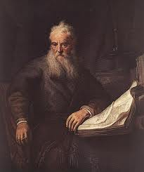
Romans Outline
Salutation (1:1-17)
Sin (1:18–3:20)
Salvation (3:21–5:21)
Sanctification (6–8)
Sovereignty (9–11)
Service (12:1–15:13)
Summation (15:14–16:27)

Slide 74
Genesis 28:21b-22 What Jacob Will Do
Dedication (21b)
Pillar (22a)
Tithe (22b)

Slide 75
Genesis 28:21b-22 What Jacob Will Do
Dedication (21b)
Pillar (22a)
Tithe (22b)

Slide 77
Psalm 147:19-20
“He declares His words to Jacob, His statutes and His ordinances to Israel. He has not dealt thus with any nation; And as for His ordinances, they have not known them. Praise the Lord!”

Slide 78
Conclusion

Slide 79
Genesis 28 Chapter Summary
Jacob’s flight to Haran (1-5)
Esau’s third wife (6-9)
Reconfirmation of the Covenant (10-22)

Slide 80
²⁴ The Lord bless you, and keep you; ²⁵ The Lord make His face shine on you, And be gracious to you; ²⁶ The Lord lift up His countenance on you, And give you peace.
Numbers 6:24–26 (NASB95)

