Slide 1
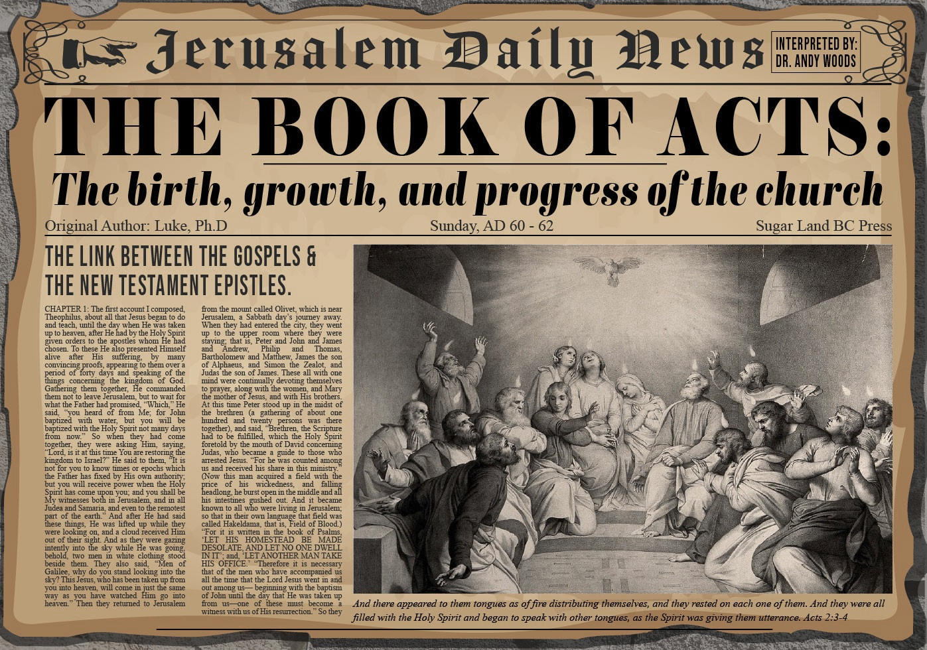


Slide 2
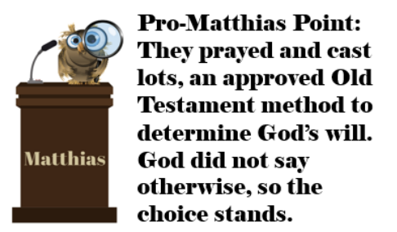
Acts 1
Chapter Summary
  Prologue (1-5)
  Jesus’ Ascension (6-11)
  Return to Jerusalem (12-14)
  Matthias Chosen (15-26)

Slide 3
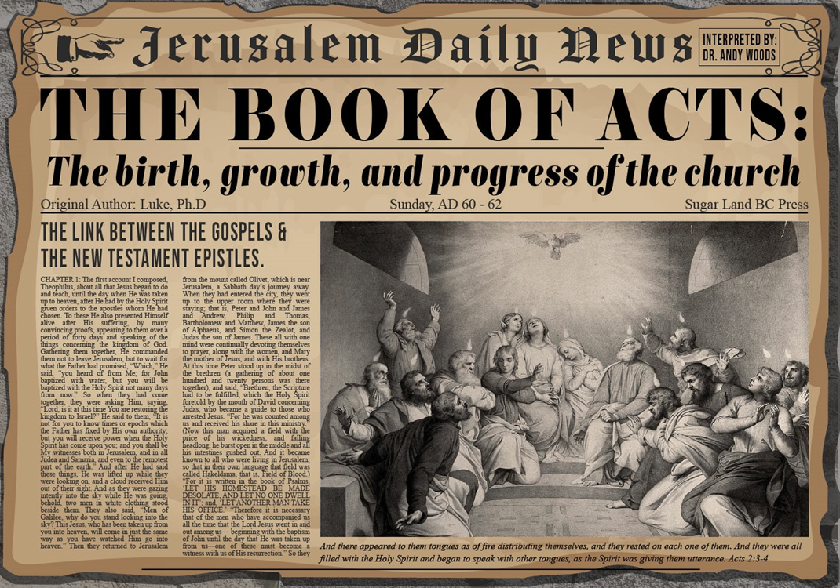
Acts 2
Chapter Summary
  Coming of the Holy Spirit (1-4)
  Holy Spirit’s Impact (5-13)
  Peter’s Sermon (14-36)
  Sermon’s Impact (37-47)

Slide 4


Acts 2:13, 15
¹³ “But others were mocking and saying, ‘They are full of sweet wine.’… ¹⁵ ‘For these men are not drunk, as you suppose, for it is only the third hour of the day.’”

Slide 5
Peter’s Sermon
Acts 2:14-36
  Introduction (14)
  Refutation of Drunkenness Charge (15-35)
  Conclusion (36)

Slide 6
Acts 2
Chapter Summary
  Coming of the Holy Spirit (1-4)
  Holy Spirit’s Impact (5-13)
  Peter’s Sermon (14-36)
  Sermon’s Impact (37-47)

Slide 7
Coming of the Holy Spirit
Acts 2:37-47
  Salvation (37-41)
  Church (42-47)

Slide 8
Coming of the Holy Spirit
Acts 2:37-47
  Salvation (37-41)
  Church (42-47)

Slide 9
Acts 2:37-41
Salvation
      Conviction (37)
      Repentance & Baptism (38-39)
      Consequence of Repentance (40)
      Result (41)

Slide 10
Acts 2:37-41
Salvation
      Conviction (37)
      Repentance & Baptism (38-39)
      Consequence of Repentance (40)
      Result (41)

Slide 11
John 16:7–11
⁷ “But I tell you the truth, it is to your advantage that I go away; for if I do not go away, the Helper will not come to you; but if I go, I will send Him to you. ⁸ “And He, when He comes, will convict the world concerning sin and righteousness and judgment; ⁹ concerning sin, because they do not believe in Me; ¹⁰ and concerning righteousness, because I go to the Father and you no longer see Me; ¹¹ and concerning judgment, because the ruler of this world has been judged.

Slide 12
Acts 2:37-41
Salvation
      Conviction (37)
      Repentance & Baptism (38-39)
      Consequence of Repentance (40)
      Result (41)

Slide 13

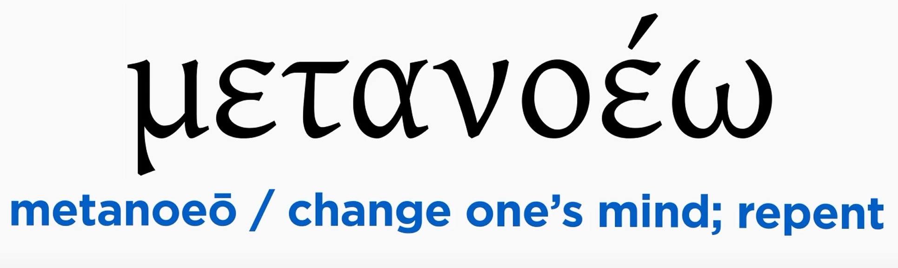
Acts 2:38
“Peter said to them, “Repent [metanoeō], and each of you be baptized in the name of Jesus Christ for (eis) the forgiveness of your sins; and you will receive the gift of the Holy Spirit.”

Slide 14


Acts 2:38
Douay-Rheims 1899 American Edition (DRA)
“But Peter said to them: Do penance, and be baptized every one of you in the name of Jesus Christ, for the remission of your sins: and you shall receive the gift of the Holy Ghost.”

Slide 15
2 Peter 3:9
Douay-Rheims 1899 American Edition (DRA)
“The Lord delayeth not his promise, as some imagine, but dealeth patiently for your sake, not willing that any should perish, but that all should return to penance.”

Slide 16
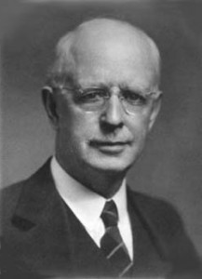
Lewis Sperry Chafer
vol. 7, Systematic Theology (Grand Rapids, MI: Kregel Publications, 1993), 265-66.
“This vital newness of mind is a part of believing, after all, and therefore it may be and is used as a synonym for believing at times (cf. Acts 17:30; 20:21; 26:20; Rom. 2:4; 2Tim. 2:25; 2 Pet. 3:9). Repentance nevertheless cannot be added to believing as a condition of salvation, because upwards of 150 passages of Scripture condition salvation upon believing only (cf. John 3:16; Acts 16:31).”

Slide 17

Acts 17:30-31
“³⁰ Therefore having overlooked the times of ignorance, God is now declaring to men that all people everywhere should repent [metanoeō], ³¹ because He has fixed a day in which He will judge the world in righteousness through a Man whom He has appointed, having furnished proof to all men by raising Him from the dead.”

Slide 18
2 Peter 3:9
“The Lord is not slow about His promise, as some count slowness, but is patient toward you, not wishing for any to perish but for all to come to repentance.”

Slide 19

Matthew 12:24
“But when the Pharisees heard this, they said, ‘This man casts out demons only by Beelzebul the ruler of the demons.’”

Slide 20
Matthew Outline
Pedigree of the king (1–2)
  Preparation of the king (3–4)
    Pedagogy of the king (5–7)
      Power of the king (8–9)
        Program of the king (10)
          Progressive rejection of the king (11–12)
        Preparation of the king’s disciples (13–20)
      Presentation & rejection of the king (21–23)
    Prophecies of the king (24–25)
  Passion of the king (26–27)
Proof of the king (28)

Slide 21
Transition from Public to Private Ministry
 | PUBLIC | PRIVATE
Scripture | Matt. 1–12 | Matt. 13–28
Focus | Nation | Remnant
Miracles | Proof to nation | Training for remnant
Kingdom Offer | Prominent | Disappears
Teaching | Discourse | Parabolic
Interim program | Not mentioned | Prominent
Crucifixion; Resurrection | Not mentioned (4:17) | Prominent (16:21)

Slide 22

Acts 2:38
“Peter said to them, ‘Repent, and each of you be baptized in the name of Jesus Christ for (eis) the forgiveness of your sins; and you will receive the gift of the Holy Spirit.’”

Slide 23
Acts 2:38
“Peter said to them, ‘Repent, and each of you be baptized in the name of Jesus Christ for (eis) the forgiveness of your sins; and you will receive the gift of the Holy Spirit.’”

Slide 24
Matthew 12:41
“The men of Nineveh will stand up with this generation at the judgment and will condemn it because they repented at [in the face of/because of] (eis) the preaching of Jonah; and behold, something greater than Jonah is here.”

Slide 25

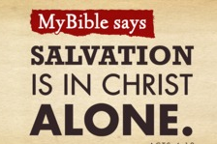
Acts 4:12
“And there is salvation in no one else; for there is no other name under heaven that has been given among men by which we must [dei] be saved.”

Slide 26
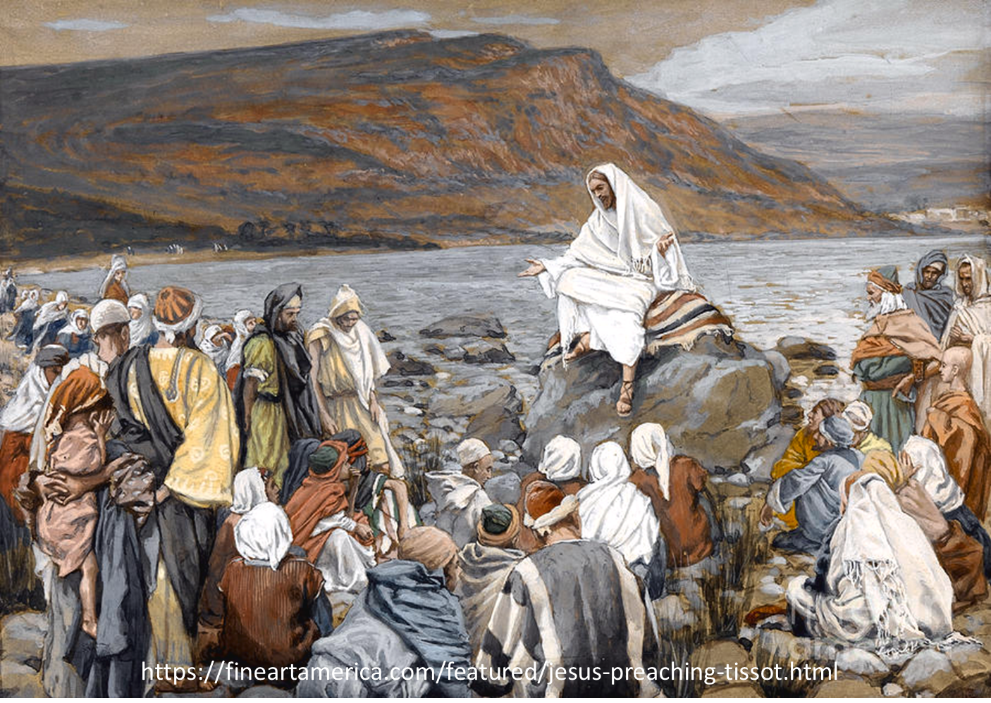
Luke 4:43
“But He said to them, “I must [dei] preach the kingdom of God to the other cities also, for I was sent for this purpose.”

Slide 27
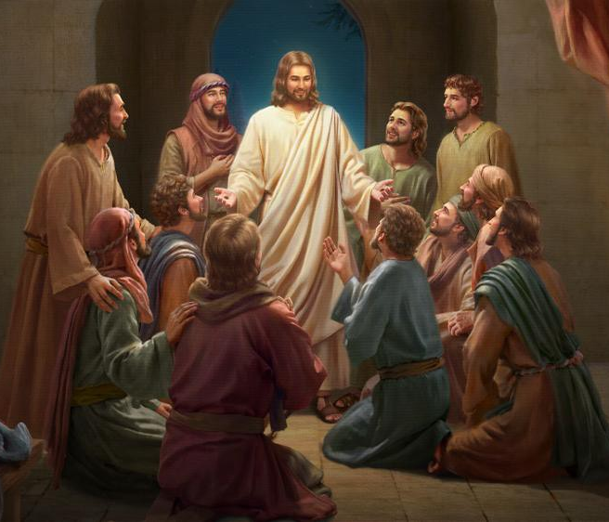
Luke 24:44
“Now He said to them, “These are My words which I spoke to you while I was still with you, that all things which are written about Me in the Law of Moses and the Prophets and the Psalms must [dei] be fulfilled.”

Slide 28

“…one of the mistakes that human beings make is believing that there is only one way…We don’t accept that there are diverse ways of being in the world; that there are millions of ways to be a human being. And many ways…many paths to what you call God. That her path might be something else and when she gets there she might call it the light. But her loving, and her kindness, and her generosity brings her to the…same point that it brings you…
www.youtube.com/watch?v=Lb2RUpMDk34

Slide 29
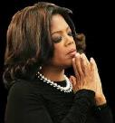
…It doesn’t matter whether she called it ‘God’ along the way or not…There couldn’t possibly be just one way!…There couldn’t possibly be only one way with millions of people in the world!...You think…if you are somewhere on the planet and you never hear the name of Jesus but yet you live with a loving heart. You lived as Jesus would have had you to live. You lived for the same purpose as Jesus came to the planet to teach us all, but you are in some remote part of the earth and you never heard the name of Jesus. You cannot get to Heaven…?”
www.youtube.com/watch?v=Lb2RUpMDk34

Slide 30
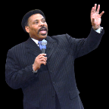
Tony Evans
Totally Saved: Understanding, Experiencing and Enjoying the
Greatness of Your Salvation (Chicago: Moody, 2002), 355, 359.
“In a class I once taught at Dallas Seminary, I inadvertently asked an exam question on material I had not covered in class. One of the students brought this discrepancy to my attention. To be fair, I had to rescore all of the test papers because I could not hold the students liable for information they had never been given…So the premise is that God will not hold people accountable for a decision they cannot make, based on information they have not received…And people in faraway lands who have never heard the gospel still have their own sins to answer for. This means we need to talk about the provision God has made for those who cannot believe….Here's the spiritual principle at work: When people respond to what they do know of God, He takes personal responsibility for giving them more information about Himself.... In the case of a person…

Slide 31
Tony Evans
Totally Saved: Understanding, Experiencing and Enjoying the
Greatness of Your Salvation (Chicago: Moody, 2002), 355, 359.
…who never hears the gospel and never knows the name of Jesus, but who responds to the light he has, God, treats that person like an Old Testament saint, if you will. That is, if the person trusts in what God has revealed, God deals with that person based on the knowledge he has, not the information he never received. I call this trans-dispensationalism...By this I mean if a person is sincerely seeking God and desiring to know Him, and is responding to the truth he knows, if there is no missionary or direct manifestation of God, then God judges that person based on his faith in the light he has received. And as in the case of Abraham, God will retroactively count this person as righteous by applying the death of Christ from the dispensation of grace.”

Slide 32
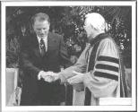
Hl9Aps://www.youtube.com/watch?v=hrf60-zHl9A
Dr. Schuller: "Tell me, what is the future of Christianity?"
Dr. Graham: "Well, Christianity and being a true believer, you know, I think there's the body of Christ which comes from all the Christian groups around the world, or outside the Christian groups. I think that everybody that loves Christ or knows Christ, whether they're conscious of it or not, they're members of the body of Christ. And I don't think that we're going to see a great sweeping revival that will turn the whole world to Christ at any time…and that’s what God is doing today. He is calling people out of the world for His name. Whether they come from the Muslim world, or the Buddhist world, or the Christian world, or the non-believing world, they are members of the body of Christ because they've been called . . .

Slide 33
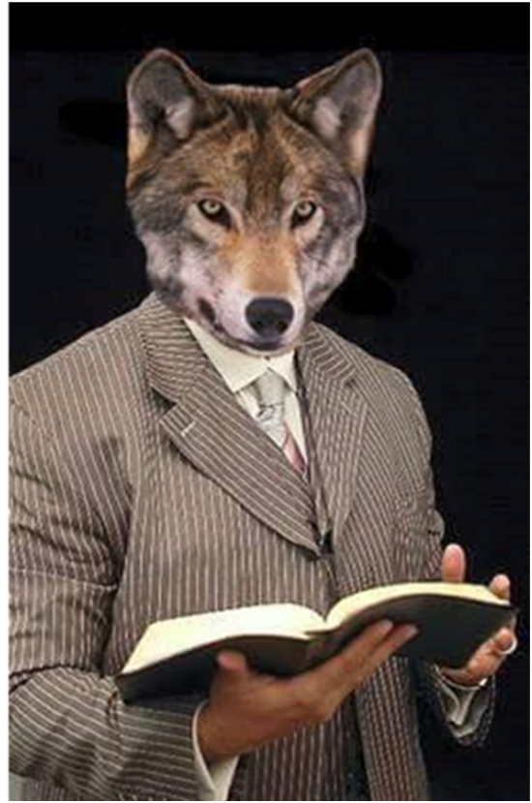
Hl9Aps://www.youtube.com/watch?v=hrf60-zHl9A
…by God. They may not even know the name of Jesus, but they know in their hearts they need something that they don't have and they turn to the only light that they have and I think they're saved and they're going to be with us in heaven.”
Dr. Schuller: "This is fantastic. I'm so thrilled to hear you say that. There's a wideness in God's mercy.”
Dr. Graham: “There is."

Slide 34


Slide 35
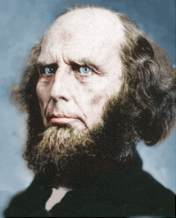
Poor Word Choices
ABC method – Admit, Believe, Call
Miscellaneous poor word choices – confess, deny, yield, surrender, sorrow, make, ask, forsake, receive, accept, invite
Negative influence of Charles Finney

Slide 36
Matthew 23:37-39
³⁷ “Jerusalem, Jerusalem, who kills the prophets and stones those who are sent to her! How often I wanted to gather [episynagō] your children together, the way a hen gathers [episynagō] her chicks under her wings, and you were unwilling. ³⁸ Behold, your house is being left to you desolate! ³⁹ For I say to you, from now on you will not see Me until you say, ‘Blessed is He who comes in the name of the Lord!’”

Slide 37

Romans 8:29-30
²⁹ For those whom He foreknew, He also predestined to become conformed to the image of His Son, so that He would be the firstborn among many brethren; ³⁰ and these whom He predestined, He also called; and these whom He called, He also justified; and these whom He justified, He also glorified.

Slide 38
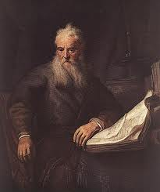
Romans Outline
Salutation (1:1-17)
Sin (1:18–3:20)
Salvation (3:21–5:21)
Sanctification (6–8)
Sovereignty (9–11)
Service (12:1–15:13)
Summation (15:14–16:27)

Slide 39


Slide 40
V. Sovereignty (Rom 9–11)
Israel in the past: elected (Rom 9)
Israel in the present: rejected (Rom 10)
Israel in the future: accepted (Rom 11)

Slide 41

Lewis Sperry Chafer, vol. 7, Systematic Theology
(Grand Rapids, MI: Kregel Publications, 1993), 265-66.
Belief-God’s One Condition for Justification
“…because upwards of 150 passages of Scripture condition salvation upon believing only (cf. John 3:16; Acts 16:31).”

Slide 42
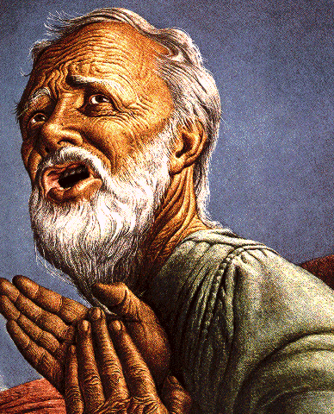
Belief – God’s One Condition for Justification
Gen 15:6
Then he believed in the LORD; and He reckoned it to him as righteousness.
John 3:16
For God so loved the world, that He gave His only begotten Son, that whoever believes in Him shall not perish, but have eternal life.
Acts 16:30-31
"Sirs, what must I do to be saved?" They said, "Believe in the Lord Jesus, and you will be saved..."

Slide 43
Acts 2:37-41
Salvation
      Conviction (37)
      Repentance & Baptism (38-39)
      Consequence of Repentance (40)
      Result (41)

Slide 44


Slide 45
Six Parts of a Suzerain-Vassal Treaty in Deuteronomy
Preamble (1:1-5)
Prologue (1:6–4:40)
Covenant obligations (5–26)
Storage and reading instructions (27:2-3; 31:9, 24, 26)
Witnesses (32:1)
Blessings and curses (28)

Slide 46
Six Parts of a Suzerain-Vassal Treaty in Deuteronomy
Preamble (1:1-5)
Prologue (1:6–4:40)
Covenant obligations (5–26)
Storage and reading instructions (27:2-3; 31:9, 24, 26)
Witnesses (32:1)
Blessings and curses (28)

Slide 47
Deuteronomy 28:49-50
⁴⁹ “The Lord will bring a nation against you from afar, from the end of the earth, as the eagle swoops down, a nation whose language you shall not understand, ⁵⁰ a nation of fierce countenance who will have no respect for the old, nor show favor to the young.”

Slide 48
ISRAEL'S JUDGMENTS
Division of the kingdom in 931 B.C. (1 Kgs. 12)
Assyrian judgment in 722 B.C. (2 Kgs. 17)
Babylonian captivity in 586 B.C. (2 Kgs. 25)
Rome Diaspora in A.D. 70 (Luke 19:41-44)

Slide 49
ISRAEL'S JUDGMENTS
Division of the kingdom in 931 B.C. (1 Kgs. 12)
Assyrian judgment in 722 B.C. (2 Kgs. 17)
Babylonian captivity in 586 B.C. (2 Kgs. 25)
Rome Diaspora in A.D. 70 (Luke 19:41-44)

Slide 50
Eusebius (A.D. 260-340)
Ecclesiastical History, 3.5.3
"But the people of the church in Jerusalem had been commanded by a revelation, vouchsafed to approved men there before the war, to leave the city and to dwell in a certain town of Perea called Pella. And when those that believed in Christ had come thither from Jerusalem, then, as if the royal city of the Jews and the whole land of Judea were entirely destitute of holy men, the judgment of God at length overtook those who had committed such outrages against Christ and his apostles, and totally destroyed that generation of impious men."
Epiphanius (De pond. et mens. 15) also records this flight of the Christians to Pella.)

Slide 51
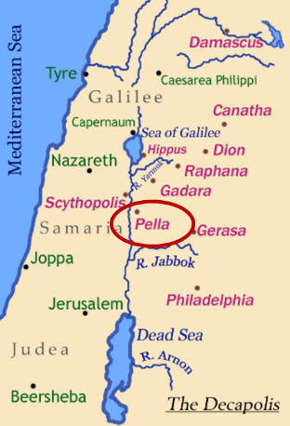
Pella
Pella was a town situated beyond the Jordan, in the north of Perea, within the dominions of Herod Agrippa II. The surrounding population was chiefly Gentile. See Pliny V. 18, and Josephus, B. J. III. 3. 3, and I. 4. 8.

Slide 52

Ezekiel 36:24-28
²⁴ “For I will take you from the nations, gather you from all the lands and bring you into your own land. ²⁵ Then I will sprinkle clean water on you, and you will be clean; I will cleanse you from all your filthiness and from all your idols. ²⁶ Moreover, I will give you a new heart and put a new spirit within you; and I will remove the heart of stone from your flesh and give you a heart of flesh. ²⁷ I will put My Spirit within you and cause you to walk in My statutes, and you will be careful to observe My ordinances. ²⁸ You will live in the land that I gave to your forefathers; so you will be My people, and I will be your God.”

Slide 53

Charles L. Feinberg
The Prophecy of Ezekiel: The Glory of the Lord, Paperback ed. (Chicago: Moody, 1969; reprint, Chicago: Moody, 1984), 231-32.
“Verses 25–29 teach that the complete return of Israel will occur after the defeat of Gog and his Confederates. Ezekiel summarized his prophecies of hope and restoration. When he stated that God will have mercy upon the whole house of Israel, he had in mind that all previous restorations were partial. Now a universal and final restoration will take place. It was God who allowed them to go into captivity; it is he who will see to it that they are regathered; indeed, it is he who will insure that not one is left out of the land...In conclusion, to summarize all the benefits promised, Ezekiel spoke of the outpouring of the Spirit upon the house of Israel (italics added).”

Slide 54
Acts 2:37-41
Salvation
      Conviction (37)
      Repentance & Baptism (38-39)
      Consequence of Repentance (40)
      Result (41)

Slide 55

John 1:12
“But as many as received Him, to them He gave the right to become children of God, even to those who believe in His name.”

Slide 56
Acts 2:41
“So then, those who had received his word were baptized; and that day there were added about three thousand souls.”

Slide 57
Reasons for Understanding 1000 Literally
John’s use of indefinite concepts elsewhere
  Revelation 20:3,8
Exception to the “# of years” examples?
Other numbers are taken literally
  Two witnesses (11:3), 7000 people (11:13), 4 Angels (7:1) 7 Angels (8:6),144,000 Jews (7:4), 42 months (11:2), 1260 days (11:3)
Not always a symbolic interpretation
  (Rev. 17:18)

Slide 58


Slide 59

Message
  Birth and growth of the church numerically, geographically, ethnically.
  Components
  Numerically (progress reports)
  Geographically (From Jerusalem to Rome)
  Ethnically (From Judaism to Gentile domination)

Slide 60
Progress Reports
  Clearest: Acts 2:47; 6:7; 9:31; 12:24; 16:5; 19:20; 28:30-31
  Less clear: Acts 1:13, 15; 2:41; 4:4, 31; 5:14, 42; 8:25, 40; 11:21; 13:49; 17:6

Slide 61
Coming of the Holy Spirit
Acts 2:37-47
  Salvation (37-41)
  Church (42-47)

Slide 62
Acts 2:42-47
Church
      Priorities (42)
      Miracles (43)
      Unity (44)
      Communal living (45)
      Lord’s Table (46)
      Evangelism (47)

Slide 63
Acts 2:42-47
Church
      Priorities (42)
      Miracles (43)
      Unity (44)
      Communal living (45)
      Lord’s Table (46)
      Evangelism (47)

Slide 64
Activities of the Local Church
(Acts 2:41-47)
Doctrine (Acts 2:42)
Ordinances (Acts 2:41-42, 46)
Prayer (Acts 2:42)
Evangelism (Acts 2:47)
Worship (Acts 2:47)
Benevolence (Acts 2:44-45)
Fellowship (Acts 2:42, 46-47)

Slide 65
Acts 2:42-47
Church
      Priorities (42)
      Miracles (43)
      Unity (44)
      Communal living (45)
      Lord’s Table (46)
      Evangelism (47)

Slide 66

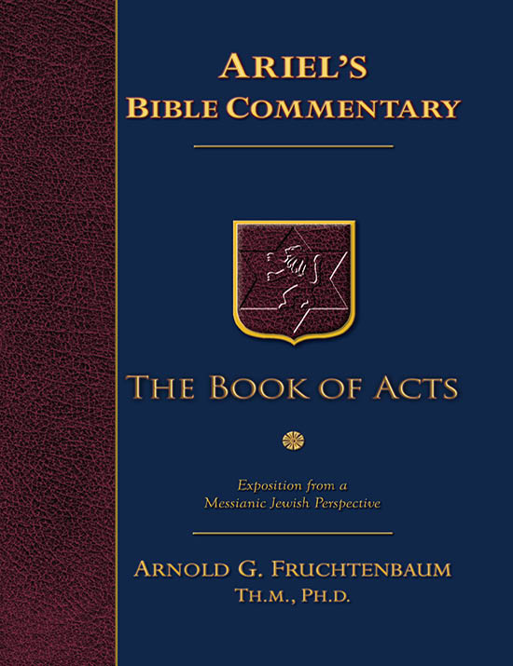
Dr. Arnold G. Fruchtenbaum
The Book of Acts, 83
“The apostles did many signs and wonders. In fact, the only ones who performed miracles in the book of Acts were the apostles or their delegates, such as Stephen (Acts 6:8). These apostolic legates were appointed by the laying on of hands by the apostles. Signs and wonders were not performed by the believers at large.”

Slide 67

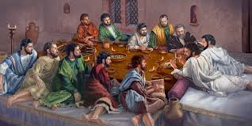
Ephesians 2:20
“having been built on the foundation of the apostles and prophets, Christ Jesus Himself being the corner stone.”

Slide 68
Miracle Clusters In Scripture
NUM. | ERA | AUTHENTICATION
1. | Moses | Law
2. | Joshua | Conquest
3. | Elijah-Elisha | Prophet
4. | Christ | Kingdom offer
5. | Apostles | Church
6. | Tribulation & Millennium | Kingdom establishment

Slide 69
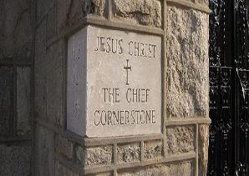
2 Timothy 4:20
“Erastus remained at Corinth, but Trophimus I left sick at Miletus.”

Slide 70
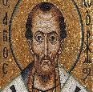
Chrysostom (A.D. 345‒407)
Patriarch of Constantinople, Chrysostom, Homily 29 on First Corinthians.
“This whole place is very obscure: but the obscurity is produced by our ignorance of the facts referred to and by their cessation, being such as then used to occur but now no longer take place. And why do they not happen now? Why look now, the cause too of the obscurity has produced us again another question: namely, why did they then happen, and now do so no more?”

Slide 71
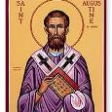
Augustine (A.D. 354‒430)
Bishop of Hippo, Homily 6:10 on the First Epistle of John.
“In the earliest times, the Holy Ghost fell upon them that believed: and they spoke with tongues, which they had not learned, as the Spirit gave them utterance. Acts 2:4 These were signs adapted to the time. For there behooved to be that betokening of the Holy Spirit in all tongues, to show that the Gospel of God was to run through all tongues over the whole earth. That thing was done for a betokening, and it passed away. . . . If then the witness of the presence of the Holy Ghost be not now given through these miracles, by what is it given, by what does one get to know that he has received the Holy Ghost?”

Slide 72

Philip Schaff
History of the Christian Church, vol. 1 , p. 236-37.
“We do not know how long the glossolalia, as thus described by Paul, continued. It passed away gradually with the other extraordinary or strictly supernatural gifts of the apostolic age. It is not mentioned in the Pastoral, nor in the Catholic Epistles. We have but a few allusions to it at the close of the second century. Irenæus (Adv. Haer. 1. v. c. 6 § 1,) speaks of ‘many brethren’ whom he heard in the church having the gift of prophecy and of speaking in ‘diverse tongues’ (παντοδαπαῖς γλώσσαις), bringing the hidden things of men (τὰ κρύφια τῶν ἀνθρώπων) to light and expounding the mysteries of God (τὰ μυστήρια τοῦ θεοῦ). It is not clear whether by the term ‘diverse,’ which does not elsewhere occur, he means a speaking in foreign languages, or in . . .

Slide 73
Philip Schaff
History of the Christian Church, vol. 1 , p. 236-37.
“…diversities of tongues altogether peculiar, like those meant by Paul.” The latter is more probable. Irenæus himself had to learn the language of Gaul. Tertullian (Adv. Marc. V. 8; comp. De Anima, c. 9) obscurely speaks of the spiritual gifts, including the gift of tongues, as being still manifest among the Montanists to whom he belonged. At the time of Chrysostom it had entirely disappeared; at least he accounts for the obscurity of the gift from our ignorance of the fact. From that time on the glossolalia was usually misunderstood as a miraculous and permanent gift of foreign languages for missionary purposes. But the whole history of missions furnishes no clear example of such a gift for such a purpose.”

Slide 74
Acts 2:42-47
Church
      Priorities (42)
      Miracles (43)
      Unity (44)
      Communal living (45)
      Lord’s Table (46)
      Evangelism (47)

Slide 75

John 17:20-23
²⁰ “I do not ask on behalf of these alone, but for those also who believe in Me through their word; ²¹ that they may all be one; even as You, Father, are in Me and I in You, that they also may be in Us, so that the world may believe that You sent Me. ²² The glory which You have given Me I have given to them, that they may be one, just as We are one; ²³ I in them and You in Me, that they may be perfected in unity, so that the world may know that You sent Me, and loved them, even as You have loved Me.”

Slide 76
1 Corinthians 12:13
“For by one Spirit we were all baptized into one body, whether Jews or Greeks, whether slaves or free, and we were all made to drink of one Spirit.”

Slide 77
Lewis Sperry Chafer
vol. 5, Systematic Theology (Grand Rapids, MI: Kregel Publications, 1993), 158.
“Thoughtless and absurd is the modern notion that Christ was praying that denominations which exist in this remote time and in a country then unknown might become organically united in one, and therefore it is the duty of all sects to unite and thus help to answer this prayer. As indicated before, this unity is sought at the hand of the Father, indicating that it is a divine undertaking. It is that, and it results in a unity as organic and vital as that between the Father and the Son. This prayer began to be answered on the Day of Pentecost when believers were by the Spirit baptized into one Body, and is constantly answered whenever a soul is saved and thus joined as a member to the Body of Christ by the same baptism of the Spirit.”

Slide 78
Acts 2:42-47
Church
      Priorities (42)
      Miracles (43)
      Unity (44)
      Communal living (45)
      Lord’s Table (46)
      Evangelism (47)

Slide 79
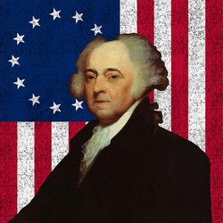
John Adams
John Adams, A Defence of the Constitutions of Government of the United States of America, 3 vols., American Constitutional and Legal History, ed. Leonard W. Levy (London: Dilly, 1787; reprint, NY: Da Capo, 1971), 3:217
“The moment the idea is admitted into society, that property is not as sacred as the laws of God, and that there is not a force of law and public justice to protect it, anarchy and tyranny commence. If ‘Thou Shalt Not Covet,’ and ‘Thou Shalt Not Steal’ were not commandments of Heaven, they must be made inviolable precepts in every society before it can be civilized or made free.”

Slide 80


Slide 81
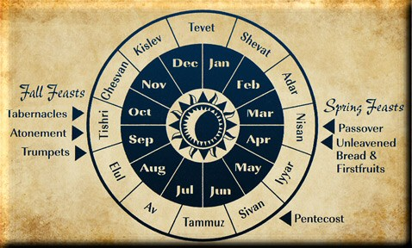

Slide 82
Acts 2:42-47
Church
      Priorities (42)
      Miracles (43)
      Unity (44)
      Communal living (45)
      Lord’s Table (46)
      Evangelism (47)

Slide 83
Acts 2:42-47
Church
      Priorities (42)
      Miracles (43)
      Unity (44)
      Communal living (45)
      Lord’s Table (46)
      Evangelism (47)

Slide 84

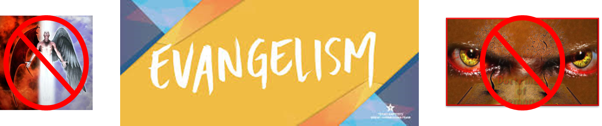
Matthew 16:18
“I also say to you that you are Peter, and upon this rock I will build [oikodomeō] My church; and the gates of Hades WILL NOT overpower it.”

Slide 85
Conclusion

Slide 86
Acts 2
Chapter Summary
  Coming of the Holy Spirit (1-4)
  Holy Spirit’s Impact (5-13)
  Peter’s Sermon (14-36)
  Sermon’s Impact (37-47)

