Slide 1


Dr. Andy Woods
Senior Pastor – Sugar Land Bible Church
President – Chafer Theological Seminary

Slide 2

Structure
1 THESSALONIANS 1-3 | 1 THESSALONIANS 4-5
Personal Experience | Practical Exhortation
Looking Back | Looking Forward

Slide 3

Structure
Personal (1–3)
  Genuine conversion (1)
  Impure motives (2:1-16)
  Lack of concern (2:17–3:13)
Practical (4–5)
  Immorality (4:1-8)
  Laziness (4:9-12)
  Eschatology (4:13–5:11)
  Ministry imbalances (5:12-15)
  Progressive sanctification (5:16-28)

Slide 4
Christian Living (4:1-12)
General conduct (4:1-2)
Negative command: sexual sin (4:3-8)
Positive command: brotherly love (4:9-12)

Slide 5
Structure
Personal (1–3)
  Genuine conversion (1)
  Impure motives (2:1-16)
  Lack of concern (2:17–3:13)
Practical (4–5)
  Immorality (4:1-8)
  Laziness (4:9-12)
  Eschatology (4:13–5:11)
  Ministry imbalances (5:12-15)
  Progressive sanctification (5:16-28)

Slide 6

1 Thessalonians 4:13-18
¹³ "But we do not want you to be uninformed, brethren, about those who are asleep, so that you will not grieve as do the rest who have no hope. ¹⁴ For if we believe that Jesus died and rose again, even so God will bring with Him those who have fallen asleep in Jesus. ¹⁵ For this we say to you by the word of the Lord, that we who are alive and remain until the coming of the Lord, will not precede those who have fallen asleep. ¹⁶ For the Lord Himself will descend from . . .

Slide 7
1 Thessalonians 4:13-18
. . .heaven with a shout, with the voice of the archangel and with the trumpet of God, and the dead in Christ will rise first. ¹⁷ Then we who are alive and remain will be caught up together with them in the clouds to meet the Lord in the air, and so we shall always be with the Lord. ¹⁸ Therefore comfort one another with these words."

Slide 8
Unique Characteristics
Every chapter ends with a reference to the Second Advent
Small amount of time in between planting of the church and the first letter to the church

Slide 9

2 Thessalonians 2:5
“Do you not remember that while I was still with you, I was telling you these things?”

Slide 10
1 Thessalonians 4:13-18
¹³ "But we do not want you to be uninformed, brethren, about those who are asleep, so that you will not grieve as do the rest who have no hope. ¹⁴ For if we believe that Jesus died and rose again, even so God will bring with Him those who have fallen asleep in Jesus. ¹⁵ For this we say to you by the word of the Lord, that we who are alive and remain until the coming of the Lord, will not precede those who have fallen asleep. ¹⁶ For the Lord Himself will descend from . . .

Slide 11
Order of Paul’s Letters
Galatians (A.D. 49)
1‒2 Thessalonians (A.D. 51)
1‒2 Corinthians (A.D. 56)
Romans (A.D. 57)
Ephesians, Colossians, Philemon, Philippians (A.D. 60‒62)
1 Timothy, Titus (A.D. 62‒66)
2 Timothy (A.D. 67)

Slide 12
Five General Comments
(1 Thess. 4:13-18)
Not the first mention of The Rapture
“Rapture” comes from the Latin
The Rapture is distinct from the Second Advent
Only for the Church Age believer
Pre-tribulationalism is the correct view
Notes:
Outline

Slide 13
Five General Comments
(1 Thess. 4:13-18)
Not the first mention of The Rapture
“Rapture” comes from the Latin
The Rapture is distinct from the Second Advent
Only for the Church Age believer
Pre-tribulationalism is the correct view
Notes:
Outline

Slide 14


John 14:1–4
¹ “Do not let your heart be troubled; believe in God, believe also in Me. ² In My Father’s house are many dwelling places; if it were not so, I would have told you; for I go to prepare a place for you. ³ If I go and prepare a place for you, I will come again and receive you to Myself, that where I am, there you may be also. ⁴ And you know the way where I am going.”

Slide 15
Parallels
JOHN 14:1-4 | 1 THESS 4:13-18
trouble (1) | sorrow (13)
Believe (1) | believe (14)
God, me (1) | Jesus, God (14)
told you (2) | say to you (15)
come again (3) | coming of the Lord (15)
receive, you (3) | caught up (17)
to myself (3) | to meet the Lord (17)
be where I am (3) | ever be with the Lord (17)
J. B. Smith, A Revelation of Jesus Christ: A Commentary on the Book of Revelation, 311-13

Slide 16
1 Thessalonians 4:13-18
¹³ "But we do not want you to be uninformed, brethren, about those who are asleep, so that you will not grieve as do the rest who have no hope. ¹⁴ For if we believe that Jesus died and rose again, even so God will bring with Him those who have fallen asleep in Jesus. ¹⁵ For this we say to you by the word of the Lord, that we who are alive and remain until the coming of the Lord, will not precede those who have fallen asleep. ¹⁶ For the Lord Himself will descend from . . .

Slide 17
Five General Comments
(1 Thess. 4:13-18)
Not the first mention of The Rapture
“Rapture” comes from the Latin
The Rapture is distinct from the Second Advent
Only for the Church Age believer
Pre-tribulationalism is the correct view
Notes:
Outline

Slide 18
1 Thessalonians 4:13-18
. . .heaven with a shout, with the voice of the archangel and with the trumpet of God, and the dead in Christ will rise first. ¹⁷ Then we who are alive and remain will be caught up (harpazō) together with them in the clouds to meet the Lord in the air, and so we shall always be with the Lord. ¹⁸ Therefore comfort one another with these words."

Slide 19

Catching Away of All Living Believers
(1 Thess. 4:17)
Harpazo = seized or caught up by force
Harpazo (Greek) = rapere (Latin) = rapture (English)

Slide 20
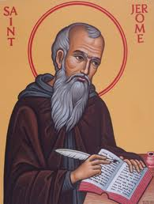
Latin Vulgate Translation
(1 Thess. 4:17)
“Deinde nos, qui vivimus, qui relinquimur, simul rapiemur cum illis in nubibus obviam Christo in aëra, et sic semper cum Domino erimus.”
Andrew Curtis and Isaiah Hoogendyk, The Lexham Latin-English Interlinear Vulgate (Bellingham, WA: Lexham Press, 2016), 1 Th 4:17.

Slide 21
Five General Comments
(1 Thess. 4:13-18)
Not the first mention of The Rapture
“Rapture” comes from the Latin
The Rapture is distinct from the Second Advent
Only for the Church Age believer
Pre-tribulationalism is the correct view
Notes:
Outline

Slide 22
RAPTURE DISTINCT FROM SECOND ADVENT
RAPTURE (1 Thess 4:13-17; 1 Cor 15:51-57) | SECOND COMING (Rev 19:11-16)
Christ comes in the air (1 Thess 4:16) | Christ comes to the earth (Zech 14:4)
For His saints (1 Thess 4:15-17) | With His saints (Rev 19:14)
Blessing (1 Thess 4:18) | Judgment (Rev 19:15)
Effects only believers (1 Thess 4:16) | Effects both believers and unbelievers (Rev 19:15)
Invisible (1 Thess 4:16) | Visible to all (Rev 1:7)
Announced only by an archangel (1 Thess 4:16) | Involves myriads of angels (Jude 14)
Resurrection (1 Cor 15: 51) | No resurrection
Rescue of the church (1 Thess 1:10) | Rescue of Israel (Matt 23:37-39)

Slide 23
Five General Comments
(1 Thess. 4:13-18)
Not the first mention of The Rapture
“Rapture” comes from the Latin
The Rapture is distinct from the Second Advent
Only for the Church Age believer
Pre-tribulationalism is the correct view
Notes:
Outline

Slide 24
1 Thessalonians 4:13-18
. . .heaven with a shout, with the voice of the archangel and with the trumpet of God, and the dead in Christ will rise first. ¹⁷ Then we who are alive and remain will be caught up together with them in the clouds to meet the Lord in the air, and so we shall always be with the Lord. ¹⁸ Therefore comfort one another with these words."

Slide 25


Slide 26

Revelation 20:4-6
“⁴ Then I saw thrones, and they sat on them, and judgment was given to them. And I saw the souls of those who had been beheaded because of their testimony of Jesus and because of the word of God, and those who had not worshiped the beast or his image, and had not received the mark on their forehead and on their hand; and they came to life [zaō] and reigned with Christ for a thousand years….

Slide 27
Revelation 20:4-6
…⁵ The rest of the dead did not come to life [zaō] until the thousand years were completed. This is the first resurrection [anastasis]. ⁶ Blessed and holy is the one who has a part in the first resurrection [anastasis]; over these the second death has no power, but they will be priests of God and of Christ and will reign with Him for a thousand years.”

Slide 28
Revelation 20:4-6
“⁴ Then I saw thrones, and they sat on them, and judgment was given to them. And I saw the souls of those who had been beheaded because of their testimony of Jesus and because of the word of God, and those who had not worshiped the beast or his image, and had not received the mark on their forehead and on their hand; and they came to life [zaō] and reigned with Christ for a thousand years….

Slide 29
1 Thessalonians 4:13-18
. . .heaven with a shout, with the voice of the archangel and with the trumpet of God, and the dead in Christ will rise first. ¹⁷ Then we who are alive and remain will be caught up (harpazō) together with them in the clouds to meet the Lord in the air, and so we shall always be with the Lord. ¹⁸ Therefore comfort one another with these words."

Slide 30

1 Corinthians 15:20-23
“²⁰ But now Christ has been raised from the dead, the first fruits of those who are asleep. ²¹ For since by a man came death, by a man also came the resurrection of the dead. ²² For as in Adam all die, so also in Christ all will be made alive. ²³ But each in his own order: Christ the first fruits, after that those who are Christ’s at His coming.”

Slide 31
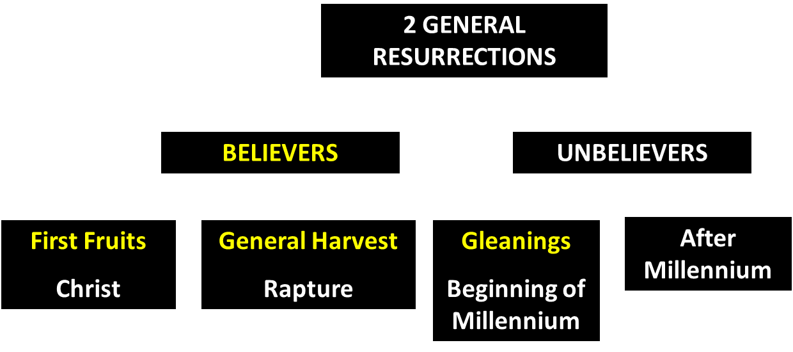
God’s Resurrection Program

Slide 32
1 Corinthians 15:20-23
“²⁰ But now Christ has been raised from the dead, the first fruits of those who are asleep. ²¹ For since by a man came death, by a man also came the resurrection of the dead. ²² For as in Adam all die, so also in Christ all will be made alive. ²³ But each in his own order (tagma): Christ the first fruits, after that those who are Christ’s at His coming.”

Slide 33
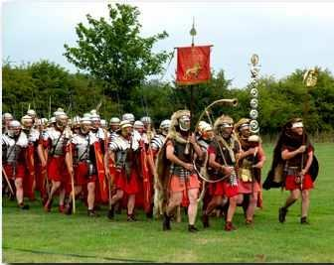
Order or Tagma (1 Cor. 15:23)
General – Christ’s resurrection (1 Cor. 15:23)
Officer – Rapture (1 Thess. 4:13-18)
Soldiers – OT saints & Tribulation martyrs (Rev. 20:4)
Captives – Unsaved of all ages (Rev. 20:5)

Slide 34
Five General Comments
(1 Thess. 4:13-18)
Not the first mention of The Rapture
“Rapture” comes from the Latin
The Rapture is distinct from the Second Advent
Only for the Church Age believer
Pre-tribulationalism is the correct view
Notes:
Outline

Slide 35
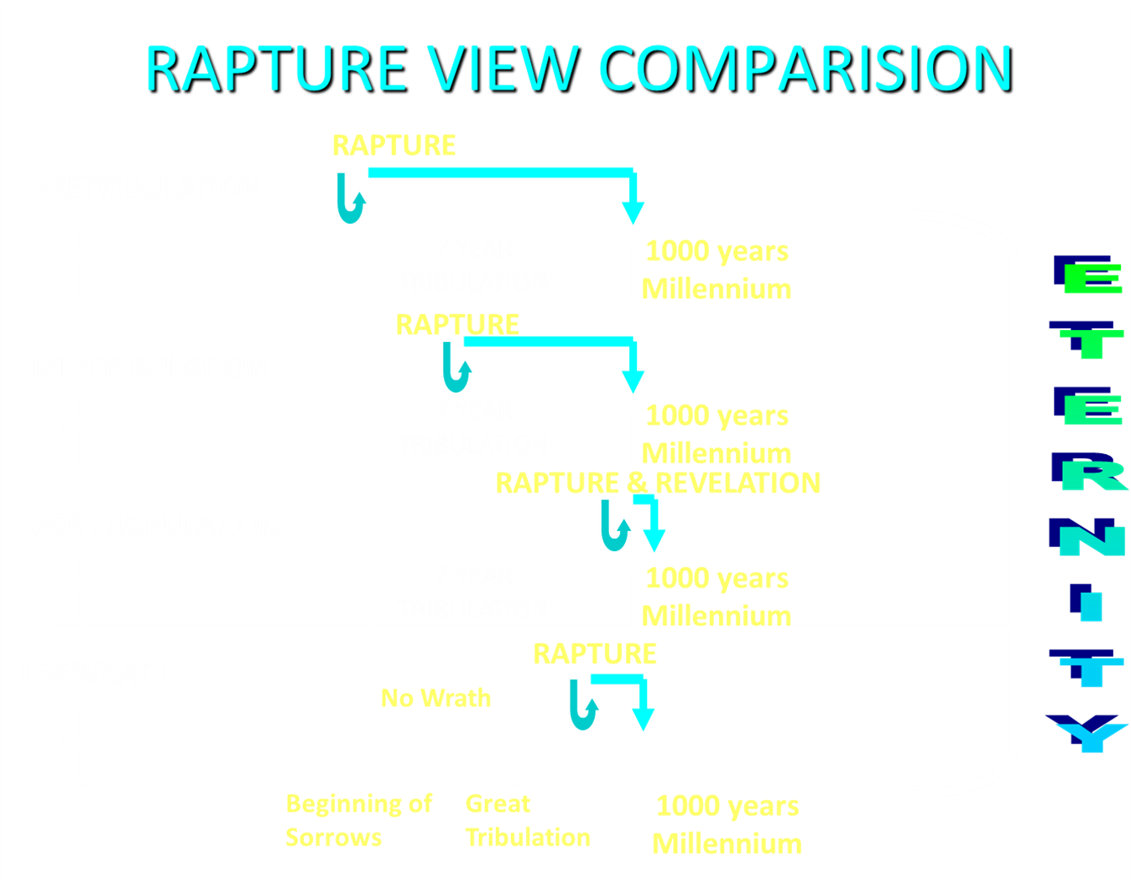

Slide 36
When is the Rapture?
7 Arguments Favoring the Pre-Tribulation View
Tribulation's purpose concerns Israel (Jer 30:7; Dan 9:24)
No biblical reference to the church on earth during the Tribulation period (Rev 4-22)
Church is promised an exemption from divine wrath (1 Thess 1:10; 5:9; Rom 5:9; Rev 3:10; 6:17)
Rapture is imminent (1 Cor 15:51; 1 Thess 4:15)
Rapture is a comfort (1 Thess 4:18)
Antichrist cannot come to power until the restrainer is removed (2 Thess 2:6-7)
Symbolic parallels (2 Peter 2:5-9)

Slide 37
Pre-Tribulationalism is the Correct View
    Imminency (15)
    Comfort (18)
    Exemption from Divine Wrath (1 Thess. 1:10; 5:9)

Slide 38
Pre-Tribulationalism is the Correct View
    Imminency (15)
    Comfort (18)
    Exemption from Divine Wrath (1 Thess. 1:10; 5:9)

Slide 39
1 Thessalonians 4:13-18
¹³ "But we do not want you to be uninformed, brethren, about those who are asleep, so that you will not grieve as do the rest who have no hope. ¹⁴ For if we believe that Jesus died and rose again, even so God will bring with Him those who have fallen asleep in Jesus. ¹⁵ For this we say to you by the word of the Lord, that we who are alive and remain until the coming of the Lord, will not precede those who have fallen asleep. ¹⁶ For the Lord Himself will descend from . . .

Slide 40


1 Corinthians 15:51
“Behold, I tell you a mystery; we will not all sleep, but we will all be changed.”

Slide 41
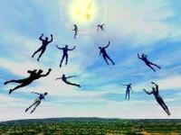
Imminent
(1 Cor 15:51; 1 Thess 4:15)
Imminency definition
James 5:8; 1 Thess 1:10; 1 Cor 1:7; Philip 3:20
We are to be looking for Jesus Christ and not the Antichrist!
Motivator (Holiness, Evangelism)
Feast of Trumpets?

Slide 42
Imminent
(1 Cor 15:51; 1 Thess 4:15)
Imminency definition
James 5:8; 1 Thess 1:10; 1 Cor 1:7; Philip 3:20
We are to be looking for Jesus Christ and not the Antichrist!
Motivator (Holiness, Evangelism)
Feast of Trumpets?

Slide 43
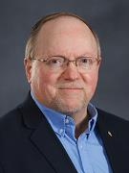
Wayne Brindle
"Biblical Evidence for the Imminence of the Rapture," Bibliotheca Sacra 158, no. 630 (April-June 2001): 138-51.
“Four criteria may be suggested, any one of which indicates imminence:
The passage speaks of Christ’s return as at any moment.
The passage speaks of Christ’s return as ‘near,’ without stating any signs that must precede His coming.
The passage speaks of Christ’s return as something that gives believers hope and encouragement, without indicating that these believers will suffer tribulation.
The passage speaks of Christ’s return as giving hope without relating it to God’s judgment of unbelievers.”

Slide 44
Imminent
(1 Cor 15:51; 1 Thess 4:15)
Imminency definition
James 5:8; 1 Thess 1:10; 1 Cor 1:7; Philip 3:20
We are to be looking for Jesus Christ and not the Antichrist!
Motivator (Holiness, Evangelism)
Feast of Trumpets?

Slide 45


1 Thessalonians 1:10
“and to wait for His Son from heaven, whom He raised from the dead, that is Jesus, who rescues (rhyomai) us from (ek) the wrath (orgē) to come..”

Slide 46
John 14:1–4
¹ “Do not let your heart be troubled; believe in God, believe also in Me. ² In My Father’s house are many dwelling places; if it were not so, I would have told you; for I go to prepare a place for you. ³ If I go and prepare a place for you, I will come again and receive you to Myself, that where I am, there you may be also. ⁴ And you know the way where I am going.”

Slide 47
Imminent
(1 Cor 15:51; 1 Thess 4:15)
Imminency definition
James 5:8; 1 Thess 1:10; 1 Cor 1:7; Philip 3:20
We are to be looking for Jesus Christ and not the Antichrist!
Motivator (Holiness, Evangelism)
Feast of Trumpets?

Slide 48


Slide 49
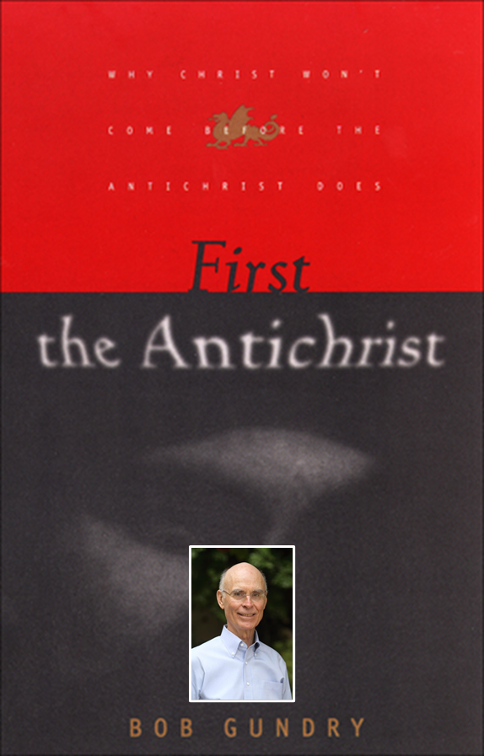
Robert H. Gundry, The Church and the Tribulation: Why Christ Won't Come Before the Antichrist Does (Grand Rapids: Zondervan, 1973).

Slide 50


Slide 51
Imminent
(1 Cor 15:51; 1 Thess 4:15)
Imminency definition
James 5:8; 1 Thess 1:10; 1 Cor 1:7; Philip 3:20
We are to be looking for Jesus Christ and not the Antichrist!
Motivator (Holiness, Evangelism)
Feast of Trumpets?

Slide 52

2 Peter 3:10-11
“¹⁰ But the day of the Lord will come like a thief, in which the heavens will pass away with a roar and the elements will be destroyed with intense heat, and the earth and its works will be burned up. ¹¹ Since all these things are to be destroyed in this way, what sort of people ought you to be in holy conduct and godliness.”

Slide 53
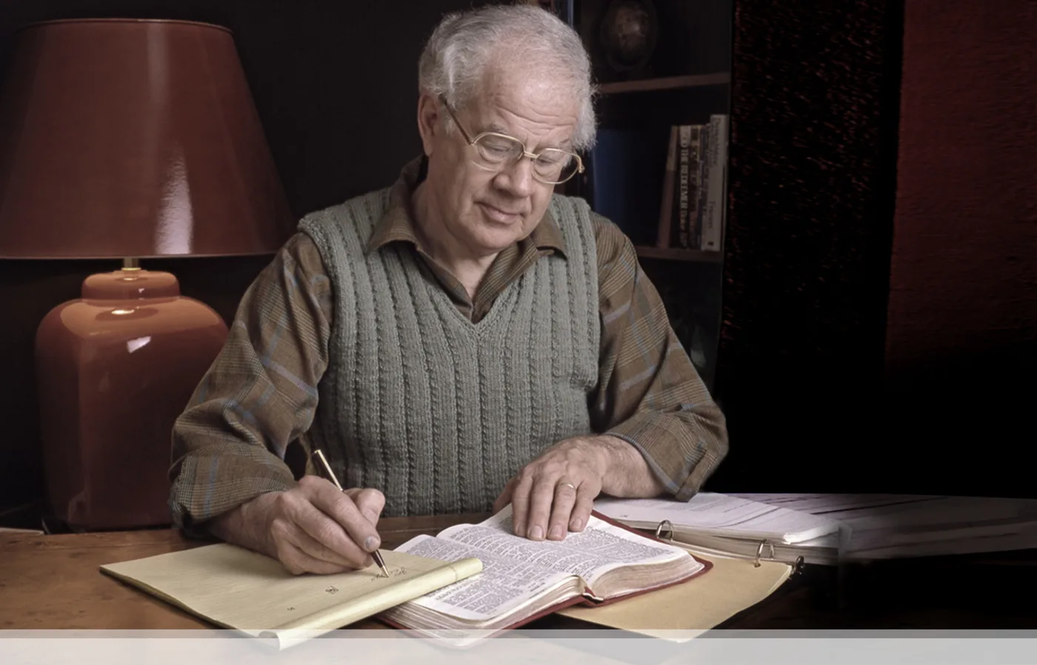
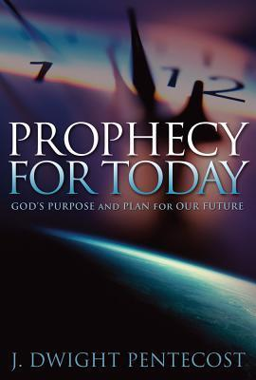
J. Dwight Pentecost
Prophecy For Today, Page 20
“A short time ago, I took occasion to go through the New Testament to mark each reference to the coming of the Lord Jesus Christ and to observe the use made of that teaching about His coming. I was struck a new with the fact that almost without exception, when the coming of Christ is mentioned in the New Testament, it is followed by an exhortation to godliness and holy living.”

Slide 54
Imminent
(1 Cor 15:51; 1 Thess 4:15)
Imminency definition
James 5:8; 1 Thess 1:10; 1 Cor 1:7; Philip 3:20
We are to be looking for Jesus Christ and not the Antichrist!
Motivator (Holiness, Evangelism)
Feast of Trumpets?

Slide 55
Levitical Feasts (Lev. 23)
Feast | Season | Purpose | Type
Passover | Spring | Redemption | 1 Cor. 5:7
Unleavened Bread | Spring | Separation | John 6:35
1st fruits | Spring | Praise | 1 Cor. 15:20
Pentecost | Spring | Praise | Acts 2:1-4
Trumpets | Fall | New Year | Matt. 24:31
Atonement | Fall | Lev 16 | Zech. 12:10
Booths | Fall | Wilderness provision | Zech. 14:16-18

Slide 56


Slide 57
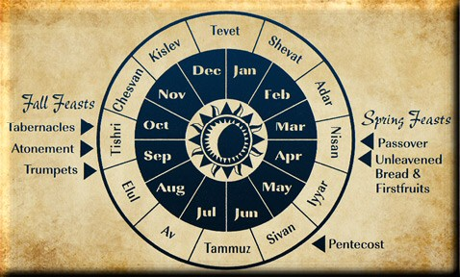

Slide 58


Slide 59


Psalm 147:19-20
“He declares His words to Jacob, His statutes and His ordinances to Israel. He has not dealt thus with any nation; And as for His ordinances, they have not known them. Praise the Lord!”

Slide 60
Pre-Tribulationalism is the Correct View
    Imminency (15)
    Comfort (18)
    Exemption from Divine Wrath (1 Thess. 1:10; 5:9)

Slide 61
1 Thessalonians 4:13-18
. . .heaven with a shout, with the voice of the archangel and with the trumpet of God, and the dead in Christ will rise first. ¹⁷ Then we who are alive and remain will be caught up together with them in the clouds to meet the Lord in the air, and so we shall always be with the Lord. ¹⁸ Therefore comfort one another with these words."

Slide 62
John 14:1–4
¹ “Do not let your heart be troubled; believe in God, believe also in Me. ² In My Father’s house are many dwelling places; if it were not so, I would have told you; for I go to prepare a place for you. ³ If I go and prepare a place for you, I will come again and receive you to Myself, that where I am, there you may be also. ⁴ And you know the way where I am going.”

Slide 63

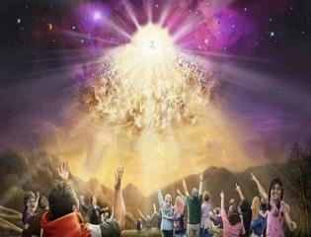

Titus 2:13
“Looking for the blessed hope and the appearing of the glory of our great God and Savior, Christ Jesus.”
63

Slide 64
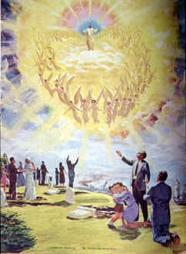
Comfort
John 14:1; 1 Thess 4:18; Titus 2:13
Other rapture views are not comforting since they place the church into divine wrath

Slide 66
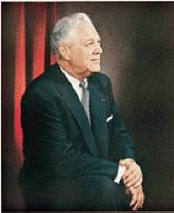
Donald Grey Barnhouse
Cited in Mark Hitchcock, “An Overview of Pretribulational arguments,” online: www.pre-trib.org, accessed 27 August 2013, 29-30.
“Jesus may come today, Glad day! Glad day!
And I would see my friend;
Dangers and troubles would end If Jesus should come today.
Glad day! Glad day! Is it the crowning day?
I’ll live for today, nor anxious be, Jesus, my Lord, I soon shall see;
Glad day! Glad day! Is it the crowning day?”

Slide 67
Donald Grey Barnhouse
Cited in Mark Hitchcock, “An Overview of Pretribulational arguments,” online: www.pre-trib.org, accessed 27 August 2013, 29-30.
By way of parody, Dr. Barnhouse also pointed out that if the midtrib or posttrib advocates sang this song, it would instead have to say:
“Jesus can’t come today, Sad day! Sad day! And I won't see my friend; Dangers and troubles won’t end Because Jesus can’t come today. Sad day! Sad day! Today is not the crowning day? I won’t live for today, and anxious I’ll be, The Beast and the False Prophet I soon shall see, Sad day! Sad day! Today is not the crowning day?”

Slide 68
Pre-Tribulationalism is the Correct View
    Imminency (15)
    Comfort (18)
    Exemption from Divine Wrath (1 Thess. 1:10; 5:9)

Slide 69

Promised Exemption from Divine Wrath
The promise (1 Thess 1:10; 5:9; Rom 5:9; 8:1; Rev 3:10)
Tribulation = divine wrath/anger (Rev 6:16-17; 11:18; 14:10; 15:1, 7; 16:1, 19; 19:15)

Slide 70
1 Thessalonians 1:10
“and to wait for His Son from heaven, whom He raised from the dead, that is Jesus, who rescues (rhyomai) us from (ek) the wrath (orgē) to come..”

Slide 71
Revelation 6:16-17
^{“16} and they said to the mountains and to the rocks, “Fall on us and hide us from the presence of Him who sits on the throne, and from the wrath [orgḗ] of the Lamb; ¹⁷ for the great day of their wrath [orgḗ] has come, and who is able to stand?”

Slide 72

Rev. 6:16-17
Robert L. Thomas, Revelation 1–7: An Exegetical Commentary, ed. Kenneth Barker (Chicago: Moody, 1992), 457-58.
"Mankind in his rebellion correctly analyzes the cosmic and terrestrial disturbances as a part of the great end-time day of wrath from the one sitting on the throne and from the Lamb. The verb ēlethen ("has come") is aorist indicative, referring to a previous arrival of wrath, not something that is about to take place. Men see the arrival of this day at least as early as the cosmic upheavals that characterize the sixth seal (6:12-14), but upon reflection they probably recognize that it was already in effect with the death of one-fourth of the population (6:7-8), the worldwide famine (6:5-6), and the global warfare (6:3-4). The rapid sequence of all of these events could not escape notice, but the light of their true explanation does not dawn upon human consciousness until the severe phenomena of the sixth seal arrive."

Slide 73

1st Six Seals (Revelation 6)
SEAL 1 – 6:1-2 – Advent of antichrist
SEAL 2 – 6:3-4 – War
SEAL 3 – 6:5-6 – Famine
SEAL 4 – 6:7-8 – Death
SEAL 5 – 6:9-11 – Martyrdoms
SEAL 6 – 6:12-17 – Cosmic disturbances

Slide 74
Romans 2:8-9
^{“8} but to those who are selfishly ambitious and do not obey the truth, but obey unrighteousness, wrath [orgḗ] and indignation [thumós]. ⁹ There will be tribulation [thlípsis] and distress for every soul of man who does evil, of the Jew first and also of the Greek.”

Slide 75


Slide 76
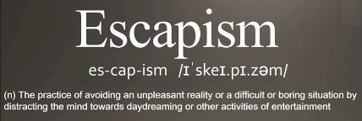
Pretribulationism is not Escapism
Trials (John 16:33)
Man’s wrath (2 Tim 3:12)
Satan’s wrath (Eph 6:11-12)
World’s wrath (John 15:18-19)

Slide 77
Conclusion

Slide 78
Five General Comments
(1 Thess. 4:13-18)
Not the first mention of The Rapture
“Rapture” comes from the Latin
The Rapture is distinct from the Second Advent
Only for the Church Age believer
Pre-tribulationalism is the correct view
Notes:
Outline

Slide 79
Structure
Personal (1–3)
  Genuine conversion (1)
  Impure motives (2:1-16)
  Lack of concern (2:17–3:13)
Practical (4–5)
  Immorality (4:1-8)
  Laziness (4:9-12)
  Eschatology (4:13–5:11)
  Ministry imbalances (5:12-15)
  Progressive sanctification (5:16-28)

