Slide 1
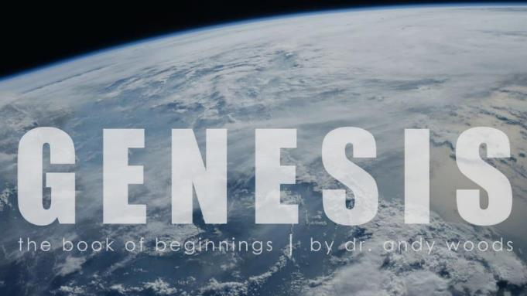
Genesis 12‒50
Israel’s Birth & Preservation

Slide 2
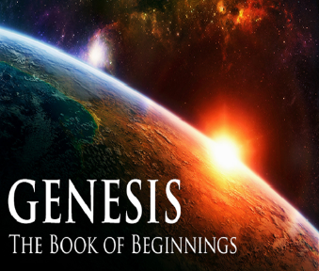
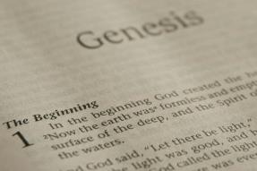
GENESIS STRUCTURE
Genesis 12-50 (four people)
Abraham (12:1–25:11)
Isaac (25:12–26:35)
Jacob (27–36)
Joseph (37–50)

Slide 3
Genesis 28 Chapter Summary
Jacob’s flight to Haran (1-5)
Esau’s third wife (6-9)
Reconfirmation of the Covenant (10-22)

Slide 4
Genesis 28:10-22 Reconfirmation of the Covenant
Circumstances (10-12)
Covenant reaffirmed (13-15)
Jacob’s recognition (16-17)
Pillar (18-19)
Vow (20-22)

Slide 5
Genesis 28:16-17 Jacob’s Recognition
Recognition (16)
Fear (17a)
Place (17b)
Conclusion (17c)

Slide 6
Genesis 28:16-17 Jacob’s Recognition
Recognition (16)
Fear (17a)
Place (17b)
Conclusion (17c)

Slide 7
Genesis 28:16-17 Jacob’s Recognition
Recognition (16)
Fear (17a)
Place (17b)
Conclusion (17c)

Slide 8
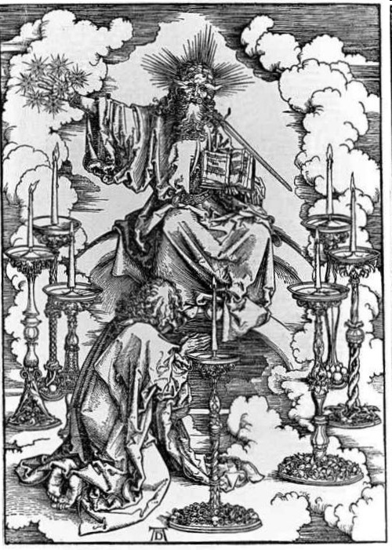

Slide 9
Genesis 28:16-17 Jacob’s Recognition
Recognition (16)
Fear (17a)
Place (17b)
Conclusion (17c)

Slide 10
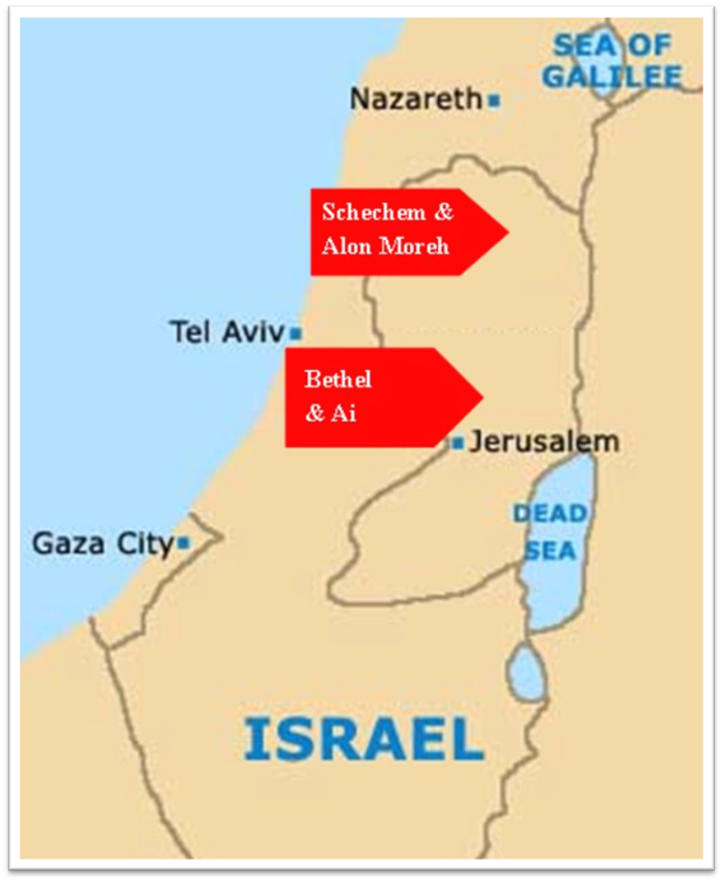

Slide 11
Genesis 28:16-17 Jacob’s Recognition
Recognition (16)
Fear (17a)
Place (17b)
Conclusion (17c)

Slide 12
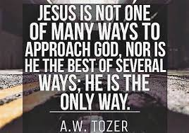
John 14:6
“Jesus said to him, ‘I am the way, and the truth, and the life; no one comes to the Father but through Me.’”

Slide 13
Genesis 28:10-22 Reconfirmation of the Covenant
Circumstances (10-12)
Covenant reaffirmed (13-15)
Jacob’s recognition (16-17)
Pillar (18-19)
Vow (20-22)

Slide 14
Genesis 28:18-19 Pillar
Pillar (18)
Name (19)

Slide 15
Genesis 28:18-19 Pillar
Pillar (18)
Name (19)

Slide 16
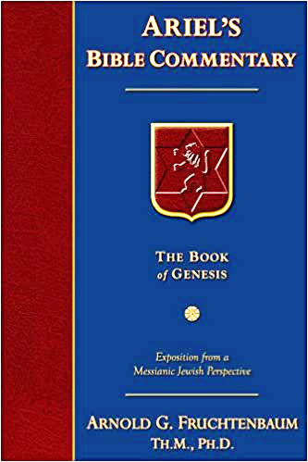
Dr. Arnold G. Fruchtenbaum
The Book of Genesis, 436
“The next thing he did was: And he took one of the stones of the place, and put it under his head, which has been misunderstood to mean that he used it as a pillow, but a stone would make a rather uncomfortable pillow. The Hebrew literally reads, ‘at his head,’ not ‘under his head.’ It means the stone was placed at his head, as was the case with Saul’s spear in I Samuel 26:7, where the same terminology is used. Then: and lay down in that place to sleep.”

Slide 17
Genesis 28:18-19 Pillar
Pillar (18)
Name (19)

Slide 18
Genesis 12‒25 Abraham’s Early Journeys
Unconditional promises (Gen. 12:1-3) From Haran to Canaan (Gen. 12:4-5) In Canaan (Gen. 12:6-9) In Egypt (Gen. 12:10-20) Abram and Lot Separate (Gen. 13:1-13) Reaffirmation of Abram’s promises (Gen. 13:14-18) Abram Rescues Lot (14:1-24) Abrahamic Covenant (15:1-21) Hagar & Ishmael (16:1-16) Circumcision (Gen. 17:1-27) | Sodom & Gomorrah (Gen. 18‒19) Abraham & Abimelech (Gen. 20) Isaac’s birth (Gen. 21:1-7) Ishmael’s expulsion (21:8-21) Abraham & Abimelech’s covenant (21:22-34) Abraham sacrifices Isaac (22) Sarah’s death (23) Isaac’s marriage (24) Abraham & Keturah (25:1-6) Abraham’s death (25:7-11)

Slide 19
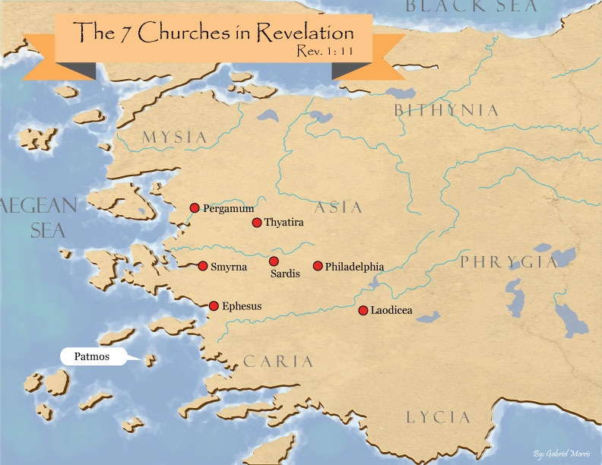

Slide 20
Genesis 28:10-22 Reconfirmation of the Covenant
Circumstances (10-12)
Covenant reaffirmed (13-15)
Jacob’s recognition (16-17)
Pillar (18-19)
Vow (20-22)

Slide 21
Genesis 28:20-22 Vow
Vow (20a)
Content (20b-22)

Slide 22
Genesis 28:20-22 Vow
Vow (20a)
Content (20b-22)

Slide 23
Genesis 28:20-22 Vow
Vow (20a)
Content (20b-22)

Slide 24
Genesis 28:20b-22 Content
What God will do (20b-21a)
What Jacob will do (21b-22)

Slide 25
Genesis 28:20b-22 Content
What God will do (20b-21a)
What Jacob will do (21b-22)

Slide 26
Genesis 28:20b-21a What God Would Do
God’s presence (20b)
God’s protection (20c)
God’s provision (20d)
Father’s house (21a)

Slide 27
Genesis 28:20b-21a What God Would Do
God’s presence (20b)
God’s protection (20c)
God’s provision (20d)
Father’s house (21a)

Slide 28
Dr. Arnold G. Fruchtenbaum
The Book of Genesis, 438-39
“In verse 20b–21a, he focused on what God would do, beginning in verse 21b with God’s provision for Jacob: If God will be with me, meaning if God’s presence will be indeed with him. The word if can also mean ‘since.' [Since] God will be with me, which is really more of a response of gratitude than a response of testing, and will keep me in this way that I go, and will give me bread to eat, and raiment to put on.”

Slide 29
Genesis 28:20b-21a What God Would Do
God’s presence (20b)
God’s protection (20c)
God’s provision (20d)
Father’s house (21a)

Slide 30
Genesis 28:20b-21a What God Would Do
God’s presence (20b)
God’s protection (20c)
God’s provision (20d)
Father’s house (21a)

Slide 31
God’s Provision for the Giver (Phil. 4:19)
Exodus 16
1 Kings 17:2-6
Psalm 37:25
Matthew 6:25-34

Slide 32
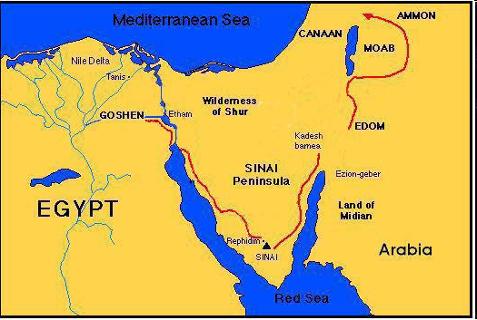

Slide 33
Genesis 28:20b-21a What God Would Do
God’s presence (20b)
God’s protection (20c)
God’s provision (20d)
Father’s house (21a)

Slide 34
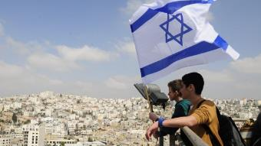
Reliability of the “Divine Regathering” Predictions
 | RETURN | PREDICTED | FULFILLED
1st | From Egypt to Canaan | Gen. 15:13-14 | Joshua 1‒12
2nd | From Babylon to Israel | Jer. 25:11; 29:10 | Ezra & Nehemiah
3rd | From the Diaspora to Israel’s restoration | Ezekiel 36:24-28 | Millennial Kingdom

Slide 35
Genesis 28:20b-22 Content
What God will do (20b-21a)
What Jacob will do (21b-22)

Slide 36
Genesis 28:21b-22 What Jacob Will Do
Dedication (21b)
Pillar (22a)
Tithe (22b)

Slide 37
Genesis 28:21b-22 What Jacob Will Do
Dedication (21b)
Pillar (22a)
Tithe (22b)

Slide 38
Romans 12:1
¹ Therefore I urge you, brethren, by the mercies of God, to present your bodies a living and holy sacrifice, acceptable to God, which is your spiritual service of worship.

Slide 39
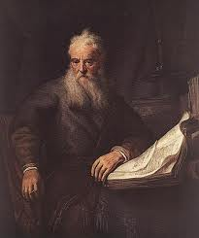
Romans Outline
Salutation (1:1-17)
Sin (1:18–3:20)
Salvation (3:21–5:21)
Sanctification (6–8)
Sovereignty (9–11)
Service (12:1–15:13)
Summation (15:14–16:27)

Slide 41
Genesis 28:21b-22 What Jacob Will Do
Dedication (21b)
Pillar (22a)
Tithe (22b)

Slide 42
Genesis 28:21b-22 What Jacob Will Do
Dedication (21b)
Pillar (22a)
Tithe (22b)

Slide 43
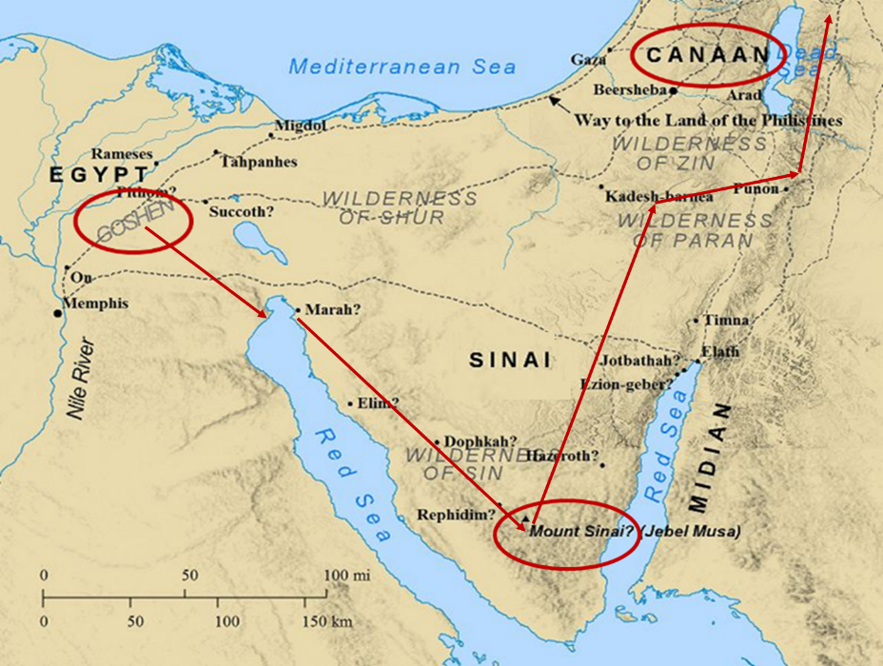

Slide 44
Psalm 147:19-20
“He declares His words to Jacob, His statutes and His ordinances to Israel. He has not dealt thus with any nation; And as for His ordinances, they have not known them. Praise the Lord!”

Slide 45
Conclusion

Slide 46
Genesis 28 Chapter Summary
Jacob’s flight to Haran (1-5)
Esau’s third wife (6-9)
Reconfirmation of the Covenant (10-22)

Slide 47
Genesis 28:10-22 Reconfirmation of the Covenant
Circumstances (10-12)
Covenant reaffirmed (13-15)
Jacob’s recognition (16-17)
Pillar (18-19)
Vow (20-22)

Slide 48
²⁴ The Lord bless you, and keep you; ²⁵ The Lord make His face shine on you, And be gracious to you; ²⁶ The Lord lift up His countenance on you, And give you peace.
Numbers 6:24–26 (NASB95)

