Slide 1
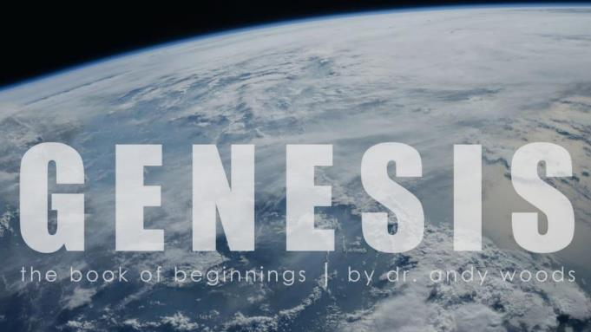
Genesis 12‒50
Israel’s Birth & Preservation

Slide 2
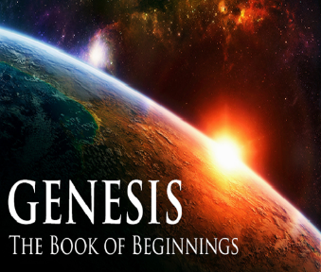
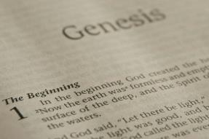
GENESIS STRUCTURE
Genesis 12-50 (four people)
Abraham (12:1–25:11)
Isaac (25:12–26:35)
Jacob (27–36)
Joseph (37–50)

Slide 3
Genesis 29 Chapter Summary
Jacob’s Arrival (1-14)
Jacob’s Marriages (15-30)
Jacob's Sons (31-35)

Slide 4
Genesis 29 Chapter Summary
Jacob’s Arrival (1-14)
Jacob’s Marriages (15-30)
Jacob’s Sons (31-35)

Slide 5
I. Genesis 29:1-14 Jacob’s Arrival
Journey (1)
At the well (2-3)
Conversation with the locals (4-8)
Jacob meets Rachel (9-12)
Jacob in Laban’s home (13-14)

Slide 6
I. Genesis 29:1-14 Jacob’s Arrival
Journey (1)
At the well (2-3)
Conversation with the locals (4-8)
Jacob meets Rachel (9-12)
Jacob in Laban’s home (13-14)

Slide 7
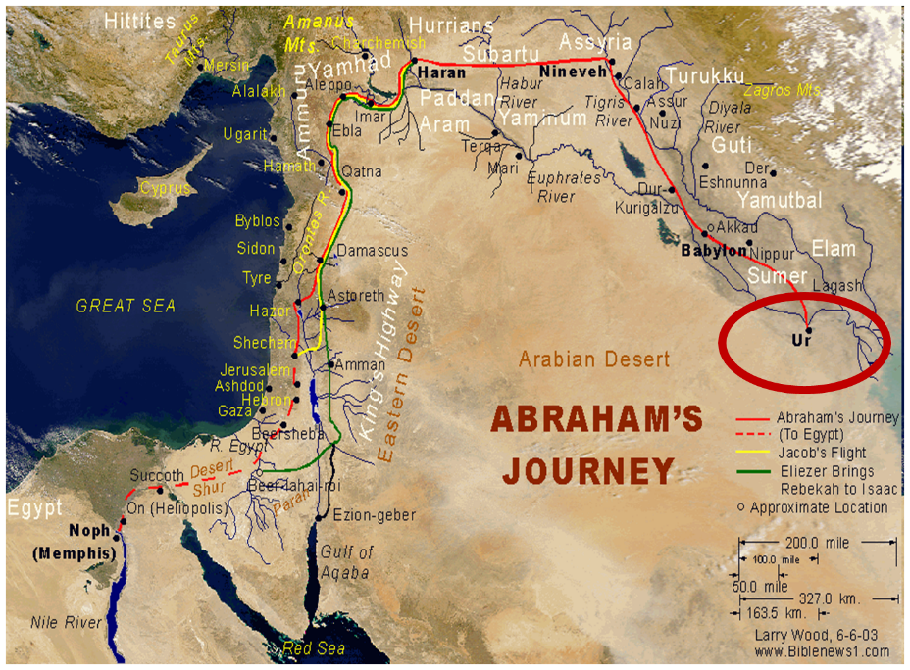

Slide 8
I. Genesis 29:1-14 Jacob’s Arrival
Journey (1)
At the well (2-3)
Conversation with the locals (4-8)
Jacob meets Rachel (9-12)
Jacob in Laban’s home (13-14)

Slide 9
Genesis 12‒25 Abraham’s Early Journeys
Unconditional promises (Gen. 12:1-3) From Haran to Canaan (Gen. 12:4-5) In Canaan (Gen. 12:6-9) In Egypt (Gen. 12:10-20) Abram and Lot Separate (Gen. 13:1-13) Reaffirmation of Abram’s promises (Gen. 13:14-18) Abram Rescues Lot (14:1-24) Abrahamic Covenant (15:1-21) Hagar & Ishmael (16:1-16) Circumcision (Gen. 17:1-27) | Sodom & Gomorrah (Gen. 18‒19) Abraham & Abimelech (Gen. 20) Isaac’s birth (Gen. 21:1-7) Ishmael’s expulsion (21:8-21) Abraham & Abimelech’s covenant (21:22-34) Abraham sacrifices Isaac (22) Sarah’s death (23) Isaac’s marriage (24) Abraham & Keturah (25:1-6) Abraham’s death (25:7-11)

Slide 10
I. Genesis 29:1-14 Jacob’s Arrival
Journey (1)
At the well (2-3)
Conversation with the locals (4-8)
Jacob meets Rachel (9-12)
Jacob in Laban’s home (13-14)

Slide 11
Genesis 29:4-8 Conversation with the Locals
Location (4)
Family (5-6)
Procedure (7-8)

Slide 12
Genesis 29:4-8 Conversation with the Locals
Location (4)
Family (5-6)
Procedure (7-8)

Slide 14
Genesis 29:4-8 Conversation with the Locals
Location (4)
Family (5-6)
Procedure (7-8)

Slide 15
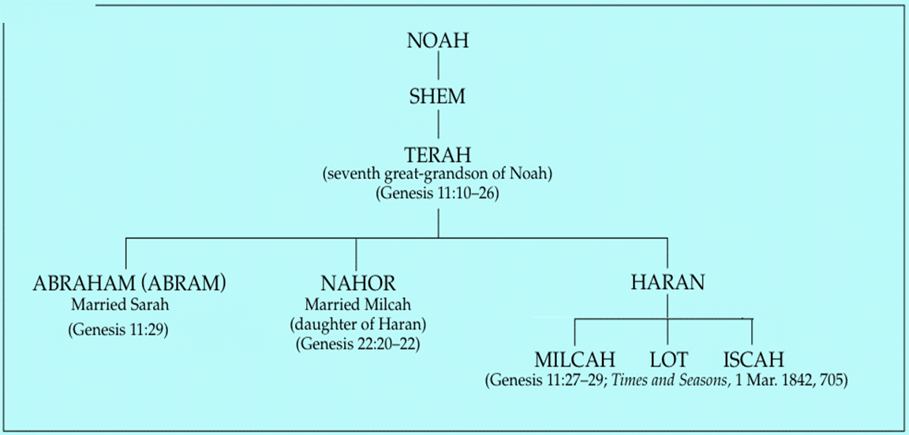

Slide 16
Genesis 22:20-24 Rebekah’s Lineage
Timing (20a)
Nahor’s children (20b-24)
From Milcah (20b-23)
From Reumah (24)

Slide 17
Nahor’s children through Milcah (Gen. 22:20b-23)
1. Uz (Job 1:1) | 5. Hazo
2. Buz | 6. Pildash
3. Aram | 7. Jidlaph
4. Chesed | 8. Bethuel (Gen. 24)

Slide 18
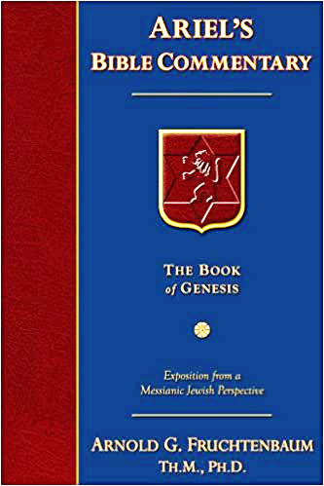
Dr. Arnold G. Fruchtenbaum
The Book of Genesis, 441
“In verses 5–6 came Jacob’s inquiry of his family: And [Jacob] said unto them, Know ye Laban the son of Nahor? Laban was actually the son of Bethuel, and here the word son is used in the sense of grandson.”

Slide 19
Genesis 29:4-8 Conversation with the Locals
Location (4)
Family (5-6)
Procedure (7-8)

Slide 20
I. Genesis 29:1-14 Jacob’s Arrival
Journey (1)
At the well (2-3)
Conversation with the locals (4-8)
Jacob meets Rachel (9-12)
Jacob in Laban’s home (13-14)

Slide 21
Genesis 29:9-12 Jacob Meets Rachel
Rachel’s arrival (9)
Jacob’s first sight of Rachel (10a)
Jacob’s reaction (10b-12a)
Rachel’s response (12b)

Slide 22
Genesis 29:9-12 Jacob Meets Rachel
Rachel’s arrival (9)
Jacob’s first sight of Rachel (10a)
Jacob’s reaction (10b-12a)
Rachel’s response (12b)

Slide 23
Genesis 29:9-12 Jacob Meets Rachel
Rachel’s arrival (9)
Jacob’s first sight of Rachel (10a)
Jacob’s reaction (10b-12a)
Rachel’s response (12b)

Slide 24
Genesis 29:9-12 Jacob Meets Rachel
Rachel’s arrival (9)
Jacob’s first sight of Rachel (10a)
Jacob’s reaction (10b-12a)
Rachel’s response (12b)

Slide 25
Genesis 29:10b-12a Jacob’s Reaction
Removal of the stone (10b)
Greeting & kiss (11)
Identifies self (12a)

Slide 26
Genesis 29:10b-12a Jacob’s Reaction
Removal of the stone (10b)
Greeting & kiss (11)
Identifies self (12a)

Slide 27
Genesis 29:10b-12a Jacob’s Reaction
Removal of the stone (10b)
Greeting & kiss (11)
Identifies self (12a)

Slide 28
Charles Ryrie The Ryrie Study Bible, page 28
Genesis 29:11 (RSB:NASB1995U): Genesis 29:11. “Jacob kissed Rachel, a proper greeting for cousins, and wept for joy at finding his relatives.”

Slide 29
Genesis 29:10b-12a Jacob’s Reaction
Removal of the stone (10b)
Greeting & kiss (11)
Identifies self (12a)

Slide 30
Dr. Arnold G. Fruchtenbaum
The Book of Genesis, 442
“Third, in verse 12a, he identified himself: And Jacob told Rachel that he was her father’s brother. Here, the word brother is used in the sense of “nephew,” since he was Laban’s nephew. Also, he was Rebekah’s son; Rebekah was Rachel’s aunt.”

Slide 31
Genesis 29:9-12 Jacob Meets Rachel
Rachel’s arrival (9)
Jacob’s first sight of Rachel (10a)
Jacob’s reaction (10b-12a)
Rachel’s response (12b)

Slide 32
I. Genesis 29:1-14 Jacob’s Arrival
Journey (1)
At the well (2-3)
Conversation with the locals (4-8)
Jacob meets Rachel (9-12)
Jacob in Laban’s home (13-14)

Slide 33
Genesis 29:13-14 Jacob in Laban’s Home
Meeting between Jacob & Laban (13)
Jacob becomes Laban’s guest (14)

Slide 34
Genesis 29:13-14 Jacob in Laban’s Home
Meeting between Jacob & Laban (13)
Jacob becomes Laban’s guest (14)

Slide 35
Dr. Arnold G. Fruchtenbaum
The Book of Genesis, 442
“Genesis 29:13–14 describes Jacob in the home of Laban, with verse 13 recording the meeting between Jacob and Laban. The timing was: And it came to pass, when Laban heard the tidings of Jacob his sister’s sons. Laban’s sister had left ninety-seven years earlier.”

Slide 36
Genesis 29:13-14 Jacob in Laban’s Home
Meeting between Jacob & Laban (13)
Jacob becomes Laban’s guest (14)

Slide 37
Genesis 29 Chapter Summary
Jacob’s Arrival (1-14)
Jacob’s Marriages (15-30)
Jacob’s Sons (31-35)

Slide 38
II. Genesis 29:15-30 Jacob’s Marriages
Marriage contract (15-19)
Marriages (20-30)

Slide 39
II. Genesis 29:15-30 Jacob’s Marriages
Marriage contract (15-19)
Marriages (20-30)

Slide 40
Genesis 29:15-19 Marriage Contract
Laban’s inquiry (15)
Laban’s daughters (16-17)
Jacob’s wages (18)
Laban’s agreement (19)

Slide 41
Genesis 29:15-19 Marriage Contract
Laban’s inquiry (15)
Laban’s daughters (16-17)
Jacob’s wages (18)
Laban’s agreement (19)

Slide 42
Genesis 29:15-19 Marriage Contract
Laban’s inquiry (15)
Laban’s daughters (16-17)
Jacob’s wages (18)
Laban’s agreement (19)

Slide 43
Genesis 29:16-17 Laban’s Daughters
Names (16)
Distinctives (17)

Slide 44
Genesis 29:16-17 Laban’s Daughters
Names (16)
Distinctives (17)

Slide 45
Genesis 29:16-17 Laban’s Daughters
Names (16)
Distinctives (17)

Slide 46
Genesis 29:15-19 Marriage Contract
Laban’s inquiry (15)
Laban’s daughters (16-17)
Jacob’s wages (18)
Laban’s agreement (19)

Slide 47
Genesis 12‒25 Abraham’s Early Journeys
Unconditional promises (Gen. 12:1-3) From Haran to Canaan (Gen. 12:4-5) In Canaan (Gen. 12:6-9) In Egypt (Gen. 12:10-20) Abram and Lot Separate (Gen. 13:1-13) Reaffirmation of Abram’s promises (Gen. 13:14-18) Abram Rescues Lot (14:1-24) Abrahamic Covenant (15:1-21) Hagar & Ishmael (16:1-16) Circumcision (Gen. 17:1-27) | Sodom & Gomorrah (Gen. 18‒19) Abraham & Abimelech (Gen. 20) Isaac’s birth (Gen. 21:1-7) Ishmael’s expulsion (21:8-21) Abraham & Abimelech’s covenant (21:22-34) Abraham sacrifices Isaac (22) Sarah’s death (23) Isaac’s marriage (24) Abraham & Keturah (25:1-6) Abraham’s death (25:7-11)

Slide 48
Genesis 29:15-19 Marriage Contract
Laban’s inquiry (15)
Laban’s daughters (16-17)
Jacob’s wages (18)
Laban’s agreement (19)

Slide 49
II. Genesis 29:15-30 Jacob’s Marriages
Marriage contract (15-19)
Marriages (20-30)

Slide 50
Genesis 29:20-30 Jacob’s Marriages
Seven years of labor for Rachel (20)
Marriage to Leah (21-25a)
Marriage to Rachel (25b-30)

Slide 51
Genesis 29:20-30 Jacob’s Marriages
Seven years of labor for Rachel (20)
Marriage to Leah (21-25a)
Marriage to Rachel (25b-30)

Slide 52
Genesis 29:20-30 Jacob’s Marriages
Seven years of labor for Rachel (20)
Marriage to Leah (21-25a)
Marriage to Rachel (25b-30)

Slide 53
Genesis 29:21-25a Marriage to Leah
Jacob’s demand (21)
Festivities (22)
Wedding night (23)
Wedding gift (24)
Jacob’s discovery (25a)

Slide 54
Genesis 29:21-25a Marriage to Leah
Jacob’s demand (21)
Festivities (22)
Wedding night (23)
Wedding gift (24)
Jacob’s discovery (25a)

Slide 55
Genesis 29:21-25a Marriage to Leah
Jacob’s demand (21)
Festivities (22)
Wedding night (23)
Wedding gift (24)
Jacob’s discovery (25a)

Slide 56
Genesis 29:21-25a Marriage to Leah
Jacob’s demand (21)
Festivities (22)
Wedding night (23)
Wedding gift (24)
Jacob’s discovery (25a)

Slide 57
Dr. Arnold G. Fruchtenbaum
The Book of Genesis, 445
“Now the deceiver is deceived, although the motivations differ from good to bad. This is divine retribution in four ways. First, Isaac’s blindness equals the darkness of Jacob’s wedding night, and neither could see well as a result. Second, this Jacob is deceived by being presented the older for the younger, the reversal of Isaac’s presentation of Jacob for Esau. Third, Isaac thought Jacob was Esau and Jacob thought Leah was Rachel. Fourth, Jacob pretended to be his older brother, while Leah pretended to be her younger sister.”

Slide 58
Genesis 29:21-25a Marriage to Leah
Jacob’s demand (21)
Festivities (22)
Wedding night (23)
Wedding gift (24)
Jacob’s discovery (25a)

Slide 59
Dr. Arnold G. Fruchtenbaum
The Book of Genesis, 445
“In verse 24 is the wedding gift: And Laban gave Zilpah, meaning “nearness” or “intimacy,” his handmaid unto his daughter Leah for a handmaid. This practice is in keeping with what is known from the Nuzi Tablets.”

Slide 60
Genesis 29:21-25a Marriage to Leah
Jacob’s demand (21)
Festivities (22)
Wedding night (23)
Wedding gift (24)
Jacob’s discovery (25a)

Slide 61
Genesis 29:20-30 Jacob’s Marriages
Seven years of labor for Rachel (20)
Marriage to Leah (21-25a)
Marriage to Rachel (25b-30)

Slide 62
Genesis 29:25b-30 Marriage to Rachel
Jacob’s complaint (25b)
Laban’s response (26-27)
Jacob’s agreement (28)
Wedding gift (29)
Consummation (30a)
Second seven years (30b)

Slide 63
Genesis 29:25b-30 Marriage to Rachel
Jacob’s complaint (25b)
Laban’s response (26-27)
Jacob’s agreement (28)
Wedding gift (29)
Consummation (30a)
Second seven years (30b)

Slide 64
Genesis 29:25b-30 Marriage to Rachel
Jacob’s complaint (25b)
Laban’s response (26-27)
Jacob’s agreement (28)
Wedding gift (29)
Consummation (30a)
Second seven years (30b)

Slide 65
Genesis 29:26-27 Laban’s Response
Local custom (26)
Laban’s offer (27)

Slide 66
Genesis 29:26-27 Laban’s Response
Local custom (26)
Laban’s offer (27)

Slide 67
Genesis 29:26-27 Laban’s Response
Local custom (26)
Laban’s offer (27)

Slide 68
Genesis 29:25b-30 Marriage to Rachel
Jacob’s complaint (25b)
Laban’s response (26-27)
Jacob’s agreement (28)
Wedding gift (29)
Consummation (30a)
Second seven years (30b)

Slide 69
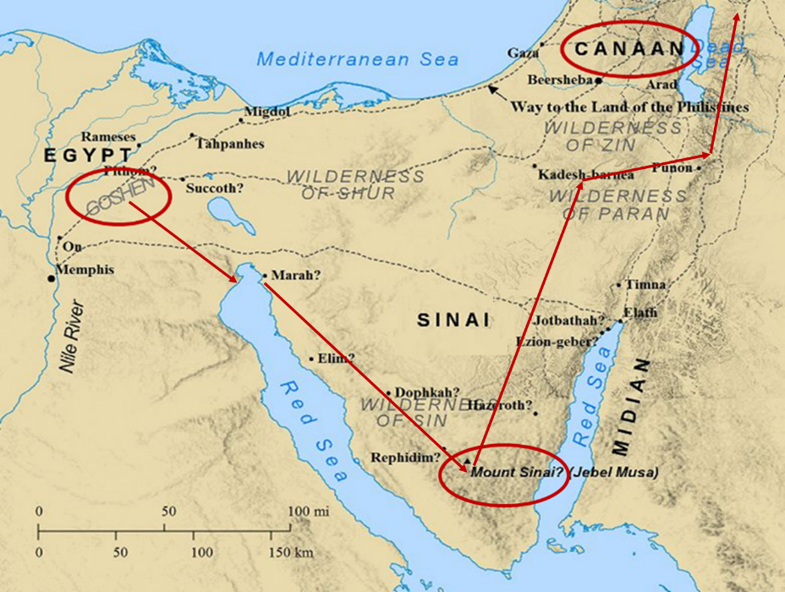

Slide 70
Genesis 29:25b-30 Marriage to Rachel
Jacob’s complaint (25b)
Laban’s response (26-27)
Jacob’s agreement (28)
Wedding gift (29)
Consummation (30a)
Second seven years (30b)

Slide 71
Dr. Arnold G. Fruchtenbaum
The Book of Genesis, 446
“Verse 29 discloses the wedding gift: And Laban gave to Rachel his daughter Bilhah, meaning ‘terror,’ his handmaid to be her handmaid. Again, this is in keeping with the Nuzi Tablets.”

Slide 72
Genesis 29:25b-30 Marriage to Rachel
Jacob’s complaint (25b)
Laban’s response (26-27)
Jacob’s agreement (28)
Wedding gift (29)
Consummation (30a)
Second seven years (30b)

Slide 73
Genesis 29:25b-30 Marriage to Rachel
Jacob’s complaint (25b)
Laban’s response (26-27)
Jacob’s agreement (28)
Wedding gift (29)
Consummation (30a)
Second seven years (30b)

Slide 74
Genesis 29 Chapter Summary
Jacob’s Arrival (1-14)
Jacob’s Marriages (15-30)
Jacob’s Sons (31-35)

Slide 75
Distinctions Between 144,000 & Multitude
144,000 | MULTITUDE
Revelation 7:1-8 | Revelation 7:9-17
Numbered | Innumerable
Jews | All nations
Sealed | Slain
Sealed before the Tribulation | Converted out of the Tribulation
Hitchcock and Ice, The Truth Behind Left Behind, 77

Slide 76
III. Genesis 29:31-35 Jacob’s Sons
God’s providence (31)
Leah’s four sons (32-35a)
Conclusion (35b)

Slide 77
III. Genesis 29:31-35 Jacob’s Sons
God’s providence (31)
Leah’s four sons (32-35a)
Conclusion (35b)

Slide 78
III. Genesis 29:31-35 Jacob’s Sons
God’s providence (31)
Leah’s four sons (32-35a)
Conclusion (35b)

Slide 79
Genesis 29:32-35a Leah’s Four Sons
Reuben’s birth (32)
Simeon’s birth (33)
Levi’s birth (34)
Judah’s birth (35a)

Slide 80
Genesis 29:32-35a Leah’s Four Sons
Reuben’s birth (32)
Simeon’s birth (33)
Levi’s birth (34)
Judah’s birth (35a)

Slide 81
Genesis 29:32-35a Leah’s Four Sons
Reuben’s birth (32)
Simeon’s birth (33)
Levi’s birth (34)
Judah’s birth (35a)

Slide 82
Genesis 29:32-35a Leah’s Four Sons
Reuben’s birth (32)
Simeon’s birth (33)
Levi’s birth (34)
Judah’s birth (35a)

Slide 84
Genesis 29:32-35a Leah’s Four Sons
Reuben’s birth (32)
Simeon’s birth (33)
Levi’s birth (34)
Judah’s birth (35a)

Slide 85
Dr. Arnold G. Fruchtenbaum
The Book of Genesis, 448
“In the naming of the first three sons, Leah named them with a basic hope that Jacob would learn to love her or at least treat her equally. That never happened. By the time she came to her fourth son, she focused on God and not on Jacob, realizing that although not loved by Jacob, she was loved by God. The two key institutions of Israel, priesthood (Levi) and royalty (Judah), came from an unplanned and unwanted marriage.”

Slide 86
III. Genesis 29:31-35 Jacob’s Sons
God’s providence (31)
Leah’s four sons (32-35a)
Conclusion (35b)

Slide 87
Conclusion

Slide 88
Genesis 29 Chapter Summary
Jacob’s Arrival (1-14)
Jacob’s Marriages (15-30)
Jacob’s Sons (31-35)

Slide 89
²⁴ The Lord bless you, and keep you; ²⁵ The Lord make His face shine on you, And be gracious to you; ²⁶ The Lord lift up His countenance on you, And give you peace.
Numbers 6:24–26 (NASB95)

