Slide 1
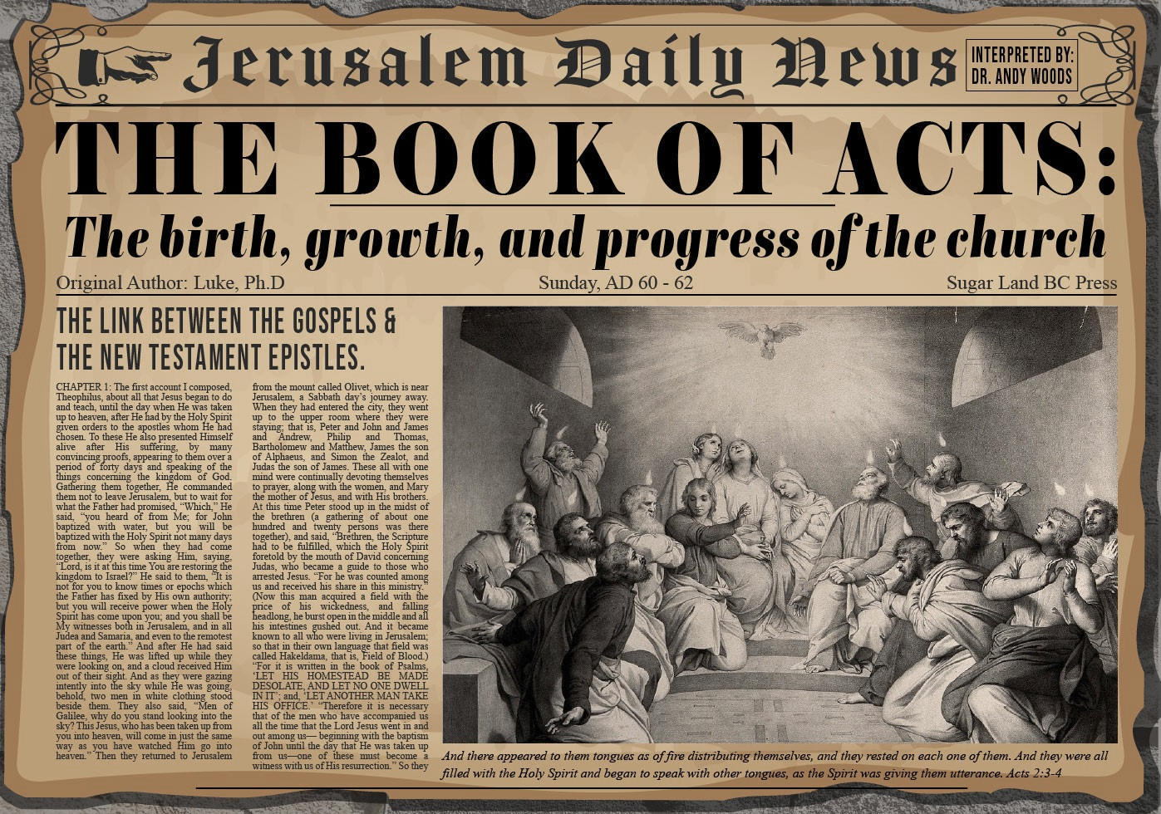


Slide 2
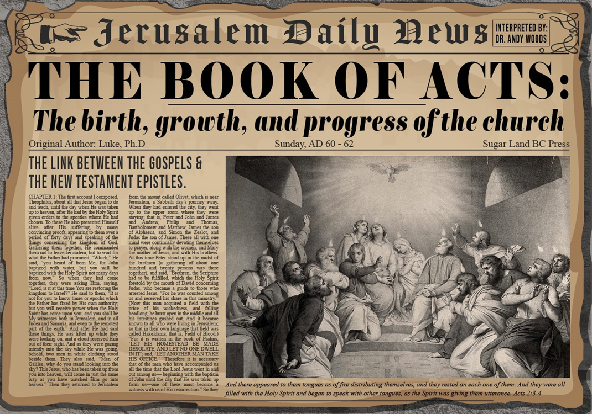
Acts 2
Chapter Summary
  Coming of the Holy Spirit (1-4)
  Holy Spirit’s Impact (5-13)
  Peter’s Sermon (14-36)
  Sermon’s Impact (37-47)

Slide 3
Coming of the Holy Spirit
Acts 2:37-47
  Salvation (37-41)
  Church (42-47)

Slide 4


Slide 5
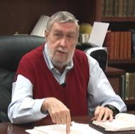
Jay Adams
Competent to Counsel, 70.
“But counselors, as Christians, are obligated to present the claims of Christ. They must present the good news that Christ Jesus died on the cross in the place of His own, that He bore the guilt and suffered the penalty for their sins. He died that all whom the Father had given to Him might come unto Him and have life everlasting. As a reformed Christian, the writer believes that counselors must not tell any unsaved counselee that Christ died for him, FOR THEY CANNOT SAY THAT. No man knows except Christ Himself who are His elect for whom He died." [emphasis mine]

Slide 6
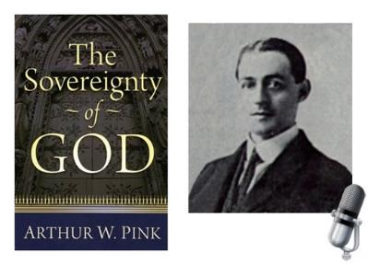
A. W. Pink
Sovereignty of God, p. 160, 163.
“The fact is, that the love of God, is a truth for the Saints only…In like manner, the ‘world’ in John 3:16 must, in the final analysis, refer to the world of God’s people.”

Slide 7
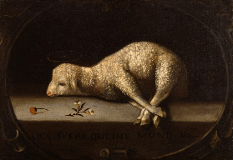
Extent of the Atonement
  Unlimited
  Biblical support
    John 1:29; 3:16-17; 4:42; 6:51; 12:32, 47
    Acts 17:30
    2 Cor 5:19
    1 Tim. 2:4, 6; 4:10
    Titus 2:11
    Heb. 2:9
    2 Pet. 2:1
    1 John 2:2; 4:14

Slide 8
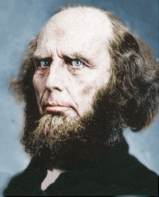
Poor Word Choices
ABC method – Admit, Believe, Call
Miscellaneous poor word choices – confess, deny, yield, surrender, sorrow, make, ask, forsake, receive, accept, invite
Negative influence of Charles Finney

Slide 9

Matthew 23:37-39
³⁷ “Jerusalem, Jerusalem, who kills the prophets and stones those who are sent to her! How often I wanted to gather [episynagō] your children together, the way a hen gathers [episynagō] her chicks under her wings, and you were unwilling. ³⁸ Behold, your house is being left to you desolate! ³⁹ For I say to you, from now on you will not see Me until you say, ‘Blessed is He who comes in the name of the Lord!’”

Slide 10

Romans 8:29-30
²⁹ For those whom He foreknew, He also predestined to become conformed to the image of His Son, so that He would be the firstborn among many brethren; ³⁰ and these whom He predestined, He also called; and these whom He called, He also justified; and these whom He justified, He also glorified.

Slide 11
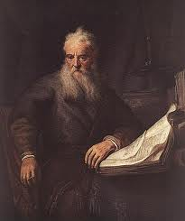
Romans Outline
Salutation (1:1-17)
Sin (1:18–3:20)
Salvation (3:21–5:21)
Sanctification (6–8)
Sovereignty (9–11)
Service (12:1–15:13)
Summation (15:14–16:27)

Slide 12


Slide 13
V. Sovereignty (Rom 9–11)
Israel in the past: elected (Rom 9)
Israel in the present: rejected (Rom 10)
Israel in the future: accepted (Rom 11)

Slide 14

Lewis Sperry Chafer, vol. 7, Systematic Theology
(Grand Rapids, MI: Kregel Publications, 1993), 265-66.
Belief-God’s One Condition for Justification
“…because upwards of 150 passages of Scripture condition salvation upon believing only (cf. John 3:16; Acts 16:31).”

Slide 15
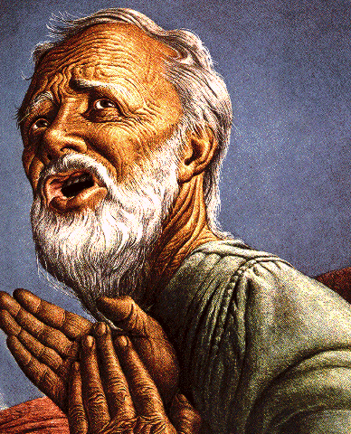
Belief – God’s One Condition for Justification
Gen 15:6
Then he believed in the LORD; and He reckoned it to him as righteousness.
John 3:16
For God so loved the world, that He gave His only begotten Son, that whoever believes in Him shall not perish, but have eternal life.
Acts 16:30-31
"Sirs, what must I do to be saved?" They said, "Believe in the Lord Jesus, and you will be saved..."

Slide 16
Acts 2:37-41
Salvation
      Conviction (37)
      Repentance & Baptism (38-39)
      Consequence of Repentance (40)
      Result (41)

Slide 17


Slide 18
Six Parts of a Suzerain-Vassal Treaty in Deuteronomy
Preamble (1:1-5)
Prologue (1:6–4:40)
Covenant obligations (5–26)
Storage and reading instructions (27:2-3; 31:9, 24, 26)
Witnesses (32:1)
Blessings and curses (28)

Slide 19
Six Parts of a Suzerain-Vassal Treaty in Deuteronomy
Preamble (1:1-5)
Prologue (1:6–4:40)
Covenant obligations (5–26)
Storage and reading instructions (27:2-3; 31:9, 24, 26)
Witnesses (32:1)
Blessings and curses (28)

Slide 20


Deuteronomy 28:49-50
⁴⁹ “The Lord will bring a nation against you from afar, from the end of the earth, as the eagle swoops down, a nation whose language you shall not understand, ⁵⁰ a nation of fierce countenance who will have no respect for the old, nor show favor to the young.”

Slide 21
ISRAEL'S JUDGMENTS
Division of the kingdom in 931 B.C. (1 Kgs. 12)
Assyrian judgment in 722 B.C. (2 Kgs. 17)
Babylonian captivity in 586 B.C. (2 Kgs. 25)
Rome Diaspora in A.D. 70 (Luke 19:41-44)

Slide 22
ISRAEL'S JUDGMENTS
Division of the kingdom in 931 B.C. (1 Kgs. 12)
Assyrian judgment in 722 B.C. (2 Kgs. 17)
Babylonian captivity in 586 B.C. (2 Kgs. 25)
Rome Diaspora in A.D. 70 (Luke 19:41-44)

Slide 23
Eusebius (A.D. 260-340)
Ecclesiastical History, 3.5.3
"But the people of the church in Jerusalem had been commanded by a revelation, vouchsafed to approved men there before the war, to leave the city and to dwell in a certain town of Perea called Pella. And when those that believed in Christ had come thither from Jerusalem, then, as if the royal city of the Jews and the whole land of Judea were entirely destitute of holy men, the judgment of God at length overtook those who had committed such outrages against Christ and his apostles, and totally destroyed that generation of impious men."
Epiphanius (De pond. et mens. 15) also records this flight of the Christians to Pella.)

Slide 24
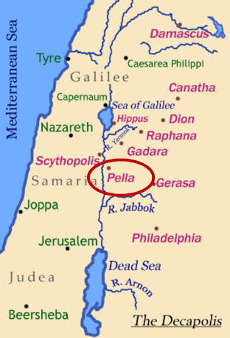
Pella
Pella was a town situated beyond the Jordan, in the north of Perea, within the dominions of Herod Agrippa II. The surrounding population was chiefly Gentile. See Pliny V. 18, and Josephus, B. J. III. 3. 3, and I. 4. 8.

Slide 25

Ezekiel 36:24-28
²⁴ “For I will take you from the nations, gather you from all the lands and bring you into your own land. ²⁵ Then I will sprinkle clean water on you, and you will be clean; I will cleanse you from all your filthiness and from all your idols. ²⁶ Moreover, I will give you a new heart and put a new spirit within you; and I will remove the heart of stone from your flesh and give you a heart of flesh. ²⁷ I will put My Spirit within you and cause you to walk in My statutes, and you will be careful to observe My ordinances. ²⁸ You will live in the land that I gave to your forefathers; so you will be My people, and I will be your God.”

Slide 26

Charles L. Feinberg
The Prophecy of Ezekiel: The Glory of the Lord, Paperback ed. (Chicago: Moody, 1969; reprint, Chicago: Moody, 1984), 231-32.
“Verses 25–29 teach that the complete return of Israel will occur after the defeat of Gog and his Confederates. Ezekiel summarized his prophecies of hope and restoration. When he stated that God will have mercy upon the whole house of Israel, he had in mind that all previous restorations were partial. Now a universal and final restoration will take place. It was God who allowed them to go into captivity; it is he who will see to it that they are regathered; indeed, it is he who will insure that not one is left out of the land...In conclusion, to summarize all the benefits promised, Ezekiel spoke of the outpouring of the Spirit upon the house of Israel (italics added).”

Slide 27
Acts 2:37-41
Salvation
      Conviction (37)
      Repentance & Baptism (38-39)
      Consequence of Repentance (40)
      Result (41)

Slide 28
Acts 2:41
“So then, those who had received his word were baptized; and that day there were added about three thousand souls.”

Slide 29
Acts 2:41
“So then, those who had received his word were baptized; and that day there were added about three thousand souls.”

Slide 30

John 1:12
“But as many as received Him, to them He gave the right to become children of God, even to those who believe in His name.”

Slide 31
Acts 2:41
“So then, those who had received his word were baptized; and that day there were added about three thousand souls.”

Slide 32
Acts 2:41
“So then, those who had received his word were baptized; and that day there were added about three thousand souls.”

Slide 33
Reasons for Understanding 1000 Literally
(Revelation 20:1-10)
John’s use of indefinite concepts elsewhere
  Revelation 20:3,8
Exception to the “# of years” examples?
Other numbers are taken literally
  Two witnesses (11:3), 7000 people (11:13), 4 Angels (7:1) 7 Angels (8:6),144,000 Jews (7:4), 42 months (11:2), 1260 days (11:3)
Not always a symbolic interpretation
  (Rev. 17:18)

Slide 34


Slide 35

Message
  Birth and growth of the church numerically, geographically, ethnically.
  Components
  Numerically (progress reports)
  Geographically (From Jerusalem to Rome)
  Ethnically (From Judaism to Gentile domination)

Slide 36
Progress Reports
  Clearest: Acts 2:47; 6:7; 9:31; 12:24; 16:5; 19:20; 28:30-31
  Less clear: Acts 1:13, 15; 2:41; 4:4, 31; 5:14, 42; 8:25, 40; 11:21; 13:49; 17:6

Slide 37
Coming of the Holy Spirit
Acts 2:37-47
  Salvation (37-41)
  Church (42-47)

Slide 38
Acts 2:42-47
Church
      Priorities (42)
      Miracles (43)
      Unity (44)
      Communal living (45)
      Lord’s Table (46)
      Evangelism (47)

Slide 39
Acts 2:42-47
Church
      Priorities (42)
      Miracles (43)
      Unity (44)
      Communal living (45)
      Lord’s Table (46)
      Evangelism (47)

Slide 40
Activities of the Local Church
(Acts 2:41-47)
Doctrine (Acts 2:42)
Ordinances (Acts 2:41-42, 46)
Prayer (Acts 2:42)
Evangelism (Acts 2:47)
Worship (Acts 2:47)
Benevolence (Acts 2:44-45)
Fellowship (Acts 2:42, 46-47)

Slide 41
Acts 2:42-47
Church
      Priorities (42)
      Miracles (43)
      Unity (44)
      Communal living (45)
      Lord’s Table (46)
      Evangelism (47)

Slide 42

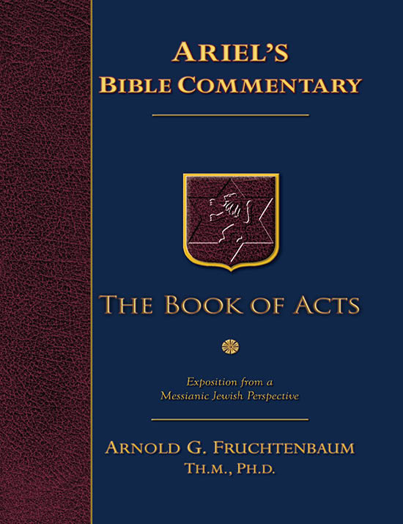
Dr. Arnold G. Fruchtenbaum
The Book of Acts, 83
“The apostles did many signs and wonders. In fact, the only ones who performed miracles in the book of Acts were the apostles or their delegates, such as Stephen (Acts 6:8). These apostolic legates were appointed by the laying on of hands by the apostles. Signs and wonders were not performed by the believers at large.”

Slide 43

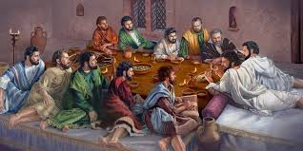
Ephesians 2:20
“having been built on the foundation of the apostles and prophets, Christ Jesus Himself being the corner stone.”

Slide 44
Miracle Clusters In Scripture
NUM. | ERA | AUTHENTICATION
1. | Moses | Law
2. | Joshua | Conquest
3. | Elijah-Elisha | Prophet
4. | Christ | Kingdom offer
5. | Apostles | Church
6. | Tribulation & Millennium | Kingdom establishment

Slide 45
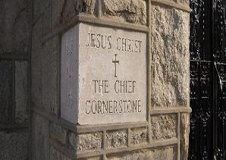
2 Timothy 4:20
“Erastus remained at Corinth, but Trophimus I left sick at Miletus.”

Slide 46
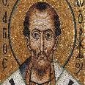
Chrysostom (A.D. 345‒407)
Patriarch of Constantinople, Chrysostom, Homily 29 on First Corinthians.
“This whole place is very obscure: but the obscurity is produced by our ignorance of the facts referred to and by their cessation, being such as then used to occur but now no longer take place. And why do they not happen now? Why look now, the cause too of the obscurity has produced us again another question: namely, why did they then happen, and now do so no more?”

Slide 47
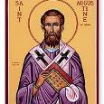
Augustine (A.D. 354‒430)
Bishop of Hippo, Homily 6:10 on the First Epistle of John.
“In the earliest times, the Holy Ghost fell upon them that believed: and they spoke with tongues, which they had not learned, as the Spirit gave them utterance. Acts 2:4 These were signs adapted to the time. For there behooved to be that betokening of the Holy Spirit in all tongues, to show that the Gospel of God was to run through all tongues over the whole earth. That thing was done for a betokening, and it passed away. . . . If then the witness of the presence of the Holy Ghost be not now given through these miracles, by what is it given, by what does one get to know that he has received the Holy Ghost?”

Slide 48

Philip Schaff
History of the Christian Church, vol. 1 , p. 236-37.
“We do not know how long the glossolalia, as thus described by Paul, continued. It passed away gradually with the other extraordinary or strictly supernatural gifts of the apostolic age. It is not mentioned in the Pastoral, nor in the Catholic Epistles. We have but a few allusions to it at the close of the second century. Irenæus (Adv. Haer. 1. v. c. 6 § 1,) speaks of ‘many brethren’ whom he heard in the church having the gift of prophecy and of speaking in ‘diverse tongues’ (παντοδαπαῖς γλώσσαις), bringing the hidden things of men (τὰ κρύφια τῶν ἀνθρώπων) to light and expounding the mysteries of God (τὰ μυστήρια τοῦ θεοῦ). It is not clear whether by the term ‘diverse,’ which does not elsewhere occur, he means a speaking in foreign languages, or in . . .

Slide 49
Philip Schaff
History of the Christian Church, vol. 1 , p. 236-37.
“…diversities of tongues altogether peculiar, like those meant by Paul.” The latter is more probable. Irenæus himself had to learn the language of Gaul. Tertullian (Adv. Marc. V. 8; comp. De Anima, c. 9) obscurely speaks of the spiritual gifts, including the gift of tongues, as being still manifest among the Montanists to whom he belonged. At the time of Chrysostom it had entirely disappeared; at least he accounts for the obscurity of the gift from our ignorance of the fact. From that time on the glossolalia was usually misunderstood as a miraculous and permanent gift of foreign languages for missionary purposes. But the whole history of missions furnishes no clear example of such a gift for such a purpose.”

Slide 50
Acts 2:42-47
Church
      Priorities (42)
      Miracles (43)
      Unity (44)
      Communal living (45)
      Lord’s Table (46)
      Evangelism (47)

Slide 51

John 17:20-23
²⁰ “I do not ask on behalf of these alone, but for those also who believe in Me through their word; ²¹ that they may all be one; even as You, Father, are in Me and I in You, that they also may be in Us, so that the world may believe that You sent Me. ²² The glory which You have given Me I have given to them, that they may be one, just as We are one; ²³ I in them and You in Me, that they may be perfected in unity, so that the world may know that You sent Me, and loved them, even as You have loved Me.”

Slide 52

1 Corinthians 12:13
“For by one Spirit we were all baptized into one body, whether Jews or Greeks, whether slaves or free, and we were all made to drink of one Spirit.”

Slide 53
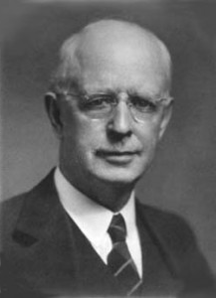
Lewis Sperry Chafer
vol. 5, Systematic Theology (Grand Rapids, MI: Kregel Publications, 1993), 158.
“Thoughtless and absurd is the modern notion that Christ was praying that denominations which exist in this remote time and in a country then unknown might become organically united in one, and therefore it is the duty of all sects to unite and thus help to answer this prayer. As indicated before, this unity is sought at the hand of the Father, indicating that it is a divine undertaking. It is that, and it results in a unity as organic and vital as that between the Father and the Son. This prayer began to be answered on the Day of Pentecost when believers were by the Spirit baptized into one Body, and is constantly answered whenever a soul is saved and thus joined as a member to the Body of Christ by the same baptism of the Spirit.”

Slide 54
Acts 2:42-47
Church
      Priorities (42)
      Miracles (43)
      Unity (44)
      Communal living (45)
      Lord’s Table (46)
      Evangelism (47)

Slide 55
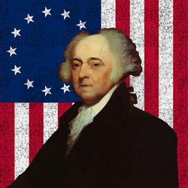
John Adams
John Adams, A Defence of the Constitutions of Government of the United States of America, 3 vols., American Constitutional and Legal History, ed. Leonard W. Levy (London: Dilly, 1787; reprint, NY: Da Capo, 1971), 3:217
“The moment the idea is admitted into society, that property is not as sacred as the laws of God, and that there is not a force of law and public justice to protect it, anarchy and tyranny commence. If ‘Thou Shalt Not Covet,’ and ‘Thou Shalt Not Steal’ were not commandments of Heaven, they must be made inviolable precepts in every society before it can be civilized or made free.”

Slide 56


Slide 57
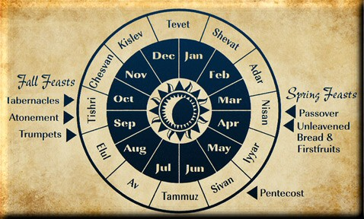

Slide 58
Acts 2:42-47
Church
      Priorities (42)
      Miracles (43)
      Unity (44)
      Communal living (45)
      Lord’s Table (46)
      Evangelism (47)

Slide 59
Acts 2:42-47
Church
      Priorities (42)
      Miracles (43)
      Unity (44)
      Communal living (45)
      Lord’s Table (46)
      Evangelism (47)

Slide 60

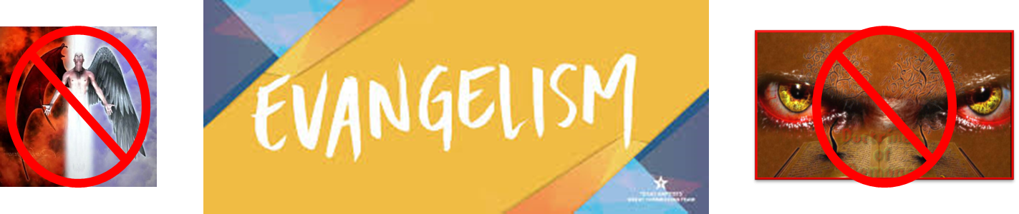
Matthew 16:18
“I also say to you that you are Peter, and upon this rock I will build [oikodomeō] My church; and the gates of Hades WILL NOT overpower it.”

Slide 61
Acts 2:47 (NASB; NKJV)
“praising God and having favor with all the people. And the Lord was adding to their number day by day those who were being saved.”
“praising God and having favor with all the people. And the Lord added to the church daily those who were being saved.”

Slide 62

Arnold Fruchtenbaum
Arnold G. Fruchtenbaum, “Israel and the Church,” in Issues in Dispensationalism, ed. Wesley R. Willis and John R. Master (Chicago: Moody, 1994), 118.
“In the book of Acts, both Israel and the church exist simultaneously. The term Israel is used twenty times and ekklēsia (church) nineteen times, yet the two groups are always kept distinct.”

Slide 63
Conclusion

Slide 64
Acts 2
Chapter Summary
  Coming of the Holy Spirit (1-4)
  Holy Spirit’s Impact (5-13)
  Peter’s Sermon (14-36)
  Sermon’s Impact (37-47)

