Slide 1
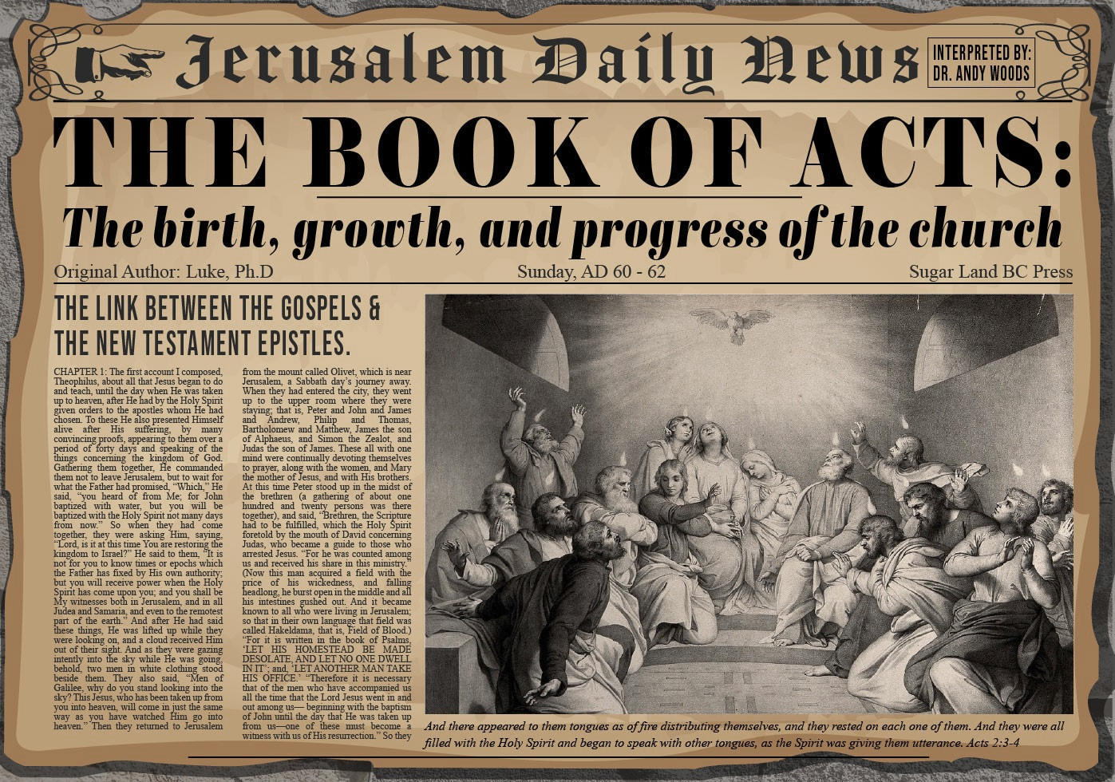


Slide 2
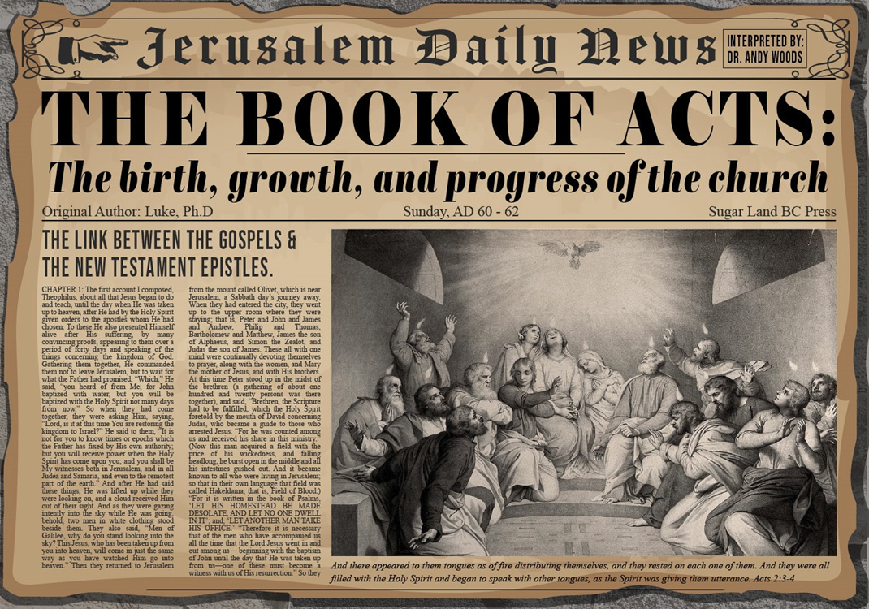
Introductory Matters
Title
Authorship
Biography
Place of writing
Recipient
Purpose
Message
Method
Sources
Date
Structure
Scope
Themes
Unique characteristics

Slide 3
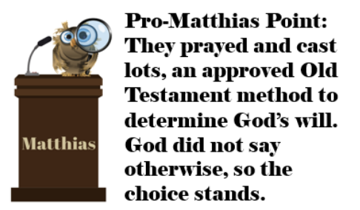
Acts 1
Chapter Summary
  Prologue (1-5)
  Jesus’ Ascension (6-11)
  Return to Jerusalem (12-14)
  Matthias Chosen (15-26)

Slide 4
Acts 2
Chapter Summary
  Coming of the Holy Spirit (1-4)
  Holy Spirit’s Impact (5-13)
  Peter’s Sermon (14-36)
  Sermon’s Impact (37-47)

Slide 5
Acts 2
Chapter Summary
  Coming of the Holy Spirit (1-4)
  Holy Spirit’s Impact (5-13)
  Peter’s Sermon (14-36)
  Sermon’s Impact (37-47)

Slide 6
Coming of the Holy Spirit
Acts 2:1-4
  Occasion (1)
  Events (2-4)

Slide 7
Acts 2
Chapter Summary
  Coming of the Holy Spirit (1-4)
  Holy Spirit’s Impact (5-13)
  Peter’s Sermon (14-36)
  Sermon’s Impact (37-47)

Slide 8
Holy Spirit’s Impact
Acts 2:5-13
  Circumstances (5)
  Manifestation of tongues (6-8)
  Nations in the Diaspora (9-12)
  Charge of drunkenness (13)

Slide 9
Acts 2
Chapter Summary
  Coming of the Holy Spirit (1-4)
  Holy Spirit’s Impact (5-13)
  Peter’s Sermon (14-36)
  Sermon’s Impact (37-47)

Slide 10
Peter’s Sermon
Acts 2:14-36
  Introduction (14)
  Refutation of Drunkenness Charge (15-35)
  Conclusion (36)

Slide 11
Peter’s Sermon
Acts 2:14-36
  Introduction (14)
  Refutation of Drunkenness Charge (15-35)
  Conclusion (36)

Slide 12
Mistaken Replacement?
Pro
  No Spirit yet
  Lots
  Matthias disappears
  Paul
Con
  No textual indication of an error
  Twelve esteemed (2:14; 6:2)
  God’s choice (1:24)
  Prov 16:33
  Paul unqualified (1:21-22)
  Focus on Peter & Paul

Slide 13


Slide 14
Peter’s Sermon
Acts 2:14-36
  Introduction (14)
  Refutation of Drunkenness Charge (15-35)
  Conclusion (36)

Slide 15
Acts 2:15-35
Refutation of the Charge of Drunkenness
      Too early (15)
      Use of Joel 2:28-32 (16-21)
      Christ’s miracles (22)
      Crucifixion (23)
      Resurrection (24)
      Use of Psalm 16:8-11 (25-29)
      Use of Psalm 132:11 (30-32)
      High priestly ministry (33)
      Use of Psalm 110:1 (34-35)

Slide 16
Acts 2:15-35
Refutation of the Charge of Drunkenness
      Too early (15)
      Use of Joel 2:28-32 (16-21)
      Christ’s miracles (22)
      Crucifixion (23)
      Resurrection (24)
      Use of Psalm 16:8-11 (25-29)
      Use of Psalm 132:11 (30-32)
      High priestly ministry (33)
      Use of Psalm 110:1 (34-35)

Slide 17


Acts 2:13, 15
¹³ “But others were mocking and saying, ‘They are full of sweet wine.’… ¹⁵ ‘For these men are not drunk, as you suppose, for it is only the third hour of the day.’”

Slide 18
Acts 2:15-35
Refutation of the Charge of Drunkenness
      Too early (15)
      Use of Joel 2:28-32 (16-21)
      Christ’s miracles (22)
      Crucifixion (23)
      Resurrection (24)
      Use of Psalm 16:8-11 (25-29)
      Use of Psalm 132:11 (30-32)
      High priestly ministry (33)
      Use of Psalm 110:1 (34-35)

Slide 19
Acts 2:16-21
¹⁶ “but this is what was spoken of through the prophet Joel: ¹⁷ ‘And it shall be in the last days,’ God says, ‘That I will pour forth of My Spirit on all mankind; And your sons and your daughters shall prophesy, And your young men shall see visions, And your old men shall dream dreams; ¹⁸ Even on My bond slaves, both men and women, I will in those days pour forth of My Spirit And they shall prophesy, ¹⁹ ‘And I will grant wonders in the sky above And signs on the earth below, …

Slide 20
Acts 2:16-21
…Blood, and fire, and vapor of smoke. ²⁰ ‘The sun will be turned into darkness And the moon into blood, Before the great and glorious day of the Lord shall come.²¹ ‘And it shall be that everyone who calls on the name of the Lord will be saved.’”

Slide 21

Analogical Fulfillment View
(Joel 2:28-32; Acts 2:16-21)
  Spirit Poured Out On All Flesh?
  Joel 2 Predictions Not Found In Acts 2
  Acts 2 Realities Not Found In Joel 2
  Different Wording in Acts 2
  Absence of “Fulfilled”
  “This is That”?
Arnold G. Fruchtenbaum, “Rabbinic Quotations of the Old Testament and How It relates to Joel 2 and Acts 2,” 5–7, accessed April 1, 2016, http://www.pre-trib.org; Thomas L. Constable, “Notes on Acts,” 42–49, accessed April 1, 2016, http://www.soniclight.com.

Slide 22
Analogical Fulfillment View
(Joel 2:28-32; Acts 2:16-21)
  Spirit Poured Out On All Flesh?
  Joel 2 Predictions Not Found In Acts 2
  Acts 2 Realities Not Found In Joel 2
  Different Wording in Acts 2
  Absence of “Fulfilled”
  “This is That”?
Arnold G. Fruchtenbaum, “Rabbinic Quotations of the Old Testament and How It relates to Joel 2 and Acts 2,” 5–7, accessed April 1, 2016, http://www.pre-trib.org; Thomas L. Constable, “Notes on Acts,” 42–49, accessed April 1, 2016, http://www.soniclight.com.

Slide 23
Acts 2:16-18
¹⁶ “but this is what was spoken of through the prophet Joel: ¹⁷ ‘And it shall be in the last days,’ God says, ‘That I will pour forth of My Spirit on all mankind; And your sons and your daughters shall prophesy, And your young men shall see visions, And your old men shall dream dreams; ¹⁸ Even on My bond slaves, both men and women, I will in those days pour forth of My Spirit And they shall prophesy….”

Slide 24
Acts 2:41
“So then, those who had received his word were baptized; and that day there were added about three thousand souls.”

Slide 25


Slide 26
Analogical Fulfillment View
(Joel 2:28-32; Acts 2:16-21)
  Spirit Poured Out On All Flesh?
  Joel 2 Predictions Not Found In Acts 2
  Acts 2 Realities Not Found In Joel 2
  Different Wording in Acts 2
  Absence of “Fulfilled”
  “This is That”?
Arnold G. Fruchtenbaum, “Rabbinic Quotations of the Old Testament and How It relates to Joel 2 and Acts 2,” 5–7, accessed April 1, 2016, http://www.pre-trib.org; Thomas L. Constable, “Notes on Acts,” 42–49, accessed April 1, 2016, http://www.soniclight.com.

Slide 27
Acts 2:19-21
¹⁹ “ ‘And I will grant wonders in the sky above And signs on the earth below, Blood, and fire, and vapor of smoke. ²⁰ ‘The sun will be turned into darkness And the moon into blood, Before the great and glorious day of the Lord shall come.²¹ ‘And it shall be that everyone who calls on the name of the Lord will be saved.’”

Slide 28
Acts 2:19-21
¹⁹ “ ‘And I will grant wonders in the sky above And signs on the earth below, Blood, and fire, and vapor of smoke. ²⁰ ‘The sun will be turned into darkness And the moon into blood, Before the great and glorious day of the Lord shall come.²¹ ‘And it shall be that everyone who calls on the name of the Lord will be saved.’”

Slide 29
Acts 2:16-18
¹⁶ “but this is what was spoken of through the prophet Joel: ¹⁷ ‘And it shall be in the last days,’ God says, ‘That I will pour forth of My Spirit on all mankind; And your sons and your daughters shall prophesy, And your young men shall see visions, And your old men shall dream dreams; ¹⁸ Even on My bond slaves, both men and women, I will in those days pour forth of My Spirit And they shall prophesy….”

Slide 30


Joel 2:32
“And it will come about that whoever calls on the name of the Lord Will be delivered; For on Mount Zion and in Jerusalem There will be those who escape, As the Lord has said, Even among the survivors whom the Lord calls.”

Slide 31
Analogical Fulfillment View
(Joel 2:28-32; Acts 2:16-21)
  Spirit Poured Out On All Flesh?
  Joel 2 Predictions Not Found In Acts 2
  Acts 2 Realities Not Found In Joel 2
  Different Wording in Acts 2
  Absence of “Fulfilled”
  “This is That”?
Arnold G. Fruchtenbaum, “Rabbinic Quotations of the Old Testament and How It relates to Joel 2 and Acts 2,” 5–7, accessed April 1, 2016, http://www.pre-trib.org; Thomas L. Constable, “Notes on Acts,” 42–49, accessed April 1, 2016, http://www.soniclight.com.

Slide 32
Holy Spirit’s Impact
Acts 2:5-13
  Circumstances (5)
  Manifestation of tongues (6-8)
  Nations in the Diaspora (9-12)
  Charge of drunkenness (13)

Slide 33
Analogical Fulfillment View
(Joel 2:28-32; Acts 2:16-21)
  Spirit Poured Out On All Flesh?
  Joel 2 Predictions Not Found In Acts 2
  Acts 2 Realities Not Found In Joel 2
  Different Wording in Acts 2
  Absence of “Fulfilled”
  “This is That”?
Arnold G. Fruchtenbaum, “Rabbinic Quotations of the Old Testament and How It relates to Joel 2 and Acts 2,” 5–7, accessed April 1, 2016, http://www.pre-trib.org; Thomas L. Constable, “Notes on Acts,” 42–49, accessed April 1, 2016, http://www.soniclight.com.

Slide 34
Acts 2:16-18
¹⁶ “but this is what was spoken of through the prophet Joel: ¹⁷ ‘And it shall be in the last days,’ God says, ‘That I will pour forth of My Spirit on all mankind; And your sons and your daughters shall prophesy, And your young men shall see visions, And your old men shall dream dreams; ¹⁸ Even on My bond slaves, both men and women, I will in those days pour forth of My Spirit And they shall prophesy….”

Slide 35
Acts 2:16-18
¹⁶ “but this is what was spoken of through the prophet Joel: ¹⁷ ‘And it shall be in the last days,’ God says, ‘That I will pour forth of My Spirit on all mankind; And your sons and your daughters shall prophesy, And your young men shall see visions, And your old men shall dream dreams; ¹⁸ Even on My bond slaves, both men and women, I will in those days pour forth of My Spirit And they shall prophesy….”

Slide 36
Analogical Fulfillment View
(Joel 2:28-32; Acts 2:16-21)
  Spirit Poured Out On All Flesh?
  Joel 2 Predictions Not Found In Acts 2
  Acts 2 Realities Not Found In Joel 2
  Different Wording in Acts 2
  Absence of “Fulfilled”
  “This is That”?
Arnold G. Fruchtenbaum, “Rabbinic Quotations of the Old Testament and How It relates to Joel 2 and Acts 2,” 5–7, accessed April 1, 2016, http://www.pre-trib.org; Thomas L. Constable, “Notes on Acts,” 42–49, accessed April 1, 2016, http://www.soniclight.com.

Slide 37
Acts 1:16
“Brethren, the Scripture had to be fulfilled (plēroō), which the Holy Spirit foretold by the mouth of David concerning Judas, who became a guide to those who arrested Jesus.”

Slide 38
Analogical Fulfillment View
(Joel 2:28-32; Acts 2:16-21)
  Spirit Poured Out On All Flesh?
  Joel 2 Predictions Not Found In Acts 2
  Acts 2 Realities Not Found In Joel 2
  Different Wording in Acts 2
  Absence of “Fulfilled”
  “This is That”?
Arnold G. Fruchtenbaum, “Rabbinic Quotations of the Old Testament and How It relates to Joel 2 and Acts 2,” 5–7, accessed April 1, 2016, http://www.pre-trib.org; Thomas L. Constable, “Notes on Acts,” 42–49, accessed April 1, 2016, http://www.soniclight.com.

Slide 39
Acts 2:16-18
¹⁶ “but this is what / that (touto estin to) was spoken of through the prophet Joel: ¹⁷ ‘And it shall be in the last days,’ God says, ‘That I will pour forth of My Spirit on all mankind; And your sons and your daughters shall prophesy, And your young men shall see visions, And your old men shall dream dreams; ¹⁸ Even on My bond slaves, both men and women, I will in those days pour forth of My Spirit And they shall prophesy….”

Slide 40
1 Corinthians 11:24-26
²⁴ “and when He had given thanks, He broke it and said, “This is (touto estin to) My body, which is for you; do this in remembrance of Me.” ²⁵ In the same way He took the cup also after supper, saying, “This cup is the new covenant in My blood; do this, as often as you drink it, in remembrance of Me.” ²⁶ For as often as you eat this bread and drink the cup, you proclaim the Lord’s death until He comes.”

Slide 41
Acts 2:15-35
Refutation of the Charge of Drunkenness
      Too early (15)
      Use of Joel 2:28-32 (16-21)
      Christ’s miracles (22)
      Crucifixion (23)
      Resurrection (24)
      Use of Psalm 16:8-11 (25-29)
      Use of Psalm 132:11 (30-32)
      High priestly ministry (33)
      Use of Psalm 110:1 (34-35)

Slide 42
Acts 2:22
“Men of Israel, listen to these words: Jesus the Nazarene, a man attested to you by God with miracles and wonders and signs which God performed through Him in your midst, just as you yourselves know.”

Slide 43

John 20:30-31
“Therefore many other signs Jesus also performed in the presence of the disciples, which are not written in this book; but these have been written so that you may believe that Jesus is the Christ, the Son of God; and that believing you may have life in His name.”

Slide 44
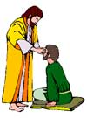
“SEVEN SIGNS” in Gospel of John
1. Changing Water into Wine | 2:11
2. Healing official’s son | 4:46-54
3. Healing an invalid at the Pool of Bethesda | 5:1-18
4. Feeding the 5,000 | 6:5-14
5. Walking on water | 6:16-21
6. Healing a blind man | 9:1-7
7. Raising dead Lazarus | 11:1-45

Slide 45
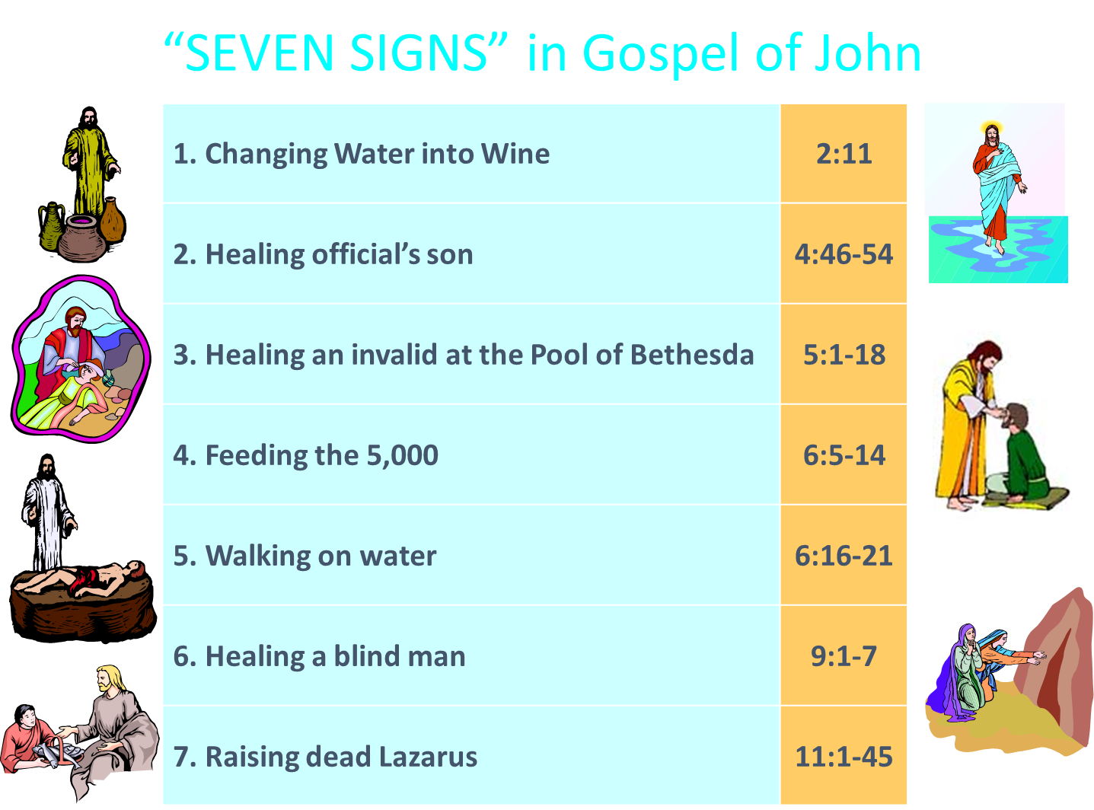
John 3:2
“this man came to Jesus by night and said to Him, “Rabbi, we know that You have come from God as a teacher; for no one can do these signs that You do unless God is with him.”

Slide 46
Matthew 11:2-6
“² Now when John, while imprisoned, heard of the works of Christ, he sent word by his disciples ³ and said to Him, ‘Are You the Expected One, or shall we look for someone else?’ ⁴ Jesus answered and said to them, ’Go and report to John what you hear and see: ⁵ the blind receive sight and the lame walk, the lepers are cleansed and the deaf hear the dead are raised up, and the poor have the . . .

Slide 47
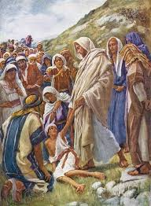
Matthew 11:2-6
... gospel preached to them. ⁶ And blessed is he who does not take offense at Me.’”

Slide 48
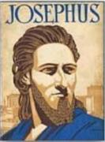
Josephus
Antiquities 18.3.3
“About this time there lived Jesus, a wise man, if indeed one ought to call him a man. For he was one who performed surprising deeds and was a teacher of such people as accept the truth gladly. He won over many Jews and many of the Greeks. He was the Christ. And when, upon the accusation of the principal men among us, Pilate had condemned him to a cross, those who had first come to love him did not cease. He appeared to them spending a third day restored to life, for the prophets of God had foretold these things and a thousand other marvels about him. And the tribe of the Christians, so called after him, has still to this day not disappeared.”

Slide 49
Acts 2:22
“Men of Israel, listen to these words: Jesus the Nazarene, a man attested to you by God with miracles and wonders and signs which God performed through Him in your midst, just as you yourselves know.”

Slide 50
Acts 2:15-35
Refutation of the Charge of Drunkenness
      Too early (15)
      Use of Joel 2:28-32 (16-21)
      Christ’s miracles (22)
      Crucifixion (23)
      Resurrection (24)
      Use of Psalm 16:8-11 (25-29)
      Use of Psalm 132:11 (30-32)
      High priestly ministry (33)
      Use of Psalm 110:1 (34-35)

Slide 51
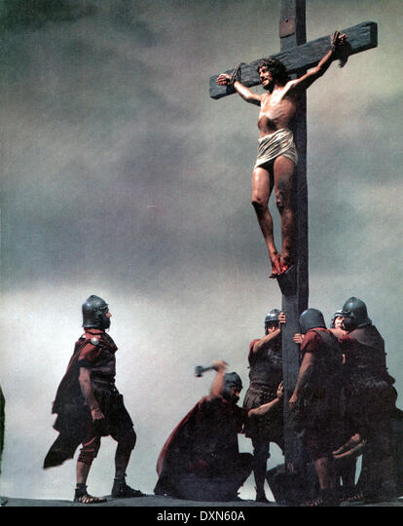
Acts 2:23
“this Man, delivered over by the predetermined plan and foreknowledge of God, you nailed to a cross by the hands of godless men and put Him to death.”

Slide 52
Acts 2:23
“this Man, delivered over by the predetermined plan and foreknowledge of God, you nailed to a cross by the hands of godless men and put Him to death.”

Slide 53
Acts 2:23
“this Man, delivered over by the predetermined plan and foreknowledge of God, you nailed to a cross by the hands of godless men and put Him to death.”

Slide 54
Acts 2:15-35
Refutation of the Charge of Drunkenness
      Too early (15)
      Use of Joel 2:28-32 (16-21)
      Christ’s miracles (22)
      Crucifixion (23)
      Resurrection (24)
      Use of Psalm 16:8-11 (25-29)
      Use of Psalm 132:11 (30-32)
      High priestly ministry (33)
      Use of Psalm 110:1 (34-35)

Slide 55
Acts 2:15-35
Refutation of the Charge of Drunkenness
      Too early (15)
      Use of Joel 2:28-32 (16-21)
      Christ’s miracles (22)
      Crucifixion (23)
      Resurrection (24)
      Use of Psalm 16:8-11 (25-29)
      Use of Psalm 132:11 (30-32)
      High priestly ministry (33)
      Use of Psalm 110:1 (34-35)

Slide 56
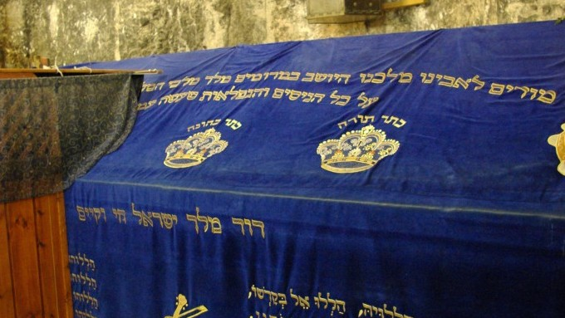

Slide 57

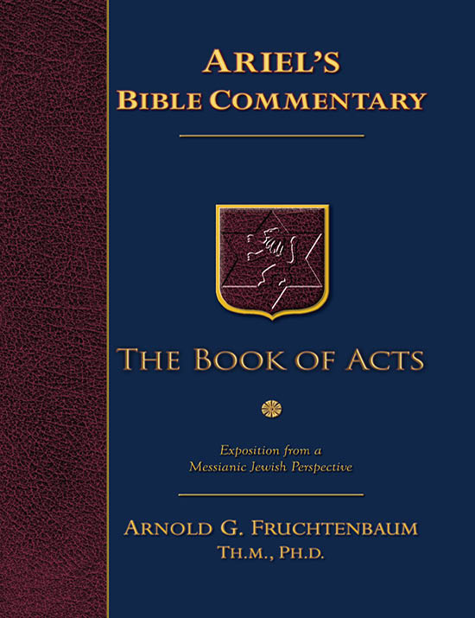
Dr. Arnold G. Fruchtenbaum
The Book of Acts, 74
“Either way, this type of quotation would be considered as ‘literal prophecy plus literal fulfillment,’ because in the context of Psalm 16, the psalmist was clearly speaking of the resurrection of the Messiah. Even some rabbis understood this passage to be Messianic. For example, the Midrash Tehillim on this verse states, ‘My glory rejoices over King Messiah, who shall rise up out of me (i.e., from David).’”
m. Tehillim on Psalm 16:9 as quoted by F. F. Bruce in The Acts of the Apostles: Greek Text with Introduction and Commentary (Grand Rapids, MI: Eerdmans, 1990), p. 124.

Slide 58
Acts 2:15-35
Refutation of the Charge of Drunkenness
      Too early (15)
      Use of Joel 2:28-32 (16-21)
      Christ’s miracles (22)
      Crucifixion (23)
      Resurrection (24)
      Use of Psalm 16:8-11 (25-29)
      Use of Psalm 132:11 (30-32)
      High priestly ministry (33)
      Use of Psalm 110:1 (34-35)

Slide 59
Acts 2:30
“And so, because he was a prophet and knew that God had sworn to him with an oath to seat one of his descendants on his throne.”

Slide 60


Slide 61

2 Samuel 7:12-16
“¹² When your days are complete and you lie down with your fathers, I will raise up your descendant after you, who will come forth from you, and I will establish his kingdom. ¹³ He shall build a house for My name, and I will establish the throne of his kingdom forever. ¹⁴ I will be a father to him and he will be a son to Me; when he commits iniquity, I will correct him with the rod of men. . .

Slide 62
2 Samuel 7:12-16
… and the strokes of the sons of men, ¹⁵ but My lovingkindness shall not depart from him, as I took it away from Saul, whom I removed from before you. ¹⁶ Your house and your kingdom shall endure before Me forever; your throne shall be established forever.” ¹⁷ In accordance with all these words and all this vision, so Nathan spoke to David.”

Slide 63
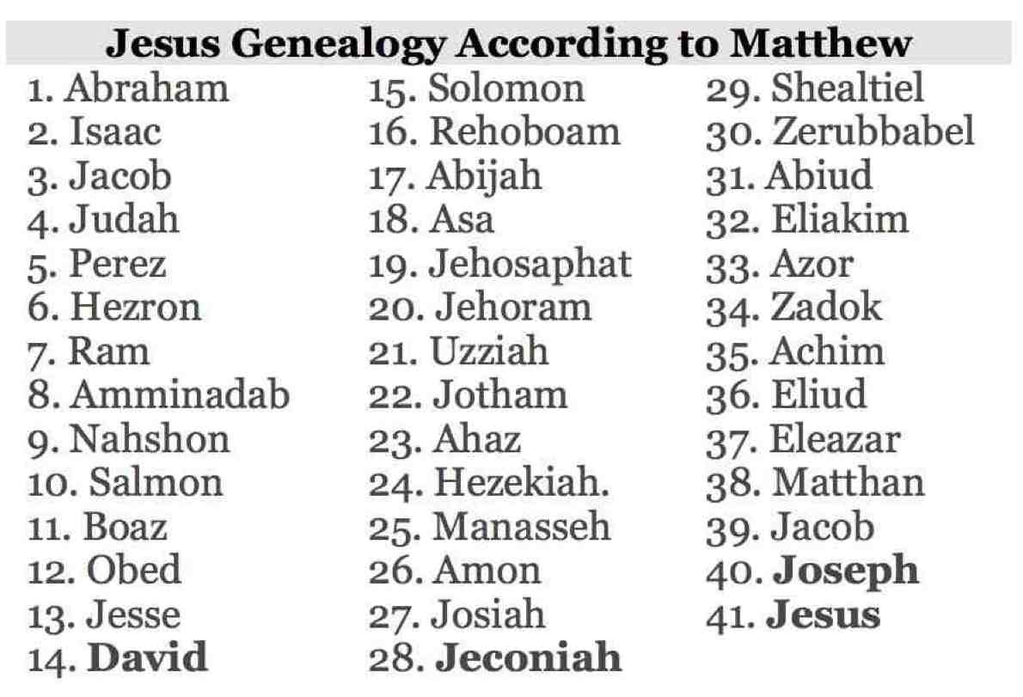

Slide 64
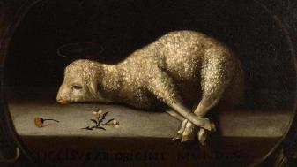
John 1:29
“The next day he saw Jesus coming to him and said, ‘Behold, the Lamb of God who takes away the sin of the world!’”

Slide 65
Acts 2:15-35
Refutation of the Charge of Drunkenness
      Too early (15)
      Use of Joel 2:28-32 (16-21)
      Christ’s miracles (22)
      Crucifixion (23)
      Resurrection (24)
      Use of Psalm 16:8-11 (25-29)
      Use of Psalm 132:11 (30-32)
      High priestly ministry (33)
      Use of Psalm 110:1 (34-35)

Slide 66
Acts 2:33
“Therefore having been exalted to the right hand of God, and having received from the Father the promise of the Holy Spirit, He has poured forth this which you both see and hear.”

Slide 67
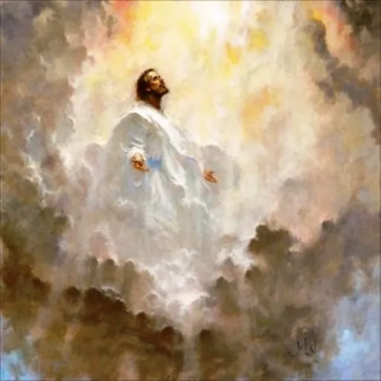
John 17:5
“Now, Father, glorify Me together with Yourself, with the glory which I had with You before the world was.”

Slide 68
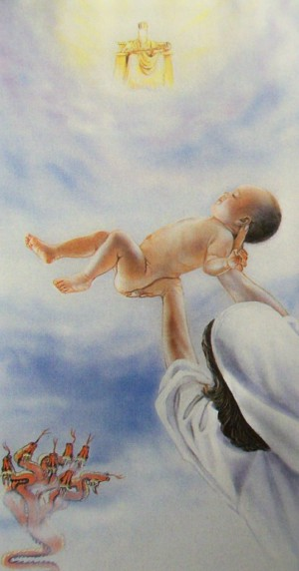
Revelation 12:5
“And she gave birth to a son, a male child, who is to rule all the nations with a rod of iron; and her child was caught up to God and to His throne.”

Slide 69
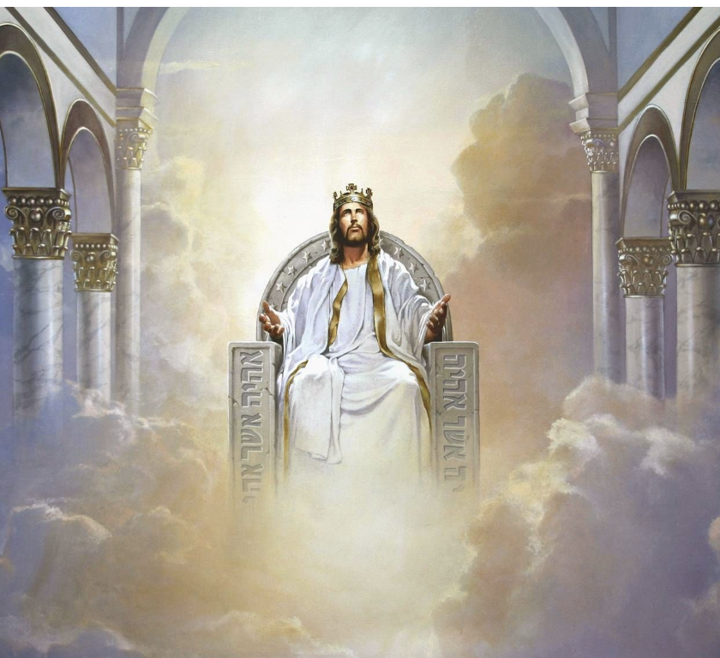
Revelation 3:21
“He who overcomes, I will grant [future tense of didōmi] to him to sit down with Me on My throne, as I also overcame and sat down [aorist tense of kathizō] with My Father on His throne.”

Slide 70
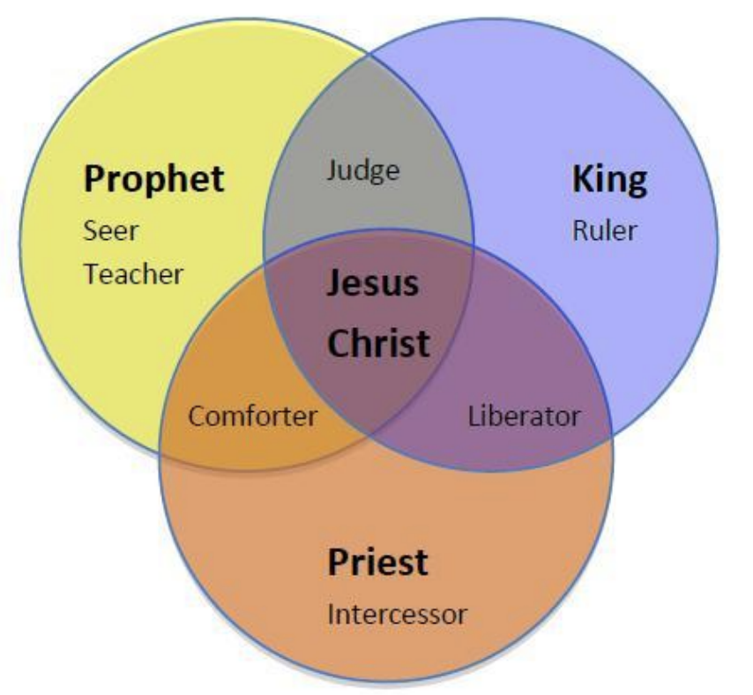
CHRIST’S THREE OFFICES
Prophet (First Coming)
Priest (Present Session)
King (Second Coming)

Slide 71

Lewis Sperry Chafer
vol. 5, Systematic Theology (Grand Rapids, MI: Kregel Publications, 1993), 273-74.
“The present ministry of Christ in heaven, known as His session, is far-reaching both in consequence and import. It too, has not been treated even with a passing consideration by Covenant theologians, doubtless due to their inability—because of being confronted with their one covenant theory—to introduce features and ministries which indicate a new divine purpose in the Church and by so much tend to disrupt the unity of a supposed immutable purpose and covenant of God’s. Since, as will be seen, certain vital ministries of Christ in heaven provide completely for the believer’s security, the present session of Christ has been eschewed by Arminians in a manner equally unpardonable. This neglect accounts very well . . .

Slide 72
Lewis Sperry Chafer
vol. 5, Systematic Theology (Grand Rapids, MI: Kregel Publications, 1993), 273-74.
…for the emphasis of their pulpit ministrations. The Christian public, because deprived of the knowledge of Christ’s present ministry, are unaware of its vast realities, though they are able from childhood itself to relate the mere historical facts and activities of Christ during His three and one-half years of service on earth. That Christ is doing anything now is not recognized by Christians generally and for this part-truth kind of preaching is wholly responsible. It yet remains true, whether neglected by one or the other kind of theologian, that Christ is now engaged in ministry which determines the service and destiny of all those who have put their trust in Him.”

Slide 73
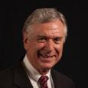
Dave Anderson
The King-Priest of Psalm 110 in Hebrews (New York: Lang, 2001), 2.
“But clearly Jesus did not set up a natural theocratic kingdom with Himself as the king ruling from Jerusalem on earth before His resurrection. So, what happened to the kingdom He promised? It was postponed, many NT interpreters suggest. . . . But if the premillennial view just espoused is true, that leaves the question concerning the present ministry of Christ. What is He doing right now?”

Slide 74
Dave Anderson
The King-Priest of Psalm 110 in Hebrews (New York: Lang, 2001), 296.
“But classical or revised dispensationalists should also recognize the already eschatology of Hebrews. Christ is not passive on the throne. He is reigning. He has subjects. And because He is the forerunner, there are many present blessings which belong to the eschatological age which can be enjoyed now because the Davidic Covenant with some of its blessings has been inaugurated.”

Slide 75


Slide 76
Christ’s High Priestly Activities in His Present Session
Sustains creation (Col. 1:16-17) | Keeps the Saints (John 10:27-29; 1 Pet. 1:5)
Head over the Church (Eph. 1:22-23) | Intercedes for the Saints (Rom. 8:34; Heb. 7:25)
Groom of the Church (Eph. 5:22-33) | Advocate for the Saints (Heb. 9:24; 1 John 2:1)
Building the Church (Matt. 16:18; Acts 2:41; 4:4) | Restores broken fellowship (1 John 1:9)
Bestowal of Spiritual Gifts (Eph. 4:7-12) | Disciplines His children (Heb. 12:5-13)
Melchizedekian High Priestly role (Heb. 6:20) | 12. Indwells His people (John 14:23)

Slide 77
Acts 2:33
“Therefore having been exalted to the right hand of God, and having received from the Father the promise of the Holy Spirit, He has poured forth this which you both see and hear.”

Slide 78
John 14:16-18
“¹⁶ I will ask the Father, and He will give you another Helper, that He may be with you forever; ¹⁷ that is the Spirit of truth, whom the world cannot receive, because it does not see Him or know Him, but you know Him because He abides with you and will be in you. ¹⁸ “I will not leave you as orphans; I will come to you.”

Slide 79
John 16:5-7
⁵ “But now I am going to Him who sent Me; and none of you asks Me, ‘Where are You going?’ ⁶ But because I have said these things to you, sorrow has filled your heart. ⁷ But I tell you the truth, it is to your advantage that I go away; for if I do not go away, the Helper will not come to you; but if I go, I will send Him to you.’”

Slide 80
Luke 11:9-13
⁹ “So I say to you, ask, and it will be given to you; seek, and you will find; knock, and it will be opened to you. ¹⁰ For everyone who asks, receives; and he who seeks, finds; and to him who knocks, it will be opened. ¹¹ Now suppose one of you fathers is asked by his son for a fish; he will not give him a snake instead of a fish, will he? ¹² Or if he is asked for an egg, he will not give him a scorpion, will he? ¹³ If you then, being evil, know how to give good gifts to your children, how much more will your heavenly Father give the Holy Spirit to those who ask Him?”

Slide 81

Luke 24:49
“And behold, I am sending forth the promise of My Father upon you; but you are to stay in the city until you are clothed with power from on high.”

Slide 82

Acts 1:4–5
⁴ Gathering them together, He commanded them not to leave Jerusalem, but to wait for what the Father had promised, “Which,” He said, “you heard of from Me; ⁵ for John baptized with water, but you will be baptized with the Holy Spirit not many days from now.”

Slide 83
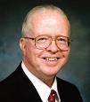
Zane Hodges
Zane C. Hodges, “A Dispensational Understanding of Acts 2,” in Issues in Dispensationalism, ed. John R. Master Wesley R. Willis, Charles C. Ryrie (Chicago: Moody, 1994), 177.
“Yet even apart from this consideration, Bock misses the point of the quotation from Psalm 110 in Acts 2. As verse 33 makes clear, the real link is with the outpouring of the Holy Spirit. It is a well-confirmed New Testament teaching that the gift of the Holy Spirit is the direct consequence of our Lord’s ascension to the Father. According to John’s Gospel, the Lord informed the disciples, ‘it is to your advantage that I go away; for if I do not go away, the helper will not come to you; but if I depart, I will send him to you’ (16:7). Earlier He had also said, “and I will pray to the Father, and He will give you another helper, that He may abide with you forever” (14:16). Our Lord’s return to the Father and His intercession there are necessary to the outpouring of the Holy Spirit....

Slide 84
Zane Hodges
Zane C. Hodges, “A Dispensational Understanding of Acts 2,” in Issues in Dispensationalism, ed. John R. Master Wesley R. Willis, Charles C. Ryrie (Chicago: Moody, 1994), 177.
...Thus, in Luke-Acts the gift of the Spirit is termed ‘the promise of the Father’ for which the disciples must wait until after Jesus’ ascension to Heaven (Luke 24:49; Acts 1:4). Bock labels Psalm 110 a ‘resurrection proof text.’ However, it is not an explicit statement of the resurrection since the resurrection is not mentioned in the Psalm. It does prophesy enthronement at God’s right hand. The point of Peter quoting Psalm 110 is simply this: the seated Christ is the source of the Spirit’s outpouring. By His intercession He has secured what God the Father promised. This is precisely what Acts 2:33 states: ‘therefore being exalted to the right hand of God, and having received from the Father the promise of the Holy Spirit, He poured out this which you see and hear.’”

Slide 85
Acts 2:13, 15
¹³ “But others were mocking and saying, ‘They are full of sweet wine.’… ¹⁵ ‘For these men are not drunk, as you suppose, for it is only the third hour of the day.’”

Slide 86
Acts 2:15-35
Refutation of the Charge of Drunkenness
      Too early (15)
      Use of Joel 2:28-32 (16-21)
      Christ’s miracles (22)
      Crucifixion (23)
      Resurrection (24)
      Use of Psalm 16:8-11 (25-29)
      Use of Psalm 132:11 (30-32)
      High priestly ministry (33)
      Use of Psalm 110:1 (34-35)

Slide 87
Acts 2:34-35
“For it was not David who ascended into heaven, but he himself says: ‘The Lord said to my Lord, “Sit at My right hand, Until I make Your enemies a footstool for Your feet.’”

Slide 88
Acts 2:34-35
“For it was not David who ascended into heaven, but he himself says: ‘The Lord said to my Lord, “Sit at My right hand, Until I make Your enemies a footstool for Your feet.’”

Slide 89
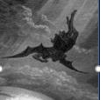
Satan’s Progressive Defeat
Initial eviction from heaven (Isa 14:12-15; Ezek 28:12-17)
Eden (Gen 3:15)
Pre-diluvian world (1 Pet 3:19-20)
Cross (John 12:31; 16:11; Col 2:15; Heb 2:14; 1 John 3:8)
Mid point of the Tribulation (Rev 12:9)
Beginning of millennium (Rev 20:2-3)
End of millennium (Rev 20:10)

Slide 90

Names & Titles Demonstrating
Satan’s Post-Fall, Earthly Authority
(Job 1:7; 2:2; Luke 4:5-8; Rom. 8:19-22)
Prince of this world (John 12:31; 14:30; 16:11)
God of this age (2 Cor. 4:4)
Prince and power of the air (Eph. 2:2)
Who the believer wrestles with (Eph. 6:12)
Roaring lion (1 Pet. 5:8)
Whole world lies in his power (1 John 5:19)

Slide 91
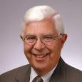
Elliot Johnson
Elliott Johnson, “Hermeneutical Principles and the Interpretation of Psalm 110,” Bibliotheca Sacra 149 (October–December 1992): 433–34.
Peter’s use of Psalm 110:1 in Acts 2:34–35 is often used to justify Christ’s present Davidic enthronement. Yet of Psalm 110, Elliott Johnson observes that the Messiah’s present position as depicted in this Psalm fails to include imagery of coronation. Only Christ’s priestly activity is mentioned. Such coronation imagery would certainly have been mentioned if in fact the Psalm were intended to describe Christ’s enthronement as Davidic King.

Slide 92

1 Kings 2:11-12
“The days that David reigned over Israel were forty years: seven years he reigned in Hebron and thirty-three years he reigned in Jerusalem. And Solomon sat on the throne of David his father, and his kingdom was firmly established.”

Slide 93
Changes | Biblical Davidic Throne | Davidic Throne Now?
Place: | Earth | Heaven
People: | Israel | Gentile Church
Israel: | Converted | Unconverted
Realm | Physical | Spiritual

Slide 94


George Eldon Ladd
A Theology of the New Testament (Grand Rapids: Eerdmans, 1974), 336–37.
“[T]he new redemptive events in the course of Heilsgeschichte have compelled Peter to reinterpret the Old Testament. Because of the resurrection and ascension of Jesus, Peter transfers the messianic Davidic throne from Jerusalem to God’s right hand in heaven. Jesus has now been enthroned as the Davidic Messiah on the throne of David, and is awaiting the final consummation of his messianic reign.. .. This involves a rather radical reinterpretation of Old Testament prophecies, but no more so than the entire reinterpretation of God’s redemptive plan by the early church. In fact, it is an essential part of this reinterpretation demanded by the events of redemptive history.. ..Jesus is enthroned as the Messiah.... He must reign until all his enemies are made a stool for his feet.”

Slide 95

“Complementary Hermeneutics” in Progressive Dispensationalism
“…the New Testament does introduce change and advance; it does not merely repeat Old Testament revelation. In making complementary additions, however, it does not jettison Old Testament promises. The enhancement is not at the expense of the original promise.”
Craig Blaising and Darrell Bock, “Dispensationalism, Israel and the Church: Assessment and Dialogue,” in Dispensationalism, Israel and the Church, ed. Craig Blaising and Darrell Bock (Grand Rapids: Zondervan, 1992), 392–93.
Notes:
WRONG!!!

Slide 96
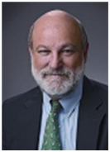
Darrell Bock
“Evidence from Acts,” in The Coming Millennial Kingdom, ed. Donald Campbell and Jeffrey Townsend (Chicago: Moody, 1992), 194.
“The Davidic throne and the heavenly throne of Jesus at the right hand of the Father are one and the same.”

Slide 97
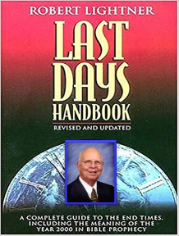
Is Jesus Now Reigning on David’s Throne?
“‘Complementary hermeneutics’ must not be confused with the historic orthodox doctrine of progressive revelation. The latter truth means that God revealed His truth gradually, sometimes over a long period of time. What was revealed later never changed the original revelation, however. The meaning and the recipients of the original promise always remain the same.”
Robert Lightner, Last Days Handbook (Nashville: Thomas Nelson, 1997), 210.

Slide 98


Is Jesus Now Reigning on David’s Throne?
“So, they have not only changed the people to include the Church, but they have also changed the place where the covenant is to be fulfilled. Now it’s not only on earth, but it’s also in heaven. . . . The people have changed and the place has changed.”
Robert Lightner, “Progressive Dispensationalism,” Conservative Theological Journal 4, no. 11 (March 2000): 53–54.

Slide 99
Acts 2:30
“And so, because he was a prophet and knew that God had sworn to him with an oath to seat one of his descendants on his throne.”

Slide 100
Acts 2:34-35
“For it was not David who ascended into heaven, but he himself says: ‘The Lord said to my Lord, “Sit at My right hand, Until I make Your enemies a footstool for Your feet.’”

Slide 101
Darrell Bock
Darrell Bock, “The Reign of the Lord Christ,” in Dispensationalism, Israel and the Church, ed. Craig A. Blaising and Darrell L. Bock (Grand Rapids: Zondervan, 1992), 49–50.
“Having mentioned the need to call on the Lord, Peter turns to recent events. He recounts Jesus’ ministry in death but notes the death is not able to hold him (vv. 22–24). Peter goes on to note that such impotency for death was predicted in Psalm 16, the second Old Testament citation in Acts 2 (vv. 25–28). The text is clearly presented as having been fulfilled in Jesus’ resurrection. The psalm 16 citation leads to the mention of David and a defense of the fact that a resurrection understanding of the text cannot refer to David, since he is buried (v. 29)…. “The crucial linking allusion appears at this point. Peter notes that David was a prophet. Not only was David a prophet, he was the conscience beneficiary of an oath God had made to him that “one of the fruit of his [David’s] loins” (KJV)…

Slide 102
Darrell Bock
Darrell Bock, “The Reign of the Lord Christ,” in Dispensationalism, Israel and the Church, ed. Craig A. Blaising and Darrell L. Bock (Grand Rapids: Zondervan, 1992), 49–50.
…would sit on his throne (Acts 2:30). The term kathisai (to sit), which is reintroduced in the citation of Psalm 110 (note kathou, “sit,” in v. 34). The allusion in verse 30 is to Psalm 132:11, a Psalm which is strongly Israelitish and national in tone (see vv. 12–18). The Psalm in turn is a reflection of the promise made to David in 2 Samuel 7, especially verse 12. This 2 Samuel passage is better known as the Davidic covenant. What is crucial is that David’s awareness of this covenant promise is immediately linked to his understanding of the resurrection in Psalm 16, which in turn is immediately tied to the resurrection proof text of Psalm 110 (vv. 31–35)… “Being seated on David’s throne is linked to being seated at God’s right hand. In other words, Jesus’ resurrection-ascension to God’s right hand …

Slide 103
Darrell Bock
Darrell Bock, “The Reign of the Lord Christ,” in Dispensationalism, Israel and the Church, ed. Craig A. Blaising and Darrell L. Bock (Grand Rapids: Zondervan, 1992), 49–50.
…hand is put forward by Peter as a fulfillment of the Davidic covenant, just as the allusion to Joel fulfills the new covenant. To say that Peter is only interested to argue that the Messiah must be raised misses the point of the connection in these verses and ignores entirely the allusion to Psalm 132 in the Davidic covenant. This passage and Luke 1:68–79 also counter the claim that no New Testament text asserts the present work of Jesus’ as a reigning Davidite sitting on David’s Throne. The throne on which Jesus is said to sit is the one promised to David’s descendent through the Davidic promise of 2 Samuel, which was initially passed on through Solomon. Jesus sits here as David’s promised Son on David’s promised Throne. This fits Old Testament imagery as well. The idea of sitting describes the idea of rule, as the parallelism of Jeremiah 22:30 shows. As the Davidic heir, Jesus sits in and rules from heaven.”

Slide 104
Zane Hodges
Zane C. Hodges, “A Dispensational Understanding of Acts 2,” in Issues in Dispensationalism, ed. John R. Master Wesley R. Willis, Charles C. Ryrie (Chicago: Moody, 1994), 178.
“This precise point—the ascension—is in view in Acts 2:34: ‘For David did not send into heavens, but he says himself . . .’ It is simply incorrect to treat Psalm 16 as linked with Psalm 110 by asserting that both are resurrection proof texts. Psalm 16 is, but Psalm 110 is not. Rather, Peter quoted each Psalm with its own quite distinct emphasis in support of two different elements in his presentation.”

Slide 105
Zane Hodges
Zane C. Hodges, “A Dispensational Understanding of Acts 2,” in Issues in Dispensationalism, ed. John R. Master Wesley R. Willis, Charles C. Ryrie (Chicago: Moody, 1994), 175–76.
“But unless Bock is reading the Greek text in the form found in the Majority Text (not likely, to be sure), there appears to be a translational gaffe here that slightly overstates the similarity between verses 30 and 34. As you read the modern editions of the Greek New Testament, the verb kathisai in verse 30 is not to be read as intransitive (‘to sit’) but as transitive (‘to seat’; cf. the NIV here). In verse 34, however, the intransitive sense ‘to sit’ is correct, even though a slightly different Greek verb is involved. But, in view of the difference in verbs, Bock is not technically accurate when he states that the former verb is ‘reintroduced’ in the quotation from Psalm 110. Clearly this would be quibbling were it not for the fact that Bock is trying to make these verses parallel by appealing to the use of a single verb in the same sense in both verses.”

Slide 106
Is Jesus Now Reigning from David’s Throne?
(Acts 2)
Verse: | Acts 2:30 | Acts 2:34
Psalm | 132:11 | 110:1
Verb: | kathízō | káthēmai
Kind of verb: | Transitive | Intransitive
Translation | To seat or place | To sit

Slide 107
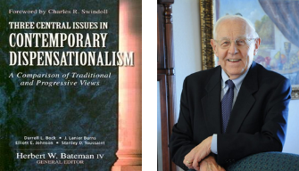
Stanley D. Toussaint
“Israel and the Church of a Traditional Dispensationalist,” in Three Central Issues in Contemporary Dispensationalism, ed. Herbert W. Bateman (Grand Rapids: Kregel, 1999), 242.
“[T]he word Kingdom does not occur in Acts 2. . . . It is difficult to explain why Luke does not use the term if the kingdom is being inaugurated. He employs it forty-five times in the gospel and uses it two more times in Acts 1. . . . [O]ne would expect Luke to use the word if such a startling thing as the inauguration of the kingdom had taken place. The fact that Luke uses kingdom only eight times in Acts after such heavy usage in his gospel implies that the kingdom had not begun but was in fact, postponed.”

Slide 108

Was the kingdom re-offered in Acts? No!
The king was absent (Acts 1:9-11)
Irreversible language found in the Gospels (Matt. 12:31-32; 21:42; 22:7)
A new age in the kingdom’s absence has already been disclosed (Luke 19:11-27; Matt. 13; 24‒25)
“Kingdom” is mentioned 45x in Luke’s Gospel but only 8x in Acts
Expression “repent for the kingdom of heaven is at hand” is absent from Acts

Slide 109
Was the kingdom re-offered in Acts? No!
Co-mingling of kingdom truth with Church Age truth
The timing of the kingdom has already been fixed by the Father’s authority (Acts 1:6-7)
Peter was merely preaching the personal Gospel in Acts 2
Acts 3:19-21 is laying out the condition by which the kingdom will ultimately come to the earth (Acts 3:19-21)
The miracles in Acts authenticate the new age of the Church (Heb. 2:2-3) and not the ongoing offer of the kingdom

Slide 110
Peter’s Sermon
Acts 2:14-36
  Introduction (14)
  Refutation of Drunkenness Charge (15-35)
  Conclusion (36)

Slide 111
Acts 2
Chapter Summary
  Coming of the Holy Spirit (1-4)
  Holy Spirit’s Impact (5-13)
  Peter’s Sermon (14-36)
  Sermon’s Impact (37-47)

Slide 112
Coming of the Holy Spirit
Acts 2:37-47
  Salvation (37-41)
  Church (42-47)

Slide 113
Coming of the Holy Spirit
Acts 2:37-47
  Salvation (37-41)
  Church (42-47)

Slide 114
Acts 2:37-41
Salvation
      Conviction (37)
      Repentance & Baptism (38-39)
      Consequence of Repentance (40)
      Result (41)

Slide 115
Acts 2:37-41
Salvation
      Conviction (37)
      Repentance & Baptism (38-39)
      Consequence of Repentance (40)
      Result (41)

Slide 116
John 16:7–11
⁷ “But I tell you the truth, it is to your advantage that I go away; for if I do not go away, the Helper will not come to you; but if I go, I will send Him to you. ⁸ “And He, when He comes, will convict the world concerning sin and righteousness and judgment; ⁹ concerning sin, because they do not believe in Me; ¹⁰ and concerning righteousness, because I go to the Father and you no longer see Me; ¹¹ and concerning judgment, because the ruler of this world has been judged.

Slide 117
Acts 2:37-41
Salvation
      Conviction (37)
      Repentance & Baptism (38-39)
      Consequence of Repentance (40)
      Result (41)

Slide 118

Acts 2:38
“Peter said to them, “Repent [metanoeō], and each of you be baptized in the name of Jesus Christ for (eis) the forgiveness of your sins; and you will receive the gift of the Holy Spirit.”

Slide 119


2 Peter 3:9
Douay-Rheims 1899 American Edition (DRA)
“The Lord delayeth not his promise, as some imagine, but dealeth patiently for your sake, not willing that any should perish, but that all should return to penance.”

Slide 120
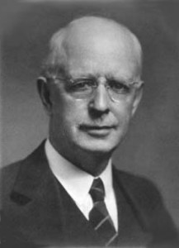
Lewis Sperry Chafer vol. 7, Systematic Theology (Grand Rapids, MI: Kregel Publications, 1993), 265-66.
“This vital newness of mind is a part of believing, after all, and therefore it may be and is used as a synonym for believing at times (cf. Acts 17:30; 20:21; 26:20; Rom. 2:4; 2Tim. 2:25; 2 Pet. 3:9). Repentance nevertheless cannot be added to believing as a condition of salvation, because upwards of 150 passages of Scripture condition salvation upon believing only (cf. John 3:16; Acts 16:31).”

Slide 121

Acts 17:30-31
“³⁰ Therefore having overlooked the times of ignorance, God is now declaring to men that all people everywhere should repent [metanoeō], ³¹ because He has fixed a day in which He will judge the world in righteousness through a Man whom He has appointed, having furnished proof to all men by raising Him from the dead.”

Slide 122
2 Peter 3:9
“The Lord is not slow about His promise, as some count slowness, but is patient toward you, not wishing for any to perish but for all to come to repentance.”

Slide 123

Matthew 12:24
“But when the Pharisees heard this, they said, ‘This man casts out demons only by Beelzebul the ruler of the demons.’”

Slide 124
Matthew Outline
Pedigree of the king (1–2)
  Preparation of the king (3–4)
    Pedagogy of the king (5–7)
      Power of the king (8–9)
        Program of the king (10)
          Progressive rejection of the king (11–12)
        Preparation of the king’s disciples (13–20)
      Presentation & rejection of the king (21–23)
    Prophecies of the king (24–25)
  Passion of the king (26–27)
Proof of the king (28)

Slide 125
Transition from Public to Private Ministry
 | PUBLIC | PRIVATE
Scripture | Matt. 1–12 | Matt. 13–28
Focus | Nation | Remnant
Miracles | Proof to nation | Training for remnant
Kingdom Offer | Prominent | Disappears
Teaching | Discourse | Parabolic
Interim program | Not mentioned | Prominent
Crucifixion; Resurrection | Not mentioned (4:17) | Prominent (16:21)

Slide 126

Acts 2:38
“Peter said to them, ‘Repent, and each of you be baptized in the name of Jesus Christ for (eis) the forgiveness of your sins; and you will receive the gift of the Holy Spirit.’”

Slide 127
Acts 2:38
“Peter said to them, “Repent, and each of you be baptized in the name of Jesus Christ for (eis) the forgiveness of your sins; and you will receive the gift of the Holy Spirit.”

Slide 128
Matthew 12:41
“The men of Nineveh will stand up with this generation at the judgment and will condemn it because they repented at [in the face of/because of] (eis) the preaching of Jonah; and behold, something greater than Jonah is here.”

Slide 129
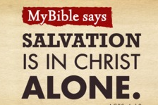
Acts 4:12
“And there is salvation in no one else; for there is no other name under heaven that has been given among men by which we must [dei] be saved.”

Slide 130
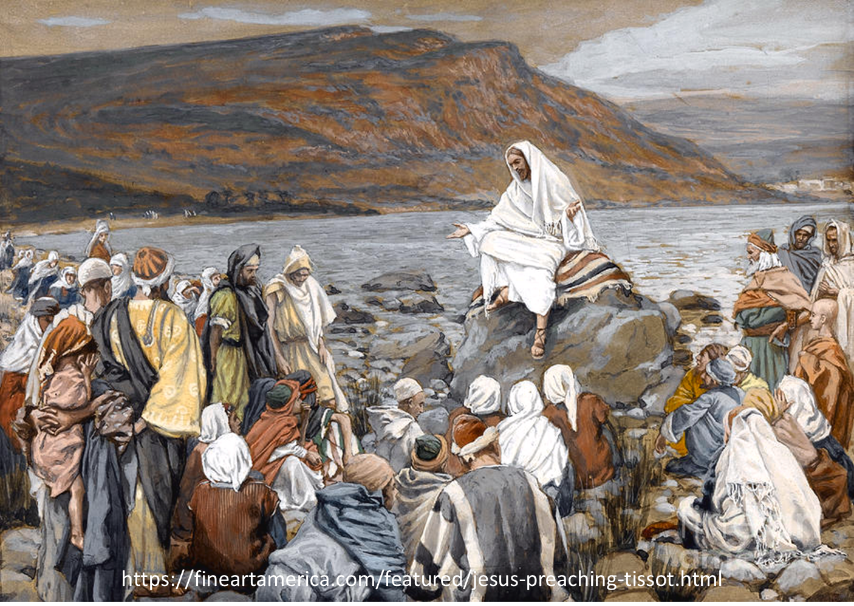
Luke 4:43
“But He said to them, “I must [dei] preach the kingdom of God to the other cities also, for I was sent for this purpose.”

Slide 131
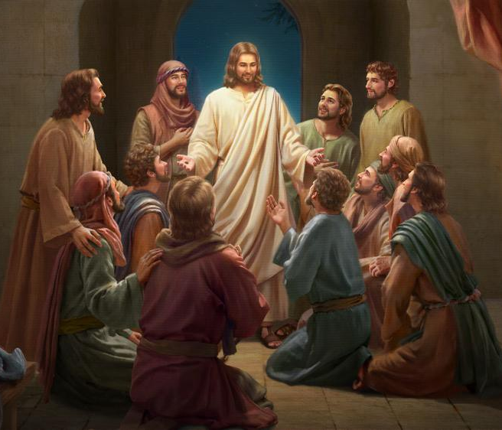
Luke 24:44
“Now He said to them, “These are My words which I spoke to you while I was still with you, that all things which are written about Me in the Law of Moses and the Prophets and the Psalms must [dei] be fulfilled.”

Slide 132

“…one of the mistakes that human beings make is believing that there is only one way…We don’t accept that there are diverse ways of being in the world; that there are millions of ways to be a human being. And many ways…many paths to what you call God. That her path might be something else and when she gets there she might call it the light. But her loving, and her kindness, and her generosity brings her to the…same point that it brings you…
www.youtube.com/watch?v=Lb2RUpMDk34

Slide 133
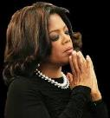
…It doesn’t matter whether she called it ‘God’ along the way or not…There couldn’t possibly be just one way!…There couldn’t possibly be only one way with millions of people in the world!...You think…if you are somewhere on the planet and you never hear the name of Jesus but yet you live with a loving heart. You lived as Jesus would have had you to live. You lived for the same purpose as Jesus came to the planet to teach us all, but you are in some remote part of the earth and you never heard the name of Jesus. You cannot get to Heaven…?”
www.youtube.com/watch?v=Lb2RUpMDk34

Slide 134
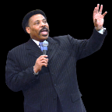
Tony Evans
Totally Saved: Understanding, Experiencing and Enjoying the
Greatness of Your Salvation (Chicago: Moody, 2002), 355, 359.
“In a class I once taught at Dallas Seminary, I inadvertently asked an exam question on material I had not covered in class. One of the students brought this discrepancy to my attention. To be fair, I had to rescore all of the test papers because I could not hold the students liable for information they had never been given…So the premise is that God will not hold people accountable for a decision they cannot make, based on information they have not received…And people in faraway lands who have never heard the gospel still have their own sins to answer for. This means we need to talk about the provision God has made for those who cannot believe….Here's the spiritual principle at work: When people respond to what they do know of God, He takes personal responsibility for giving them more information about Himself.... In the case of a person…

Slide 135
Tony Evans
Totally Saved: Understanding, Experiencing and Enjoying the
Greatness of Your Salvation (Chicago: Moody, 2002), 355, 359.
…who never hears the gospel and never knows the name of Jesus, but who responds to the light he has, God, treats that person like an Old Testament saint, if you will. That is, if the person trusts in what God has revealed, God deals with that person based on the knowledge he has, not the information he never received. I call this trans-dispensationalism...By this I mean if a person is sincerely seeking God and desiring to know Him, and is responding to the truth he knows, if there is no missionary or direct manifestation of God, then God judges that person based on his faith in the light he has received. And as in the case of Abraham, God will retroactively count this person as righteous by applying the death of Christ from the dispensation of grace.”

Slide 136
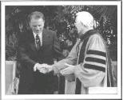
Hl9Aps://www.youtube.com/watch?v=hrf60-zHl9A
Dr. Schuller: "Tell me, what is the future of Christianity?"
Dr. Graham: "Well, Christianity and being a true believer, you know, I think there's the body of Christ which comes from all the Christian groups around the world, or outside the Christian groups. I think that everybody that loves Christ or knows Christ, whether they're conscious of it or not, they're members of the body of Christ. And I don't think that we're going to see a great sweeping revival that will turn the whole world to Christ at any time…and that’s what God is doing today. He is calling people out of the world for His name. Whether they come from the Muslim world, or the Buddhist world, or the Christian world, or the non-believing world, they are members of the body of Christ because they've been called . . .

Slide 137
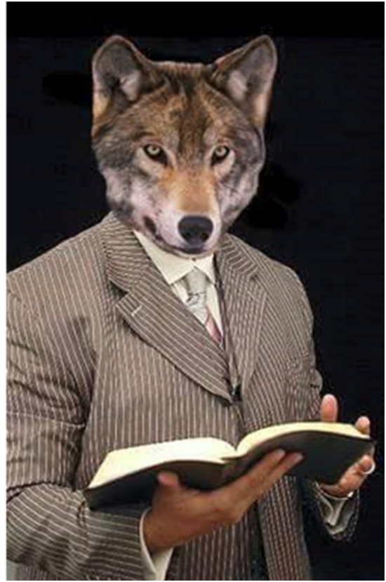
Hl9Aps://www.youtube.com/watch?v=hrf60-zHl9A
…by God. They may not even know the name of Jesus, but they know in their hearts they need something that they don't have and they turn to the only light that they have and I think they're saved and they're going to be with us in heaven.”
Dr. Schuller: "This is fantastic. I'm so thrilled to hear you say that. There's a wideness in God's mercy.”
Dr. Graham: “There is."

Slide 139
Acts 2:37-41
Salvation
      Conviction (37)
      Repentance & Baptism (38-39)
      Consequence of Repentance (40)
      Result (41)

Slide 140


Slide 141
Six Parts of a Suzerain-Vassal Treaty in Deuteronomy
Preamble (1:1-5)
Prologue (1:6–4:40)
Covenant obligations (5–26)
Storage and reading instructions (27:2-3; 31:9, 24, 26)
Witnesses (32:1)
Blessings and curses (28)

Slide 142
Six Parts of a Suzerain-Vassal Treaty in Deuteronomy
Preamble (1:1-5)
Prologue (1:6–4:40)
Covenant obligations (5–26)
Storage and reading instructions (27:2-3; 31:9, 24, 26)
Witnesses (32:1)
Blessings and curses (28)

Slide 143
Deuteronomy 28:49-50
⁴⁹ “The Lord will bring a nation against you from afar, from the end of the earth, as the eagle swoops down, a nation whose language you shall not understand, ⁵⁰ a nation of fierce countenance who will have no respect for the old, nor show favor to the young.”

Slide 144
ISRAEL'S JUDGMENTS
Division of the kingdom in 931 B.C. (1 Kgs. 12)
Assyrian judgment in 722 B.C. (2 Kgs. 17)
Babylonian captivity in 586 B.C. (2 Kgs. 25)
Rome Diaspora in A.D. 70 (Luke 19:41-44)

Slide 145
ISRAEL'S JUDGMENTS
Division of the kingdom in 931 B.C. (1 Kgs. 12)
Assyrian judgment in 722 B.C. (2 Kgs. 17)
Babylonian captivity in 586 B.C. (2 Kgs. 25)
Rome Diaspora in A.D. 70 (Luke 19:41-44)

Slide 146
Eusebius (A.D. 260-340)
Ecclesiastical History, 3.5.3
"But the people of the church in Jerusalem had been commanded by a revelation, vouchsafed to approved men there before the war, to leave the city and to dwell in a certain town of Perea called Pella. And when those that believed in Christ had come thither from Jerusalem, then, as if the royal city of the Jews and the whole land of Judea were entirely destitute of holy men, the judgment of God at length overtook those who had committed such outrages against Christ and his apostles, and totally destroyed that generation of impious men."
Epiphanius (De pond. et mens. 15) also records this flight of the Christians to Pella.)

Slide 147
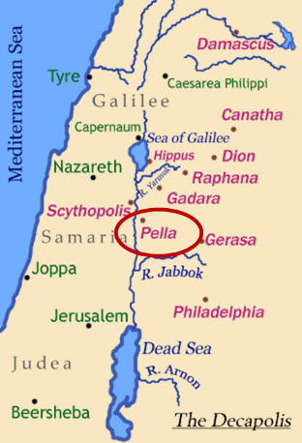
Pella
Pella was a town situated beyond the Jordan, in the north of Perea, within the dominions of Herod Agrippa II. The surrounding population was chiefly Gentile. See Pliny V. 18, and Josephus, B. J. III. 3. 3, and I. 4. 8.

Slide 148

Ezekiel 36:24-28
²⁴ “For I will take you from the nations, gather you from all the lands and bring you into your own land. ²⁵ Then I will sprinkle clean water on you, and you will be clean; I will cleanse you from all your filthiness and from all your idols. ²⁶ Moreover, I will give you a new heart and put a new spirit within you; and I will remove the heart of stone from your flesh and give you a heart of flesh. ²⁷ I will put My Spirit within you and cause you to walk in My statutes, and you will be careful to observe My ordinances. ²⁸ You will live in the land that I gave to your forefathers; so you will be My people, and I will be your God.”

Slide 149

Charles L. Feinberg
The Prophecy of Ezekiel: The Glory of the Lord, Paperback ed. (Chicago: Moody, 1969; reprint, Chicago: Moody, 1984), 231-32.
“Verses 25–29 teach that the complete return of Israel will occur after the defeat of Gog and his Confederates. Ezekiel summarized his prophecies of hope and restoration. When he stated that God will have mercy upon the whole house of Israel, he had in mind that all previous restorations were partial. Now a universal and final restoration will take place. It was God who allowed them to go into captivity; it is he who will see to it that they are regathered; indeed, it is he who will insure that not one is left out of the land...In conclusion, to summarize all the benefits promised, Ezekiel spoke of the outpouring of the Spirit upon the house of Israel (italics added).”

Slide 150
Acts 2:37-41
Salvation
      Conviction (37)
      Repentance & Baptism (38-39)
      Consequence of Repentance (40)
      Result (41)

Slide 151
Acts 2:41
“So then, those who had received his word were baptized; and that day there were added about three thousand souls.”

Slide 152

John 1:12
“But as many as received Him, to them He gave the right to become children of God, even to those who believe in His name.”

Slide 154

Message
  Birth and growth of the church numerically, geographically, ethnically.
  Components
  Numerically (progress reports)
  Geographically (From Jerusalem to Rome)
  Ethnically (From Judaism to Gentile domination)

Slide 155
Coming of the Holy Spirit
Acts 2:37-47
  Salvation (37-41)
  Church (42-47)

Slide 156
Acts 2:42-47
Church
      Priorities (42)
      Miracles (43)
      Unity (44)
      Communal living (45)
      Lord’s Table (46)
      Evangelism (47)

Slide 157
Acts 2:42-47
Church
      Priorities (42)
      Miracles (43)
      Unity (44)
      Communal living (45)
      Lord’s Table (46)
      Evangelism (47)

Slide 158
Activities of the Local Church
(Acts 2:41-47)
Doctrine (Acts 2:42)
Ordinances (Acts 2:41-42, 46)
Prayer (Acts 2:42)
Evangelism (Acts 2:47)
Worship (Acts 2:47)
Benevolence (Acts 2:44-45)
Fellowship (Acts 2:42, 46-47)

Slide 159
Acts 2:42-47
Church
      Priorities (42)
      Miracles (43)
      Unity (44)
      Communal living (45)
      Lord’s Table (46)
      Evangelism (47)

Slide 160
Dr. Arnold G. Fruchtenbaum
The Book of Acts, 83
“The apostles did many signs and wonders. In fact, the only ones who performed miracles in the book of Acts were the apostles or their delegates, such as Stephen (Acts 6:8). These apostolic legates were appointed by the laying on of hands by the apostles. Signs and wonders were not performed by the believers at large.”

Slide 161

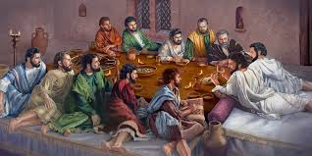
Ephesians 2:20
“having been built on the foundation of the apostles and prophets, Christ Jesus Himself being the corner stone.”

Slide 162
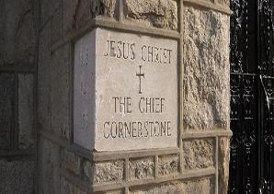
2 Timothy 4:20
“Erastus remained at Corinth, but Trophimus I left sick at Miletus.”

Slide 163
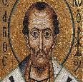
Chrysostom (A.D. 345‒407)
Patriarch of Constantinople, Chrysostom, Homily 29 on First Corinthians.
“This whole place is very obscure: but the obscurity is produced by our ignorance of the facts referred to and by their cessation, being such as then used to occur but now no longer take place. And why do they not happen now? Why look now, the cause too of the obscurity has produced us again another question: namely, why did they then happen, and now do so no more?”

Slide 164
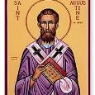
Augustine (A.D. 354‒430)
Bishop of Hippo, Homily 6:10 on the First Epistle of John.
“In the earliest times, the Holy Ghost fell upon them that believed: and they spoke with tongues, which they had not learned, as the Spirit gave them utterance. Acts 2:4 These were signs adapted to the time. For there behooved to be that betokening of the Holy Spirit in all tongues, to show that the Gospel of God was to run through all tongues over the whole earth. That thing was done for a betokening, and it passed away. . . . If then the witness of the presence of the Holy Ghost be not now given through these miracles, by what is it given, by what does one get to know that he has received the Holy Ghost?”

Slide 165

Philip Schaff
History of the Christian Church, vol. 1 , p. 236-37.
“We do not know how long the glossolalia, as thus described by Paul, continued. It passed away gradually with the other extraordinary or strictly supernatural gifts of the apostolic age. It is not mentioned in the Pastoral, nor in the Catholic Epistles. We have but a few allusions to it at the close of the second century. Irenæus (Adv. Haer. 1. v. c. 6 § 1,) speaks of ‘many brethren’ whom he heard in the church having the gift of prophecy and of speaking in ‘diverse tongues’ (παντοδαπαῖς γλώσσαις), bringing the hidden things of men (τὰ κρύφια τῶν ἀνθρώπων) to light and expounding the mysteries of God (τὰ μυστήρια τοῦ θεοῦ). It is not clear whether by the term ‘diverse,’ which does not elsewhere occur, he means a speaking in foreign languages, or in diversities of tongues altogether peculiar, like those meant by Paul.”

Slide 166
Philip Schaff
History of the Christian Church, vol. 1 , p. 236-37.
“The latter is more probable. Irenæus himself had to learn the language of Gaul. Tertullian (Adv. Marc. V. 8; comp. De Anima, c. 9) obscurely speaks of the spiritual gifts, including the gift of tongues, as being still manifest among the Montanists to whom he belonged. At the time of Chrysostom it had entirely disappeared; at least he accounts for the obscurity of the gift from our ignorance of the fact. From that time on the glossolalia was usually misunderstood as a miraculous and permanent gift of foreign languages for missionary purposes. But the whole history of missions furnishes no clear example of such a gift for such a purpose.”

Slide 167
Acts 2:42-47
Church
      Priorities (42)
      Miracles (43)
      Unity (44)
      Communal living (45)
      Lord’s Table (46)
      Evangelism (47)

Slide 168

John 17:20-23
²⁰ “I do not ask on behalf of these alone, but for those also who believe in Me through their word; ²¹ that they may all be one; even as You, Father, are in Me and I in You, that they also may be in Us, so that the world may believe that You sent Me. ²² The glory which You have given Me I have given to them, that they may be one, just as We are one; ²³ I in them and You in Me, that they may be perfected in unity, so that the world may know that You sent Me, and loved them, even as You have loved Me.”

Slide 169
1 Corinthians 12:13
“For by one Spirit we were all baptized into one body, whether Jews or Greeks, whether slaves or free, and we were all made to drink of one Spirit.”

Slide 170
Lewis Sperry Chafer vol. 5, Systematic Theology (Grand Rapids, MI: Kregel Publications, 1993), 158.
“Thoughtless and absurd is the modern notion that Christ was praying that denominations which exist in this remote time and in a country then unknown might become organically united in one, and therefore it is the duty of all sects to unite and thus help to answer this prayer. As indicated before, this unity is sought at the hand of the Father, indicating that it is a divine undertaking. It is that, and it results in a unity as organic and vital as that between the Father and the Son. This prayer began to be answered on the Day of Pentecost when believers were by the Spirit baptized into one Body, and is constantly answered whenever a soul is saved and thus joined as a member to the Body of Christ by the same baptism of the Spirit.”

Slide 171
Acts 2:42-47
Church
      Priorities (42)
      Miracles (43)
      Unity (44)
      Communal living (45)
      Lord’s Table (46)
      Evangelism (47)

Slide 172
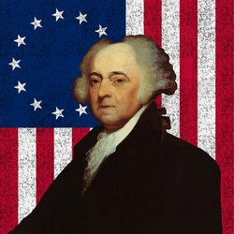
John Adams
“The moment the idea is admitted into society, that property is not as sacred as the laws of God, and that there is not a force of law and public justice to protect it, anarchy and tyranny commence. If ‘Thou Shalt Not Covet,’ and ‘Thou Shalt Not Steal’ were not commandments of Heaven, they must be made inviolable precepts in every society before it can be civilized or made free.”
John Adams, A Defence of the Constitutions of Government of the United States of America, 3 vols., American Constitutional and Legal History, ed. Leonard W. Levy (London: Dilly, 1787; reprint, NY: Da Capo, 1971), 3:217

Slide 173


Slide 174
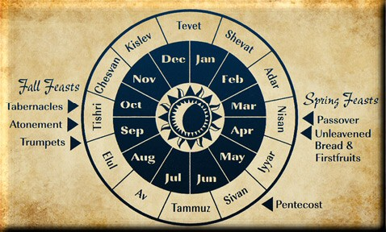

Slide 175
Acts 2:42-47
Church
      Priorities (42)
      Miracles (43)
      Unity (44)
      Communal living (45)
      Lord’s Table (46)
      Evangelism (47)

Slide 176
Acts 2:42-47
Church
      Priorities (42)
      Miracles (43)
      Unity (44)
      Communal living (45)
      Lord’s Table (46)
      Evangelism (47)

Slide 177


Matthew 16:18
“I also say to you that you are Peter, and upon this rock I will build [oikodomeō] My church; and the gates of Hades WILL NOT overpower it.”
177

Slide 178
Conclusion

Slide 179
Acts 2
Chapter Summary
  Coming of the Holy Spirit (1-4)
  Holy Spirit’s Impact (5-13)
  Peter’s Sermon (14-36)
  Sermon’s Impact (37-47)

