Slide 1
Dr. Andy Woods
Senior Pastor – Sugar Land Bible Church
President – Chafer Theological Seminary

Slide 2
Structure
Personal (1–3)
Genuine conversion (1)
Impure motives (2:1-16)
Lack of concern (2:17–3:13)
Practical (4–5)
Immorality (4:1-8)
Laziness (4:9-12)
Eschatology (4:13–5:11)
Ministry imbalances (5:12-15)
Progressive sanctification (5:16-28)

Slide 3
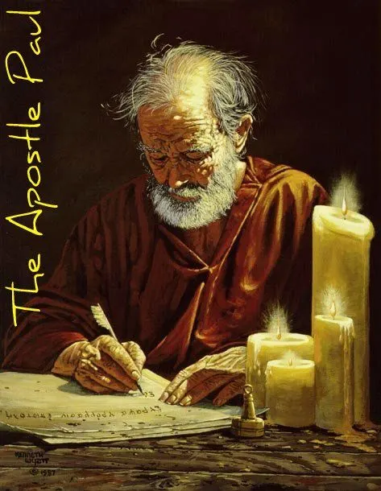
Structure
1 THESSALONIANS 1-3 | 1 THESSALONIANS 4-5
Personal Experience | Practical Exhortation
Looking Back | Looking Forward

Slide 4
Structure
Personal (1–3)
Genuine conversion (1)
Impure motives (2:1-16)
Lack of concern (2:17–3:13)
Practical (4–5)
Immorality (4:1-8)
Laziness (4:9-12)
Eschatology (4:13–5:11)
Ministry imbalances (5:12-15)
Progressive sanctification (5:16-28)

Slide 5
Christian Living (4:1-12)
General conduct (4:1-2)
Negative command: sexual sin (4:3-8)
Positive command: brotherly love (4:9-12)

Slide 6
Christian Living (4:1-12)
General conduct (4:1-2)
Negative command: sexual sin (4:3-8)
Positive command: brotherly love (4:9-12)

Slide 7
Christian Living (4:1-12)
General conduct (4:1-2)
Negative command: sexual sin (4:3-8)
Positive command: brotherly love (4:9-12)

Slide 8
Three Tenses of Salvation
Phase | Justification | Sanctification | Glorification
Tense | Past | Present | Future
Saved from sin’s: | Penalty | Power | Presence
Scripture | Eph 2:8-9; Titus 3:5 | Philip 2:12 | Rom 5:10

Slide 9
Genesis 1:27
“God created man in His own image, in the image of God He created him; male and female He created them.”
Genesis 2:24
“For this reason a man shall leave his father and his mother, and be joined to his wife; and they shall become one flesh.”

Slide 10
Vessel?
Acquire a wife
Possess your own body

Slide 11
Vessel?
Acquire a wife
Possess your own body

Slide 12
Vessel?
Acquire a wife
Possess your own body

Slide 13
5 Reasons for Sexual Purity (4:5-8)
Sexual immorality characterizes pagans (4:5)
Sexual immorality invokes God’s judgment on both parties (4:6a)
Previous warnings against sexual immorality (4:6b)
Sexual immorality frustrates God’s holy call on the believer’s life (4:7)
The Holy Spirit empowers the believer toward purity (4:8)

Slide 14
5 Reasons for Sexual Purity (4:5-8)
Sexual immorality characterizes pagans (4:5)
Sexual immorality invokes God’s judgment on both parties (4:6a)
Previous warnings against sexual immorality (4:6b)
Sexual immorality frustrates God’s holy call on the believer’s life (4:7)
The Holy Spirit empowers the believer toward purity (4:8)

Slide 15
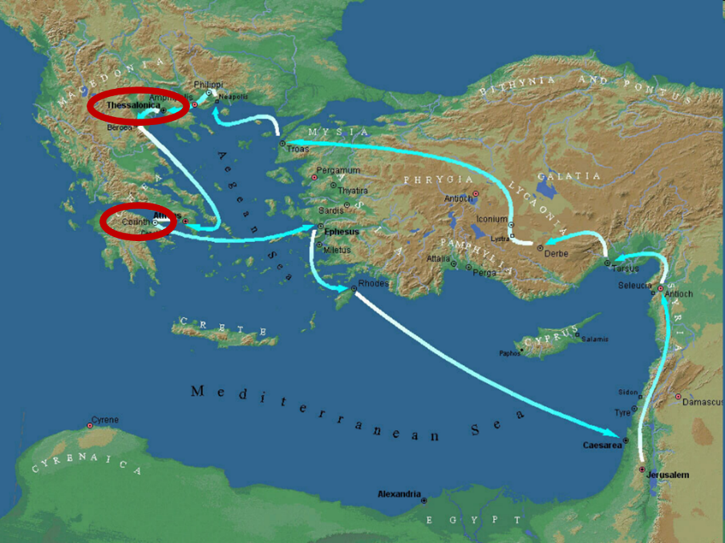

Slide 16
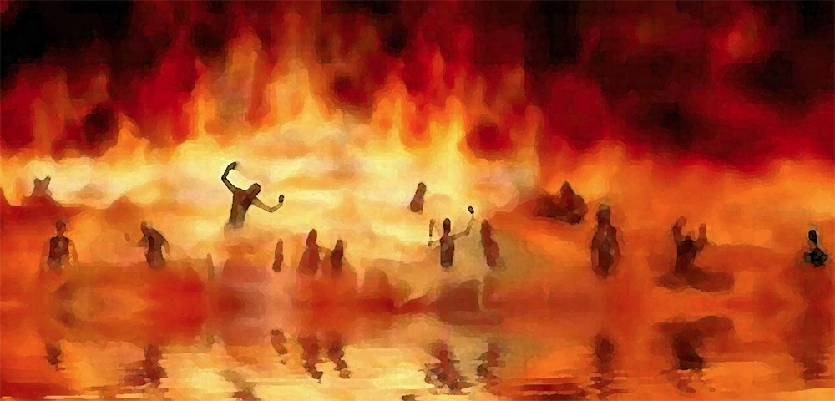
Revelation 21:8
“But for the cowardly and unbelieving and abominable and murderers and immoral persons and sorcerers and idolaters and all liars, their part will be in the lake that burns with fire and brimstone, which is the second death.”

Slide 17
5 Reasons for Sexual Purity (4:5-8)
Sexual immorality characterizes pagans (4:5)
Sexual immorality invokes God’s judgment on both parties (4:6a)
Previous warnings against sexual immorality (4:6b)
Sexual immorality frustrates God’s holy call on the believer’s life (4:7)
The Holy Spirit empowers the believer toward purity (4:8)

Slide 18
5 Reasons for Sexual Purity (4:5-8)
Sexual immorality characterizes pagans (4:5)
Sexual immorality invokes God’s judgment on both parties (4:6a)
Previous warnings against sexual immorality (4:6b)
Sexual immorality frustrates God’s holy call on the believer’s life (4:7)
The Holy Spirit empowers the believer toward purity (4:8)

Slide 20
5 Reasons for Sexual Purity (4:5-8)
Sexual immorality characterizes pagans (4:5)
Sexual immorality invokes God’s judgment on both parties (4:6a)
Previous warnings against sexual immorality (4:6b)
Sexual immorality frustrates God’s holy call on the believer’s life (4:7)
The Holy Spirit empowers the believer toward purity (4:8)

Slide 21
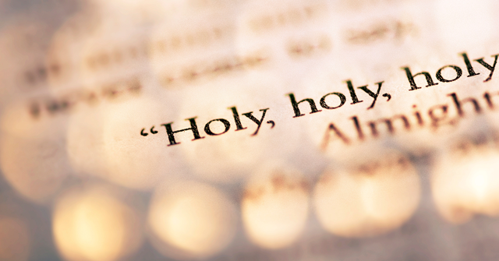
1 Peter 1:15-16
“¹⁵ but like the Holy One who called you, be holy yourselves also in all your behavior; ¹⁶ because it is written, “You shall be holy, for I am holy.’”

Slide 22
5 Reasons for Sexual Purity (4:5-8)
Sexual immorality characterizes pagans (4:5)
Sexual immorality invokes God’s judgment on both parties (4:6a)
Previous warnings against sexual immorality (4:6b)
Sexual immorality frustrates God’s holy call on the believer’s life (4:7)
The Holy Spirit empowers the believer toward purity (4:8)

Slide 23
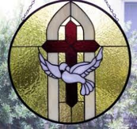
1 Samuel 16:13-14
¹³ Then Samuel took the horn of oil and anointed him in the midst of his brothers; and the Spirit of the Lord came mightily upon David from that day forward. And Samuel arose and went to Ramah. ¹⁴ Now the Spirit of the Lord departed from Saul, and an evil spirit from the Lord terrorized him.

Slide 24
John 14:16-17
¹⁶ I will ask the Father, and He will give you another Helper, that He may be with you forever; ¹⁷ that is the Spirit of truth, whom the world cannot receive, because it does not see Him or know Him, but you know Him because He abides with you and will be in you.

Slide 25
Conclusion

Slide 26
Structure
Personal (1–3)
Genuine conversion (1)
Impure motives (2:1-16)
Lack of concern (2:17–3:13)
Practical (4–5)
Immorality (4:1-8)
Laziness (4:9-12)
Eschatology (4:13–5:11)
Ministry imbalances (5:12-15)
Progressive sanctification (5:16-28)

Slide 27
Christian Living (4:1-12)
General conduct (4:1-2)
Negative command: sexual sin (4:3-8)
Positive command: brotherly love (4:9-12)

Slide 28
Christian Living (4:1-12)
General conduct (4:1-2)
Negative command: sexual sin (4:3-8)
Positive command: brotherly love (4:9-12)

Slide 29
How to Exhibit Brotherly Love (4:9-12)
Quiet Life
Mind your own business
Work

