Slide 1


Genesis 12‒50
Israel’s Birth & Preservation

Slide 2


GENESIS STRUCTURE
  Genesis 12-50 (four people)
    Abraham (12:1–25:11)
    Isaac (25:12–26:35)
    Jacob (27–36)
    Joseph (37–50)

Slide 3
Genesis 27
Chapter Summary
  Isaac’s intent (1-5)
  The conspiracy (5-17)
  Deception and blessing (18-29)
  Isaac blesses Esau (30-40)
  Plan to flee to Haran (41-46)

Slide 4

Genesis 27:30-40
Isaac Blesses Esau
    Return of Esau (30)
    Esau prepares meal (31)
    Isaac’s realization (32-33)
    Esau’s reaction (34)
    Isaac’s reaction (35)
    Esau’s request (36)
    Isaac’s answer (37)
    Esau’s lament (38)
    Esau’s blessing (39-40)

Slide 5
Genesis 27:30-40
Isaac Blesses Esau
    Return of Esau (30)
    Esau prepares meal (31)
    Isaac’s realization (32-33)
    Esau’s reaction (34)
    Isaac’s reaction (35)
    Esau’s request (36)
    Isaac’s answer (37)
    Esau’s lament (38)
    Esau’s blessing (39-40)

Slide 6
Genesis 27:30-40
Isaac Blesses Esau
    Return of Esau (30)
    Esau prepares meal (31)
    Isaac’s realization (32-33)
    Esau’s reaction (34)
    Isaac’s reaction (35)
    Esau’s request (36)
    Isaac’s answer (37)
    Esau’s lament (38)
    Esau’s blessing (39-40)

Slide 7
Genesis 27:30-40
Isaac Blesses Esau
    Return of Esau (30)
    Esau prepares meal (31)
    Isaac’s realization (32-33)
    Esau’s reaction (34)
    Isaac’s reaction (35)
    Esau’s request (36)
    Isaac’s answer (37)
    Esau’s lament (38)
    Esau’s blessing (39-40)

Slide 8
Genesis 27:32-33
Isaac’s Realization
      Identification (32)
      Reaction (33)

Slide 9
Genesis 27:32-33
Isaac’s Realization
      Identification (32)
      Reaction (33)

Slide 10
Genesis 27:32-33
Isaac’s Realization
      Identification (32)
      Reaction (33)

Slide 11
Genesis 27:30-40
Isaac Blesses Esau
    Return of Esau (30)
    Esau prepares meal (31)
    Isaac’s realization (32-33)
    Esau’s reaction (34)
    Isaac’s reaction (35)
    Esau’s request (36)
    Isaac’s answer (37)
    Esau’s lament (38)
    Esau’s blessing (39-40)

Slide 12
Genesis 27:34
Esau’s Reaction
      Cry (34a)
      Request (34b)

Slide 13
Genesis 27:34
Esau’s Reaction
      Cry (34a)
      Request (34b)

Slide 14
Genesis 27:34
Esau’s Reaction
      Cry (34a)
      Request (34b)

Slide 15
Genesis 27:30-40
Isaac Blesses Esau
    Return of Esau (30)
    Esau prepares meal (31)
    Isaac’s realization (32-33)
    Esau’s reaction (34)
    Isaac’s reaction (35)
    Esau’s request (36)
    Isaac’s answer (37)
    Esau’s lament (38)
    Esau’s blessing (39-40)

Slide 16
Genesis 27:35
Isaac’s Reaction
      Truth (35a)
      Lie (35b)

Slide 17
Genesis 27:35
Isaac’s Reaction
      Truth (35a)
      Lie (35b)

Slide 18
Genesis 27:35
Isaac’s Reaction
      Truth (35a)
      Lie (35b)

Slide 19

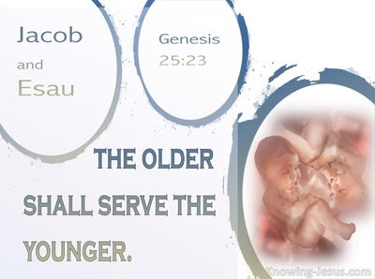
Genesis 25:23
“The Lord said to her, ‘Two nations are in your womb; And two peoples will be separated from your body; And one people shall be stronger than the other; And the older shall serve the younger.’”

Slide 20
Genesis 27:30-40
Isaac Blesses Esau
    Return of Esau (30)
    Esau prepares meal (31)
    Isaac’s realization (32-33)
    Esau’s reaction (34)
    Isaac’s reaction (35)
    Esau’s request (36)
    Isaac’s answer (37)
    Esau’s lament (38)
    Esau’s blessing (39-40)

Slide 21
Genesis 27:36
Esau’s Request
      Complaint (36a)
      Request (36b)

Slide 22
Genesis 27:36
Esau’s Request
      Complaint (36a)
      Request (36b)

Slide 23


Dr. Arnold G. Fruchtenbaum
The Book of Genesis, 428
“In 27:36 came Esau’s complaint and request. Esau’s complaint was: And he said, Is not he rightly named Jacob [yaaqov]? for he has supplanted me these two times. In Hebrew, the word supplanted comes from the same root as akav, “Jacob.” The meaning coming from Esau’s lips goes from “over-reacher” or “supplanter” to “deceiver.” The meaning of the name now moved from a positive to a negative implication, but it was done by Esau and not by God. Again, Jacob’s name comes from the Hebrew root akav, which basically means “heel.” It also has the meaning in verbal form “to hold the heel in order to get before.” That is its usage in Jeremiah 9:4. It has the meaning of “heel-grabber,” one who trips another by the heel or overtakes and supplants him in the race. Therefore, by way of etymology, Jacob equaling “supplanter” is a developed meaning, not the actual . . .

Slide 24
Dr. Arnold G. Fruchtenbaum
The Book of Genesis, 428
. . .meaning of the word. Jacob twice “overtook” Esau; that is, Jacob “tripped” him and “supplanted” him in the race. Esau’s rhetorical question was: “Is he called Jacob, ‘over-reacher,’ that he has twice overreached me?” “Is it because he bears this name that it has now twice come to pass?” In other words, the question was: “Is it all in the name?” Of course, it was not all in the name but rather in the outworking of God’s plan. According to Esau, the two times were, first: He took away my birthright, which was a lie since Esau had sold his birthright; and second: and behold, now he has taken away my blessing. This second claim, too, was a lie, since the blessing belonged to the one with the birthright. Here again, in the Hebrew text is a word play with a chiastic (symmetrical) construction. “My birthright he took; he took my blessing.””

Slide 25
Genesis 27:36
Esau’s Request
      Complaint (36a)
      Request (36b)

Slide 26
Genesis 27:30-40
Isaac Blesses Esau
    Return of Esau (30)
    Esau prepares meal (31)
    Isaac’s realization (32-33)
    Esau’s reaction (34)
    Isaac’s reaction (35)
    Esau’s request (36)
    Isaac’s answer (37)
    Esau’s lament (38)
    Esau’s blessing (39-40)

Slide 27
Genesis 27:27b-29
Blessing
      Blessings of God (27b)
      Agricultural blessings (28)
      Lordship blessings (29a-b)
      Blessing and curse (29c)

Slide 28
Dr. Arnold G. Fruchtenbaum
The Book of Genesis, 429
“In other words, the blessing given to Jacob is irrevocable. Indeed, the Nuzi Tablets teach that such oral testaments were binding, and there is an example in the Nuzi Court Record of Tarmiye. Tarmiye’s two older brothers contested his inheritance of a slave girl, and Tarmiye’s defense was based upon his father’s oral testament. The tablet reads as follows:
  ‘My father Huya was sick and lay on a couch; then my father seized my hand and spoke thus to me: My other sons being older have acquired a wife, so I give here Sululi-Istar as your wife.’”
Indeed, the court ruled in his favor, because these oral-type . . .

Slide 29
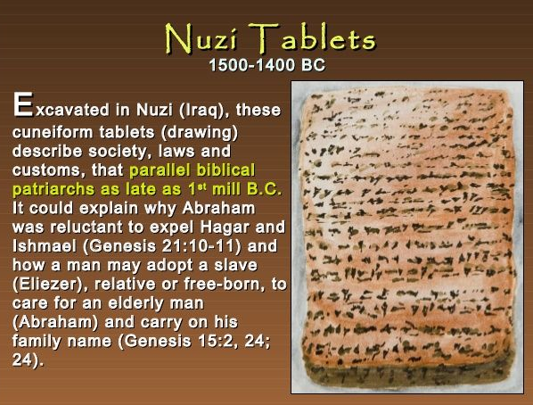
Dr. Arnold G. Fruchtenbaum
The Book of Genesis, 429
. . .testaments were considered binding. Isaac began his statement in verse 2 by saying: I am old and know not the day of my death. The Nuzi Tablets also begin the same way when introducing the final disposition of property. So here again with Isaac’s blessing of his sons was a strong correlation with Ancient Near Eastern Texts.”

Slide 30
Genesis 27:30-40
Isaac Blesses Esau
    Return of Esau (30)
    Esau prepares meal (31)
    Isaac’s realization (32-33)
    Esau’s reaction (34)
    Isaac’s reaction (35)
    Esau’s request (36)
    Isaac’s answer (37)
    Esau’s lament (38)
    Esau’s blessing (39-40)

Slide 31
Genesis 27:38
Esau’s Lament
      Lament (38a)
      Cry (38b)

Slide 32
Genesis 27:38
Esau’s Lament
      Lament (38a)
      Cry (38b)

Slide 33
Genesis 27:38
Esau’s Lament
      Lament (38a)
      Cry (38b)

Slide 34
Genesis 27:30-40
Isaac Blesses Esau
    Return of Esau (30)
    Esau prepares meal (31)
    Isaac’s realization (32-33)
    Esau’s reaction (34)
    Isaac’s reaction (35)
    Esau’s request (36)
    Isaac’s answer (37)
    Esau’s lament (38)
    Esau’s blessing (39-40)

Slide 35
Genesis 27:39-40
Esau’s Blessings
      Land (39)
      Nation (40)

Slide 36
Genesis 27:39-40
Esau’s Blessings
      Land (39)
      Nation (40)

Slide 37
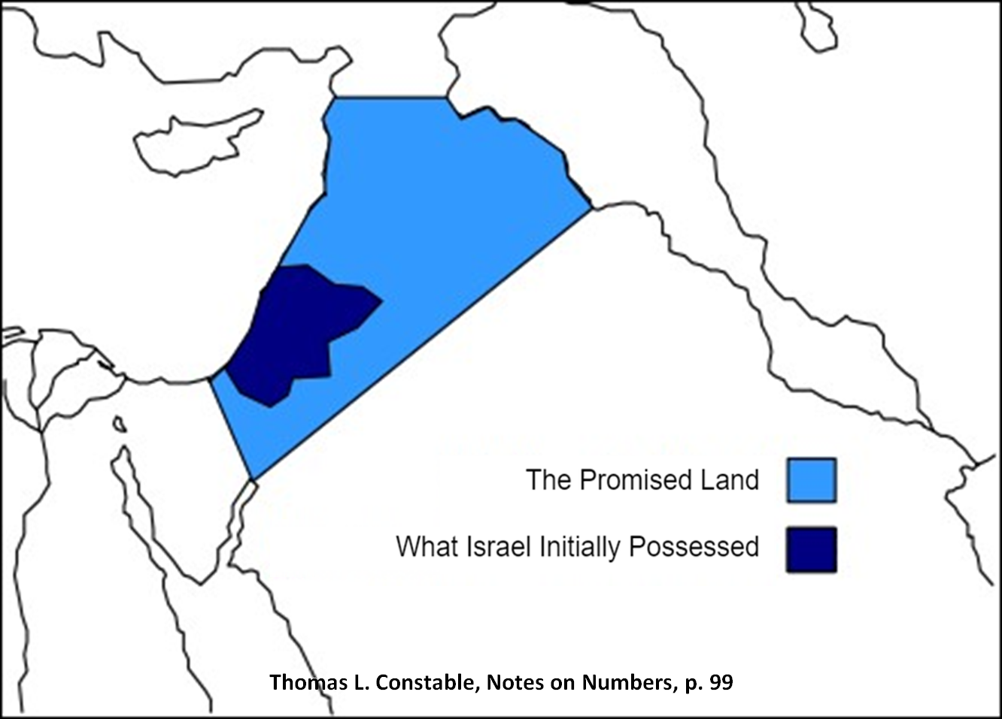

Slide 38
Dr. Arnold G. Fruchtenbaum
The Book of Genesis, 429-30
“At this point, there is a blessing for Esau, in 27:39–40. In verse 39, he first of all speaks concerning Esau: Behold, of the fatness of the earth shall be your dwelling. In the Hebrew text there is a min partitive; literally, it should read: ‘Away from the fatness of the earth shall be your dwelling.’ The next phrase, of the dew of heaven from above, also has a min partitive, literally meaning ‘away from the dew of heaven.’ The point is that while in some translations, it sounds similar to the blessing he gave to Jacob, in the Hebrew text it is actually the opposite of what was promised to Jacob. It means that since Esau’s place is away from this and away from that, Esau will not inherit the Land. Whatever his blessing, it will be away from the Land; he will not be the inheritor of this Land.”

Slide 39
Genesis 27:39-40
Esau’s Blessings
      Land (39)
      Nation (40)

Slide 40
Genesis 27:40
Nation
      Sword (40a)
      Subjugation (40b)
      Freedom (40c)

Slide 41
Genesis 27:40
Nation
      Sword (40a)
      Subjugation (40b)
      Freedom (40c)

Slide 42


Slide 43
Genesis 27:40
Nation
      Sword (40a)
      Subjugation (40b)
      Freedom (40c)

Slide 44
Genesis 25:23
“The Lord said to her, ‘Two nations are in your womb; And two peoples will be separated from your body; And one people shall be stronger than the other; And the older shall serve the younger.’”

Slide 45
Genesis 27:40
Nation
      Sword (40a)
      Subjugation (40b)
      Freedom (40c)

Slide 46
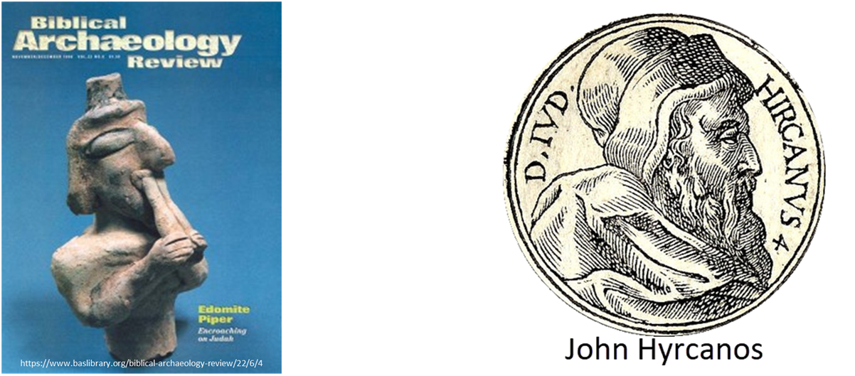
Dr. Arnold G. Fruchtenbaum
The Book of Genesis, 430
“In subsequent history, when the Jews went into Babylonian Captivity, the Edomites left their territory at Mount Seir in the Trans-Jordan and moved into the southern part of Judah, where they became known as Idumeans. In addition, later these Idumeans were conquered by one of the descendants of the Maccabees, John Hyrcanos, who conquered them in 129 b.c., forcibly converted them to Judaism, and then incorporated Idumea into the Jewish Judean State. Eventually, these converted Idumeans produced the dynastic rule of the House of Herod.”

Slide 47


John 13:19; 14:29
“^{13:19} From now on I am telling you before it comes to pass, so that when it does occur, you may believe that I am He… ^{14:29} Now I have told you before it happens, so that when it happens, you may believe.”

Slide 48
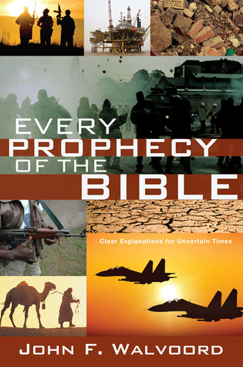

Slide 49
Genesis 27
Chapter Summary
  Isaac’s intent (1-4)
  The conspiracy (5-17)
  Deception and blessing (18-29)
  Isaac blesses Esau (30-40)
  Plan to flee to Haran (41-46)

Slide 50
Genesis 27:41-46
Plan to Flee to Haran
    Cause (41)
    Rebekah’s solution (42-46)

Slide 51
Genesis 27:41-46
Plan to Flee to Haran
    Cause (41)
    Rebekah’s solution (42-46)

Slide 52

Matthew 5:21-22
“²¹ “You have heard that the ancients were told, ‘You shall not commit murder’ and ‘Whoever commits murder shall be liable to the court.’ ²² But I say to you that everyone who is angry with his brother shall be guilty before the court; and whoever says to his brother, ‘You good-for-nothing,’ shall be guilty before the supreme court; and whoever says, ‘You fool,’ shall be guilty enough to go into the fiery hell.”

Slide 53

Matthew 5:27-28
“²⁷ You have heard that it was said, ‘You shall not commit adultery’; ²⁸ but I say to you that everyone who looks at a woman with lust for her has already committed adultery with her in his heart.”

Slide 54
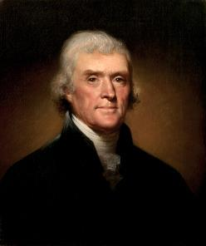
Thomas Jefferson
On April 21, 1803, Jefferson wrote to Dr. Benjamin Rush, also a signer of the Declaration
"My views ... are the result of a life of inquiry and reflection, and very different from the anti-Christian system imputed to me by those who know nothing of my opinions. To the corruptions of Christianity, I am, indeed, opposed; but not to the genuine precepts of Jesus Himself. I am a Christian in the only sense in which He wished any one to be; sincerely attached to his doctrines in preference to all others...His system of morals...if filled up in the style and spirit of the rich fragments He left us, would be the most perfect and sublime that has ever been taught by man...His moral doctrines...were more pure and . . .

Slide 55
Thomas Jefferson
On April 21, 1803, Jefferson wrote to Dr. Benjamin Rush, also a signer of the Declaration
...perfect than those of the most correct of the philosophers...gathering all into one family under the bonds of love, charity, peace, common wants and common aids. A development of this head will evince the peculiar superiority of the system of Jesus over all others. The precepts of philosophy, and of the Hebrew code, laid hold of actions only. He pushed his scrutinies into the heart of man; erected his tribunal in the region of his thoughts, and purified the waters at the fountain head.”

Slide 56
Genesis 27:41-46
Plan to Flee to Haran
    Cause (41)
    Rebekah’s solution (42-46)

Slide 57
Genesis 27:42-46
Rebekah’s Solution
      Discovery (42a)
      Problem (42b)
      Instruction (43-44a)
      Purpose (44b-45)
      Excuse (46)

Slide 58
Genesis 27:42-46
Rebekah’s Solution
      Discovery (42a)
      Problem (42b)
      Instruction (43-44a)
      Purpose (44b-45)
      Excuse (46)

Slide 59
Genesis 27:42-46
Rebekah’s Solution
      Discovery (42a)
      Problem (42b)
      Instruction (43-44a)
      Purpose (44b-45)
      Excuse (46)

Slide 60


Genesis 3:15
“And I will put enmity Between you and the woman, And between your seed and her seed; He shall bruise you on the head, And you shall bruise him on the heel.”

Slide 61
Messiah must be Jewish or from the line of Jacob
Numbers 24:17

Slide 62
Balaam's 7 Oracles Blessing Israel (23-24)
First oracle (23:1-12), Balaam explained that God’s blessings upon Israel were irrevocable.
Second oracle (23:13-26), Balaam explained that the source of Israel’s blessing was her unique relationship to Yahweh
Third oracle (23:27–24:14), Balaam extolled Israel’s beauty.
Fourth oracle (24:15-19), Balaam explained that a future messianic deliverer (Gen 49:10) would spring forth and exercise dominion from Israel.

Slide 63
Balaam's 7 Oracles Blessing Israel (23-24)
Fifth oracle (Num 24:20) predicts Amalek’s destruction. Amalek was the first foe that Israel had to fight against after leaving Egypt (Exod 17).
Sixth oracle (24:21-22) predicts the destruction of the Midianite group known as the Kenites as well as Assyria.
The nations of the seventh oracle are difficult to identify (24:23-24).

Slide 64

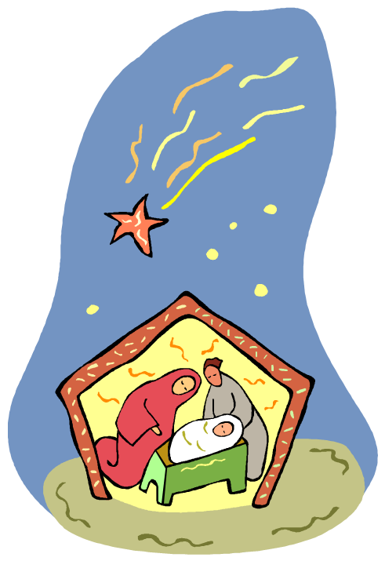
Numbers 24:17
“I see him, but not now; I behold him, but not near; A star shall come forth from Jacob, A scepter shall rise from Israel, And shall crush through the forehead of Moab, And tear down all the sons of Sheth.”

Slide 65
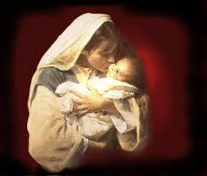

Satanic Attempts to Stop Messiah’s Birth
Cain & Abel (Gen. 4)
Sons of God (Gen. 6)
Pharaoh persecutes Israel (Exod. 1)
Joash protected from Athaliah (2 Chron. 22‒23)
Haman persecutes Israel (Esther)
Antiochus Epiphanés (Dan. 11:31)
Herod persecutes Christ (Matt 2; Rev 12:4)

Slide 66
Genesis 27:42-46
Rebekah’s Solution
      Discovery (42a)
      Problem (42b)
      Instruction (43-44a)
      Purpose (44b-45)
      Excuse (46)

Slide 67
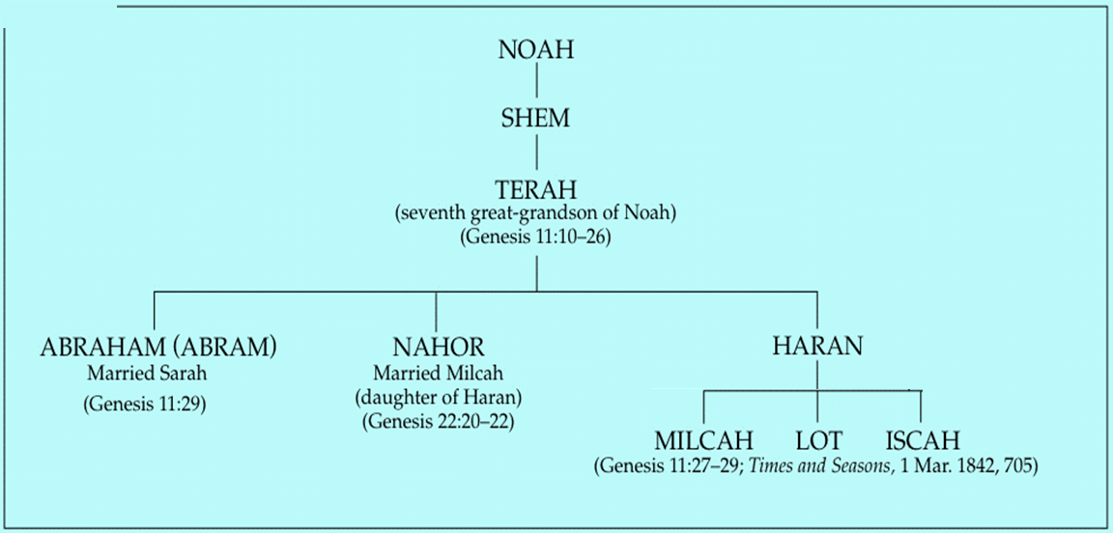

Slide 68


Nahor’s children through Milcah (Gen. 22:20b-23)
1. Uz (Job 1:1) | 5. Hazo
2. Buz | 6. Pildash
3. Aram | 7. Jidlaph
4. Chesed | 8. Bethuel (Gen. 24)

Slide 69


Slide 70
Genesis 27:42-46
Rebekah’s Solution
      Discovery (42a)
      Problem (42b)
      Instruction (43-44a)
      Purpose (44b-45)
      Excuse (46)

Slide 71


Genesis 9:6
“Whoever sheds man’s blood, By man his blood shall be shed, For in the image of God He made man.”

Slide 72
Noahic vs. Abrahamic & Mosaic Covenants
Name | NOAHIC | ABRAHAMIC | MOSAIC
Human agent | Noah | Abraham | Moses
Scripture | Gen. 8‒9 | Gen. 12‒17 | Exod. 19‒40
Covenant (Berith) | Gen. 9:9 | Gen. 15:18 | Exod. 19:5
Party | World, humanity | Israel, Hebrews | Israel, Hebrews
Israel | Pre-Israel | Post-Israel | Post-Israel

Slide 73
Noahic vs. Abrahamic & Mosaic Covenants
Covenant | NOAHIC | ABRAHAMIC | MOSAIC
Conditional or unconditional | Unconditional | Unconditional | Conditional
Promises | No more flood judgment, enduring earth, capital punishment | Ownership of land, seed, and blessing | Enjoyment or possession of land, seed, and blessing
Sign | Rainbow | Circumcision | Sabbath
Purpose | Restrain & preserve | Redemptive | Redemptive
Directly binding today? | Yes | No | No

Slide 74
Genesis 27:42-46
Rebekah’s Solution
      Discovery (42a)
      Problem (42b)
      Instruction (43-44a)
      Purpose (44b-45)
      Excuse (46)

Slide 75
VI. Genesis 26:34-35
Esau’s Wives
    Esau’s age (34a)
    Names of wives (34b)
    Impact on Esau’s parents (35)

Slide 76
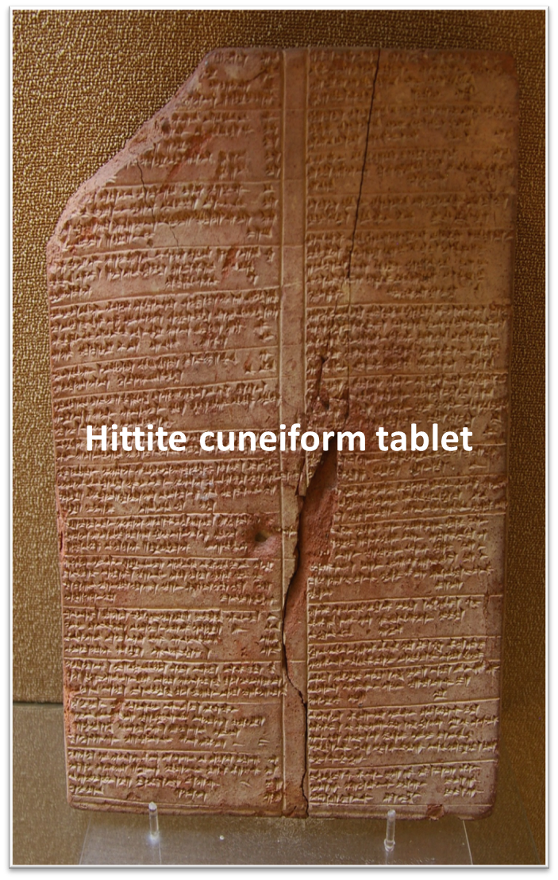
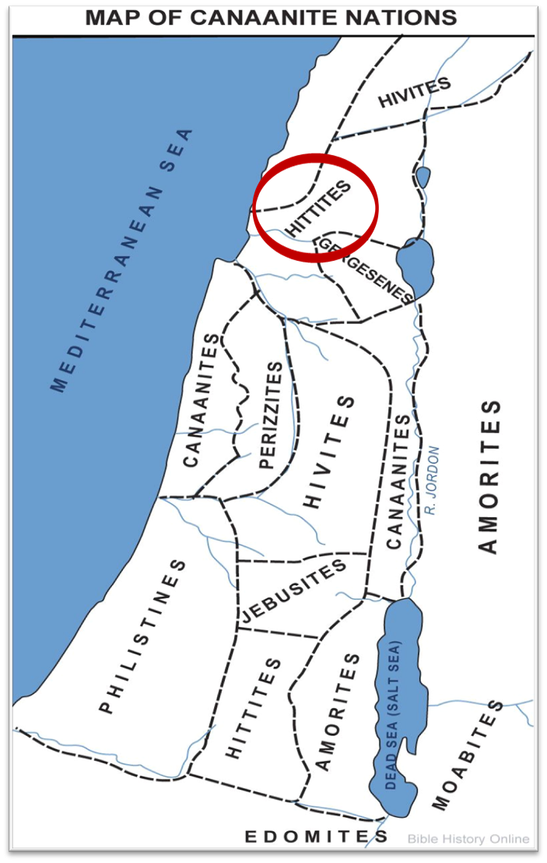

Slide 77
Conclusion

Slide 78
Genesis 27
Chapter Summary
  Isaac’s intent (1-4)
  The conspiracy (5-17)
  Deception and blessing (18-29)
  Isaac blesses Esau (30-40)
  Plan to flee to Haran (41-46)

Slide 79

²⁴ The Lord bless you, and keep you; ²⁵ The Lord make His face shine on you, And be gracious to you; ²⁶ The Lord lift up His countenance on you, And give you peace.
Numbers 6:24–26 (NASB95)

