Slide 1
Dr. Andy Woods
Senior Pastor – Sugar Land Bible Church
President – Chafer Theological Seminary

Slide 2
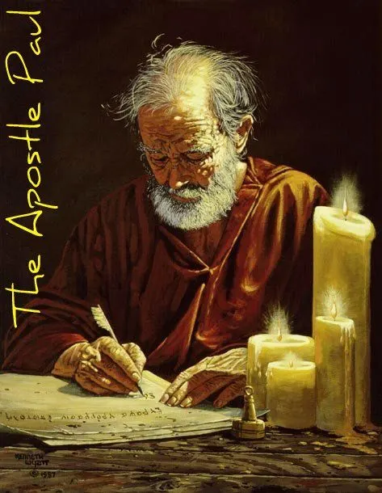
Structure
1 THESSALONIANS 1-3 | 1 THESSALONIANS 4-5
Personal Experience | Practical Exhortation
Looking Back | Looking Forward

Slide 3
Structure
Personal (1–3)
Genuine conversion (1)
Impure motives (2:1-16)
Lack of concern (2:17–3:13)
Practical (4–5)
Immorality (4:1-8)
Laziness (4:9-12)
Eschatology (4:13–5:11)
Ministry imbalances (5:12-15)
Progressive sanctification (5:16-28)

Slide 4
Christian Living (4:1-12)
General conduct (4:1-2)
Negative command: sexual sin (4:3-8)
Positive command: brotherly love (4:9-12)

Slide 5
Positive Command (4:9-12)
General Command to love (4:9-10)
Specifics on how to love (4:11)
Results (4:12)

Slide 6
Positive Command (4:9-12)
General Command to love (4:9-10)
Specifics on how to love (4:11)
Results (4:12)

Slide 7
I. General Command to Love (4:9-10)
Love the brethren (9a)
A pre-known commandment (9b)
Practiced toward the Macedonians (10a)
Always room for improvement (10b)

Slide 8
I. General Command to Love (4:9-10)
Love the brethren (9a)
A pre-known commandment (9b)
Practiced toward the Macedonians (10a)
Always room for improvement (10b)

Slide 9
I. General Command to Love (4:9-10)
Love the brethren (9a)
A pre-known commandment (9b)
Practiced toward the Macedonians (10a)
Always room for improvement (10b)

Slide 10
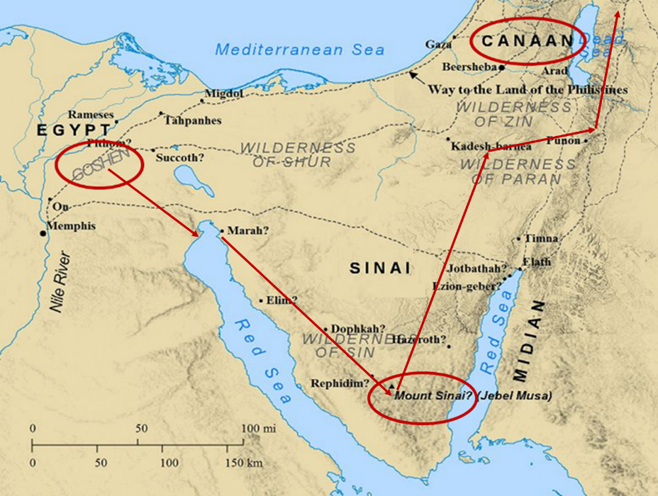

Slide 11
I. General Command to Love (4:9-10)
Love the brethren (9a)
A pre-known commandment (9b)
Practiced toward the Macedonians (10a)
Always room for improvement (10b)

Slide 12
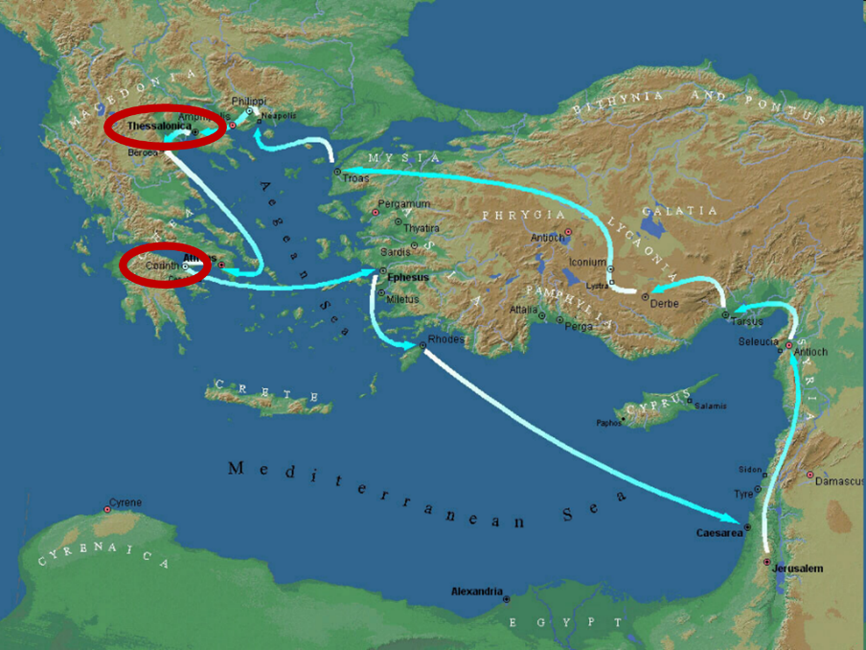

Slide 13
I. General Command to Love (4:9-10)
Love the brethren (9a)
A pre-known commandment (9b)
Practiced toward the Macedonians (10a)
Always room for improvement (10b)

Slide 14
Three Tenses of Salvation
Phase | Justification | Sanctification | Glorification
Tense | Past | Present | Future
Saved from sin’s: | Penalty | Power | Presence
Scripture | Eph 2:8-9; Titus 3:5 | Philip 2:12 | Rom 5:10

Slide 15
Positive Command (4:9-12)
General Command to love (4:9-10)
Specifics on how to love (4:11)
Results (4:12)

Slide 16
II. Specifics on how to Love (4:11)
Aspiration (11a)
Quiet life (11b)
Mind your own business (11c)
Work with your hands (11d)
Apostolic authority (11e)

Slide 17
II. Specifics on how to Love (4:11)
Aspiration (11a)
Quiet life (11b)
Mind your own business (11c)
Work with your hands (11d)
Apostolic authority (11e)

Slide 18
Charles Ryrie Ryrie Study Bible, page 1485
1 Thessalonians 4:11: (RSB:NASB1995U): 4:11 make it your ambition, or aspire. The Greek word is used only here and in Rom. 15:20 and 2 Cor. 5:9. The problems mentioned in 2 Thess. 3:11–12 gave rise to these exhortations.”

Slide 19
II. Specifics on how to Love (4:11)
Aspiration (11a)
Quiet life (11b)
Mind your own business (11c)
Work with your hands (11d)
Apostolic authority (11e)

Slide 20
II. Specifics on how to Love (4:11)
Aspiration (11a)
Quiet life (11b)
Mind your own business (11c)
Work with your hands (11d)
Apostolic authority (11e)

Slide 21
II. Specifics on how to Love (4:11)
Aspiration (11a)
Quiet life (11b)
Mind your own business (11c)
Work with your hands (11d)
Apostolic authority (11e)

Slide 22
Genesis 3:17-19a
¹⁷ Then to Adam He said, “Because you have listened to the voice of your wife, and have eaten from the tree about which I commanded you, saying, ‘You shall not eat from it’; Cursed is the ground because of you; In toil you will eat of it All the days of your life. ¹⁸ “Both thorns and thistles it shall grow for you; And you will eat the plants of the field; ¹⁹ By the sweat of your face You will eat bread...”

Slide 23
II. Specifics on how to Love (4:11)
Aspiration (11a)
Quiet life (11b)
Mind your own business (11c)
Work with your hands (11d)
Apostolic authority (11e)

Slide 24
Positive Command (4:9-12)
General Command to love (4:9-10)
Specifics on how to love (4:11)
Results (4:12)

Slide 25
III. Results (4:12)
Proper testimony to unbelievers (12a)
Lack of need (12b)

Slide 26
III. Results (4:12)
Proper testimony to unbelievers (12a)
Lack of need (12b)

Slide 27
Charles Ryrie Ryrie Study Bible, page 1485
1 Thessalonians 4:12 (RSB:NASB1995U): 4:12 outsiders. I.e., non-Christians.”

Slide 28
III. Results (4:12)
Proper testimony to unbelievers (12a)
Lack of need (12b)

Slide 29
Conclusion

Slide 30
Christian Living (4:1-12)
General conduct (4:1-2)
Negative command: sexual sin (4:3-8)
Positive command: brotherly love (4:9-12)

Slide 31
Structure
Personal (1–3)
Genuine conversion (1)
Impure motives (2:1-16)
Lack of concern (2:17–3:13)
Practical (4–5)
Immorality (4:1-8)
Laziness (4:9-12)
Eschatology (4:13–5:11)
Ministry imbalances (5:12-15)
Progressive sanctification (5:16-28)

Slide 32
Positive Command (4:9-12)
General Command to love (4:9-10)
Specifics on how to love (4:11)
Results (4:12)

Slide 33
Structure
Personal (1–3)
Genuine conversion (1)
Impure motives (2:1-16)
Lack of concern (2:17–3:13)
Practical (4–5)
Immorality (4:1-8)
Laziness (4:9-12)
Eschatology (4:13–5:11)
Ministry imbalances (5:12-15)
Progressive sanctification (5:16-28)

