Slide 1


Genesis 12‒50
Israel’s Birth & Preservation

Slide 2


GENESIS STRUCTURE
  Genesis 12-50 (four people)
    Abraham (12:1–25:11)
    Isaac (25:12–26:35)
    Jacob (27–36)
    Joseph (37–50)

Slide 3
Genesis 27
Chapter Summary
  Isaac’s intent (1-4)
  The conspiracy (5-17)
  Deception and blessing (18-29)
  Isaac blesses Esau (30-40)
  Plan to flee to Haran (41-46)

Slide 4
Genesis 27:41-46
Plan to Flee to Haran
    Cause (41)
    Rebekah’s solution (42-46)

Slide 5
Genesis 27:41-46
Plan to Flee to Haran
    Cause (41)
    Rebekah’s solution (42-46)

Slide 6


Slide 7

Matthew 5:21-22
“²¹ “You have heard that the ancients were told, ‘You shall not commit murder’ and ‘Whoever commits murder shall be liable to the court.’ ²² But I say to you that everyone who is angry with his brother shall be guilty before the court; and whoever says to his brother, ‘You good-for-nothing,’ shall be guilty before the supreme court; and whoever says, ‘You fool,’ shall be guilty enough to go into the fiery hell.”

Slide 8

Matthew 5:27-28
“²⁷ You have heard that it was said, ‘You shall not commit adultery’; ²⁸ but I say to you that everyone who looks at a woman with lust for her has already committed adultery with her in his heart.”

Slide 9
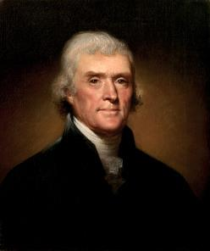
Thomas Jefferson
On April 21, 1803, Jefferson wrote to Dr. Benjamin Rush, also a signer of the Declaration
"My views ... are the result of a life of inquiry and reflection, and very different from the anti-Christian system imputed to me by those who know nothing of my opinions. To the corruptions of Christianity, I am, indeed, opposed; but not to the genuine precepts of Jesus Himself. I am a Christian in the only sense in which He wished any one to be; sincerely attached to his doctrines in preference to all others...His system of morals...if filled up in the style and spirit of the rich fragments He left us, would be the most perfect and sublime that has ever been taught by man...His moral doctrines...were more pure and . . .

Slide 10
Thomas Jefferson
On April 21, 1803, Jefferson wrote to Dr. Benjamin Rush, also a signer of the Declaration
...perfect than those of the most correct of the philosophers...gathering all into one family under the bonds of love, charity, peace, common wants and common aids. A development of this head will evince the peculiar superiority of the system of Jesus over all others. The precepts of philosophy, and of the Hebrew code, laid hold of actions only. He pushed his scrutinies into the heart of man; erected his tribunal in the region of his thoughts, and purified the waters at the fountain head.”

Slide 11
Genesis 27:41-46
Plan to Flee to Haran
    Cause (41)
    Rebekah’s solution (42-46)

Slide 12
Genesis 27:42-46
Rebekah’s Solution
      Discovery (42a)
      Problem (42b)
      Instruction (43-44a)
      Purpose (44b-45)
      Excuse (46)

Slide 13
Genesis 27:42-46
Rebekah’s Solution
      Discovery (42a)
      Problem (42b)
      Instruction (43-44a)
      Purpose (44b-45)
      Excuse (46)

Slide 14
Genesis 27:42-46
Rebekah’s Solution
      Discovery (42a)
      Problem (42b)
      Instruction (43-44a)
      Purpose (44b-45)
      Excuse (46)

Slide 15


Genesis 3:15
“And I will put enmity Between you and the woman, And between your seed and her seed; He shall bruise you on the head, And you shall bruise him on the heel.”

Slide 16
Messiah must be Jewish or from the line of Jacob
Numbers 24:17

Slide 17
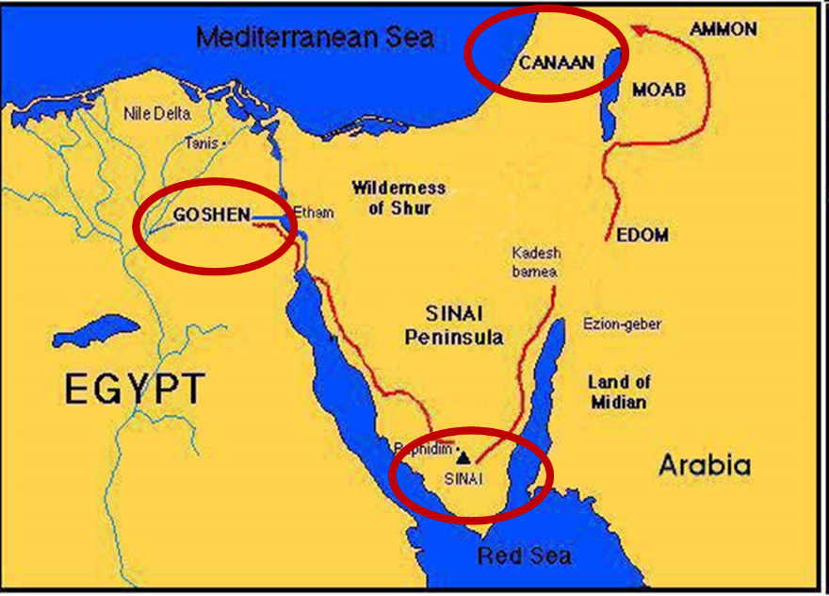

Slide 18
Balaam's 7 Oracles Blessing Israel (23-24)
First oracle (23:1-12), Balaam explained that God’s blessings upon Israel were irrevocable.
Second oracle (23:13-26), Balaam explained that the source of Israel’s blessing was her unique relationship to Yahweh
Third oracle (23:27–24:14), Balaam extolled Israel’s beauty.
Fourth oracle (24:15-19), Balaam explained that a future messianic deliverer (Gen 49:10) would spring forth and exercise dominion from Israel.

Slide 19
Balaam's 7 Oracles Blessing Israel (23-24)
Fifth oracle (Num 24:20) predicts Amalek’s destruction. Amalek was the first foe that Israel had to fight against after leaving Egypt (Exod 17).
Sixth oracle (24:21-22) predicts the destruction of the Midianite group known as the Kenites as well as Assyria.
The nations of the seventh oracle are difficult to identify (24:23-24).

Slide 20

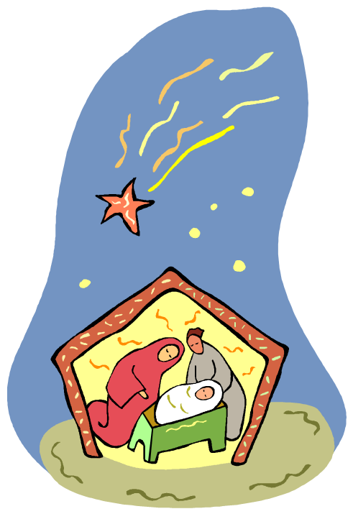
Numbers 24:17
“I see him, but not now; I behold him, but not near; A star shall come forth from Jacob, A scepter shall rise from Israel, And shall crush through the forehead of Moab, And tear down all the sons of Sheth.”

Slide 21
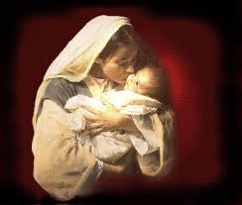

Satanic Attempts to Stop Messiah’s Birth
Cain & Abel (Gen. 4)
Sons of God (Gen. 6)
Pharaoh persecutes Israel (Exod. 1)
Joash protected from Athaliah (2 Chron. 22‒23)
Haman persecutes Israel (Esther)
Antiochus Epiphanés (Dan. 11:31)
Herod persecutes Christ (Matt 2; Rev 12:4)

Slide 22

Revelation 12:1-5
¹And a great sign appeared in heaven: a woman clothed in the sun, and the moon under her feet, and upon her head a crown of twelve stars; ²and she was with child; and she cried out, being in labor pain to give birth. ³And another sign was seen in heaven: and behold, a great red dragon, having seven heads and ten horns, and upon his heads seven diadems.

Slide 23
Revelation 12:1-5 (cont’d)
⁴And his tail swept a third part of the stars of heaven, and did cast them to the earth: and the dragon stood before the woman that is about to give birth, so that when she gave birth he may devour her child. ⁵And she gave birth to a son, a man child, who is to rule all the nations with a rod of iron: and her child was caught up unto God, and to his throne.

Slide 24
Genesis 27:42-46
Rebekah’s Solution
      Discovery (42a)
      Problem (42b)
      Instruction (43-44a)
      Purpose (44b-45)
      Excuse (46)

Slide 25
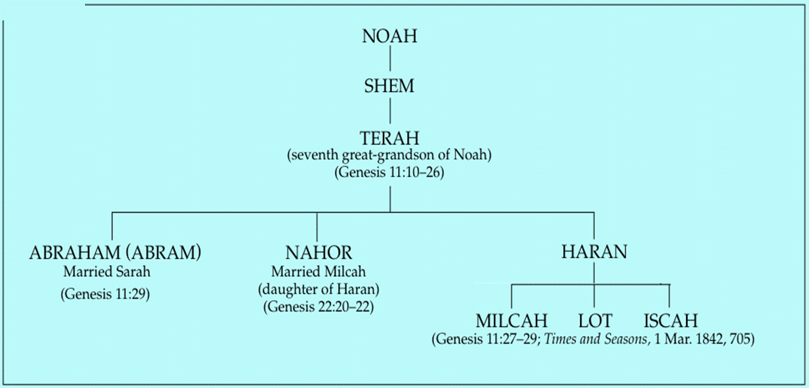

Slide 26
Genesis 22:20-24
Rebekah’s Lineage
    Timing (20a)
    Nahor’s children (20b-24)
      From Milcah (20b-23)
      From Reumah (24)

Slide 27


Nahor’s children through Milcah (Gen. 22:20b-23)
1. Uz (Job 1:1) | 5. Hazo
2. Buz | 6. Pildash
3. Aram | 7. Jidlaph
4. Chesed | 8. Bethuel (Gen. 24)

Slide 28


Slide 29

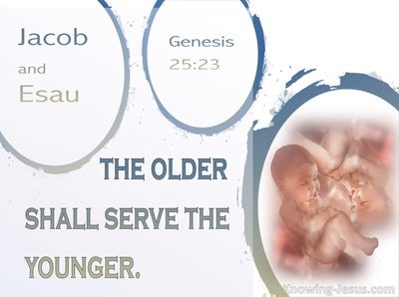
Genesis 25:23
“The Lord said to her, ‘Two nations are in your womb; And two peoples will be separated from your body; And one people shall be stronger than the other; And the older shall serve the younger.’”

Slide 30
Genesis 27:42-46
Rebekah’s Solution
      Discovery (42a)
      Problem (42b)
      Instruction (43-44a)
      Purpose (44b-45)
      Excuse (46)

Slide 31


Dr. Arnold G. Fruchtenbaum
The Book of Genesis, 432
“Meanwhile, Rebekah’s plan was: Then I will send, and fetch you from thence. This she would never get to do, because she would die before Jacob’s return took place. Her fear was: Why should I be bereaved of you both in one day? because if Jacob were murdered, Esau would have to be executed in accordance with the Noahic Covenant in 9:6.”

Slide 32


Genesis 9:6
“Whoever sheds man’s blood, By man his blood shall be shed, For in the image of God He made man.”

Slide 33
Noahic vs. Abrahamic & Mosaic Covenants
Name | NOAHIC | ABRAHAMIC | MOSAIC
Human agent | Noah | Abraham | Moses
Scripture | Gen. 8‒9 | Gen. 12‒17 | Exod. 19‒40
Covenant (Berith) | Gen. 9:9 | Gen. 15:18 | Exod. 19:5
Party | World, humanity | Israel, Hebrews | Israel, Hebrews
Israel | Pre-Israel | Post-Israel | Post-Israel

Slide 34
Noahic vs. Abrahamic & Mosaic Covenants
Covenant | NOAHIC | ABRAHAMIC | MOSAIC
Conditional or unconditional | Unconditional | Unconditional | Conditional
Promises | No more flood judgment, enduring earth, capital punishment | Ownership of land, seed, and blessing | Enjoyment or possession of land, seed, and blessing
Sign | Rainbow | Circumcision | Sabbath
Purpose | Restrain & preserve | Redemptive | Redemptive
Directly binding today? | Yes | No | No

Slide 35
Genesis 27:42-46
Rebekah’s Solution
      Discovery (42a)
      Problem (42b)
      Instruction (43-44a)
      Purpose (44b-45)
      Excuse (46)

Slide 36
VI. Genesis 26:34-35
Esau’s Wives
    Esau’s age (34a)
    Names of wives (34b)
    Impact on Esau’s parents (35)

Slide 37
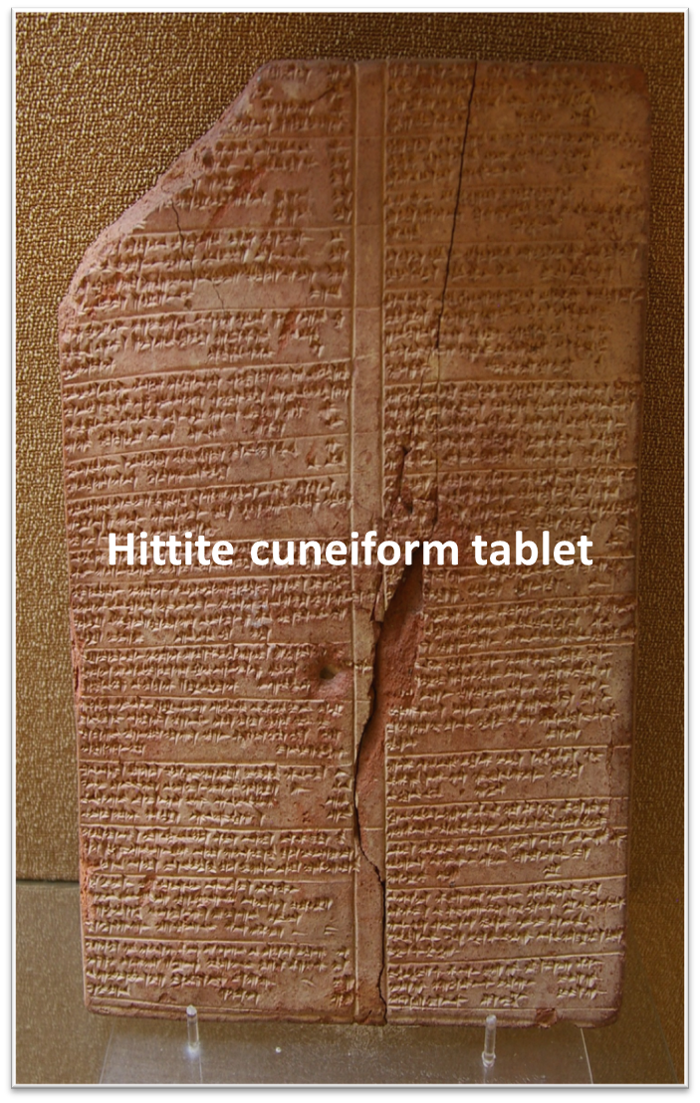
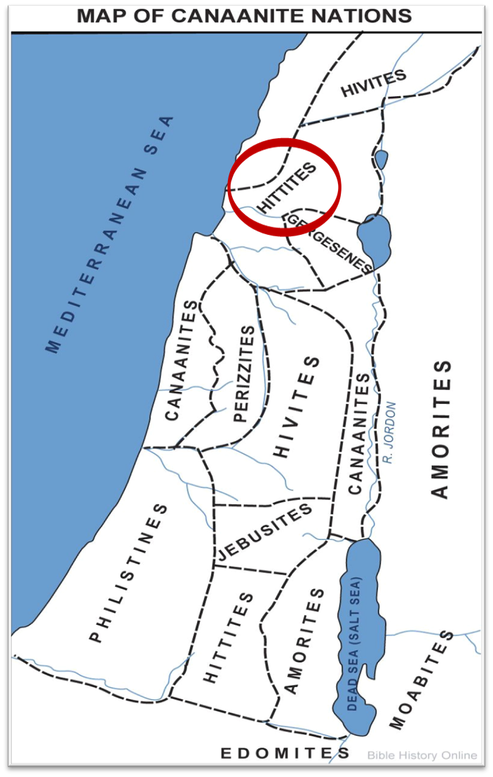

Slide 38
Genesis 25:23
“The Lord said to her, ‘Two nations are in your womb; And two peoples will be separated from your body; And one people shall be stronger than the other; And the older shall serve the younger.’”

Slide 39
Yielding to the Old Nature:
Consequences For the Believer
Conviction (2 Pet 2:7-8; Ps 32:1-5)
Divine discipline (Heb 12:5-11)
Premature death (Acts 5:1-11; 1 Cor 11:30; 1 John 5:16; Rev 2:22-23)
Loss of reward (1 Cor 3:15; 9:27; 2 John 8; Rev 3:11)
Loss of fellowship (1 John 1:9)
Excommunication (1 Cor 5:4-5; Matt 18:15-17)
Temporal consequences (Gal 6:7-8)
Unanswered prayer (Ps 66:18; 1 Pet 3:7)
Loss of testimony (Gen 19:14)
Loss of leadership privileges (1 Tim 3:1-13)

Slide 40
Conclusion

Slide 41
Genesis 27
Chapter Summary
  Isaac’s intent (1-4)
  The conspiracy (5-17)
  Deception and blessing (18-29)
  Isaac blesses Esau (30-40)
  Plan to flee to Haran (41-46)

Slide 42
Genesis 27:41-46
Plan to Flee to Haran
    Cause (41)
    Rebekah’s solution (42-46)

Slide 43

²⁴ The Lord bless you, and keep you; ²⁵ The Lord make His face shine on you, And be gracious to you; ²⁶ The Lord lift up His countenance on you, And give you peace.
Numbers 6:24–26 (NASB95)

