Slide 1
Genesis 12‒50
Israel’s Birth & Preservation

Slide 2
GENESIS STRUCTURE
Genesis 12-50 (four people)
Abraham (12:1–25:11)
Isaac (25:12–26:35)
Jacob (27–36)
Joseph (37–50)

Slide 3
Genesis 28 Chapter Summary
Jacob’s flight to Haran (1-5)
Esau’s third wife (6-9)
Reconfirmation of the Covenant (10-22)

Slide 4
Genesis 28 Chapter Summary
Jacob’s flight to Haran (1-5)
Esau’s third wife (6-9)
Reconfirmation of the Covenant (10-22)

Slide 5
Genesis 28:1-5 Jacob’s to Flight to Haran
Jacob fetched (1a)
Instructions regarding wife (1b-2)
Isaac’s covenant reaffirmation (3-4)
Jacob’s departure (5)

Slide 6
Genesis 28:1-5 Jacob’s to Flight to Haran
Jacob fetched (1a)
Instructions regarding wife (1b-2)
Isaac’s covenant reaffirmation (3-4)
Jacob’s departure (5)

Slide 7
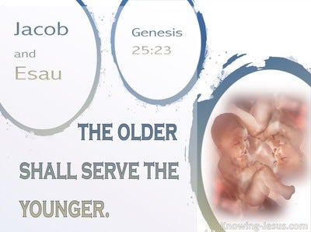
Genesis 25:23
“The Lord said to her, ‘Two nations are in your womb; And two peoples will be separated from your body; And one people shall be stronger than the other; And the older shall serve the younger.’”

Slide 8
Genesis 28:1-5 Jacob’s to Flight to Haran
Jacob fetched (1a)
Instructions regarding wife (1b-2)
Isaac’s covenant reaffirmation (3-4)
Jacob’s departure (5)

Slide 9
Genesis 28:1b-2 Instructions Regarding Wife
Negative (1b)
Positive (2)

Slide 10
Genesis 28:1b-2 Instructions Regarding Wife
Negative (1b)
Positive (2)

Slide 11
Genesis 15:16
“Then in the fourth generation they will return here, for the wrongdoing of the Amorite is not yet complete.”

Slide 12
Genesis 12‒25 Abraham’s Early Journeys
Unconditional promises (Gen. 12:1-3) From Haran to Canaan (Gen. 12:4-5) In Canaan (Gen. 12:6-9) In Egypt (Gen. 12:10-20) Abram and Lot Separate (Gen. 13:1-13) Reaffirmation of Abram’s promises (Gen. 13:14-18) Abram Rescues Lot (14:1-24) Abrahamic Covenant (15:1-21) Hagar & Ishmael (16:1-16) Circumcision (Gen. 17:1-27) | Sodom & Gomorrah (Gen. 18‒19) Abraham & Abimelech (Gen. 20) Isaac’s birth (Gen. 21:1-7) Ishmael’s expulsion (21:8-21) Abraham & Abimelech’s covenant (21:22-34) Abraham sacrifices Isaac (22) Sarah’s death (23) Isaac’s marriage (24) Abraham & Keturah (25:1-6) Abraham’s death (25:7-11)

Slide 13
Genesis 28:1b-2 Instructions Regarding Wife
Negative (1b)
Positive (2)

Slide 14
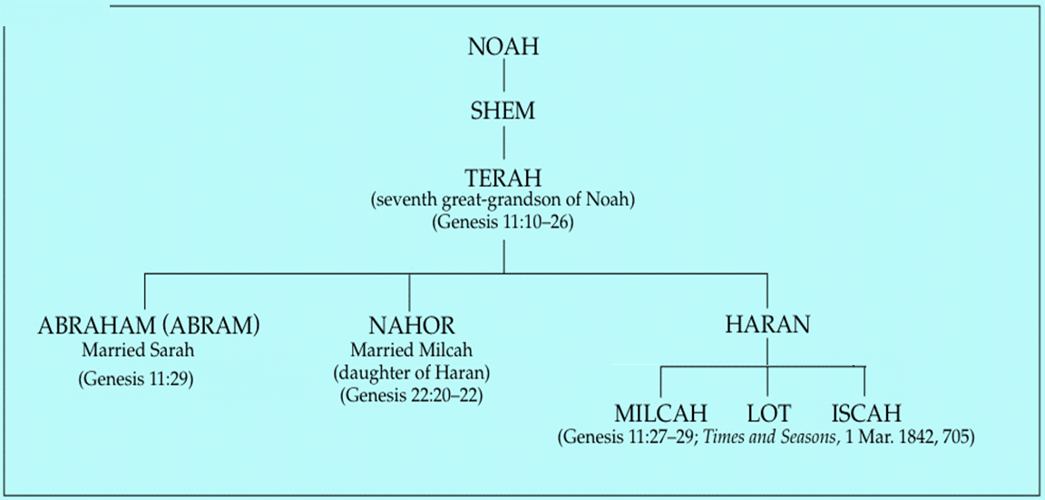

Slide 15
Genesis 22:20-24 Rebekah’s Lineage
Timing (20a)
Nahor’s children (20b-24)
From Milcah (20b-23)
From Reumah (24)

Slide 16
Nahor’s children through Milcah (Gen. 22:20b-23)
1. Uz (Job 1:1) | 5. Hazo
2. Buz | 6. Pildash
3. Aram | 7. Jidlaph
4. Chesed | 8. Bethuel (Gen. 24)

Slide 17
Genesis 28:1-5 Jacob’s to Flight to Haran
Jacob fetched (1a)
Instructions regarding wife (1b-2)
Isaac’s covenant reaffirmation (3-4)
Jacob’s departure (5)

Slide 18
Genesis 25:23
“The Lord said to her, ‘Two nations are in your womb; And two peoples will be separated from your body; And one people shall be stronger than the other; And the older shall serve the younger.’”

Slide 19
Genesis 28:3-4 Isaac’s Covenant Reaffirmation
Blessing (3a)
Fruitfulness (3b)
Seed multiplication (3c)
Company of peoples (3d)
Blessings of Abraham (4a)
Land (4b)

Slide 20
Genesis 28:3-4 Isaac’s Covenant Reaffirmation
Blessing (3a)
Fruitfulness (3b)
Seed multiplication (3c)
Company of peoples (3d)
Blessings of Abraham (4a)
Land (4b)

Slide 21
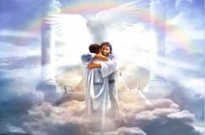
Ephesians 1:3
“Blessed be the God and Father of our Lord Jesus Christ, who has blessed us with every spiritual blessing in the heavenly places in Christ.”

Slide 22
Genesis 28:3-4 Isaac’s Covenant Reaffirmation
Blessing (3a)
Fruitfulness (3b)
Seed multiplication (3c)
Company of peoples (3d)
Blessings of Abraham (4a)
Land (4b)

Slide 23
Genesis 28:3-4 Isaac’s Covenant Reaffirmation
Blessing (3a)
Fruitfulness (3b)
Seed multiplication (3c)
Company of peoples (3d)
Blessings of Abraham (4a)
Land (4b)

Slide 24
Genesis 28:3-4 Isaac’s Covenant Reaffirmation
Blessing (3a)
Fruitfulness (3b)
Seed multiplication (3c)
Company of peoples (3d)
Blessings of Abraham (4a)
Land (4b)

Slide 26
Genesis 28:3-4 Isaac’s Covenant Reaffirmation
Blessing (3a)
Fruitfulness (3b)
Seed multiplication (3c)
Company of peoples (3d)
Blessings of Abraham (4a)
Land (4b)

Slide 28
Genesis 28:3-4 Isaac’s Covenant Reaffirmation
Blessing (3a)
Fruitfulness (3b)
Seed multiplication (3c)
Company of peoples (3d)
Blessings of Abraham (4a)
Land (4b)

Slide 29
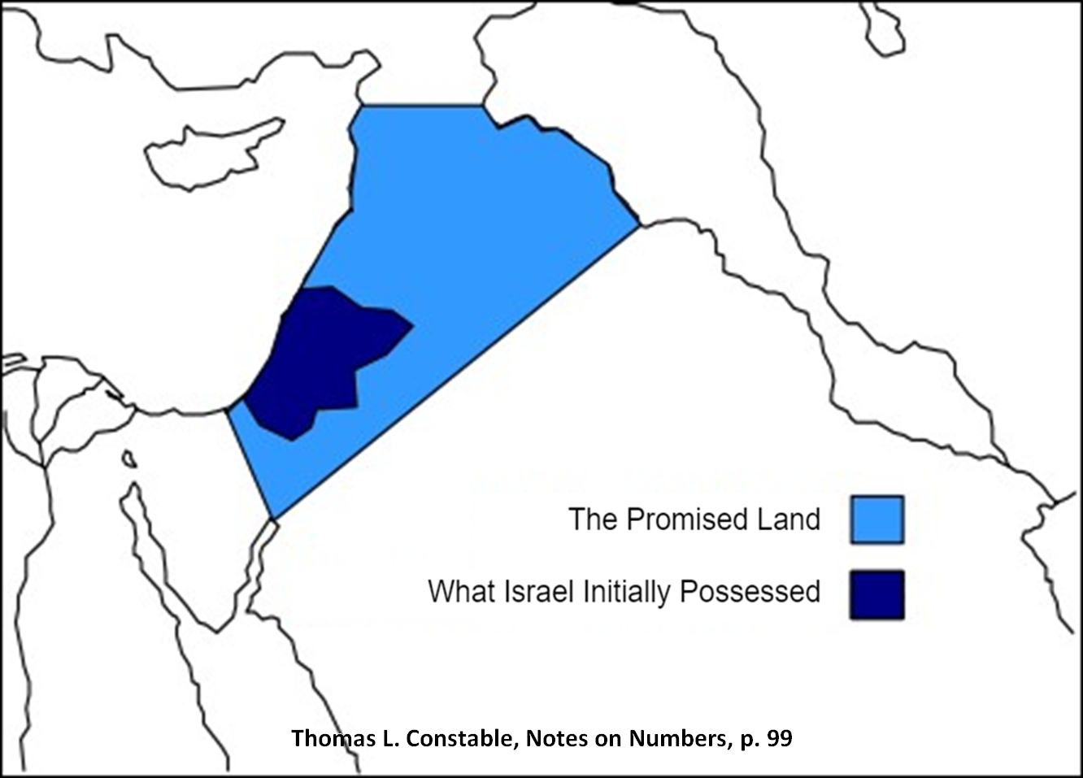

Slide 30
Genesis 28:1-5 Jacob’s to Flight to Haran
Jacob fetched (1a)
Instructions regarding wife (1b-2)
Isaac’s covenant reaffirmation (3-4)
Jacob’s departure (5)

Slide 31
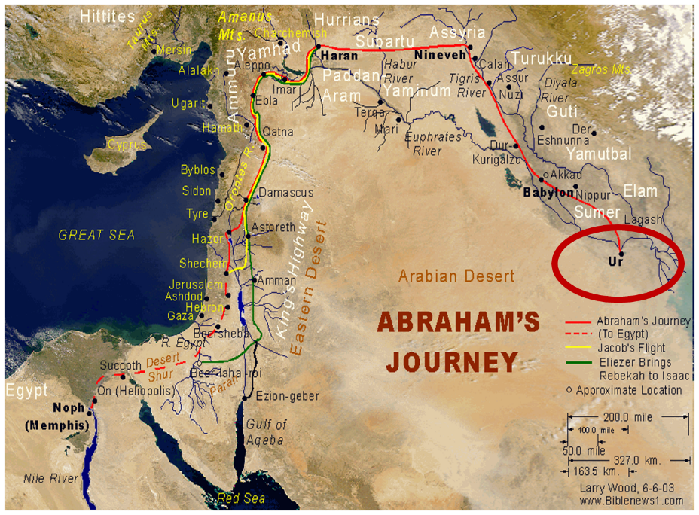

Slide 33
Genesis 22:20-24 Rebekah’s Lineage
Timing (20a)
Nahor’s children (20b-24)
From Milcah (20b-23)
From Reumah (24)

Slide 34
Nahor’s children through Milcah (Gen. 22:20b-23)
1. Uz (Job 1:1) | 5. Hazo
2. Buz | 6. Pildash
3. Aram | 7. Jidlaph
4. Chesed | 8. Bethuel (Gen. 24)

Slide 35
Genesis 28 Chapter Summary
Jacob’s flight to Haran (1-5)
Esau’s third wife (6-9)
Reconfirmation of the Covenant (10-22)

Slide 36
Genesis 28:6-9 Esau’s Third Wife
Esau’s observation (6-8)
Esau’s action (9)

Slide 37
Genesis 28:6-9 Esau’s Third Wife
Esau’s observation (6-8)
Esau’s action (9)

Slide 38
Genesis 28:6-8 Esau’s Observation
Isaac’s charge (6)
Jacob’s obedience (7)
Isaac’s displeasure (8)

Slide 39
Genesis 28:6-8 Esau’s Observation
Isaac’s charge (6)
Jacob’s obedience (7)
Isaac’s displeasure (8)

Slide 41
Genesis 28:6-8 Esau’s Observation
Isaac’s charge (6)
Jacob’s obedience (7)
Isaac’s displeasure (8)

Slide 42
Genesis 28:6-8 Esau’s Observation
Isaac’s charge (6)
Jacob’s obedience (7)
Isaac’s displeasure (8)

Slide 43
Genesis 26:34-35 Esau’s Wives
Esau’s age (34a)
Names of wives (34b)
Impact on Esau’s parents (35)

Slide 44
Genesis 12‒25 Abraham’s Early Journeys
Unconditional promises (Gen. 12:1-3) From Haran to Canaan (Gen. 12:4-5) In Canaan (Gen. 12:6-9) In Egypt (Gen. 12:10-20) Abram and Lot Separate (Gen. 13:1-13) Reaffirmation of Abram’s promises (Gen. 13:14-18) Abram Rescues Lot (14:1-24) Abrahamic Covenant (15:1-21) Hagar & Ishmael (16:1-16) Circumcision (Gen. 17:1-27) | Sodom & Gomorrah (Gen. 18‒19) Abraham & Abimelech (Gen. 20) Isaac’s birth (Gen. 21:1-7) Ishmael’s expulsion (21:8-21) Abraham & Abimelech’s covenant (21:22-34) Abraham sacrifices Isaac (22) Sarah’s death (23) Isaac’s marriage (24) Abraham & Keturah (25:1-6) Abraham’s death (25:7-11)

Slide 45
Genesis 28:6-9 Esau’s Third Wife
Esau’s observation (6-8)
Esau’s action (9)

Slide 46
Genesis 26:34-35 Esau’s Wives
Esau’s age (34a)
Names of wives (34b)
Impact on Esau’s parents (35)

Slide 47
Genesis 12‒25 Abraham’s Early Journeys
Unconditional promises (Gen. 12:1-3) From Haran to Canaan (Gen. 12:4-5) In Canaan (Gen. 12:6-9) In Egypt (Gen. 12:10-20) Abram and Lot Separate (Gen. 13:1-13) Reaffirmation of Abram’s promises (Gen. 13:14-18) Abram Rescues Lot (14:1-24) Abrahamic Covenant (15:1-21) Hagar & Ishmael (16:1-16) Circumcision (Gen. 17:1-27) | Sodom & Gomorrah (Gen. 18‒19) Abraham & Abimelech (Gen. 20) Isaac’s birth (Gen. 21:1-7) Ishmael’s expulsion (21:8-21) Abraham & Abimelech’s covenant (21:22-34) Abraham sacrifices Isaac (22) Sarah’s death (23) Isaac’s marriage (24) Abraham & Keturah (25:1-6) Abraham’s death (25:7-11)

Slide 48
Dr. Arnold G. Fruchtenbaum
The Book of Genesis, 435
“In 28:9 is Esau’s response: And Esau went unto Ishmael. Ishmael was no longer living, so this would mean he went to the House of Ishmael: and took, besides the wives that he had. He already had two, and now he took Mahalath the daughter of Ishmael Abraham’s son. So basically, he married his cousin, who was the sister of Nebaioth, to be his wife. According to Genesis 36:3, she was also known as Basemath.”

Slide 49
Genesis 28 Chapter Summary
Jacob’s flight to Haran (1-5)
Esau’s third wife (6-9)
Reconfirmation of the Covenant (10-22)

Slide 50
Genesis 28:10-22 Reconfirmation of the Covenant
Circumstances (10-12)
Covenant reaffirmed (13-15)
Jacob’s recognition (16-17)
Pillar (18-19)
Vow (20-22)

Slide 51
Genesis 28:10-22 Reconfirmation of the Covenant
Circumstances (10-12)
Covenant reaffirmed (13-15)
Jacob’s recognition (16-17)
Pillar (18-19)
Vow (20-22)

Slide 52
Genesis 28:10-12 Circumstances
Journey (10)
Bethel (11)
Dream (12)

Slide 53
Genesis 28:10-12 Circumstances
Journey (10)
Bethel (11)
Dream (12)

Slide 54
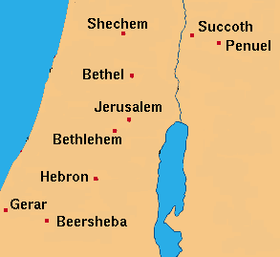

Slide 56
Genesis 28:10-12 Circumstances
Journey (10)
Bethel (11)
Dream (12)

Slide 57
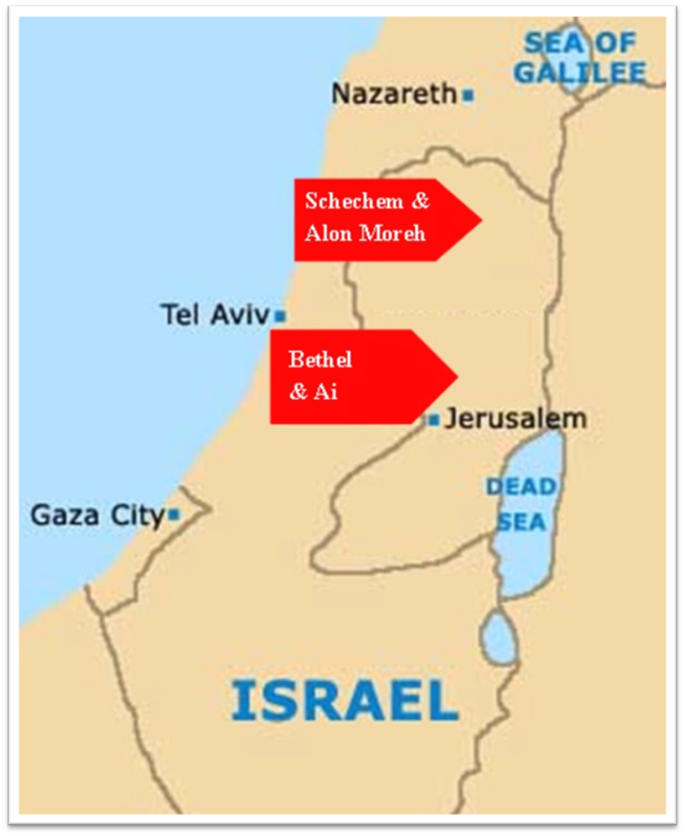

Slide 58
Dr. Arnold G. Fruchtenbaum
The Book of Genesis, 436
“The next thing he did was: And he took one of the stones of the place, and put it under his head, which has been misunderstood to mean that he used it as a pillow, but a stone would make a rather uncomfortable pillow. The Hebrew literally reads, ‘at his head,’ not ‘under his head.’ It means the stone was placed at his head, as was the case with Saul’s spear in I Samuel 26:7, where the same terminology is used. Then: and lay down in that place to sleep.”

Slide 59
Genesis 28:10-12 Circumstances
Journey (10)
Bethel (11)
Dream (12)

Slide 60
Dr. Arnold G. Fruchtenbaum
The Book of Genesis, 436-37
“In the dream Jacob saw something before him: And behold a ladder. The Hebrew word for ladder here is sulam, a hapax-legomenon. It was not a ladder in the modern sense of the term but has the meaning of a ‘stairway,’ indeed a stairway to heaven. It was set upon the earth, which is where Jacob was, and reached to heaven, where God was. The ladder pictured Jacob having access to Heaven.”

Slide 61
Dr. Arnold G. Fruchtenbaum
The Book of Genesis, 437
“Furthermore: And behold, the angels of God. In the Book of Genesis, the phrase the angels of God is found only twice, here and in 32:1; and it is significant as to the circumstances when it appears. Here in verse 12, the angels of God are mentioned as Jacob departs from the Land.”

Slide 62
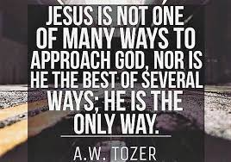
John 14:6
“Jesus said to him, ‘I am the way, and the truth, and the life; no one comes to the Father but through Me.’”

Slide 63
Genesis 28:10-22 Reconfirmation of the Covenant
Circumstances (10-12)
Covenant reaffirmed (13-15)
Jacob’s recognition (16-17)
Pillar (18-19)
Vow (20-22)

Slide 64
Genesis 28:13-15 Covenant Reaffirmed
Divine identification (13a)
Four covenant provisions (13b-15)

Slide 65
Genesis 28:13-15 Covenant Reaffirmed
Divine identification (13a)
Four covenant provisions (13b-15)

Slide 66
Genesis 28:13-15 Covenant Reaffirmed
Divine identification (13a)
Four covenant provisions (13b-15)

Slide 67
Genesis 28:13b-15 Four Covenant Provisions
Land (13b)
Seed (14a)
Blessing to the Gentiles (14b)
Jacob’s Personal Promises (15)

Slide 68
Genesis 28:13b-15 Four Covenant Provisions
Land (13b)
Seed (14a)
Blessing to the Gentiles (14b)
Jacob’s Personal Promises (15)

Slide 71
Genesis 28:13b-15 Four Covenant Provisions
Land (13b)
Seed (14a)
Blessing to the Gentiles (14b)
Jacob’s Personal Promises (15)

Slide 72
Genesis 28:13b-15 Four Covenant Provisions
Land (13b)
Seed (14a)
Blessing to the Gentiles (14b)
Jacob’s Personal Promises (15)

Slide 73
VI. 8 New Promises Genesis 12:1-3
Land (Gen. 12:1b)
Great nation (Gen. 12:2a)
Personal blessing (Gen. 12:2b)
Great name (Gen. 12:2c)
Blessing to others (Gen. 12:2d)
Blessing to blessers (Gen. 12:3a)
Cursing to cursers (Gen. 12:3b)
Blessing to the world (Gen. 12:3c)

Slide 74
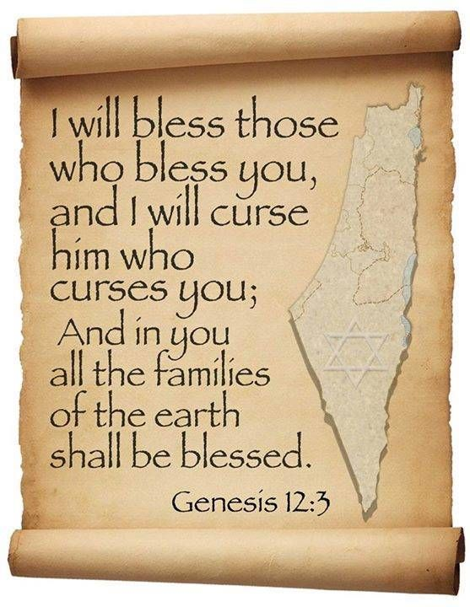
Genesis 12:3
“And I will bless those who bless you, And the one who curses you I will curse. And in you all the families of the earth will be blessed.”

Slide 75
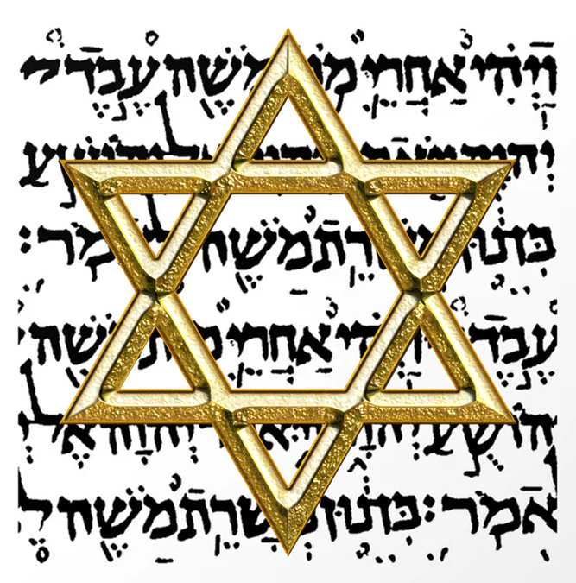
Israel’s Three Blessings to the World (Gen 12:3b)
Scripture (Rom 3:2)
Savior (John 4:22)
Kingdom (Isa 2:2-3)

Slide 76
Genesis 28:13b-15 Four Covenant Provisions
Land (13b)
Seed (14a)
Blessing to the Gentiles (14b)
Jacob’s Personal Promises (15)

Slide 77
Genesis 28:15 Jacob’s Personal Promises
God’s presence (15a)
God’s protection (15b)
Land (15c)
God’s commitment (15d)

Slide 78
Genesis 28:15 Jacob’s Personal Promises
God’s presence (15a)
God’s protection (15b)
Land (15c)
God’s commitment (15d)

Slide 79
Genesis 28:15 Jacob’s Personal Promises
God’s presence (15a)
God’s protection (15b)
Land (15c)
God’s commitment (15d)

Slide 80
Genesis 28:15 Jacob’s Personal Promises
God’s presence (15a)
God’s protection (15b)
Land (15c)
God’s commitment (15d)

Slide 81
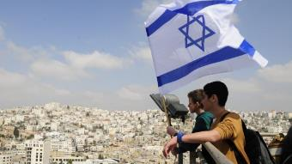
Reliability of the “Divine Regathering” Predictions
 | RETURN | PREDICTED | FULFILLED
1st | From Egypt to Canaan | Gen. 15:13-14 | Joshua 1‒12
2nd | From Babylon to Israel | Jer. 25:11; 29:10 | Ezra & Nehemiah
3rd | From the Diaspora to Israel’s restoration | Ezekiel 36:24-28 | Millennial Kingdom

Slide 82
Genesis 28:15 Jacob’s Personal Promises
God’s presence (15a)
God’s protection (15b)
Land (15c)
God’s commitment (15d)

Slide 83
Evidence of Abrahamic Covenant’s Unconditional Nature
ANE covenant ratification ceremony (Gen 15)
Lack of stated conditions for Israel’s obedience (Gen 15)
Covenant's eternality (Gen 17:7, 13, 19; Ps. 90:2)
Covenant's immutability (Heb 6:13-18; Mal. 3:6)
Trans-generational reaffirmation despite perpetual national disobedience (Jer 31:35-37)
Walvoord, The Millennial Kingdom, 149-52

Slide 84
Genesis 28:10-22 Reconfirmation of the Covenant
Circumstances (10-12)
Covenant reaffirmed (13-15)
Jacob’s recognition (16-17)
Pillar (18-19)
Vow (20-22)

Slide 85
Genesis 28:16-17 Jacob’s Recognition
Recognition (16)
Fear (17a)
Place (17b)
Conclusion (17c)

Slide 86
Genesis 28:16-17 Jacob’s Recognition
Recognition (16)
Fear (17a)
Place (17b)
Conclusion (17c)

Slide 87
Genesis 28:16-17 Jacob’s Recognition
Recognition (16)
Fear (17a)
Place (17b)
Conclusion (17c)

Slide 88
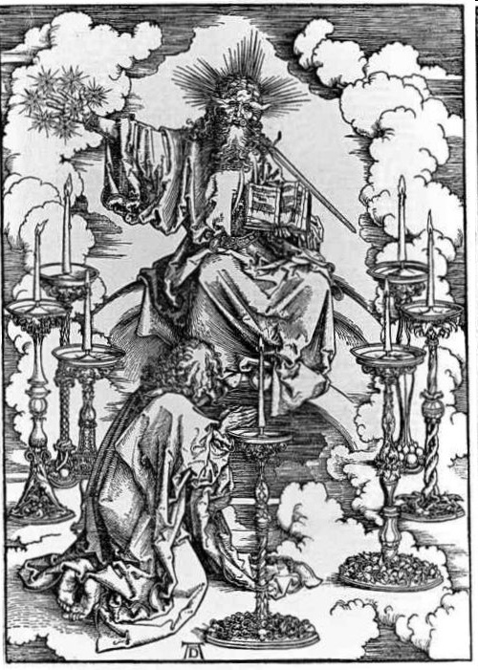

Slide 89
Genesis 28:16-17 Jacob’s Recognition
Recognition (16)
Fear (17a)
Place (17b)
Conclusion (17c)

Slide 90
Genesis 28:16-17 Jacob’s Recognition
Recognition (16)
Fear (17a)
Place (17b)
Conclusion (17c)

Slide 91
John 14:6
“Jesus said to him, ‘I am the way, and the truth, and the life; no one comes to the Father but through Me.’”

Slide 92
Genesis 28:10-22 Reconfirmation of the Covenant
Circumstances (10-12)
Covenant reaffirmed (13-15)
Jacob’s recognition (16-17)
Pillar (18-19)
Vow (20-22)

Slide 93
Genesis 28:18-19 Pillar
Pillar (18)
Name (19)

Slide 94
Genesis 28:18-19 Pillar
Pillar (18)
Name (19)

Slide 95
Genesis 28:18-19 Pillar
Pillar (18)
Name (19)

Slide 97
Genesis 28:10-22 Reconfirmation of the Covenant
Circumstances (10-12)
Covenant reaffirmed (13-15)
Jacob’s recognition (16-17)
Pillar (18-19)
Vow (20-22)

Slide 98
Genesis 28:20-22 Vow
Vow (20a)
Content (20b-22)

Slide 99
Genesis 28:20-22 Vow
Vow (20a)
Content (20b-22)

Slide 100
Genesis 28:20-22 Vow
Vow (20a)
Content (20b-22)

Slide 101
Genesis 28:20b-22 Content
What God will do (20b-21a)
What Jacob will do (21b-22)

Slide 102
Genesis 28:20b-22 Content
What God will do (20b-21a)
What Jacob will do (21b-22)

Slide 103
Genesis 28:20b-21a What God Would Do
God’s presence (20b)
God’s provision (20c)
Father’s house (21a)

Slide 104
Genesis 28:20b-21a What God Would Do
God’s presence (20b)
God’s provision (20c)
Father’s house (21a)

Slide 105
Dr. Arnold G. Fruchtenbaum
The Book of Genesis, 438-39
“In verse 20b–21a, he focused on what God would do, beginning in verse 21b with God’s provision for Jacob: If God will be with me, meaning if God’s presence will be indeed with him. The word if can also mean ‘since.' [Since] God will be with me, which is really more of a response of gratitude than a response of testing, and will keep me in this way that I go, and will give me bread to eat, and raiment to put on.”

Slide 106
Genesis 28:20b-21a What God Would Do
God’s presence (20b)
God’s provision (20c)
Father’s house (21a)

Slide 107
God’s Provision for the Giver (Phil. 4:19)
Exodus 16
1 Kings 17:2-6
Psalm 37:25
Matthew 6:25-34

Slide 108
Genesis 28:20b-21a What God Would Do
God’s presence (20b)
God’s provision (20c)
Father’s house (21a)

Slide 109
Genesis 28:20b-22 Content
What God will do (20b-21a)
What Jacob will do (21b-22)

Slide 110
Genesis 28:21b-22 What Jacob Will Do
Dedication (21b)
Pillar (22a)
Tithe (22b)

Slide 111
Genesis 28:21b-22 What Jacob Will Do
Dedication (21b)
Pillar (22a)
Tithe (22b)

Slide 112
Romans 12:1
¹ Therefore I urge you, brethren, by the mercies of God, to present your bodies a living and holy sacrifice, acceptable to God, which is your spiritual service of worship.

Slide 113
Genesis 28:21b-22 What Jacob Will Do
Dedication (21b)
Pillar (22a)
Tithe (22b)

Slide 114
Genesis 28:21b-22 What Jacob Will Do
Dedication (21b)
Pillar (22a)
Tithe (22b)

Slide 116
Psalm 147:19-20
“He declares His words to Jacob, His statutes and His ordinances to Israel. He has not dealt thus with any nation; And as for His ordinances, they have not known them. Praise the Lord!”

Slide 117
Conclusion

Slide 118
Genesis 28 Chapter Summary
Jacob’s flight to Haran (1-5)
Esau’s third wife (6-9)
Reconfirmation of the Covenant (10-22)

Slide 119
²⁴ The Lord bless you, and keep you; ²⁵ The Lord make His face shine on you, And be gracious to you; ²⁶ The Lord lift up His countenance on you, And give you peace.
Numbers 6:24–26 (NASB95)

