Slide 1


Dr. Andy Woods
Senior Pastor – Sugar Land Bible Church
President – Chafer Theological Seminary

Slide 2

Structure
1 THESSALONIANS 1-3 | 1 THESSALONIANS 4-5
Personal Experience | Practical Exhortation
Looking Back | Looking Forward

Slide 3

Structure
Personal (1–3)
  Genuine conversion (1)
  Impure motives (2:1-16)
  Lack of concern (2:17–3:13)
Practical (4–5)
  Immorality (4:1-8)
  Laziness (4:9-12)
  Eschatology (4:13–5:11)
  Ministry imbalances (5:12-15)
  Progressive sanctification (5:16-28)

Slide 4
Christian Living (4:1-12)
General conduct (4:1-2)
Negative command: sexual sin (4:3-8)
Positive command: brotherly love (4:9-12)

Slide 5
Positive Command (4:9-12)
General Command to love (4:9-10)
Specifics on how to love (4:11)
Results (4:12)

Slide 6

II. Specifics on how to Love (4:11)
  Aspiration (11a)
  Quiet life (11b)
  Mind your own business (11c)
  Work with your hands (11d)
  Apostolic authority (11e)

Slide 7
Positive Command (4:9-12)
General Command to love (4:9-10)
Specifics on how to love (4:11)
Results (4:12)

Slide 8
III. Results (4:12)
  Proper testimony to unbelievers (12a)
  Lack of need (12b)

Slide 9
III. Results (4:12)
  Proper testimony to unbelievers (12a)
  Lack of need (12b)

Slide 10


Charles Ryrie
Ryrie Study Bible, page 1485
1 Thessalonians 4:12 (RSB:NASB1995U): 4:12 outsiders. I.e., non-Christians.”

Slide 11
III. Results (4:12)
  Proper testimony to unbelievers (12a)
  Lack of need (12b)

Slide 12
Structure
Personal (1–3)
  Genuine conversion (1)
  Impure motives (2:1-16)
  Lack of concern (2:17–3:13)
Practical (4–5)
  Immorality (4:1-8)
  Laziness (4:9-12)
  Eschatology (4:13–5:11)
  Ministry imbalances (5:12-15)
  Progressive sanctification (5:16-28)

Slide 13

1 Thessalonians 4:13-18
¹³ "But we do not want you to be uninformed, brethren, about those who are asleep, so that you will not grieve as do the rest who have no hope. ¹⁴ For if we believe that Jesus died and rose again, even so God will bring with Him those who have fallen asleep in Jesus. ¹⁵ For this we say to you by the word of the Lord, that we who are alive and remain until the coming of the Lord, will not precede those who have fallen asleep. ¹⁶ For the Lord Himself will descend from . . .

Slide 14
1 Thessalonians 4:13-18
. . .heaven with a shout, with the voice of the archangel and with the trumpet of God, and the dead in Christ will rise first. ¹⁷ Then we who are alive and remain will be caught up together with them in the clouds to meet the Lord in the air, and so we shall always be with the Lord. ¹⁸ Therefore comfort one another with these words."

Slide 15
Unique Characteristics
Every chapter ends with a reference to the Second Advent
Small amount of time in between planting of the church and the first letter to the church

Slide 16

2 Thessalonians 2:5
“Do you not remember that while I was still with you, I was telling you these things?”

Slide 17
1 Thessalonians 4:13-18
¹³ "But we do not want you to be uninformed, brethren, about those who are asleep, so that you will not grieve as do the rest who have no hope. ¹⁴ For if we believe that Jesus died and rose again, even so God will bring with Him those who have fallen asleep in Jesus. ¹⁵ For this we say to you by the word of the Lord, that we who are alive and remain until the coming of the Lord, will not precede those who have fallen asleep. ¹⁶ For the Lord Himself will descend from . . .

Slide 18
Order of Paul’s Letters
Galatians (A.D. 49)
1‒2 Thessalonians (A.D. 51)
1‒2 Corinthians (A.D. 56)
Romans (A.D. 57)
Ephesians, Colossians, Philemon, Philippians (A.D. 60‒62)
1 Timothy, Titus (A.D. 62‒66)
2 Timothy (A.D. 67)

Slide 19
1 Thessalonians 4:13-18
¹³ "But we do not want you to be uninformed, brethren, about those who are asleep, so that you will not grieve as do the rest who have no hope. ¹⁴ For if we believe that Jesus died and rose again, even so God will bring with Him those who have fallen asleep in Jesus. ¹⁵ For this we say to you by the word of the Lord, that we who are alive and remain until the coming of the Lord, will not precede those who have fallen asleep. ¹⁶ For the Lord Himself will descend from . . .

Slide 20
1 Thessalonians 4:13-18
. . .heaven with a shout, with the voice of the archangel and with the trumpet of God, and the dead in Christ will rise first. ¹⁷ Then we who are alive and remain will be caught up together with them in the clouds to meet the Lord in the air, and so we shall always be with the Lord. ¹⁸ Therefore comfort one another with these words."

Slide 21
1 Thessalonians 4:13-18
. . .heaven with a shout, with the voice of the archangel and with the trumpet of God, and the dead in Christ will rise first. ¹⁷ Then we who are alive and remain will be caught up together with them in the clouds to meet the Lord in the air, and so we shall always be with the Lord. ¹⁸ Therefore comfort one another with these words."

Slide 22
1 Thessalonians 4:13-18
. . .heaven with a shout, with the voice of the archangel and with the trumpet of God, and the dead in Christ will rise first. ¹⁷ Then we who are alive and remain will be caught up (harpazō) together with them in the clouds to meet the Lord in the air, and so we shall always be with the Lord. ¹⁸ Therefore comfort one another with these words."

Slide 23
1 Thessalonians 4:13-18
. . .heaven with a shout, with the voice of the archangel and with the trumpet of God, and the dead in Christ will rise first. ¹⁷ Then we who are alive and remain will be caught up together with them in the clouds to meet the Lord in the air, and so we shall always be with the Lord. ¹⁸ Therefore comfort one another with these words."

Slide 24
1 Thessalonians 4:13-18
¹³ "But we do not want you to be uninformed, brethren, about those who are asleep, so that you will not grieve as do the rest who have no hope. ¹⁴ For if we believe that Jesus died and rose again, even so God will bring with Him those who have fallen asleep in Jesus. ¹⁵ For this we say to you by the word of the Lord, that we who are alive and remain until the coming of the Lord, will not precede those who have fallen asleep. ¹⁶ For the Lord Himself will descend from . . .

Slide 25


John 14:1–4
¹ “Do not let your heart be troubled; believe in God, believe also in Me. ² In My Father’s house are many dwelling places; if it were not so, I would have told you; for I go to prepare a place for you. ³ If I go and prepare a place for you, I will come again and receive you to Myself, that where I am, there you may be also. ⁴ And you know the way where I am going.”

Slide 26
Parallels
JOHN 14:1-4 | 1 THESS 4:13-18
trouble (1) | sorrow (13)
Believe (1) | believe (14)
God, me (1) | Jesus, God (14)
told you (2) | say to you (15)
come again (3) | coming of the Lord (15)
receive, you (3) | caught up (17)
to myself (3) | to meet the Lord (17)
be where I am (3) | ever be with the Lord (17)
J. B. Smith, A Revelation of Jesus Christ: A Commentary on the Book of Revelation, 311-13

Slide 27
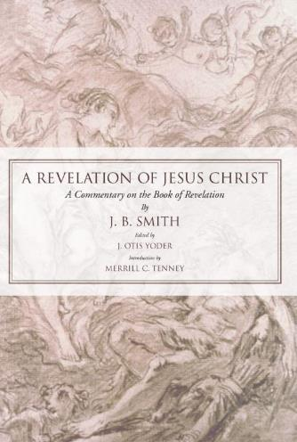
J. B. Smith
A Revelation of Jesus Christ: A Commentary on the Book of Revelation (Scottdale, PA: Herald Press, 1961), pp. 312-13.
“The words or phrases are almost an exact parallel. They follow one another in both passages in exactly the same order. Only the righteous are dealt with in each case. There is not a single irregularity in the progression of words from first to last. Either column takes the believer from the troubles of earth to the glories of heaven.”

Slide 28
1 Thessalonians 4:13-18
¹³ "But we do not want you to be uninformed, brethren, about those who are asleep, so that you will not grieve as do the rest who have no hope. ¹⁴ For if we believe that Jesus died and rose again, even so God will bring with Him those who have fallen asleep in Jesus. ¹⁵ For this we say to you by the word of the Lord, that we who are alive and remain until the coming of the Lord, will not precede those who have fallen asleep. ¹⁶ For the Lord Himself will descend from . . .

Slide 29
1 Thessalonians 4:13-18
. . .heaven with a shout, with the voice of the archangel and with the trumpet of God, and the dead in Christ will rise first. ¹⁷ Then we who are alive and remain will be caught up (harpazō) together with them in the clouds to meet the Lord in the air, and so we shall always be with the Lord. ¹⁸ Therefore comfort one another with these words."

Slide 30

Catching Away of All Living Believers
(1 Thess. 4:17)
Harpazo = seized or caught up by force
Harpazo (Greek) = rapere (Latin) = rapture (English)

Slide 31
RAPTURE DISTINCT FROM SECOND ADVENT
RAPTURE (1 Thess 4:13-17; 1 Cor 15:51-57) | SECOND COMING (Rev 19:11-16)
Christ comes in the air (1 Thess 4:16) | Christ comes to the earth (Zech 14:4)
For His saints (1 Thess 4:15-17) | With His saints (Rev 19:14)
Blessing (1 Thess 4:18) | Judgment (Rev 19:15)
Effects only believers (1 Thess 4:16) | Effects both believers and unbelievers (Rev 19:15)
Invisible (1 Thess 4:16) | Visible to all (Rev 1:7)
Announced only by an archangel (1 Thess 4:16) | Involves myriads of angels (Jude 14)
Resurrection (1 Cor 15: 51) | No resurrection
Rescue of the church (1 Thess 1:10) | Rescue of Israel (Matt 23:37-39)

Slide 32
1 Thessalonians 4:13-18
. . .heaven with a shout, with the voice of the archangel and with the trumpet of God, and the dead in Christ will rise first. ¹⁷ Then we who are alive and remain will be caught up together with them in the clouds to meet the Lord in the air, and so we shall always be with the Lord. ¹⁸ Therefore comfort one another with these words."

Slide 33


Slide 34

Revelation 20:4-6
…⁵ The rest of the dead did not come to life [zaō] until the thousand years were completed. This is the first resurrection [anastasis]. ⁶ Blessed and holy is the one who has a part in the first resurrection [anastasis]; over these the second death has no power, but they will be priests of God and of Christ and will reign with Him for a thousand years.”

Slide 35
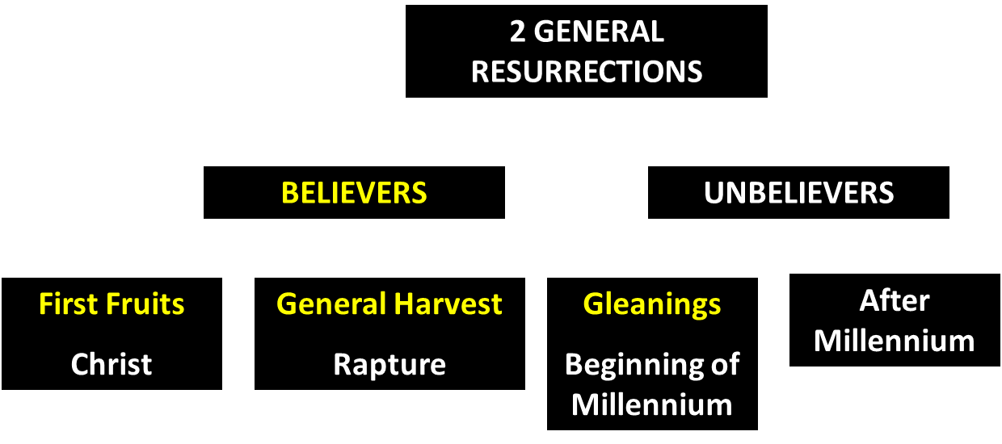
God’s Resurrection Program

Slide 36
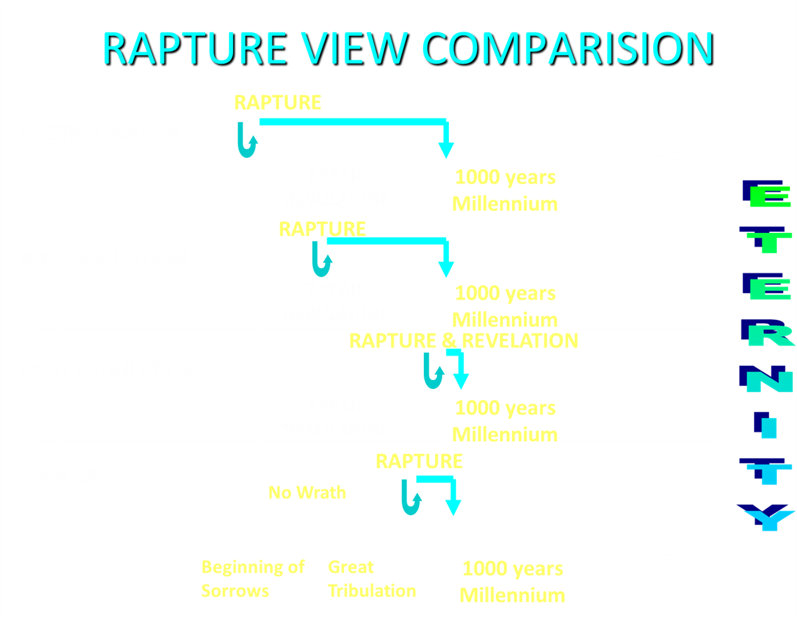

Slide 37
1 Thessalonians 4:13-18
¹³ "But we do not want you to be uninformed, brethren, about those who are asleep, so that you will not grieve as do the rest who have no hope. ¹⁴ For if we believe that Jesus died and rose again, even so God will bring with Him those who have fallen asleep in Jesus. ¹⁵ For this we say to you by the word of the Lord, that we who are alive and remain until the coming of the Lord, will not precede those who have fallen asleep. ¹⁶ For the Lord Himself will descend from . . .

Slide 38
1 Thessalonians 4:13-18
. . .heaven with a shout, with the voice of the archangel and with the trumpet of God, and the dead in Christ will rise first. ¹⁷ Then we who are alive and remain will be caught up together with them in the clouds to meet the Lord in the air, and so we shall always be with the Lord. ¹⁸ Therefore comfort one another with these words."

Slide 39


1 Thessalonians 1:10
“and to wait for His Son from heaven, whom He raised from the dead, that is Jesus, who rescues (rhyomai) us from (ek) the wrath (orgē) to come..”

Slide 40

Promised Exemption from Divine Wrath
The promise (1 Thess 1:10; 5:9; Rom 5:9; 8:1; Rev 3:10)
Tribulation = divine wrath/anger (Rev 6:16-17; 11:18; 14:10; 15:1, 7; 16:1, 19; 19:15)

Slide 41


Slide 42
Conclusion

Slide 43
Structure
Personal (1–3)
  Genuine conversion (1)
  Impure motives (2:1-16)
  Lack of concern (2:17–3:13)
Practical (4–5)
  Immorality (4:1-8)
  Laziness (4:9-12)
  Eschatology (4:13–5:11)
  Ministry imbalances (5:12-15)
  Progressive sanctification (5:16-28)

