Slide 1
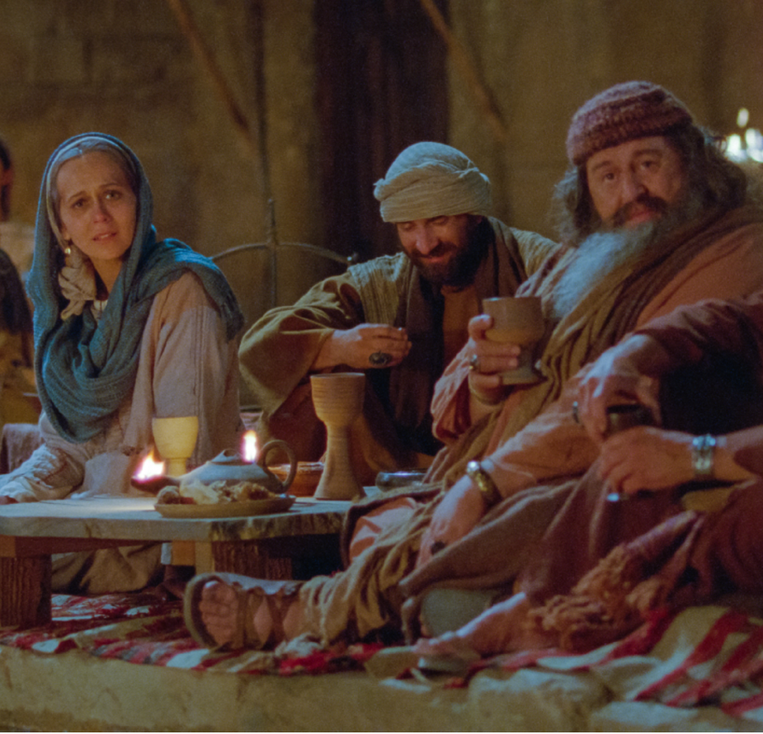
THE JEWISH WEDDING SYSTEM AND THE BRIDE OF MESSIAH
Olivier Melnick
Chosen People Ministries

Slide 2
INTRODUCTION
The Ancient Jewish Wedding.
A unique relationship between the Bridegroom and the Bride.
A powerful parallel.
Eschatological significance.

Slide 3
A POWERFUL PARALLEL
The Groom = Yeshua the Messiah
The Bride = The Body of Messiah
The order of the Jewish wedding sheds some light on the order of end times events

Slide 4
YESHUA OUR ONLY HOPE
The Arrangement
The Preparation
The Fetching of the Bride
The Ceremony
The Marriage Feast
The Home of the Bride

Slide 5
The Arrangement
The father of the Groom made arrangements with the father of the Bride.
A set price was paid by the Father of the Groom.
Many times, that stage occurred when the future mates were children.

Slide 6
The Arrangement FULFILLED
God the Father is the Father of the Groom,
He paid the price for the Bride (the Church.)
The price for the bride was His son’s blood, shed on the cross on our behalf.
The arrangement was sealed.

Slide 7
The Arrangement FULFILLED
Ephesians 5:25b Messiah also loved the Church, and gave Himself up for it;
1 Corinthians 6:20 For you have been bought with a price: therefore, glorify God in your body.

Slide 8
The Arrangement FULFILLED
John 3:16a For God so loved the world, that He gave His only begotten Son.
1 Timothy 2:5-6 For there is one God, and one mediator also between God and men, the man Yeshua the Messiah, who gave Himself as a ransom for all, the testimony given at the proper time.

Slide 9
2. The Preparation
Known as “The Period of Betrothal”
Typically lasted one year.
A time when the Bride is being prepared.
A time when the Bride is observed for purity.
This is one of the reasons why it lasts more than 9 months.

Slide 10
2. The Preparation
Numbers 5:11-31 – The water of bitterness
Talmud: Tractates Sotah and Gittin
Adultery/Pregnancy annuls the relationship.
This explains Joseph’s concern for Mary.
He might have sent her away if Gabriel had not approached him.

Slide 11
2. The Preparation FULFILLED
The Bride of Messiah (Church) is being perfected for the Bridegroom (Messiah)
The process is known as sanctification (set apart).
The goal is to present a glorious bride to the bridegroom.

Slide 12
2. The Preparation FULFILLED
II Corinthians 11:2 For I am jealous over you with a godly jealousy; for I betrothed you to one husband that I might present you as a pure virgin to Messiah.

Slide 13
2. The Preparation FULFILLED
Ephesians 5:26-27: That He might sanctify her, having cleansed her by the washing of water with the word, that He might present to Himself the church in all her glory, having no spot or wrinkle or any such thing; but that she would be holy and blameless.

Slide 14
2. The Preparation FULFILLED
The Church will be:
Spotless
No outward defilement.
No wrinkle, which means no evidence of aging.
It will be holy, which means that it would have finally reached full sanctification
There will be no blemish or inward defilement.

Slide 15
2. The Preparation
The Bridegroom:
Goes away to his home.
Spends a year preparing a place for his bride.
Returns to fetch his bride.

Slide 16
2. The Preparation FULFILLED
John 14:3
3 And if I go and prepare a place for you, I am coming again and will take you to Myself, so that where I am, there you also will be.

Slide 17
2. The Preparation FULFILLED
It will culminate at the Bema Seat Judgment
(for believers) – Rewards not salvation
2 Corinthians 5:10 For we must all appear before the judgment seat of Messiah, so that each one may receive compensation for his deeds done through the body, in accordance with what he has done, whether good or bad.
Different from the Great White Throne Judgment (Revelation 20:11-15) – (For unbelievers) – Eternal damnation

Slide 18
3.The Fetching of the bride

Slide 19
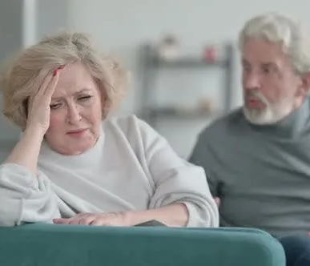
The FETCHING of the bride. Is not to be confused with The KVETCHING of the bride. KVETCH: (Yiddish) To complain persistently and whiningly.

Slide 20
3.The Fetching of the bride
The Bridegroom:
Returns to the home of the Bride.
He takes his bride to their new home.
This leads to a bridal procession
(Matthew 25:1-13)

Slide 21
3.The Fetching of the bride The Bridal Procession
Matthew 25:1-13 25 “Then the kingdom of heaven will be comparable to ten virgins, who took their lamps and went out to meet the groom. 2 Five of them were foolish, and five were prudent. 3 For when the foolish took their lamps, they did not take extra oil with them; 4 but the prudent ones took oil in flasks with their lamps. 5 Now while the groom was delaying, they all became drowsy and began to sleep. 6 But at midnight there finally was a shout: ‘Behold, the groom! Come out to meet him.’

Slide 22
7 Then all those virgins got up and trimmed their lamps. 8 But the foolish virgins said to the prudent ones, ‘Give us some of your oil, because our lamps are going out.’ 9 However, the prudent ones answered, ‘No, there most certainly would not be enough for us and you too; go instead to the merchants and buy some for yourselves.’ 10 But while they were on their way to buy the oil, the groom came, and those who were ready went in with him to the wedding feast; and the door was shut. 11 Yet later, the other virgins also came, saying, ‘Lord, lord, open up for us.’ 12 But he answered, ‘Truly I say to you, I do not know you.’ 13 Be on the alert then, because you do not know the day nor the hour.

Slide 23
3.The Fetching of the bride FULFILLED BY THE RAPTURE
I Thessalonians 4:13-18 But we do not want you to be uninformed, brethren, about those who are asleep, so that you will not grieve as do the rest who have no hope. 14 For if we believe that Yeshua died and rose again, even so God will bring with Him those who have fallen asleep in Yeshua. 15 For this we say to you by the word of the Lord, that we who are alive

Slide 24
3.The Fetching of the bride
and remain until the coming of the Lord, will not precede those who have fallen asleep. 16 For the Lord Himself will descend from heaven with a shout, with the voice of the archangel and with the trumpet of God, and the dead in Messiah will rise first. 17 Then we who are alive and remain will be caught up together with them in the clouds to meet the Lord in the air, and so we shall always be with the Lord. 18 Therefore comfort one another with these words.

Slide 25
3. The Fetching of the bride Seven Steps
1. Messiah will come from Heaven into the earth’s atmosphere, and in that sense, He will enter into the realm of the home of the bride.
2. He will give a shout, like a military command for the process to begin.
3. Michael, the archangel will repeat Messiah’s command like a sub-commander would repeat the orders of a general.

Slide 26
3. The Fetching of the bride Seven Steps
4. Then comes the trump of God
5. The dead in Messiah will rise first.
6. The living will then meet Messiah in the air.
7. The believers will be with the Lord to never be separated again.

Slide 27
3. The Fetching of the bride
Up to that point,
SANCTIFICATION has been a process from the time of salvation forward, leading to its final state known as GLORIFICATION when believers are in Heaven.

Slide 28
4.The Ceremony
Was conducted at the home of the Groom.
It Included immediate family and two witnesses.
FULFILLED by a ceremony in heaven for the raptured Bride (Church) and the Groom (Yeshua)

Slide 29
4.The Ceremony
Revelation 19:6-9 Then I heard something like the voice of a great multitude and like the sound of many waters and like the sound of mighty peals of thunder, saying, “Hallelujah! For the Lord our God, the Almighty, reigns. Marriage of the Lamb7 Let us rejoice and be glad and give the glory to Him, for the marriage of the Lamb has come and His bride has made herself ready.” 8 It was given to her to clothe herself in fine linen, bright and clean; for the fine linen is the righteous acts of the saints.

Slide 30
4.The Ceremony
Revelation 19:11-16 And I saw heaven opened, and behold, a white horse, and He who sat on it is called Faithful and True, and in righteousness, He judges and wages war. 12 His eyes are a flame of fire, and on His head are many diadems, and He has a name written on Him which no one knows except Himself. 13 He is clothed with a robe dipped in blood, and His name is called The Word of God.

Slide 31
4.The Ceremony
14 And the armies which are in heaven, clothed in fine linen, white and clean, were following Him on white horses. 15 From His mouth comes a sharp sword, so that with it He may strike down the nations, and He will rule them with a rod of iron; and He treads the winepress of the fierce wrath of God, the Almighty. 16 And on His robe and on His thigh He has a name written, “KING OF KINGS, AND LORD OF LORDS.”

Slide 32
4.The Ceremony
As it pertains to the Church, three aspects of the whole Jewish wedding system are found here.
1. The marriage and the Ceremony take place in Heaven, before the second coming.
2. The wife has made herself ready, as she is now glorified (no spot, blemish, or wrinkles).
3. She is dressed in fine white linen, which represents the righteous acts of the saints.
By this time, the Bema Seat Judgment of Messiah is over with, full sanctification is attained, and the Bride (Church) is indeed like a pure virgin being presented to Messiah.

Slide 33
5.The Marriage Feast
Many more people were invited.
The feast would last one or two weeks.
It will be FULFILLED by the Marriage Supper of the Lamb on earth to inaugurate the Millennial Kingdom.

Slide 34
5.The Marriage Feast
Isaiah 26:19 Your dead will live; Their corpses will rise. You who lie in the dust, awake and shout for joy, For your dew is as the dew of the dawn, And the earth will give birth to the departed spirits.
Daniel 12:2: Many of those who sleep in the dust of the ground will awake, these to everlasting life, but the others to disgrace and everlasting contempt.

Slide 35
5.The Marriage Feast
Revelation 19:7-10 7 Let’s rejoice and be glad and give the glory to Him, because the marriage of the Lamb has come, and His bride has prepared herself.” 8 It was given to her to clothe herself in fine linen, bright and clean; for the fine linen is the righteous acts of the saints. 9 Then he said to me, “Write: ‘Blessed are those who are invited to the wedding feast of the Lamb.’”

Slide 36
5.The Marriage Feast
Revelation 19:7-10 And he said to me, “These are the true words of God.” 10 Then I fell at his feet to worship him. But he said to me, “Do not do that; I am a fellow servant of yours and your brothers and sisters who hold the testimony of Yeshua; worship God! For the testimony of Yeshua is the spirit of prophecy.”

Slide 37
5.The Marriage Feast WHO ARE THE EXTRA GUESTS?
• John the Baptist (John 3:28-30)
“A friend of the Bridegroom” • Tribulation Saints (Revelation 20:4-6)
Resurrected after the Second Coming
• Israel (Romans 11:26)
“Then all Israel will be saved”

Slide 38
6.The Home of the Bride
• The groom is responsible to provide a home for his bride during the second stage known as the preparation stage.
John 14:1-3 Do not let your heart be troubled; believe in God, believe also in Me. In My Father’s house are many dwelling places; if it were not so, I would have told you; for I go to prepare a place for you. If I go and prepare a place for you, I will come again and receive you to Myself, that where I am, there you may be also.

Slide 39
6.The Home of the Bride FULFILLED ?
• The New Jerusalem/Eternal Order
Revelation 21:9-10 9 Then one of the seven angels who had the seven bowls, full of the seven last plagues, came and spoke with me, saying, “Come here, I will show you the bride, the wife of the Lamb.” 10 And he carried me away in the Spirit to a great and high mountain, and showed me the holy city, Jerusalem, coming down out of heaven from God,

Slide 40
THE BIG PICTURE
•When it comes to the Jewish wedding system and the relationship between Yeshua and His bride (the Church), some aspects have been fulfilled and others await fulfillment.
•They all point to Yeshua being our only hope.

Slide 41
YESHUA OUR ONLY HOPE
The Arrangement:
YESHUA’S DEATH & RESURRECTION
2. The Preparation:
SANCTIFICATION OF THE CHURCH
3. The Fetching of the Bride:
RAPTURE OF THE SAINTS

Slide 42
YESHUA OUR ONLY HOPE
4. The Ceremony:
OUR TIME IN HEAVEN
5. The Marriage Feast:
MARRIAGE SUPPER OF THE LAMB
6. The Home of the Bride:
THE NEW JERUSALEM

Slide 43
A NEW WAY TO LOOK AT ESCHATOLOGY
• The Fetching of the Bride happens first, and then the Marriage Feast:
THIS SEEMS TO INDICATE THAT THE RAPTURE OF THE SAINTS WILL OCCUR BEFORE THE MILLENNIAL KINGDOM.

Slide 44
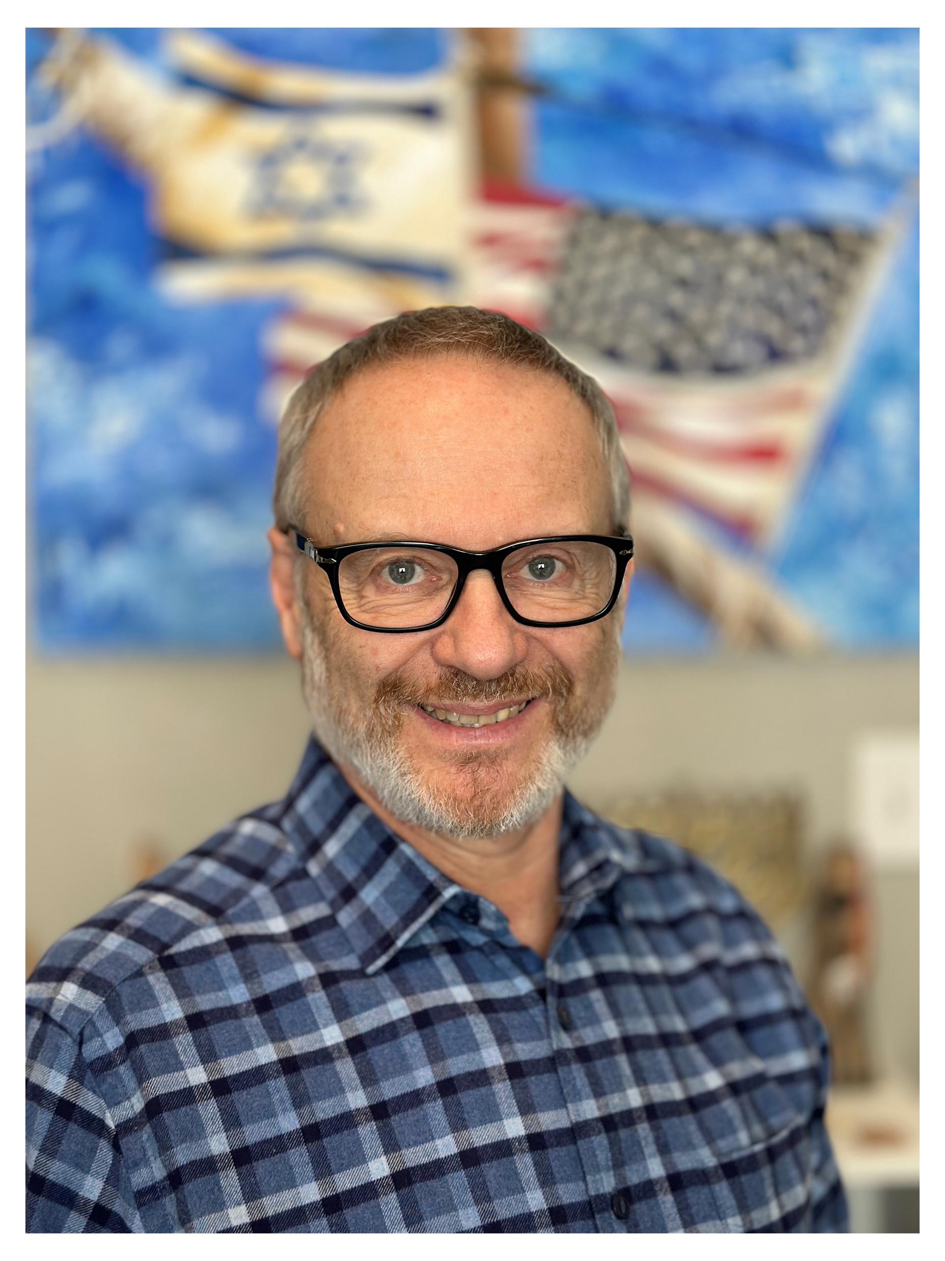
SUPPORT US AT: WWW.CHOSENPEOPLE.COM/OLIVIER
FOLLOW US ON TWITTER,
INSTAGRAM AND
YOUTUBE AT: @OlivierMelnick

