Slide 1
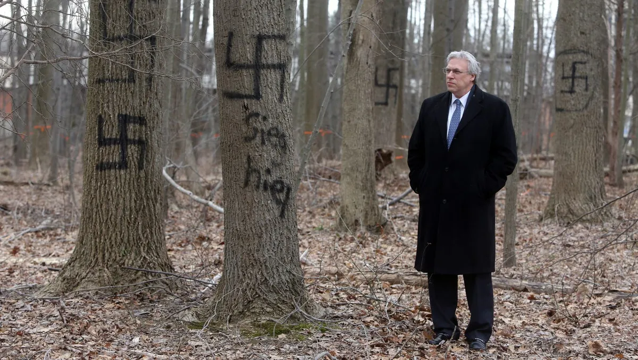
THE NORMALIZATION OF ANTISEMITISM
WHEN THE OLDEST HATRED
BECOMES THE NEW NORMAL
OLIVIER MELNICK, CHOSEN PEOPLE MINISTRIES, DALLAS, TX

Slide 2
DEFINITIONS
ANTISEMITISM IS THE IRRATIONAL AND DEMONIC HATRED OF THE JEWISH PEOPLE AND OF ISRAEL, CHARACTERIZED BY THOUGHTS, WORDS, AND/OR DEEDS AGAINST THEM.

Slide 3
DEFINITIONS
NORMALIZATION IS THE PROCESS BY WHICH SOMETHING PREVIOUSLY CONSIDERED ABNORMAL OR UNACCEPTABLE BECOMES PERCEIVED AS NORMAL.

Slide 4
ANTISEMITISM THROUGHOUT HUMAN HISTORY
• THEOLOGICAL ANTI-JUDAISM
• CLASSICAL ANTISEMITISM
• RACIAL ANTISEMITISM
THE HOLOCAUST
• NEW ANTISEMITISM
• END-TIMES ANTISEMITISM
• TRIBULATION ANTISEMITISM

Slide 5
ANTISEMITISM THROUGHOUT HUMAN HISTORY
• THEOLOGICAL ANTI-JUDAISM
From the biblical account to the Dark Ages.
• CLASSICAL ANTISEMITISM
From the Dark Ages to Post WWI.

Slide 6
ANTISEMITISM THROUGHOUT HUMAN HISTORY
• RACIAL ANTISEMITISM
The Holocaust Years (1933-1945).
• NEW ANTISEMITISM
Post-Holocaust to today.

Slide 7
ANTISEMITISM THROUGHOUT HUMAN HISTORY
• END-TIMES ANTISEMITISM
2012-Current.
• TRIBULATION ANTISEMITISM
Final seven years of mankind before the Millennial Kingdom.

Slide 8
THE ULTIMATE OXYMORON!
THE NORMALIZATION
OF ANTISEMITISM
CAN ANOTHER HOLOCAUST HAPPEN?

Slide 9
THE 6 MAJOR CAUSES
Simon Wiesenthal, Every Day Remembrance Day: A Chronicle of Jewish Martyrdom. 1. Hatred (bigotry, prejudice)
2. Dictatorship (one, a few, or many)
3. Bureaucracy (a rigid hierarchy of bureaus, chiefs, and petty officials, leading to the the attitude of “I was just following orders!”)

Slide 10
THE 6 MAJOR CAUSES
4. Technology (to provide the practical instruments for mass murder.)
5. A crisis (like a war, an opportune moment to act on the hatred.)
A minority or “scapegoat” to be demonized, leading to its ethnic cleansing.)

Slide 11
THE 6 MAJOR CAUSES

Slide 12
THE GOYIM DEFENSE LEAGUE
•“Do you think you should be put in ovens?”
•“Leave our country, go back to Israel where you bomb Palestinian kids.”

Slide 13
THE 10 STAGES TOWARD THE NORMALIZATION OF ANTISEMITISM
• Apathy • Lack of education • Low or incorrect reporting • Desensitization • Lack of accountability
• Empowerment • Demonization of the defenders • Persecution of Jews and defenders • Encouragement to kill • Mass murder of Jews

Slide 14
1. APATHY
• People don’t seem to care about Antisemitism unless they are directly affected through someone they know.
• Antisemitism is not on most Christians’ radar.
• When people don’t care, they don’t respond or react.

Slide 15
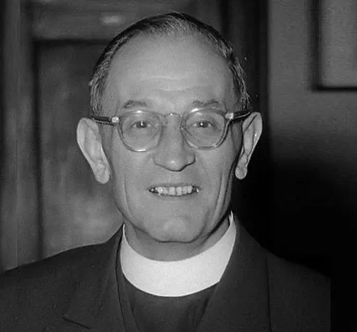
1. APATHY TOWARD A SOLUTION
• If people continue being apathetic toward antisemitism, they will miss the greater danger looming over other communities.
Pastor Martin Niemöller

Slide 16
1. APATHY TOWARD A SOLUTION
First they came for the socialists, and I did not speak out, because I was not a socialist.
Then they came for the trade unionists, and I did not speak out, because I was not a trade unionist.
Then they came for the Jews, and I did not speak out, because I was not a Jew.
Then they came for me, and there was no one left to speak for me.

Slide 17
2. LACK OF EDUCATION
• Antisemitism didn’t happen
in a vacuum.
• Most people are unaware of
the key players.
. Victims
. Perpetrators
. Co-perpetrators
. Bystanders
. Rescuers

Slide 18
2. LACK OF EDUCATION
• According to a Pew Research Survey, 84% of Americans still do not know what the term BDS means (Boycott, Divestment & Sanctions.)¹
• Many Christians are in denial regarding Martin Luther’s antisemitic diatribes at the end of his life. 1 https://www.pewresearch.org/religion/2022/05/26/modest-warming-in-u-s-views-on-israel-and-palestinians/05-26-22_israel-report_0-10/

Slide 19
2. LACK OF EDUCATION
• Most Christians have never heard of the 1920 San Remo Conference, which was more legally defining for modern Israel than the 1947 UN vote for the partition of British Mandate Palestine.
HOW CAN WE FIGHT AN ENEMY WE DO NOT KNOW?

Slide 20
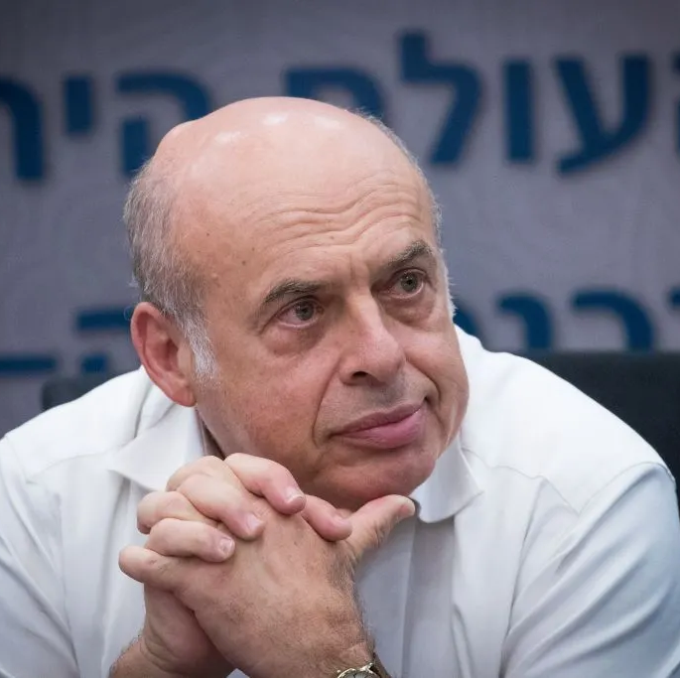
2. LACK OF EDUCATION TOWARD A SOLUTION
The 3 Ds of Antisemitism by Natan Sharansky (Russian Refusenik)
• Demonization
• Double-Standards
• Delegitimization

Slide 21
2. LACK OF EDUCATION TOWARD A SOLUTION
The first "D" is the test of demonization. When the Jewish state is being demonized; when Israel's actions are blown out of all sensible proportion; when comparisons are made between Israelis and Nazis and between Palestinian refugee camps and Auschwitz - this is anti-Semitism, not legitimate criticism of Israel.

Slide 22
2. LACK OF EDUCATION TOWARD A SOLUTION
The second "D" is the test of double standards. When criticism of Israel is applied selectively; when Israel is singled out by the United Nations for human rights abuses while the behavior of known and major abusers, such as China, Iran, Cuba, and Syria, is ignored; when Israel’s Magen David Adom, alone among the world's ambulance services, is denied admission to the International Red Cross - this is anti-Semitism.

Slide 23
2. LACK OF EDUCATION TOWARD A SOLUTION
The third "D" is the test of delegitimization: when Israel's fundamental right to exist is denied - alone among all peoples in the world - this too is anti-Semitism.
https://www.jcpa.org/phas/phas-sharansky-f04.htm

Slide 24
3. LOW OR INCORRECT REPORTING
• Jan 2022 in Colleyville, TX: A Hostage situation at a synagogue by a Muslim man was initially declared not antisemitic by the local FBI director.
• The FBI changed its story after pressure from the Jewish community.

Slide 25
3. LOW OR INCORRECT REPORTING
• May 2022 in Lyon, France: 90-year-old Jewish man René Hadjaj was pushed
out of his from 17th – story window by a neighbor. The authorities initially saw no reason to suspect antisemitism.

Slide 26
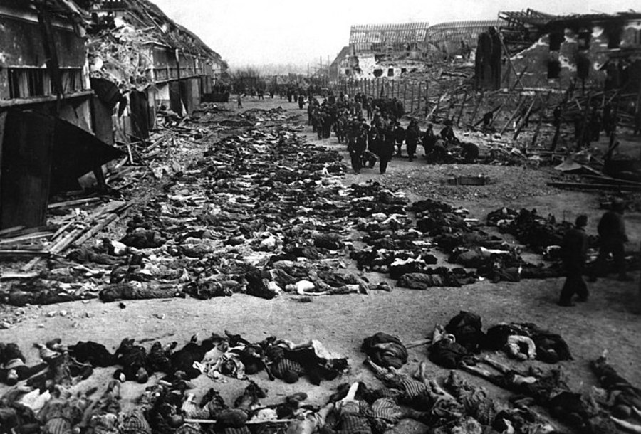
3. LOW OR INCORRECT REPORTING
• February 2023, the Palestinian Campaign for the Academic and Cultural Boycott of Israel used a photo they labeled “1948 Tantura Massacre.”
The photo has been verified to be from the Nordhausen Concentration camp in Germany.

Slide 27
3. LOW OR INCORRECT REPORTING TOWARD A SOLUTION
• When you are a victim of antisemitism or witness it, report it to: The Authorities, the Media and Jewish Advocacy Groups such as:
StandWithUs, The Canary Mission, Moment Magazine Antisemitism Monitor, and The Committee for Accuracy in Middle East Reporting in America (CAMERA).
SILENCE IS COMPLICITY

Slide 28
4. DESENSITIZATION
• Desensitization is a diminished emotional response to a negative or positive stimulus.
• Desensitization can come both from friends and foes. It is expected from foes, but what about when it comes from friends?

Slide 29
4. DESENSITIZATION TOWARD A SOLUTION
• When we hear comments that are clearly insensitive about Jewish people including jokes, we can no longer just roll our eyes. It is our duty to bring it to the attention of the person.
• Quickly
• Privately
• Lovingly

Slide 30
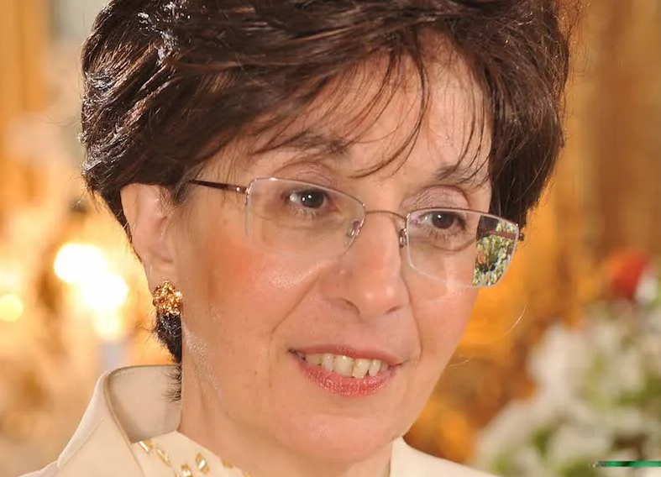
5. NO ACCOUNTABILITY
• May 2017 in Paris, France: Retired Jewish Doctor Sarah Halimi was thrown out of her 2nd-floor window by her neighbor Kolibi Traoré screaming “Allahu akbar.”

Slide 31
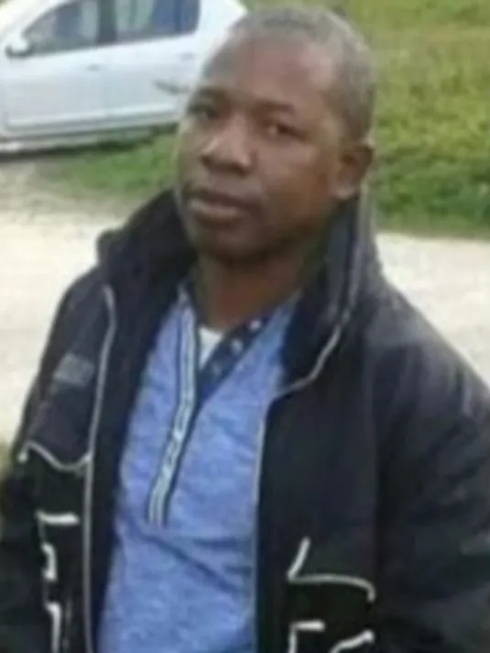
5. NO ACCOUNTABILITY
• 2021 Paris, France: Halimi’s killer Kolibi Traoré was not even put on trial after the French Court de Cassation deemed him not responsible since he was high on cannabis when he acted.

Slide 32
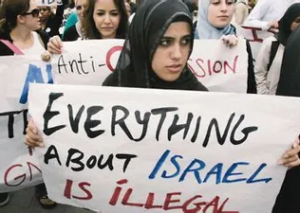
5. NO ACCOUNTABILITY
• Campus Intifada or Campus
Jihad: Over 200 American
Colleges facilitate conferences and seminars led by antisemites
and pro-Palestinian speakers while boycotting and blocking any event about Israel or Zionism.

Slide 33
5. NO ACCOUNTABILITY
• US bipartisan task force requested by Congress in 2022.
. Identify the problem
. Form committees to discuss strategy
. Gather statistics
. Implement very little
. Almost zero enforcing

Slide 34
5. NO ACCOUNTABILITY TOWARD A SOLUTION
• When you are made aware of the lack of accountability you should also report it to: The Authorities, the Media and Jewish Advocacy Groups such as:
StandWithUs, The Canary Mission, Moment Magazine Antisemitism Monitor, and The Committee for Accuracy in Middle East Reporting in America (CAMERA).

Slide 35
6. EMPOWERMENT
• The result of the lack of accountability is the empowerment of the perpetrators and an increase
In antisemitic crimes.
• According to the ADL, antisemitic incidents reached an all-time high in 2021 (34% increase over 2020)
• Attacks against synagogues increased by 61%
• 2022 will most likely break the 2021 record. https://www.adl.org/resources/press-release/adl-audit-finds-antisemitic-incidents-united-states-reached-all-time-high

Slide 36
6. EMPOWERMENT TOWARD A SOLUTION
• When you are made aware of the empowerment of antisemites:
• Don’t let them intimidate you.
• Know the law so you can warn people.
• Report the culprits.

Slide 37
7. DEMONIZATION OF THE DEFENDERS
• The current polarization of America makes it very difficult to dialogue or speak up to defend people. Civility seems to be a thing of the past.
• Those who choose to defend the victims of antisemitism are exposing themselves.
• We must take a side and defend it.

Slide 38
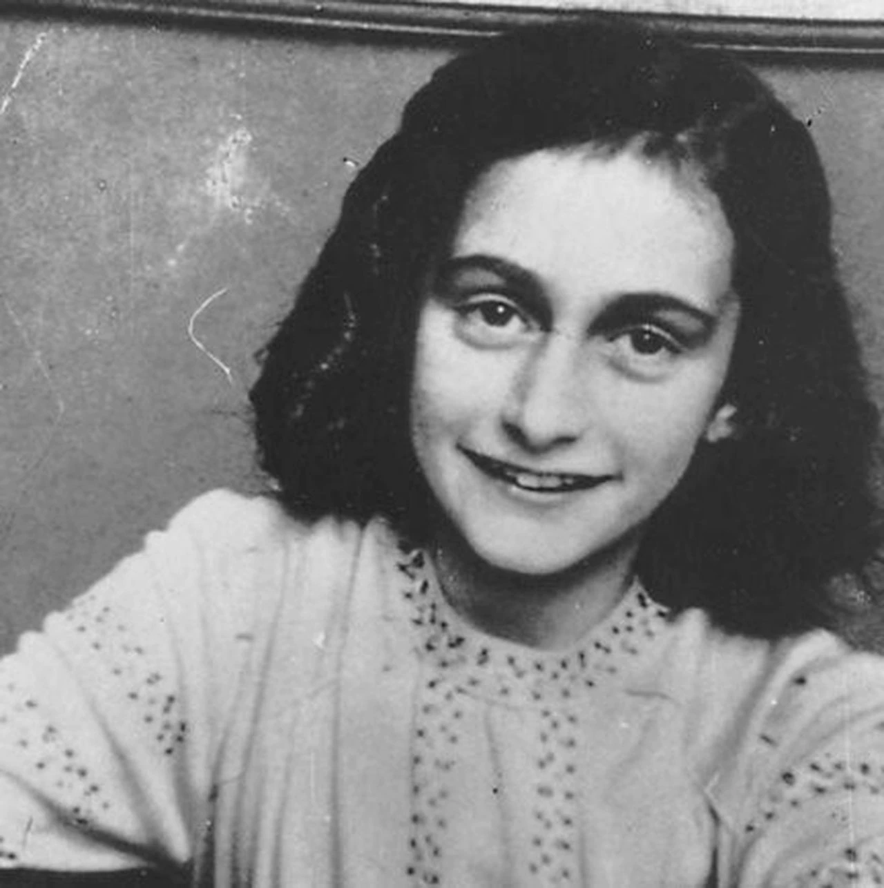
7. DEMONIZATION OF THE DEFENDERS TOWARD A SOLUTION
THOSE WHO HID ANNE FRANK
WERE BREAKING THE LAW,
THOSE WHO KILLED HER
WERE FOLLOWING IT!

Slide 39
8. INCREASED PERSECUTION OF JEWS
• Starting in the mid 1930s, the persecution of Jews was mandated, encouraged and even rewarded.
• Persecution can be physical OR verbal.
• Paris, December 2022, a TV guest is publicly criticized for wearing a kippa (skullcap) on the set, and asked to keep his religion to himself.

Slide 40
8. INCREASED PERSECUTION OF JEWS
• 2022, 9 UC Berkeley Law Schools decide to develop “Jewish Free” zones on campus.
• The move was eerily reminiscent of a “Judenfrei” Nazi Germany.
• Some of the language used by the law schools was very concerning:

Slide 41
8. INCREASED PERSECUTION OF JEWS
“in the interest of protecting the safety and welfare of Palestinian students on campus [insert organization name] will not invite speakers that have expressed and continued to hold views or host/sponsor/promote events in support of Zionism, the apartheid state of Israel, and the occupation of Palestine.”

Slide 42
8. INCREASED PERSECUTION OF JEWS TOWARD A SOLUTION
THE DANIEL APPROACH:
Daniel 3:16-18 16 Shadrach, Meshach and Abed-nego replied to the king, “O Nebuchadnezzar, we do not need to give you an answer concerning this matter. 17 If it be so, our God whom we serve is able to deliver us from the furnace of blazing fire; and He will deliver us out of your hand, O king.
18 But even if He does not, let it be known to you, O king, that we are not going to serve your gods or worship the golden image that you have set up.”

Slide 43
8. INCREASED PERSECUTION OF JEWS TOWARD A SOLUTION
CIVIL DISOBEDIENCE:
• There must be a crystal-clear conflict between the laws of man and the laws of God.
• There must be an exhaustion of all creative legal remedies. Civil disobedience must always be a last resort for believers.
• There must be a willingness for consequences.
• Maintaining of respect for civil authorities.

Slide 44
9. ENCOURAGEMENT TO KILL JEWS
• Kanye West’s diatribe, “I’m a bit sleepy tonight but when I wake up, I’m going Death Con 3 on Jewish people.”
• The words of a celebrity with over 30MM followers.
• The support and defense from another celebrity.

Slide 45
9. ENCOURAGEMENT TO KILL JEWS
• Candace Owens defense, “If you are an honest person, you did not think this tweet was antisemitic, you didn’t think that he wrote this tweet because he hates or wants to genocide the Jewish people. This does not represent the beginning of a Holocaust.”
https://www.jpost.com/diaspora/antisemitism/article-719370.

Slide 46
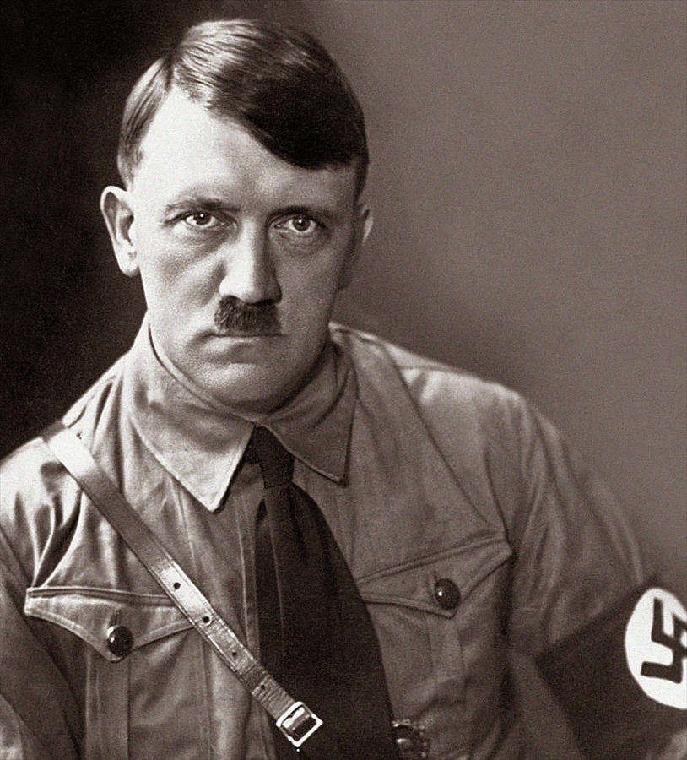
9. ENCOURAGEMENT TO KILL JEWS

Slide 47
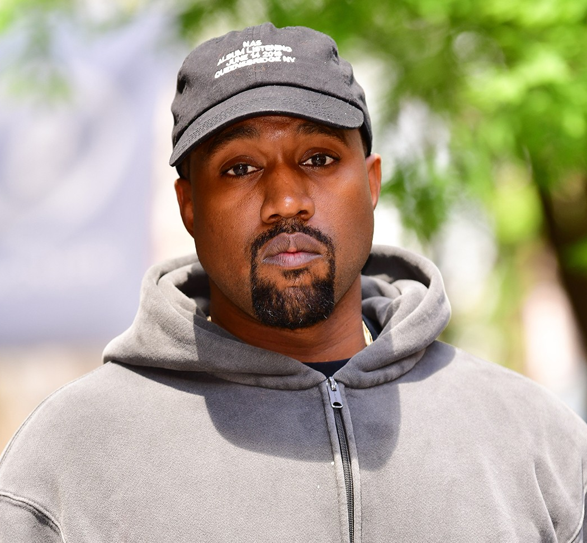
9. ENCOURAGEMENT TO KILL JEWS
?

Slide 48
10. MASS MURDER OF JEWS
• The worst of Jewish hatred will be unleashed during the Great Tribulation.
Zechariah 13:8-9 8 “It will come about in all the land,” Declares the Lord, “That two parts in it will be cut off and perish, But the third will be left in it. 9 “And I will bring the third part through the fire, Refine them as silver is refined, And test them as gold is tested. They will call on My name, And I will answer them; I will say, ‘They are My people,’ And they will say, ‘The Lord is my God.’”

Slide 49
NORMALIZATION
ONCE SOMETHING PREVIOUSLY CONSIDERED ABNORMAL OR
UNACCEPTABLE HAS BECOME NORMAL,
THEN THE NORMAL BECOMES ABNORMAL

Slide 50
A lone man refusing to do the Nazi salute, 1936

Slide 51
AN UPSIDE-DOWN WORLD
Isaiah 5:20 Woe to those who call evil good, and good evil; Who substitute darkness for light and light for darkness; Who substitute bitter for sweet and sweet for bitter!

Slide 52
BELIEVERS WILL BECOME ABNORMAL
WE ARE
HERE
?
JACOB’S
TROUBLE
RAPTURE

Slide 53
BELIEVERS WILL BECOME ABNORMAL
WHAT IS LEFT FOR US TO DO WHEN WE HAVE BECOME ABNORMAL TO SOCIETY?
• When it comes to Jewish people, all that might be left for us as believers is to PROTECT THEM and PROVIDE for them.

Slide 54
A BIBLICAL MODEL: Matthew 25:31-46
THE NEW RIGHTEOUS AMONG THE NATIONS.
³⁴ “Then the King will say to those on His right, ‘Come, you who are blessed of My Father, inherit the kingdom prepared for you from the foundation of the world. ³⁵ For I was hungry, and you gave Me something to eat; I was thirsty, and you gave Me something to drink; I was a stranger, and you invited Me in; ³⁶ naked, and you clothed Me; I was sick, and you visited Me; I was in prison, and you came to Me.’

Slide 55
A BIBLICAL MODEL: Matthew 25:31-46
³⁷ Then the righteous will answer Him, ‘Lord, when did we see You hungry, and feed You, or thirsty, and give You something to drink? ³⁸ And when did we see You as a stranger, and invite You in, or naked, and clothe You? ³⁹ And when did we see You sick, or in prison, and come to You?’ ⁴⁰ And the King will answer and say to them, ‘Truly I say to you, to the extent that you did it for one of the least of these brothers or sisters of Mine, you did it for Me.’
THE TIME IS NOW!

Slide 56
THE 10 STAGES TOWARD THE NORMALIZATION OF ANTISEMITISM
✅ Apathy ✅ Lack of education ✅ Low or incorrect reporting ✅ Desensitization ✅ Lack of accountability
✅ Empowerment ✅ Demonization of the defenders ✅ Persecution of Jews and defenders ✅ Encouragement to kill Jews
10. Mass murder of Jews

Slide 57
RESOURCES
• STANDWITHUS.COM
• CANARYMISSION.ORG
• MOMENTMAG.COM/ANTISEMITISM-MONITOR
• CAMERA.ORG
• MACCABEETASKFORCE.ORG
• ADL.ORG/ADL-TRACKER
• MEMRI.ORG

Slide 58
THE NORMALIZATION OF ANTISEMITISM
WHEN THE OLDEST HATRED
BECOMES THE NEW NORMAL
olivier@chosenpeople.com

