Slide 2
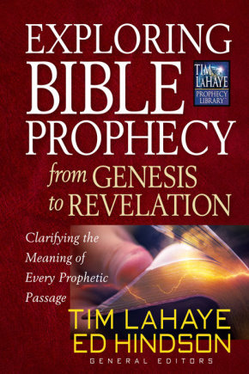

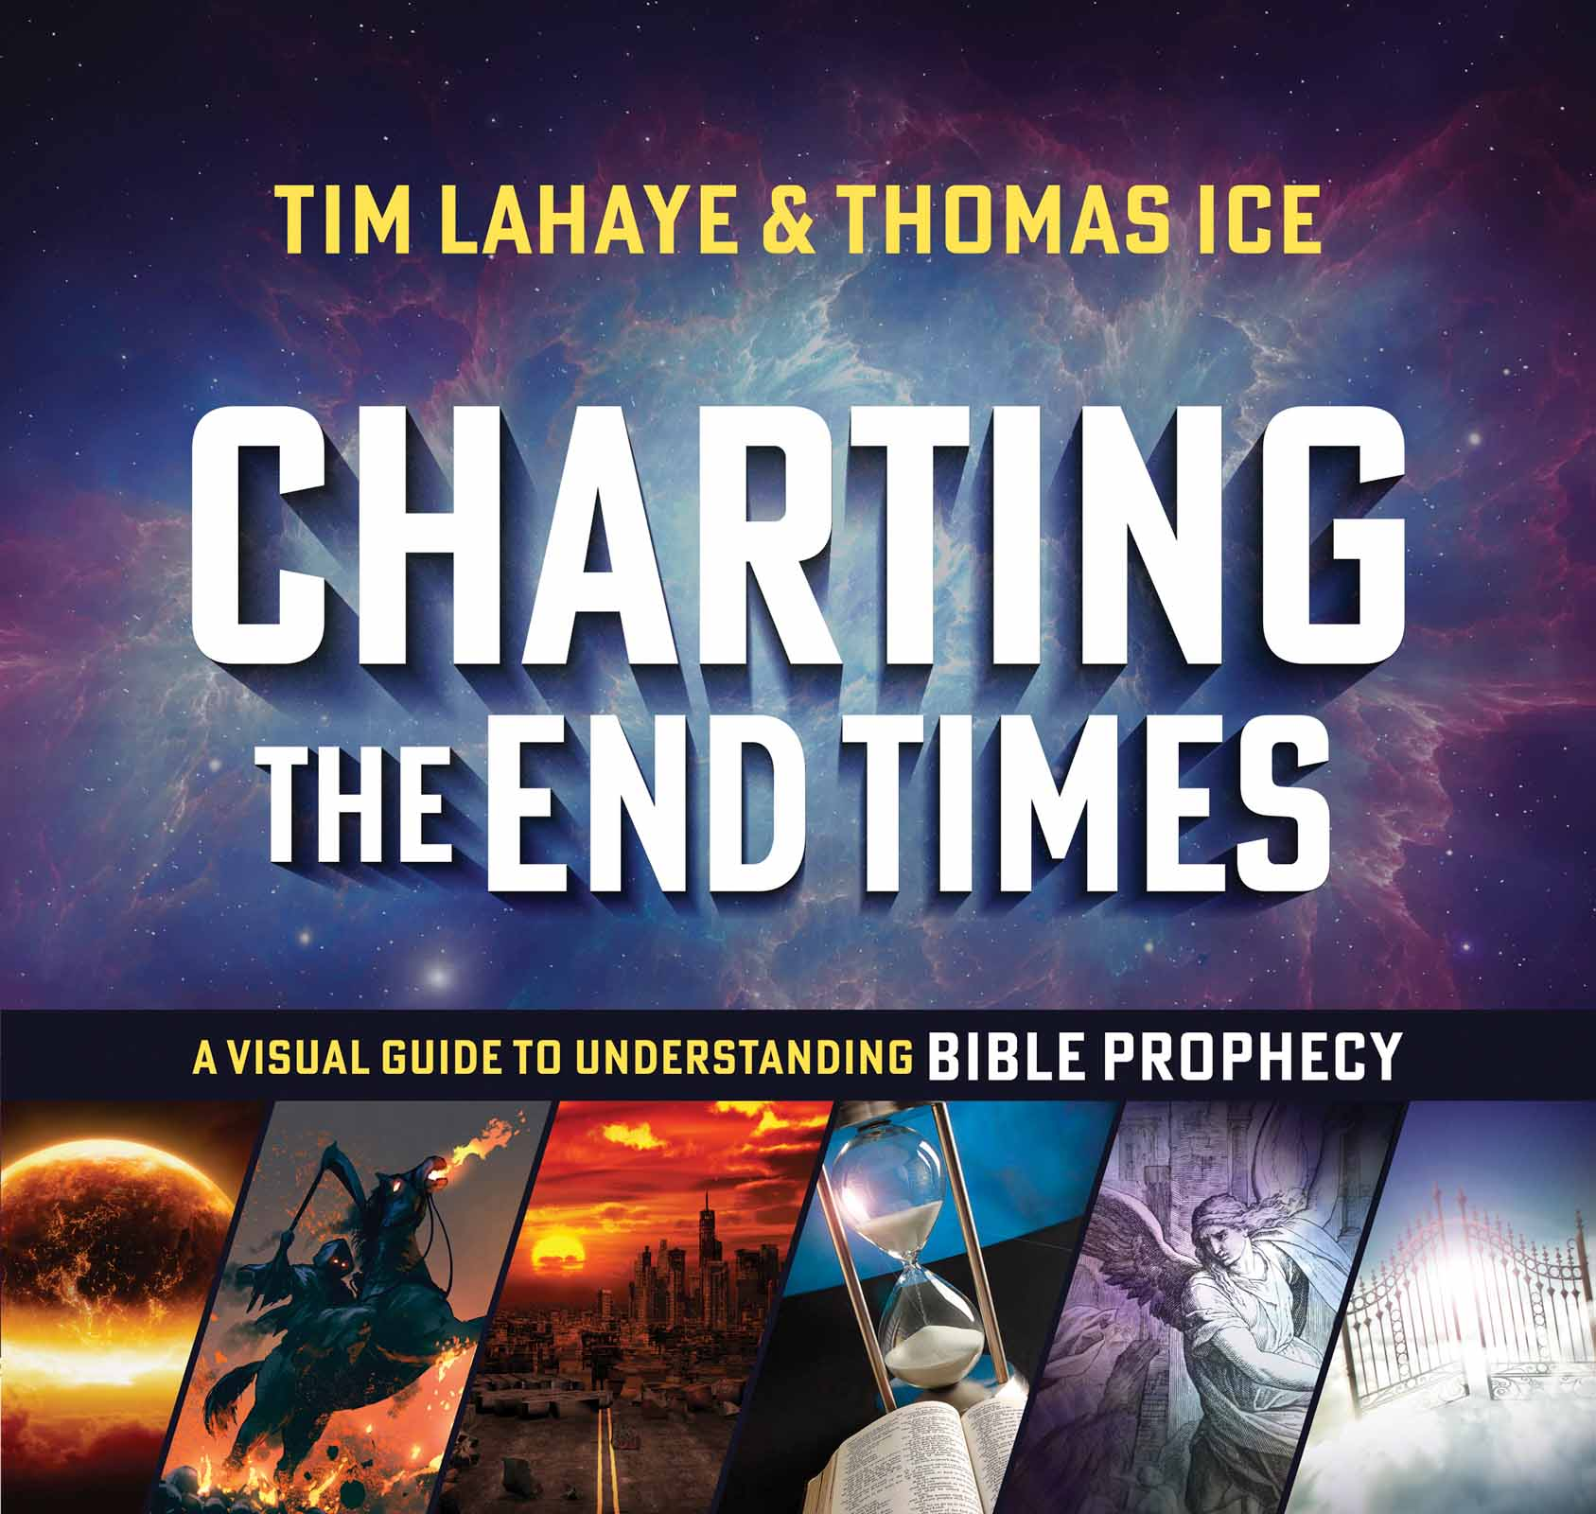
According To Prophecy Ministries Resources
Resources from According To Prophecy Ministries

Slide 3

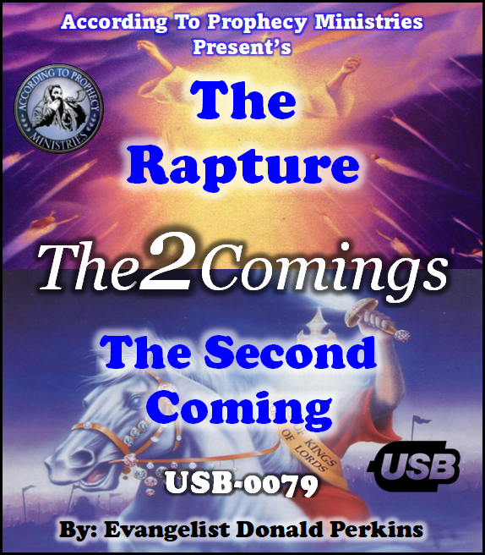
According To Prophecy Ministries Resources
Resources from According To Prophecy Ministries

Slide 4


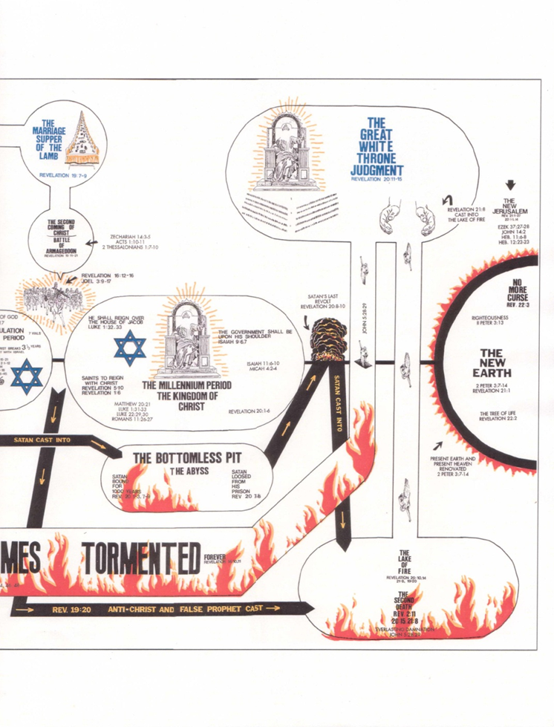

Slide 5







Visit our website:

Slide 7

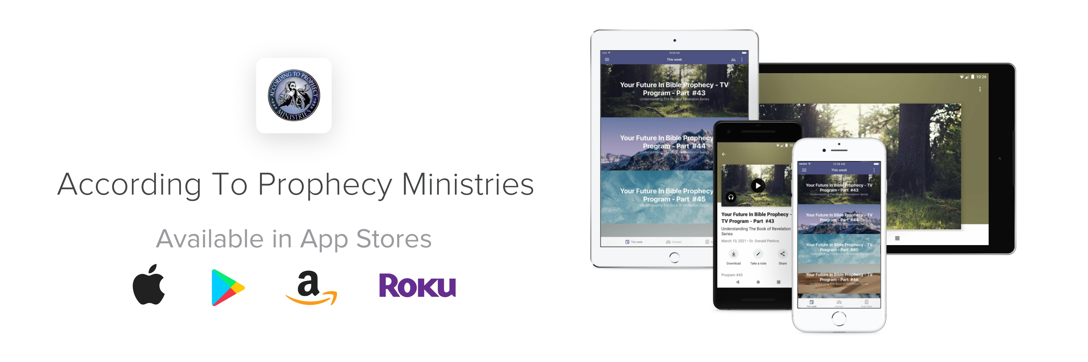
Download our New Ministry App
from your favorite App Store today!

Slide 8
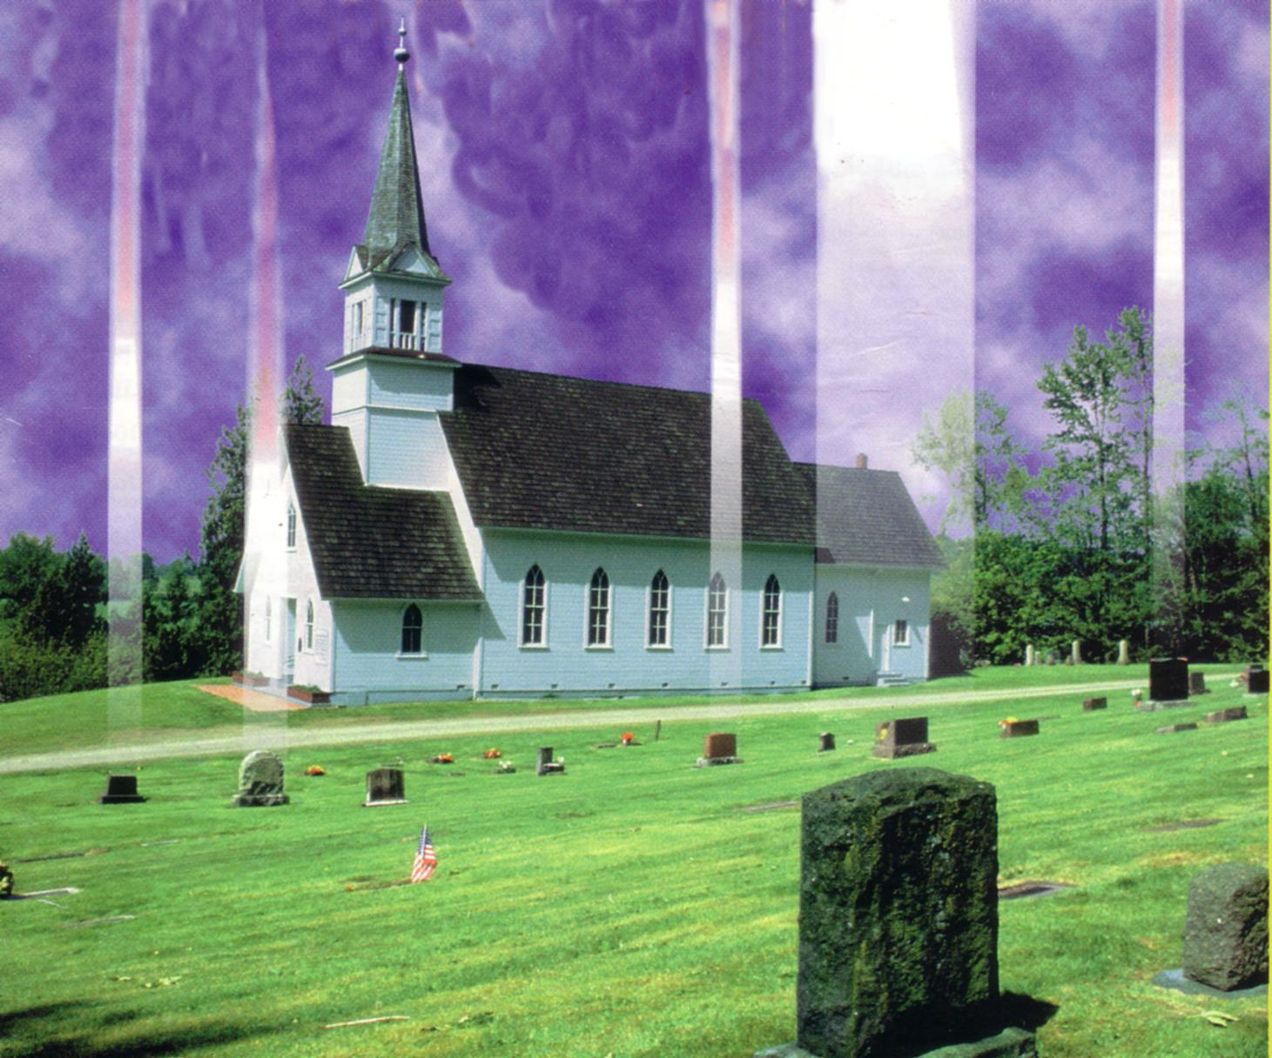
The Rapture of the Church
What it is and What it is not!

Slide 9
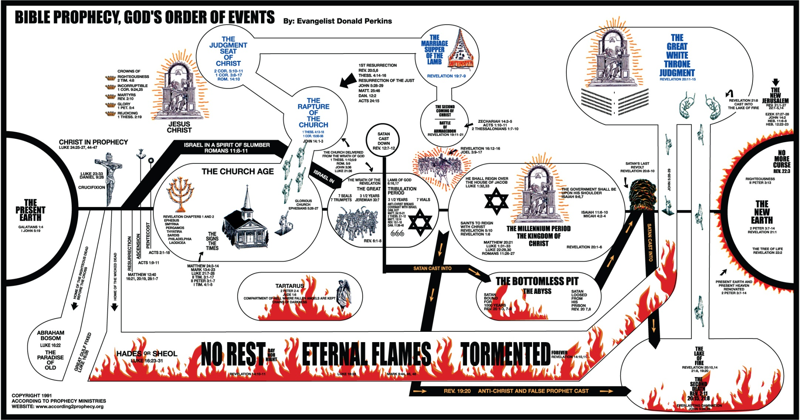
The Rapture of the Church

Slide 10
The Rapture of the Church
Topics of discussion
What is the Rapture?
The Timing of the Rapture
A doctrine of Imminence
A closer look at the Rapture Text
Warning against dating the Rapture!
The Benefits of the Rapture
The Differences between the Rapture & 2nd Coming
What should be the attitude of the Church?

Slide 11
The Rapture in Scriptures

Slide 12
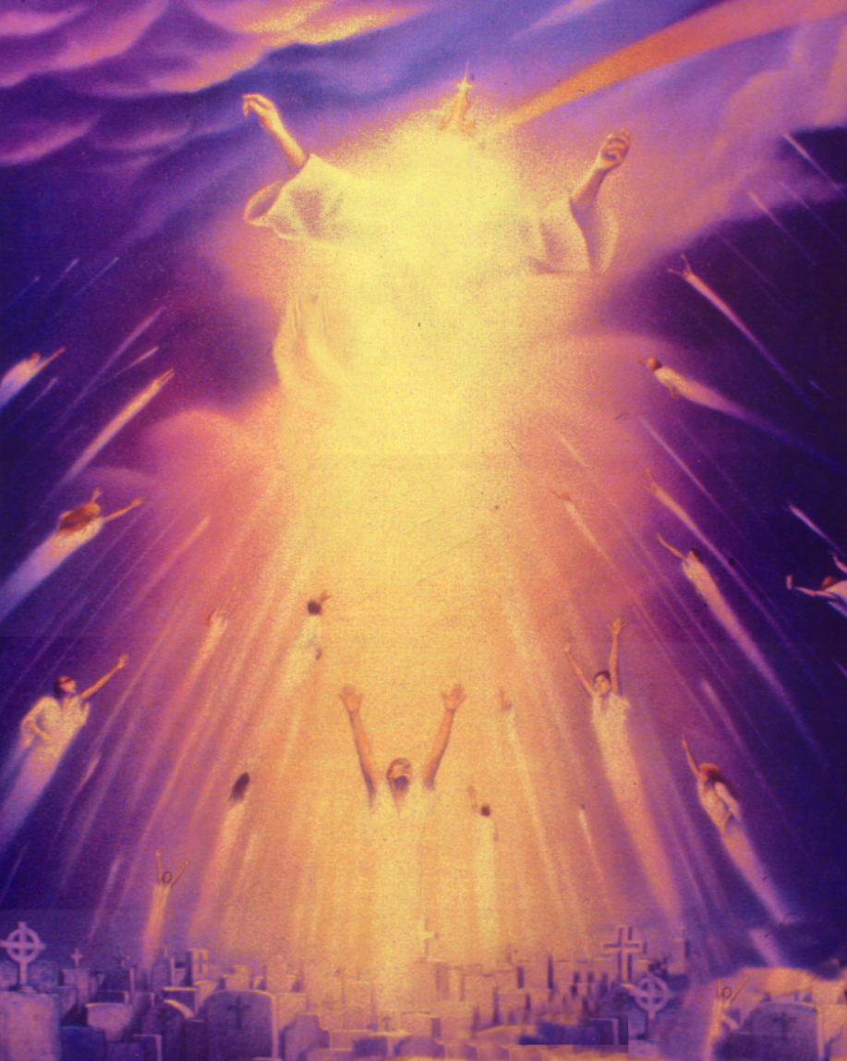
The Scriptural Text for the Rapture of the Church
1 Thessalonians 4:13-18 (KJV)
“But I would not have you to be ignorant, brethren concerning them which are asleep, that ye sorrow not , even as others which have no hope. For if we believe that Jesus died and rose again, even so them also which sleep in Jesus will God bring with him. For this we say unto you by the word of the Lord, that we which are alive and remain unto the coming of the Lord shall not prevent them which are asleep.”

Slide 13
The Scriptural Text for the Rapture of the Church
1 Thessalonians 4:13-18 (KJV)
“For the Lord himself shall descend from heaven with a shout, with the voice of the archangel, and with the trump of God: and the dead in Christ shall rise first: Then we which are alive and remain shall be caught up together with them in the clouds, to meet the Lord in the air: and so shall we ever be with the Lord. Wherefore comfort one another with these words.”

Slide 14
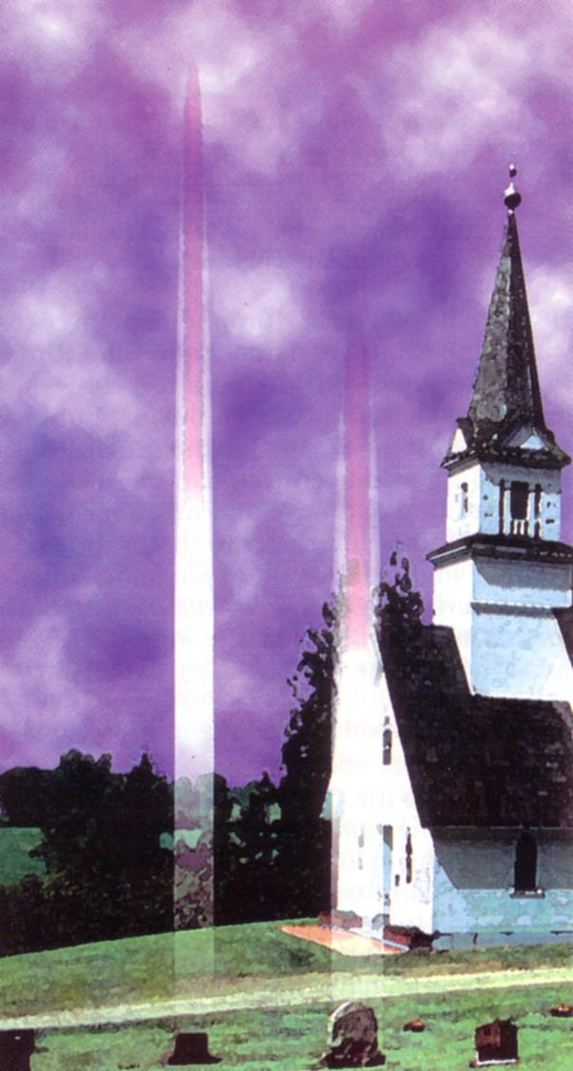
The Rapture of the Church
Dr. Grant R. Jeffrey in his book, “Apocalypse”, page 80 states:
“The Rapture is one of the most important doctrines in the Bible. However, many have avoided studying this subject because it is the most supernatural event in the Scriptures. Unfortunately, most discussions about the translation of the saints have focused exclusively on the question of the timing of the Rapture relative to the Tribulation. While the timing is very important, many Christians have lost sight of the true purpose of the Rapture. Although this event will remove the living saints to heaven to escape the Anti-Christ, its primary purpose is to provide all believers, living and departed, with their eternal resurrection bodies.”
Dr. John F. Walvoord in his book, “The Prophecy Knowledge Handbook”, page 481 states:
“…The Rapture of the church is always presented as the next event and, as such, one that is not dependent on immediate preceding events. The Rapture of the church, defined in 1 Thessalonians 4:17 as being “caught up together with them in the clouds to meet the Lord in the air,” is a wonderful truth especially designed to encourage Christians.”

Slide 15
What is the Rapture?

Slide 16
Definition of the term Rapture
The term “Rapture ” does not appear in the English translation of the Bible. The word is actually taken from the Latin Vulgate translation of the Scriptures. It appears as “Caught Up” in the English Bible. In the Greek, it appears as the verb Harpazo.
Rapture: def: (Latin) “to catch up, to snatch away, or to take out.”
Harpazo: def: (Greek) “to seize upon with force, also used generally as meaning to forceably seize upon or take to oneself.”

Slide 17
The Timing of the Rapture

Slide 18
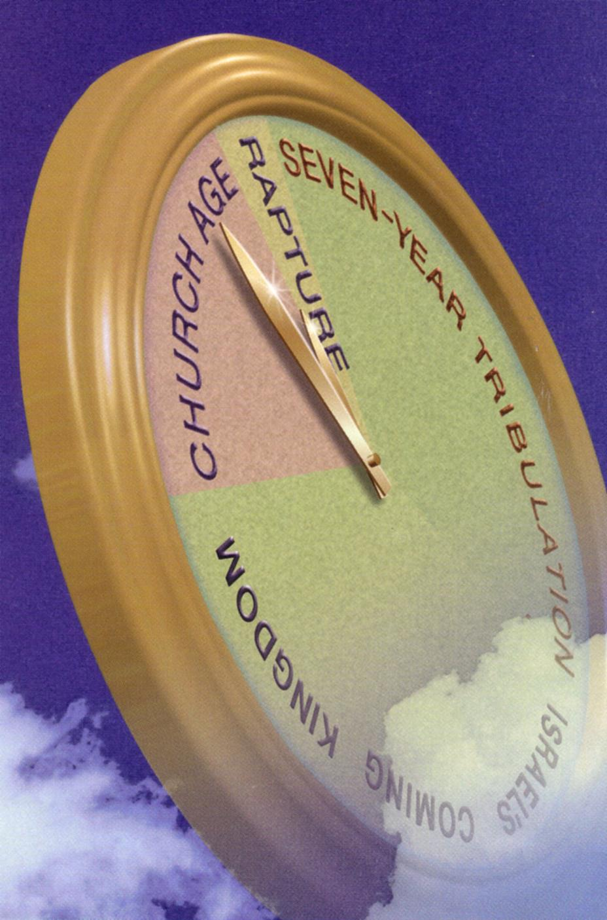
The Timing of the Rapture
Post-Tribulation Rapture
This view teaches that Jesus will Rapture the Church at the close of the Great Tribulation Period.
Pre-Wrath Rapture
This view teaches that the church will be Raptured ¾ into the Great Tribulation Period.
Mid-Tribulation Rapture
This view teaches that the Church will be Raptured at the mid-point of the Great Tribulation Period.

Slide 19
The Timing of the Rapture
Pre-Tribulation Rapture
This view teaches that Jesus will Rapture the Church before the start of the Great Tribulation Period.
Understanding the purpose of the Great Tribulation Period will clarify the confusion around the timing of the Rapture.
This view, I believe, stands the test of dispensational accuracy.

Slide 20
Why I Believe in a Pre-Tribulational Rapture View

Slide 21
Why I Believe in a Pre-Tribulation?
1) Because of Daniel’s Seventy Week Prophecy
2) Because the Tribulation is primarily Jewish in Nature
3) Because of What God is doing in the Nation of Israel, behind the scenes Today!

Slide 22
Why I Believe in a PreTribulational Rapture View

Slide 23
Because of Daniel’s Seventy Week Prophecy

Slide 24

No purpose for the Church in the Tribulation
“The next inference of a Pre-Tribulation Rapture is a very important one that is often overlooked. There is no purpose for the Church during the Tribulation because the focus of this entire seven year period is the Jewish people. To understand this point, we must go back 2,500 years to the time of Daniel while he was in captivity in Babylon.”

Slide 25
No purpose for the Church in the Tribulation
“The Church will soon be taken out of this world before God once again gives His undivided attention to the Jewish people during the 70th week of Daniel’s 70 Weeks of Years. Again, there is just no purpose for the Church here on earth during the Tribulation. The Tribulation is when God’s focus returns to Israel.”

Slide 28
A doctrine of Imminence

Slide 29
The Rapture – A doctrine of Imminence
The Imminent return of Christ, is the teaching that Jesus will come back at any time. This teaching of imminence, or (“at any moment coming”) is not a new doctrine. It was taught all through the Scriptures.
James 5:8, Be ye also patient; stablish your hearts: for the coming of the Lord draweth nigh.”
1 Timothy 6:14, That thou keep this commandment without spot, unrebukeable until the appearing of our Lord Jesus Christ.”
Titus 2:13, Looking for that blessed hope and glorious appearing of the great God and our Saviour Jesus Christ.”
1 Peter 4:7, “But the end of all things is at hand: be ye therefore sober, and watch unto prayer.”

Slide 30
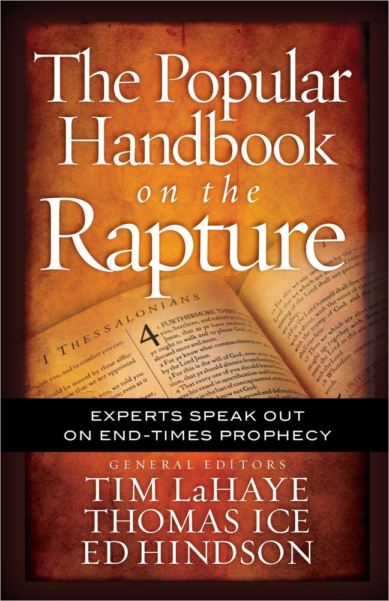
A doctrine of Imminence
“Christians of the Apostolic period (AD 33-100) expected Jesus to return imminently, which means that Jesus can return for His church at any moment, and no predicted event must necessarily precede His return. As Dr. Renald Showers notes, “Other things may happen before the imminent event, but nothing else must happen before it happens. If something else must take place before an event can happen, that event is not imminent. Showers also points out three other significant things about an imminent events.”

Slide 31
A doctrine of Imminence
“(1) Since we do not know how much time will elapse before the imminent event, we should be ready for it to happen at any moment: (2) we cannot set a date for it to occur; and (3) we cannot say that it has to happen soon (implying a short period of time). The rapture was “just as imminent when the New Testament was written as it is today.”

Slide 32
A closer look at the Rapture Text

Slide 33
The Scriptural Text for the Rapture of the Church
1 Thessalonians 4:13-18 (KJV)
“But I would not have you to be ignorant, brethren concerning them which are asleep, that ye sorrow not , even as others which have no hope. For if we believe that Jesus died and rose again, even so them also which sleep in Jesus will God bring with him. For this we say unto you by the word of the Lord, that we which are alive and remain unto the coming of the Lord shall not prevent them which are asleep.”

Slide 34
The Scriptural Text for the Rapture of the Church
1 Thessalonians 4:13-18 (KJV)
“For the Lord himself shall descend from heaven with a shout, with the voice of the archangel, and with the trump of God: and the dead in Christ shall rise first: Then we which are alive and remain shall be caught up together with them in the clouds, to meet the Lord in the air: and so shall we ever be with the Lord. Wherefore comfort one another with these words.”

Slide 35
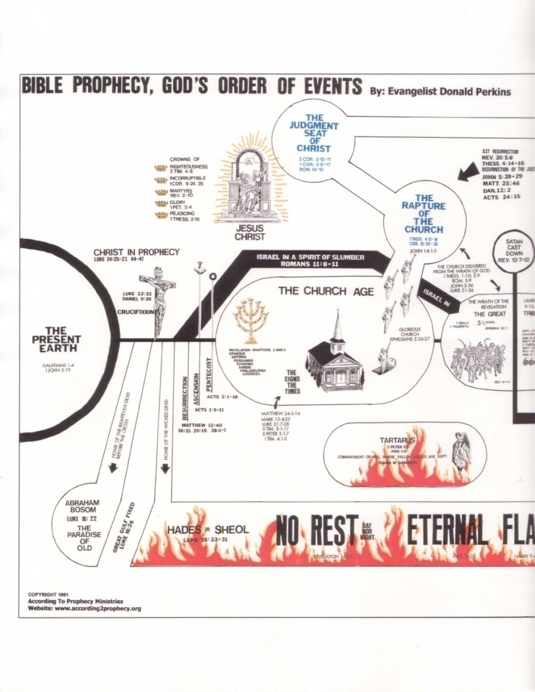
Example of Raptures in the Scriptures
1 Corinthians 15:51-53,
51, “Behold, I shew you a mystery; We shall not all sleep, but we shall all be changed,
52, In a moment, in the twinkling of an eye, at the last trump: for the trumpet shall sound, and the dead shall be raised incorruptible, and we shall be changed.
53, For this corruptible must put on incorruption, and this mortal must put on immortality.”

Slide 36
Example of Raptures in the Scriptures
Acts 1:9-11, Here, as Jesus was caught up, His disciples saw him go up into Heaven.
Revelation 11:11-12, Here, as the two Witnesses are caught up, their enemies watched them go into Heaven.
I believe, at the time of the Rapture of the Church, the world will witness our departure as a testimony to the Word of God and a witness against them.

Slide 37
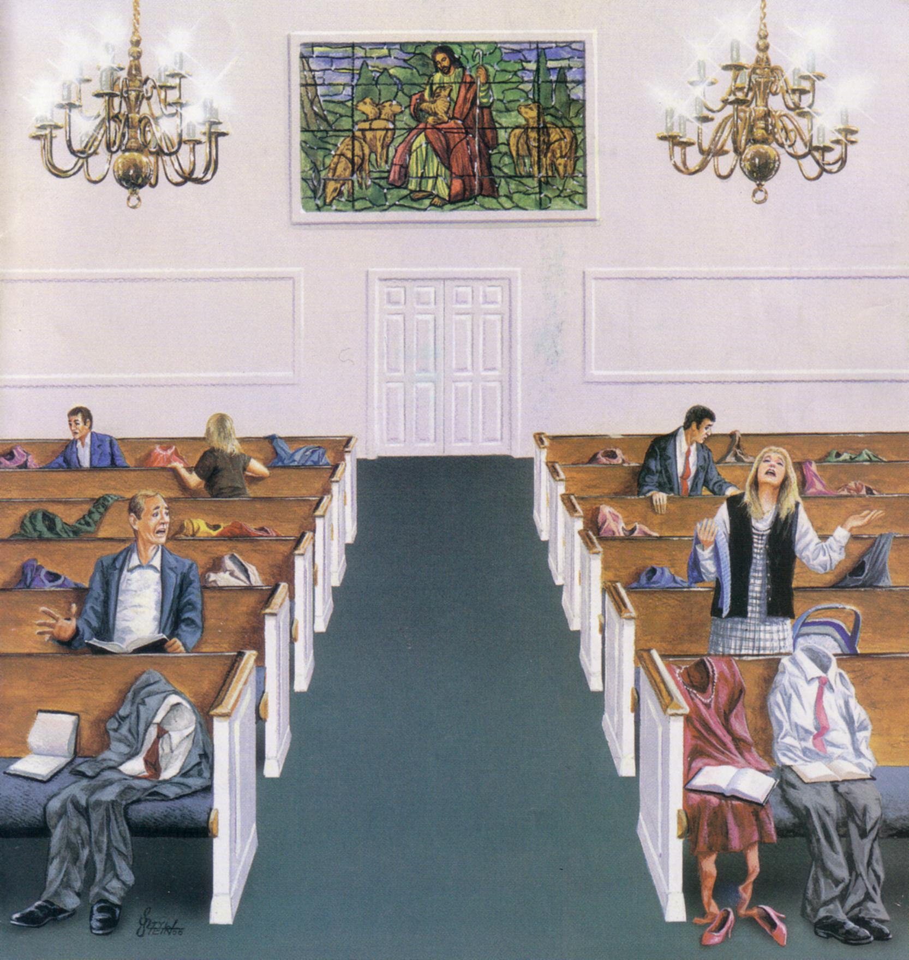
B
E
H
I
N
D
L
E
F
T

Slide 38
Warning against dating the Rapture!

Slide 39

Warning against dating the Rapture!
Luke 12:40, “Be ye therefore ready also: for the Son of man cometh at an hour when ye think not."

Slide 40

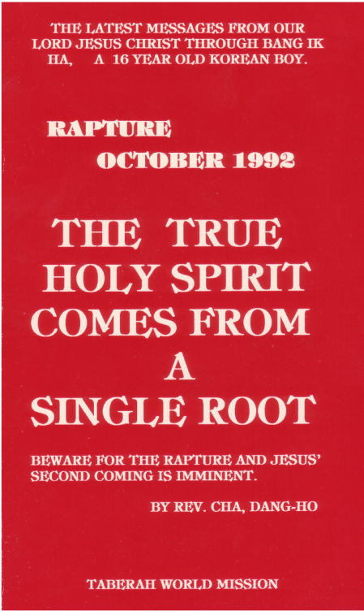

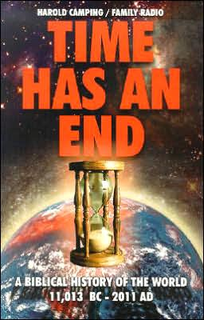
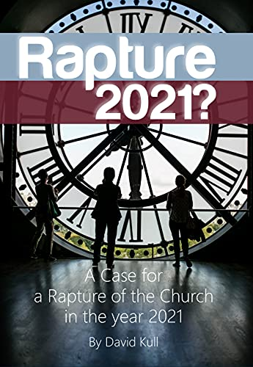
Warning against dating the Rapture!
Books that claimed to know
the actual date of the Rapture!

Slide 41
Warning against dating the Rapture!
“Seoul Korea, For months, thousands of believers proclaiming the
Rapture is coming!” stood on street corners and predicted the end of the world. Believers had quit jobs or school and sold every thing to prepare to ascend to heaven late yesterday. But early today 15 minutes after the midnight deadline passed,

Slide 42
Warning against dating the Rapture!
“worshippers were told heaven could wait. “Nothing has happened,’ said the Rev. Chang Man-ho of Seoul’s largest doomsday church, the Mission for the Coming Days. “Sorry, let’s go home. Let’s go back to a normal life.” “God lied to us,” an angry congregant said as he left another church.”

Slide 43
Warning against dating the Rapture!
“They, like an estimated 20,000 South Koreans, had believed they would be lifted to heaven at the stroke of midnight. The phenomenon known as the Rapture,… set off a social crisis in South Korea as scores of believers sold their homes, quit their jobs, abandoned their families and underwent abortions to prepare for the one-way ride to heaven.

Slide 44
Warning against dating the Rapture!
At least four followers committed suicide before Wednesday, but no new suicides were reported after midnight. At 12:10 a.m. today, as 1,500 riot police officers 200 Plainclothes detective and 200 journalists kept watch outside the church,

Slide 45
Warning against dating the Rapture!
a teenage boy stuck his head out the third-floor window and yelled to the crowd: “Nothing’s happen!” Eight minutes later, two girls peeked out the same window. They told reporters they never believed in the Rapture anyway…”

Slide 46
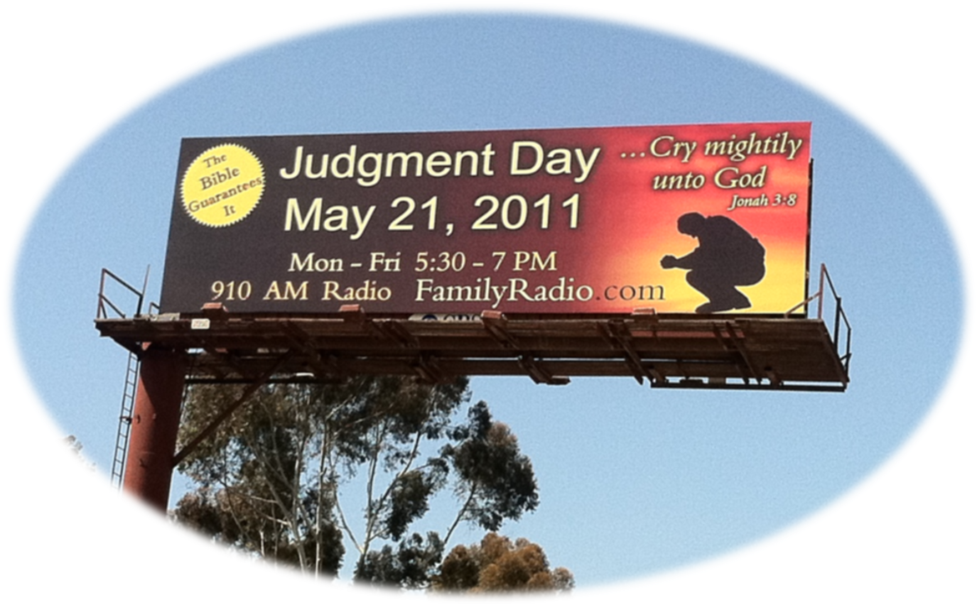
The Dangers of Date-Setting!

Slide 47
The Benefits of the Rapture

Slide 48
The benefits of the Rapture
The taking up of the Church from the earth, before the Great Tribulation Period. 1 Thessalonians 1:10; 5:9; Romans 5:9; Luke 21:36; Revelation 3:10.
The Glorification of the Resurrected and Living Saints. 1 Thessalonians 4:14-17; 1 Corinthians 15:50-57; Philippians 3:20-21; 1 John 3:2; John 6:39-40; Colossians 3:4,

Slide 49

The Glorification of the Saints
“The instantaneous completion of the sanctifying process. This is the final aspect of God’s saving work for the redeemed. It involves even “the redemption of our body.”
… Glorification means instantaneous Christlikeness for all saints.”

Slide 50
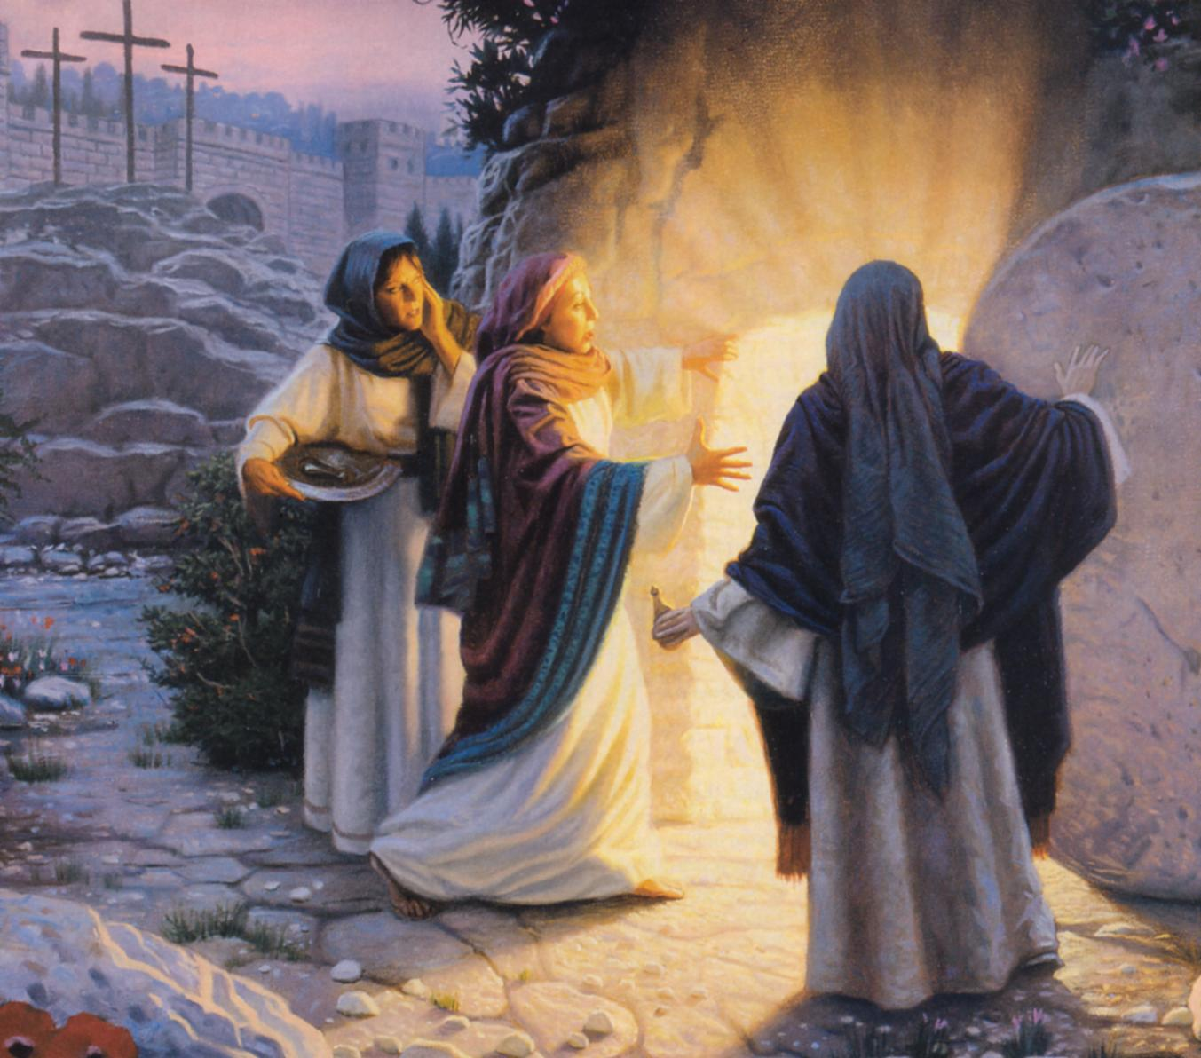
Jesus Christ Glorified, a perfect example of the Glorified Saints
Jesus gave us a wonderful examples of the life of the glorified saints. After He was glorified He did many notable things in that Glorified body.
John 20:18-20, 26
Jesus enter – while doors shut
John 21:9-14;
Acts 10:38-41
Jesus ate – in glorified body

Slide 51
The Differences between the Rapture & Second Coming

Slide 52

The Differences between the Rapture & Second Coming
“As a young Bible student 18 years of age I used to become confused by the average minister’s preaching on the second coming and the Rapture. Almost without exception these persons would refer to the Rapture and the Second Coming as the same event, using both terms interchangeably of the one coming of Christ, there being as they supposed, two parts, two stages, and two phases of the one coming. They would point to the many signs of the Second Coming, or Rapture, and tell how the Tribulation and 7-year reign of Antichrist would have to take place before the Second Coming or Rapture, then make a plea for persons not ready for the event to meet at the altar of prayer immediately. The reason given for such urgency was that the Rapture could take place that night – perhaps even before the people could get down to the altar.”

Slide 53
The Differences between the Rapture & Second Coming
“I could never reconcile the conflicting statements – that there should be 7 years of tribulation and the reign of Antichrist before the coming of Christ, and yet it could happen “tonight.” What these teachers should have said was that the Rapture and the Second Coming were two distinct subjects, the events being unrelated to each other, and that whereas the Rapture could take place “tonight” the Second Coming could not take place until after the Tribulation and the last 7 years of this age which would include the reign of Antichrist. It is still truth to teach that the Rapture could take place now at any moment. As to the Second Advent it must be understood that this event cannot take place until after the Tribulation and the reign of Antichrist. In fact, all the prophecies must be fulfilled in detail before the Second Coming of Christ ...”

Slide 54

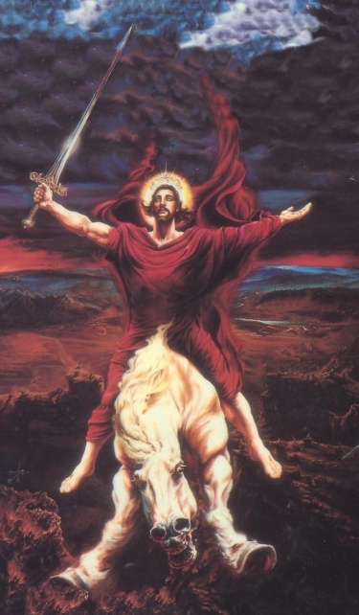
The Differences between the Rapture & Second Coming
The Rapture of the Church:
Jesus is coming to gather the Saints. 1 Thess. 4:17
Jesus will not touch the earth at this time. 1 Thess. 4:17
Jesus is coming to raise the Righteous dead. 1 Thess. 4:17
Will cause the Great Tribulation to begin. 1 Thess. 4:11-18
Will allow the reign of the Anti-Christ to begin. Rev. 6:2
The Second Coming of Jesus Christ:
Jesus will come back with the Saints. Rev. 19:14
Jesus will touch the earth at this time. Zech. 14:4
Jesus will come as a Man of War. Rev. 19:11
Will cause the Battle of Armageddon to begin. Rev. 19:17-21
Will end the reign of the Anti-Christ. Rev. 19:20

Slide 55

The Differences between the Rapture & Second Coming
“These two episodes, the Rapture and the Second Coming, are so different that it is impossible to combine them. One involves Jesus coming for His church; the other concerns His appearance in power and judgment to the earth.”

Slide 56
What should be the attitude of the Church?

Slide 57
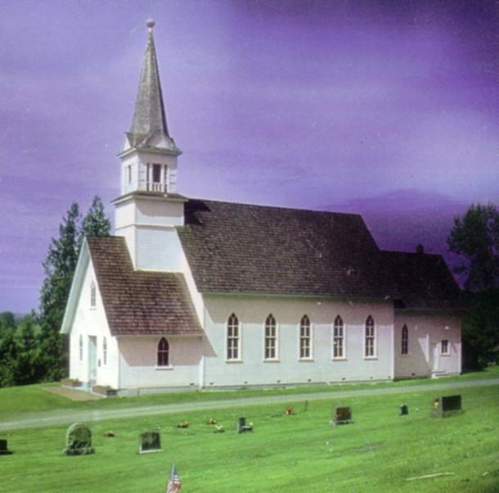
What should be the attitude of the Church?
1 Corinthians 1:7, “So that you come behind in no gift; waiting for the coming of our Lord Jesus Christ.”
1 Thessalonians 1:10, “And to wait for His Son from Heaven…”
Titus 2:11-13, “Looking for that Blessed hope, and glorious appearing of the Great God and Saviour Jesus Christ.”
Philippians 3:20, “For our conversation is in heaven for whence also we look for the Saviour, the Lord Jesus Christ.
2 Timothy 4:8, “Henceforth there is laid up for me a crown of righteousness, which the Lord, the righteous judge, shall give me at that day: and not to me only, but unto all them also that love his appearing.”
1 John 3:3, “And every man that hath this hope in him purifieth himself, even as he is pure.”

Slide 58
The Rapture of the Church
What it is and What is not!

Slide 63
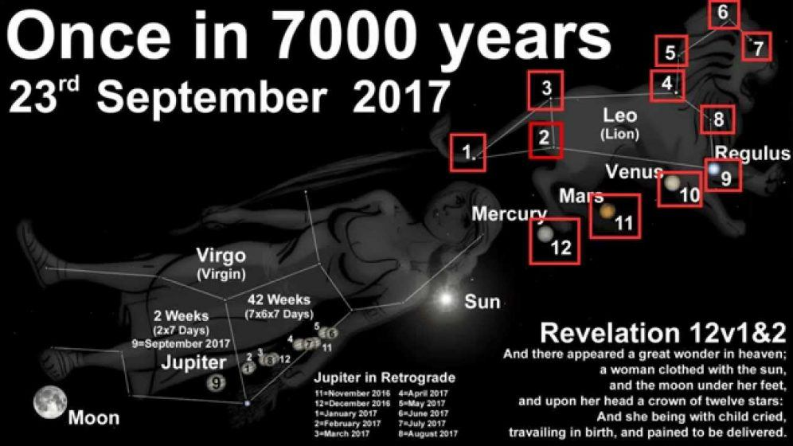
False Rapture Prophecy of Jesus Christ

Slide 64
False Rapture Prophecy of Jesus Christ
On September 23, 2017 the sun will be in the zodiac constellation Virgo—“a woman clothed with the sun”. The moon will be at the feet of Virgo—“with the moon under her feet”. The ‘nine’ stars of the zodiac constellation Leo, plus three planets (Mercury, Venus, and Mars), will be at the head of Virgo—“on her head a crown of twelve stars”. The planet Jupiter will be in the center of Virgo, and as the weeks pass after September 23 Jupiter will exit Virgo to the east, past her feet, so to speak—“She was with child and wailed aloud in pain as she labored to give birth”. Jupiter is the largest of the planets, the “king” of the planets, so to speak—“She gave birth to a son, a male child, destined to rule all the nations with an iron rod”. Must this not be a sign of something momentous, like the Internet sources say? - The Catholic Astronomer
Some claim in this Revelation 12 prophecy, that Jesus could Rapture the Church or Return for His 2nd coming?

Slide 65
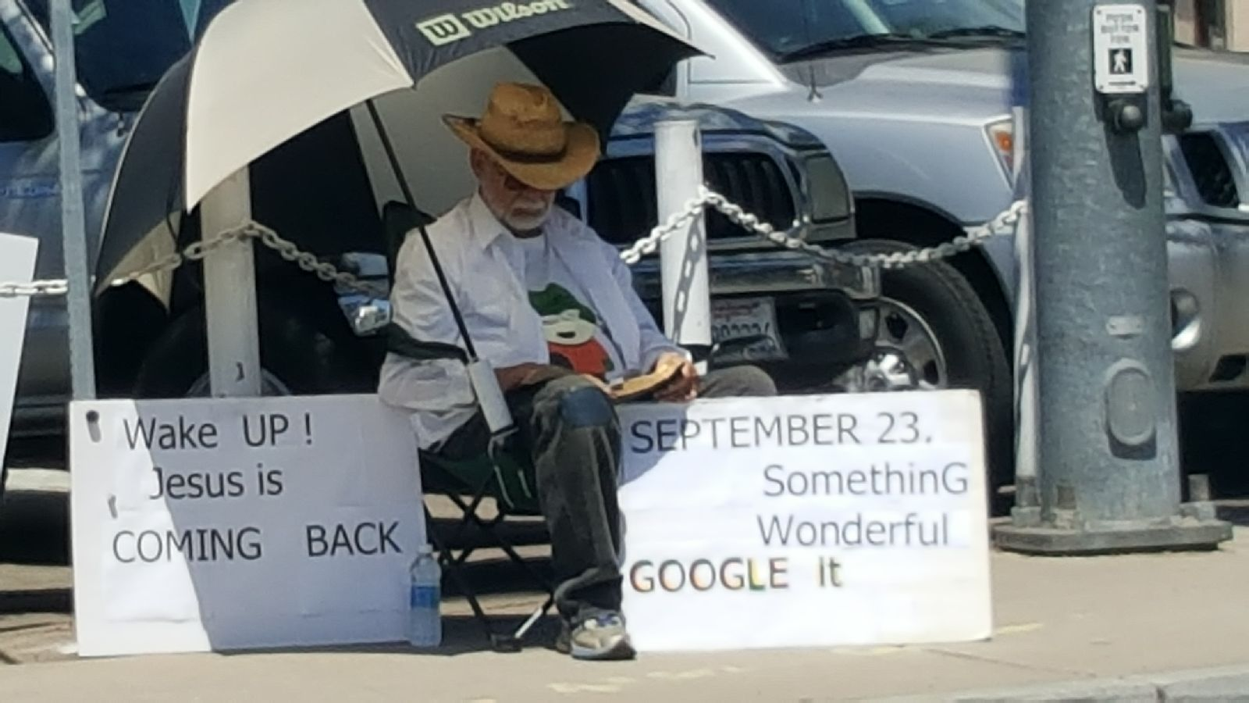
False Rapture Prophecy of Jesus Christ
This Photo was taken in San Diego, CA. April - 2017

