Slide 1
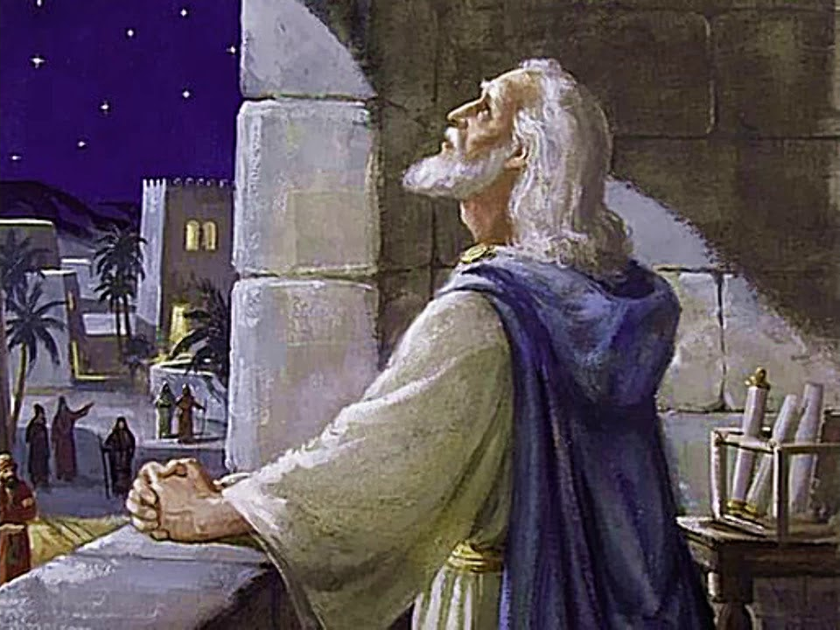

DANIEL AND THE FUTURE
2023 SLBC Prophecy Conference
Dr. Andy Woods
Senior Pastor – Sugar Land Bible Church
President Chafer Theological Seminary

Slide 2
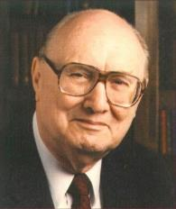
John Walvoord
Prophecy Knowledge Handbook, Page 212
“The authenticity of the Book of Daniel went unchallenged from the time of its writing, before 530 BC, until the third century of the Christian era, or almost 900 years. A pagan and atheistic writer by the name of Porphyry (third century AD) raised the question whether the Book of Daniel was a genuine biblical prophecy on the premise that prophecy of the future is impossible. Porphyry found that the Book of Daniel was so accurate in describing future events that it must have been written after the event. He advanced the theory that the book was a forgery, written in the Maccabean period, about 175 BC…”

Slide 3
John Walvoord
Prophecy Knowledge Handbook, Page 212
“For another 1,300 years Daniel was considered as a genuine book by orthodox Christians and Jews until modern liberalism arose in the seventeenth century. Critics of the Bible as the inspired Word of God picked up Porphyry’s idea and attempted to prove that Daniel was not a genuine book of the Bible.”

Slide 4
HOW DID DANIEL WARN US ABOUT THE FUTURE?
Final form of human government (Dan. 2; 7)
Antichrist Prefigurement (Dan. 8; 11)
Tribulation period outline (Dan. 9:27)
Breaking of Israel (Dan. 12:1, 7)
Future resurrection program (Dan. 12:2)
75-day interval (Dan. 12:11-12)
Progressive illumination (Dan. 12:4, 8-9)
Notes:
Outline

Slide 5
HOW DID DANIEL WARN US ABOUT THE FUTURE?
Final form of human government (Dan. 2; 7)
Antichrist Prefigurement (Dan. 8; 11)
Tribulation period outline (Dan. 9:27)
Breaking of Israel (Dan. 12:1, 7)
Future resurrection program (Dan. 12:2)
75-day interval (Dan. 12:11-12)
Progressive illumination (Dan. 12:4, 8-9)
Notes:
Outline

Slide 6
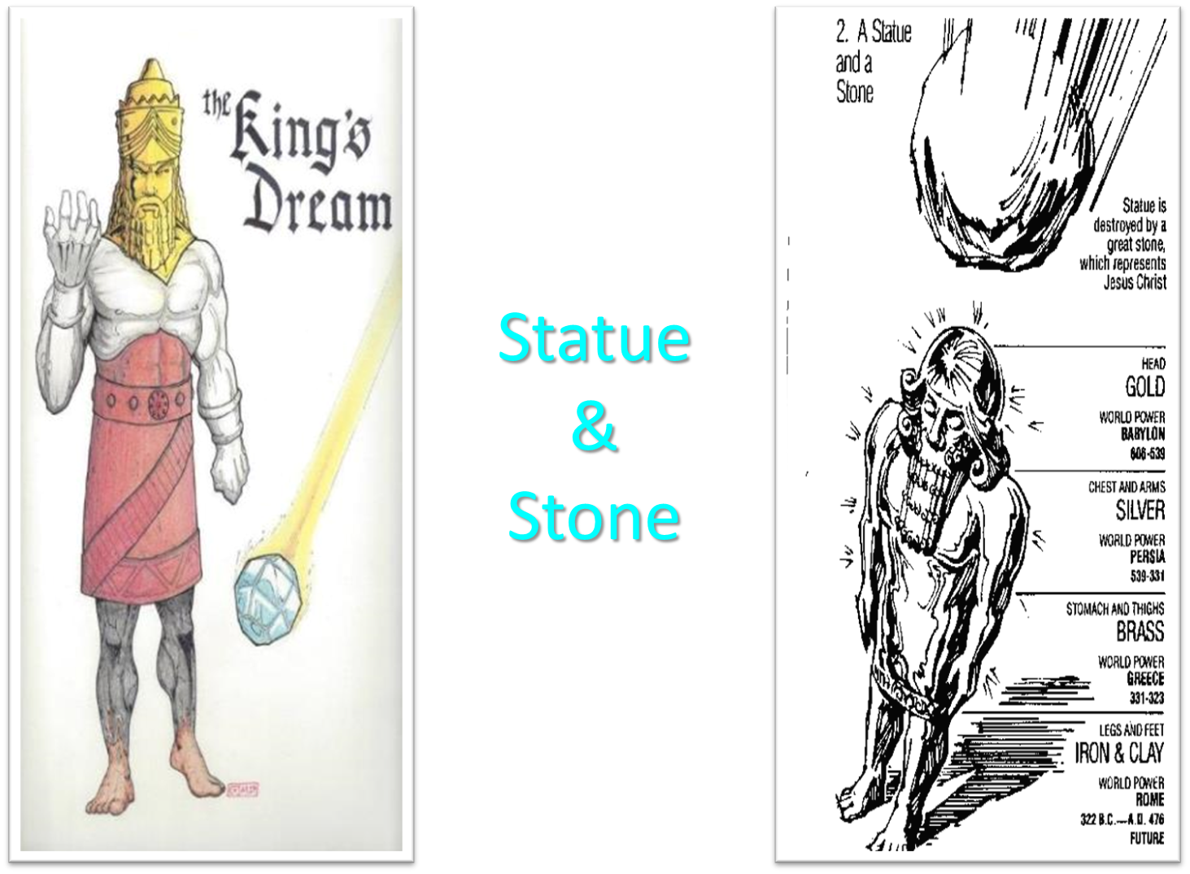

Slide 7

Daniel 2:41-43
“⁴¹ In that you saw the feet and toes, partly of potter’s clay and partly of iron, it will be a divided kingdom; but it will have in it the toughness of iron, inasmuch as you saw the iron mixed with common clay. ⁴² As the toes of the feet were partly of iron and partly of pottery, so some of the kingdom will be strong and part of it will be brittle. ⁴³ And in that you saw the iron mixed with common clay, they will combine with one another in the seed of men; but they will not adhere to one another, even as iron does not combine with pottery.”

Slide 8


Daniel 2:44
“In the days of those kings the God of heaven will set up a kingdom which will never be destroyed, and that kingdom will not be left for another people; it will crush and put an end to all these kingdoms, but it will itself endure forever.

Slide 9
Outline
  Chiasm “Aramaic” ( 2-7)
1. Gentile History (2)
  2. Protection (3)
    3. Revelation to a gentile king (4)
    3. Revelation to a gentile king (5)
  2. Protection (6)
1. Gentile history (7)

Slide 10
Comparing Daniel 2 & 7: A Matter of Perspective
 | Daniel 2 | Daniel 7
Receiver | Nebuchadnezzar | Daniel
Position | Oppressor | Oppressee
Nationality | Babylonian | Hebrew
Perspective | Jewish | Gentile
Viewpoint | Antropocentric | Theocentric
Description | Statue | Beasts
Appearance | Beautiful | Grotesque

Slide 11


Slide 12

Daniel 7:19
“Then I desired to know the exact meaning of the fourth beast, which was different from all the others, exceedingly dreadful, with its teeth of iron and its claws of bronze, and which devoured, crushed and trampled down the remainder with its feet…”

Slide 13


Matthew 16:18
“I also say to you that you are Peter, and upon this rock I will build [oikodomeō] My church; and the gates of Hades WILL NOT overpower it.”

Slide 14

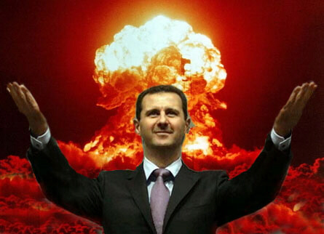
Daniel 7:23
“The fourth beast will be a fourth kingdom on the earth, which will be different from all the other kingdoms and will devour the whole earth and tread it down and crush it.”

Slide 15

David Rockefeller cited in Memoirs, page 405.
“For more than a century ideological extremists…have seized upon well-publicized incidents…to attack the Rockefeller family for the inordinate influence they claim we wield over American political and economic institutions. Some even believe we are part of a secret cabal working against the best interests of the United States, characterizing my family and me as 'internationalists' and of conspiring with others around the world to build a more integrated global political and economic structure--one world, if you will. If that's the charge, I stand guilty, and I am proud of it.”

Slide 16


Daniel 7:24
As for the ten horns, out of this kingdom ten kings will arise; and another will arise after them, and he will be different from the previous ones and will subdue three kings.”

Slide 17

Arnold Fruchtenbaum
Footsteps of the Messiah, Page 36
“This stage was seen in both Daniel 2 in the ten toes and in Daniel seven in the ten horns...the One World Government will divide into ten kingdoms that will cover the whole world – not merely Europe. It has become common today to refer to the ten kingdoms as being in Europe only, especially the Former Common Market, now the European Union. But the text does not allow for this kind of interpretation. At the very best, the European Union might become one of the ten, but it could hardly become all of the ten. A careful reading of the Daniel passage states that once the Fourth Empire rules the whole world, . . .

Slide 18
Arnold Fruchtenbaum
Footsteps of the Messiah, Page 36
. . . then this One World Government will split into ten kingdoms. This requires the ten kingdoms to cover the entire world, not just the territory known as Europe. It would be a mistake to make too much of the European Union as being the Ten Division Stage. It would be far more consistent with the text to view it as possibly one of the ten, but not the entire ten. More consistent with Daniel's prophecy is the recommendation of the Club of Rome that the world be divided into ten administrative districts to avoid a world economic collapse...”

Slide 19
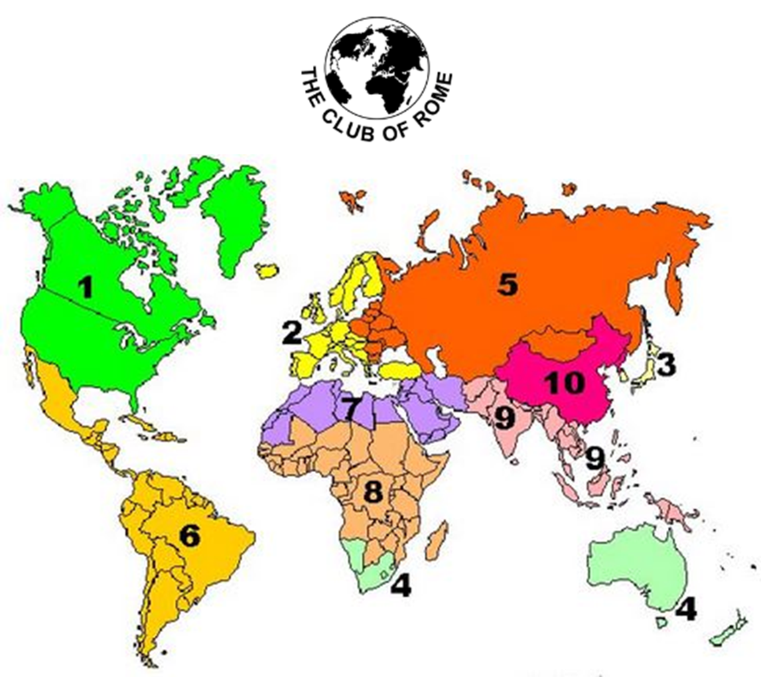

Slide 20

Daniel 7:25
“He will speak out against the Most High and wear down the saints of the Highest One, and he will intend to make alterations in times and in law; and they will be given into his hand for a time, times, and half a time.”

Slide 21

Genesis 1:14
Then God said, “Let there be lights in the expanse of the heavens to separate the day from the night, and let them be for signs and for seasons and for days and years.”

Slide 22


Slide 23
HOW DID DANIEL WARN US ABOUT THE FUTURE?
Final form of human government (Dan. 2; 7)
Antichrist Prefigurement (Dan. 8; 11)
Tribulation period outline (Dan. 9:27)
Breaking of Israel (Dan. 12:1, 7)
Future resurrection program (Dan. 12:2)
75-day interval (Dan. 12:11-12)
Progressive illumination (Dan. 12:4, 8-9)
Notes:
Outline

Slide 24
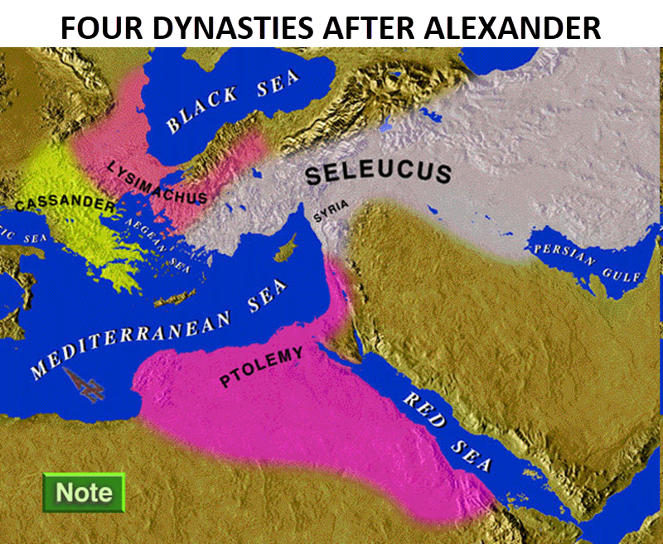

Slide 25
Intertestamental Chronology (Dates BC)
SELEUCIDS
Seleucus I 312-281
Antiochus I 281-261
Antiochus II 261-246
Seleucus II 246-226
Seleucus III 226-223
Antiochus III 223-187
Seleucus IV Philapator 187-175
Antiochus IV Epiphanes 175-163

Slide 26

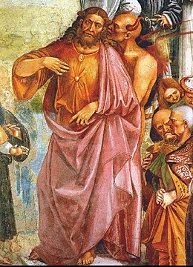
Daniel 11:31
Forces from him will arise, desecrate the sanctuary fortress, and do away with the regular sacrifice. And they will set up the abomination of desolation.

Slide 27

HANUKKAH
The Maccabean revolt
December 25th 164 BC : the temple is liberated and rededicated
1 & 2 Maccabees
The miracle of the lamp oil
Hanukkah “Feast of Dedication” (festival of lights).
Christmas / Jewish Holiday
John 10:22-24

Slide 28
Levitical Feasts (Lev. 23)
Feast | Season | Purpose | Type
Passover | Spring | Redemption | 1 Cor. 5:7
Unleavened Bread | Spring | Separation | John 6:35
1st fruits | Spring | Praise | 1 Cor. 15:20
Pentecost | Spring | Praise | Acts 2:1-4
Trumpets | Fall | New Year | Matt. 24:31
Atonement | Fall | Lev 16 | Zech. 12:10
Booths | Fall | Wilderness provision | Zech. 14:16-18

Slide 29


Slide 30
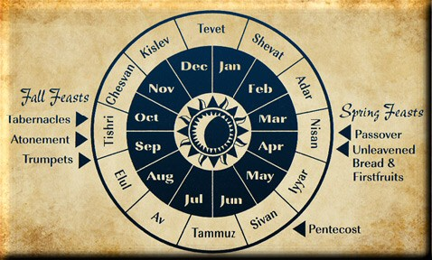

Slide 31
Daniel 9:27
And he will make a firm covenant with the many for one week, but in the middle of the week he will put a stop to sacrifice and grain offering; and on the wing of abominations will come one who makes desolate, even until a complete destruction, one that is decreed, is poured out on the one who makes desolate.

Slide 32


Slide 33
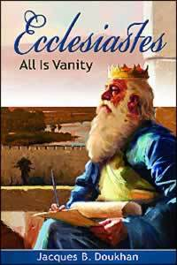
Ecclesiastes 1:9
“That which has been is that which will be, And that which has been done is that which will be done. So there is nothing new under the sun.”

Slide 34
Zechariah 12:10
“I will pour out on the house of David and on the inhabitants of Jerusalem, the Spirit of grace and of supplication, so that they will look on Me whom they have pierced; and they will mourn for Him, as one mourns for an only son, and they will weep bitterly over Him like the bitter weeping over a firstborn.”

Slide 35
Romans 11:25-26
“²⁵ For I do not want you, brethren, to be uninformed of this mystery—so that you will not be wise in your own estimation—that a partial hardening has happened to Israel until the fullness of the Gentiles has come in; ²⁶ and so all Israel will be saved; just as it is written, ‘The Deliverer will come from Zion, He will remove ungodliness from Jacob.’”

Slide 36
HOW DID DANIEL WARN US ABOUT THE FUTURE?
Final form of human government (Dan. 2; 7)
Antichrist Prefigurement (Dan. 8; 11)
Tribulation period outline (Dan. 9:27)
Breaking of Israel (Dan. 12:1, 7)
Future resurrection program (Dan. 12:2)
75-day interval (Dan. 12:11-12)
Progressive illumination (Dan. 12:4, 8-9)
Notes:
Outline

Slide 37


Slide 38
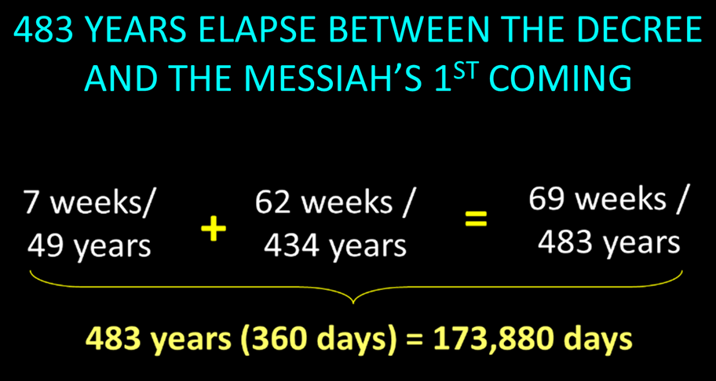

Slide 39

Messiah must present Himself to Israel on March 30, A.D. 33 (Daniel 9:25)

Slide 40

Luke 19:42-44
^{“42} saying, ‘If you had known in this day, even you, the things which make for peace! But now they have been hidden from your eyes. ⁴³ For the days will come upon you when your enemies will throw up a barricade against you, and surround you and hem you in on every side, ⁴⁴ and they will level you to the ground and your children within you, and they will not leave in you one stone upon another, because you did not recognize the time of your visitation.’”

Slide 41
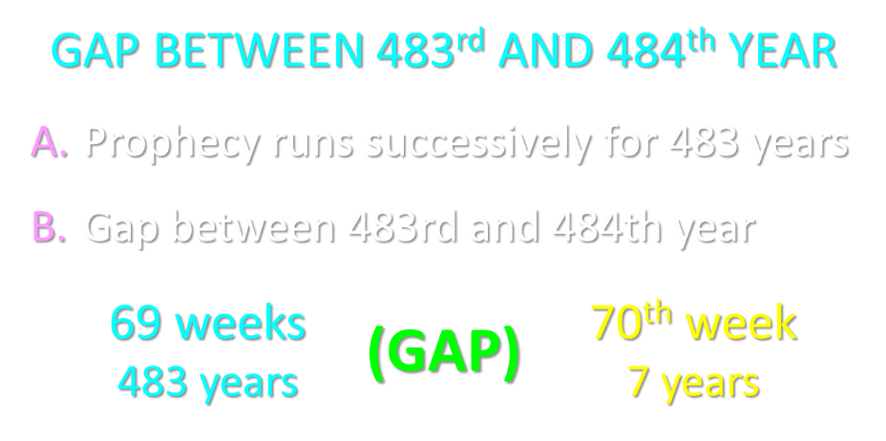

Slide 42
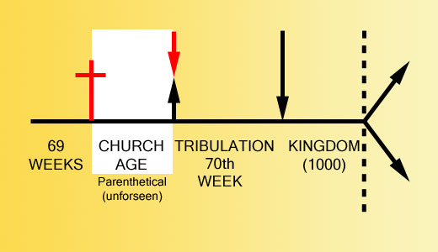

Slide 43
Daniel 9:27
And he will make a firm covenant with the many for one week, but in the middle of the week he will put a stop to sacrifice and grain offering; and on the wing of abominations will come one who makes desolate, even until a complete destruction, one that is decreed, is poured out on the one who makes desolate.

Slide 44


Slide 45


Slide 46


Slide 47
HOW DID DANIEL WARN US ABOUT THE FUTURE?
Final form of human government (Dan. 2; 7)
Antichrist Prefigurement (Dan. 8; 11)
Tribulation period outline (Dan. 9:27)
Breaking of Israel (Dan. 12:1, 7)
Future resurrection program (Dan. 12:2)
75-day interval (Dan. 12:11-12)
Progressive illumination (Dan. 12:4, 8-9)
Notes:
Outline

Slide 48

Daniel 12:1-2
“¹ Now at that time Michael, the great prince who stands guard over the sons of your people, will arise. And there will be a time of distress such as never occurred since there was a nation until that time; and at that time your people, everyone who is found written in the book, will be rescued. ² Many of those who sleep in the dust of the ground will awake, these to everlasting life, but the others to disgrace and everlasting contempt.”

Slide 49


Jeremiah 30:6-7
“⁶ Ask now, and see If a male can give birth. Why do I see every man With his hands on his loins, as a woman in childbirth? And why have all faces turned pale? ⁷ Alas! for that day is great, There is none like it; And it is the time of Jacob’s distress (Gen. 32:8; 35:10), But he will be saved from it.”

Slide 50
Matthew 24:21-22
“²¹ For then there will be a great tribulation, such as has not occurred since the beginning of the world until now, nor ever will. ²² Unless those days had been cut short, no life would have been saved; but for the sake of the elect those days will be cut short.”

Slide 51

Daniel 12:7
I heard the man dressed in linen, who was above the waters of the river, as he raised his right hand and his left toward heaven, and swore by Him who lives forever that it would be for a time, times, and half a time; and as soon as they finish shattering the power of the holy people, all these events will be completed.

Slide 52
Matthew 16:18
“I also say to you that you are Peter, and upon this rock I will build [oikodomeō] My church; and the gates of Hades WILL NOT overpower it.”

Slide 53

Zechariah 13:8-9
⁸“It will come about in all the land,” Declares the Lord, “That two parts in it will be cut off and perish; But the third will be left in it. ⁹“And I will bring the third part through the fire, Refine them as silver is refined, And test them as gold is tested. They will call on My name, And I will answer them; I will say, ‘They are My people,’ And they will say, ‘The Lord is my God.’ ”

Slide 54
HOW DID DANIEL WARN US ABOUT THE FUTURE?
Final form of human government (Dan. 2; 7)
Antichrist Prefigurement (Dan. 8; 11)
Tribulation period outline (Dan. 9:27)
Breaking of Israel (Dan. 12:1, 7)
Future resurrection program (Dan. 12:2)
75-day interval (Dan. 12:11-12)
Progressive illumination (Dan. 12:4, 8-9)
Notes:
Outline

Slide 55
Daniel 12:1-2
“¹ Now at that time Michael, the great prince who stands guard over the sons of your people, will arise. And there will be a time of distress such as never occurred since there was a nation until that time; and at that time your people, everyone who is found written in the book, will be rescued. ² Many of those who sleep in the dust of the ground will awake, these to everlasting life, but the others to disgrace and everlasting contempt.”

Slide 56
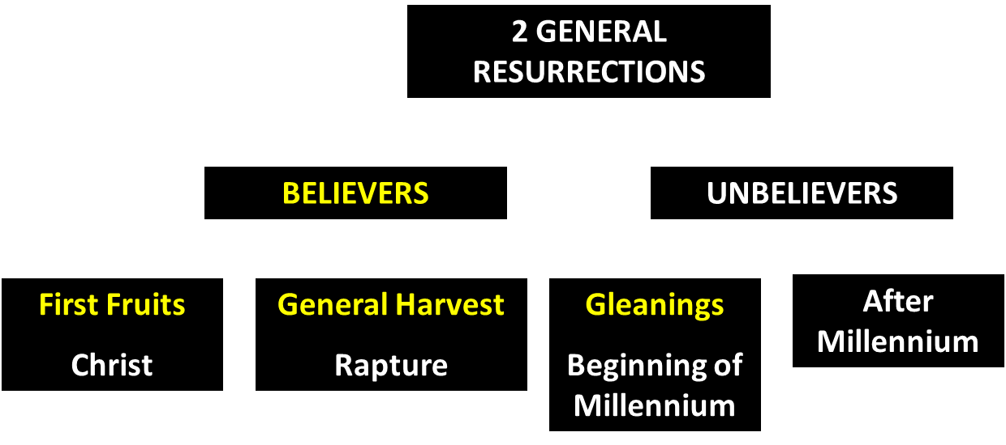
God’s Resurrection Program

Slide 57

1 Corinthians 15:20-23
“²⁰ But now Christ has been raised from the dead, the first fruits of those who are asleep. ²¹-For since by a man came death, by a man also came the resurrection of the dead. ²²-For as in Adam all die, so also in Christ all will be made alive. ²³-But each in his own order: Christ the first fruits, after that those who are Christ’s at His coming.”

Slide 58

1 Corinthians 15:50-51
“⁵⁰ Now I say this, brethren, that flesh and blood cannot inherit the kingdom of God; nor does the perishable inherit the imperishable. ⁵¹ Behold, I tell you a mystery; we will not all sleep, but we will all be changed.”

Slide 59
Revelation 20:4-6
“⁴ Then I saw thrones, and they sat on them, and judgment was given to them. And I saw the souls of those who had been beheaded because of their testimony of Jesus and because of the word of God, and those who had not worshiped the beast or his image, and had not received the mark on their forehead and on their hand; and they came to life [zaō] and reigned with Christ for a thousand years….

Slide 61
Revelation 20:4-6
…⁵ The rest of the dead did not come to life [zaō] until the thousand years were completed. This is the first resurrection [anastasis]. ⁶ Blessed and holy is the one who has a part in the first resurrection [anastasis]; over these the second death has no power, but they will be priests of God and of Christ and will reign with Him for a thousand years.”

Slide 62
HOW DID DANIEL WARN US ABOUT THE FUTURE?
Final form of human government (Dan. 2; 7)
Antichrist Prefigurement (Dan. 8; 11)
Tribulation period outline (Dan. 9:27)
Breaking of Israel (Dan. 12:1, 7)
Future resurrection program (Dan. 12:2)
75-day interval (Dan. 12:11-12)
Progressive illumination (Dan. 12:4, 8-9)
Notes:
Outline

Slide 63
Daniel 12:11-12
“¹¹ From the time that the regular sacrifice is abolished and the abomination of desolation is set up, there will be 1,290 days. ¹² How blessed is he who keeps waiting and attains to the 1,335 days!”

Slide 65
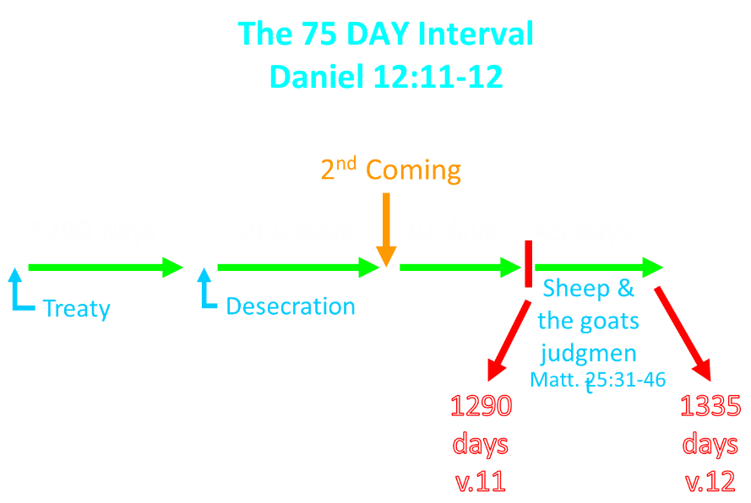

Slide 66

Dr. Arnold Fruchtenbaum
Footsteps of the Messiah, 355.
“The Millennium will not begin the day immediately following the last day of the Great Tribulation because there will be a seventy-five day interval. During this time between the Great Tribulation and the start of the Messianic Age, a number of events will occur. The existence of this interval is demonstrated in Daniel 12:11-12.”

Slide 67
The 75 DAY Interval
Daniel 12:11-12
The Beast cast into the Lake of Fire (Rev. 19:20)
The False Prophet cast into the Lake of Fire (Rev. 19:20)
The binding of Satan (Rev. 20:1-3)
The Judgment of the Jews (Ezek. 20:33-44)
The Judgment of the Gentiles (Matt. 25:31-46)
Resurrection of OT saints (Dan. 12:2) & Tribulation martyrs (Rev. 20:4-5)
Rewarding of OT saints & Tribulation martyrs (Dan. 12:3)
Fruchtenbaum, Footsteps of the Messiah, 356-66

Slide 68
HOW DID DANIEL WARN US ABOUT THE FUTURE?
Final form of human government (Dan. 2; 7)
Antichrist Prefigurement (Dan. 8; 11)
Tribulation period outline (Dan. 9:27)
Breaking of Israel (Dan. 12:1, 7)
Future resurrection program (Dan. 12:2)
75-day interval (Dan. 12:11-12)
Progressive illumination (Dan. 12:4, 8-9)
Notes:
Outline

Slide 69

Jude 3
“Beloved, while I was making every effort to write you about our common salvation, I felt the necessity to write to you appealing that you contend earnestly for the faith that was once for all time handed down to the saints.”

Slide 70
Revelation 22:18-19
“I testify to everyone who hears the words of the prophecy of this book: if anyone adds to them, God will add to him the plagues which are written in this book; ¹⁹ and if anyone takes away from the words of the book of this prophecy, God will take away his part from the tree of life and from the holy city, which are written in this book.”

Slide 71

Daniel 12:4, 9
“But as for you, Daniel, conceal these words and seal up the book until the end of time; many will go back and forth, and knowledge will increase...Go your way, Daniel, for these words are concealed and sealed up until the end time.”

Slide 72
Amos 8:12
“People will stagger from sea to sea And from the north even to the east; They will go to and fro to seek the word of the Lord, But they will not find it.”

Slide 73
History of Doctrine
Canon (A.D. 180)
Christology (A.D. 500)
Atonement (A.D. 1100)
Salvation (A.D. 1500)
Eschatology (A.D. 1800)

Slide 74
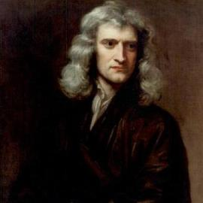
Sir Isaac Newton (1642–1727)
"About the time of the end, a body of men will be raised up who will turn their attention to the Prophecies, and insist upon their literal interpretation, in the midst of much clamor and opposition."
Isaac Newton cited in Nathaniel West, The Thousand Years in Both Testaments, 462.

Slide 75
Conclusion

Slide 76
HOW DID DANIEL WARN US ABOUT THE FUTURE?
Final form of human government (Dan. 2; 7)
Antichrist Prefigurement (Dan. 8; 11)
Tribulation period outline (Dan. 9:27)
Breaking of Israel (Dan. 12:1, 7)
Future resurrection program (Dan. 12:2)
75-day interval (Dan. 12:11-12)
Progressive illumination (Dan. 12:4, 8-9)
Notes:
Outline

