Slide 1

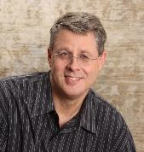
IS PREMILLENNIALISM WRONG?
2023 SLBC Prophecy Conference
Dr. Andy Woods
Senior Pastor – Sugar Land Bible Church
President Chafer Theological Seminary

Slide 2


Slide 3
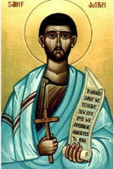
Justin Martyr
Dialogue with Trypho, 80.
“But I and every other completely orthodox Christian feel certain that there will be a resurrection of the flesh, followed by a thousand years in the rebuilt, embellished, and enlarged city of Jerusalem as was announced by the prophets Ezekiel, Isaiah, and the others.”

Slide 4

Philip Schaff
History of the Christian Church, vol. 2 , p. 614.
“The most striking point in the eschatology of the ante-Nicene age (A.D. 100–325) is the prominent chiliasm, or millenarianism, that is the belief of a visible reign of Christ in glory on earth with the risen saints for a thousand years, before the general resurrection and judgment. It was indeed not the doctrine of the church embodied in any creed or form of devotion, but a widely current opinion of distinguished teachers, such as Barnabas, Papias, Justin Martyr, Irenaeus, Tertullian, Methodius, and Lactantius.”

Slide 5
Edward Gibbon
History of Christianity (NY: Eckler, 1916), 141-44.
“The ancient and popular doctrine of the Millennium was intimately connected with the second coming of Christ. As the works of the creation had been finished in six days, their duration in their present state, according to a tradition which was attributed to the prophet Elijah, was fixed to six thousand years. By the same analogy it was inferred, that this long period of labor and contention, which was now almost elapsed, would be succeeded by a joyful Sabbath of a thousand years; and that Christ, with the triumphant band of the saints and the elect who had escaped death, or who had been miraculously revived, would reign upon earth till the time appointed for the last and general resurrection…The assurance of such a . . .

Slide 6
Edward Gibbon
History of Christianity (NY: Eckler, 1916), 141-44.
… Millennium was carefully inculcated by a succession of fathers from Justin Martyr, and Irenaeus, who conversed with the immediate disciples of the apostles, down to Lactantius, who was preceptor to the son of Constantine. Though it might not be universally received, it appears to have been the reigning sentiment of the orthodox believers; and it seems so well adapted to the desires and apprehensions of mankind, that it must have contributed in a very considerable degree to the progress of the Christian faith.”

Slide 7
Chronology of Revelation
Armageddon | Rev. 16:16
Second Coming | Rev. 19:11-21
Millennium | Rev. 20:1-10
Great White Throne Judgment | Rev. 20:11-15
Destruction of the Earth | Rev. 21:1
Eternal State | Rev. 21-22

Slide 8
Why A Millennium?
1000 years = literal time period
Vindicates God’s authority
Fulfills OT promises
Fulfills God’s purpose for Jerusalem
Completes the resurrection program
Only Christ’s rule results in lasting peace
Demonstrates the problem of man’s nature
Notes:
Outline

Slide 9
Why A Millennium?
1000 years = literal time period
Vindicates God’s authority
Fulfills OT promises
Fulfills God’s purpose for Jerusalem
Completes the resurrection program
Only Christ’s rule results in lasting peace
Demonstrates the problem of man’s nature
Notes:
Outline

Slide 10
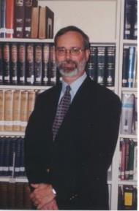
Kenneth L. Gentry
He Shall Have Dominion: A Post Millennial Eschatology (Tyler, Texas: Institute for Christian economics, 1992), page 335.
“The proper understanding of the thousand-year time frame in Revelation 20 is that it is representative of a long and glorious era and is not limited to a literal 365,000 days. The figure represents a perfect cube of 10, which is the number of quantitative perfection.”

Slide 11
Reasons for Understanding 1000 Literally
John’s use of indefinite concepts elsewhere
  Revelation 20:3,8
Exception to the “# of years” examples?
Other numbers are taken literally
  Two witnesses (11:3), 7000 people (11:13), 4 Angels (7:1) 7 Angels (8:6),144,000 Jews (7:4), 42 months (11:2), 1260 days (11:3)
Not always a symbolic interpretation
  (Rev. 17:18)

Slide 12


Revelation 17:18
“The woman whom you saw is the great city, which reigns over the kings of the earth.”

Slide 13

Robert Thomas
Revelation 8 to 22: An Exegetical Commentary (Chicago: Moody Press, 1992), 408.
Robert Thomas observes that, "no number in Revelation is verifiably a symbolic number.”

Slide 14
Why A Millennium?
1000 years = literal time period
Vindicates God’s authority
Fulfills OT promises
Fulfills God’s purpose for Jerusalem
Completes the resurrection program
Only Christ’s rule results in lasting peace
Demonstrates the problem of man’s nature
Notes:
Outline

Slide 15

Names & Titles Demonstrating Satan’s
Post-Fall, Earthly Authority
(Job 1:7; 2:2; Luke 4:5-8; Rom. 8:19-22)
Prince of this world (John 12:31; 14:30; 16:11)
God of this age (2 Cor. 4:4)
Prince and power of the air (Eph. 2:2)
Who the believer wrestles with (Eph. 6:12)
Roaring lion (1 Pet. 5:8)
Whole world lies in his power (1 John 5:19)

Slide 16
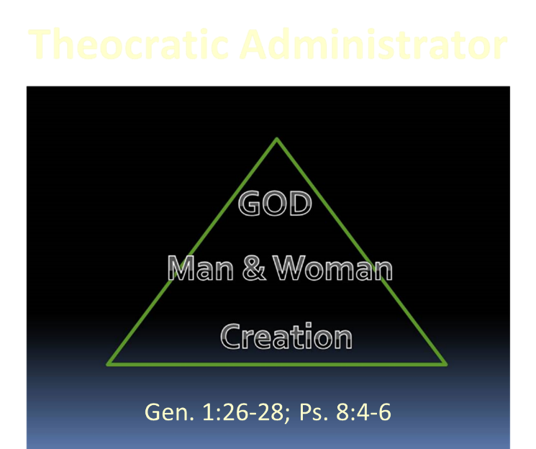

Slide 17

Charles Ryrie
Basic Theology, Page 511
“Why is an earthly kingdom necessary? Did He not receive His inheritance when He was raised and exalted in heaven? Is not His present rule His inheritance? Why does there need to be an earthly kingdom? Because He must be triumphant in the same arena where He was seemingly defeated. His rejection by the rulers of this world was on this earth (1 Cor. 2:8). His exaltation must also be on this earth. And so it shall be when He comes again to rule this world in righteousness. He has waited long for His inheritance; soon He shall receive it.”

Slide 19
Why A Millennium?
1000 years = literal time period
Vindicates God’s authority
Fulfills OT promises
Fulfills God’s purpose for Jerusalem
Completes the resurrection program
Only Christ’s rule results in lasting peace
Demonstrates the problem of man’s nature
Notes:
Outline

Slide 20
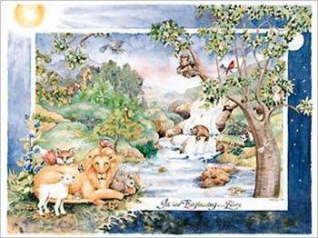
Fulfill Old Testament Promises
Isaiah 65:17-25

Slide 21
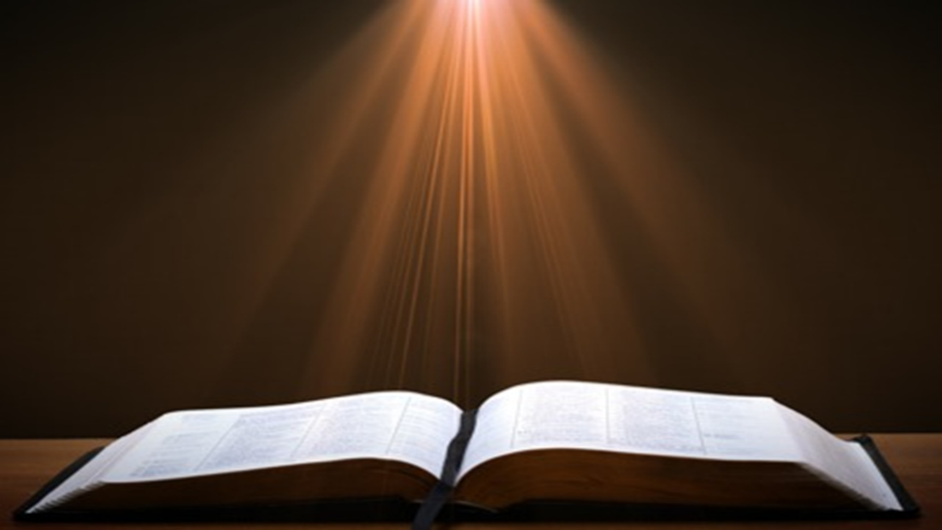
Isaiah 65:17-25
“¹⁷ For behold, I create new heavens and a new earth; And the former things will not be remembered or come to mind.¹⁸ “But be glad and rejoice forever in what I create; For behold, I create Jerusalem for rejoicing And her people for gladness.¹⁹ “I will also rejoice in Jerusalem and be glad in My people; And there will no longer be heard in her The voice of weeping and the sound of crying.²⁰ “No longer will there be in it an infant who lives but a few days, Or an old man who does not live out his days; For . . .

Slide 22
Isaiah 65:17-25
... the youth will die at the age of one hundred And the one who does not reach the age of one hundred Will be thought accursed.²¹ “They will build houses and inhabit them; They will also plant vineyards and eat their fruit.²² “They will not build and another inhabit, They will not plant and another eat; For as the lifetime of a tree, so will be the days of My people, And My chosen ones will wear out the work of their hands.²³ “They will not labor in vain, Or bear children for calamity; For they are …

Slide 23

Isaiah 65:17-25
...the offspring of those blessed by the Lord, And their descendants with them.²⁴ It will also come to pass that before they call, I will answer; and while they are still speaking, I will hear. ²⁵ The wolf and the lamb will graze together, and the lion will eat straw like the ox; and dust will be the serpent’s food. They will do no evil or harm in all My holy mountain,” says the Lord.

Slide 25

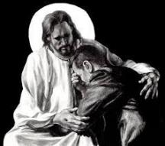
Revelation 21:4
“and He will wipe away every tear from their eyes; and there will no longer be any death; there will no longer be any mourning, or crying, or pain; the first things have passed away.”

Slide 26
DIFFERENCES BETWEEN THE MILLENNIUM & ETERNAL STATE
MILLENNIUM (REV. 20:1-10) | ETERNAL STATE (REV. 21‒22)
Present earth (Gen. 13:17) | New Earth (Rev. 21:1)
Waters (Gen. 15:18-21) | No sea (Rev. 21:1)
Rebellion (Zech. 14:16-18) | No rebellion (Rev. 21:4)
Tribal land (Ezek. 47:13-23) | Tribal city gates (Rev. 21:12)
Sin exists (Ezek 45:22) | No sin (Rev. 21:4)
Temple (Ezek. 40‒46) | No temple (Rev. 21:22)
Rod of iron (Ps. 2:6-8) | No rod needed (Rev. 21:8)
Death (Isa. 65:20) | No death (Rev. 21:4)
Sun exists (Isa. 30:26) | No sun (Rev. 21:23; 22:5)

Slide 27
Millennium Rev.20 | Eternal State Rev.21-22
Sin restrained | Sin removed
Curse restrained | Curse removed
Death | No death
Mortals / resurrected | Resurrected only
Mortals Destinies undecided | All Destinies sealed
Renovation | Recreation
Temporary | Eternal
Transitional | Non-transitional

Slide 28
Millennium and Eternal State
 | Rev 20:1-10 | Rev 21–22
Time | 20:4 | 22:5
Luminaries | Isa 30:26 | 21:23; 22:5
Temple | Ezek 40–48 | 21:22
Death | Isa 65:20 | 21:4
Satanic activity | 20:7 | 20:10
Rebellion | 20:8-9 | 21:27

Slide 29
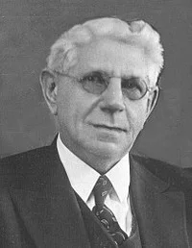
Premillennialism: A One-Text Theology?
"The only scriptural basis for this theory [i.e.' premillennialism] is Revelation 20:1-6, after an Old Testament content has been poured into it.”
Louis Berkhof, Systematic Theology: With a Complete Textual Index, 4th and rev. ed. (Grand Rapids: Eerdman's, 1932; reprint, Grand Rapids: Baker, 1996), 715.

Slide 30
Why A Millennium?
1000 years = literal time period
Vindicates God’s authority
Fulfills OT promises
Fulfills God’s purpose for Jerusalem
Completes the resurrection program
Only Christ’s rule results in lasting peace
Demonstrates the problem of man’s nature
Notes:
Outline

Slide 31

Isaiah 2:1-4
¹ “The word which Isaiah the son of Amoz saw concerning Judah and Jerusalem.² Now it will come about that In the last days The mountain of the house of the Lord Will be established as the chief of the mountains, And will be raised above the hills; And all the nations will stream to it.³ And many peoples will come and say, “Come, let us go up to the mountain of the Lord, To the house of the God of Jacob; . . .

Slide 32

Isaiah 2:1-4
. . .That He may teach us concerning His ways And that we may walk in His paths.” For the law will go forth from Zion And the word of the Lord from Jerusalem.⁴ And He will judge between the nations, And will render decisions for many peoples; And they will hammer their swords into plowshares and their spears into pruning hooks. Nation will not lift up sword against nation, And never again will they learn war.”

Slide 33

Zechariah 14:16-18
“¹⁶ Then it will come about that any who are left of all the nations that went against Jerusalem will go up from year to year to worship the King, the Lord of hosts, and to celebrate the Feast of Booths. ¹⁷ And it will be that whichever of the families of the earth does not go up to Jerusalem to worship the King, the Lord of hosts, there will be no rain on them. ¹⁸ If the family of Egypt does not go up or enter, then no rain will fall on them; it will be the plague with which the Lord smites the nations who do not go up to celebrate the Feast of Booths.”

Slide 34
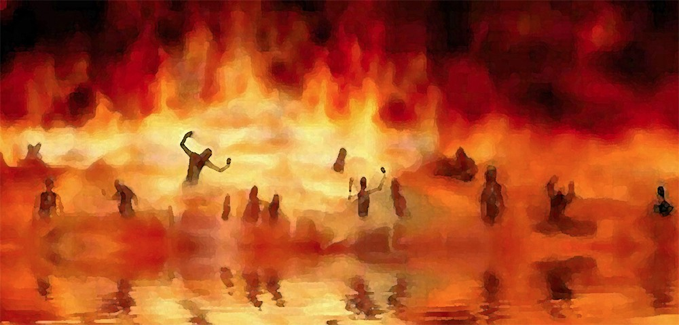
Revelation 21:8
“But for the cowardly and unbelieving and abominable and murderers and immoral persons and sorcerers and idolaters and all liars, their part will be in the lake that burns with fire and brimstone, which is the second death.”

Slide 35

Revelation 20:7-9
“⁷ When the thousand years are completed [teleō], Satan will be released from his prison, ⁸ and will come out to deceive the nations which are in the four corners of the earth, Gog and Magog, to gather them together for the war; the number of them is like the sand of the seashore. ⁹ And they came up on the broad plain of the earth and surrounded the camp of the saints and the beloved city, and fire came down from heaven and devoured them.”

Slide 36
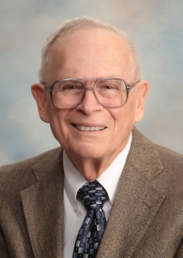
Robert Thomas
Four Views on the Book of Revelation, page 207.
“At the end of the Millennium that city will be Satan’s prime objective with his rebel army, because Israel will be a leader among the nations.”

Slide 37
Why A Millennium?
1000 years = literal time period
Vindicates God’s authority
Fulfills OT promises
Fulfills God’s purpose for Jerusalem
Completes the resurrection program
Only Christ’s rule results in lasting peace
Demonstrates the problem of man’s nature
Notes:
Outline

Slide 38


Genesis 3:19
“By the sweat of your face You will eat bread, Till you return to the ground, Because from it you were taken; For you are dust, And to dust you shall return.”

Slide 39


2 Cor. 4:16
Therefore we do not lose heart, but though our outer man is decaying, yet our inner man is being renewed day by day.

Slide 40

Daniel 12:1-2
“¹ Now at that time Michael, the great prince who stands guard over the sons of your people, will arise. And there will be a time of distress such as never occurred since there was a nation until that time; and at that time your people, everyone who is found written in the book, will be rescued. ² Many of those who sleep in the dust of the ground will awake, these to everlasting life, but the others to disgrace and everlasting contempt.”

Slide 41
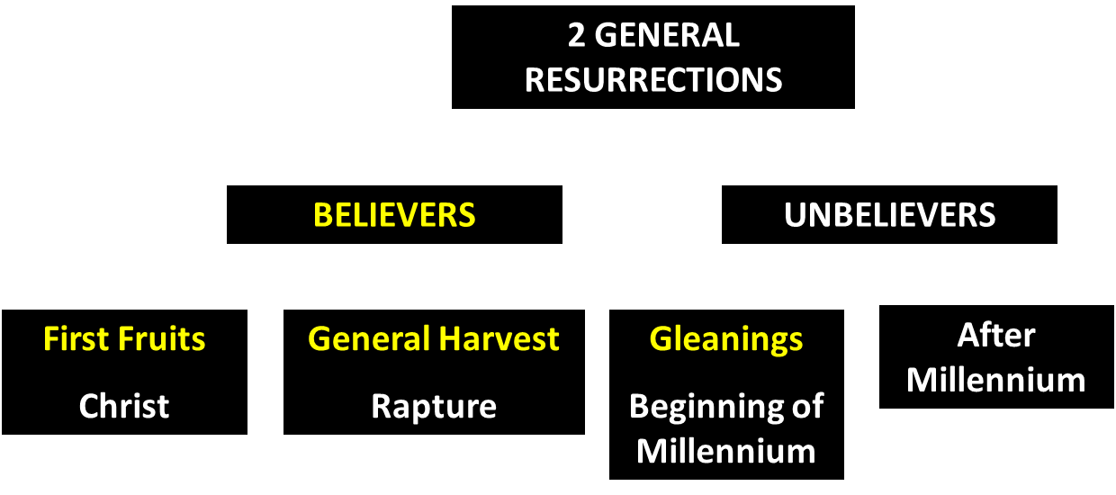
God’s Resurrection Program

Slide 42

1 Corinthians 15:20-23
“²⁰ But now Christ has been raised from the dead, the first fruits of those who are asleep. ²¹ For since by a man came death, by a man also came the resurrection of the dead. ²² For as in Adam all die, so also in Christ all will be made alive. ²³ But each in his own order: Christ the first fruits, after that those who are Christ’s at His coming.”

Slide 43

1 Corinthians 15:50-51
“⁵⁰ Now I say this, brethren, that flesh and blood cannot inherit the kingdom of God; nor does the perishable inherit the imperishable. ⁵¹ Behold, I tell you a mystery; we will not all sleep, but we will all be changed.”

Slide 44

Revelation 20:4-6
“⁴ Then I saw thrones, and they sat on them, and judgment was given to them. And I saw the souls of those who had been beheaded because of their testimony of Jesus and because of the word of God, and those who had not worshiped the beast or his image, and had not received the mark on their forehead and on their hand; and they came to life [zaō] and reigned with Christ for a thousand years….

Slide 45
Revelation 20:4-6
…⁵ The rest of the dead did not come to life [zaō] until the thousand years were completed. This is the first resurrection [anastasis]. ⁶ Blessed and holy is the one who has a part in the first resurrection [anastasis]; over these the second death has no power, but they will be priests of God and of Christ and will reign with Him for a thousand years.”

Slide 47
1 Corinthians 15:20-23
“²⁰ But now Christ has been raised from the dead, the first fruits of those who are asleep. ²¹ For since by a man came death, by a man also came the resurrection of the dead. ²² For as in Adam all die, so also in Christ all will be made alive. ²³ But each in his own order (tagma): Christ the first fruits, after that those who are Christ’s at His coming.”

Slide 48
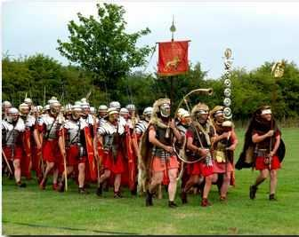
Order or Tagma (1 Cor. 15:23)
General – Christ’s resurrection (1 Cor. 15:23)
Officer – Rapture (1 Thess. 4:13-18)
Soldiers – OT saints & Tribulation martyrs (Rev. 20:4)
Captives – Unsaved of all ages (Rev. 20:5)

Slide 50
Why A Millennium?
1000 years = literal time period
Vindicates God’s authority
Fulfills OT promises
Fulfills God’s purpose for Jerusalem
Completes the resurrection program
Only Christ’s rule results in lasting peace
Demonstrates the problem of man’s nature
Notes:
Outline

Slide 51

Only Christ’s Rule Over Fallen Creation
Will Result in Lasting Peace

Slide 53
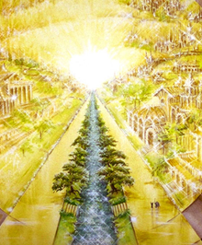
Eternal State is Future
No Satan (Rev 20:10)
No sea (Rev 21:1)
No death, crying, or pain (Rev 21:4)
No Sun (Rev 22:5)
No Moon (Rev 21:23)
No temple (Rev. 21:22)
No night (Rev 21:25)
No evil (Rev 21:27)
No curse (Rev 22:3)

Slide 54
Why A Millennium?
1000 years = literal time period
Vindicates God’s authority
Fulfills OT promises
Fulfills God’s purpose for Jerusalem
Completes the resurrection program
Only Christ’s rule results in lasting peace
Demonstrates the problem of man’s nature
Notes:
Outline

Slide 55
Man’s Real Problem
Nature vs. Environment
(Rom. 5:12; Jer. 17:9; Mark 7:20-23)

Slide 56
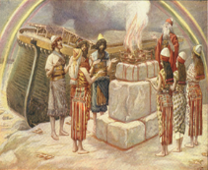
Genesis 8:21
The Lord smelled the soothing aroma; and the Lord said to Himself, “I will never again curse the ground on account of man, for the intent of man’s heart is evil from his youth; and I will never again destroy every living thing, as I have done.

Slide 57

Jeremiah 17:9
“The heart is more deceitful than all else And is desperately sick; Who can understand it?.”

Slide 58
Mark 7:20–23
²⁰ And He was saying, “That which proceeds out of the man, that is what defiles the man. ²¹ “For from within, out of the heart of men, proceed the evil thoughts, fornications, thefts, murders, adulteries, ²² deeds of coveting and wickedness, as well as deceit, sensuality, envy, slander, pride and foolishness. ²³ “All these evil things proceed from within and defile the man.”

Slide 59

Romans 5:12
“Therefore, just as through one man sin entered into the world, and death through sin, and so death spread to all men, because all sinned—.”

Slide 61
Scripture’s Four Judgments
NAME | SHEEP AND GOAT | JUDGMENT OF THE JEWS | BEMA SEAT | GREAT WHITE THRONE
SCRIPTURE | Matt 25:31-46 | Ezek 20:33-44 | 1 Cor 3:10-15 | Rev 20:11-15
PLACE | Earth, Jerusalem | Earth, wilderness | Heaven | Earth
AUDIENCE | Gentile Tribulation survivors | Jewish Tribulation survivors | Church Age believers | All unsaved
WHEN | After Tribulation | After Tribulation | After rapture | After Millennium
PURPOSE | Saved Gentiles enter kingdom | Saved Jews enter kingdom | Reward believers | Degree of punishment in hell
EVALUATION | Treatment of Christ’s brethren | Passing under shepherd’s rod | Works taken through fire | Not in the book; judged by books

Slide 62
Zechariah 14:16-18
“¹⁶ Then it will come about that any who are left of all the nations that went against Jerusalem will go up from year to year to worship the King, the Lord of hosts, and to celebrate the Feast of Booths. ¹⁷ And it will be that whichever of the families of the earth does not go up to Jerusalem to worship the King, the Lord of hosts, there will be no rain on them. ¹⁸ If the family of Egypt does not go up or enter, then no rain will fall on them; it will be the plague with which the Lord smites the nations who do not go up to celebrate the Feast of Booths.”

Slide 63
Revelation 20:7-9
“⁷ When the thousand years are completed [teleō], Satan will be released from his prison, ⁸ and will come out to deceive the nations which are in the four corners of the earth, Gog and Magog, to gather them together for the war; the number of them is like the sand of the seashore. ⁹ And they came up on the broad plain of the earth and surrounded the camp of the saints and the beloved city, and fire came down from heaven and devoured them.”

Slide 65
Conclusion

Slide 66
Why A Millennium?
1000 years = literal time period
Vindicates God’s authority
Fulfills OT promises
Fulfills God’s purpose for Jerusalem
Completes the resurrection program
Only Christ’s rule results in lasting peace
Demonstrates the problem of man’s nature
Notes:
Outline

