Slide 1


Genesis 12‒50
Israel’s Birth & Preservation

Slide 2


GENESIS STRUCTURE
  Genesis 12-50 (four people)
    Abraham (12:1–25:11)
    Isaac (25:12–26:35)
    Jacob (27–36)
    Joseph (37–50)

Slide 3
Genesis 27
Chapter Summary
  Isaac’s intent (1-4)
  The conspiracy (5-17)
  Deception and blessing (18-29)
  Isaac blesses Esau (30-40)
  Plan to flee to Haran (41-46)

Slide 4
Genesis 27
Chapter Summary
  Isaac’s intent (1-4)
  The conspiracy (5-17)
  Deception and blessing (18-29)
  Isaac blesses Esau (30-40)
  Plan to flee to Haran (41-46)

Slide 5
Genesis 27:18-29
Deception and Blessing
    Deception (18-27a)
    Blessing (27b-29)

Slide 6
Genesis 27:18-29
Deception and Blessing
    Deception (18-27a)
    Blessing (27b-29)

Slide 7
Genesis 27:18-27a
Deception
      Jacob’s entrance (18)
      Jacob’s first lie (19)
      Jacob’s second lie (20)
      Isaac’s test (21-23)
      Jacob’s third lie (24)
      Meal (25)
      Kiss (26-27a)

Slide 8
Genesis 27:18-27a
Deception
      Jacob’s entrance (18)
      Jacob’s first lie (19)
      Jacob’s second lie (20)
      Isaac’s test (21-23)
      Jacob’s third lie (24)
      Meal (25)
      Kiss (26-27a)

Slide 9
Genesis 27:18-27a
Deception
      Jacob’s entrance (18)
      Jacob’s first lie (19)
      Jacob’s second lie (20)
      Isaac’s test (21-23)
      Jacob’s third lie (24)
      Meal (25)
      Kiss (26-27a)

Slide 10

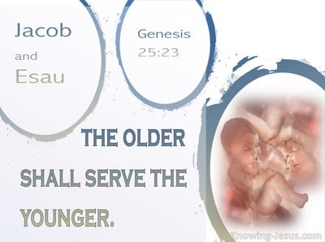
Genesis 25:23
“The Lord said to her, ‘Two nations are in your womb; And two peoples will be separated from your body; And one people shall be stronger than the other; And the older shall serve the younger.’”

Slide 11


Dr. Arnold G. Fruchtenbaum
The Book of Genesis, 424
“So Jacob lied, and his deception of his father was indeed sinful; that is where Jacob’s sin lay. It should be noted that the sin is not the stealing of the patriarchal blessing, but the deception of the father. However, what Isaac and Esau were trying to do was even more sinful, because they were trying to thwart the very purpose of God.”

Slide 12
Genesis 27:18-27a
Deception
      Jacob’s entrance (18)
      Jacob’s first lie (19)
      Jacob’s second lie (20)
      Isaac’s test (21-23)
      Jacob’s third lie (24)
      Meal (25)
      Kiss (26-27a)

Slide 13
Genesis 27:18-27a
Deception
      Jacob’s entrance (18)
      Jacob’s first lie (19)
      Jacob’s second lie (20)
      Isaac’s test (21-23)
      Jacob’s third lie (24)
      Meal (25)
      Kiss (26-27a)

Slide 14
Genesis 26:21-23
Isaac’s Test
      Suspicion (21)
      Deception (22)
      Reason (23a)
      Result (23b)

Slide 15
Genesis 26:21-23
Isaac’s Test
      Suspicion (21)
      Deception (22)
      Reason (23a)
      Result (23b)

Slide 16
Genesis 26:21-23
Isaac’s Test
      Suspicion (21)
      Deception (22)
      Reason (23a)
      Result (23b)

Slide 17

Charles Ryrie
The Ryrie Study Bible, page 35
Genesis 27:17-19 (RSB:NASB1995U): Jacob had to resort to lying (vv. 19, 24), and Isaac allowed his senses of touch (v. 22), taste (v. 25), and smell (v. 27) to overrule what he heard (v. 22). The blessing included both benediction (v. 28) and prediction (v. 29).”

Slide 18
Matt 24 / Rev 6 Parallels
Prediction | Birth pangs (Matt 24) | Seal judgments (Rev 6)
1. False Christ | 24:5 | 6:2
2. War | 24:6 | 6:3-4
3. Famine | 24:7 | 6:5-6
4. Death | 24:6-7 | 6:7-8
5. Martyrs | 24:9-13 | 6:9-11
6. Earthquakes | 24:7 | 6:12-17
7. Evangelism | 24:14 | 7:1-9

Slide 19
Genesis 26:21-23
Isaac’s Test
      Suspicion (21)
      Deception (22)
      Reason (23a)
      Result (23b)

Slide 20
Genesis 26:21-23
Isaac’s Test
      Suspicion (21)
      Deception (22)
      Reason (23a)
      Result (23b)

Slide 21
Genesis 27:18-27a
Deception
      Jacob’s entrance (18)
      Jacob’s first lie (19)
      Jacob’s second lie (20)
      Isaac’s test (21-23)
      Jacob’s third lie (24)
      Meal (25)
      Kiss (26-27a)

Slide 22
Genesis 27:18-27a
Deception
      Jacob’s entrance (18)
      Jacob’s first lie (19)
      Jacob’s second lie (20)
      Isaac’s test (21-23)
      Jacob’s third lie (24)
      Meal (25)
      Kiss (26-27a)

Slide 23
Genesis 27:18-27a
Deception
      Jacob’s entrance (18)
      Jacob’s first lie (19)
      Jacob’s second lie (20)
      Isaac’s test (21-23)
      Jacob’s third lie (24)
      Meal (25)
      Kiss (26-27a)

Slide 24
Genesis 27:18-29
Deception and Blessing
    Deception (18-27a)
    Blessing (27b-29)

Slide 25
Genesis 27:27b-29
Blessing
      Blessings of God (27b)
      Agricultural blessings (28)
      Lordship blessings (29a-b)
      Blessing and curse (29c)

Slide 26
Genesis 27:27b-29
Blessing
      Blessings of God (27b)
      Agricultural blessings (28)
      Lordship blessings (29a-b)
      Blessing and curse (29c)

Slide 27
Genesis 27:27b-29
Blessing
      Blessings of God (27b)
      Agricultural blessings (28)
      Lordship blessings (29a-b)
      Blessing and curse (29c)

Slide 28
Genesis 27:27b-29
Blessing
      Blessings of God (27b)
      Agricultural blessings (28)
      Lordship blessings (29a-b)
      Blessing and curse (29c)

Slide 29
Genesis 26:29a-b
Isaac’s Test
      Nations (29a)
      Brethren (29b)

Slide 30
Genesis 26:29a-b
Isaac’s Test
      Nations (29a)
      Brethren (29b)

Slide 31

Zechariah 14:16-18
“¹⁶ Then it will come about that any who are left of all the nations that went against Jerusalem will go up from year to year to worship the King, the Lord of hosts, and to celebrate the Feast of Booths. ¹⁷ And it will be that whichever of the families of the earth does not go up to Jerusalem to worship the King, the Lord of hosts, there will be no rain on them. ¹⁸ If the family of Egypt does not go up or enter, then no rain will fall on them; it will be the plague with which the Lord smites the nations who do not go up to celebrate the Feast of Booths.”

Slide 32

Isaiah 2:1-4
¹ “The word which Isaiah the son of Amoz saw concerning Judah and Jerusalem.² Now it will come about that In the last days The mountain of the house of the Lord Will be established as the chief of the mountains, And will be raised above the hills; And all the nations will stream to it.³ And many peoples will come and say, “Come, let us go up to the mountain of the Lord, To the house of the God of Jacob; . . .

Slide 33

Isaiah 2:1-4
. . .That He may teach us concerning His ways And that we may walk in His paths.” For the law will go forth from Zion And the word of the Lord from Jerusalem.⁴ And He will judge between the nations, And will render decisions for many peoples; And they will hammer their swords into plowshares and their spears into pruning hooks. Nation will not lift up sword against nation, And never again will they learn war.”

Slide 34

Revelation 20:7-9
“⁷ When the thousand years are completed [teleō], Satan will be released from his prison, ⁸ and will come out to deceive the nations which are in the four corners of the earth, Gog and Magog, to gather them together for the war; the number of them is like the sand of the seashore. ⁹ And they came up on the broad plain of the earth and surrounded the camp of the saints and the beloved city, and fire came down from heaven and devoured them.”

Slide 35
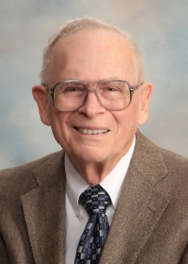
Robert Thomas
Four Views on the Book of Revelation, page 207.
“At the end of the Millennium that city will be Satan’s prime objective with his rebel army, because Israel will be a leader among the nations.”

Slide 36
Genesis 26:29a-b
Isaac’s Test
      Nations (29a)
      Brethren (29b)

Slide 37
Genesis 25:23
“The Lord said to her, ‘Two nations are in your womb; And two peoples will be separated from your body; And one people shall be stronger than the other; And the older shall serve the younger.’”

Slide 38

Cain Murders Abel
(Gen. 4:3-8)
  4:3-5a
  Messianic line through Abel (Gen 3:21; Heb 11:4) contrary to Eve’s false expectation (4:1)
  Begins selection of younger over older pattern (Abel over Cain, Seth over Cain, Shem over Japheth, Isaac over Ishmael, Jacob over Esau, Judah and Joseph over their brothers, and Ephraim over Manasseh)

Slide 39
Genesis 27:27b-29
Blessing
      Blessings of God (27b)
      Agricultural blessings (28)
      Lordship blessings (29a-b)
      Blessing and curse (29c)

Slide 40

Genesis 12:3
“And I will bless those who bless you, And the one who curses [kalal] you I will curse [aor]. And in you all the families of the earth will be blessed.”

Slide 41
Dr. Arnold G. Fruchtenbaum
The Book of Genesis, 426
“Therefore, contrary to Isaac’s expectations or hope, the Abrahamic Covenant was to be sustained through Jacob and not through Esau. Thus, Isaac blessed Jacob, and this was the result of divine intervention in spite of Jacob’s sin. Isaac blessed Jacob against his own will, as indeed later Balaam will bless Israel against his own will.”

Slide 42
Genesis 27
Chapter Summary
  Isaac’s intent (1-5)
  The conspiracy (5-17)
  Deception and blessing (18-29)
  Isaac blesses Esau (30-40)
  Plan to flee to Haran (41-46)

Slide 43
Genesis 27:30-40
Isaac Blesses Esau
    Return of Esau (30)
    Esau prepares meal (31)
    Isaac’s realization (32-33)
    Esau’s reaction (34)
    Isaac’s reaction (35)
    Esau’s request (36)
    Isaac’s answer (37)
    Esau’s lament (38)
    Esau’s blessing (39-40)

Slide 44
Genesis 27:30-40
Isaac Blesses Esau
    Return of Esau (30)
    Esau prepares meal (31)
    Isaac’s realization (32-33)
    Esau’s reaction (34)
    Isaac’s reaction (35)
    Esau’s request (36)
    Isaac’s answer (37)
    Esau’s lament (38)
    Esau’s blessing (39-40)

Slide 45
Genesis 27:30-40
Isaac Blesses Esau
    Return of Esau (30)
    Esau prepares meal (31)
    Isaac’s realization (32-33)
    Esau’s reaction (34)
    Isaac’s reaction (35)
    Esau’s request (36)
    Isaac’s answer (37)
    Esau’s lament (38)
    Esau’s blessing (39-40)

Slide 46
Genesis 27:30-40
Isaac Blesses Esau
    Return of Esau (30)
    Esau prepares meal (31)
    Isaac’s realization (32-33)
    Esau’s reaction (34)
    Isaac’s reaction (35)
    Esau’s request (36)
    Isaac’s answer (37)
    Esau’s lament (38)
    Esau’s blessing (39-40)

Slide 47
Genesis 27:32-33
Isaac’s Realization
      Identification (32)
      Reaction (33)

Slide 48
Genesis 27:32-33
Isaac’s Realization
      Identification (32)
      Reaction (33)

Slide 49
Genesis 27:32-33
Isaac’s Realization
      Identification (32)
      Reaction (33)

Slide 50
Genesis 27:30-40
Isaac Blesses Esau
    Return of Esau (30)
    Esau prepares meal (31)
    Isaac’s realization (32-33)
    Esau’s reaction (34)
    Isaac’s reaction (35)
    Esau’s request (36)
    Isaac’s answer (37)
    Esau’s lament (38)
    Esau’s blessing (39-40)

Slide 51
Genesis 27:34
Esau’s Reaction
      Cry (34a)
      Request (34b)

Slide 52
Genesis 27:34
Esau’s Reaction
      Cry (34a)
      Request (34b)

Slide 53
Genesis 27:34
Esau’s Reaction
      Cry (34a)
      Request (34b)

Slide 54
Genesis 27:30-40
Isaac Blesses Esau
    Return of Esau (30)
    Esau prepares meal (31)
    Isaac’s realization (32-33)
    Esau’s reaction (34)
    Isaac’s reaction (35)
    Esau’s request (36)
    Isaac’s answer (37)
    Esau’s lament (38)
    Esau’s blessing (39-40)

Slide 55
Genesis 27:35
Isaac’s Reaction
      Truth (35a)
      Lie (35b)

Slide 56
Genesis 27:35
Isaac’s Reaction
      Truth (35a)
      Lie (35b)

Slide 57
Genesis 25:23
“The Lord said to her, ‘Two nations are in your womb; And two peoples will be separated from your body; And one people shall be stronger than the other; And the older shall serve the younger.’”

Slide 58
Genesis 27:35
Isaac’s Reaction
      Truth (35a)
      Lie (35b)

Slide 59
Genesis 25:23
“The Lord said to her, ‘Two nations are in your womb; And two peoples will be separated from your body; And one people shall be stronger than the other; And the older shall serve the younger.’”

Slide 60
Genesis 27:30-40
Isaac Blesses Esau
    Return of Esau (30)
    Esau prepares meal (31)
    Isaac’s realization (32-33)
    Esau’s reaction (34)
    Isaac’s reaction (35)
    Esau’s request (36)
    Isaac’s answer (37)
    Esau’s lament (38)
    Esau’s blessing (39-40)

Slide 61
Genesis 27:36
Esau’s Request
      Complaint (36a)
      Request (36b)

Slide 62
Genesis 27:36
Esau’s Request
      Complaint (36a)
      Request (36b)

Slide 63
Dr. Arnold G. Fruchtenbaum
The Book of Genesis, 428
“In 27:36 came Esau’s complaint and request. Esau’s complaint was: And he said, Is not he rightly named Jacob [yaaqov]? for he has supplanted me these two times. In Hebrew, the word supplanted comes from the same root as akav, ‘Jacob.’ The meaning coming from Esau’s lips goes from ‘over-reacher’ or ‘supplanter’ to ‘deceiver.’ The meaning of the name now moved from a positive to a negative implication, but it was done by Esau and not by God. Again, Jacob’s name comes from the Hebrew root akav, which basically means ‘heel.’ It also has the meaning in verbal form ‘to hold the heel in order to get before.’”

Slide 64
Dr. Arnold G. Fruchtenbaum
The Book of Genesis, 428
“That is its usage in Jeremiah 9:4. It has the meaning of ‘heel-grabber,’ one who trips another by the heel or overtakes and supplants him in the race. Therefore, by way of etymology, Jacob equaling ‘supplanter’ is a developed meaning, not the actual meaning of the word. Jacob twice ‘overtook’ Esau; that is, Jacob ‘tripped’ him and ‘supplanted’ him in the race. Esau’s rhetorical question was: ‘Is he called Jacob, ‘over-reacher,’ that he has twice overreached me?’ ‘Is it because he bears this name that it has now twice come to pass?’ In other words, the question was: ‘Is it all in the name?’”

Slide 65
Dr. Arnold G. Fruchtenbaum
The Book of Genesis, 428
“Of course, it was not all in the name but rather in the outworking of God’s plan. According to Esau, the two times were, first: He took away my birthright, which was a lie since Esau had sold his birthright; and second: and behold, now he has taken away my blessing. This second claim, too, was a lie, since the blessing belonged to the one with the birthright.”

Slide 66
Genesis 27:36
Esau’s Request
      Complaint (36a)
      Request (36b)

Slide 67
Genesis 27:30-40
Isaac Blesses Esau
    Return of Esau (30)
    Esau prepares meal (31)
    Isaac’s realization (32-33)
    Esau’s reaction (34)
    Isaac’s reaction (35)
    Esau’s request (36)
    Isaac’s answer (37)
    Esau’s lament (38)
    Esau’s blessing (39-40)

Slide 68
Dr. Arnold G. Fruchtenbaum
The Book of Genesis, 429
“In other words, the blessing given to Jacob is irrevocable. Indeed, the Nuzi Tablets teach that such oral testaments were binding, and there is an example in the Nuzi Court Record of Tarmiye. Tarmiye’s two older brothers contested his inheritance of a slave girl, and Tarmiye’s defense was based upon his father’s oral testament. The tablet reads as follows:
  ‘My father Huya was sick and lay on a couch; then my father seized my hand and spoke thus to me: My other sons being older have acquired a wife, so I give here Sululi-Istar as your wife.’”
Indeed, the court ruled in his favor, because these oral-type . . .

Slide 69
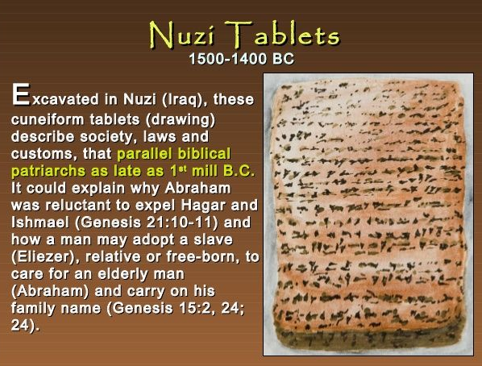
Dr. Arnold G. Fruchtenbaum
The Book of Genesis, 429
. . .testaments were considered binding. Isaac began his statement in verse 2 by saying: I am old and know not the day of my death. The Nuzi Tablets also begin the same way when introducing the final disposition of property. So here again with Isaac’s blessing of his sons was a strong correlation with Ancient Near Eastern Texts.”

Slide 70
Genesis 27:30-40
Isaac Blesses Esau
    Return of Esau (30)
    Esau prepares meal (31)
    Isaac’s realization (32-33)
    Esau’s reaction (34)
    Isaac’s reaction (35)
    Esau’s request (36)
    Isaac’s answer (37)
    Esau’s lament (38)
    Esau’s blessing (39-40)

Slide 71
Genesis 27:38
Esau’s Lament
      Lament (38a)
      Cry (38b)

Slide 72
Genesis 27:38
Esau’s Lament
      Lament (38a)
      Cry (38b)

Slide 73
Genesis 27:38
Esau’s Lament
      Lament (38a)
      Cry (38b)

Slide 74
Genesis 27:30-40
Isaac Blesses Esau
    Return of Esau (30)
    Esau prepares meal (31)
    Isaac’s realization (32-33)
    Esau’s reaction (34)
    Isaac’s reaction (35)
    Esau’s request (36)
    Isaac’s answer (37)
    Esau’s lament (38)
    Esau’s blessing (39-40)

Slide 75
Genesis 27:39-40
Esau’s Blessings
      Land (39)
      Nation (40)

Slide 76
Genesis 27:39-40
Esau’s Blessings
      Land (39)
      Nation (40)

Slide 77
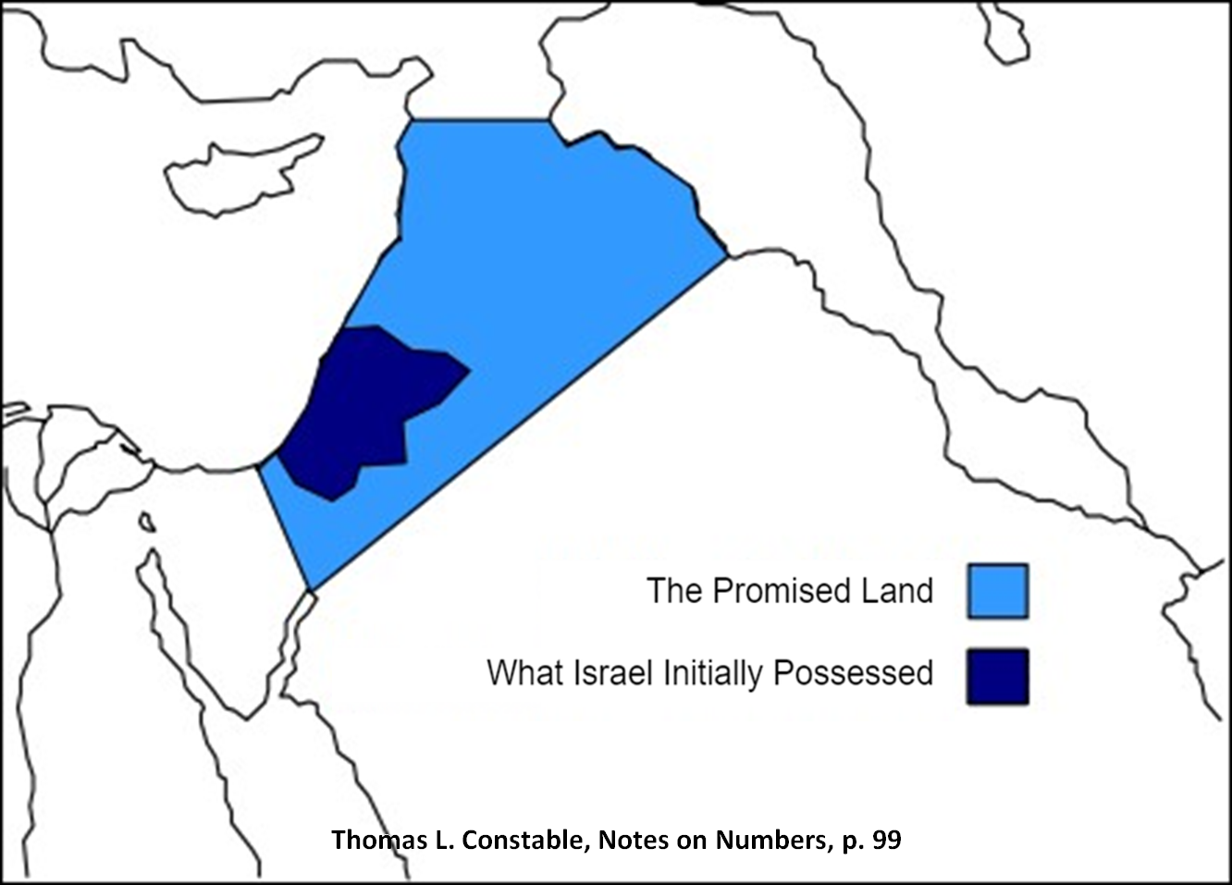

Slide 78
Dr. Arnold G. Fruchtenbaum
The Book of Genesis, 429-30
“At this point, there is a blessing for Esau, in 27:39–40. In verse 39, he first of all speaks concerning Esau: Behold, of the fatness of the earth shall be your dwelling. In the Hebrew text there is a min partitive; literally, it should read: ‘Away from the fatness of the earth shall be your dwelling.’ The next phrase, of the dew of heaven from above, also has a min partitive, literally meaning ‘away from the dew of heaven.’ The point is that while in some translations, it sounds similar to the blessing he gave to Jacob, in the Hebrew text it is actually the opposite of what was promised to Jacob. It means that since Esau’s place is away from this and away from that, Esau will not inherit the Land. Whatever his blessing, it will be away from the Land; he will not be the inheritor of this Land.”

Slide 79
Genesis 27:39-40
Esau’s Blessings
      Land (39)
      Nation (40)

Slide 80
Genesis 27:40
Nation
      Sword (40a)
      Subjugation (40b)
      Freedom (40c)

Slide 81
Genesis 27:40
Nation
      Sword (40a)
      Subjugation (40b)
      Freedom (40c)

Slide 82


Slide 83
Genesis 27:40
Nation
      Sword (40a)
      Subjugation (40b)
      Freedom (40c)

Slide 84
Genesis 25:23
“The Lord said to her, ‘Two nations are in your womb; And two peoples will be separated from your body; And one people shall be stronger than the other; And the older shall serve the younger.’”

Slide 85
Genesis 27:40
Nation
      Sword (40a)
      Subjugation (40b)
      Freedom (40c)

Slide 86
Dr. Arnold G. Fruchtenbaum
The Book of Genesis, 430
“In subsequent history, when the Jews went into Babylonian Captivity, the Edomites left their territory at Mount Seir in the Trans-Jordan and moved into the southern part of Judah, where they became known as Idumeans. In addition, later these Idumeans were conquered by one of the descendants of the Maccabees, John Hyrcanos, who conquered them in 129 b.c., forcibly converted them to Judaism, and then incorporated Idumea into the Jewish Judean State. . . .

Slide 87
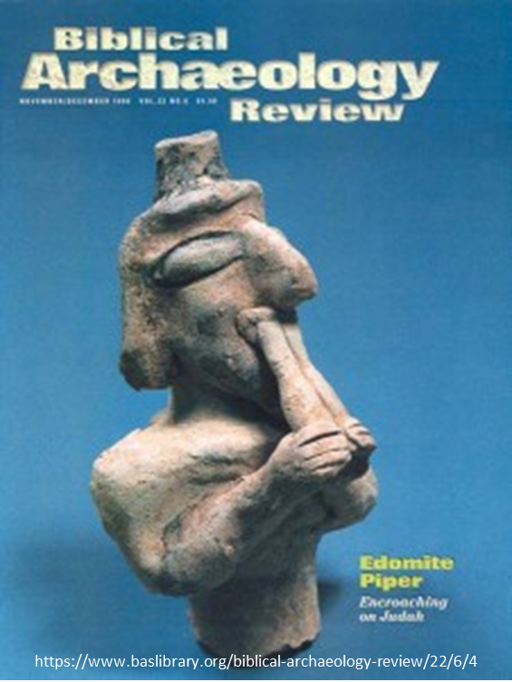
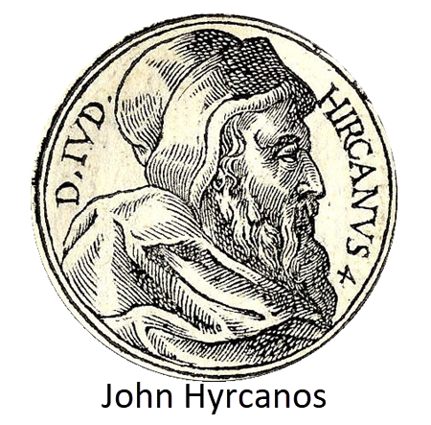
Dr. Arnold G. Fruchtenbaum
The Book of Genesis, 430
…Eventually, these converted Idumeans produced the dynastic rule of the House of Herod.”

Slide 88


John 13:19; 14:29
“^{13:19} From now on I am telling you before it comes to pass, so that when it does occur, you may believe that I am He… ^{14:29} Now I have told you before it happens, so that when it happens, you may believe.”

Slide 89
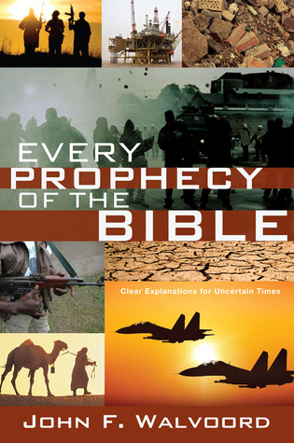

Slide 90
Genesis 27
Chapter Summary
  Isaac’s intent (1-4)
  The conspiracy (5-17)
  Deception and blessing (18-29)
  Isaac blesses Esau (30-40)
  Plan to flee to Haran (41-46)

Slide 91
Genesis 27:41-46
Plan to Flee to Haran
    Cause (41)
    Rebekah’s solution (42-46)

Slide 92
Genesis 27:41-46
Plan to Flee to Haran
    Cause (41)
    Rebekah’s solution (42-46)

Slide 93

Matthew 5:21-22
“²¹ “You have heard that the ancients were told, ‘You shall not commit murder’ and ‘Whoever commits murder shall be liable to the court.’ ²² But I say to you that everyone who is angry with his brother shall be guilty before the court; and whoever says to his brother, ‘You good-for-nothing,’ shall be guilty before the supreme court; and whoever says, ‘You fool,’ shall be guilty enough to go into the fiery hell.”

Slide 94

Matthew 5:27-28
“²⁷ You have heard that it was said, ‘You shall not commit adultery’; ²⁸ but I say to you that everyone who looks at a woman with lust for her has already committed adultery with her in his heart.”

Slide 95
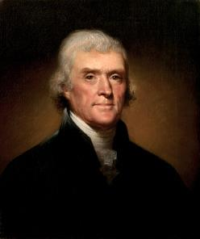
Thomas Jefferson
On April 21, 1803, Jefferson wrote to Dr. Benjamin Rush, also a signer of the Declaration
"My views ... are the result of a life of inquiry and reflection, and very different from the anti-Christian system imputed to me by those who know nothing of my opinions. To the corruptions of Christianity, I am, indeed, opposed; but not to the genuine precepts of Jesus Himself. I am a Christian in the only sense in which He wished any one to be; sincerely attached to his doctrines in preference to all others...His system of morals...if filled up in the style and spirit of the rich fragments He left us, would be the most perfect and sublime that has ever been taught by man...His moral doctrines...were more pure and . . .

Slide 96
Thomas Jefferson
On April 21, 1803, Jefferson wrote to Dr. Benjamin Rush, also a signer of the Declaration
...perfect than those of the most correct of the philosophers...gathering all into one family under the bonds of love, charity, peace, common wants and common aids. A development of this head will evince the peculiar superiority of the system of Jesus over all others. The precepts of philosophy, and of the Hebrew code, laid hold of actions only. He pushed his scrutinies into the heart of man; erected his tribunal in the region of his thoughts, and purified the waters at the fountain head.”

Slide 97
Genesis 27:41-46
Plan to Flee to Haran
    Cause (41)
    Rebekah’s solution (42-46)

Slide 98
Genesis 27:42-46
Rebekah’s Solution
      Discovery (42a)
      Problem (42b)
      Instruction (43-44a)
      Purpose (44b-45)
      Excuse (46)

Slide 99
Genesis 27:42-46
Rebekah’s Solution
      Discovery (42a)
      Problem (42b)
      Instruction (43-44a)
      Purpose (44b-45)
      Excuse (46)

Slide 100
Genesis 27:42-46
Rebekah’s Solution
      Discovery (42a)
      Problem (42b)
      Instruction (43-44a)
      Purpose (44b-45)
      Excuse (46)

Slide 101


Genesis 3:15
“And I will put enmity Between you and the woman, And between your seed and her seed; He shall bruise you on the head, And you shall bruise him on the heel.”

Slide 102
Messiah must be Jewish or from the line of Jacob
Numbers 24:17

Slide 103
Balaam's 7 Oracles Blessing Israel (23-24)
First oracle (23:1-12), Balaam explained that God’s blessings upon Israel were irrevocable.
Second oracle (23:13-26), Balaam explained that the source of Israel’s blessing was her unique relationship to Yahweh
Third oracle (23:27–24:14), Balaam extolled Israel’s beauty.
Fourth oracle (24:15-19), Balaam explained that a future messianic deliverer (Gen 49:10) would spring forth and exercise dominion from Israel.

Slide 104
Balaam's 7 Oracles Blessing Israel (23-24)
Fifth oracle (Num 24:20) predicts Amalek’s destruction. Amalek was the first foe that Israel had to fight against after leaving Egypt (Exod 17).
Sixth oracle (24:21-22) predicts the destruction of the Midianite group known as the Kenites as well as Assyria.
The nations of the seventh oracle are difficult to identify (24:23-24).

Slide 105

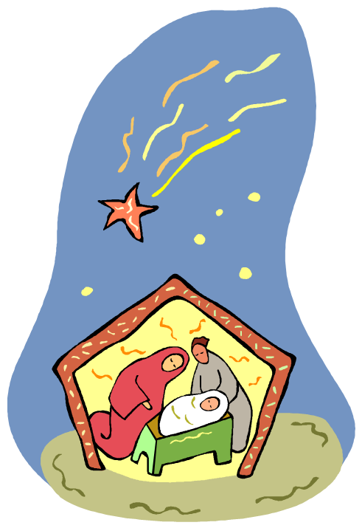
Numbers 24:17
“I see him, but not now; I behold him, but not near; A star shall come forth from Jacob, A scepter shall rise from Israel, And shall crush through the forehead of Moab, And tear down all the sons of Sheth.”

Slide 106
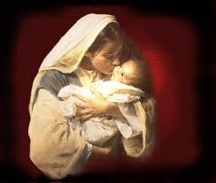
Satanic Attempts to Stop Messiah’s Birth
Cain & Abel (Gen. 4)
Sons of God (Gen. 6)
Pharaoh persecutes Israel (Exod. 1)
Joash protected from Athaliah (2 Chron. 22‒23)
Haman persecutes Israel (Esther)
Antiochus Epiphanés (Dan. 11:31)
Herod persecutes Christ (Matt 2; Rev 12:4)

Slide 107
Genesis 27:42-46
Rebekah’s Solution
      Discovery (42a)
      Problem (42b)
      Instruction (43-44a)
      Purpose (44b-45)
      Excuse (46)

Slide 108
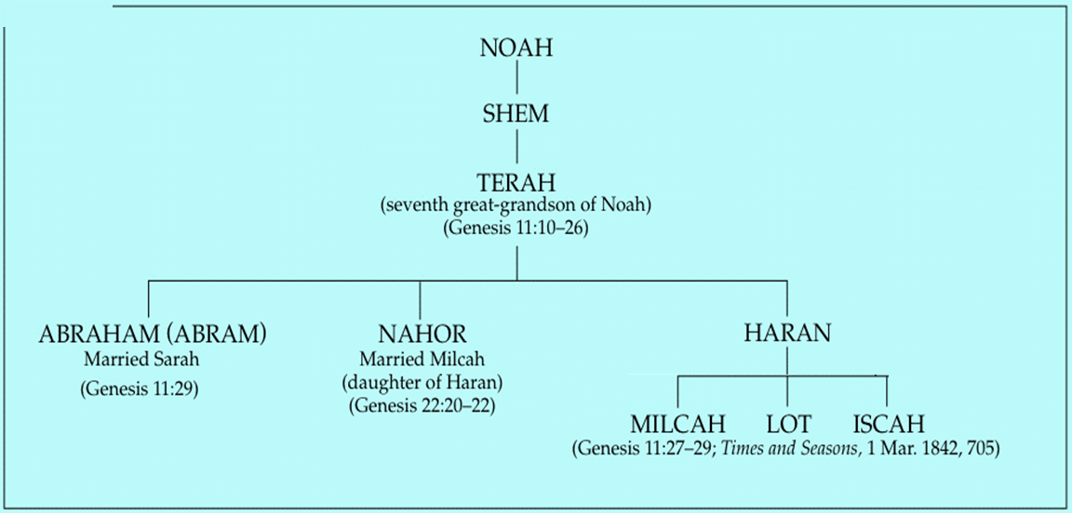

Slide 109


Nahor’s children through Milcah (Gen. 22:20b-23)
1. Uz (Job 1:1) | 5. Hazo
2. Buz | 6. Pildash
3. Aram | 7. Jidlaph
4. Chesed | 8. Bethuel (Gen. 24)

Slide 110


Slide 111
Genesis 27:42-46
Rebekah’s Solution
      Discovery (42a)
      Problem (42b)
      Instruction (43-44a)
      Purpose (44b-45)
      Excuse (46)

Slide 112


Genesis 9:6
“Whoever sheds man’s blood, By man his blood shall be shed, For in the image of God He made man.”

Slide 113
Noahic vs. Abrahamic & Mosaic Covenants
Name | NOAHIC | ABRAHAMIC | MOSAIC
Human agent | Noah | Abraham | Moses
Scripture | Gen. 8‒9 | Gen. 12‒17 | Exod. 19‒40
Covenant (Berith) | Gen. 9:9 | Gen. 15:18 | Exod. 19:5
Party | World, humanity | Israel, Hebrews | Israel, Hebrews
Israel | Pre-Israel | Post-Israel | Post-Israel

Slide 114
Noahic vs. Abrahamic & Mosaic Covenants
Covenant | NOAHIC | ABRAHAMIC | MOSAIC
Conditional or unconditional | Unconditional | Unconditional | Conditional
Promises | No more flood judgment, enduring earth, capital punishment | Ownership of land, seed, and blessing | Enjoyment or possession of land, seed, and blessing
Sign | Rainbow | Circumcision | Sabbath
Purpose | Restrain & preserve | Redemptive | Redemptive
Directly binding today? | Yes | No | No

Slide 115
Genesis 27:42-46
Rebekah’s Solution
      Discovery (42a)
      Problem (42b)
      Instruction (43-44a)
      Purpose (44b-45)
      Excuse (46)

Slide 116
VI. Genesis 26:34-35
Esau’s Wives
    Esau’s age (34a)
    Names of wives (34b)
    Impact on Esau’s parents (35)

Slide 117
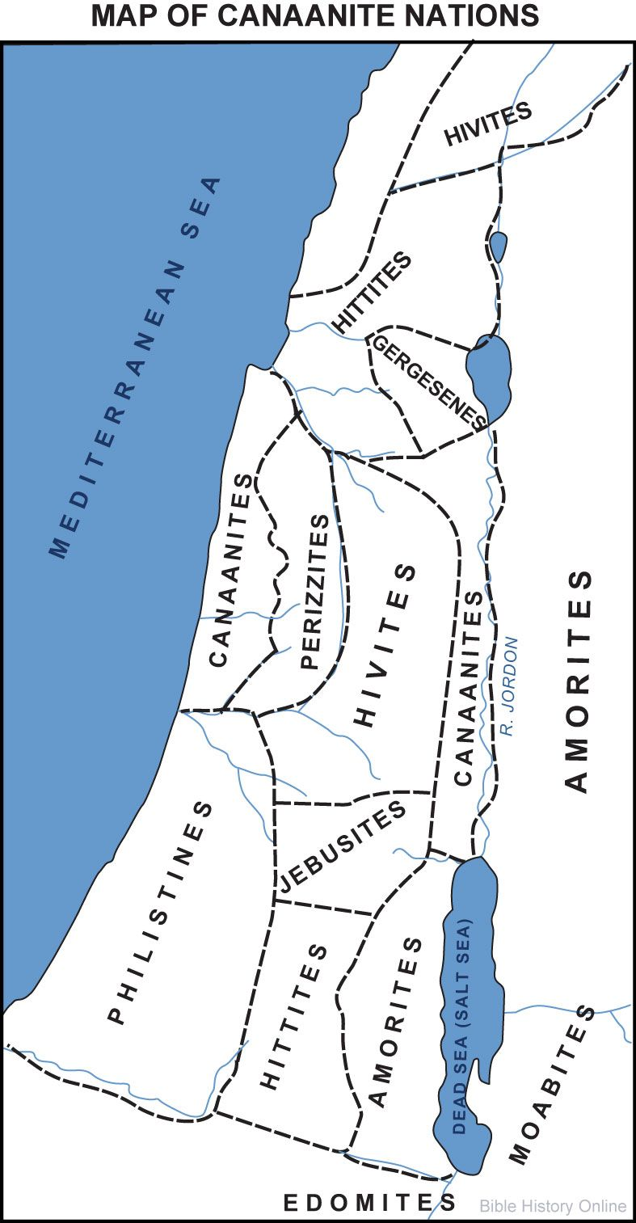


Slide 118
Conclusion

Slide 119
Genesis 27
Chapter Summary
  Isaac’s intent (1-4)
  The conspiracy (5-17)
  Deception and blessing (18-29)
  Isaac blesses Esau (30-40)
  Plan to flee to Haran (41-46)

Slide 120

²⁴ The Lord bless you, and keep you; ²⁵ The Lord make His face shine on you, And be gracious to you; ²⁶ The Lord lift up His countenance on you, And give you peace.
Numbers 6:24–26 (NASB95)

