Slide 1


Dr. Andy Woods
Senior Pastor – Sugar Land Bible Church
President – Chafer Theological Seminary

Slide 2

Structure
1 THESSALONIANS 1-3 | 1 THESSALONIANS 4-5
Personal Experience | Practical Exhortation
Looking Back | Looking Forward

Slide 3

Structure
Personal (1–3)
  Genuine conversion (1)
  Impure motives (2:1-16)
  Lack of concern (2:17–3:13)
Practical (4–5)
  Immorality (4:1-8)
  Laziness (4:9-12)
  Eschatology (4:13–5:11)
  Ministry imbalances (5:12-15)
  Progressive sanctification (5:16-28)

Slide 4
Lack of Concern? (2:17–3:13)
Paul’s plan to visit (2:17-18)
Paul’s concern for their glorification (2:19-20)
Timothy’s visit (3:1-5)
Relief at Timothy’s report (3:6-10)
Paul’s prayer (3:11-13)

Slide 5
5. Paul’s Prayer (3:11-13)
Return to them (11)
Progressive sanctification (12)
Blamelessness at the Bema (13)

Slide 6
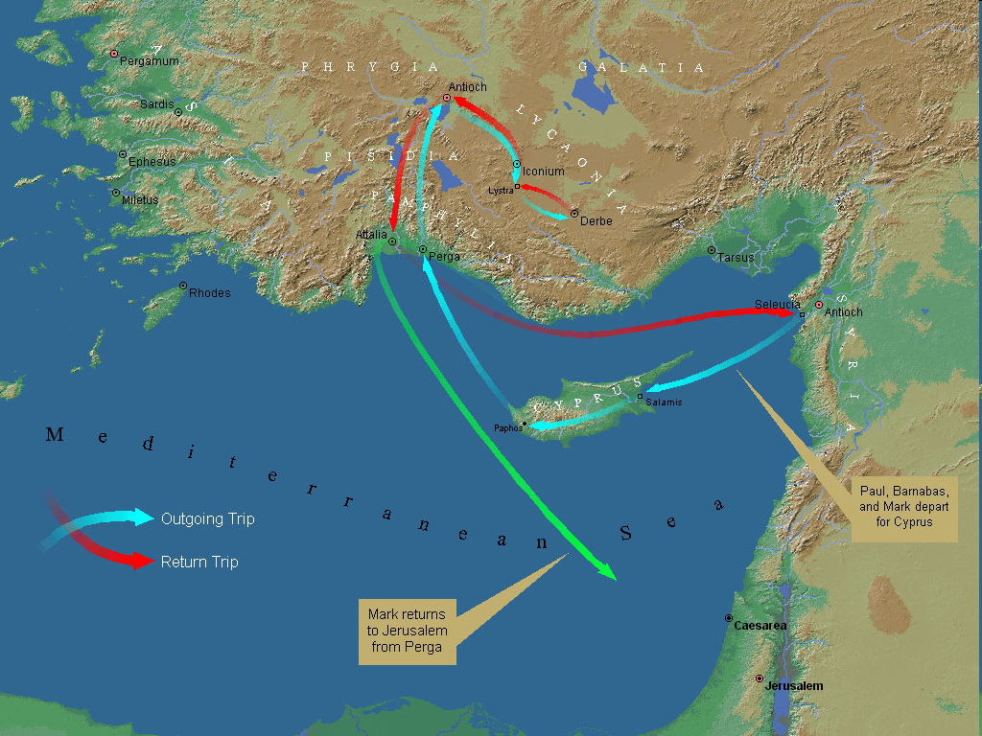
First Missionary Journey

Slide 7

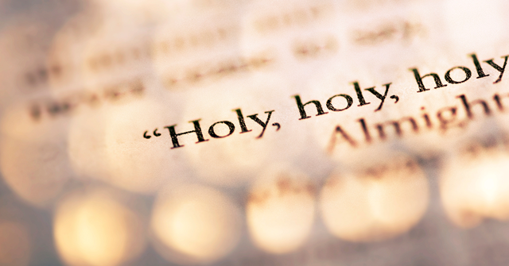
1 Peter 1:15-16
“¹⁵ but like the Holy One who called you, be holy yourselves also in all your behavior; ¹⁶ because it is written, “You shall be holy, for I am holy.’”

Slide 8

2 Peter 3:10-11
“¹⁰ But the day of the Lord will come like a thief, in which the heavens will pass away with a roar and the elements will be destroyed with intense heat, and the earth and its works will be burned up. ¹¹ Since all these things are to be destroyed in this way, what sort of people ought you to be in holy conduct and godliness.”

Slide 9

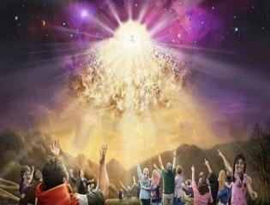

Titus 2:13
“Looking for the blessed hope and the appearing of the glory of our great God and Savior, Christ Jesus.”

Slide 10
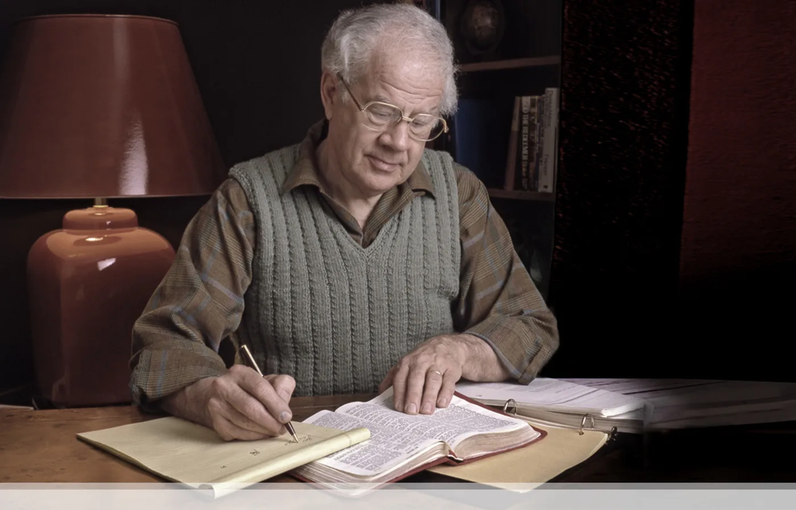

J. Dwight Pentecost
Prophecy For Today, Page 20
“A short time ago, I took occasion to go through the New Testament to mark each reference to the coming of the Lord Jesus Christ and to observe the use made of that teaching about His coming. I was struck a new with the fact that almost without exception, when the coming of Christ is mentioned in the New Testament, it is followed by an exhortation to godliness and holy living.”

Slide 11
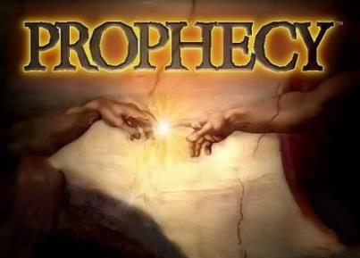
Biblical Prophecy: Importance
27% of Scripture was prophetic at the time it was written
2 Peter 1:19

Slide 12

1 Thessalonians 4:13-18
¹³ "But we do not want you to be uninformed, brethren, about those who are asleep, so that you will not grieve as do the rest who have no hope. ¹⁴ For if we believe that Jesus died and rose again, even so God will bring with Him those who have fallen asleep in Jesus. ¹⁵ For this we say to you by the word of the Lord, that we who are alive and remain until the coming of the Lord, will not precede those who have fallen asleep. ¹⁶ For the Lord Himself will descend from . . .

Slide 13
1 Thessalonians 4:13-18
. . .heaven with a shout, with the voice of the archangel and with the trumpet of God, and the dead in Christ will rise first. ¹⁷ Then we who are alive and remain will be caught up together with them in the clouds to meet the Lord in the air, and so we shall always be with the Lord. ¹⁸ Therefore comfort one another with these words."

Slide 14
Unique Characteristics
Every chapter ends with a reference to the Second Advent
Small amount of time in between planting of the church and the first letter to the church

Slide 15


1 Thessalonians 1:10
“and to wait for His Son from heaven, whom He raised from the dead, that is Jesus, who rescues (rhyomai) us from (ek) the wrath (orgē) to come..”

Slide 16
Lack of Concern? (2:17–3:13)
Paul’s plan to visit (2:17-18)
Paul’s concern for their glorification (2:19-20)
Timothy’s visit (3:1-5)
Relief at Timothy’s report (3:6-10)
Paul’s prayer (3:11-13)

Slide 17
Structure
Personal (1–3)
  Genuine conversion (1)
  Impure motives (2:1-16)
  Lack of concern (2:17–3:13)
Practical (4–5)
  Immorality (4:1-8)
  Laziness (4:9-12)
  Eschatology (4:13–5:11)
  Ministry imbalances (5:12-15)
  Progressive sanctification (5:16-28)

Slide 18
Structure
1 THESSALONIANS 1-3 | 1 THESSALONIANS 4-5
Personal Experience | Practical Exhortation
Looking Back | Looking Forward

Slide 19
Structure
Personal (1–3)
  Genuine conversion (1)
  Impure motives (2:1-16)
  Lack of concern (2:17–3:13)
Practical (4–5)
  Immorality (4:1-8)
  Laziness (4:9-12)
  Eschatology (4:13–5:11)
  Ministry imbalances (5:12-15)
  Progressive sanctification (5:16-28)

Slide 20
Christian Living (4:1-12)
General conduct (4:1-2)
Negative command: sexual sin (4:3-8)
Positive command: brotherly love (4:9-12)

Slide 21
Christian Living (4:1-12)
General conduct (4:1-2)
Negative command: sexual sin (4:3-8)
Positive command: brotherly love (4:9-12)

Slide 22
Order of Paul’s Letters
Galatians (A.D. 49)
1‒2 Thessalonians (A.D. 51)
1‒2 Corinthians (A.D. 56)
Romans (A.D. 57)
Ephesians, Colossians, Philemon, Philippians (A.D. 60‒62)
1 Timothy, Titus (A.D. 62‒66)
2 Timothy (A.D. 67)

Slide 23
Christian Living (4:1-12)
General conduct (4:1-2)
Negative command: sexual sin (4:3-8)
Positive command: brotherly love (4:9-12)

Slide 24
Three Tenses of Salvation
Phase | Justification | Sanctification | Glorification
Tense | Past | Present | Future
Saved from sin’s: | Penalty | Power | Presence
Scripture | Eph 2:8-9; Titus 3:5 | Philip 2:12 | Rom 5:10

Slide 25


Genesis 1:27
“God created man in His own image, in the image of God He created him; male and female He created them.”
Genesis 2:24
“For this reason a man shall leave his father and his mother, and be joined to his wife; and they shall become one flesh.”

Slide 26
Vessel?
Acquire a wife
Possess your own body

Slide 27
Vessel?
Acquire a wife
Possess your own body

Slide 28
Vessel?
Acquire a wife
Possess your own body

Slide 29
5 Reasons for Sexual Purity (4:5-8)
Sexual immorality characterizes pagans (4:5)
Sexual immorality invokes God’s judgment on both parties (4:6a)
Previous warnings against sexual immorality (4:6b)
Sexual immorality frustrates God’s holy call on the believer’s life (4:7)
The Holy Spirit empowers the believer toward purity (4:8)

Slide 30
5 Reasons for Sexual Purity (4:5-8)
Sexual immorality characterizes pagans (4:5)
Sexual immorality invokes God’s judgment on both parties (4:6a)
Previous warnings against sexual immorality (4:6b)
Sexual immorality frustrates God’s holy call on the believer’s life (4:7)
The Holy Spirit empowers the believer toward purity (4:8)

Slide 31
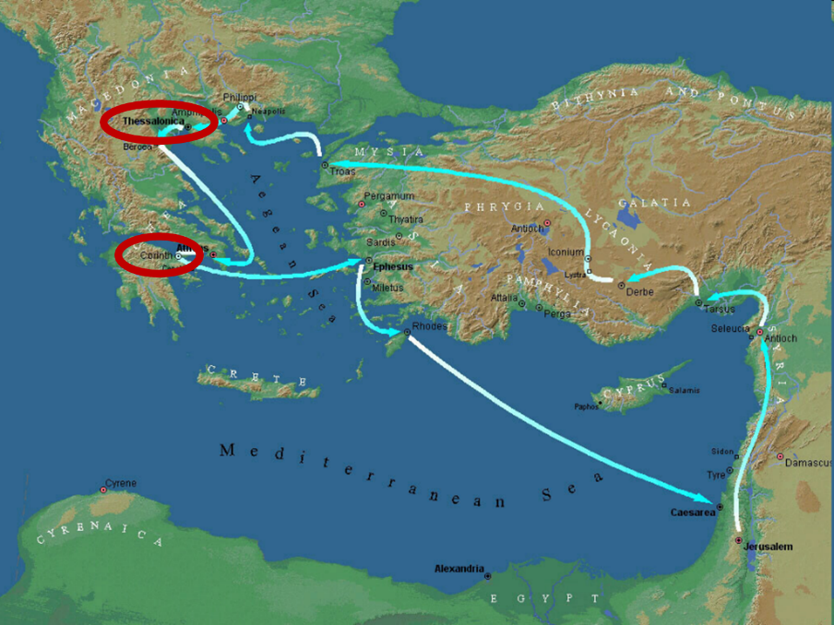

Slide 32

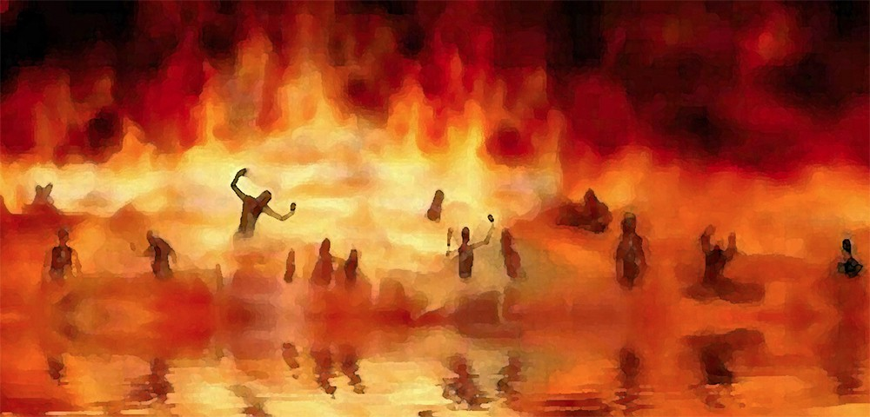
Revelation 21:8
“But for the cowardly and unbelieving and abominable and murderers and immoral persons and sorcerers and idolaters and all liars, their part will be in the lake that burns with fire and brimstone, which is the second death.”

Slide 33
5 Reasons for Sexual Purity (4:5-8)
Sexual immorality characterizes pagans (4:5)
Sexual immorality invokes God’s judgment on both parties (4:6a)
Previous warnings against sexual immorality (4:6b)
Sexual immorality frustrates God’s holy call on the believer’s life (4:7)
The Holy Spirit empowers the believer toward purity (4:8)

Slide 34
5 Reasons for Sexual Purity (4:5-8)
Sexual immorality characterizes pagans (4:5)
Sexual immorality invokes God’s judgment on both parties (4:6a)
Previous warnings against sexual immorality (4:6b)
Sexual immorality frustrates God’s holy call on the believer’s life (4:7)
The Holy Spirit empowers the believer toward purity (4:8)

Slide 36
5 Reasons for Sexual Purity (4:5-8)
Sexual immorality characterizes pagans (4:5)
Sexual immorality invokes God’s judgment on both parties (4:6a)
Previous warnings against sexual immorality (4:6b)
Sexual immorality frustrates God’s holy call on the believer’s life (4:7)
The Holy Spirit empowers the believer toward purity (4:8)

Slide 37
1 Peter 1:15-16
“¹⁵ but like the Holy One who called you, be holy yourselves also in all your behavior; ¹⁶ because it is written, “You shall be holy, for I am holy.’”

Slide 38
5 Reasons for Sexual Purity (4:5-8)
Sexual immorality characterizes pagans (4:5)
Sexual immorality invokes God’s judgment on both parties (4:6a)
Previous warnings against sexual immorality (4:6b)
Sexual immorality frustrates God’s holy call on the believer’s life (4:7)
The Holy Spirit empowers the believer toward purity (4:8)

Slide 39


1 Samuel 16:13-14
¹³ Then Samuel took the horn of oil and anointed him in the midst of his brothers; and the Spirit of the Lord came mightily upon David from that day forward. And Samuel arose and went to Ramah. ¹⁴ Now the Spirit of the Lord departed from Saul, and an evil spirit from the Lord terrorized him.

Slide 40
John 14:16-17
¹⁶ I will ask the Father, and He will give you another Helper, that He may be with you forever; ¹⁷ that is the Spirit of truth, whom the world cannot receive, because it does not see Him or know Him, but you know Him because He abides with you and will be in you.

Slide 41
Conclusion

Slide 42
Structure
Personal (1–3)
  Genuine conversion (1)
  Impure motives (2:1-16)
  Lack of concern (2:17–3:13)
Practical (4–5)
  Immorality (4:1-8)
  Laziness (4:9-12)
  Eschatology (4:13–5:11)
  Ministry imbalances (5:12-15)
  Progressive sanctification (5:16-28)

Slide 43
Christian Living (4:1-12)
General conduct (4:1-2)
Negative command: sexual sin (4:3-8)
Positive command: brotherly love (4:9-12)

Slide 44
Christian Living (4:1-12)
General conduct (4:1-2)
Negative command: sexual sin (4:3-8)
Positive command: brotherly love (4:9-12)

Slide 45

How to Exhibit Brotherly Love (4:9-12)
Quiet Life
Mind your own business
Work

