Slide 1
Dr. Andy Woods
Senior Pastor – Sugar Land Bible Church
President – Chafer Theological Seminary

Slide 2
Introductory Matters
Authorship |  | Occasion
Recipients |  | Structure
Place of writing |  | Unique characteristics
Date |  | Purpose
Audience |  | Message

Slide 3
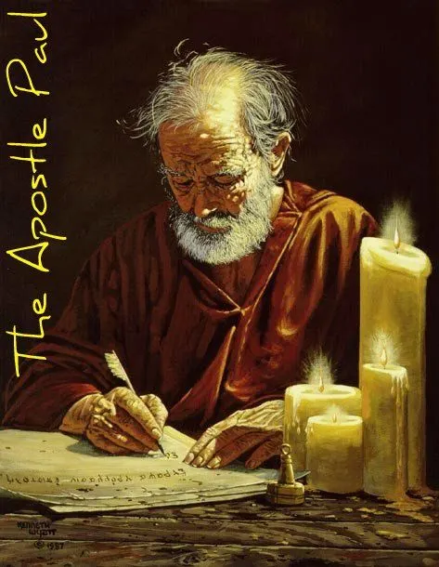
Structure
1 THESSALONIANS 1-3 | 1 THESSALONIANS 4-5
Personal Experience | Practical Exhortation
Looking Back | Looking Forward

Slide 4
Structure
Personal (1–3)
Genuine conversion (1)
Impure motives (2:1-16)
Lack of concern (2:17–3:13)
Practical (4–5)
Immorality (4:1-8)
Laziness (4:9-12)
Eschatology (4:13–5:11)
Ministry imbalances (5:12-15)
Progressive sanctification (5:16-28)

Slide 5
Lack of Concern? (2:17–3:13)
Paul’s plan to visit (2:17-18)
Paul’s concern for their glorification (2:19-20)
Timothy’s visit (3:1-5)
Relief at Timothy’s report (3:6-10)
Paul’s prayer (3:11-13)

Slide 6
Three Tenses of Salvation
Phase | Justification | Sanctification | Glorification
Tense | Past | Present | Future
Saved from sin’s: | Penalty | Power | Presence
Scripture | Eph 2:8-9; Titus 3:5 | Philip 2:12 | Rom 5:10

Slide 7
2 Peter 1:5-7
⁵ Now for this very reason also, applying all diligence, in your faith supply moral excellence, and in your moral excellence, knowledge, ⁶ and in your knowledge, self-control, and in your self-control, perseverance, and in your perseverance, godliness, ⁷ and in your godliness, brotherly kindness, and in your brotherly kindness, love.

Slide 8
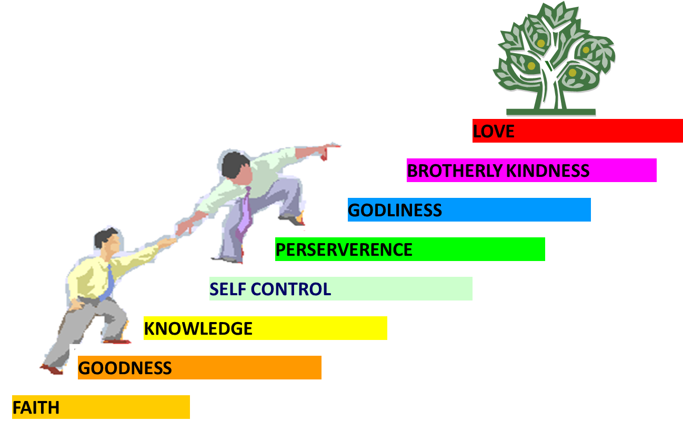
PORTRAIT OF GROWTH 1:5-7

Slide 9
2 Peter 1:5-7
⁵ Now for this very reason also, applying all diligence, in your faith supply moral excellence, and in your moral excellence, knowledge, ⁶ and in your knowledge, self-control, and in your self-control, perseverance, and in your perseverance, godliness, ⁷ and in your godliness, brotherly kindness, and in your brotherly kindness, love.

Slide 10
2 Peter 1:5-7
⁵ Now for this very reason also, applying all diligence, in your faith supply moral excellence, and in your moral excellence, knowledge, ⁶ and in your knowledge, self-control, and in your self-control, perseverance, and in your perseverance, godliness, ⁷ and in your godliness, brotherly kindness, and in your brotherly kindness, love.

Slide 11
1 Peter 5:8
“⁸ Be of sober spirit, be on the alert. Your adversary, the devil, prowls around like a roaring lion, seeking someone to devour. ⁹ But resist him, firm in your faith, knowing that the same experiences of suffering are being accomplished by your brethren who are in the world.”

Slide 12
Ephesians 4:11-16
“¹¹ And He gave some as apostles, and some as prophets, and some as evangelists, and some as pastors and teachers, ¹² for the equipping [katartismos] of the saints for the work of service, to the building up of the body of Christ;”

Slide 13
Ephesians 4:11-16
“¹³ until we all attain to the unity of the faith, and of the knowledge of the Son of God, to a mature man, to the measure of the stature which belongs to the fullness of Christ. ¹⁴ As a result, we are no longer to be children, tossed here and there by waves and carried about by every wind of doctrine, by the trickery of men, by craftiness in deceitful scheming;”

Slide 14
Ephesians 4:11-16
“¹⁵ but speaking the truth in love, we are to grow up in all aspects into Him who is the head, even Christ, ¹⁶ from whom the whole body, being fitted and held together by what every joint supplies, according to the proper working of each individual part, causes the growth of the body for the building up of itself in love.”

Slide 15
Lack of Concern? (2:17–3:13)
Paul’s plan to visit (2:17-18)
Paul’s concern for their glorification (2:19-20)
Timothy’s visit (3:1-5)
Relief at Timothy’s report (3:6-10)
Paul’s prayer (3:11-13)

Slide 16
5. Paul’s Prayer (3:11-13)
Return to them (11)
Progressive sanctification (12)
Blamelessness at the Bema (13)

Slide 17
5. Paul’s Prayer (3:11-13)
Return to them (11)
Progressive sanctification (12)
Blamelessness at the Bema (13)

Slide 18
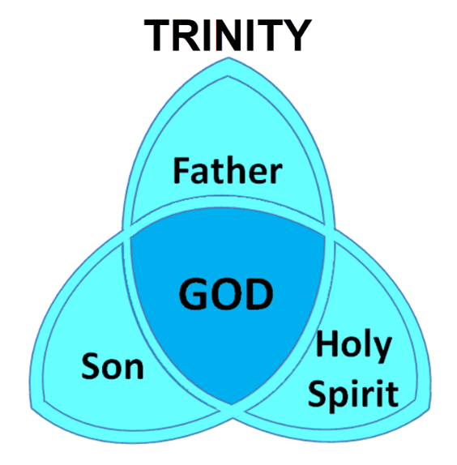
To Emphasize Christ’s Eternality

Slide 19
Ezekiel 28:13, 15
¹³ “You were in Eden, the garden of God; Every precious stone was your covering: The ruby, the topaz and the diamond; The beryl, the onyx and the jasper; The lapis lazuli, the turquoise and the emerald; And the gold, the workmanship of your settings and sockets, Was in you. On the day that you were created They were prepared… ¹⁵ “You were blameless in your ways From the day you were created Until unrighteousness was found in you.

Slide 20
5. Paul’s Prayer (3:11-13)
Return to them (11)
Progressive sanctification (12)
Blamelessness at the Bema (13)

Slide 21
Structure
Personal (1–3)
Genuine conversion (1)
Impure motives (2:1-16)
Lack of concern (2:17–3:13)
Practical (4–5)
Immorality (4:1-8)
Laziness (4:9-12)
Eschatology (4:13–5:11)
Ministry imbalances (5:12-15)
Progressive sanctification (5:16-28)

Slide 22
5. Paul’s Prayer (3:11-13)
Return to them (11)
Progressive sanctification (12)
Blamelessness at the Bema (13)

Slide 23
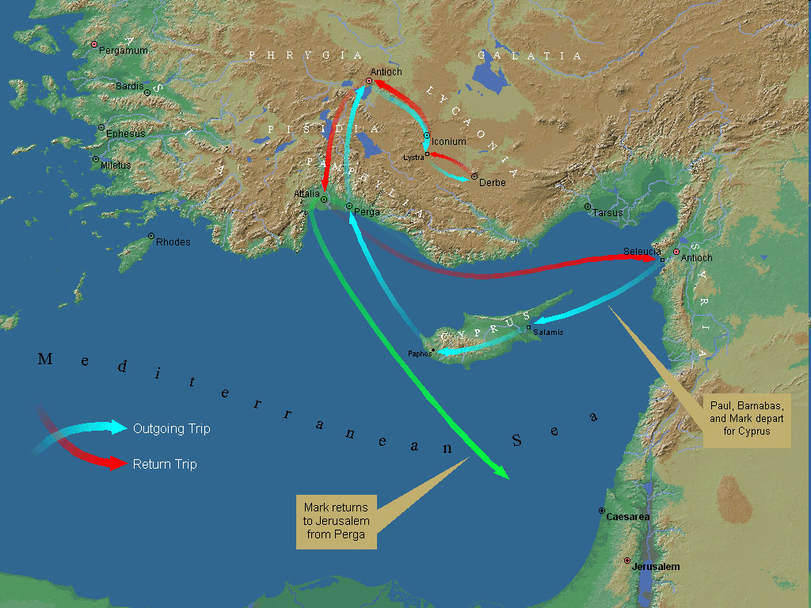
First Missionary Journey

Slide 24
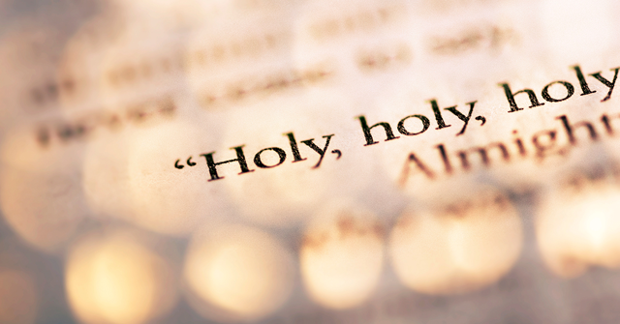
1 Peter 1:15-16
“¹⁵ but like the Holy One who called you, be holy yourselves also in all your behavior; ¹⁶ because it is written, “You shall be holy, for I am holy.’”

Slide 25
2 Peter 3:10-11
“¹⁰ But the day of the Lord will come like a thief, in which the heavens will pass away with a roar and the elements will be destroyed with intense heat, and the earth and its works will be burned up. ¹¹ Since all these things are to be destroyed in this way, what sort of people ought you to be in holy conduct and godliness.”

Slide 26
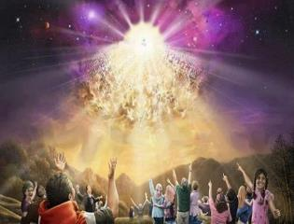
Titus 2:13
“Looking for the blessed hope and the appearing of the glory of our great God and Savior, Christ Jesus.”

Slide 27
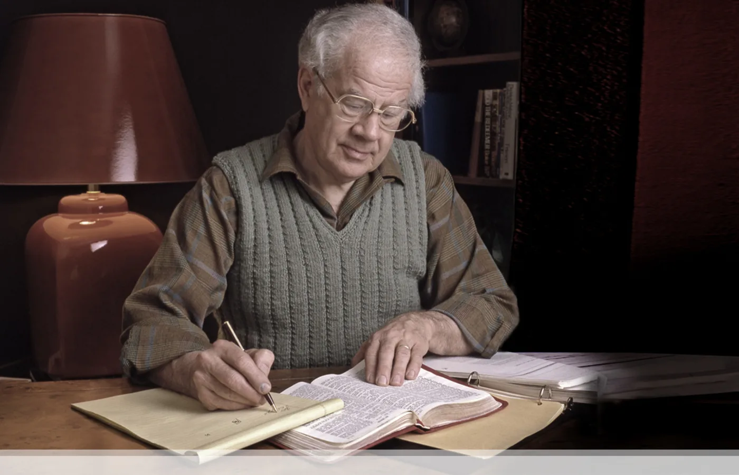
J. Dwight Pentecost
Prophecy For Today, Page 20
“A short time ago, I took occasion to go through the New Testament to mark each reference to the coming of the Lord Jesus Christ and to observe the use made of that teaching about His coming. I was struck a new with the fact that almost without exception, when the coming of Christ is mentioned in the New Testament, it is followed by an exhortation to godliness and holy living.”

Slide 28
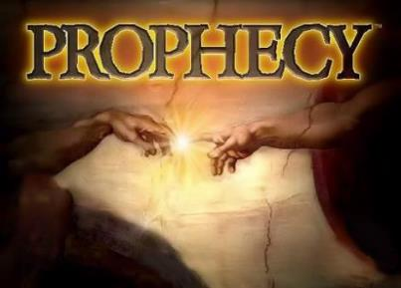
Biblical Prophecy: Importance
27% of Scripture was prophetic at the time it was written
2 Peter 1:19

Slide 29
1 Thessalonians 4:13-18
¹³ "But we do not want you to be uninformed, brethren, about those who are asleep, so that you will not grieve as do the rest who have no hope. ¹⁴ For if we believe that Jesus died and rose again, even so God will bring with Him those who have fallen asleep in Jesus. ¹⁵ For this we say to you by the word of the Lord, that we who are alive and remain until the coming of the Lord, will not precede those who have fallen asleep. ¹⁶ For the Lord Himself will descend from . . .

Slide 30
1 Thessalonians 4:13-18
. . .heaven with a shout, with the voice of the archangel and with the trumpet of God, and the dead in Christ will rise first. ¹⁷ Then we who are alive and remain will be caught up together with them in the clouds to meet the Lord in the air, and so we shall always be with the Lord. ¹⁸ Therefore comfort one another with these words."

Slide 31
Unique Characteristics
Every chapter ends with a reference to the Second Advent
Small amount of time in between planting of the church and the first letter to the church

Slide 32
1 Thessalonians 1:10
“and to wait for His Son from heaven, whom He raised from the dead, that is Jesus, who rescues (rhyomai) us from (ek) the wrath (orgē) to come..”

Slide 33
Structure
Personal (1–3)
Genuine conversion (1)
Impure motives (2:1-16)
Lack of concern (2:17–3:13)
Practical (4–5)
Immorality (4:1-8)
Laziness (4:9-12)
Eschatology (4:13–5:11)
Ministry imbalances (5:12-15)
Progressive sanctification (5:16-28)

Slide 34
Conclusion

Slide 35
Lack of Concern? (2:17–3:13)
Paul’s plan to visit (2:17-18)
Paul’s concern for their glorification (2:19-20)
Timothy’s visit (3:1-5)
Relief at Timothy’s report (3:6-10)
Paul’s prayer (3:11-13)

Slide 36
Structure
1 THESSALONIANS 1-3 | 1 THESSALONIANS 4-5
Personal Experience | Practical Exhortation
Looking Back | Looking Forward

Slide 37
Structure
Personal (1–3)
Genuine conversion (1)
Impure motives (2:1-16)
Lack of concern (2:17–3:13)
Practical (4–5)
Immorality (4:1-8)
Laziness (4:9-12)
Eschatology (4:13–5:11)
Ministry imbalances (5:12-15)
Progressive sanctification (5:16-28)

