Slide 1
Dr. Andy Woods
Senior Pastor – Sugar Land Bible Church
President – Chafer Theological Seminary

Slide 2
Introductory Matters
Authorship |  | Occasion
Recipients |  | Structure
Place of writing |  | Unique characteristics
Date |  | Purpose
Audience |  | Message

Slide 3
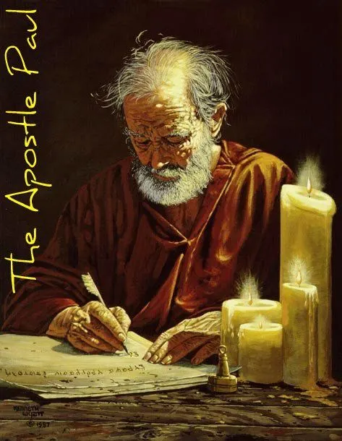
Structure
1 THESSALONIANS 1-3 | 1 THESSALONIANS 4-5
Personal Experience | Practical Exhortation
Looking Back | Looking Forward

Slide 4
Structure
Personal (1–3)
Genuine conversion (1)
Impure motives (2:1-16)
Lack of concern (2:17–3:13)
Practical (4–5)
Immorality (4:1-8)
Laziness (4:9-12)
Eschatology (4:13–5:11)
Ministry imbalances (5:12-15)
Progressive sanctification (5:16-28)

Slide 5
Lack of Concern? (2:17–3:13)
Paul’s plan to visit (2:17-18)
Paul’s concern for their glorification (2:19-20)
Timothy’s visit (3:1-5)
Relief at Timothy’s report (3:6-10)
Paul’s prayer (3:11-13)

Slide 6
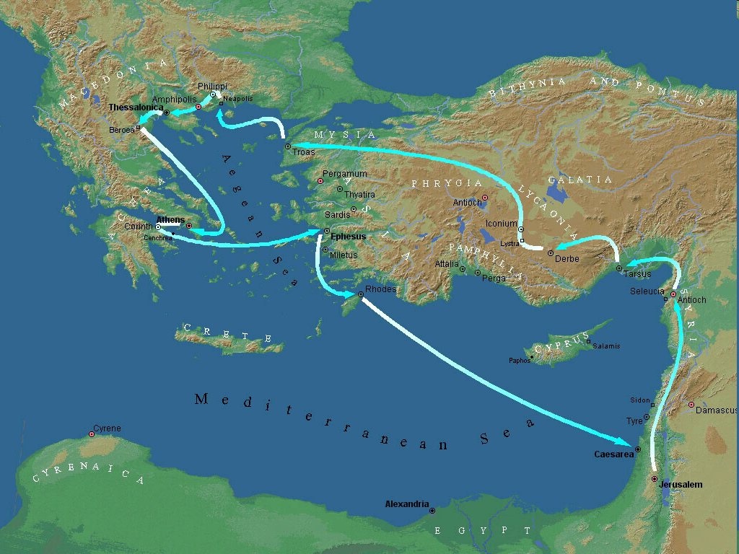
Second Missionary Journey

Slide 7
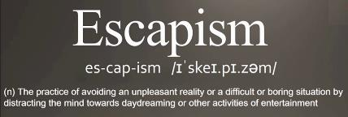
Pretribulationism is not Escapism
Trials (John 16:33)
Man’s wrath (2 Tim 3:12)
Satan’s wrath (Eph 6:11-12)
World’s wrath (John 15:18-19)

Slide 8
John 13:19; 14:29
“^{13:19} From now on I am telling you before it comes to pass, so that when it does occur, you may believe that I am He… ^{14:29} Now I have told you before it happens, so that when it happens, you may believe.”

Slide 10
Three Tenses of Salvation
Phase | Justification | Sanctification | Glorification
Tense | Past | Present | Future
Saved from sin’s: | Penalty | Power | Presence
Scripture | Eph 2:8-9; Titus 3:5 | Philip 2:12 | Rom 5:10

Slide 11
2 Timothy 2:11-13
“It is a trustworthy statement: For if we died with Him, we will also live with Him; ¹² If we endure, we will also reign with Him; If we deny Him, He also will deny us; ¹³ If we are faithless, He remains faithful, for He cannot deny Himself.”

Slide 12
Galatians 3:3
“Are you so foolish? Having begun by the Spirit, are you now being perfected by the flesh?”

Slide 13
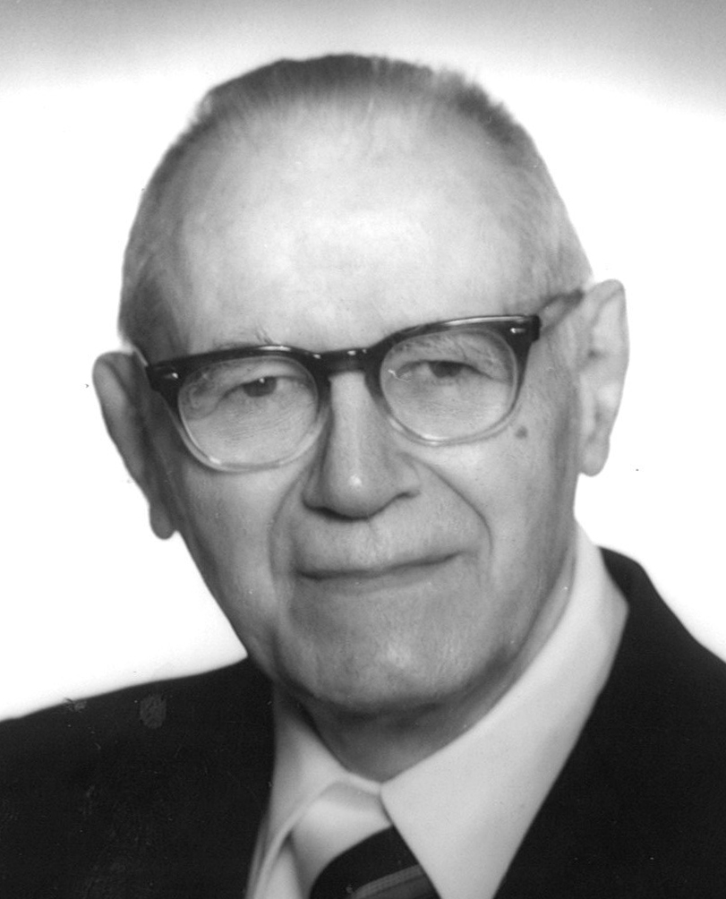
William Hendriksen
A Commentary on the Gospel of John, 3d ed.
(London: Banner of Truth Trust, 1964), p. 127.
“Many trusted in His name; i.e., because of the manner in which his power was displayed they accepted him as a great prophet and perhaps even as the Messiah. This, however, is not the same as saying that they surrendered their hearts to him. Not all faith is saving faith...”

Slide 14
1 Corinthians 3:10-15
“¹⁰ According to the grace of God which was given to me, like a wise master builder I laid a foundation, and another is building on it. But each man must be careful how he builds on it. ¹¹ For no man can lay a foundation other than the one which is laid, which is Jesus Christ. ¹² Now if any man builds on the foundation with gold, silver, precious stones, wood, hay, straw…”

Slide 15
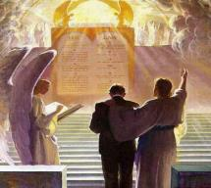
1 Corinthians 3:10-15
“¹⁴ If any man’s work which he has built on it remains, he will receive a reward. ¹⁵ If any man’s work is burned up, he will suffer loss; but he himself will be saved, yet so as through fire.”

Slide 16
SCRIPTURE’S FIVE CROWNS (Rev 4:10: 3:11; 2 John 8) | SCRIPTURE’S FIVE CROWNS (Rev 4:10: 3:11; 2 John 8)
Scripture | Crown | Purpose
1 Cor. 9:24-27 | Incorruptible | Gaining mastery over the flesh
1 Thess. 2:19-20 | Rejoicing | Soul winning
Jas. 1:12; Rev. 2:10 | Life | Enduring trials
1 Pet. 5:2-4 | Glory | Shepherding God’s people
2 Tim. 4:8 | Righteousness | Longing for His appearing

Slide 17
1 Corinthians 9:24-27
“²⁴ Do you not know that those who run in a race all run, but only one receives the prize? Run in such a way that you may win. ²⁵ Everyone who competes in the games exercises self-control in all things. They then do it to receive a perishable wreath, but we an imperishable. ²⁶ Therefore I run in such a way, as not without aim; I box in such a way, as not beating the air; ²⁷ but I discipline my body and make it my slave, so that, after I have preached to others, I myself will not be disqualified.”

Slide 18
Lack of Concern? (2:17–3:13)
Paul’s plan to visit (2:17-18)
Paul’s concern for their glorification (2:19-20)
Timothy’s visit (3:1-5)
Relief at Timothy’s report (3:6-10)
Paul’s prayer (3:11-13)

Slide 19
Three Tenses of Salvation
Phase | Justification | Sanctification | Glorification
Tense | Past | Present | Future
Saved from sin’s: | Penalty | Power | Presence
Scripture | Eph 2:8-9; Titus 3:5 | Philip 2:12 | Rom 5:10

Slide 20
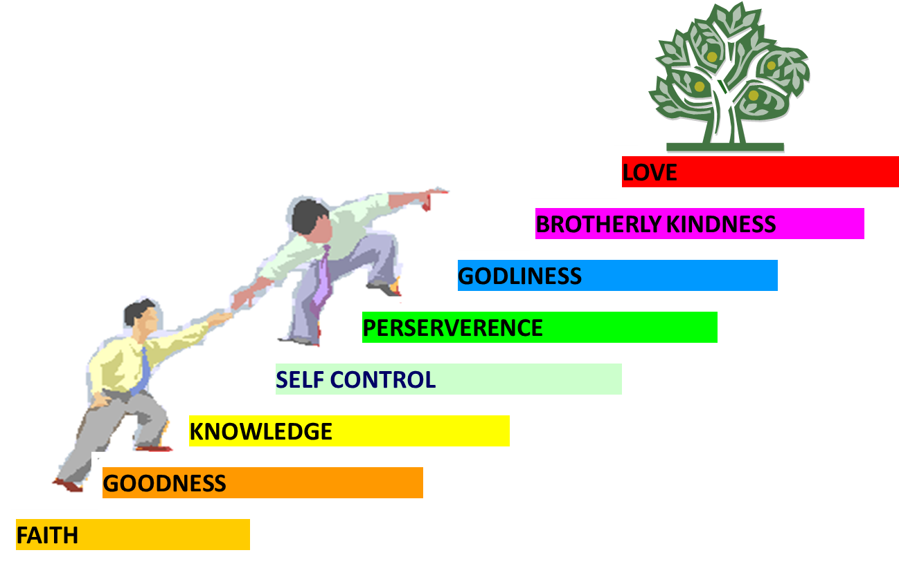
PORTRAIT OF GROWTH 1:5-7

Slide 21
2 Peter 1:5-7
⁵ Now for this very reason also, applying all diligence, in your faith supply moral excellence, and in your moral excellence, knowledge, ⁶ and in your knowledge, self-control, and in your self-control, perseverance, and in your perseverance, godliness, ⁷ and in your godliness, brotherly kindness, and in your brotherly kindness, love.

Slide 22
2 Peter 1:5-7
⁵ Now for this very reason also, applying all diligence, in your faith supply moral excellence, and in your moral excellence, knowledge, ⁶ and in your knowledge, self-control, and in your self-control, perseverance, and in your perseverance, godliness, ⁷ and in your godliness, brotherly kindness, and in your brotherly kindness, love.

Slide 23
1 Peter 5:8 (NASB)
“⁸ Be of sober spirit, be on the alert. Your adversary, the devil, prowls around like a roaring lion, seeking someone to devour. ⁹ But resist him, firm in your faith, knowing that the same experiences of suffering are being accomplished by your brethren who are in the world.”

Slide 24
Ephesians 4:11-16
“¹¹ And He gave some as apostles, and some as prophets, and some as evangelists, and some as pastors and teachers, ¹² for the equipping of the saints for the work of service, to the building up of the body of Christ;”

Slide 25
Ephesians 4:11-16
“¹³ until we all attain to the unity of the faith, and of the knowledge of the Son of God, to a mature man, to the measure of the stature which belongs to the fullness of Christ. ¹⁴ As a result, we are no longer to be children, tossed here and there by waves and carried about by every wind of doctrine, by the trickery of men, by craftiness in deceitful scheming;”

Slide 26
Ephesians 4:11-16
“¹⁵ but speaking the truth in love, we are to grow up in all aspects into Him who is the head, even Christ, ¹⁶ from whom the whole body, being fitted and held together by what every joint supplies, according to the proper working of each individual part, causes the growth of the body for the building up of itself in love.”

Slide 27
Lack of Concern? (2:17–3:13)
Paul’s plan to visit (2:17-18)
Paul’s concern for their glorification (2:19-20)
Timothy’s visit (3:1-5)
Relief at Timothy’s report (3:6-10)
Paul’s prayer (3:11-13)

Slide 28
5. Paul’s Prayer (3:11-13)
Return to them (11)
Progressive sanctification (12)
Blamelessness at the Bema (13)

Slide 29
5. Paul’s Prayer (3:11-13)
Return to them (11)
Progressive sanctification (12)
Blamelessness at the Bema (13)

Slide 30
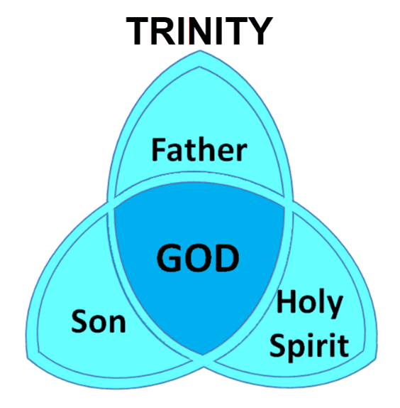
To Emphasize Christ’s Eternality

Slide 31
Ezekiel 28:13, 15
¹³ “You were in Eden, the garden of God; Every precious stone was your covering: The ruby, the topaz and the diamond; The beryl, the onyx and the jasper; The lapis lazuli, the turquoise and the emerald; And the gold, the workmanship of your settings and sockets, Was in you. On the day that you were created They were prepared… ¹⁵ “You were blameless in your ways From the day you were created Until unrighteousness was found in you.

Slide 32
5. Paul’s Prayer (3:11-13)
Return to them (11)
Progressive sanctification (12)
Blamelessness at the Bema (13)

Slide 33
Structure
Personal (1–3)
Genuine conversion (1)
Impure motives (2:1-16)
Lack of concern (2:17–3:13)
Practical (4–5)
Immorality (4:1-8)
Laziness (4:9-12)
Eschatology (4:13–5:11)
Ministry imbalances (5:12-15)
Progressive sanctification (5:16-28)

Slide 34
5. Paul’s Prayer (3:11-13)
Return to them (11)
Progressive sanctification (12)
Blamelessness at the Bema (13)

Slide 35
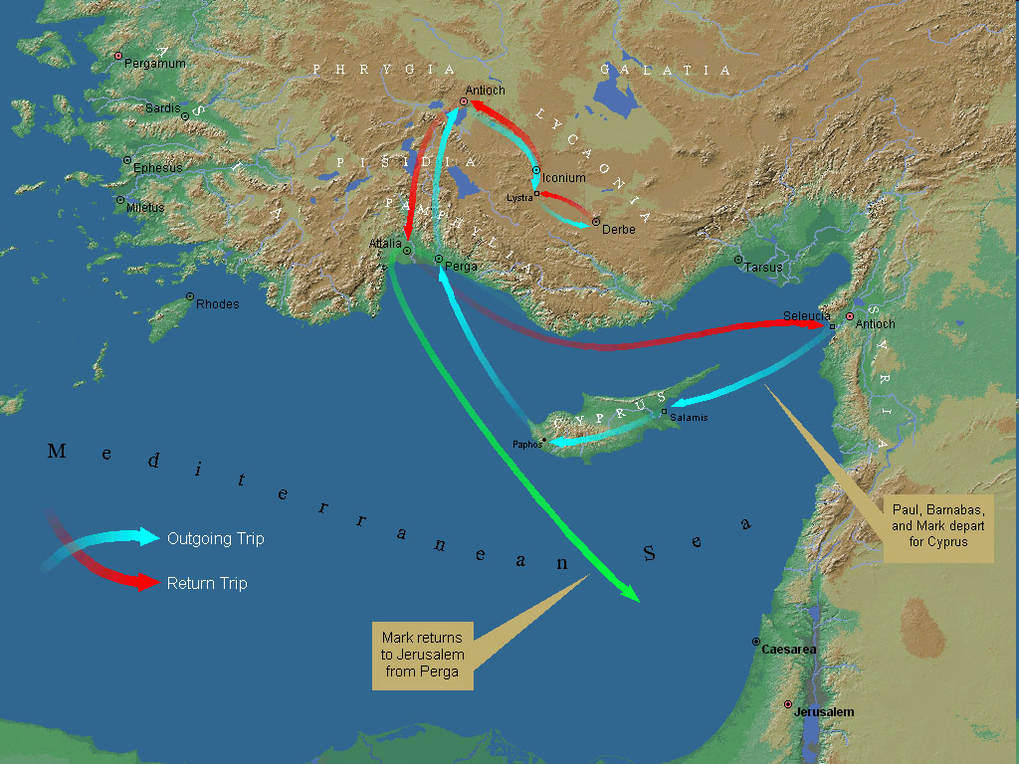
First Missionary Journey

Slide 36
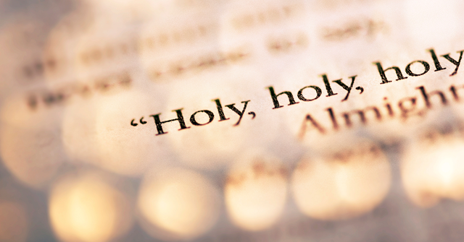
1 Peter 1:15-16
“¹⁵ but like the Holy One who called you, be holy yourselves also in all your behavior; ¹⁶ because it is written, “You shall be holy, for I am holy.’”

Slide 37
2 Peter 3:10-11
“¹⁰ But the day of the Lord will come like a thief, in which the heavens will pass away with a roar and the elements will be destroyed with intense heat, and the earth and its works will be burned up. ¹¹ Since all these things are to be destroyed in this way, what sort of people ought you to be in holy conduct and godliness.”

Slide 38
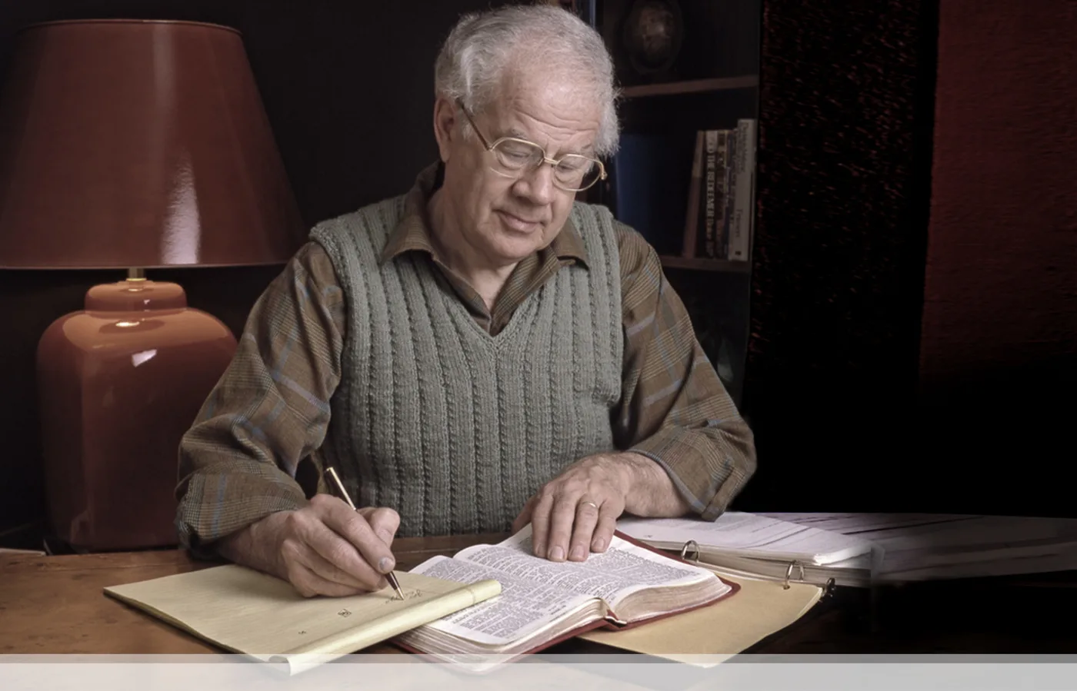
J. Dwight Pentecost
Prophecy For Today, Page 20
“A short time ago, I took occasion to go through the New Testament to mark each reference to the coming of the Lord Jesus Christ and to observe the use made of that teaching about His coming. I was struck a new with the fact that almost without exception, when the coming of Christ is mentioned in the New Testament, it is followed by an exhortation to godliness and holy living.”

Slide 39
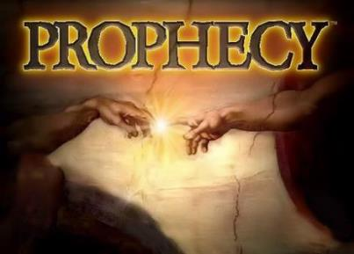
Biblical Prophecy: Importance
27% of Scripture was prophetic at the time it was written
2 Peter 1:19

Slide 40
1 Thessalonians 4:13-18
¹³ "But we do not want you to be uninformed, brethren, about those who are asleep, so that you will not grieve as do the rest who have no hope. ¹⁴ For if we believe that Jesus died and rose again, even so God will bring with Him those who have fallen asleep in Jesus. ¹⁵ For this we say to you by the word of the Lord, that we who are alive and remain until the coming of the Lord, will not precede those who have fallen asleep. ¹⁶ For the Lord Himself will descend from . . .

Slide 41
1 Thessalonians 4:13-18
. . .heaven with a shout, with the voice of the archangel and with the trumpet of God, and the dead in Christ will rise first. ¹⁷ Then we who are alive and remain will be caught up together with them in the clouds to meet the Lord in the air, and so we shall always be with the Lord. ¹⁸ Therefore comfort one another with these words."

Slide 42
Unique Characteristics
Every chapter ends with a reference to the Second Advent
Small amount of time in between planting of the church and the first letter to the church

Slide 43
1 Thessalonians 1:10
“and to wait for His Son from heaven, whom He raised from the dead, that is Jesus, who rescues (rhyomai) us from (ek) the wrath (orgē) to come..”

Slide 44
Structure
Personal (1–3)
Genuine conversion (1)
Impure motives (2:1-16)
Lack of concern (2:17–3:13)
Practical (4–5)
Immorality (4:1-8)
Laziness (4:9-12)
Eschatology (4:13–5:11)
Ministry imbalances (5:12-15)
Progressive sanctification (5:16-28)

Slide 45
Conclusion

Slide 46
Lack of Concern? (2:17–3:13)
Paul’s plan to visit (2:17-18)
Paul’s concern for their glorification (2:19-20)
Timothy’s visit (3:1-5)
Relief at Timothy’s report (3:6-10)
Paul’s prayer (3:11-13)

Slide 47
Structure
1 THESSALONIANS 1-3 | 1 THESSALONIANS 4-5
Personal Experience | Practical Exhortation
Looking Back | Looking Forward

Slide 48
Structure
Personal (1–3)
Genuine conversion (1)
Impure motives (2:1-16)
Lack of concern (2:17–3:13)
Practical (4–5)
Immorality (4:1-8)
Laziness (4:9-12)
Eschatology (4:13–5:11)
Ministry imbalances (5:12-15)
Progressive sanctification (5:16-28)

