Slide 2
Introductory Matters
Title
Authorship
Biography
Place of writing
Recipient
Purpose
Message
Method
Sources
Date
Structure
Scope
Themes
Unique characteristics

Slide 3
Acts 1 Chapter Summary
Prologue (1-5)
Jesus’ Ascension (6-11)
Return to Jerusalem (12-14)
Matthias Chosen (15-26)

Slide 4
IV. Matthias Chosen Acts 1:15-26
Peter’s Proposition (15-20)
Apostolic Qualifications (21-22)
Matthias Selected (23-26)

Slide 5
IV. Matthias Chosen Acts 1:15-26
Peter’s Proposition (15-20)
Apostolic Qualifications (21-22)
Matthias Selected (23-26)

Slide 6
IV. Matthias Chosen Acts 1:15-26
Peter’s Proposition (15-20)
Apostolic Qualifications (21-22)
Matthias Selected (23-26)

Slide 7
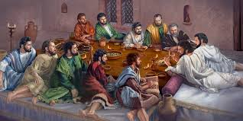
Ephesians 2:20
“having been built on the foundation of the apostles and prophets, Christ Jesus Himself being the corner stone.”

Slide 8
IV. Matthias Chosen Acts 1:15-26
Peter’s Proposition (15-20)
Apostolic Qualifications (21-22)
Matthias Selected (23-26)

Slide 9
2 Thessalonians 2:3
“Let no one in any way deceive you, for it will not come unless the apostasy [apostasia] comes first, and the man of lawlessness is revealed, the son of destruction.”

Slide 10
Ephesians 2:20
“having been built on the foundation of the apostles and prophets, Christ Jesus Himself being the corner stone.”

Slide 11
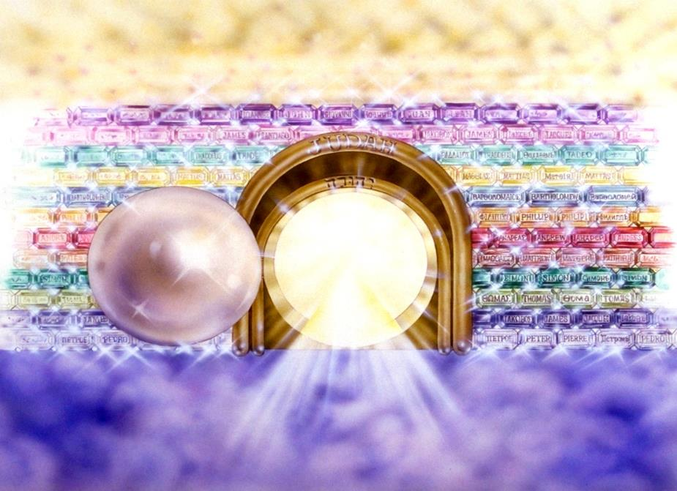
Notes:
Here you see an artist’s ideas of…
12 Gates = 12 Tribes of Israel
12 Foundation Stones = 12 Apostles of the Church

Slide 12
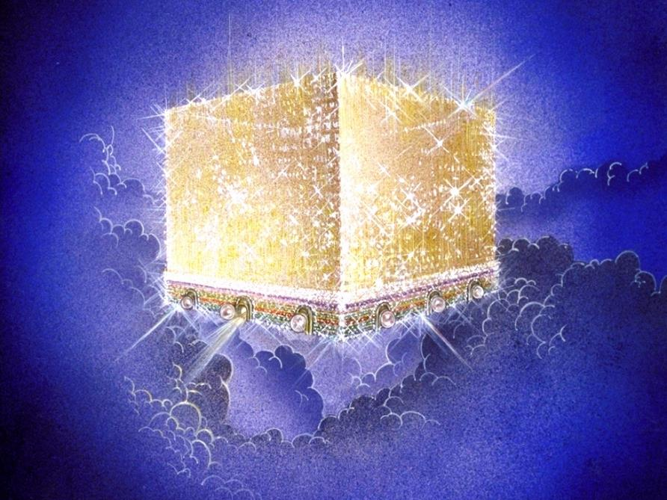
Notes:
Every city needs light. God, the ultimate source of power, illumines the city from his glory. Have you ever taken time to look at a sunset just after it has rained? As the sun sets, there is a kind of a glow cast on everything. It captures the spirit. This is just a little foretaste of the glory and splendor of heaven.

Slide 13
Message
Birth and growth of the church numerically, geographically, ethnically.
Components
Numerically (progress reports)
Geographically (From Jerusalem to Rome)
Ethnically (From Judaism to Gentile domination)

Slide 14
Mistaken Replacement?
Pro
No Spirit yet
Lots
Matthias disappears
Paul
Con
No textual indication of an error
Twelve esteemed (2:14; 6:2)
God’s choice (1:24)
Prov 16:33
Paul unqualified (1:21-22)
Focus on Peter & Paul

Slide 15
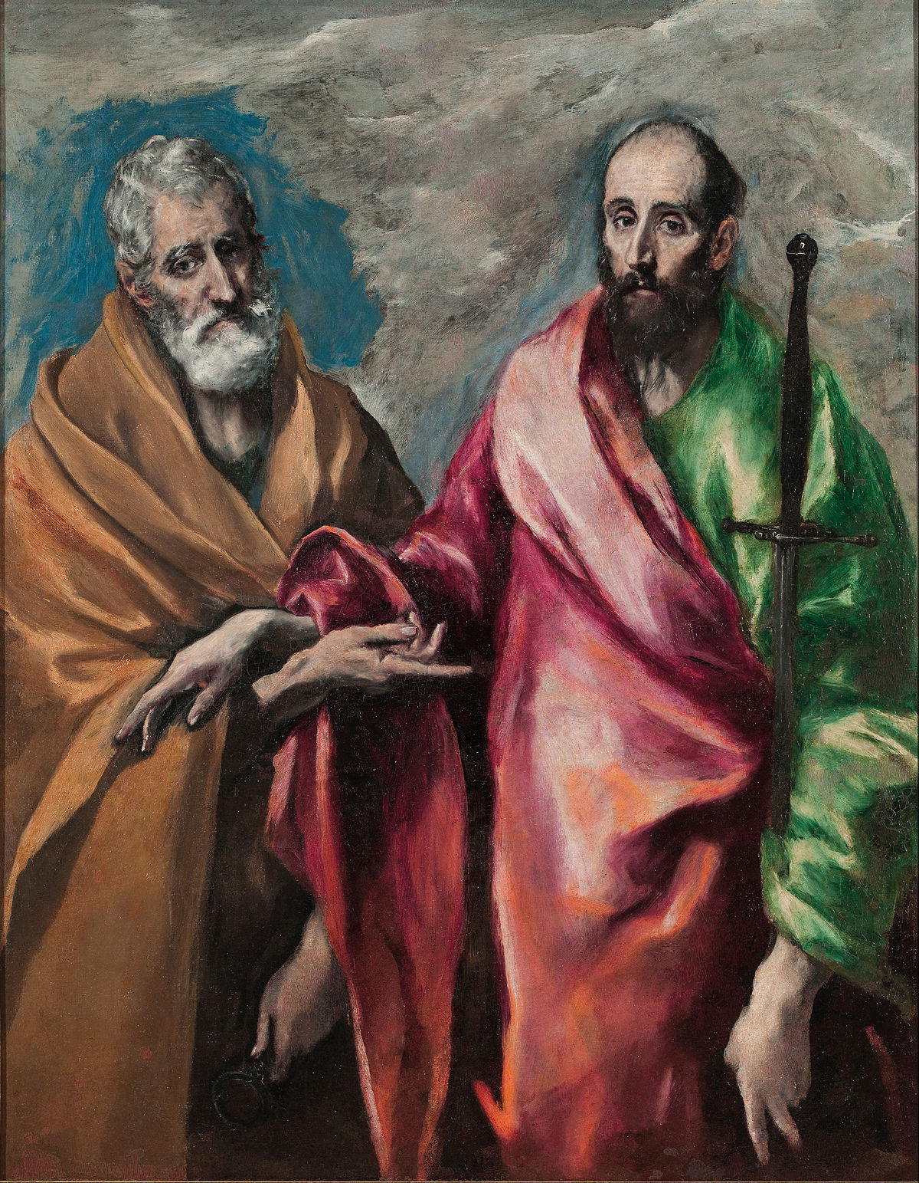
Title
Acts of the Apostles
Misleading?
Acts of the Holy Spirit
Geographical expansion
Two apostles: Peter and Paul

Slide 16
From Peter to Paul
Reference | Center | Person | Place | Outreach
Acts 1–12 | Jerusalem | Peter | Jerusalem, Judea, Samaria | Jewish
Acts 13–28 | Antioch | Paul | Uttermost parts | Gentiles

Slide 17
From Peter to Paul
Peter | Paul
Heals a man lame from birth (3:1-11) | Heals a man lame from birth (14:8-18)
Heals by shadow (3:15-16) | Heals by handkerchief (19:11-12)
Success is a cause of jealousy (5:17) | Success is a cause of jealousy (13:45)
Confronts a sorcerer (8:9-24) | Confronts a sorcerer (13:6-11)
Raises Dorcas (9:36-41) | Raises Eutychus (20:9-12)
Jailed and miraculously freed (12:3-19) | Jailed and miraculously freed (16:25-34)

Slide 18
Conclusion

Slide 19
Acts 1 Chapter Summary
Prologue (1-5)
Jesus’ Ascension (6-11)
Return to Jerusalem (12-14)
Matthias Chosen (15-26)

