Slide 2
JONAH: AN INTRODUCTION
Who wrote it? (Authorship)
When was it written? (Date)
Who was it written to? (Audience)
Historicity of the book? (fact of fiction?)
Genre of the book?
What is it all about? (Message)

Slide 3
JONAH: AN INTRODUCTION
Why was it written? (Purpose)
What’s in it? (Survey)
Christ in Jonah?
What makes this book unique?
Structure of the book?
Outline of book?

Slide 4
JONAH: AN INTRODUCTION
Who wrote it? (Authorship)
When was it written? (Date)
Who was it written to? (Audience)
Historicity of the book? (fact of fiction?)
Genre of the book?
What is it all about? (Message)

Slide 5
JONAH: AN INTRODUCTION
Who wrote it? Jonah
When was it written? (Date)
Who was it written to? (Audience)
Historicity of the book? (fact of fiction?)
Genre of the book?
What is it all about? (Message)

Slide 6
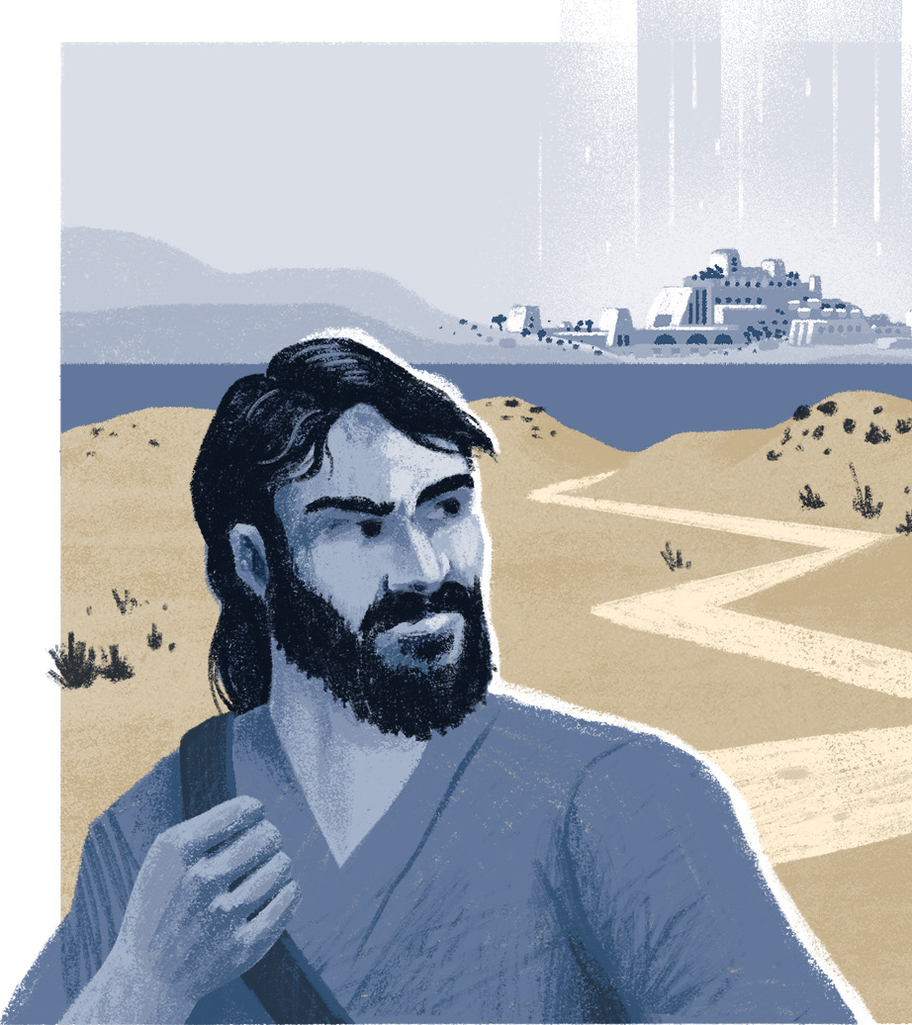
WHO WAS JONAH?
Son of Amittai (Jonah 1:1)
Yonah means dove (see Gen 8:8; Lev 1:14
Comes from the root אנה (‘nh – lament) see Is. 3:26; 2 Kings 5:7)
Prophet from Gath-Hepher (2 Kings 14:25) during the reign of Jeroboam II (793-753 BC).

Slide 7
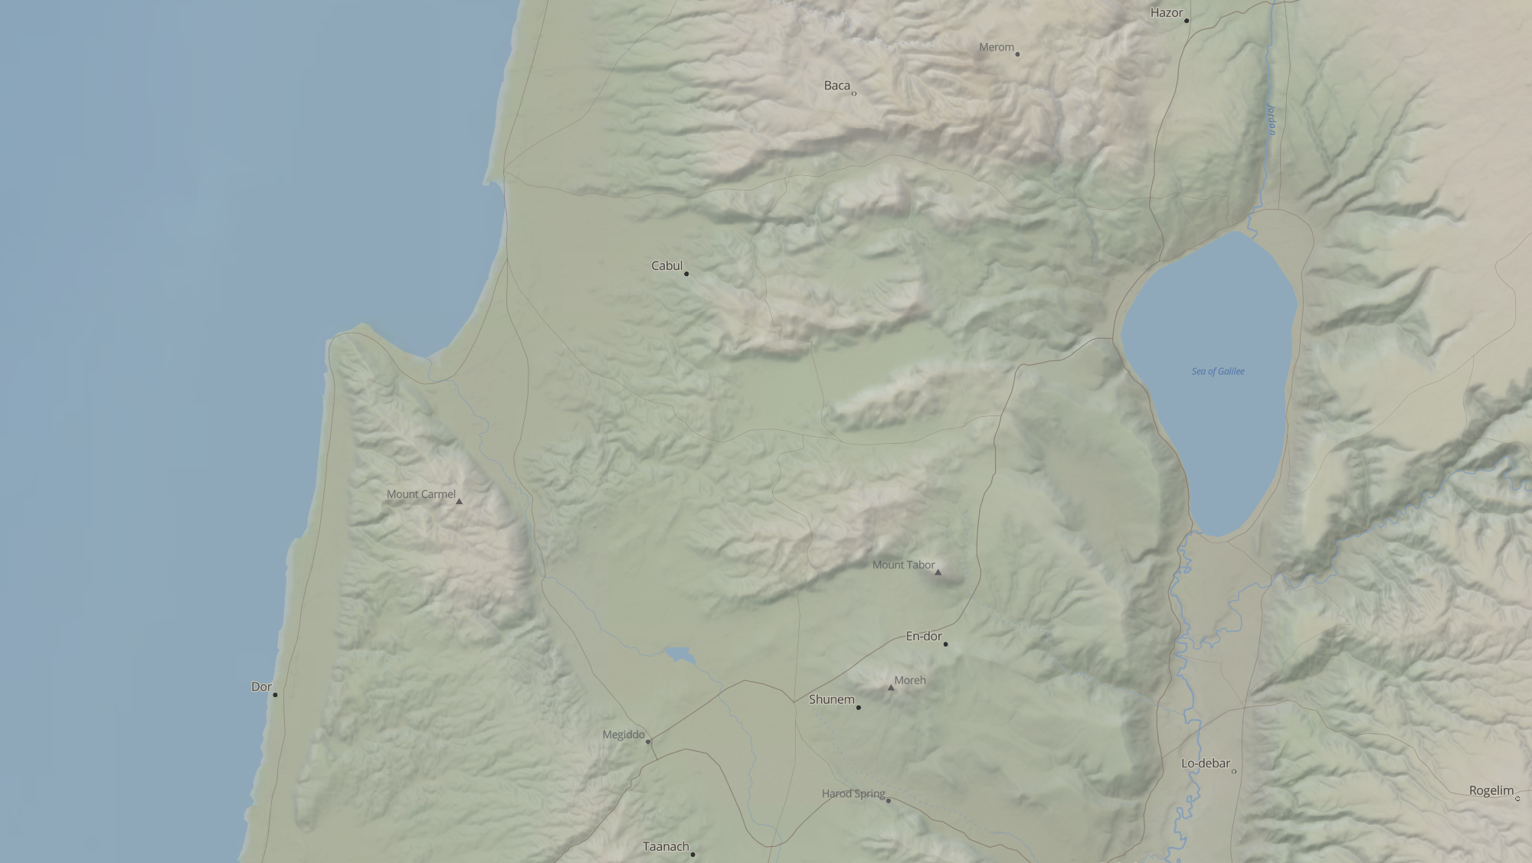
WHO WAS JONAH?
Capernaum
Mediterranean Sea
Sea of Galilee
Gath-Heper
Nazareth

Slide 8
WHO WAS JONAH?
Son of Amittai (Jonah 1:1)
Yonah means dove (see Gen 8:8; Lev 1:14
Comes from the root אנה (‘nh – lament) see Is. 3:26; 2 Kings 5:7)
Prophet from Gath-Hepher (2 Kings 14:25) during the reign of Jeroboam II (793-753 BC).
Tribe of Zebulun

Slide 9
JONAH: AN INTRODUCTION
Who wrote it? Jonah
When was it written? (Date)
Who was it written to? (Audience)
Historicity of the book? (fact of fiction?)
Genre of the book?
What is it all about? (Message)

Slide 10
THE KINGS OF ISRAEL, NORTHERN KINGDOM | APPROXIMATE DATE | FATHER | HOW ACCESSION WAS GAINED
Jeroboam I Nadab | 931-910 910-909 | Nebat Jeroboam | Chosen by the people Inherited
Baasha | 909-886 | Common | Assassinated
Elah Zimri | 886-885 885 | Baasha Common | Inherited
Omri | 885-874 | Common | Declared so by army
Ahab Ahazia | 874-853 853-852 | Omri Ahab | Inherited Inherited
Jehoram | 852-841 | Ahab | Inherited
Jehu | 841-814 | Nimshi | Assassinated
Jehoahaz | 814-798 | Jehu | Inherited
Jehoash | 798-782 | Jehoahaz | Inherited
Jeroboam II | 793-753 | Jehoash | Inherited
Zechariah | 753-752 | Jeroboam II | Inherited
Shallum Menahem | 752 752-742 | Jabesh Gadi | Assassinated Assassinated
Pekahiah | 742-740 | Menahem | Inherited
Pekah Hoshea | 752-732 732-722 | Remaliah Elah | Coup d’etat Assassinated

Slide 11
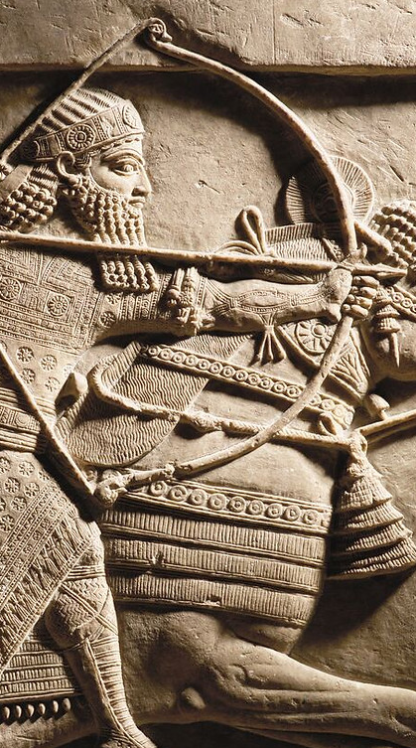
KINGS OF ASSYRIA
KING | REIGN | KING | REIGN
Ashur-uballit I | 1365–1330 | Shamsi-Adad V | 824–810
Adad-nirari I | 1307–1275 | Adad-nirari III | 810–782
Shalmaneser I | 1274–1245 | Shalmaneser IV | 782–773
Tukulti-Ninurta I | 1244–1208 | Ashur-dan III | 773–754
Ashur-dan I | 1179–1133 | Ashur-nirari V | 754–745
Tiglath-pileser I | 1115–1076 | Tiglath-pileser III | 745–727
Ashur-rabi II | 1012–972 | Shalmaneser V | 727–722
Ashur-resh-ishi II | 972–967 | Sargon II | 721–705
Tiglath-pileser II | 967–935 | Sennacherib | 704–681
Ashur-dan II | 935–912 | Esarhaddon | 681–669
Adad-nirari II | 912–889 | Ashur-banipal | 669–633
Tukulti-Ninurta II | 889–884 | Ashur-etil-ilani | 633–622
Ashur-nasir-apal II | 884–858 | Sin-shur-ishkun | 621–612
Shalmaneser III | 858–824 | Ashur-uballit | 612–608

Slide 12
JONAH: AN INTRODUCTION
Who wrote it? Jonah
When was it written? 770-750 BC
Who was it written to? (Audience)
Historicity of the book? (fact of fiction?)
Genre of the book?
What is it all about? (Message)

Slide 13
JONAH: AN INTRODUCTION
Who wrote it? Jonah
When was it written? 770-750 BC
Who was it written to? (Audience)
Historicity of the book? (History or Allegory)
Genre of the book?
What is it all about? (Message)

Slide 14
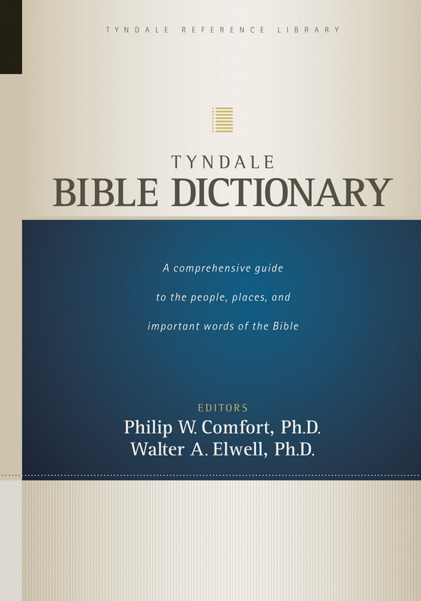
Tyndale Bible Dictionary
This name Yahweh reveals God’s nature in the highest and fullest sense possible. It includes, or presupposes, the meaning of the other names. Yahweh particularly stresses the absolute faithfulness of God. God had promised the patriarchs that he would be their God, that he would be with them and deliver and bless them, keep them, and give them a land as a place of service and inheritance. Moses is told by God that Israel is about to behold and experience the unchangeableness of God as he steadfastly and wondrously remembers his word and executes it to the fullest degree. God would prove to be a faithful, redeeming, upholding, restoring God. In working out this redemption, God would demonstrate that he is all that his name implies: merciful, gracious, patient, full of loving-kindness, truthful, faithful, forgiving, just, and righteous (Ex 34:5–6). Truly, Jacob had received an insight into the meaning of the name when he exclaimed, “I wait for thy salvation, O Yahweh” (Gn 49:18).
Yahweh, then, is the name par excellence of Israel’s God. As Yahweh, he is a faithful covenant God who, having given his word of love and life, keeps that word by bestowing love and life abundantly on his own.

Slide 15
JONAH: AN INTRODUCTION
Who wrote it? Jonah
When was it written? 770-750 BC
Who was it written to? Israel
Historicity of the book? (fact of fiction?)
Genre of the book?
What is it all about? (Message)

Slide 16
Arguments for historicity of Jonah…
Presented as normative history

Slide 17
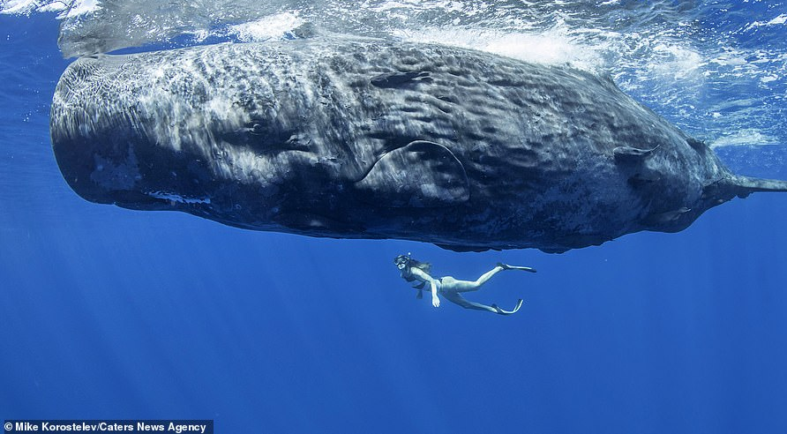

Slide 20
“In Feb. 1891, the whaling ship “Star of the East” was in the vicinity of the Falkland Islands and the lookout sighted a large sperm whale three miles away. Two boats were launched and in a short time one of the harpooners was enabled to spear the fish. The second boat attacked the whale but was upset by a lash of its tail and the men thrown into the sea, one man being drowned, and another, James Bartley, having disappeared and could not be found. The whale was killed and in a few hours was lying by the ship’s side and the crew were busy with axes and spades removing the blubber. They worked all day and part of the night. Next morning they attached some tackle to the stomach which was hoisted on the deck. The sailors were startled by something in it which gave spasmodic signs of life, and inside was found the missing sailor doubled up and unconscious. He was laid on the deck and treated to a bath of sea water which soon revived him…He remained two weeks a raving lunatic...At the end of the third week he had entirely recovered from the shock and resumed his duties.”
Article by, Ambrose John Wilson, “The Sign of the Prophet Jonah and Its Modern Confirmations,” The Princeton Theological Review 25, no. 4 (1927): 630–42.

Slide 21
“Bartley affirms that he would probably have lived inside his house of flesh until he starved, for he lost his senses through fright and not from lack of air. He remembers the sensation of being thrown out of the boat into the sea…He s then encompassed by a great darkness and he felt he was slipping along a smooth passage of some sort that seemed to move and carry him forward. The sensation lasted but a short time and then he realized he had more room. He felt about him and his hands came in contact with a yielding slimy substance that seemed to shrink from his touch. It finally dawned upon him that he had been swallowed by the whale ... he could easily breathe-, but the heat was terrible. It was not of a scorching, stifling nature, but it seemed to open the pores of his skin and draw out his vitality…His skin where it was exposed to the action of the gastric juice…face, neck and hands were bleached to a deadly whiteness and took on the appearance of parchment…(and) never recovered its natural appearance…(though otherwise) his health did not seem affected by his terrible experience.”
Article by, Ambrose John Wilson, “The Sign of the Prophet Jonah and Its Modern Confirmations,” The Princeton Theological Review 25, no. 4 (1927): 630–42.

Slide 22
Arguments for historicity of Jonah…
Presented as normative history
Jewish tradition embraced the historicity of Jonah, book canonized in the OT.

Slide 23
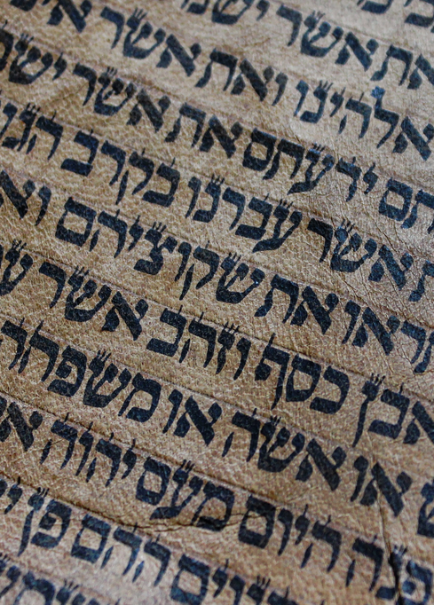
Jonah Among the Prophets: A study in Canonical Context by Elmer Dyck
“Jonah’s place in the canon is incontrovertible. Its canonicity is unquestioned, its place among the Twelve uncontested in the MSS and in canonical lists. There is not the slightest hint that the inclusion of the book among the Twelve was, until modern times, considered at all problematic.”

Slide 24
Arguments for historicity of Jonah…
Presented as normative history
Jewish tradition embraced the historicity of Jonah, book canonized in the OT.
Jonah 1:1 is historically linked to 2 Kings 14:25

Slide 25
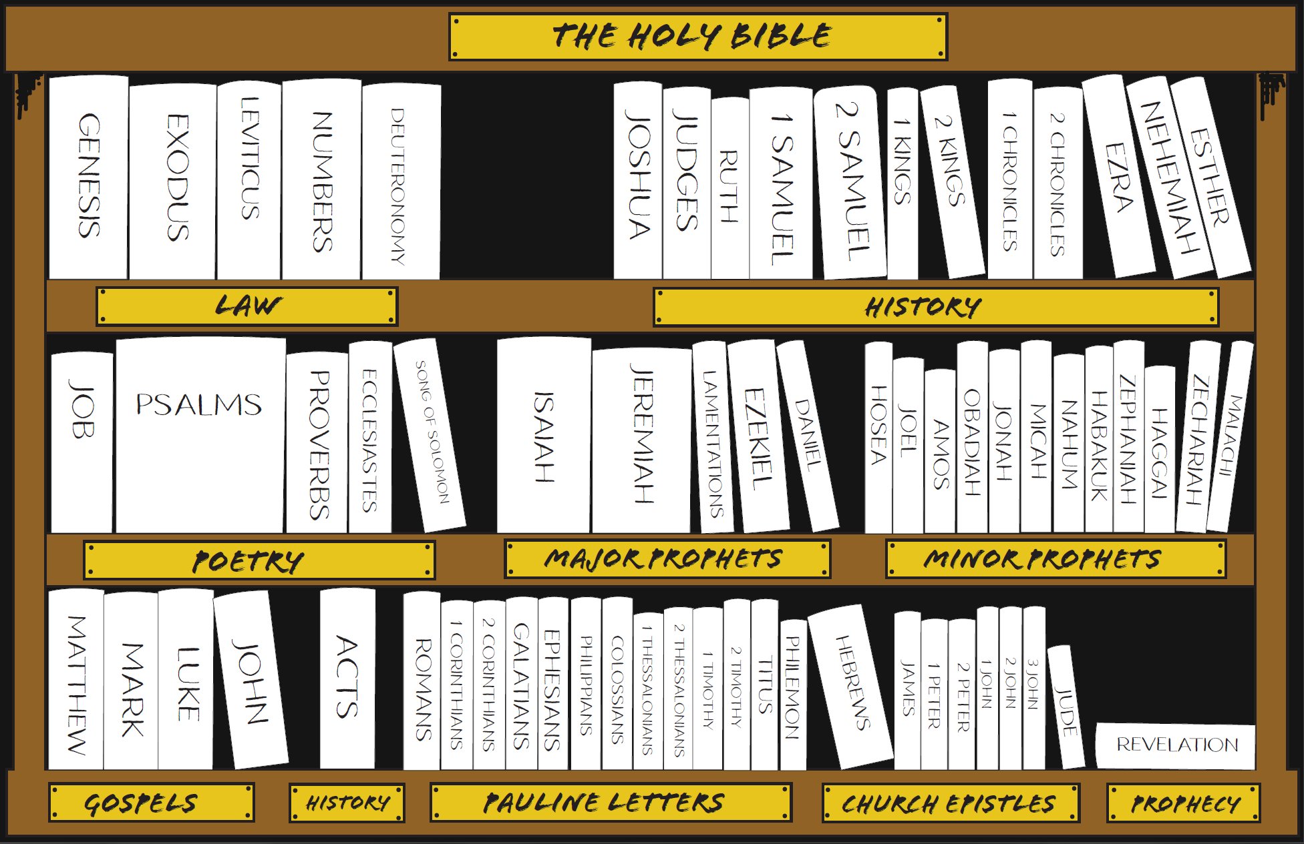

Slide 26
2 Kings 14:25
Jonah 1:1
“He restored the border of Israel from the entrance of Hamath as far as the Sea of the Arabah, according to the word of the LORD, the God of Israel, which He spoke through His servant Jonah the son of Amittai, the prophet, who was of Gath-hepher.”
“The word of the Lord came to Jonah the son of Amittai saying…”

Slide 27
2 Kings 14:25
Jonah 1:1
“He restored the border of Israel from the entrance of Hamath as far as the Sea of the Arabah, according to the word of the LORD, the God of Israel, which He spoke through His servant Jonah the son of Amittai, the prophet, who was of Gath-hepher.”
“The word of the Lord came to Jonah the son of Amittai saying…”

Slide 28
Arguments for historicity of Jonah…
Presented as normative history
Jewish tradition embraced the historicity of Jonah, book canonized in the OT.
Jonah 1:1 is historically linked to 2 Kings 14:25
Jesus took Jonah as historically accurate

Slide 29
JONAH: AN INTRODUCTION
Who wrote it? Jonah
When was it written? 770-750 BC
Who was it written to? Israel
Historicity of the book? Fact!
Genre of the book?
What is it all about? (Message)

