Slide 1
Law and Grace: An Overview Jim McGowan, Th.D. Sugar Land Bible Church 01-08-2023
…but grace and truth were realized through Jesus Christ - John 1:17
For the Law was given through Moses…
Special thanks to Dr. Vern Peterman for access to his insights and resources.

Slide 2
Session 36 Outline
Review
Purpose, Aim, and Objective
Session 35 – Matt. 6:25-34
Judges etc. – Matt. 7:1-12
General Information
Matt. 7:1-12
Concluding Observations

Slide 3
OUR PURPOSE, AIM AND OBJECTIVE
Law and Grace
…is to Compare and Contrast Law and Grace so as to properly understand these two important themes and how they are related to the life of the New Testament Believer.

Slide 4
C. I. Scofield, D. D.
The Grace of God, The Fundamentals Vol. 3, Chapter VII, p. 98
We have, most of us, been reared and now live under the influence of Galatianism. Protestant theology, alas, is for the most part, thoroughly Galatianized, in that neither law nor grace are given their distinct and separated places, as in the counsels of God, but are mingled together in one incoherent system. The law is no longer, as in the Divine intent, a ministration of death (2 Cor. 3:7), of cursing (Gal. 3:10), of conviction (Rom. 3:19), because we are taught that we must try to keep it, and that by Divine help we may. Nor, on the other hand, does grace bring us blessed deliverance from the dominion of sin, for we are kept under the law as a rule of life despite the plain declaration, “Sin shall not have dominion over you: for ye are not under the law, but under grace” (Rom. 6:14). (emphasis mine)

Slide 5
William R. Newell
Romans Verse-by-Verse (p. 274).
Grand Rapids, MI: Christian Classics Ethereal Library.
It is because Reformed theology has kept us Gentiles under the Law,—if not as a means of righteousness, then as “a rule of life,” that all the trouble has arisen. The Law is no more a rule of life than it is a means of righteousness. Walking in the Spirit has now taken the place of walking by ordinances. God has another principle under which He has put his saints: “Ye are not under law, but, under grace! (Rom. 6:14)” (italics mine)
PDF Download Here: https://archive.org/details/Romans_Verse_By_Verse-NewellWR

Slide 6
Henry Ironside
The Continual Burnt Offering: Daily Meditations on the Word of God (p. 265). Neptune, NJ: Loizeaux Brothers.
There is therefore now no condemnation
to those who are in Christ Jesus. – Romans 8:1
In Romans 7 we have a man renewed by the Spirit of God, but struggling under law, hoping thereby to subdue or find deliverance from the power of the old Adamic nature. In chapter 8 we have God’s way of deliverance through the death and resurrection of Christ with which the believer is identified before God. The chapter begins with “no condemnation” and ends with “no separation.” All who are in Christ Jesus are accepted in the Beloved and as free from every charge of guilt as He is Himself. He paid our penalty on the cross. Now we are linked up with Him in resurrection, not under law but under grace.

Slide 7
Matthew’s 3-Fold Purpose
Law and Grace: Review The SOM – Matthew 5:1–8:1 (Luke 6:17–49)
To explain:
that Jesus in whom they had believed was the long-awaited Jewish Messiah
why the kingdom had been postponed despite the fact that the king had arrived
the interim program of God during the kingdom’s absence

Slide 8
Matthew’s Message
Law and Grace: Review The SOM – Matthew 5:1–8:1 (Luke 6:17–49)
Jesus is the predicted Jewish king who ushered in an interim program by building the sons of the kingdom into the Church in between Israel’s past rejection and future acceptance of her king.

Slide 9
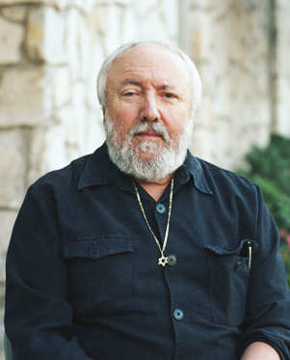
Dr. Arnold Fruchtenbaum
Fruchtenbaum, A. G. (1983). The Messianic Bible Study Collection (Vol. 94, p. 6). Ariel Ministries.
“The most important single statement in the Sermon on the Mount is Matthew 5:20: For I say unto you, that except your righteousness shall exceed the righteousness of the scribes and Pharisees, ye shall in no wise enter into the kingdom of heaven.”

Slide 10
Session 36 Outline
Review
Purpose, Aim, and Objective
Session 35 – Matt. 6:25-34
Judges etc. – Matt. 7:1-12
General Information
Matt. 7:1-12
Concluding Observations

Slide 11
Law and Grace: Review The SOM – Matthew 5:1–8:1 (Luke 6:17–49)
The ‘advantages’ of worrying – Matt. 6:25-34
Jesus, (and Paul) tell us that the advantages of worrying are an illusion – there are none.
For a believer to worry is to attempt to serve two masters!
Worry generally comes from failing to take on responsibilities that are ours or from taking on responsibilities that are not ours – both originate from the sin nature.

Slide 12
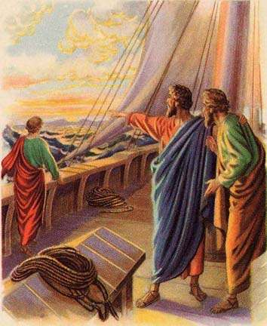
Law and Grace: Review The SOM – Matthew 5:1–8:1 (Luke 6:17–49)
Should we make any plans? – Matt. 6:25-34
Yes, both Christ and Paul made plans and carefully thought out what would happen next.
Making appropriate plans for what we can and ought to do, and for what could happen, are fine.
But our greatest need is to trust God, and…

Slide 13
Law and Grace: Review The SOM – Matthew 5:1–8:1 (Luke 6:17–49)
Should we make any plans? – Matt. 6:25-34
…all our plans ought to be made with consideration for what God has in mind:
Contentment (Phil. 4:11-13)
Conformity (Rom. 8:28-29)
Philippians 4:11-13
¹¹ Not that I speak from want, for I have learned to be content in whatever circumstances I am.
Romans 8:28-29
²⁹…those whom He foreknew, He also predestined to become conformed to the image of His Son…

Slide 14
Law and Grace: The SOM – Matthew 5:1–8:1 (Luke 6:17–49)
H. A. Ironside
Ironside, H. A. (1922). Notes on the Epistle to the Philippians (pp. 120–121). Neptune, NJ.
“John Wesley is reported to have said that he did not know which dishonored God the most — to worry, which is really to doubt His love and care, or to curse and swear. Yet every saint would shrink from the latter with abhorrence, while many of us have no sense of the wrong we do when we fret and worry. To rest in faith upon the knowledge that “all things work together for good to those who love God, who are the called according to His purpose,” should ever be our attitude.”

Slide 15
Session 36 Outline
Review
Purpose, Aim, and Objective
Session 35 – Matt. 6:25-34
Judges etc. – Matt. 7:1-12
General Information
Matt. 7:1-12
Concluding Observations

Slide 16
Matthew 7:1–12
¹ “Do not judge so that you will not be judged. ² “For in the way you judge, you will be judged; and by your standard of measure, it will be measured to you. ³ “Why do you look at the speck that is in your brother’s eye, but do not notice the log that is in your own eye? ⁴ “Or how can you say to your brother, ‘Let me take the speck out of your eye,’ and behold, the log is in your own eye? ⁵ “You hypocrite, first take the log out of your own eye, and then you will see clearly to take the speck out of your brother’s eye. ⁶ “Do not give what is holy to dogs, and do not throw your pearls before swine, or they will trample them under their feet, and turn and tear you to pieces. ⁷ “Ask, and it will be given to you; seek, and you will find; knock,. . .

Slide 17
Matthew 7:1–12
… and it will be opened to you. ⁸ “For everyone who asks receives, and he who seeks finds, and to him who knocks it will be opened. ⁹ “Or what man is there among you who, when his son asks for a loaf, will give him a stone? ¹⁰ “Or if he asks for a fish, he will not give him a snake, will he? ¹¹ “If you then, being evil, know how to give good gifts to your children, how much more will your Father who is in heaven give what is good to those who ask Him! ¹² “In everything, therefore, treat people the same way you want them to treat you, for this is the Law and the Prophets.

Slide 18
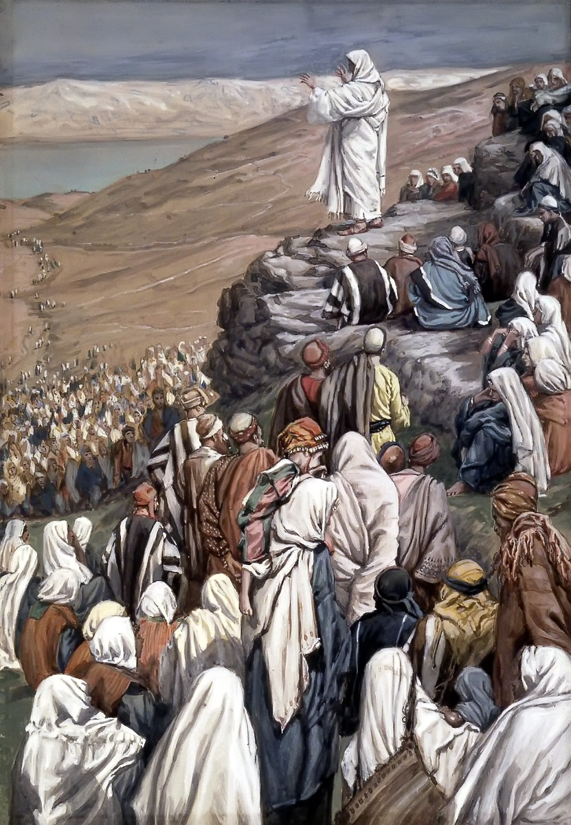
Law and Grace: The SOM – Matthew 5:1–8:1 (Luke 6:17–49)
Judges, Logs, Dogs, Swine, Fish, Snakes and Gold! Matthew 7:1-12
The first 12 verses of Matthew chapter 7 contain graphic points of spiritual and moral instruction, as Jesus continues to tell the Israelites about the Law of Moses in view of the coming kingdom.

Slide 19
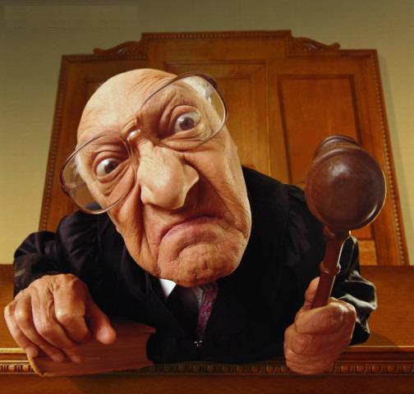
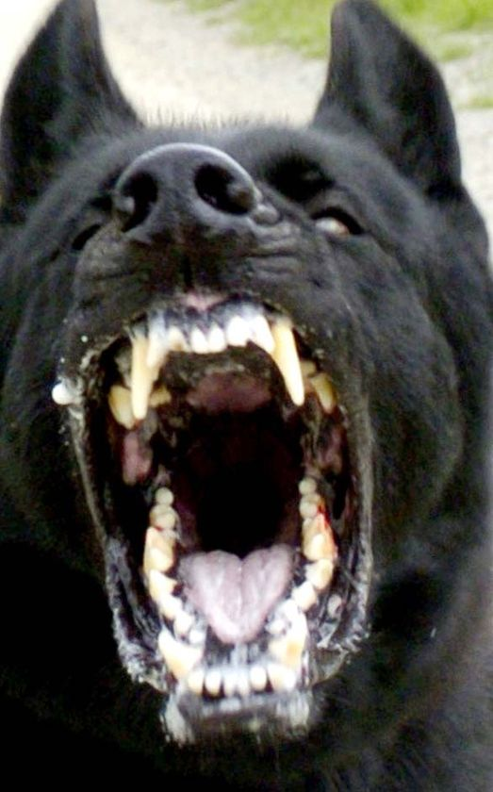
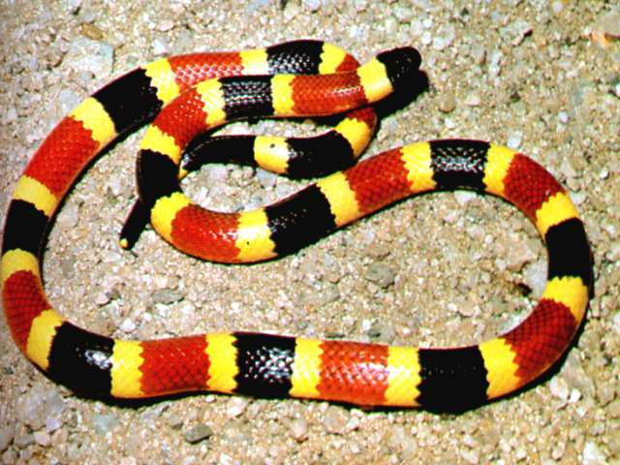
Law and Grace: The SOM – Matthew 5:1–8:1 (Luke 6:17–49)
Judges, Logs, Dogs, Swine, Fish, Snakes and Gold! Matthew 7:1-12
As Jesus does so, He will tell them not to judge, and then use logs, dogs, swine, fish and snakes as illustrations, and finish this series of moral and spiritual lessons by presenting the ‘golden rule’.

Slide 20
Law and Grace: The SOM – Matthew 5:1–8:1 (Luke 6:17–49)
We’re going to find… Matthew 7:1-12
As we study this passage, we are going to find that though Jesus was speaking to those under the Law of Moses, and we are under the principle of grace…
…there will be some really great truths for us to learn from in these 12 verses, because God does not change and we have needs in common with the Israelites.
The Law, by contrast, helps us understand grace!

Slide 21
Session 36 Outline
Review
Purpose, Aim, and Objective
Session 35 – Matt. 6:25-34
Judges etc. – Matt. 7:1-12
General Information
Matt. 7:1-12
Concluding Observations

Slide 22
Matthew 7:1–12
¹ “Do not judge so that you will not be judged. ² “For in the way you judge, you will be judged; and by your standard of measure, it will be measured to you. ³ “Why do you look at the speck that is in your brother’s eye, but do not notice the log that is in your own eye? ⁴ “Or how can you say to your brother, ‘Let me take the speck out of your eye,’ and behold, the log is in your own eye? ⁵ “You hypocrite, first take the log out of your own eye, and then you will see clearly to take the speck out of your brother’s eye. ⁶ “Do not give what is holy to dogs, and do not throw your pearls before swine, or they will trample them under their feet, and turn and tear you to pieces. ⁷ “Ask, and it will be given to you; seek, and you will find; knock,. . .

Slide 23
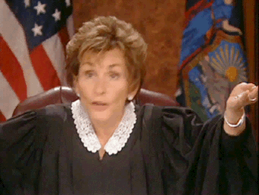
Law and Grace: The SOM – Matthew 5:1–8:1 (Luke 6:17–49)
To judge or not to judge, that is the question! Matthew 7:1-2

Slide 24
Law and Grace: The SOM – Matthew 5:1–8:1 (Luke 6:17–49)
To judge or not to judge, that is the question! Matthew 7:1-2
Jesus tells His Israelite listeners that they are not to judge!
Then He says that to the extent that they do judge and in the manner that they judge, they themselves will be judged!

Slide 25
Law and Grace: The SOM – Matthew 5:1–8:1 (Luke 6:17–49)
To judge or not to judge, that is the question! Matthew 7:1-2
This presents us with ‘apparent contradictions’ because:
The Law of Moses required the Israelites to judge themselves and others!
And Jesus will not only tell them to judge but, instruct them on how to do so!

Slide 26
Law and Grace: The SOM – Matthew 5:1–8:1 (Luke 6:17–49)
What appears to be a conflict …is a call to look carefully Matthew 7:1-2
Human beings often incorporate or accept things that are in conflict. This is especially true when it comes to the Bible.
Rather than examine the full counsel of God by comparing Scripture with Scripture, believers often apathetically embrace apparent conflicts.

Slide 27
Law and Grace: The SOM – Matthew 5:1–8:1 (Luke 6:17–49)
What appears to be a conflict …is a call to look carefully Matthew 7:1-2
The Law of Moses commanded that Israelites judge…
Leviticus 19:15
…You are to judge your neighbor…
Numbers 35:24
…the congregation shall judge…

Slide 28
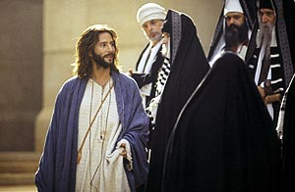
Law and Grace: The SOM – Matthew 5:1–8:1 (Luke 6:17–49)
What appears to be a conflict …is a call to look carefully Matthew 7:1-2
Christ Himself used the word ‘judge’ as an imperative (command) – ‘you must judge!’ – in John 7:24. But…
John 7:24
“Do not judge according to appearance, but judge (command) ….”

Slide 29
Law and Grace: The SOM – Matthew 5:1–8:1 (Luke 6:17–49)
What appears to be a conflict …is a call to look carefully Matthew 7:1-2
…Jesus warns against a particular ‘quality of judging’.
John 7:24
“Do not judge according to appearance, but judge with righteous judgment.”
Deuteronomy 16:18
“…judge the people with righteous judgment.”

Slide 30
John 8:15-18
¹⁵ “You judge according to the flesh; I am not judging anyone. ¹⁶ But even if I do judge, My judgment is true; for I am not alone in it, but I and the Father who sent Me. ¹⁷ Even in your law it has been written that the testimony of two men is true. ¹⁸ I am He who testifies about Myself, and the Father who sent Me testifies about Me.”

Slide 31
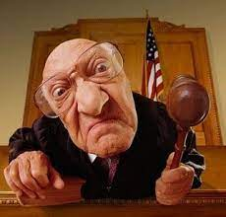
Law and Grace: The SOM – Matthew 5:1–8:1 (Luke 6:17–49)
So, what’s the problem with judging? Matthew 7:1-2
The judging that Jesus is warning about is superficial and according to the flesh, being from a human viewpoint, i.e. influenced by:
Anger
Envy
Hatred
Ignorance
Jealousy
Selfish Ambition

Slide 32
Law and Grace: The SOM – Matthew 5:1–8:1 (Luke 6:17–49)
So, what’s the problem with judging? Matthew 7:1-2
But biblically, judgment is to be just, righteous and true, and there must be an authority and responsibility for a person to judge. (cf. Psa. 19:9)
John 5:30
“I can do nothing on My own initiative. As I hear, I judge; and My judgment is just, because I do not seek My own will, but the will of Him who sent Me.

Slide 33
Matthew 7:1–12
¹ “Do not judge so that you will not be judged. ² “For in the way you judge, you will be judged; and by your standard of measure, it will be measured to you. ³ “Why do you look at the speck that is in your brother’s eye, but do not notice the log that is in your own eye? ⁴ “Or how can you say to your brother, ‘Let me take the speck out of your eye,’ and behold, the log is in your own eye? ⁵ “You hypocrite, first take the log out of your own eye, and then you will see clearly to take the speck out of your brother’s eye. ⁶ “Do not give what is holy to dogs, and do not throw your pearls before swine, or they will trample them under their feet, and turn and tear you to pieces. ⁷ “Ask, and it will be given to you; seek, and you will find; knock,. . .

Slide 34
Law and Grace: The SOM – Matthew 5:1–8:1 (Luke 6:17–49)
Logs and specks Matthew 7:3-5
Jesus is using hyperbole here!

Slide 35
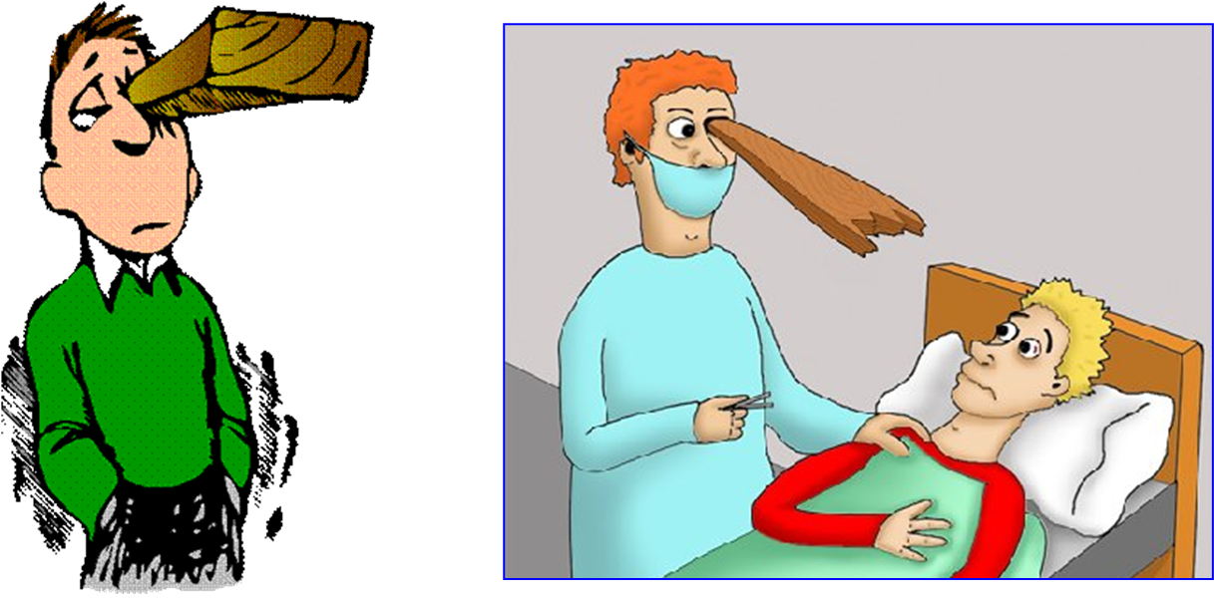
Law and Grace: The SOM – Matthew 5:1–8:1 (Luke 6:17–49)
Logs and specks Matthew 7:3-5
These verses place a priority on ‘judging or dealing with sin’, that is, the one to judge and deal with first is oneself.

Slide 36
Dr. Arnold Fruchtenbaum
Fruchtenbaum, A. G. (1983). The Messianic Bible Study Collection (Vol. 94, p. 6). Ariel Ministries.
“The most important single statement in the Sermon on the Mount is Matthew 5:20: For I say unto you, that except your righteousness shall exceed the righteousness of the scribes and Pharisees, ye shall in no wise enter into the kingdom of heaven.”

Slide 37
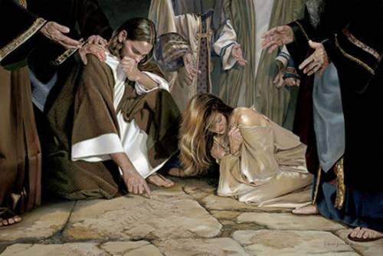
John 8:7
“He who is without sin among you, let him be the first to throw a stone at her.”

Slide 38
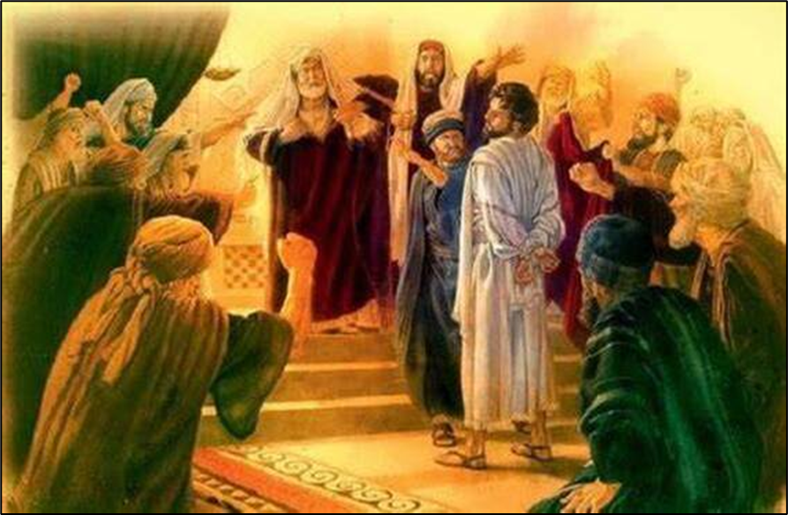
Acts 23:2-3
² But the high priest Ananias commanded those standing beside him to strike him on the mouth. ³ Then Paul said to him, “God is going to strike you, you whitewashed wall! Do you sit to try me according to the Law, and in violation of the Law, order me to be struck?”

Slide 39
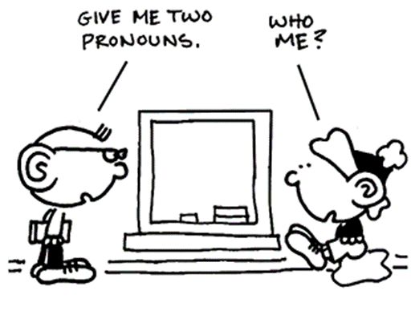
Law and Grace: The SOM – Matthew 5:1–8:1 (Luke 6:17–49)
Logs and specks Matthew 7:3-5
The principle of judging oneself under Law is also valid under Grace.
1 Corinthians 11:31
But if we judged ourselves rightly, we would not be judged.

Slide 40
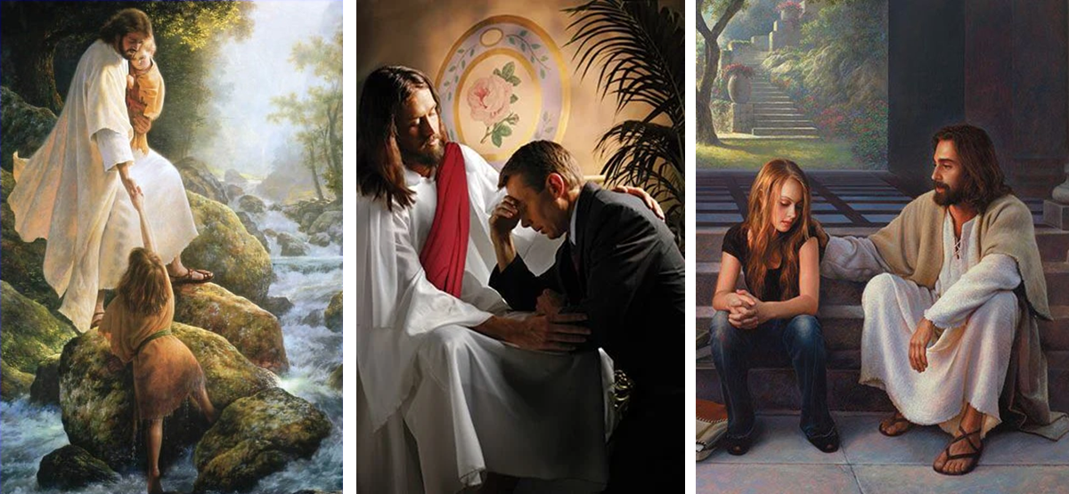
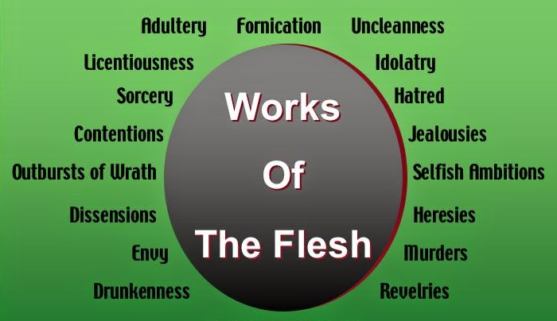
Galatians 6:1
“Brethren, even if anyone is caught in any trespass, [cf. 5:19-21] you who are spiritual, restore such a one in a spirit of gentleness; each one looking to yourself, so that you too will not be tempted.”

Slide 41
Law and Grace: The SOM – Matthew 5:1–8:1 (Luke 6:17–49)
Dogs and Swine Matthew 7:6

Slide 42
Matthew 7:1–12
¹ “Do not judge so that you will not be judged. ² “For in the way you judge, you will be judged; and by your standard of measure, it will be measured to you. ³ “Why do you look at the speck that is in your brother’s eye, but do not notice the log that is in your own eye? ⁴ “Or how can you say to your brother, ‘Let me take the speck out of your eye,’ and behold, the log is in your own eye? ⁵ “You hypocrite, first take the log out of your own eye, and then you will see clearly to take the speck out of your brother’s eye. ⁶ “Do not give what is holy to dogs, and do not throw your pearls before swine, or they will trample them under their feet, and turn and tear you to pieces. ⁷ “Ask, and it will be given to you; seek, and you will find; knock,...

Slide 43
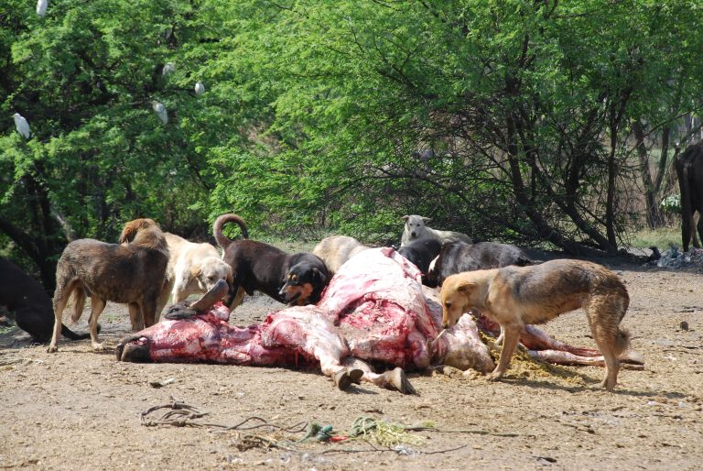
Law and Grace: The SOM – Matthew 5:1–8:1 (Luke 6:17–49)
Dogs and Swine Matthew 7:6
There are two words for ‘dog’ in the Greek. One is a pet dog.
But the word Jesus used refers to a feral dog.

Slide 44
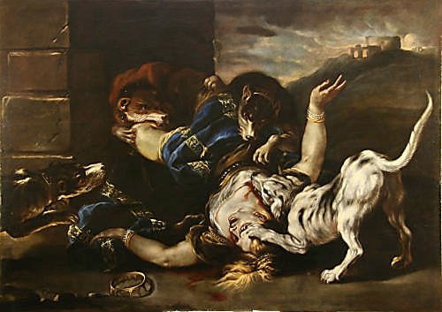
1 Kings 21:23-24
²³ “Of Jezebel also has the Lord spoken, saying, ‘The dogs will eat Jezebel in the district of Jezreel.’ ²⁴ “The one belonging to Ahab, who dies in the city, the dogs will eat, and the one who dies in the field the birds of heaven will eat.”

Slide 45
Law and Grace: The SOM – Matthew 5:1–8:1 (Luke 6:17–49)
Dogs and Swine Matthew 7:6
Swine of course under the Law of Moses were unclean animals, but Jesus also described them as vicious, and this was not hyperbole!

Slide 46
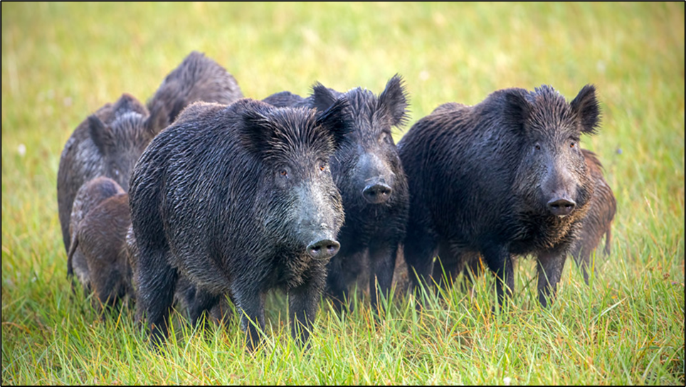
Law and Grace: The SOM – Matthew 5:1–8:1 (Luke 6:17–49)
Why the caution about Dogs and Swine? Matthew 7:6
The Israelites regularly referred to the Gentiles as dogs and swine since they too were unclean according to the Law of Moses.

Slide 47
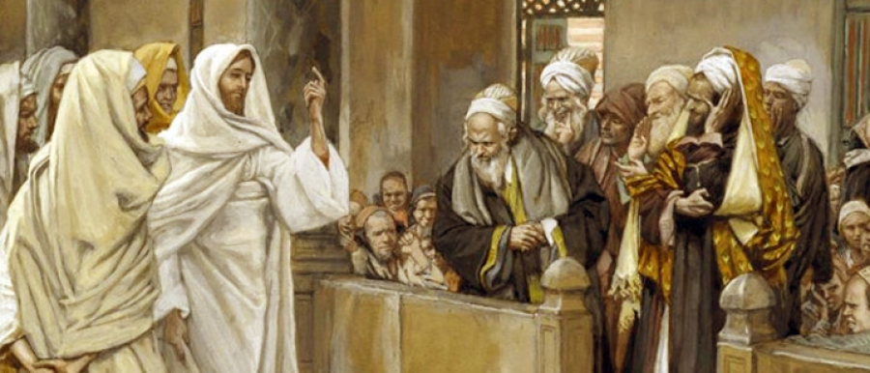
Law and Grace: The SOM – Matthew 5:1–8:1 (Luke 6:17–49)
Why the caution about Dogs and Swine? Matthew 7:6
In the context here, Jesus applied these terms to the Jewish leadership who would not acknowledge holiness when they encountered it and who placed no value on truth, even from God himself.

Slide 48
Law and Grace: The SOM – Matthew 5:1–8:1 (Luke 6:17–49)
Why the caution about Dogs and Swine? Matthew 7:6
Jesus said these strain out a gnat and swallow a camel (Matthew 23:24).

Slide 49
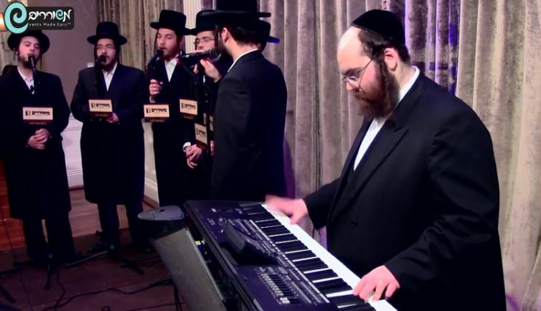
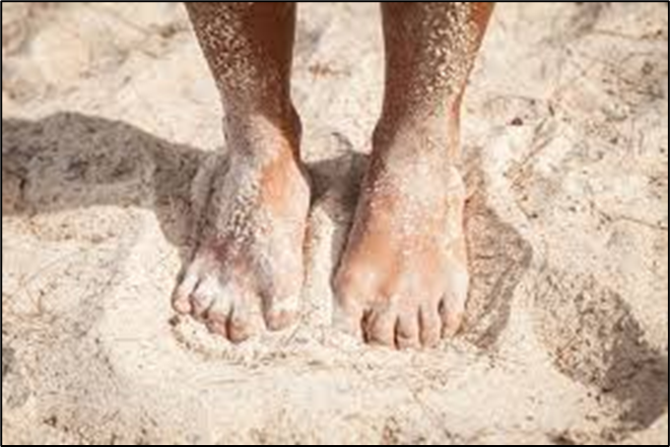
Law and Grace: The SOM – Matthew 5:1–8:1 (Luke 6:17–49)
Why the caution about Dogs and Swine? Matthew 7:6
Shaking the dust off of one’s feet was a Jewish custom that placed responsibility on those refusing to heed the message. (cf. Matt. 10:14; Acts 13:51)
Matthew 10:14
“Whoever does not receive you, nor heed your words, as you go out of that house or that city, shake the dust off your feet.” (cf. Acts 13:51)

Slide 50
Matthew 7:1–12
…⁷ “Ask, and it will be given to you; seek, and you will find; knock,...and it will be opened to you. ⁸ “For everyone who asks receives, and he who seeks finds, and to him who knocks it will be opened. ⁹ “Or what man is there among you who, when his son asks for a loaf, will give him a stone? ¹⁰ “Or if he asks for a fish, he will not give him a snake, will he? ¹¹ “If you then, being evil, know how to give good gifts to your children, how much more will your Father who is in heaven give what is good to those who ask Him! ¹² “In everything, therefore, treat people the same way you want them to treat you, for this is the Law and the Prophets.

Slide 51
Law and Grace: The SOM – Matthew 5:1–8:1 (Luke 6:17–49)
Ask, Seek and Knock Matthew 7:7-11
Jesus tells his listeners to ask, seek, and knock. Why? Because ABBA, Father wants to reward those who do so (cf. Phil. 4:6; James 1:5-6; 1 John 3:22 5:14-15).
Hebrews 11:6
“…he who comes to God must believe that He is and that He is a rewarder of those who seek Him.”

Slide 52
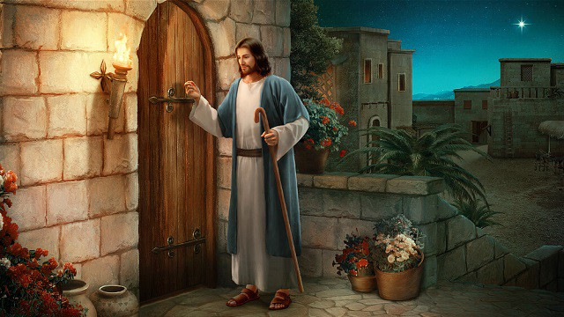
Law and Grace: The SOM – Matthew 5:1–8:1 (Luke 6:17–49)
Ask, Seek and Knock Matthew 7:7-11
Why Knock? – In New Testament times, when a person who knew you, knocked on your door, the person also called out who they were as they knocked. So, to knock implied that you were looking for fellowship.

Slide 53
‘Ask, seek and knock’ is also about God’s character! Matthew 7:7-11
Law and Grace: The SOM – Matthew 5:1–8:1 (Luke 6:17–49)
God's intent for us to come to Him in faith, is benevolence.

Slide 54
‘Ask, seek and knock’ is also about God’s character! Matthew 7:7-11
Law and Grace: The SOM – Matthew 5:1–8:1 (Luke 6:17–49)
God is not capricious, unpredictable, or unreliable.
Five Faulty Views of God
The cruel and capricious God.
The demanding and unforgiving God.
The selective and unfair God.
The distant and unavailable God.
The kind but confused God.

Slide 55
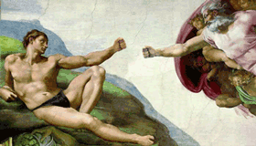
‘Ask, seek and knock’ is also about God’s character! Matthew 7:7-11
Law and Grace: The SOM – Matthew 5:1–8:1 (Luke 6:17–49)
God knows what we need, so we are not just approaching Him to inform Him of what we need, nor is God just playing a game.

Slide 56
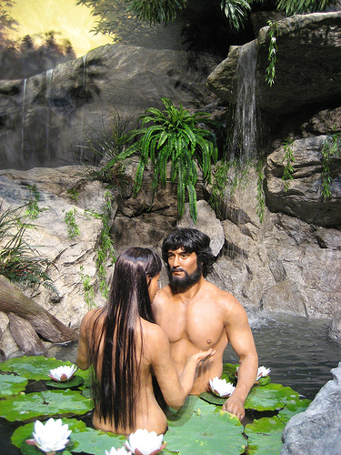
‘Ask, seek and knock’ is also about God’s character! Matthew 7:7-11
Law and Grace: The SOM – Matthew 5:1–8:1 (Luke 6:17–49)
God is personal, and we are called to interact with Him personally because we have been made in His image.

Slide 57
The ‘image and likeness of God’ in mankind – What is it? Matthew 7:7-11
Law and Grace: The SOM – Matthew 5:1–8:1 (Luke 6:17–49)
It is:
a personal image and likeness (Genesis 2:19-23)
a spiritual image and likeness (1 Corinthians 15:45)
an interpersonal image and likeness (Genesis 1:26; 1 John 1:3)
-------------------------------------------------------------------------------------------
a moral image and likeness (Ephesians 4:22-24; Colossians 3:9-10)
an authority image and likeness (Genesis 1:26)
a creative image and likeness (Exodus 25:8,9)

Slide 58
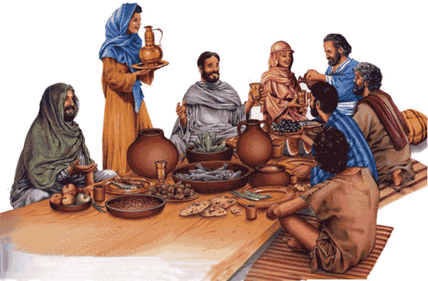
‘Ask, seek and knock’ is also about God’s character! Matthew 7:7-11
Law and Grace: The SOM – Matthew 5:1–8:1 (Luke 6:17–49)
God is personal, we are called to interact with Him personally because we have been made in His image.
As physical and spiritual beings we have needs that only God can provide.

Slide 59
Law and Grace: The SOM – Matthew 5:1–8:1 (Luke 6:17–49)
Ask, Seek and Knock Matthew 7:7-11
Ask, seek and knock are really focusing on prayer - personal communication with God Himself.
Asking is making requests of God, since He is the Provider and we are people of needs.

Slide 60
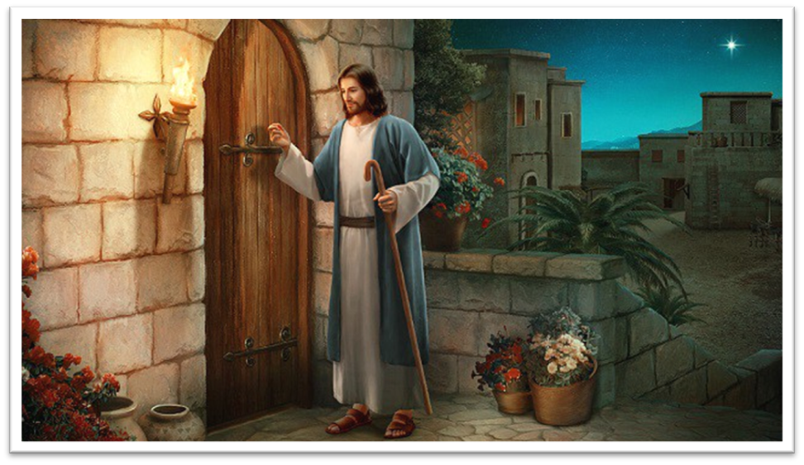
Law and Grace: The SOM – Matthew 5:1–8:1 (Luke 6:17–49)
Ask, Seek and Knock Matthew 7:7-11
Knocking speaks of personal approach, and our sincere, genuine, earnest, intent to have fellowship with Him.
Seeking is confidently approaching God, who is the Creator of all things and with Whom we have privileged access.

Slide 61
Law and Grace: The SOM – Matthew 5:1–8:1 (Luke 6:17–49)
Ask, Seek and Knock – VIP Privileged Access Matthew 7:7-11
You do know that all believers have VIP privileged access to God, right? (cf. Heb. 4:16; Eph. 3:12; 1 Jn. 3:21; 1 Jn. 5:14)

Slide 62
Matthew 7:1–12
…⁷ “Ask, and it will be given to you; seek, and you will find; knock,...and it will be opened to you. ⁸ “For everyone who asks receives, and he who seeks finds, and to him who knocks it will be opened. ⁹ “Or what man is there among you who, when his son asks for a loaf, will give him a stone? ¹⁰ “Or if he asks for a fish, he will not give him a snake, will he? ¹¹ “If you then, being evil, know how to give good gifts to your children, how much more will your Father who is in heaven give what is good to those who ask Him! ¹² “In everything, therefore, treat people the same way you want them to treat you, for this is the Law and the Prophets.

Slide 63
Matthew 7:1–12
…⁷ “Ask, and it will be given to you; seek, and you will find; knock,...and it will be opened to you. ⁸ “For everyone who asks receives, and he who seeks finds, and to him who knocks it will be opened. ⁹ “Or what man is there among you who, when his son asks for a loaf, will give him a stone? ¹⁰ “Or if he asks for a fish, he will not give him a snake, will he? ¹¹ “If you then, being evil, know how to give good gifts to your children, how much more will your Father who is in heaven give what is good to those who ask Him! ¹² “In everything, therefore, treat people the same way you want them to treat you, for this is the Law and the Prophets.

Slide 64
Law and Grace: The SOM – Matthew 5:1–8:1 (Luke 6:17–49)
The Golden Rule Matthew 7:12

Slide 65
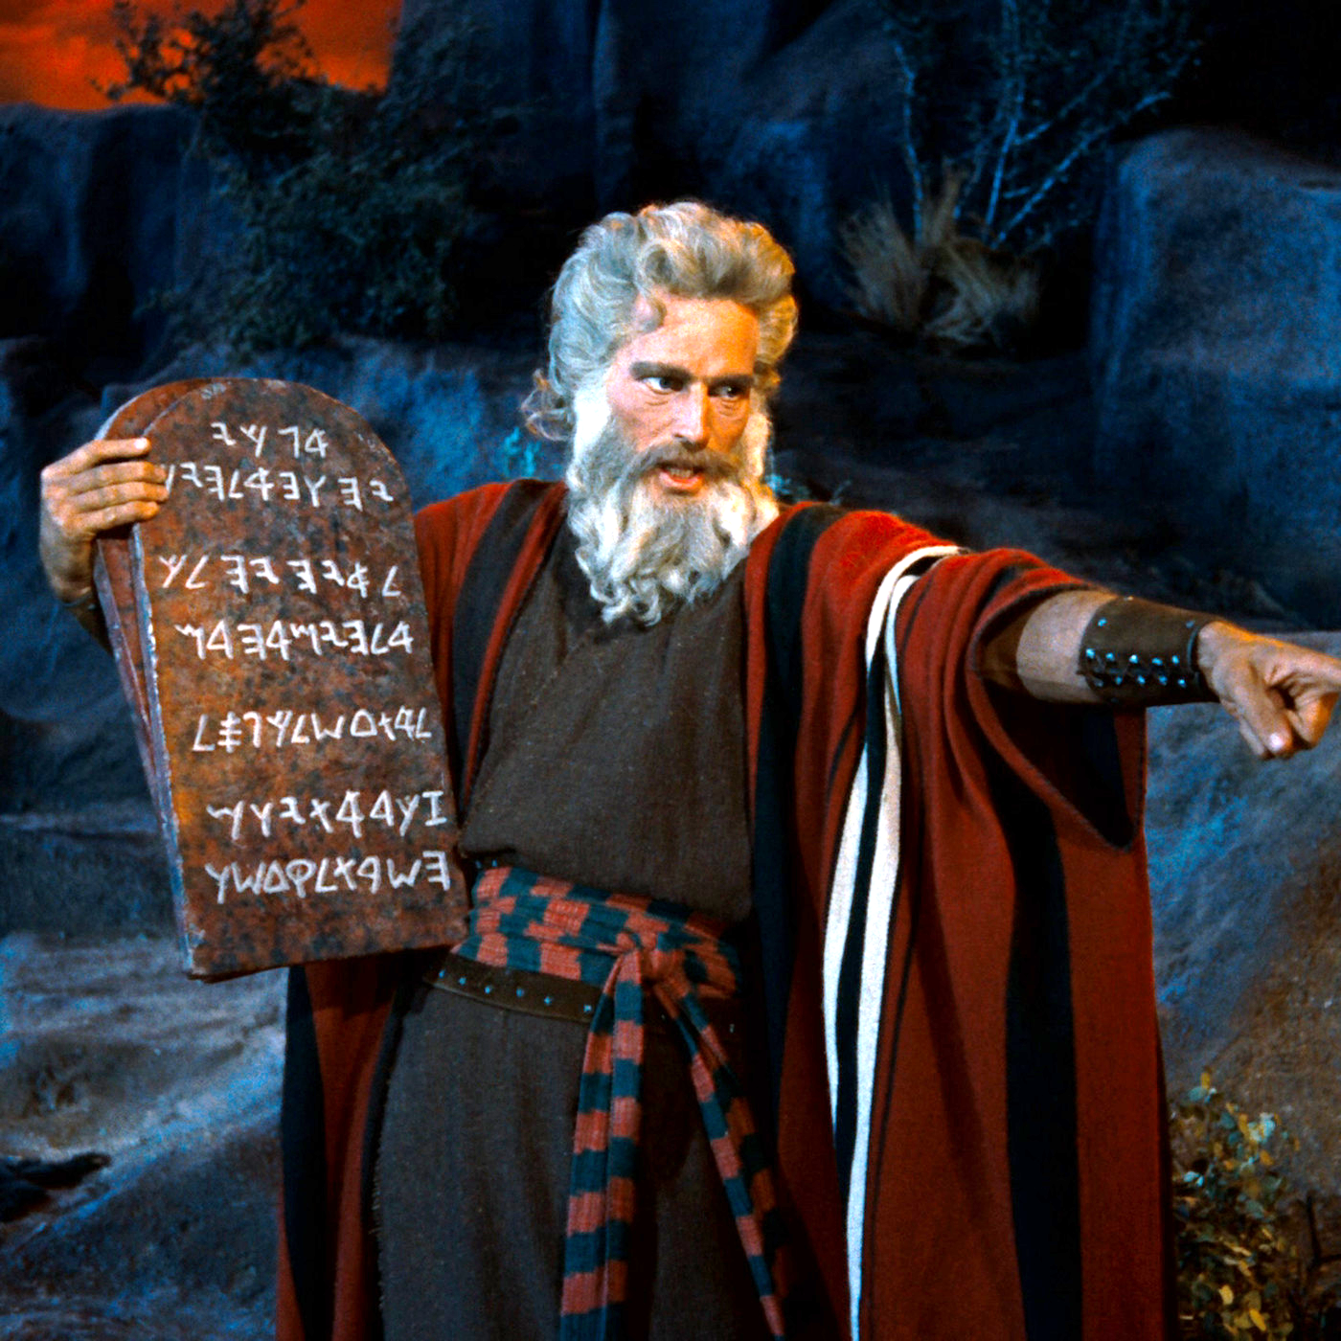
Law and Grace: The SOM – Matthew 5:1–8:1 (Luke 6:17–49)
The Golden Rule Matthew 7:12
Jesus takes His audience once again back to the Law of Moses, which declares, that the Israelite is to love his neighbor as himself (Lev. 19:18).
Just do it.
Leviticus 19:18
“…you shall love your neighbor as yourself; I am the Lord.”

Slide 66
Law and Grace: The SOM – Matthew 5:1–8:1 (Luke 6:17–49)
The Golden Rule Matthew 7:12
However, loving one’s neighbor also applies to the Body of Christ as well, but not under the principle of the Law of Moses, but under the principle of grace.

Slide 67
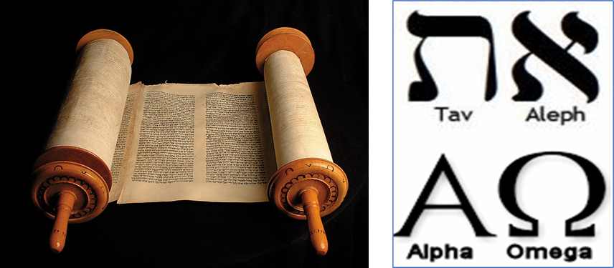
Law and Grace: The SOM – Matthew 5:1–8:1 (Luke 6:17–49)
The Golden Rule Matthew 7:12
‘The Law and the Prophets’ was an expression for the entire Old Testament. The Law [of Moses] comes at the beginning and the Prophets come at the end, so this expression meant ‘beginning to end’.
This expressions would be equivalent in Hebrew to – Aleph and Tov and in Greek to – Alpha and Omega.

Slide 68
Session 36 Outline
Review
Purpose, Aim, and Objective
Session 35 – Matt. 6:25-34
Judges etc. – Matt. 7:1-12
General Information
Matt. 7:1-12
Concluding Observations

Slide 69
Law and Grace: The SOM – Matthew 5:1–8:1 (Luke 6:17–49)
Most of what is in this passage… Matthew 7:1-12
…is either the same or similar whether under the temporary reigning principle of the Law of Moses, now set aside and abolished (Gal. 3:13, Eph. 2:15; Heb. 7:8), or living under the eternal reigning principle of Grace. The reasons are that:
God does not change,
God has created all of us in His image,
Morality is based on the character of God and,
Our needs as believers today, and those of the Israelites then, remain the same.

Slide 70
Law and Grace: An Overview Jim McGowan, Th.D. Sugar Land Bible Church 01-08-2023
…but grace and truth were realized through Jesus Christ - John 1:17
For the Law was given through Moses…
Special thanks to Dr. Vern Peterman for access to his insights and resources.

