Slide 1
Genesis 12‒50
Israel’s Birth & Preservation

Slide 2
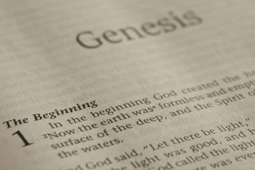
GENESIS STRUCTURE
Beginning of the Human race (Gen. 1‒11)
Beginning of the Hebrew race (Gen. 12‒50)

Slide 3
GENESIS STRUCTURE
Genesis 1-11 (four events)
Creation (1-2)
Fall (3-5)
Flood (6-9)
National dispersion (10-11)

Slide 4
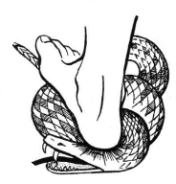
Genesis 3:15
“And I will put enmity Between you and the woman, And between your seed and her seed; He shall bruise you on the head, And you shall bruise him on the heel.”

Slide 5
GENESIS STRUCTURE
Beginning of the Human race (Gen. 1‒11)
Beginning of the Hebrew race (Gen. 12‒50)

Slide 6
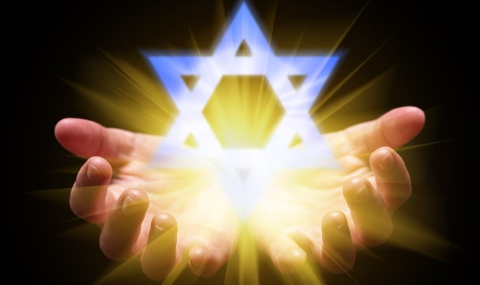
Isaiah 43:1
“But now, thus says the Lord, your Creator, O Jacob, And He who formed you, O Israel, 'Do not fear, for I have redeemed you; I have called you by name; you are Mine!'”

Slide 7
GENESIS STRUCTURE
Genesis 12-50 (four people)
Abraham (12:1–25:11)
Isaac (25:12–26:35)
Jacob (27–36)
Joseph (37–50)

Slide 8
Genesis 26 Chapter Summary
Abrahamic Covenant Reconfirmed (1-5)
Isaac & Abimelech (6-11)
Struggle for the Wells (12-22)
Sojourn in Beersheba (23-25)
Covenant with Abimelech (26-33)
Esau’s Wives (34-35)

Slide 9
V. Genesis 26:26-33 Covenant with Abimelech
Abimelech’s representatives (26)
Isaac’s question (27)
Abimelech’s observation (28-29)
Covenant made (30-31)
Well discovered (32-33)

Slide 10
V. Genesis 26:26-33 Covenant with Abimelech
Abimelech’s representatives (26)
Isaac’s question (27)
Abimelech’s observation (28-29)
Covenant made (30-31)
Well discovered (32-33)

Slide 11
Genesis 12‒25 Abraham’s Early Journeys
Unconditional promises (Gen. 12:1-3) From Haran to Canaan (Gen. 12:4-5) In Canaan (Gen. 12:6-9) In Egypt (Gen. 12:10-20) Abram and Lot Separate (Gen. 13:1-13) Reaffirmation of Abram’s promises (Gen. 13:14-18) Abram Rescues Lot (14:1-24) Abrahamic Covenant (15:1-21) Hagar & Ishmael (16:1-16) Circumcision (Gen. 17:1-27) | Sodom & Gomorrah (Gen. 18‒19) Abraham & Abimelech (Gen. 20) Isaac’s birth (Gen. 21:1-7) Ishmael’s expulsion (21:8-21) Abraham & Abimelech’s covenant (21:22-34) Abraham sacrifices Isaac (22) Sarah’s death (23) Isaac’s marriage (24) Abraham & Keturah (25:1-6) Abraham’s death (25:7-11)

Slide 12
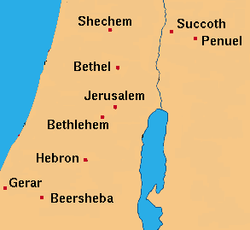

Slide 13
V. Genesis 26:26-33 Covenant with Abimelech
Abimelech’s representatives (26)
Isaac’s question (27)
Abimelech’s observation (28-29)
Covenant made (30-31)
Well discovered (32-33)

Slide 14
Pretribulationism IS NOT Escapism
Trials (John 16:33)
Man’s wrath (2 Tim. 3:12)
Satan’s wrath (Eph. 6:11-12)
World’s wrath (John 15:18-19)

Slide 15
V. Genesis 26:26-33 Covenant with Abimelech
Abimelech’s representatives (26)
Isaac’s question (27)
Abimelech’s observation (28-29)
Covenant made (30-31)
Well discovered (32-33)

Slide 16
Evidence of Abrahamic Covenant’s Unconditional Nature
ANE covenant ratification ceremony (Gen 15)
Lack of stated conditions for Israel’s obedience (Gen 15)
Covenant's eternality (Gen 17:7, 13, 19; Ps. 90:2)
Covenant's immutability (Heb 6:13-18; Mal. 3:6)
Trans-generational reaffirmation despite perpetual national disobedience (Jer 31:35-37)
Walvoord, The Millennial Kingdom, 149-52

Slide 17
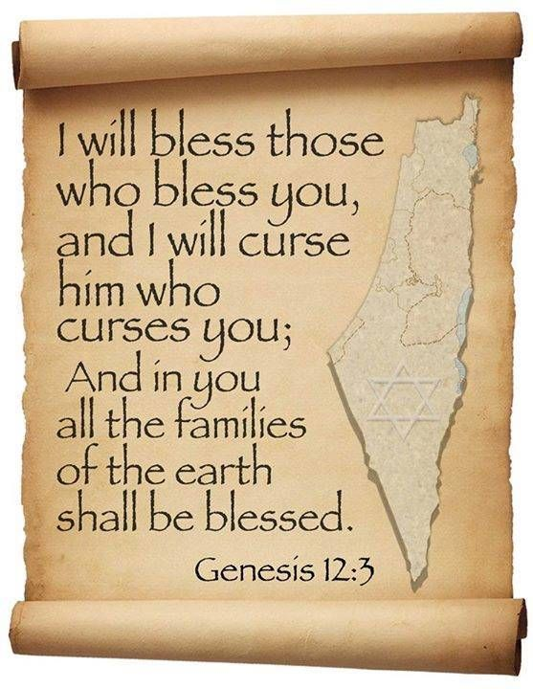
Genesis 12:3
“And I will bless those who bless you, And the one who curses [kalal] you I will curse [aor]. And in you all the families of the earth will be blessed.”

Slide 18
8 New Promises Genesis 12:1-3
Land (Gen. 12:1b)
Great nation (Gen. 12:2a)
Personal blessing (Gen. 12:2b)
Great name (Gen. 12:2c)
Blessing to others (Gen. 12:2d)
Blessing to blessers (Gen. 12:3a)
Cursing to cursers (Gen. 12:3b)
Blessing to the world (Gen. 12:3c)

Slide 19
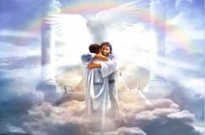
Ephesians 1:3
“Blessed be the God and Father of our Lord Jesus Christ, who has blessed us with every spiritual blessing in the heavenly places in Christ.”

Slide 21
Revelation 2:9
“I know your tribulation and your poverty (but you are rich), and the blasphemy by those who say they are Jews and are not, but are a synagogue of Satan.”

Slide 22
V. Genesis 26:26-33 Covenant with Abimelech
Abimelech’s representatives (26)
Isaac’s question (27)
Abimelech’s observation (28-29)
Covenant made (30-31)
Well discovered (32-33)

Slide 23
Genesis 26:30-31 Covenant Made
Meal (30)
Oaths (31a)
Departure (31b)

Slide 24
Genesis 26:30-31 Covenant Made
Meal (30)
Oaths (31a)
Departure (31b)

Slide 27
Revelation 3:20
“Behold, I stand at the door and knock; if anyone hears My voice and opens the door, I will come in to him and will dine with him, and he with Me.”

Slide 29
Genesis 26:30-31 Covenant Made
Meal (30)
Oaths (31a)
Departure (31b)

Slide 30
Evidence of Abrahamic Covenant’s Unconditional Nature
ANE covenant ratification ceremony (Gen 15)
Lack of stated conditions for Israel’s obedience (Gen 15)
Covenant's eternality (Gen 17:7, 13, 19; Ps. 90:2)
Covenant's immutability (Heb 6:13-18; Mal. 3:6)
Trans-generational reaffirmation despite perpetual national disobedience (Jer 31:35-37)
Walvoord, The Millennial Kingdom, 149-52

Slide 31
Genesis 26:30-31 Covenant Made
Meal (30)
Oaths (31a)
Departure (31b)

Slide 32
Genesis 12:3
“And I will bless those who bless you, And the one who curses [kalal] you I will curse [aor]. And in you all the families of the earth will be blessed.”

Slide 33
V. Genesis 26:26-33 Covenant with Abimelech
Abimelech’s representatives (26)
Isaac’s question (27)
Abimelech’s observation (28-29)
Covenant made (30-31)
Well discovered (32-33)

Slide 34
Genesis 26:32-33 Well Discovered
Find (32)
Name (33)

Slide 35
Genesis 26:32-33 Well Discovered
Find (32)
Name (33)

Slide 36
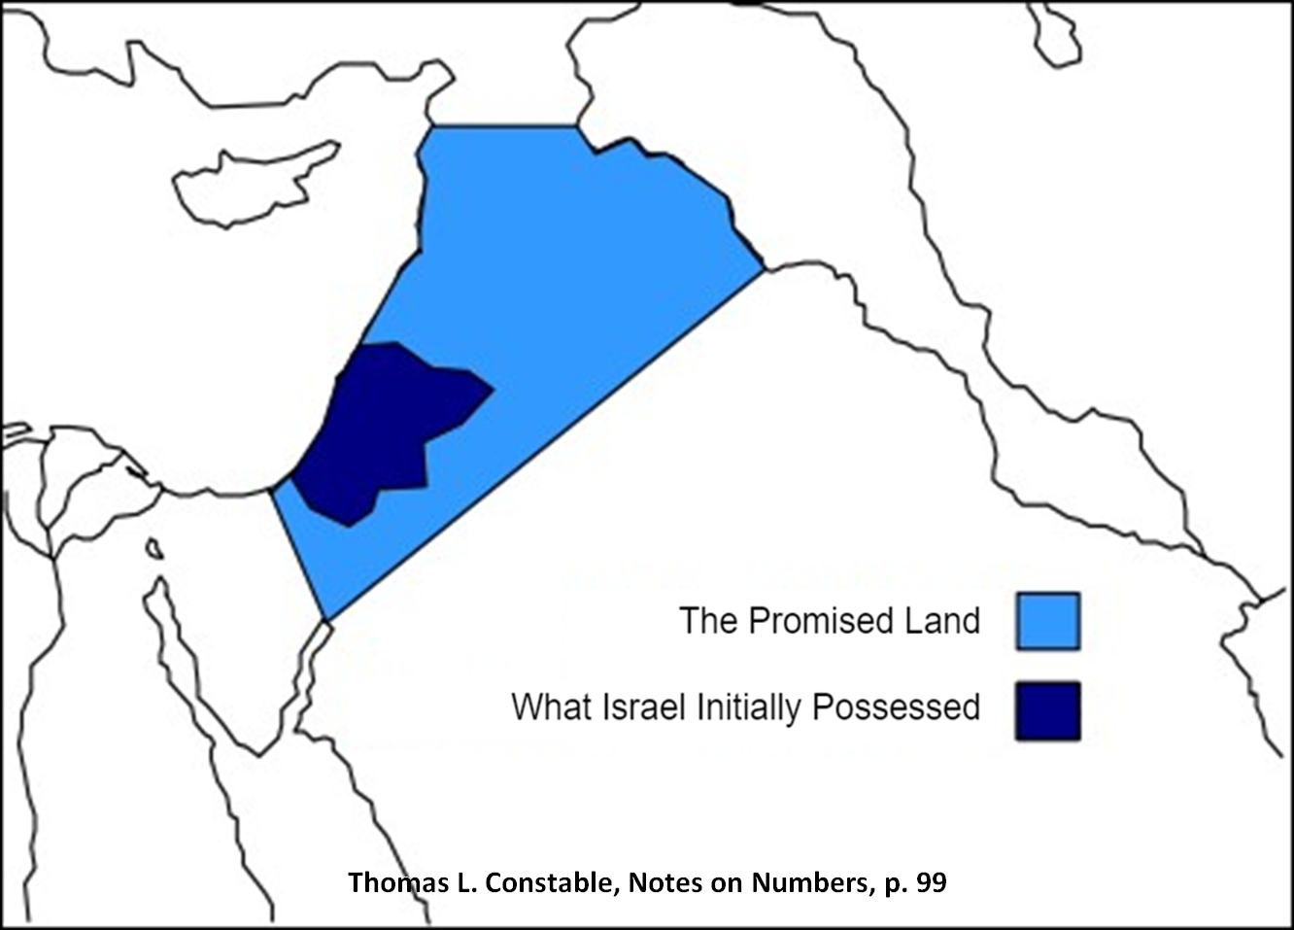

Slide 37
1 Corinthians 15:20-23
“²⁰-But now Christ has been raised from the dead, the first fruits of those who are asleep. ²¹-For since by a man came death, by a man also came the resurrection of the dead. ²²-For as in Adam all die, so also in Christ all will be made alive. ²³-But each in his own order: Christ the first fruits, after that those who are Christ’s at His coming.”

Slide 38
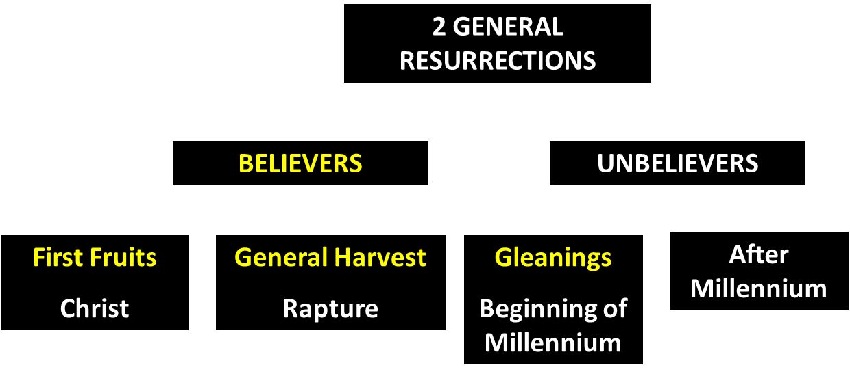
God’s Resurrection Program

Slide 39
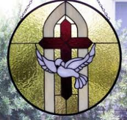
1 Samuel 16:13-14
¹³ Then Samuel took the horn of oil and anointed him in the midst of his brothers; and the Spirit of the Lord came mightily upon David from that day forward. And Samuel arose and went to Ramah. ¹⁴ Now the Spirit of the Lord departed from Saul, and an evil spirit from the Lord terrorized him.

Slide 40
John 14:16-17
¹⁶ I will ask the Father, and He will give you another Helper, that He may be with you forever; ¹⁷ that is the Spirit of truth, whom the world cannot receive, because it does not see Him or know Him, but you know Him because He abides with you and will be in you.

Slide 41
Genesis 26:32-33 Well Discovered
Find (32)
Name (33)

Slide 42
Genesis 12‒25 Abraham’s Early Journeys
Unconditional promises (Gen. 12:1-3) From Haran to Canaan (Gen. 12:4-5) In Canaan (Gen. 12:6-9) In Egypt (Gen. 12:10-20) Abram and Lot Separate (Gen. 13:1-13) Reaffirmation of Abram’s promises (Gen. 13:14-18) Abram Rescues Lot (14:1-24) Abrahamic Covenant (15:1-21) Hagar & Ishmael (16:1-16) Circumcision (Gen. 17:1-27) | Sodom & Gomorrah (Gen. 18‒19) Abraham & Abimelech (Gen. 20) Isaac’s birth (Gen. 21:1-7) Ishmael’s expulsion (21:8-21) Abraham & Abimelech’s covenant (21:22-34) Abraham sacrifices Isaac (22) Sarah’s death (23) Isaac’s marriage (24) Abraham & Keturah (25:1-6) Abraham’s death (25:7-11)

Slide 44
Genesis 26 Chapter Summary
Abrahamic Covenant Reconfirmed (1-5)
Isaac & Abimelech (6-11)
Struggle for the Wells (12-22)
Sojourn in Beersheba (23-25)
Covenant with Abimelech (26-33)
Esau’s Wives (34-35)

Slide 45
VI. Genesis 26:34-35 Esau’s Wives
Esau’s age (34a)
Names of wives (34b)
Impact on Esau’s parents (35)

Slide 46
VI. Genesis 26:34-35 Esau’s Wives
Esau’s age (34a)
Names of wives (34b)
Impact on Esau’s parents (35)

Slide 47
VI. Genesis 26:34-35 Esau’s Wives
Esau’s age (34a)
Names of wives (34b)
Impact on Esau’s parents (35)

Slide 48
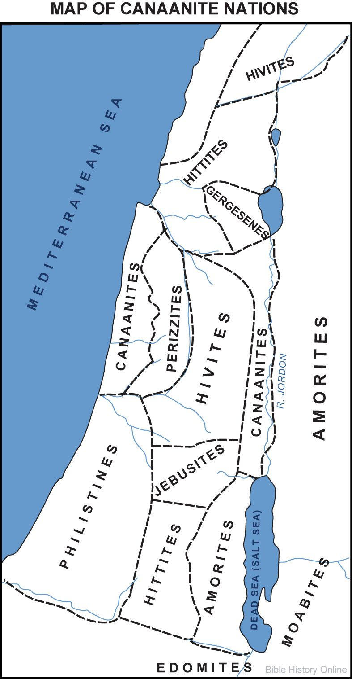

Slide 49
Genesis 15:16
“Then in the fourth generation they will return here, for the wrongdoing of the Amorite is not yet complete.”

Slide 50
Genesis 1:27
“God created man in His own image, in the image of God He created him; male and female He created them.”
Genesis 2:24
“For this reason a man shall leave his father and his mother, and be joined to his wife; and they shall become one flesh.”

Slide 51
VI. Genesis 26:34-35 Esau’s Wives
Esau’s age (34a)
Names of wives (34b)
Impact on Esau’s parents (35)

Slide 52
Dr. Arnold G. Fruchtenbaum
The Book of Genesis, 417
“Genesis 26:35 tells about the effect on his parents of Esau’s marriage to foreign wives: They were a grief of mind unto Isaac and to Rebekah. In Hebrew, it means a ‘bitterness of feeling’ or a ‘bitterness of spirit.’ Esau’s marriages emphasized his continuing unfaithfulness to the Abrahamic Covenant. Just as the selling of the birthright shows he despised his birthright and its covenant-keeping element, now by the same token the marrying of Hittite wives was a further step downward in his unfaithfulness to the covenant.”

Slide 53
Genesis 12‒25 Abraham’s Early Journeys
Unconditional promises (Gen. 12:1-3) From Haran to Canaan (Gen. 12:4-5) In Canaan (Gen. 12:6-9) In Egypt (Gen. 12:10-20) Abram and Lot Separate (Gen. 13:1-13) Reaffirmation of Abram’s promises (Gen. 13:14-18) Abram Rescues Lot (14:1-24) Abrahamic Covenant (15:1-21) Hagar & Ishmael (16:1-16) Circumcision (Gen. 17:1-27) | Sodom & Gomorrah (Gen. 18‒19) Abraham & Abimelech (Gen. 20) Isaac’s birth (Gen. 21:1-7) Ishmael’s expulsion (21:8-21) Abraham & Abimelech’s covenant (21:22-34) Abraham sacrifices Isaac (22) Sarah’s death (23) Isaac’s marriage (24) Abraham & Keturah (25:1-6) Abraham’s death (25:7-11)

Slide 54
Genesis 24 Isaac’s Marriage
Abraham’s instructions (1-9)
Servant prays (10-14)
Servant meets Rebekah (15-27)
Servant and Laban (28-49)
Betrothal of Isaac & Rebekah (50-60)
Marriage of Isaac & Rebekah (61-67)

Slide 55
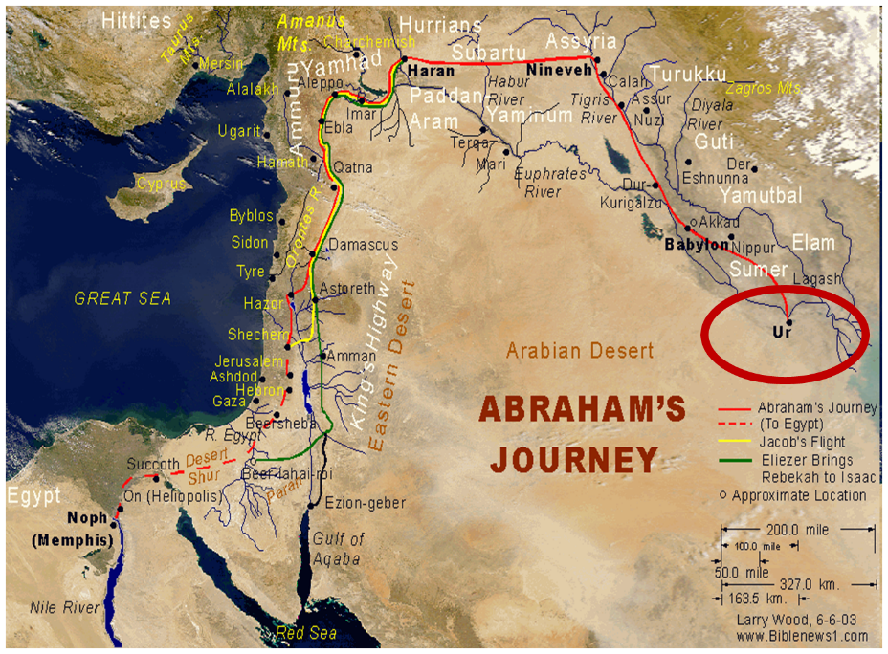

Slide 56
Conclusion

Slide 57
Genesis 26 Chapter Summary
Abrahamic Covenant Reconfirmed (1-5)
Isaac & Abimelech (6-11)
Struggle for the Wells (12-22)
Sojourn in Beersheba (23-25)
Covenant with Abimelech (26-33)
Esau’s Wives (34-35)

Slide 58
V. Genesis 26:26-33 Covenant with Abimelech
Abimelech’s representatives (26)
Isaac’s question (27)
Abimelech’s observation (28-29)
Covenant made (30-31)
Well discovered (32-33)

Slide 59
Genesis 26 Chapter Summary
Abrahamic Covenant Reconfirmed (1-5)
Isaac & Abimelech (6-11)
Struggle for the Wells (12-22)
Sojourn in Beersheba (23-25)
Covenant with Abimelech (26-33)
Esau’s Wives (34-35)

Slide 60
VI. Genesis 26:34-35 Esau’s Wives
Esau’s age (34a)
Names of wives (34b)
Impact on Esau’s parents (35)

Slide 61
GENESIS STRUCTURE
Beginning of the Human race (Gen. 1‒11)
Beginning of the Hebrew race (Gen. 12‒50)

Slide 62
GENESIS STRUCTURE
Genesis 1-11 (four events)
Creation (1-2)
Fall (3-5)
Flood (6-9)
National dispersion (10-11)

Slide 63
GENESIS STRUCTURE
Beginning of the Human race (Gen. 1‒11)
Beginning of the Hebrew race (Gen. 12‒50)

Slide 64
GENESIS STRUCTURE
Genesis 12-50 (four people)
Abraham (12:1–25:11)
Isaac (25:12–26:35)
Jacob (27–36)
Joseph (37–50)

Slide 65
GENESIS STRUCTURE
Genesis 12-50 (four people)
Abraham (12:1–25:11)
Isaac (25:12–26:35)
Jacob (27–36)
Joseph (37–50)

Slide 66
²⁴ The Lord bless you, and keep you; ²⁵ The Lord make His face shine on you, And be gracious to you; ²⁶ The Lord lift up His countenance on you, And give you peace.
Numbers 6:24–26 (NASB95)

