Slide 1
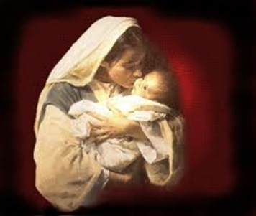

Why Believe in Christ’s Virgin Birth?

Slide 2
Brian McLaren on the Virgin Birth
VIRGIN BIRTH NOT NECESSARILY LITERAL, ONLY A SYMBOL AGAINST PATRIARCHY,
SAYS BRIAN MCLAREN – BY JOSHUA ARNOLD – DECEMBER 11, 2018
“science-defying miracle that proved something about Jesus…This approach never really worked for me. How can you use something you can’t prove—a virgin birth long ago—to prove something else—the unique identity of Jesus?” The Virgin Birth’s “greatest value isn’t in proving something, but in meaning something…I’m going to work directly with women for a change. I’m taking a step to overthrow the patriarchy.” Concerning the “virgin birth story” its “literal factuality” is “not the point.” The virgin birth is “about a profound rejection of violence.”
https://juicyecumenism.com/2018/12/11/virgin-birth-not-literal-symbol-vs-patriarchy-brian-mclaren/

Slide 3

Andy Stanley
ANDY STANLEY’S APPROACH TO THE VIRGIN BIRTH – DECEMBER 27, 2016 GERALD HARRIS
“…but if somebody can predict their own death and resurrection, I’m not all that concerned about how they got into the world, because the whole resurrection thing is so amazing and, in fact, you should know this. Christianity does not hinge on the truth or even the stories about the birth of Jesus, it really hinges on the resurrection of Jesus.”
https://christianindex.org/andy-stanleys-approach-to-the-virgin-birth/

Slide 4


Slide 5

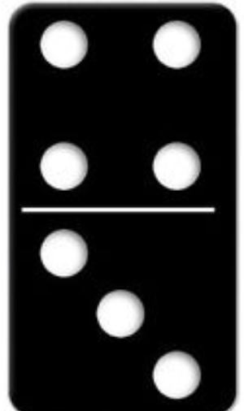
Why the Virgin Birth?
To fulfill OT prophecy
To emphasize Christ’s humanity and deity
To emphasize Christ’s eternality
To maintain Christ’s sinlessness
To protect the bodily atonement
To circumvent the curse of Jeconiah
To vindicate the NT

Slide 6
Why the Virgin Birth?
To fulfill OT prophecy
To emphasize Christ’s humanity and deity
To emphasize Christ’s eternality
To maintain Christ’s sinlessness
To protect the bodily atonement
To circumvent the curse of Jeconiah
To vindicate the NT

Slide 7

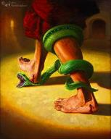
Genesis 3:15
“And I will put enmity Between you and the woman, And between your seed and her seed; He shall bruise you on the head, And you shall bruise him on the heel.”

Slide 8
Genesis 3:15
“And I will put enmity Between you and the woman, And between your seed and her seed; He shall bruise you on the head, And you shall bruise him on the heel.”

Slide 9
Isaiah 7:13-14
“Then he said, “Listen now, O house of David! Is it too slight a thing for you to try the patience of men, that you will try the patience of my God as well? ¹⁴ Therefore the Lord Himself will give you a sign: Behold, a virgin [almah] will be with child and bear a son, and she will call His name Immanuel.”
Notes:
700 yrs. Before Christ

Slide 10

Three Arguments Against the Virgin Birth
(Isa. 7:13-14)
The Hebrew word is Betulah and not Almah (Joel 1:8)!
The Hebrew word Almah does not mean virgin!
No relevance to Isaiah’s day!

Slide 11
Three Arguments Against the Virgin Birth
(Isa. 7:13-14)
The Hebrew word is Betulah and not Almah (Joel 1:8)!
The Hebrew word Almah does not mean virgin!
No relevance to Isaiah’s day!

Slide 12
Three Arguments Against the Virgin Birth
(Isa. 7:13-14)
The Hebrew word is Betulah and not Almah (Joel 1:8)!
The Hebrew word Almah does not mean virgin!
No relevance to Isaiah’s day!

Slide 13
To Fulfill Old Testament Prophecy
Almah
  OT uses (Gen 24:43; Exod 2:8; Ps 68:25; Song of Solomon 1:3; 6:8; Prov 30:18-19)
  LXX
  Matthew 1:23

Slide 14
Matthew 1:23
“Behold, the virgin virgin [parthenos] shall be with child and shall bear a Son, and they shall call His name Immanuel,” which translated means, ‘God with us’.”

Slide 15
Three Arguments Against the Virgin Birth
(Isa. 7:13-14)
The Hebrew word is Betulah and not Almah (Joel 1:8)!
The Hebrew word Almah does not mean virgin!
No relevance to Isaiah’s day!

Slide 16

ISAIAH 7 AND 8 DIFFERENCES
Isaiah 7 |  | Isaiah 8
Immanuel |  | Maher-shalal-hash-baz
Blessing |  | Judgment
Born to a virgin |  | Born to Isaiah's wife
Age 12 |  | Age 1-2
Assyrian judgment upon Judah |  | Assyrian judgment upon Syria and Israel

Slide 17
Isaiah 7:13-14
Ahaz’ Day?
  Isaiah 53 in Acts 8:31-35
  Sign (Isa 7:14)
  Two threats (Isa. 7:1-2)
    Shear Jashub (Isa. 7:3)
    David (Isa 7:13)
    From the singular to the plural “you”
  Extended context (Isa 9:6; 11:1-5)

Slide 18
Isaiah 7:13-14
Ahaz’ Day?
  Isaiah 53 in Acts 8:31-35
  Sign (Isa 7:14)
  Two threats (Isa. 7:1-2)
    Shear Jashub (Isa. 7:3)
    David (Isa 7:13)
    From the singular to the plural “you”
  Extended context (Isa 9:6; 11:1-5)

Slide 19
Isaiah 7:13-14
Ahaz’ Day?
  Isaiah 53 in Acts 8:31-35
  Sign (Isa 7:14)
  Two threats (Isa. 7:1-2)
    Shear Jashub (Isa. 7:3)
    David (Isa 7:13)
    From the singular to the plural “you”
  Extended context (Isa 9:6; 11:1-5)

Slide 20
Isaiah 7:13-14
“¹³ Then he said, “Listen now, O house of David! Is it too slight a thing for you to try the patience of men, that you will try the patience of my God as well? ¹⁴ Therefore the Lord Himself will give you a sign: Behold, a virgin will be with child and bear a son, and she will call His name Immanuel.”

Slide 21
Isaiah 7:13-14
Ahaz’ Day?
  Isaiah 53 in Acts 8:31-35
  Sign (Isa 7:14)
  Two threats (Isa. 7:1-2)
    Shear Jashub (Isa. 7:3)
    David (Isa 7:13)
    From the singular to the plural “you”
  Extended context (Isa 9:6; 11:1-5)

Slide 22
Isaiah 7:1-2
“¹ Now it came about in the days of Ahaz, the son of Jotham, the son of Uzziah, king of Judah, that Rezin the king of Aram and Pekah the son of Remaliah, king of Israel, went up to Jerusalem to wage war against it, but could not conquer it. ² When it was reported to the house of David, saying, “The Arameans have camped in Ephraim,” his heart and the hearts of his people shook as the trees of the forest shake with the wind.”

Slide 23
Isaiah 7:13-14
Ahaz’ Day?
  Isaiah 53 in Acts 8:31-35
  Sign (Isa 7:14)
  Two threats (Isa. 7:1-2)
    Shear Jashub (Isa. 7:3)
    David (Isa 7:13)
    From the singular to the plural “you”
  Extended context (Isa 9:6; 11:1-5)

Slide 24
Isaiah 7:13-14
Ahaz’ Day?
  Isaiah 53 in Acts 8:31-35
  Sign (Isa 7:14)
  Two threats (Isa. 7:1-2)
    Shear Jashub (Isa. 7:3)
    David (Isa 7:13)
    From the singular to the plural “you”
  Extended context (Isa 9:6; 11:1-5)

Slide 25
Isaiah 7:13-14
“Then he said, “Listen now, O house of David! Is it too slight a thing for you to try the patience of men, that you will try the patience of my God as well? ¹⁴ Therefore the Lord Himself will give you a sign: Behold, a virgin will be with child and bear a son, and she will call His name Immanuel.”

Slide 26
Isaiah 7:13-14
Ahaz’ Day?
  Isaiah 53 in Acts 8:31-35
  Sign (Isa 7:14)
  Two threats (Isa. 7:1-2)
    Shear Jashub (Isa. 7:3)
    David (Isa 7:13)
    From the singular to the plural “you”
  Extended context (Isa 9:6; 11:1-5)

Slide 27
Isaiah 7:9–17
⁹ “… and the head of Ephraim is Samaria and the head of Samaria is the son of Remaliah. If you [s] will not believe, you [s] surely shall not last.”’” ¹⁰ Then the Lord spoke again to Ahaz, saying, ¹¹ “Ask a sign for yourself [s] from the Lord your God; make it deep as Sheol or high as heaven.” ¹² But Ahaz said, “I will not ask, nor will I test the Lord!” ¹³ Then he said, “Listen now, O house of David! Is it too slight a thing for you [pl] to try the patience of men, that you [pl] will try the patience of my God as well? ¹⁴ “Therefore the Lord Himself will give you [pl] a sign: Behold, a virgin will be with child and bear a son, and she will…

Slide 28
Isaiah 7:9–17
... call His name Immanuel. ¹⁵ “He will eat curds and honey at the time He knows enough to refuse evil and choose good. ¹⁶ “For before the boy will know enough to refuse evil and choose good, the land whose two kings you [s] dread will be forsaken. ¹⁷ “The Lord will bring on you [s], on your people, and on your father’s house such days as have never come since the day that Ephraim separated from Judah, the king of Assyria.”

Slide 29
Isaiah 7:13-14
Ahaz’ Day?
  Isaiah 53 in Acts 8:31-35
  Sign (Isa 7:14)
  Two threats (Isa. 7:1-2)
    Shear Jashub (Isa. 7:3)
    David (Isa 7:13)
    From the singular to the plural “you”
  Extended context (Isa 9:6; 11:1-5)

Slide 30
Isaiah 7:13-14
“Then he said, “Listen now, O house of David! Is it too slight a thing for you to try the patience of men, that you will try the patience of my God as well? ¹⁴ Therefore the Lord Himself will give you a sign: Behold, a virgin will be with child and bear a son, and she will call His name Immanuel.”

Slide 31
Isaiah 9:6-7
“⁶ For a child will be born to us, a son will be given to us; And the government will rest on His shoulders; And His name will be called Wonderful Counselor, Mighty God, Eternal Father, Prince of Peace.⁷ There will be no end to the increase of His government or of peace, On the throne of David and over his kingdom, To establish it and to uphold it with justice and righteousness From then on and forevermore. The zeal of the Lord of hosts will accomplish this.”

Slide 32
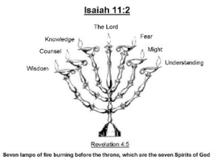
Isaiah 11:2
“The Spirit of the Lord will rest on Him, The spirit of wisdom and understanding, The spirit of counsel and strength, The spirit of knowledge and the fear of the Lord.”

Slide 33
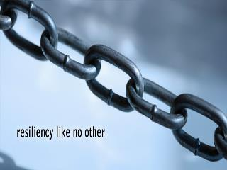
John 10:35
“If he called them gods, to whom the word of God came (and the Scripture cannot be broken).”
Notes:
No virgin birth…no inspiration, no authority of scripture.

Slide 34
Why the Virgin Birth?
To fulfill OT prophecy
To emphasize Christ’s humanity and deity
To emphasize Christ’s eternality
To maintain Christ’s sinlessness
To protect the bodily atonement
To circumvent the curse of Jeconiah
To vindicate the NT

Slide 35
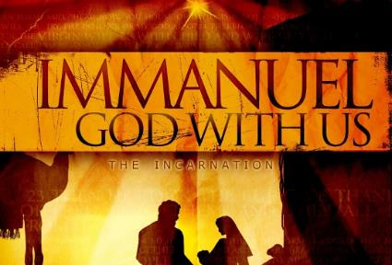
An Important Doctrine
עִמָּנוּאֵל
Incarnation
Hypostatic Union
Unique God-Man
100% God
100% Man

Slide 36
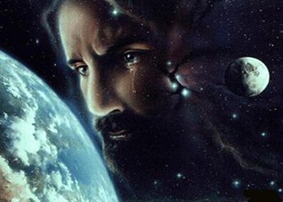
Christ’s Human Experiences
Labor (Mark 6:3)
Distress (Luke 22:44)
Being troubled (John 12:27)
Thirst (John 19:28)
Hunger (Matt 4:2)
Fatigue (John 4:6)
Sadness (John 11:35)
Lack of understanding (Matt 24:36)
Temptation (Luke 4:1-13; Heb. 4:15)

Slide 37
Luke 2:52
“And Jesus kept increasing in wisdom and stature, and in favor with God and men.”
Notes:
Intellectual, physical, spiritual, social growth

Slide 38
John 1:1, 14
“¹In the beginning was the Word, and the Word was with God, and the Word was God…¹⁴And the Word became flesh, and dwelt among us, and we saw His glory, glory as of the only begotten [monogenēs] from the Father, full of grace and truth.”

Slide 39
To Emphasize Christ’s Humanity and Deity
Humanity – Luke 2:52
Deity – John 1:1, 14
Hypostatic Union
Virgin birth emphasizes the unique God/Man
  Born naturally of a woman: humanity
  Born supernaturally of a virgin: deity

Slide 40

Galatians 4:4
“But when the fullness of the time came, God sent forth His Son, born of a woman, born under the Law.”

Slide 41
Why the Virgin Birth?
To fulfill OT prophecy
To emphasize Christ’s humanity and deity
To emphasize Christ’s eternality
To maintain Christ’s sinlessness
To protect the bodily atonement
To circumvent the curse of Jeconiah
To vindicate the NT

Slide 42
To Emphasize Christ’s Eternality
Christ’s preexistence (John 8:56-59)
Nicene Creed
Virgin birth = no beginning point

Slide 43
To Emphasize Christ’s Eternality
Christ’s preexistence (John 8:56-59)
Nicene Creed
Virgin birth = no beginning point

Slide 44

To Emphasize Christ’s Eternality

Slide 45

Lewis Sperry Chafer, Systematic Theology, vol. 1, p. 216; quoting Dr. Samuel Harris, God the Creator and Lord of All, I, 123–24.
Lewis Sperry Chafer
“The eternity of God is involved in His self-existence. He is uncaused. Therefore, He must be without beginning. He transcends the whole chain of causes and effects. Therefore, He can never cease to be.”

Slide 46
To Emphasize Christ’s Eternality
Christ’s preexistence (John 8:56-59)
Nicene Creed
Virgin birth = no beginning point

Slide 47
Nicene Creed
I believe in one God, the Father Almighty, Maker of heaven and earth, and of all things visible and invisible. And in one Lord Jesus Christ, the only-begotten Son of God, begotten of the Father before all worlds; God of God, Light of Light, very God of very God; BEGOTTEN, NOT MADE, being of one substance with the Father, by whom all things were made. Who, for us men and for our salvation, came down from heaven, and was incarnate by the Holy Spirit of the virgin Mary, and was made man; and was crucified also for us under Pontius Pilate; He suffered and was buried; and the third day He rose again, according to the Scriptures; and ascended into heaven, and sits on the right hand of the Father; and He shall come again, with glory, to judge the quick and the dead; whose kingdom shall have no end. And I believe in the Holy Ghost, the Lord and Giver of Life; who proceeds from the Father and the Son; who with the Father and the Son together is worshipped and glorified; who spoke by the prophets. And I believe in one holy catholic and apostolic Church. I acknowledge one baptism for the remission of sins; and I look for the resurrection of the dead, and the life of the world to come. Amen.
Notes:
Arianism’s error

Slide 48
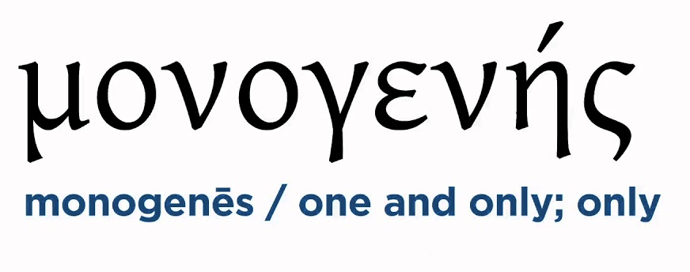
John 1:14
“And the Word became flesh, and dwelt among us, and we saw His glory, glory as of the only begotten [monogenēs] from the Father, full of grace and truth.”

Slide 49
To Emphasize Christ’s Eternality
Christ’s preexistence (John 8:56-59)
Nicene Creed
Virgin birth = no beginning point
Notes:
The uncaused cause…

Slide 50
Why the Virgin Birth?
To fulfill OT prophecy
To emphasize Christ’s humanity and deity
To emphasize Christ’s eternality
To maintain Christ’s sinlessness
To protect the bodily atonement
To circumvent the curse of Jeconiah
To vindicate the NT

Slide 51
To Maintain Christ’s Sinlessness
Christ’s perfection (John 8:46; 1 John 2:1)
Humanity’s sin nature (Ps 51:5) passed down though the man (Rom 5:12)
Virgin birth = Christ had no biological father

Slide 52
To Maintain Christ’s Sinlessness
Christ’s perfection (John 8:46; 1 John 2:1)
Humanity’s sin nature (Ps 51:5) passed down though the man (Rom 5:12)
Virgin birth = Christ had no biological father

Slide 53
To Maintain Christ’s Sinlessness
Christ’s perfection (John 8:46; 1 John 2:1)
Humanity’s sin nature (Ps 51:5) passed down though the man (Rom 5:12)
Virgin birth = Christ had no biological father

Slide 54


Romans 5:12
“Therefore, just as through one man sin entered into the world, and death through sin, and so death spread to all men, because all sinned—.”

Slide 55
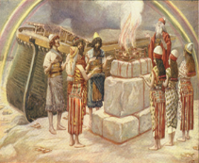
Genesis 8:21
The Lord smelled the soothing aroma; and the Lord said to Himself, “I will never again curse the ground on account of man, for the intent of man’s heart is evil from his youth; and I will never again destroy every living thing, as I have done.[emphasis mine].

Slide 56

Jeremiah 17:9
“The heart is more deceitful than all else And is desperately sick; Who can understand it?.”

Slide 57
Mark 7:20–23
²⁰ And He was saying, “That which proceeds out of the man, that is what defiles the man. ²¹ “For from within, out of the heart of men, proceed the evil thoughts, fornications, thefts, murders, adulteries, ²² deeds of coveting and wickedness, as well as deceit, sensuality, envy, slander, pride and foolishness. ²³ “All these evil things proceed from within and defile the man.”

Slide 58
To Maintain Christ’s Sinlessness
Christ’s perfection (John 8:46; 1 John 2:1)
Humanity’s sin nature (Ps 51:5) passed down though the man (Rom 5:12)
Virgin birth = Christ had no biological father

Slide 59
Why the Virgin Birth?
To fulfill OT prophecy
To emphasize Christ’s humanity and deity
To emphasize Christ’s eternality
To maintain Christ’s sinlessness
To protect the bodily atonement
To circumvent the curse of Jeconiah
To vindicate the NT

Slide 60
To Protect the Bodily Atonement
Eternal God must pay the eternal penalty for man’s sin (Rom 6:23)
A perfect substitute must pay the penalty for man’s sin (Exod. 12:5; 1 Pet 1:19)

Slide 61
To Protect the Bodily Atonement
Eternal God must pay the eternal penalty for man’s sin (Rom 6:23)
A perfect substitute must pay the penalty for man’s sin (Exod. 12:5; 1 Pet 1:19)

Slide 62
To Pay the Penalty for Man’s Sin
Rom. 6:23
Gen. 2:17
Gen. 3:21
Hebrews 2:9

Slide 63
To Protect the Bodily Atonement
Eternal God must pay the eternal penalty for man’s sin (Rom 6:23)
A perfect substitute must pay the penalty for man’s sin (Exod. 12:5; 1 Pet 1:19)
Notes:
Malachi 1:8, 14

Slide 64
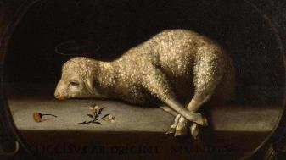
Exodus 12:5
“Your lamb shall be an unblemished male a year old; you may take it from the sheep or from the goats.” (cf. 1 Pet 1:19)

Slide 65
Why the Virgin Birth?
To fulfill OT prophecy
To emphasize Christ’s humanity and deity
To emphasize Christ’s eternality
To maintain Christ’s sinlessness
To protect the bodily atonement
To circumvent the curse of Jeconiah
To vindicate the NT

Slide 66
To Circumvent Jeconiah’s Curse
Jeremiah 22:30
Matthew 1:12
Virgin birth = Christ not an actual descendant of Jeconiah
Luke 3:31

Slide 67
To Circumvent Jeconiah’s Curse
Jeremiah 22:30
Matthew 1:12
Virgin birth = Christ not an actual descendant of Jeconiah
Luke 3:31

Slide 68
To Circumvent Jeconiah’s Curse
Jeremiah 22:30
Matthew 1:12
Virgin birth = Christ not an actual descendant of Jeconiah
Luke 3:31

Slide 69
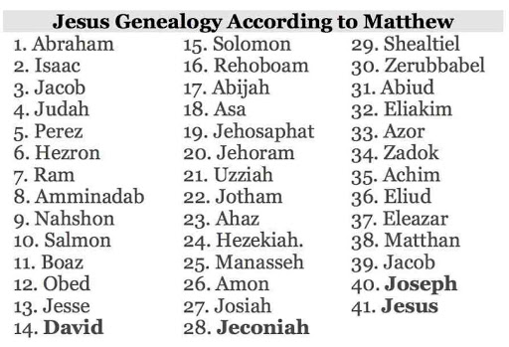

Slide 70
To Circumvent Jeconiah’s Curse
Jeremiah 22:30
Matthew 1:12
Virgin birth = Christ not an actual descendant of Jeconiah
Luke 3:31

Slide 71
To Circumvent Jeconiah’s Curse
Jeremiah 22:30
Matthew 1:12
Virgin birth = Christ not an actual descendant of Jeconiah
Luke 3:31

Slide 73
2 Samuel 7:12-16
“¹² When your days are complete and you lie down with your fathers, I will raise up your descendant after you, who will come forth from you, and I will establish his kingdom. ¹³ He shall build a house for My name, and I will establish the throne of his kingdom forever. ¹⁴ I will be a father to him and he will be a son to Me; when he commits iniquity, I will correct him with the rod of men and the strokes of the . . .

Slide 74
2 Samuel 7:12-16
…sons of men, ¹⁵ but My lovingkindness shall not depart from him, as I took it away from Saul, whom I removed from before you. ¹⁶ Your house and your kingdom shall endure before Me forever; your throne shall be established forever.” ¹⁷ In accordance with all these words and all this vision, so Nathan spoke to David.”

Slide 75
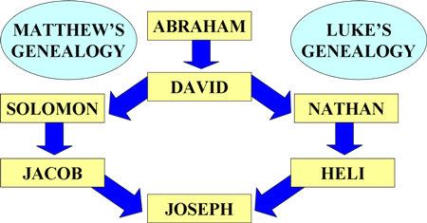
To Circumvent Jeconiah’s Curse

Slide 76
Why the Virgin Birth?
To fulfill OT prophecy
To emphasize Christ’s humanity and deity
To emphasize Christ’s eternality
To maintain Christ’s sinlessness
To protect the bodily atonement
To circumvent the curse of Jeconiah
To vindicate the NT

Slide 77
To Vindicate the NT
Matthew 1:18-25
Luke 1:26-35; 2:1-19
John 8:41

Slide 78
To Vindicate the NT
Matthew 1:18-25
Luke 1:26-35; 2:1-19
John 8:41

Slide 79
To Vindicate the NT
Matthew 1:18-25
Luke 1:26-35; 2:1-19
John 8:41

Slide 80
To Vindicate the NT
Matthew 1:18-25
Luke 1:26-35; 2:1-19
John 8:41

Slide 81
Andy Stanley
ANDY STANLEY’S APPROACH TO THE VIRGIN BIRTH – DECEMBER 27, 2016 GERALD HARRIS
“Maybe the thought is that they had to come up with some myth about the birth of Jesus to give him street cred later on… It is interesting because Matthew gives us a version of the birth of Jesus. Luke does, but Mark and John don’t even mention it; and a lot has been made of that.”
https://christianindex.org/andy-stanleys-approach-to-the-virgin-birth/

Slide 82
Conclusion

Slide 83


Slide 84
Why the Virgin Birth?
To fulfill OT prophecy
To emphasize Christ’s humanity and deity
To emphasize Christ’s eternality
To maintain Christ’s sinlessness
To protect the bodily atonement
To circumvent the curse of Jeconiah
To vindicate the NT

Slide 85

²⁴ The Lord bless you, and keep you; ²⁵ The Lord make His face shine on you, And be gracious to you; ²⁶ The Lord lift up His countenance on you, And give you peace.
Numbers 6:24–26 (NASB95)

