Slide 1
Genesis 12‒50
Israel’s Birth & Preservation

Slide 2
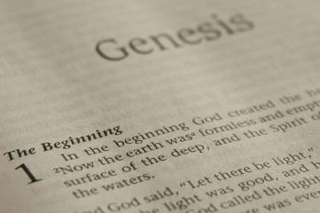
GENESIS STRUCTURE
Beginning of the Human race (Gen. 1‒11)
Beginning of the Hebrew race (Gen. 12‒50)

Slide 3
GENESIS STRUCTURE
Genesis 1-11 (four events)
Creation (1-2)
Fall (3-5)
Flood (6-9)
National dispersion (10-11)

Slide 4
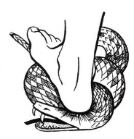
Genesis 3:15
“And I will put enmity Between you and the woman, And between your seed and her seed; He shall bruise you on the head, And you shall bruise him on the heel.”

Slide 5
GENESIS STRUCTURE
Beginning of the Human race (Gen. 1‒11)
Beginning of the Hebrew race (Gen. 12‒50)

Slide 6
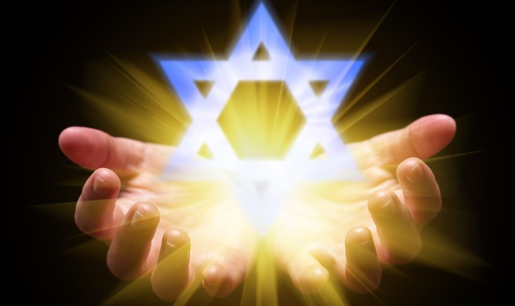
Isaiah 43:1
“But now, thus says the Lord, your Creator, O Jacob, And He who formed you, O Israel, 'Do not fear, for I have redeemed you; I have called you by name; you are Mine!'”

Slide 7
GENESIS STRUCTURE
Genesis 12-50 (four people)
Abraham (12:1–25:11)
Isaac (25:12–26:35)
Jacob (27–36)
Joseph (37–50)

Slide 8
Genesis 26 Chapter Summary
Abrahamic Covenant Reconfirmed (1-5)
Isaac & Abimelech (6-11)
Struggle for the Wells (12-22)
Sojourn in Beersheba (23-25)
Covenant with Abimelech (26-33)
Esau’s Wives (34-35)

Slide 9
IV. Genesis 26:23-25 Sojourn in Beersheba
Isaac’s journey (23)
Isaac’s covenant (24)
Isaac’s response (25)

Slide 10
IV. Genesis 26:23-25 Sojourn in Beersheba
Isaac’s journey (23)
Isaac’s covenant (24)
Isaac’s response (25)

Slide 11
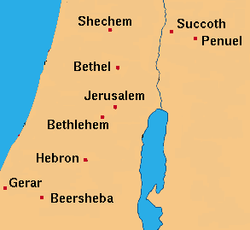

Slide 12
IV. Genesis 26:23-25 Sojourn in Beersheba
Isaac’s journey (23)
Isaac’s covenant (24)
Isaac’s response (25)

Slide 13
Genesis 26:24 Isaac’s Covenant
God’s appearance (24a)
God’s identification (24b)
God’s admonition (24c)
God’s blessing (24d)
God’s basis (24e)

Slide 14
Genesis 26:24 Isaac’s Covenant
God’s appearance (24a)
God’s identification (24b)
God’s admonition (24c)
God’s blessing (24d)
God’s basis (24e)

Slide 15
Romans 1:18–20
¹⁸ For the wrath of God is revealed from heaven against all ungodliness and unrighteousness of men who suppress the truth in unrighteousness, ¹⁹ because that which is known about God is evident within them; for God made it evident to them. ²⁰ For since the creation of the world His invisible attributes, His eternal power and divine nature, have been clearly seen, being understood through what has been made, so that they are without excuse.

Slide 16
2 Timothy 3:16-17
“All Scripture is inspired by God [theópneustos] and profitable for teaching, for reproof, for correction, for training in righteousness; so that the man of God may be adequate, equipped for every good work.”
Notes:
hapaxlegomena

Slide 17
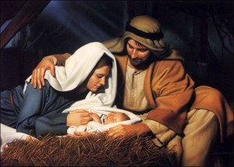
John 1:14
“And the Word became flesh, and dwelt among us, and we saw His glory, glory as of the only begotten [monogenēs] from the Father, full of grace and truth.”

Slide 18
8 New Promises Genesis 12:1-3
Land (Gen. 12:1b)
Great nation (Gen. 12:2a)
Personal blessing (Gen. 12:2b)
Great name (Gen. 12:2c)
Blessing to others (Gen. 12:2d)
Blessing to blessers (Gen. 12:3a)
Cursing to cursers (Gen. 12:3b)
Blessing to the world (Gen. 12:3c)

Slide 19
Dr. Arnold G. Fruchtenbaum
The Book of Genesis, 240
“This is the first of seven times that Abraham receives a direct revelation from God. In 12:1–3 is God’s initial call to Abram outside the Land of Canaan; in 12:7 is the first appearance to Abraham in the Land; in 13:14–17, Abraham encounters God after the separation of Lot; in 15:1–21, God signs and seals the Abrahamic Covenant; in 17:1–21, Abraham receives the token of the covenant; in 18:1–33, God speaks to him in conjunction with the destruction of Sodom; and in 22:1–2 and 22:11–18, God directs Abraham to offer Isaac.”

Slide 20
Genesis 26:24 Isaac’s Covenant
God’s appearance (24a)
God’s identification (24b)
God’s admonition (24c)
God’s blessing (24d)
God’s basis (24e)

Slide 21
Genesis 26:24 Isaac’s Covenant
God’s appearance (24a)
God’s identification (24b)
God’s admonition (24c)
God’s blessing (24d)
God’s basis (24e)

Slide 22
Genesis 26:24c God’s Admonition
Command
Reason

Slide 23
Genesis 26:24c God’s Admonition
Command
Reason

Slide 24
Genesis 26 Chapter Summary
Abrahamic Covenant Reconfirmed (1-5)
Isaac & Abimelech (6-11)
Struggle for the Wells (12-22)
Sojourn in Beersheba (23-25)
Covenant with Abimelech (26-33)
Esau’s Wives (34-35)

Slide 25
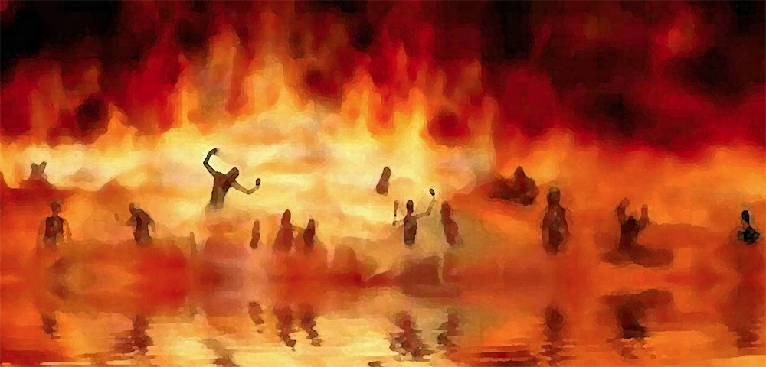
Revelation 21:8
“But for the cowardly and unbelieving and abominable and murderers and immoral persons and sorcerers and idolaters and all liars, their part will be in the lake that burns with fire and brimstone, which is the second death.”

Slide 26
Genesis 26:24c God’s Admonition
Command
Reason

Slide 27
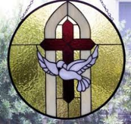
1 Samuel 16:13-14
¹³ Then Samuel took the horn of oil and anointed him in the midst of his brothers; and the Spirit of the Lord came mightily upon David from that day forward. And Samuel arose and went to Ramah. ¹⁴ Now the Spirit of the Lord departed from Saul, and an evil spirit from the Lord terrorized him.

Slide 28
John 14:16-17
¹⁶ I will ask the Father, and He will give you another Helper, that He may be with you forever; ¹⁷ that is the Spirit of truth, whom the world cannot receive, because it does not see Him or know Him, but you know Him because He abides with you and will be in you.

Slide 29
Genesis 26:24 Isaac’s Covenant
God’s appearance (24a)
God’s identification (24b)
God’s admonition (24c)
God’s blessing (24d)
God’s basis (24e)

Slide 30
Genesis 26:24d God’s Blessings
Bless you
Multiply descendants

Slide 31
Genesis 26:24d God’s Blessings
Bless you
Multiply descendants

Slide 32
8 New Promises Genesis 12:1-3
Land (Gen. 12:1b)
Great nation (Gen. 12:2a)
Personal blessing (Gen. 12:2b)
Great name (Gen. 12:2c)
Blessing to others (Gen. 12:2d)
Blessing to blessers (Gen. 12:3a)
Cursing to cursers (Gen. 12:3b)
Blessing to the world (Gen. 12:3c)

Slide 33
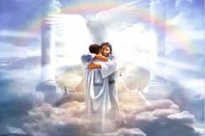
Ephesians 1:3
“Blessed be the God and Father of our Lord Jesus Christ, who has blessed us with every spiritual blessing in the heavenly places in Christ.”

Slide 35
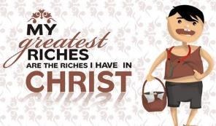
Revelation 2:9
“I know your tribulation and your poverty (but you are rich), and the blasphemy by those who say they are Jews and are not, but are a synagogue of Satan.”

Slide 36
Genesis 26:24d God’s Blessings
Bless you
Multiply descendants

Slide 37
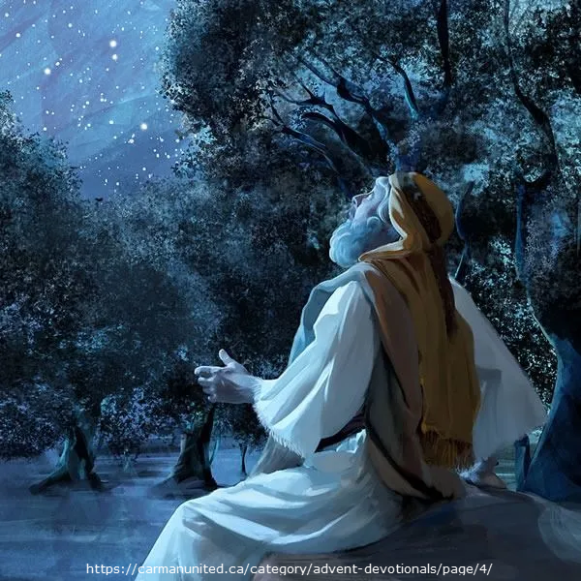
Galatians 3:16
“Now the promises were spoken to Abraham and to his seed. He does not say, “And to seeds,” as referring to many, but rather to one, “And to your seed,” that is, Christ.”

Slide 38
Genesis 3:15
“And I will put enmity Between you and the woman, And between your seed and her seed; He shall bruise you on the head, And you shall bruise him on the heel.”

Slide 39
Genesis 26:24 Isaac’s Covenant
God’s appearance (24a)
God’s identification (24b)
God’s admonition (24c)
God’s blessing (24d)
God’s basis (24e)

Slide 40
Evidence of Abrahamic Covenant’s Unconditional Nature
ANE covenant ratification ceremony (Gen 15)
Lack of stated conditions for Israel’s obedience (Gen 15)
Covenant's eternality (Gen 17:7, 13, 19; Ps. 90:2)
Covenant's immutability (Heb 6:13-18; Mal. 3:6)
Trans-generational reaffirmation despite perpetual national disobedience (Jer 31:35-37)
Walvoord, The Millennial Kingdom, 149-52

Slide 42
IV. Genesis 26:23-25 Sojourn in Beersheba
Isaac’s journey (23)
Isaac’s covenant (24)
Isaac’s response (25)

Slide 43
Genesis 26:25 Isaac’s Response
Built (25a)
Called (25b)
Pitched (25c)
Dug (25d)

Slide 44
Genesis 26:25 Isaac’s Response
Built (25a)
Called (25b)
Pitched (25c)
Dug (25d)

Slide 45
Genesis 26:25 Isaac’s Response
Built (25a)
Called (25b)
Pitched (25c)
Dug (25d)

Slide 47
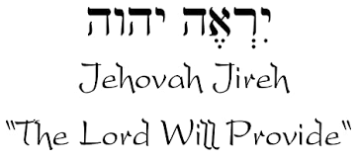

Slide 48
Acts 4:12
“And there is salvation in no one else; for there is no other name under heaven that has been given among men by which we must [dei] be saved.”

Slide 49
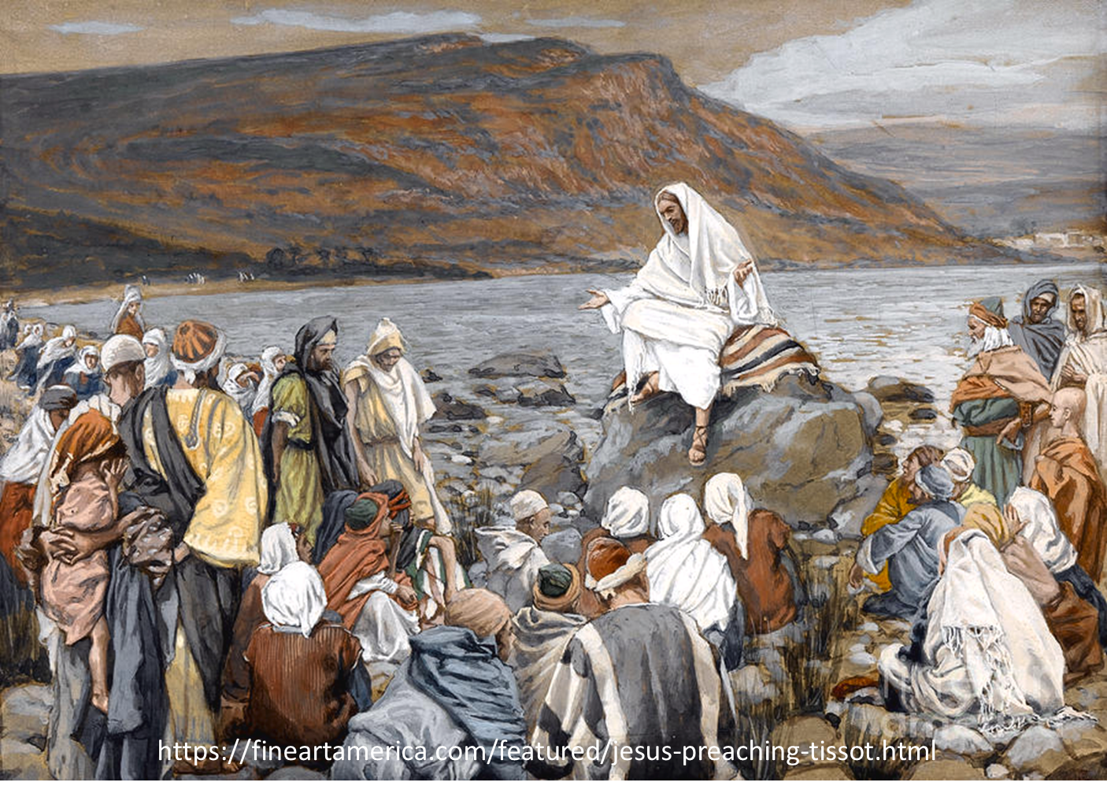
Luke 4:43
“But He said to them, “I must [dei] preach the kingdom of God to the other cities also, for I was sent for this purpose.”

Slide 50
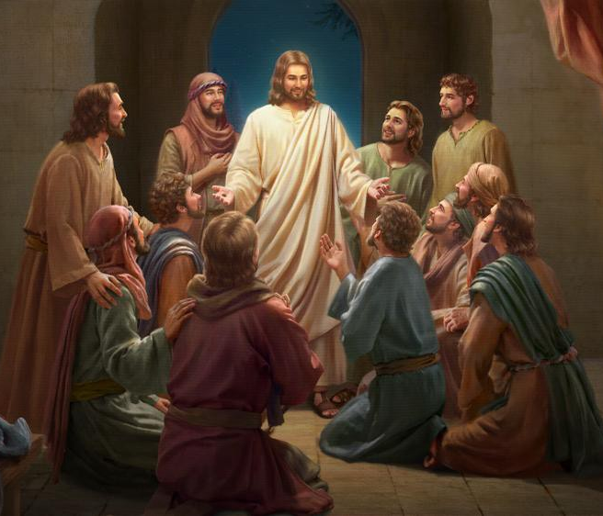
Luke 24:44
“Now He said to them, “These are My words which I spoke to you while I was still with you, that all things which are written about Me in the Law of Moses and the Prophets and the Psalms must [dei] be fulfilled.”

Slide 51
“…one of the mistakes that human beings make is believing that there is only one way…We don’t accept that there are diverse ways of being in the world; that there are millions of ways to be a human being. And many ways…many paths to what you call God. That her path might be something else and when she gets there she might call it the light. But her loving, and her kindness, and her generosity brings her to the…same point that it brings you…
www.youtube.com/watch?v=Lb2RUpMDk34

Slide 52
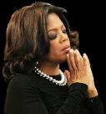
…It doesn’t matter whether she called it ‘God’ along the way or not…There couldn’t possibly be just one way!…There couldn’t possibly be only one way with millions of people in the world!...You think…if you are somewhere on the planet and you never hear the name of Jesus but yet you live with a loving heart. You lived as Jesus would have had you to live. You lived for the same purpose as Jesus came to the planet to teach us all, but you are in some remote part of the earth and you never heard the name of Jesus. You cannot get to Heaven…?”
www.youtube.com/watch?v=Lb2RUpMDk34

Slide 53
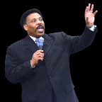
Tony Evans
Totally Saved: Understanding, Experiencing and Enjoying the
Greatness of Your Salvation (Chicago: Moody, 2002), 355, 359.
“In a class I once taught at Dallas Seminary, I inadvertently asked an exam question on material I had not covered in class. One of the students brought this discrepancy to my attention. To be fair, I had to rescore all of the test papers because I could not hold the students liable for information they had never been given…So the premise is that God will not hold people accountable for a decision they cannot make, based on information they have not received…And people in faraway lands who have never heard the gospel still have their own sins to answer for. This means we need to talk about the provision God has made for those who cannot believe….Here's the spiritual principle at work: When people respond to what they do know of God, He takes personal responsibility for giving them more information about Himself.... In the case of a person…

Slide 54
Tony Evans
Totally Saved: Understanding, Experiencing and Enjoying the
Greatness of Your Salvation (Chicago: Moody, 2002), 355, 359.
…who never hears the gospel and never knows the name of Jesus, but who responds to the light he has, God, treats that person like an Old Testament saint, if you will. That is, if the person trusts in what God has revealed, God deals with that person based on the knowledge he has, not the information he never received. I call this trans-dispensationalism...By this I mean if a person is sincerely seeking God and desiring to know Him, and is responding to the truth he knows, if there is no missionary or direct manifestation of God, then God judges that person based on his faith in the light he has received. And as in the case of Abraham, God will retroactively count this person as righteous by applying the death of Christ from the dispensation of grace.”

Slide 55
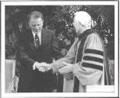
Hl9Aps://www.youtube.com/watch?v=hrf60-zHl9A
Dr. Schuller: "Tell me, what is the future of Christianity?"
Dr. Graham: "Well, Christianity and being a true believer, you know, I think there's the body of Christ which comes from all the Christian groups around the world, or outside the Christian groups. I think that everybody that loves Christ or knows Christ, whether they're conscious of it or not, they're members of the body of Christ. And I don't think that we're going to see a great sweeping revival that will turn the whole world to Christ at any time…and that’s what God is doing today. He is calling people out of the world for His name. Whether they come from the Muslim world, or the Buddhist world, or the Christian world, or the non-believing world, they are members of the body of Christ because they've been called . . .

Slide 56
Hl9Aps://www.youtube.com/watch?v=hrf60-zHl9A
…by God. They may not even know the name of Jesus, but they know in their hearts they need something that they don't have and they turn to the only light that they have and I think they're saved and they're going to be with us in heaven.”
Dr. Schuller: "This is fantastic. I'm so thrilled to hear you say that. There's a wideness in God's mercy.”
Dr. Graham: “There is."

Slide 57
Genesis 26:25 Isaac’s Response
Built (25a)
Called (25b)
Pitched (25c)
Dug (25d)

Slide 58
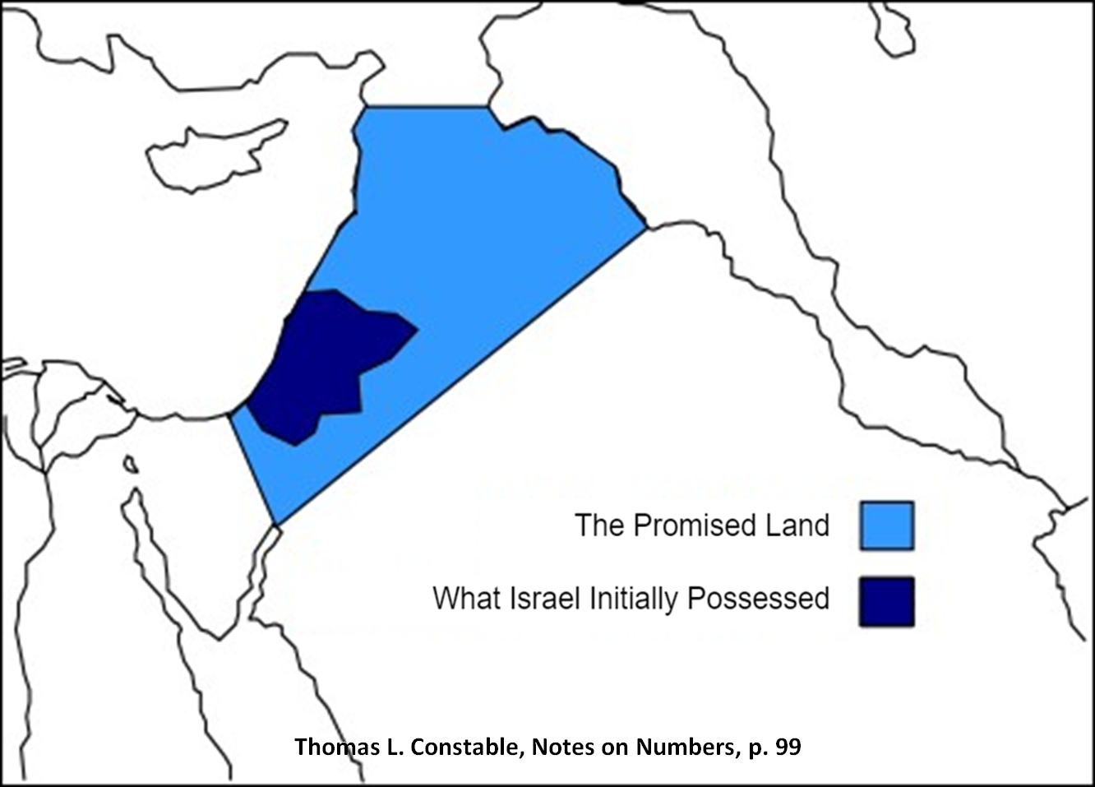

Slide 59
Genesis 26:25 Isaac’s Response
Built (25a)
Called (25b)
Pitched (25c)
Dug (25d)

Slide 60
1 Corinthians 15:20-23
“²⁰-But now Christ has been raised from the dead, the first fruits of those who are asleep. ²¹-For since by a man came death, by a man also came the resurrection of the dead. ²²-For as in Adam all die, so also in Christ all will be made alive. ²³-But each in his own order: Christ the first fruits, after that those who are Christ’s at His coming.”

Slide 61
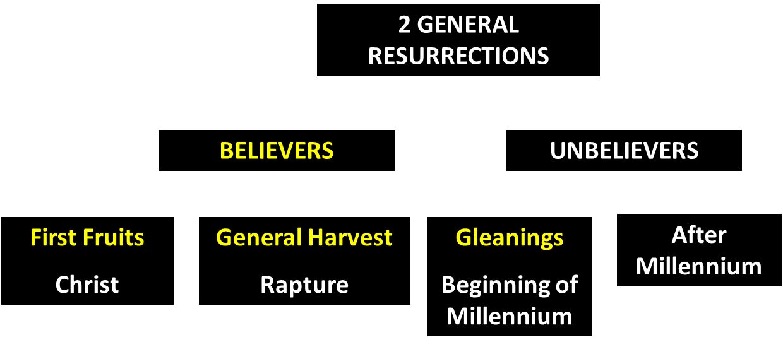
God’s Resurrection Program

Slide 62
Conclusion

Slide 63
Genesis 26 Chapter Summary
Abrahamic Covenant Reconfirmed (1-5)
Isaac & Abimelech (6-11)
Struggle for the Wells (12-22)
Sojourn in Beersheba (23-25)
Covenant with Abimelech (26-33)
Esau’s Wives (34-35)

Slide 64
IV. Genesis 26:23-25 Sojourn in Beersheba
Isaac’s journey (23)
Isaac’s covenant (24)
Isaac’s response (25)

Slide 65
Genesis 26 Chapter Summary
Abrahamic Covenant Reconfirmed (1-5)
Isaac & Abimelech (6-11)
Struggle for the Wells (12-22)
Sojourn in Beersheba (23-25)
Covenant with Abimelech (26-33)
Esau’s Wives (34-35)

Slide 66
²⁴ The Lord bless you, and keep you; ²⁵ The Lord make His face shine on you, And be gracious to you; ²⁶ The Lord lift up His countenance on you, And give you peace.
Numbers 6:24–26 (NASB95)

