Slide 1
Dr. Andy Woods
Senior Pastor – Sugar Land Bible Church
President – Chafer Theological Seminary

Slide 2
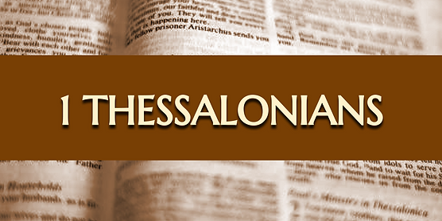
Introductory Matters
Authorship |  | Occasion
Recipients |  | Structure
Place of writing |  | Unique characteristics
Date |  | Purpose
Audience |  | Message

Slide 3
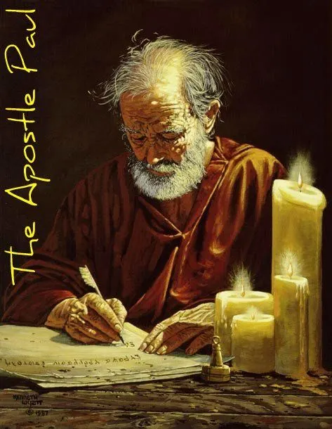
Structure
1 THESSALONIANS 1-3 | 1 THESSALONIANS 4-5
Personal Experience | Practical Exhortation
Looking Back | Looking Forward

Slide 4
Structure
Personal (1–3)
Genuine conversion (1)
Impure motives (2:1-16)
Lack of concern (2:17–3:13)
Practical (4–5)
Immorality (4:1-8)
Laziness (4:9-12)
Eschatology (4:13–5:11)
Ministry imbalances (5:12-15)
Progressive sanctification (5:16-28)

Slide 5
Lack of Concern? (2:17–3:13)
Paul’s plan to visit (2:17-18)
Paul’s concern for their glorification (2:19-20)
Timothy’s visit (3:1-5)
Relief at Timothy’s report (3:6-10)
Paul’s prayer (3:11-13)

Slide 6
Lack of Concern? (2:17–3:13)
Paul’s plan to visit (2:17-18)
Paul’s concern for their glorification (2:19-20)
Timothy’s visit (3:1-5)
Relief at Timothy’s report (3:6-10)
Paul’s prayer (3:11-13)

Slide 7
Lack of Concern? (2:17–3:13)
Paul’s plan to visit (2:17-18)
Paul’s concern for their glorification (2:19-20)
Timothy’s visit (3:1-5)
Relief at Timothy’s report (3:6-10)
Paul’s prayer (3:11-13)

Slide 8
SCRIPTURE’S FIVE CROWNS (Rev 4:10: 3:11; 2 John 8) | SCRIPTURE’S FIVE CROWNS (Rev 4:10: 3:11; 2 John 8)
Scripture | Crown | Purpose
1 Cor. 9:24-27 | Incorruptible | Gaining mastery over the flesh
1 Thess. 2:19-20 | Rejoicing | Soul winning
Jas. 1:12; Rev. 2:10 | Life | Enduring trials
1 Pet. 5:2-4 | Glory | Shepherding God’s people
2 Tim. 4:8 | Righteousness | Longing for His appearing

Slide 9
1 Corinthians 9:24-27
“²⁴ Do you not know that those who run in a race all run, but only one receives the prize? Run in such a way that you may win. ²⁵ Everyone who competes in the games exercises self-control in all things. They then do it to receive a perishable wreath, but we an imperishable. ²⁶ Therefore I run in such a way, as not without aim; I box in such a way, as not beating the air; ²⁷ but I discipline my body and make it my slave, so that, after I have preached to others, I myself will not be disqualified.”

Slide 10
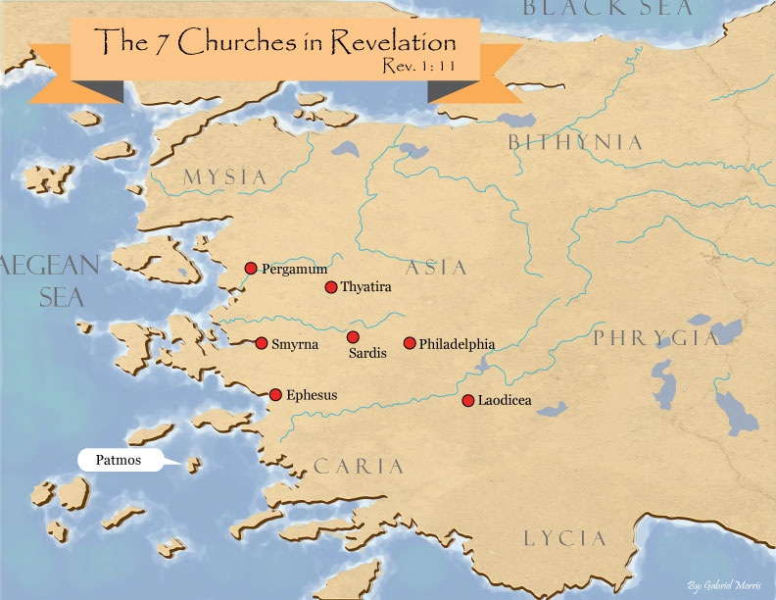

Slide 11
Unique Characteristics
Every chapter ends with a reference to the Second Advent
Small amount of time in between planting of the church and the first letter to the church

Slide 12
Lack of Concern? (2:17–3:13)
Paul’s plan to visit (2:17-18)
Paul’s concern for their glorification (2:19-20)
Timothy’s visit (3:1-5)
Relief at Timothy’s report (3:6-10)
Paul’s prayer (3:11-13)

Slide 13
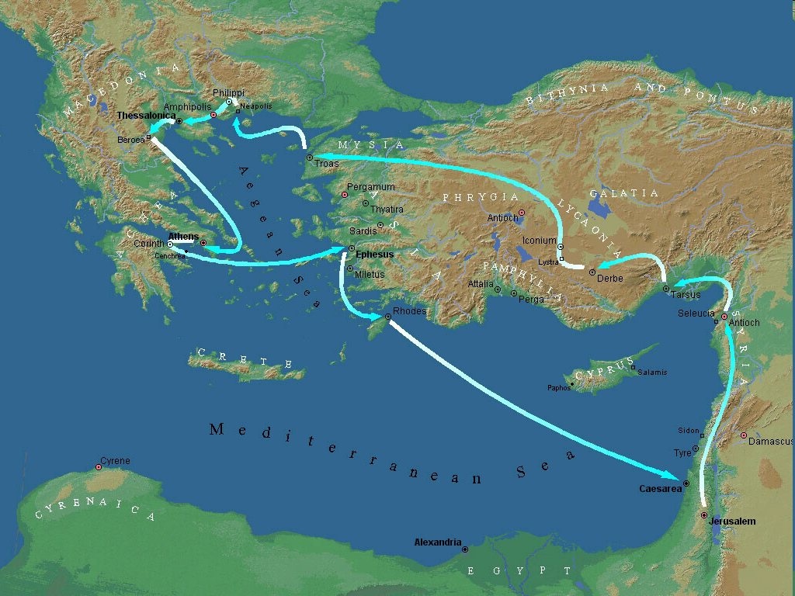
Second Missionary Journey

Slide 14
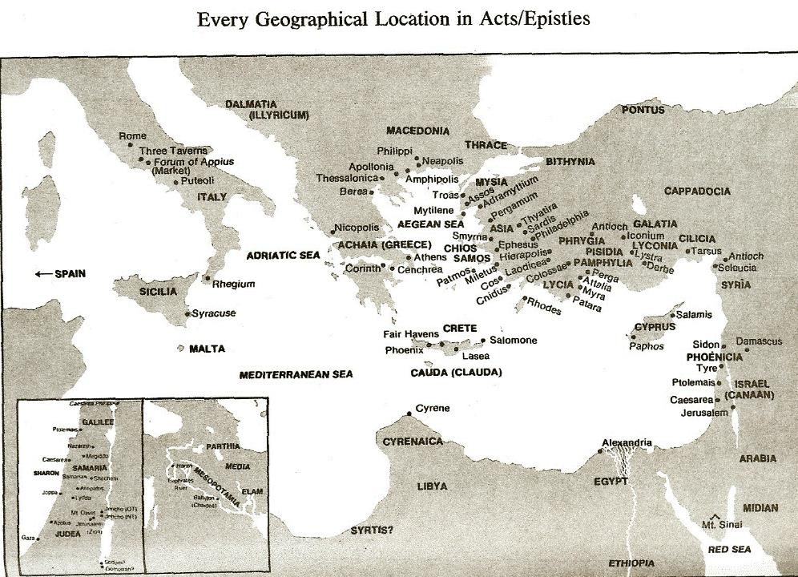

Slide 15
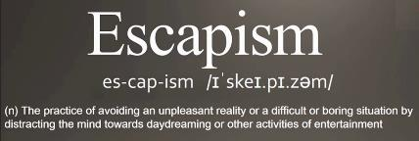
Pretribulationism is not Escapism
Trials (John 16:33)
Man’s wrath (2 Tim 3:12)
Satan’s wrath (Eph 6:11-12)
World’s wrath (John 15:18-19)

Slide 16
John 13:19; 14:29
“^{13:19} From now on I am telling you before it comes to pass, so that when it does occur, you may believe that I am He… ^{14:29} Now I have told you before it happens, so that when it happens, you may believe.”

Slide 17
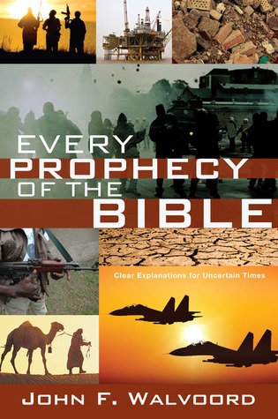

Slide 18
Three Tenses of Salvation
Phase | Justification | Sanctification | Glorification
Tense | Past | Present | Future
Saved from sin’s: | Penalty | Power | Presence
Scripture | Eph 2:8-9; Titus 3:5 | Philip 2:12 | Rom 5:10

Slide 19
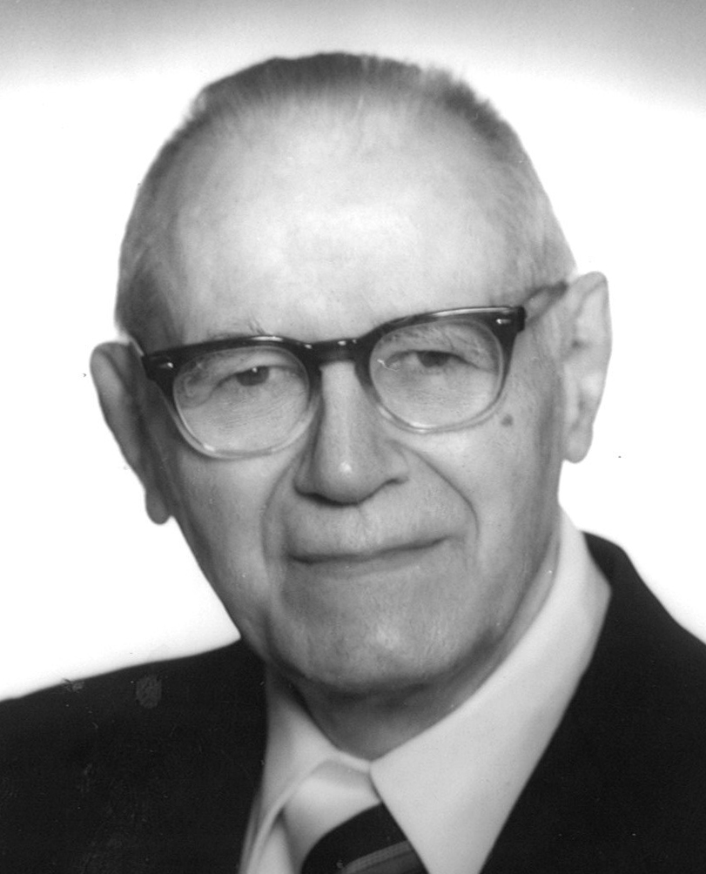
William Hendriksen
A Commentary on the Gospel of John, 3d ed.
(London: Banner of Truth Trust, 1964), p. 127.
“Many trusted in His name; i.e., because of the manner in which his power was displayed they accepted him as a great prophet and perhaps even as the Messiah. This, however, is not the same as saying that they surrendered their hearts to him. Not all faith is saving faith...”

Slide 20
1 Corinthians 3:10-15
“¹⁰ According to the grace of God which was given to me, like a wise master builder I laid a foundation, and another is building on it. But each man must be careful how he builds on it. ¹¹ For no man can lay a foundation other than the one which is laid, which is Jesus Christ. ¹² Now if any man builds on the foundation with gold, silver, precious stones, wood, hay, straw…”

Slide 21
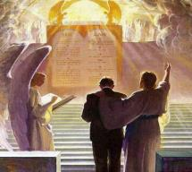
1 Corinthians 3:10-15
“¹⁴ If any man’s work which he has built on it remains, he will receive a reward. ¹⁵ If any man’s work is burned up, he will suffer loss; but he himself will be saved, yet so as through fire.”

Slide 22
SCRIPTURE’S FIVE CROWNS (Rev 4:10: 3:11; 2 John 8) | SCRIPTURE’S FIVE CROWNS (Rev 4:10: 3:11; 2 John 8)
Scripture | Crown | Purpose
1 Cor. 9:24-27 | Incorruptible | Gaining mastery over the flesh
1 Thess. 2:19-20 | Rejoicing | Soul winning
Jas. 1:12; Rev. 2:10 | Life | Enduring trials
1 Pet. 5:2-4 | Glory | Shepherding God’s people
2 Tim. 4:8 | Righteousness | Longing for His appearing

Slide 23
1 Corinthians 9:24-27
“²⁴ Do you not know that those who run in a race all run, but only one receives the prize? Run in such a way that you may win. ²⁵ Everyone who competes in the games exercises self-control in all things. They then do it to receive a perishable wreath, but we an imperishable. ²⁶ Therefore I run in such a way, as not without aim; I box in such a way, as not beating the air; ²⁷ but I discipline my body and make it my slave, so that, after I have preached to others, I myself will not be disqualified.”

Slide 25
Conclusion

Slide 26
Lack of Concern? (2:17–3:13)
Paul’s plan to visit (2:17-18)
Paul’s concern for their glorification (2:19-20)
Timothy’s visit (3:1-5)
Relief at Timothy’s report (3:6-10)
Paul’s prayer (3:11-13)

