Slide 1
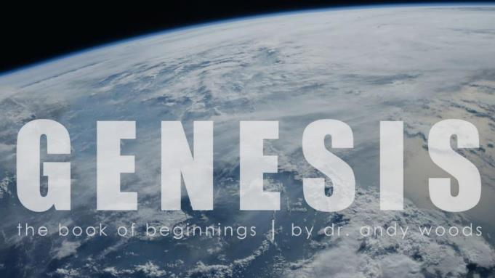
Genesis 12‒50
Israel’s Birth & Preservation

Slide 2
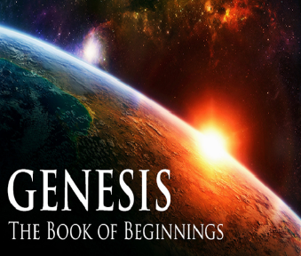
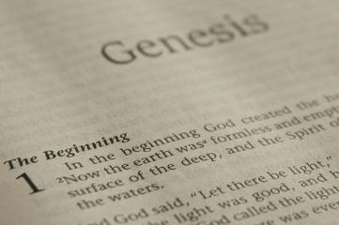
GENESIS STRUCTURE
Beginning of the Human race (Gen. 1‒11)
Beginning of the Hebrew race (Gen. 12‒50)

Slide 3
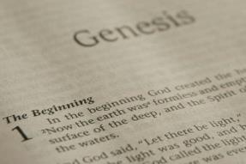
GENESIS STRUCTURE
Genesis 1-11 (four events)
Creation (1-2)
Fall (3-5)
Flood (6-9)
National dispersion (10-11)

Slide 4
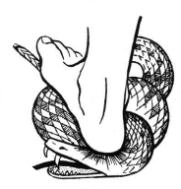
Genesis 3:15
“And I will put enmity Between you and the woman, And between your seed and her seed; He shall bruise you on the head, And you shall bruise him on the heel.”

Slide 5
GENESIS STRUCTURE
Beginning of the Human race (Gen. 1‒11)
Beginning of the Hebrew race (Gen. 12‒50)

Slide 6
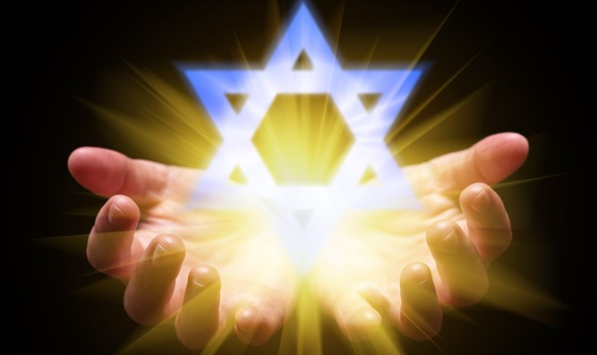
Isaiah 43:1
“But now, thus says the Lord, your Creator, O Jacob, And He who formed you, O Israel, 'Do not fear, for I have redeemed you; I have called you by name; you are Mine!'”

Slide 7
GENESIS STRUCTURE
Genesis 12-50 (four people)
Abraham (12:1–25:11)
Isaac (25:12–26:35)
Jacob (27–36)
Joseph (37–50)

Slide 8
Genesis 26 Chapter Summary
Abrahamic Covenant Reconfirmed (1-5)
Isaac & Abimelech (6-11)
Struggle for the Wells (12-22)
Sojourn in Beersheba (23-25)
Covenant with Abimelech (26-33)
Esau’s Wives (34-35)

Slide 9
III. Genesis 26:12-22 Struggle for the Wells
Isaac’s prosperity (12-14a)
Philistines’ response (14b-15)
Abimelech’s request (16)
Isaac’s departure (17)
Struggle for the wells (18-22)

Slide 10
III. Genesis 26:12-22 Struggle for the Wells
Isaac’s prosperity (12-14a)
Philistines’ response (14b-15)
Abimelech’s request (16)
Isaac’s departure (17)
Struggle for the wells (18-22)

Slide 11
Genesis 26:12-14a Isaac’s Prosperity
Produce (12)
Greatness (13)
Possessions (14a)

Slide 12
Genesis 26:12-14a Isaac’s Prosperity
Produce (12)
Greatness (13)
Possessions (14a)

Slide 13
Dr. Henry M. Morris
The Genesis Record, 422
“In verse 12 occurs the first mention of seed-sowing in the Bible, along with the information that the Lord blessed it with a hundredfold increase. Seed-sowing is frequently used in the New Testament as symbolic of witnessing; and it is noteworthy that the first mention is in the familiar parable of the sower, in which the good seed likewise brought forth a hundredfold (Matthew 13:23).”

Slide 14
Genesis 26:12-14a Isaac’s Prosperity
Produce (12)
Greatness (13)
Possessions (14a)

Slide 15
Genesis 26:12-14a Isaac’s Prosperity
Produce (12)
Greatness (13)
Possessions (14a)

Slide 16
8 New Promises Genesis 12:1-3
Land (Gen. 12:1b)
Great nation (Gen. 12:2a)
Personal blessing (Gen. 12:2b)
Great name (Gen. 12:2c)
Blessing to others (Gen. 12:2d)
Blessing to blessers (Gen. 12:3a)
Cursing to cursers (Gen. 12:3b)
Blessing to the world (Gen. 12:3c)

Slide 17
Evidence of Abrahamic Covenant’s Unconditional Nature
ANE covenant ratification ceremony (Gen 15)
Lack of stated conditions for Israel’s obedience (Gen 15)
Covenant's eternality (Gen 17:7, 13, 19; Ps. 90:2)
Covenant's immutability (Heb 6:13-18; Mal. 3:6)
Trans-generational reaffirmation despite perpetual national disobedience (Jer 31:35-37)
Walvoord, The Millennial Kingdom, 149-52

Slide 18
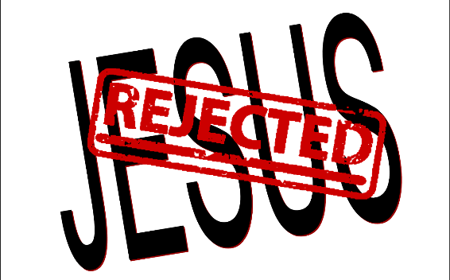
2 Timothy 2:11-13
“It is a trustworthy statement: For if we died with Him, we will also live with Him; ¹² If we endure, we will also reign with Him; If we deny Him, He also will deny us; ¹³ If we are faithless, He remains faithful, for He cannot deny Himself.”

Slide 19
III. Genesis 26:12-22 Struggle for the Wells
Isaac’s prosperity (12-14a)
Philistines’ response (14b-15)
Abimelech’s request (16)
Isaac’s departure (17)
Struggle for the wells (18-22)

Slide 20
Genesis 26:14b-15 Philistines’ Response
Internal (14b)
External (15)

Slide 21
Genesis 26:14b-15 Philistines’ Response
Internal (14b)
External (15)

Slide 22
From Peter to Paul
Peter | Paul
Heals a man lame from birth (3:1-11) | Heals a man lame from birth (14:8-18)
Heals by shadow (3:15-16) | Heals by handkerchief (19:11-12)
Success is a cause of jealousy (5:17) | Success is a cause of jealousy (13:45)
Confronts a sorcerer (8:9-24) | Confronts a sorcerer (13:6-11)
Raises Dorcas (9:36-41) | Raises Eutychus (20:9-12)
Jailed and miraculously freed (12:3-19) | Jailed and miraculously freed (16:25-34)

Slide 23
Genesis 26:14b-15 Philistines’ Response
Internal (14b)
External (15)

Slide 24
Genesis 12‒25 Abraham’s Early Journeys
Unconditional promises (Gen. 12:1-3) From Haran to Canaan (Gen. 12:4-5) In Canaan (Gen. 12:6-9) In Egypt (Gen. 12:10-20) Abram and Lot Separate (Gen. 13:1-13) Reaffirmation of Abram’s promises (Gen. 13:14-18) Abram Rescues Lot (14:1-24) Abrahamic Covenant (15:1-21) Hagar & Ishmael (16:1-16) Circumcision (Gen. 17:1-27) | Sodom & Gomorrah (Gen. 18‒19) Abraham & Abimelech (Gen. 20) Isaac’s birth (Gen. 21:1-7) Ishmael’s expulsion (21:8-21) Abraham & Abimelech’s covenant (21:22-34) Abraham sacrifices Isaac (22) Sarah’s death (23) Isaac’s marriage (24) Abraham & Keturah (25:1-6) Abraham’s death (25:7-11)

Slide 25
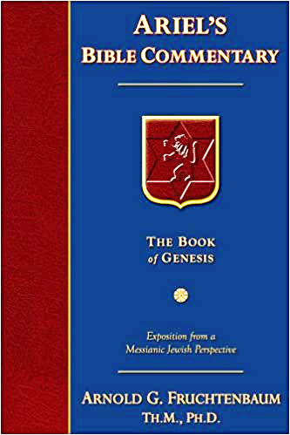
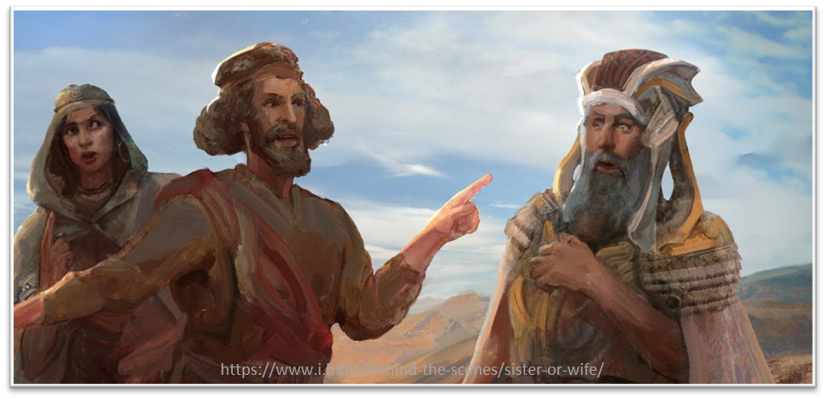
Dr. Arnold G. Fruchtenbaum
The Book of Genesis, 412
“The envy of the Philistines was so great that they were willing to cut off vital water supply in the context of a famine.”

Slide 26
III. Genesis 26:12-22 Struggle for the Wells
Isaac’s prosperity (12-14a)
Philistines’ response (14b-15)
Abimelech’s request (16)
Isaac’s departure (17)
Struggle for the wells (18-22)

Slide 27
8 New Promises Genesis 12:1-3
Land (Gen. 12:1b)
Great nation (Gen. 12:2a)
Personal blessing (Gen. 12:2b)
Great name (Gen. 12:2c)
Blessing to others (Gen. 12:2d)
Blessing to blessers (Gen. 12:3a)
Cursing to cursers (Gen. 12:3b)
Blessing to the world (Gen. 12:3c)

Slide 28
III. Genesis 26:12-22 Struggle for the Wells
Isaac’s prosperity (12-14a)
Philistines’ response (14b-15)
Abimelech’s request (16)
Isaac’s departure (17)
Struggle for the wells (18-22)

Slide 29
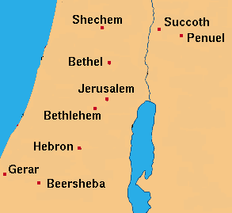

Slide 30
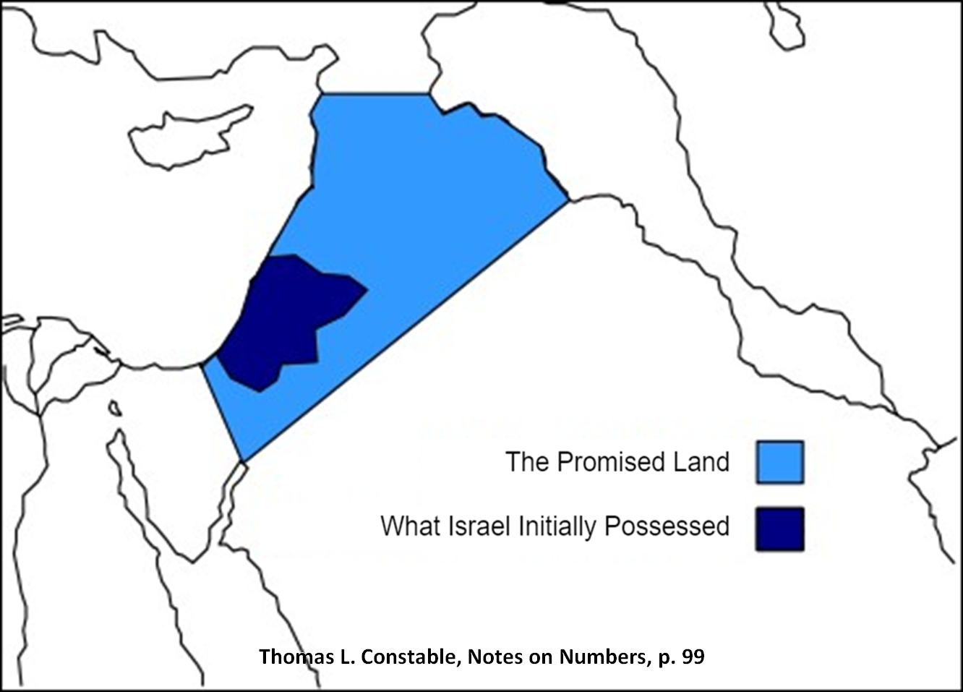

Slide 31
III. Genesis 26:12-22 Struggle for the Wells
Isaac’s prosperity (12-14a)
Philistines’ response (14b-15)
Abimelech’s request (16)
Isaac’s departure (17)
Struggle for the wells (18-22)

Slide 32
Genesis 26:18-22 Struggle for the Wells
Re-digging Abraham’s wells (18)
First well (19-20)
Second well (21)
Third well (22)

Slide 33
Genesis 26:18-22 Struggle for the Wells
Re-digging Abraham’s wells (18)
First well (19-20)
Second well (21)
Third well (22)

Slide 34
Dr. Henry M. Morris
The Genesis Record, 423
“Here there were other wells which Abraham had constructed, but these had already been plugged up when Abraham died. Evidently the Philistine settlers were not yet numerous or prosperous enough themselves to need them, but wanted to discourage others from settling there in the meantime, as they were trying to maintain a claim to the land themselves. Isaac embarked on a program of reopening these wells; no one else was using this part of the land, so he thought the Philistines would not object. To emphasize his right to the wells by way of inheritance, he used the same names Abraham had given them.”

Slide 35
Genesis 26:18-22 Struggle for the Wells
Re-digging Abraham’s wells (18)
First well (19-20)
Second well (21)
Third well (22)

Slide 36
Genesis 26:6-7 First Well
Find (19)
Contention (20)

Slide 37
Genesis 26:6-7 First Well
Find (19)
Contention (20)

Slide 38
Genesis 26:6-7 First Well
Find (19)
Contention (20)

Slide 39
Charles Ryrie The Ryrie Study Bible, page 34
Genesis 26:20 (RSB:NASB1995U): “26:20. Esek means ‘contention.’ Disputes over water rights were common in desert areas.”

Slide 40
Dr. Henry M. Morris
The Genesis Record, 423
“The Philistine herdsmen, however, claimed this water should belong to them, evidently on the ground that Isaac no longer had the right to dig new wells in their country. Rather than argue the point, Isaac instructed his own herdsmen to let them have the well and to dig another farther up the valley.”

Slide 41
Genesis 26:18-22 Struggle for the Wells
Re-digging Abraham’s wells (18)
First well (19-20)
Second well (21)
Third well (22)

Slide 42
Genesis 26:21 Second Well
Find (21a)
Contention (21b)

Slide 43
Genesis 26:21 Second Well
Find (21a)
Contention (21b)

Slide 44
Genesis 26:21 Second Well
Find (21a)
Contention (21b)

Slide 45
Genesis 26:18-22 Struggle for the Wells
Re-digging Abraham’s wells (18)
First well (19-20)
Second well (21)
Third well (22)

Slide 46
Genesis 26:22 Third Well
Find (22a)
No contention (22b)
Isaac’s conclusion (22c)

Slide 47
Genesis 26:22 Third Well
Find (22a)
No contention (22b)
Isaac’s conclusion (22c)

Slide 48
Genesis 26:22 Third Well
Find (22a)
No contention (22b)
Isaac’s conclusion (22c)

Slide 49
Genesis 26:22 Third Well
Find (22a)
No contention (22b)
Isaac’s conclusion (22c)

Slide 50
Conclusion

Slide 51
Genesis 26 Chapter Summary
Abrahamic Covenant Reconfirmed (1-5)
Isaac & Abimelech (6-11)
Struggle for the Wells (12-22)
Sojourn in Beersheba (23-25)
Covenant with Abimelech (26-33)
Esau’s Wives (34-35)

Slide 52
III. Genesis 26:12-22 Struggle for the Wells
Isaac’s prosperity (12-14a)
Philistines’ response (14b-15)
Abimelech’s request (16)
Isaac’s departure (17)
Struggle for the wells (18-22)

Slide 53
Genesis 26 Chapter Summary
Abrahamic Covenant Reconfirmed (1-5)
Isaac & Abimelech (6-11)
Struggle for the Wells (12-22)
Sojourn in Beersheba (23-25)
Covenant with Abimelech (26-33)
Esau’s Wives (34-35)

Slide 54
²⁴ The Lord bless you, and keep you; ²⁵ The Lord make His face shine on you, And be gracious to you; ²⁶ The Lord lift up His countenance on you, And give you peace.
Numbers 6:24–26 (NASB95)

