Slide 1
Dr. Andy Woods
Senior Pastor – Sugar Land Bible Church
President – Chafer Theological Seminary

Slide 2
Introductory Matters
Authorship |  | Occasion
Recipients |  | Structure
Place of writing |  | Unique characteristics
Date |  | Purpose
Audience |  | Message

Slide 3
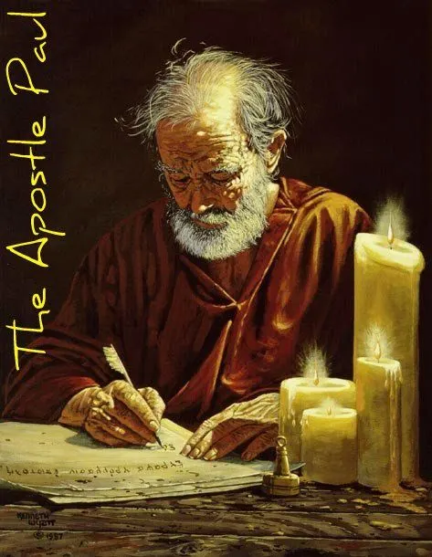
Structure
1 THESSALONIANS 1-3 | 1 THESSALONIANS 4-5
Personal Experience | Practical Exhortation
Looking Back | Looking Forward

Slide 4
Structure
Personal (1–3)
Genuine conversion (1)
Impure motives (2:1-16)
Lack of concern (2:17–3:13)
Practical (4–5)
Immorality (4:1-8)
Laziness (4:9-12)
Eschatology (4:13–5:11)
Ministry imbalances (5:12-15)
Progressive sanctification (5:16-28)

Slide 5
Structure
Personal (1–3)
Genuine conversion (1)
Impure motives (2:1-16)
Lack of concern (2:17–3:13)
Practical (4–5)
Immorality (4:1-8)
Laziness (4:9-12)
Eschatology (4:13–5:11)
Ministry imbalances (5:12-15)
Progressive sanctification (5:16-28)

Slide 6
Structure
Personal (1–3)
Genuine conversion (1)
Impure motives (2:1-16)
Lack of concern (2:17–3:13)
Practical (4–5)
Immorality (4:1-8)
Laziness (4:9-12)
Eschatology (4:13–5:11)
Ministry imbalances (5:12-15)
Progressive sanctification (5:16-28)

Slide 7
Genuine Conversion? (1 Thess 1)
Greeting (1:1)
Faith, hope, and love in Christ (1:2-3)
Response to the Gospel (1:4-5)
Joy in the midst of tribulation (1:6)
Example to those in Macedonia and Achaia (1:7)
No formal missionary endeavor (1:8-9a)
Turned from idols (1:9b)
Eschatological hope (1:10)

Slide 8
Structure
Personal (1–3)
Genuine conversion (1)
Impure motives (2:1-16)
Lack of concern (2:17–3:13)
Practical (4–5)
Immorality (4:1-8)
Laziness (4:9-12)
Eschatology (4:13–5:11)
Ministry imbalances (5:12-15)
Progressive sanctification (5:16-28)

Slide 9
Genuine Conversion? (2:13-16)
2:13 – Changed lives
2:14-15 – Part of an elite group (Judean believers, Christ, apostles, and Paul)
2:16 – Wrath stored up against enemies (Rom 2:5; Gen 15:16)

Slide 10
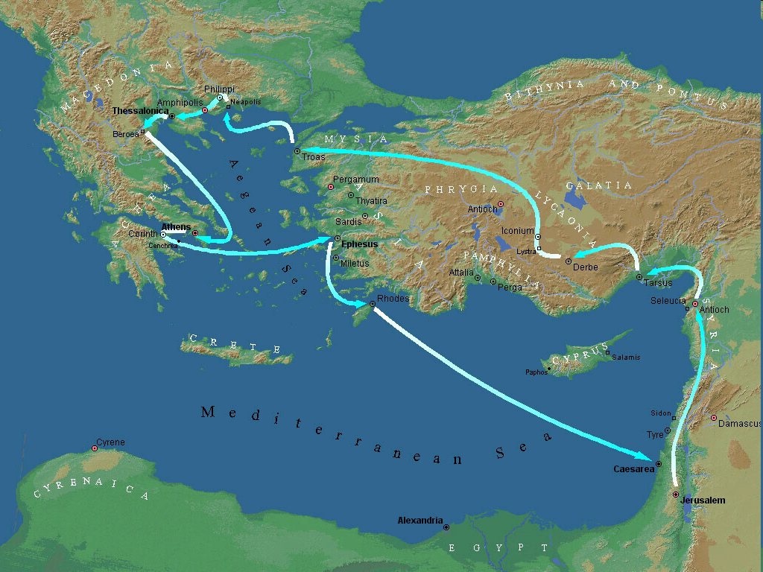
Second Missionary Journey

Slide 11
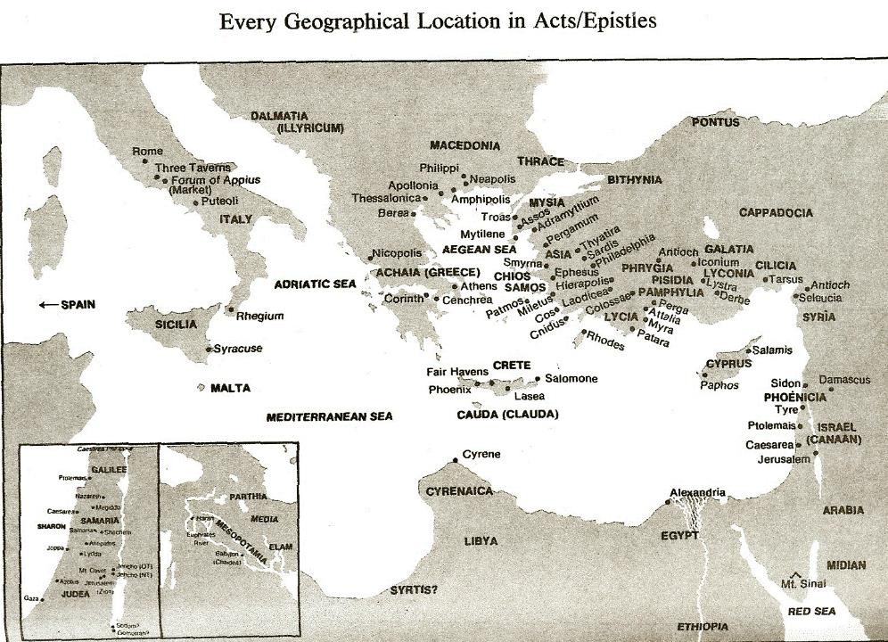

Slide 12
What Happened to Christ’s Disciples?
Disciple | Place | Martyrdom
James the Son of Alpheus | Jerusalem | Clubbed to death
Simon the Zealot | Jerusalem | Martyred
James the Son of Zebedee | Judea (Acts 12:2) | Executed
Thaddeus | Mesopotamia | Beaten to death
Peter | Babylon, Rome | Crucified upside down
Matthew | Parthia (Tehran) | Beheaded
Notes:
109 prophecies…
Peter Stoner – SCIENCE SPEAKS, An Evaluation of Certain Christian Evidences
To fulfill just 8 prophecies =1 X 10 to the twenty-eighth power!
Can we visualize this with an illustration? Suppose we took an atheistic professor, blindfolded him and covered the state of Texas two feet deep with silver dollars. Then we put a check on one of those silver dollars and mixed them up. The odds of one person fulfilling just these eight prophecies would be the same as this atheistic professor selecting the silver dollar upon which we have placed a check, in his first try.
https://www.bereanpublishers.com/the-odds-of-eight-messianic-prophecies-coming-true/

Slide 13
What Happened to Christ’s Disciples?
Disciple | Place | Martyrdom
John | Asia Minor, Patmos, Ephesus | Fried in boiling oil
Philip | E. Turkey | Tortured & crucified
Thomas | India | Speared
Bartholomew | India | Flayed & crucified
Andrew | Ukraine, Russia, Greece | Hanged
Notes:
109 prophecies…
Peter Stoner – SCIENCE SPEAKS, An Evaluation of Certain Christian Evidences
To fulfill just 8 prophecies =1 X 10 to the twenty-eighth power!
Can we visualize this with an illustration? Suppose we took an atheistic professor, blindfolded him and covered the state of Texas two feet deep with silver dollars. Then we put a check on one of those silver dollars and mixed them up. The odds of one person fulfilling just these eight prophecies would be the same as this atheistic professor selecting the silver dollar upon which we have placed a check, in his first try.
https://www.bereanpublishers.com/the-odds-of-eight-messianic-prophecies-coming-true/

Slide 14
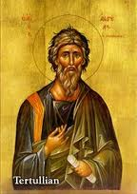
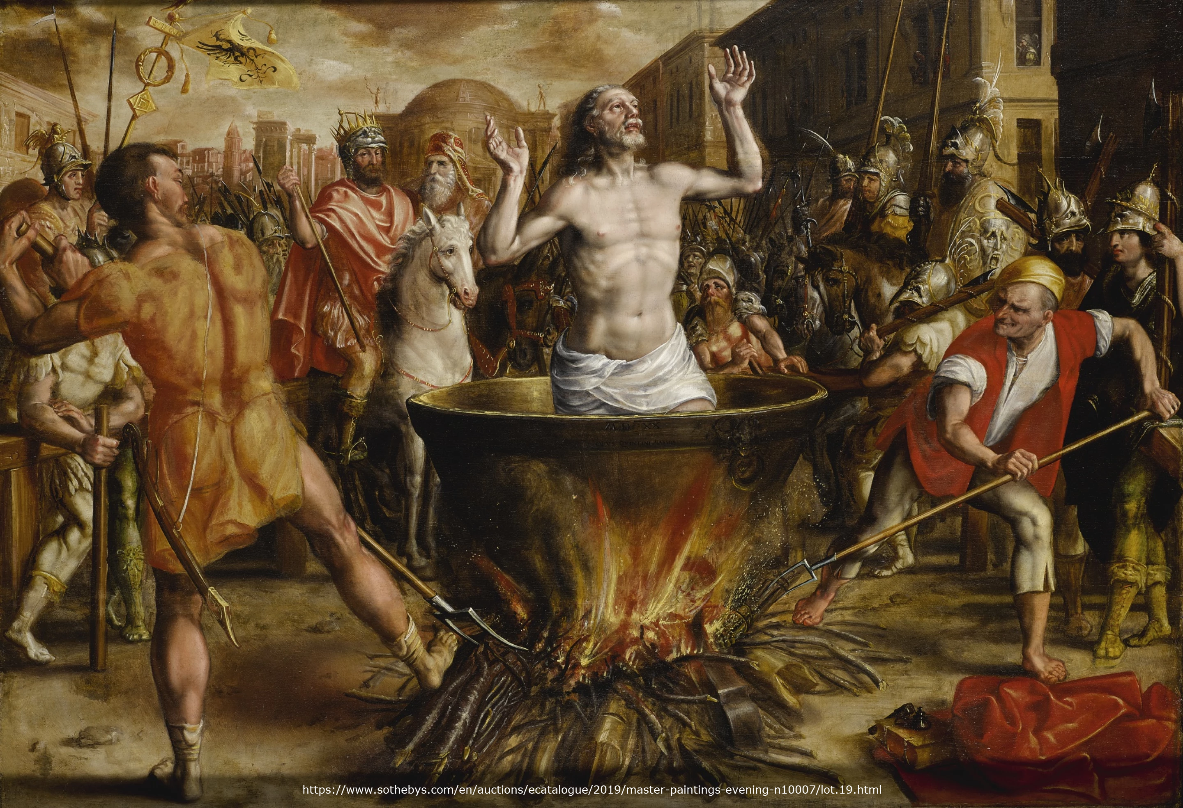
Tertullian Prescription Against Heretics, 36
“…where the Apostle John was first plunged, unhurt, into boiling oil, and thence remitted to his island-exile!”

Slide 15
Genuine Conversion? (2:13-16)
2:13 – Changed lives
2:14-15 – Part of an elite group (Judean believers, Christ, apostles, and Paul)
2:16 – Wrath stored up against enemies (Rom 2:5; Gen 15:16)

Slide 16
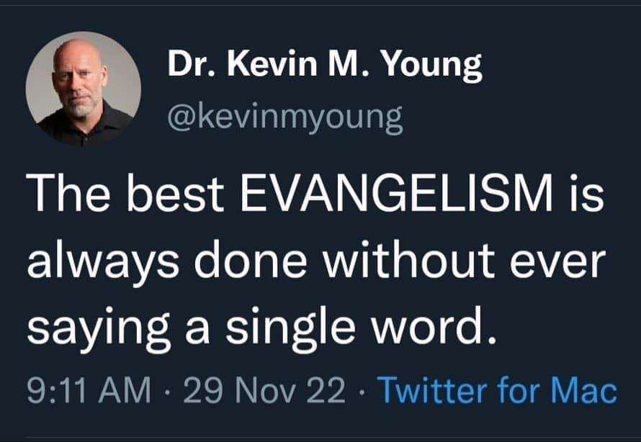

Slide 17
Genesis 15:16
“Then in the fourth generation they will return here, for the wrongdoing of the Amorite is not yet complete.”

Slide 18
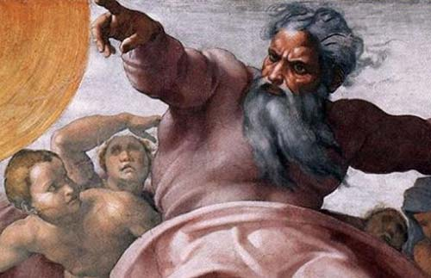
Romans 2:5
“But because of your stubbornness and unrepentant heart you are storing up wrath for yourself in the day of wrath and revelation of the righteous judgment of God.”

Slide 19
Genesis 6:1-3
“¹ Now it came about, when men began to multiply on the face of the land, and daughters were born to them, ² that the sons of God saw that the daughters of men were beautiful; and they took wives for themselves, whomever they chose. ³ Then the Lord said, “My Spirit shall not strive with man forever, because he also is flesh; nevertheless his days shall be one hundred and twenty years.”

Slide 20
Matthew 24:36-39
³⁶ “But of that day and hour no one knows, not even the angels of heaven, nor the Son, but the Father alone. ³⁷ For the coming of the Son of Man will be just like the days of Noah. ³⁸ For as in those days before the flood they were eating and drinking, marrying and giving in marriage, until the day that Noah entered the ark, ³⁹ and they did not understand until the flood came and took them all away; so will the coming of the Son of Man be.”

Slide 21
Structure
Personal (1–3)
Genuine conversion (1)
Impure motives (2:1-16)
Lack of concern (2:17–3:13)
Practical (4–5)
Immorality (4:1-8)
Laziness (4:9-12)
Eschatology (4:13–5:11)
Ministry imbalances (5:12-15)
Progressive sanctification (5:16-28)

Slide 22
Lack of Concern? (2:17–3:13)
Paul’s plan to visit (2:17-18)
Paul’s concern for their glorification (2:19-20)
Timothy’s visit (3:1-5)
Relief at Timothy’s report (3:6-10)
Paul’s prayer (3:11-13)

Slide 23
Lack of Concern? (2:17–3:13)
Paul’s plan to visit (2:17-18)
Paul’s concern for their glorification (2:19-20)
Timothy’s visit (3:1-5)
Relief at Timothy’s report (3:6-10)
Paul’s prayer (3:11-13)

Slide 24
Lack of Concern? (2:17–3:13)
Paul’s plan to visit (2:17-18)
Paul’s concern for their glorification (2:19-20)
Timothy’s visit (3:1-5)
Relief at Timothy’s report (3:6-10)
Paul’s prayer (3:11-13)

Slide 26
Unique Characteristics
Every chapter ends with a reference to the Second Advent
Small amount of time in between planting of the church and the first letter to the church

Slide 27
Conclusion

Slide 28
Lack of Concern? (2:17–3:13)
Paul’s plan to visit (2:17-18)
Paul’s concern for their glorification (2:19-20)
Timothy’s visit (3:1-5)
Relief at Timothy’s report (3:6-10)
Paul’s prayer (3:11-13)

