Slide 2
Introductory Matters
Title
Authorship
Biography
Place of writing
Recipient
Purpose
Message
Method
Sources
Date
Structure
Scope
Themes
Unique characteristics

Slide 3
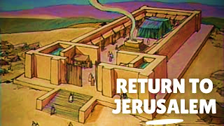
Acts 1 Chapter Summary
Prologue (1-5)
Jesus’ Ascension (6-11)
Return to Jerusalem (12-14)
Matthias Chosen (15-26)

Slide 4
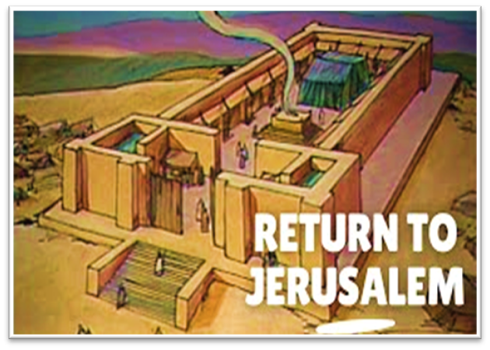
Charles Ryrie Ryrie Study Bible, page 1340
Acts 1:12: “(RSB:NASB1995U): 1:12 a Sabbath day’s journey. About 2,000 cubits, or a little more than half a mile (almost one km)—the distance the rabbis allowed Jews to journey on the Sabbath. This limitation was apparently arrived at on the basis of Ex. 16:29 interpreted by Num. 35:5.”﻿

Slide 5
Matthew 24:15-16, 20
“¹⁵ Therefore when you see the abomination of desolation which was spoken of through Daniel the prophet, standing in the holy place (let the reader understand) ¹⁶ then those who are in Judea must flee to the mountains…²⁰ But pray that your flight will not be in the winter, or on a Sabbath.”

Slide 6
Message
Birth and growth of the church numerically, geographically, ethnically.
Components
Numerically (progress reports)
Geographically (From Jerusalem to Rome)
Ethnically (From Judaism to Gentile domination)

Slide 7
Progress Reports
Clearest: Acts 2:47; 6:7; 9:31; 12:24; 16:5; 19:20; 28:30-31
Less clear: Acts 1:13, 15; 2:41; 4:4, 31; 5:14, 42; 8:25, 40; 11:21; 13:49; 17:6

Slide 8
Acts 1 Chapter Summary
Prologue (1-5)
Jesus’ Ascension (6-11)
Return to Jerusalem (12-14)
Matthias Chosen (15-26)

Slide 9
IV. Matthias Chosen Acts 1:15-26
Peter’s Proposition (15-20)
Apostolic Qualifications (21-22)
Matthias Selected (23-26)

Slide 10
IV. Matthias Chosen Acts 1:15-26
Peter’s Proposition (15-20)
Apostolic Qualifications (21-22)
Matthias Selected (23-26)

Slide 11
Message
Birth and growth of the church numerically, geographically, ethnically.
Components
Numerically (progress reports)
Geographically (From Jerusalem to Rome)
Ethnically (From Judaism to Gentile domination)

Slide 12
Progress Reports
Clearest: Acts 2:47; 6:7; 9:31; 12:24; 16:5; 19:20; 28:30-31
Less clear: Acts 1:13, 15; 2:41; 4:4, 31; 5:14, 42; 8:25, 40; 11:21; 13:49; 17:6

Slide 13
2 Timothy 3:16-17
“All Scripture is inspired by God [theopneustos] and profitable for teaching, for reproof, for correction, for training in righteousness; so that the man of God may be adequate, equipped for every good work.”
Notes:
hapaxlegomena

Slide 14
2 Peter 1:19-21
“¹⁹ So we have the prophetic word made more sure, to which you do well to pay attention as to a lamp shining in a dark place, until the day dawns and the morning star arises in your hearts. ²⁰ But know this first of all, that no prophecy of Scripture is a matter of one’s own interpretation, ²¹ for no prophecy was ever made by an act of human will, but men moved [pherō] by the Holy Spirit spoke from God.”

Slide 15
INSPIRATION OF SCRIPTURE V. 20-21
Men Wrote as they were inspired by Holy Spirit
“pherō” = to carry
Acts 27:15,17
Opposite of Knowledge of False Teachers
Which is their own imagination
Jer. 23:16

Slide 16
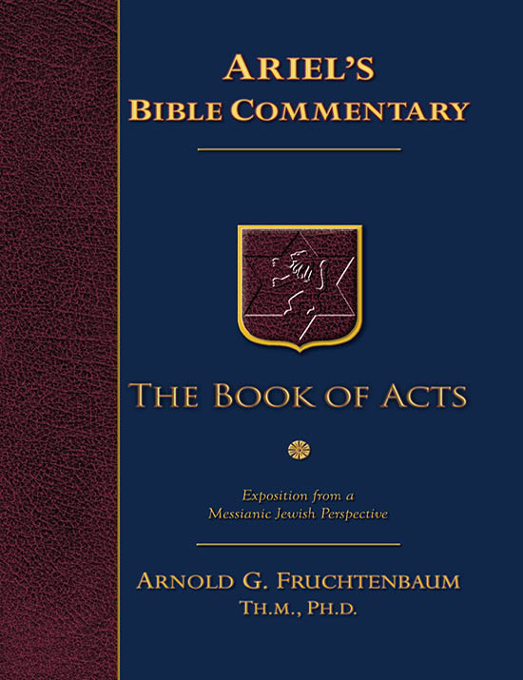
Dr. Arnold G. Fruchtenbaum
The Book of Acts, 55
“The price offered to him was thirty pieces of silver. This bribe was the money used to purchase the field, and according to Matthew, it was the chief priests who purchased it (Mt. 27:7-8). Yet, Luke stated: Now this man [Judas] obtained a field with the reward of his iniquity (Acts 1:18). From a Jewish viewpoint, both statements are true. By Jewish law, money wrongfully gained could not be put into the Temple treasury: It is not lawful to put them into the treasury, since it is the price of blood (Mt. 27:6)...”

Slide 17
Dr. Arnold G. Fruchtenbaum
The Book of Acts, 55
“However, in the case of Judas and his bribe, the donor was dead. Although the money could not be placed in the Temple treasury, it could be used for purchasing something to benefit the whole community in the name of the donor. So, the religious leaders purchased the field for the public, as a place to bury strangers, and despite Judas’ death, all legal documents of sale reflected his name. Matthew recorded the events as they occurred, and Luke documented the fact that, legally, Judas purchased the field.”

Slide 18
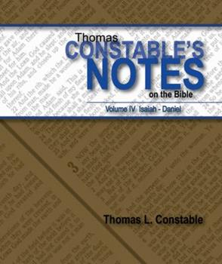
Thomas L. Constable
Constable’s online notes on Acts, p. 36.
“This account of Judas' death differs from Matthew's, who wrote that Judas hanged himself (Matt. 27:5). The two events are easy to combine, and undoubtedly both accounts were true. Perhaps Judas hanged himself and in the process also fell ‘headlong’ (lit. flat on his face) and tore open his abdomen. Perhaps the rope or branch with which he hanged himself broke. Or perhaps when others cut his corpse down it fell and broke open, as Luke described. Another view is that Judas defiled the city when he hanged himself, so the priests threw his body over the wall facing the Hinnom Valley and his ‘guts gushed out.’”

Slide 19
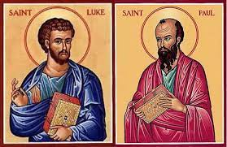
Biography
Paul’s companion (2 Tim 4:11)
Physician (Col 4:14)
Gentile
Col 4:11
Acts 1:19

Slide 20
IV. Matthias Chosen Acts 1:15-26
Peter’s Proposition (15-20)
Apostolic Qualifications (21-22)
Matthias Selected (23-26)

Slide 21
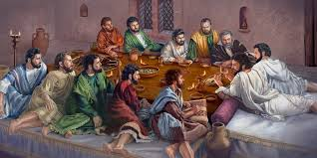
Ephesians 2:20
“having been built on the foundation of the apostles and prophets, Christ Jesus Himself being the corner stone.”

Slide 22
IV. Matthias Chosen Acts 1:15-26
Peter’s Proposition (15-20)
Apostolic Qualifications (21-22)
Matthias Selected (23-26)

Slide 23
2 Thessalonians 2:3
“Let no one in any way deceive you, for it will not come unless the apostasy [apostasia] comes first, and the man of lawlessness is revealed, the son of destruction.”

Slide 24
Ephesians 2:20
“having been built on the foundation of the apostles and prophets, Christ Jesus Himself being the corner stone.”

Slide 25
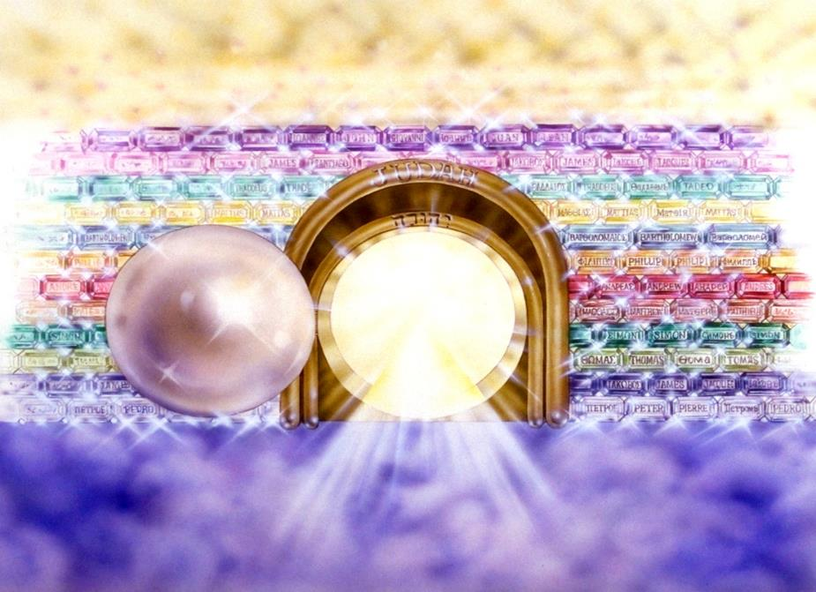
Notes:
Here you see an artist’s ideas of…
12 Gates = 12 Tribes of Israel
12 Foundation Stones = 12 Apostles of the Church

Slide 26
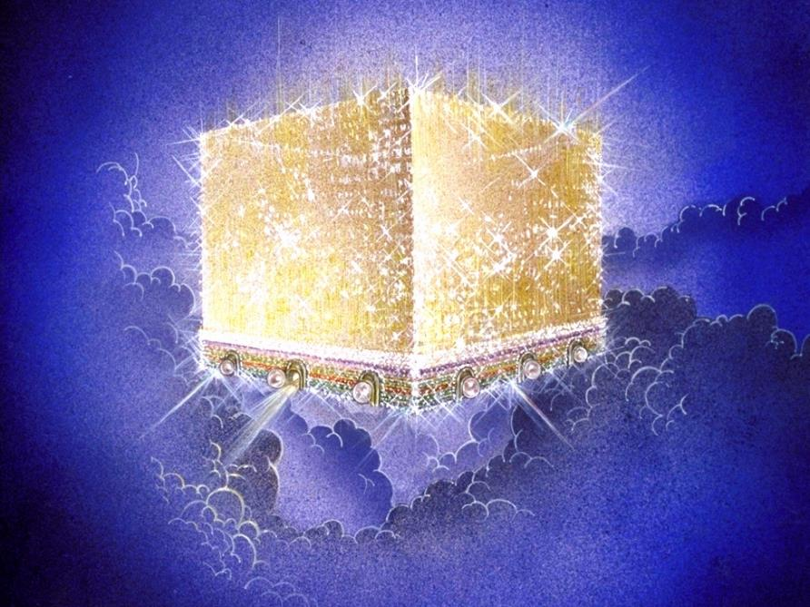
Notes:
Every city needs light. God, the ultimate source of power, illumines the city from his glory. Have you ever taken time to look at a sunset just after it has rained? As the sun sets, there is a kind of a glow cast on everything. It captures the spirit. This is just a little foretaste of the glory and splendor of heaven.

Slide 27
Message
Birth and growth of the church numerically, geographically, ethnically.
Components
Numerically (progress reports)
Geographically (From Jerusalem to Rome)
Ethnically (From Judaism to Gentile domination)

Slide 28
Mistaken Replacement?
Pro
No Spirit yet
Lots
Matthias disappears
Paul
Con
No textual indication of an error
Twelve esteemed (2:14; 6:2)
God’s choice (1:24)
Prov 16:33
Paul unqualified (1:21-22)
Focus on Peter & Paul

Slide 29
Conclusion

Slide 30
Acts 1 Chapter Summary
Prologue (1-5)
Jesus’ Ascension (6-11)
Return to Jerusalem (12-14)
Matthias Chosen (15-26)

