Slide 1
Genesis 12‒50
Israel’s Birth & Preservation

Slide 2
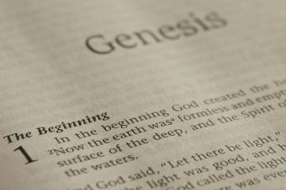
GENESIS STRUCTURE
Beginning of the Human race (Gen. 1‒11)
Beginning of the Hebrew race (Gen. 12‒50)

Slide 3
GENESIS STRUCTURE
Genesis 1-11 (four events)
Creation (1-2)
Fall (3-5)
Flood (6-9)
National dispersion (10-11)

Slide 4
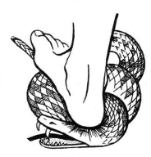
Genesis 3:15
“And I will put enmity Between you and the woman, And between your seed and her seed; He shall bruise you on the head, And you shall bruise him on the heel.”

Slide 5
GENESIS STRUCTURE
Beginning of the Human race (Gen. 1‒11)
Beginning of the Hebrew race (Gen. 12‒50)

Slide 6
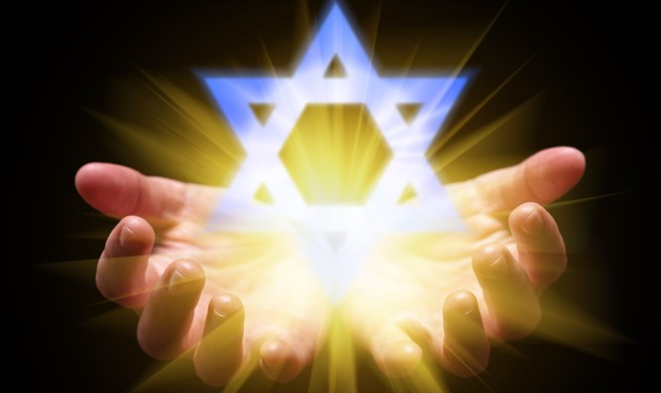
Isaiah 43:1
“But now, thus says the Lord, your Creator, O Jacob, And He who formed you, O Israel, 'Do not fear, for I have redeemed you; I have called you by name; you are Mine!'”

Slide 7
GENESIS STRUCTURE
Genesis 12-50 (four people)
Abraham (12:1–25:11)
Isaac (25:12–26:35)
Jacob (27–36)
Joseph (37–50)

Slide 8
Genesis 26 Chapter Summary
Abrahamic Covenant Reconfirmed (1-5)
Isaac & Abimelech (6-11)
Struggle for the Wells (12-22)
Sojourn in Beersheba (23-25)
Esau’s Wives (34-35)

Slide 9
Genesis 26 Chapter Summary
Abrahamic Covenant Reconfirmed (1-5)
Isaac & Abimelech (6-11)
Struggle for the Wells (12-22)
Sojourn in Beersheba (23-25)
Esau’s Wives (34-35)

Slide 10
I. Genesis 26:1-5 Abrahamic Covenant Reconfirmed
Setting (1)
Divine revelation (2-5)
Appearance (2a)
Content (2b-5)

Slide 11
I. Genesis 26:1-5 Abrahamic Covenant Reconfirmed
Setting (1)
Divine revelation (2-5)
Appearance (2a)
Content (2b-5)

Slide 13
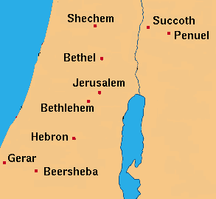

Slide 14
Genesis 12‒25 Abraham’s Early Journeys
Unconditional promises (Gen. 12:1-3) From Haran to Canaan (Gen. 12:4-5) In Canaan (Gen. 12:6-9) In Egypt (Gen. 12:10-20) Abram and Lot Separate (Gen. 13:1-13) Reaffirmation of Abram’s promises (Gen. 13:14-18) Abram Rescues Lot (14:1-24) Abrahamic Covenant (15:1-21) Hagar & Ishmael (16:1-16) Circumcision (Gen. 17:1-27) | Sodom & Gomorrah (Gen. 18‒19) Abraham & Abimelech (Gen. 20) Isaac’s birth (Gen. 21:1-7) Ishmael’s expulsion (21:8-21) Abraham & Abimelech’s covenant (21:22-34) Abraham sacrifices Isaac (22) Sarah’s death (23) Isaac’s marriage (24) Abraham & Keturah (25:1-6) Abraham’s death (25:7-11)

Slide 15
Charles Ryrie The Ryrie Study Bible, page 33
Genesis 26:1 (RSB:NASB1995U): “26:1…Abimelech is a dynastic title, such as ‘pharaoh.’ Because this occurred 97 years later, the Abimelech mentioned here was probably not the same as the ruler of chap. 20.”

Slide 16
Dr. Arnold G. Fruchtenbaum
The Book of Genesis, 406
“This was not the same Abimelech of chapter 20 and of 21:22–34. Abimelech was a dynastic name for the king of Gerar, and therefore was more of a title, such as ‘Pharaoh’ is a title, while the personal name would differ. Just as ‘Pharaoh’ was a dynastic name for the king of Egypt, Abimelech was a dynastic name for the king of Gerar. He is mentioned as being king of the Philistines. The Philistines were not yet living in the area at that time, and so the term Philistines is used proleptically, meaning that this is the place where later the Philistines settled.”

Slide 17
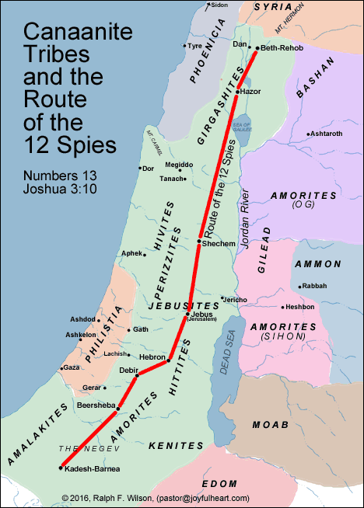

Slide 18
I. Genesis 26:1-5 Abrahamic Covenant Reconfirmed
Setting (1)
Divine revelation (2-5)
Appearance (2a)
Content (2b-5)

Slide 19
I. Genesis 26:1-5 Abrahamic Covenant Reconfirmed
Setting (1)
Divine revelation (2-5)
Appearance (2a)
Content (2b-5)

Slide 20
Dr. Arnold G. Fruchtenbaum
The Book of Genesis, 240
“This is the first of seven times that Abraham receives a direct revelation from God. In 12:1–3 is God’s initial call to Abram outside the Land of Canaan; in 12:7 is the first appearance to Abraham in the Land; in 13:14–17, Abraham encounters God after the separation of Lot; in 15:1–21, God signs and seals the Abrahamic Covenant; in 17:1–21, Abraham receives the token of the covenant; in 18:1–33, God speaks to him in conjunction with the destruction of Sodom; and in 22:1–2 and 22:11–18, God directs Abraham to offer Isaac.”

Slide 22
I. Genesis 26:1-5 Abrahamic Covenant Reconfirmed
Setting (1)
Divine revelation (2-5)
Appearance (2a)
Content (2b-5)

Slide 23
Genesis 26:2b-5 Content
Negative command (2b)
Positive command (2c-3a)
Seven provisions (3b-4)
Basis (5)

Slide 24
Genesis 26:2b-5 Content
Negative command (2b)
Positive command (2c-3a)
Seven provisions (3b-4)
Basis (5)

Slide 26
Genesis 26:2b-5 Content
Negative command (2b)
Positive command (2c-3a)
Seven provisions (3b-4)
Basis (5)

Slide 27
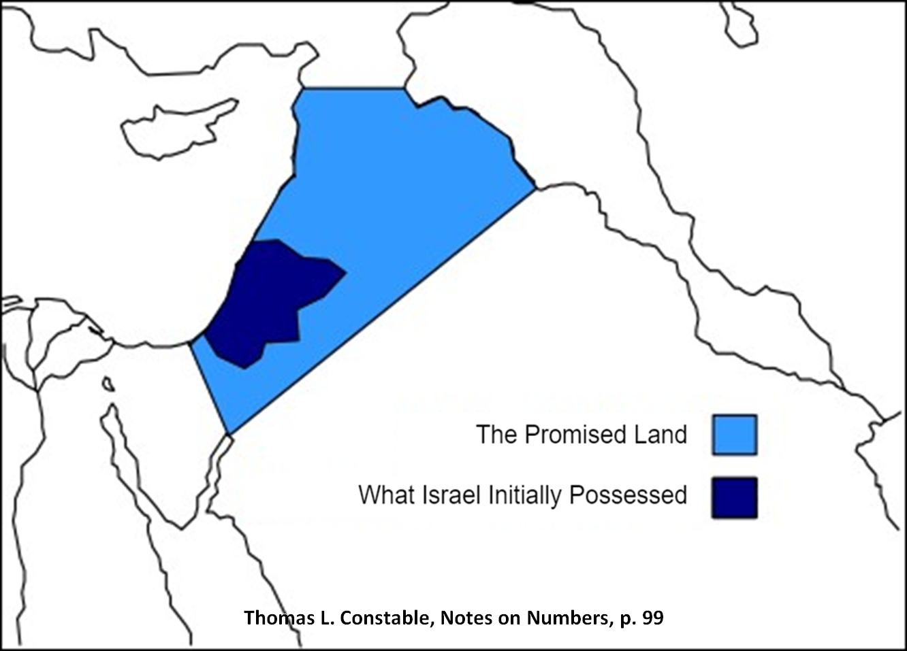
Assyria
Havilah (?)
Egypt
Shur

Slide 28
Genesis 26:2b-5 Content
Negative command (2b)
Positive command (2c-3a)
Seven provisions (3b-4)
Basis (5)

Slide 29
Genesis 25:3-4 Seven Blessings
God’s presence (3a)
God’s blessing (3b)
Land (3c)
Fulfilling oath (3d)
Seed Multiplication (4a)
Seed’s land reception (4b)
Nations blessed (4c)

Slide 30
Genesis 25:3-4 Seven Blessings
God’s presence (3a)
God’s blessing (3b)
Land (3c)
Fulfilling oath (3d)
Seed Multiplication (4a)
Seed’s land reception (4b)
Nations blessed (4c)

Slide 31
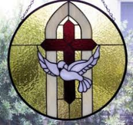
1 Samuel 16:13-14
¹³ Then Samuel took the horn of oil and anointed him in the midst of his brothers; and the Spirit of the Lord came mightily upon David from that day forward. And Samuel arose and went to Ramah. ¹⁴ Now the Spirit of the Lord departed from Saul, and an evil spirit from the Lord terrorized him.

Slide 32
John 14:16-17
¹⁶ I will ask the Father, and He will give you another Helper, that He may be with you forever; ¹⁷ that is the Spirit of truth, whom the world cannot receive, because it does not see Him or know Him, but you know Him because He abides with you and will be in you.

Slide 33
Genesis 25:3-4 Seven Blessings
God’s presence (3a)
God’s blessing (3b)
Land (3c)
Fulfilling oath (3d)
Seed Multiplication (4a)
Seed’s land reception (4b)
Nations blessed (4c)

Slide 34
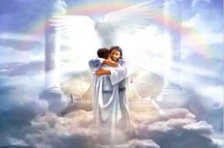
Ephesians 1:3
“Blessed be the God and Father of our Lord Jesus Christ, who has blessed us with every spiritual blessing in the heavenly places in Christ.”

Slide 35
Genesis 25:3-4 Seven Blessings
God’s presence (3a)
God’s blessing (3b)
Land (3c)
Fulfilling oath (3d)
Seed Multiplication (4a)
Seed’s land reception (4b)
Nations blessed (4c)

Slide 37
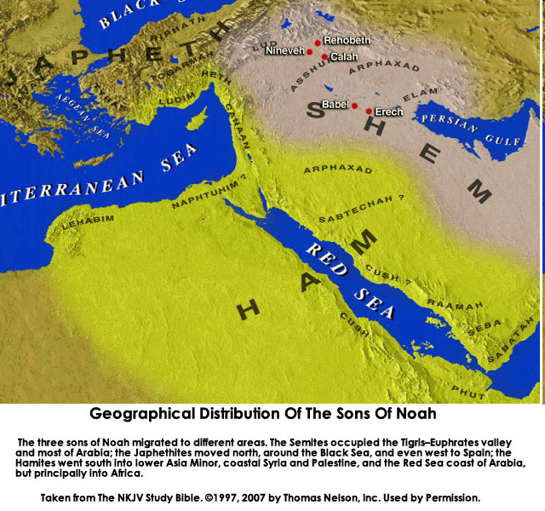
CANAAN

Slide 38
Canaan’s Sons
Sidon
Heth
Jebusite
Amorite
Girgashite
Hivite
Arkite
Sinite
Arvadite
Zemarite
Hamathite
Perrizite

Slide 40
Daniel 12:1-2
“¹ Now at that time Michael, the great prince who stands guard over the sons of your people, will arise. And there will be a time of distress such as never occurred since there was a nation until that time; and at that time your people, everyone who is found written in the book, will be rescued. ² Many of those who sleep in the dust of the ground will awake, these to everlasting life, but the others to disgrace and everlasting contempt.”

Slide 42
Genesis 25:3-4 Seven Blessings
God’s presence (3a)
God’s blessing (3b)
Land (3c)
Fulfilling oath (3d)
Seed Multiplication (4a)
Seed’s land reception (4b)
Nations blessed (4c)

Slide 43
8 New Promises Genesis 12:1-3
Land (Gen. 12:1b)
Great nation (Gen. 12:2a)
Personal blessing (Gen. 12:2b)
Great name (Gen. 12:2c)
Blessing to others (Gen. 12:2d)
Blessing to blessers (Gen. 12:3a)
Cursing to cursers (Gen. 12:3b)
Blessing to the world (Gen. 12:3c)

Slide 44
Evidence of Abrahamic Covenant’s Unconditional Nature
ANE covenant ratification ceremony (Gen 15)
Lack of stated conditions for Israel’s obedience (Gen 15)
Covenant's eternality (Gen 17:7, 13, 19; Ps. 90:2)
Covenant's immutability (Heb 6:13-18; Mal. 3:6)
Trans-generational reaffirmation despite perpetual national disobedience (Jer 31:35-37)
Walvoord, The Millennial Kingdom, 149-52

Slide 45
Genesis 25:3-4 Seven Blessings
God’s presence (3a)
God’s blessing (3b)
Land (3c)
Fulfilling oath (3d)
Seed Multiplication (4a)
Seed’s land reception (4b)
Nations blessed (4c)

Slide 46
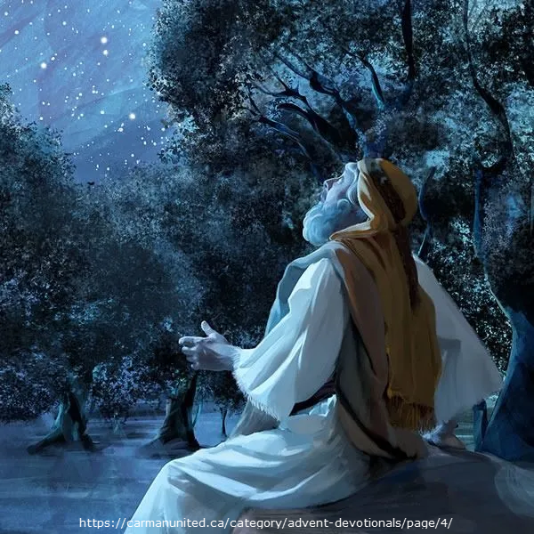
Galatians 3:16
“Now the promises were spoken to Abraham and to his seed. He does not say, “And to seeds,” as referring to many, but rather to one, “And to your seed,” that is, Christ.”

Slide 47
Genesis 3:15
“And I will put enmity Between you and the woman, And between your seed and her seed; He shall bruise you on the head, And you shall bruise him on the heel.”

Slide 48
Genesis 25:3-4 Seven Blessings
God’s presence (3a)
God’s blessing (3b)
Land (3c)
Fulfilling oath (3d)
Seed Multiplication (4a)
Seed’s land reception (4b)
Nations blessed (4c)

Slide 50
CANAAN

Slide 51
Canaan’s Sons
Sidon
Heth
Jebusite
Amorite
Girgashite
Hivite
Arkite
Sinite
Arvadite
Zemarite
Hamathite
Perrizite

Slide 53
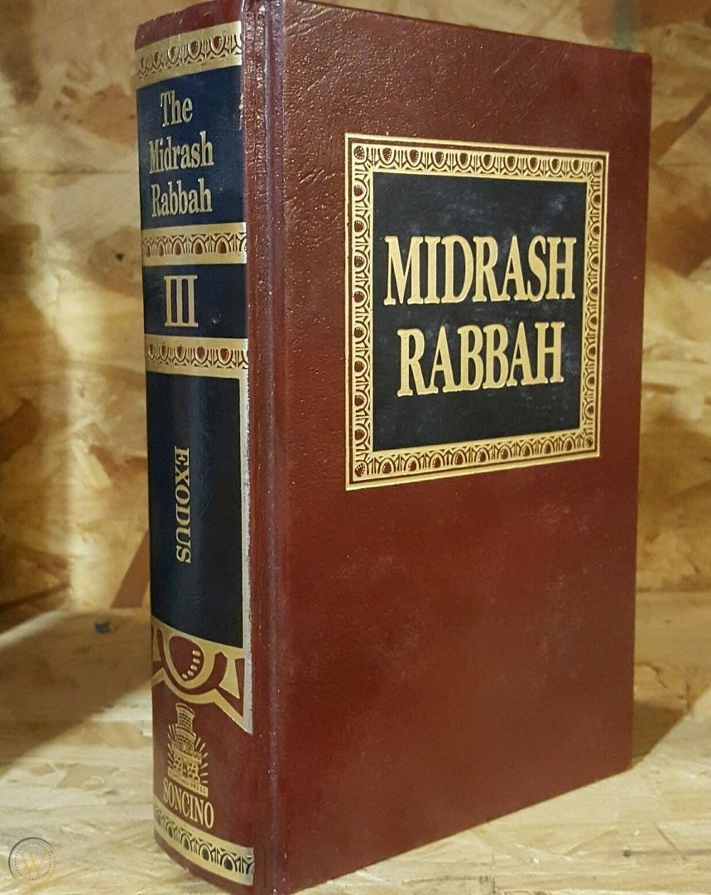
Dr. Arnold G. Fruchtenbaum
The Book of Genesis, 408-409
“A rabbinic comment on this verse reads as follows: ‘God only gave them one of the lands. When will he give them the rest? In the Messianic future.’”
Midrash Rabbah, Bereishit 64:3

Slide 55
Genesis 25:3-4 Seven Blessings
God’s presence (3a)
God’s blessing (3b)
Land (3c)
Fulfilling oath (3d)
Seed Multiplication (4a)
Seed’s land reception (4b)
Nations blessed (4c)

Slide 56
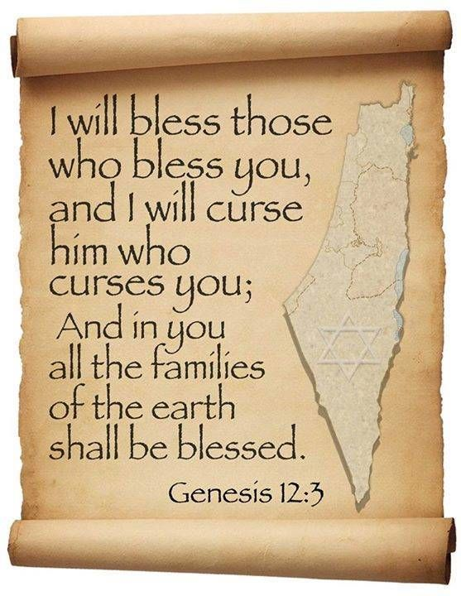
Genesis 12:3
“And I will bless those who bless you, And the one who curses you I will curse. And in you all the families of the earth will be blessed.”

Slide 57
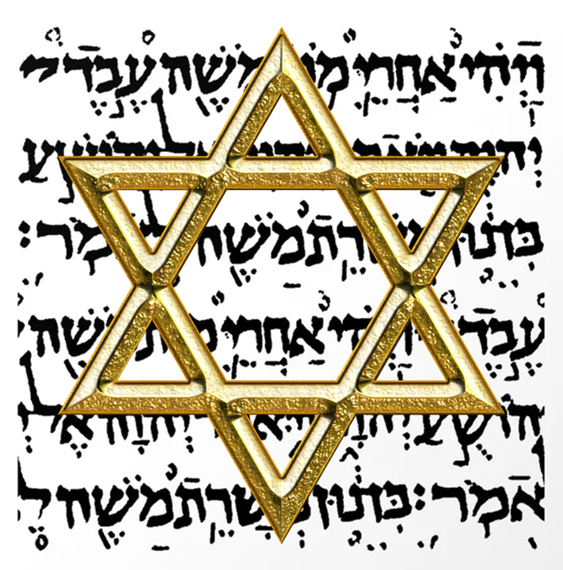
Israel’s Three Blessings to the World (Gen 12:3b)
Scripture (Rom 3:2)
Savior (John 4:22)
Kingdom (Isa 2:2-3)

Slide 58
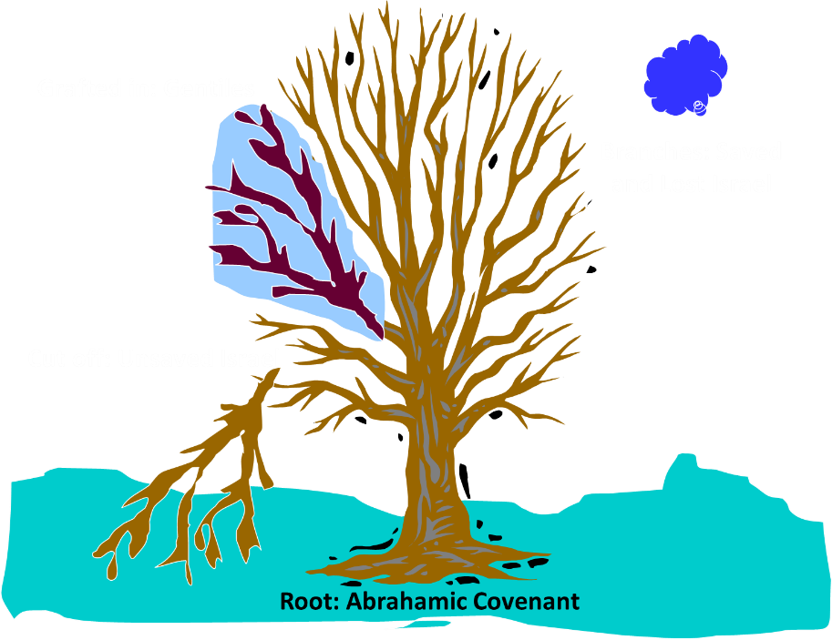
Notes:
58

Slide 59
Romans 11:13, 17-21
“¹³ But I am speaking to you who are Gentiles. Inasmuch then as I am an apostle of Gentiles, I magnify my ministry… ¹⁷ But if some of the branches were broken off, and you, being a wild olive, were grafted in among them and became partaker with them of the rich root of the olive tree, ¹⁸ do not be arrogant toward the branches; but if you are arrogant, remember that it is not you who . . .

Slide 60
Romans 11:13, 17-21
…supports the root, but the root supports you. ¹⁹ You will say then, “Branches were broken off so that I might be grafted in.” ²⁰ Quite right, they were broken off for their unbelief, but you stand by your faith. Do not be conceited, but fear; ²¹ for if God did not spare the natural branches, He will not spare you, either.”

Slide 61
Genesis 26:2b-5 Content
Negative command (2b)
Positive command (2c-3a)
Seven provisions (3b-4)
Basis (5)

Slide 62
Evidence of Abrahamic Covenant’s Unconditional Nature
ANE covenant ratification ceremony (Gen 15)
Lack of stated conditions for Israel’s obedience (Gen 15)
Covenant's eternality (Gen 17:7, 13, 19; Ps. 90:2)
Covenant's immutability (Heb 6:13-18; Mal. 3:6)
Trans-generational reaffirmation despite perpetual national disobedience (Jer 31:35-37)
Walvoord, The Millennial Kingdom, 149-52

Slide 63
Charles Ryrie The Ryrie Study Bible, page 34
Genesis 26:5 (RSB:NASB1995U): “26:5 Though the covenant made with Abraham was initiated by God’s unconditional grace, God delighted to acknowledge the worthiness of Abraham (as also in 22:16) and to confirm the covenant to Isaac.”

Slide 64
J. Dwight Pentecost Thy Kingdom Come, Page 66-67
“As before, God responded to the obedience of faith. He said to Abraham, ‘I swear by Myself, declares the Lord, that because you have done this and have not withheld your son, your only son, I will surely bless you and make your descendants as numerous as the stars in the sky and as the sand on the seashore. Your descendants will take possession of the cities of their enemies, and through your offspring all nations on earth will be blessed, because you have obeyed Me’ (Gen. 22:16–18). “Here again God promised Abraham that he would become the recipient of the covenant blessings. The covenant was not based on obedience,…

Slide 65
J. Dwight Pentecost Thy Kingdom Come, Page 66-67
…nor was the perpetuity of the covenant based on obedience—but rather the reception of covenant blessings was conditioned on obedience. Remember, an unconditional covenant may have conditional blessings. Thus, on the basis of faith that had produced obedience, Abraham would experience the blessings of the promises and the covenant.”

Slide 66
Charles Ryrie Basic Theology, page 529
Genesis 22:16-18; 26:5: “Since the covenant had been firmly established several times before these events, it would be incongruous to view these passages as conditions imposed after the clear statements of unconditionality. Rather, in these instances God acknowledged the worthiness of Abraham to remind him and his descendants that faith and obedience were necessary for participation in the benefits of the unconditional promises of the covenant.”﻿

Slide 68
Dr. Arnold G. Fruchtenbaum
The Book of Genesis, 408
“Finally, in 26:5 God declared the basis for His provisions: Because that Abraham obeyed my voice, and kept my charge, my commandments, my statutes, and my laws. This showed that while Abraham was saved by grace through faith (15:6), he also had a rule of life and showed his faith by obedience to the then-known laws of God. The Law of Moses did not yet exist. However, the Abrahamic Covenant contained a law code nonetheless, just as the Edenic, Adamic, and Noahic covenants contained law codes.”

Slide 69
James 2:20
“But are you willing to acknowledge, you foolish person, that faith without works is useless?”

Slide 70
Three Tenses of Salvation
Phase | Justification | Sanctification | Glorification
Tense | Past | Present | Future
Saved from sin’s: | Penalty | Power | Presence
Scripture | Eph 2:8-9; Titus 3:5 | Philip 2:12 | Rom 5:10

Slide 71
Conclusion

Slide 72
Genesis 26 Chapter Summary
Abrahamic Covenant Reconfirmed (1-5)
Isaac & Abimelech (6-11)
Struggle for the Wells (12-22)
Sojourn in Beersheba (23-25)
Esau’s Wives (34-35)

Slide 73
I. Genesis 26:1-5 Abrahamic Covenant Reconfirmed
Setting (1)
Divine revelation (2-5)
Appearance (2a)
Content (2b-5)

Slide 74
Genesis 26 Chapter Summary
Abrahamic Covenant Reconfirmed (1-5)
Isaac & Abimelech (6-11)
Struggle for the Wells (12-22)
Sojourn in Beersheba (23-25)
Esau’s Wives (34-35)

Slide 75
²⁴ The Lord bless you, and keep you; ²⁵ The Lord make His face shine on you, And be gracious to you; ²⁶ The Lord lift up His countenance on you, And give you peace.
Numbers 6:24–26 (NASB95)

