Slide 1
Dr. Andy Woods
Senior Pastor – Sugar Land Bible Church
President – Chafer Theological Seminary

Slide 2
Introductory Matters
Authorship |  | Occasion
Recipients |  | Structure
Place of writing |  | Unique characteristics
Date |  | Purpose
Audience |  | Message

Slide 3
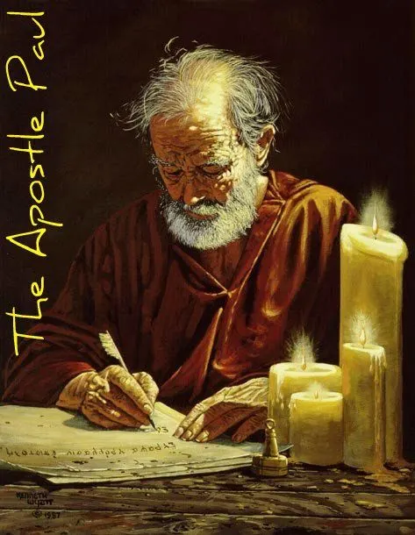
Structure
1 THESSALONIANS 1-3 | 1 THESSALONIANS 4-5
Personal Experience | Practical Exhortation
Looking Back | Looking Forward

Slide 4
Structure
Personal (1–3)
Genuine conversion (1)
Impure motives (2:1-16)
Lack of concern (2:17–3:13)
Practical (4–5)
Immorality (4:1-8)
Laziness (4:9-12)
Eschatology (4:13–5:11)
Ministry imbalances (5:12-15)
Progressive sanctification (5:16-28)

Slide 5
Structure
Personal (1–3)
Genuine conversion (1)
Impure motives (2:1-16)
Lack of concern (2:17–3:13)
Practical (4–5)
Immorality (4:1-8)
Laziness (4:9-12)
Eschatology (4:13–5:11)
Ministry imbalances (5:12-15)
Progressive sanctification (5:16-28)

Slide 6
Structure
Personal (1–3)
Genuine conversion (1)
Impure motives (2:1-16)
Lack of concern (2:17–3:13)
Practical (4–5)
Immorality (4:1-8)
Laziness (4:9-12)
Eschatology (4:13–5:11)
Ministry imbalances (5:12-15)
Progressive sanctification (5:16-28)

Slide 7
Genuine Conversion? (1 Thess 1)
Greeting (1:1)
Faith, hope, and love in Christ (1:2-3)
Response to the Gospel (1:4-5)
Joy in the midst of tribulation (1:6)
Example to those in Macedonia and Achaia (1:7)
No formal missionary endeavor (1:8-9a)
Turned from idols (1:9b)
Eschatological hope (1:10)

Slide 8
Structure
Personal (1–3)
Genuine conversion (1)
Impure motives (2:1-16)
Lack of concern (2:17–3:13)
Practical (4–5)
Immorality (4:1-8)
Laziness (4:9-12)
Eschatology (4:13–5:11)
Ministry imbalances (5:12-15)
Progressive sanctification (5:16-28)

Slide 9
Pauline Motives? (2:1-12)
2:1-2 – Message, motives, and method
2:3-12 – Elaboration
Message (2:3-4)
Motives (2:5-8)
Method (2:9-12)

Slide 10
1 Thessalonians 2:12
“So that you would walk in a manner worthy of the God who calls you into [eis] His own kingdom and glory.”

Slide 11
1 Thessalonians 2:12
“So that you would walk in a manner worthy of the God who calls you into [eis] His own kingdom and glory.”

Slide 12
1 Thessalonians 2:12
“So that you would walk in a manner worthy of the God who calls you into [eis] His own kingdom and glory.”

Slide 13
Three Tenses of Salvation
Phase | Justification | Sanctification | Glorification
Tense | Past | Present | Future
Saved from sin’s: | Penalty | Power | Presence
Scripture | Eph 2:8-9; Titus 3:5 | Philip 2:12 | Rom 5:10

Slide 14
E.R. Craven “Excursus on the Basileia,” in Revelation of John, J. P. Lange (New York: Scribner, 1874), 97.
“The preposition in the Greek is εἰς. But since believers on earth are not yet in glory, the whole expression is manifestly *proleptical, and the E. V. gives the translation, unto.”
*proleptical – the representation of something in the future as if it already existed or had occurred.

Slide 16
2 Peter 3:10-11
“¹⁰ But the day of the Lord will come like a thief, in which the heavens will pass away with a roar and the elements will be destroyed with intense heat, and the earth and its works will be burned up. ¹¹ Since all these things are to be destroyed in this way, what sort of people ought you to be in holy conduct and godliness.”

Slide 17
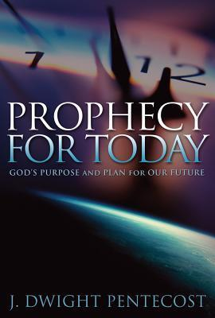
J. Dwight Pentecost
Prophecy For Today, Page 20
“A short time ago, I took occasion to go through the New Testament to mark each reference to the coming of the Lord Jesus Christ and to observe the use made of that teaching about His coming. I was struck a new with the fact that almost without exception, when the coming of Christ is mentioned in the New Testament, it is followed by an exhortation to godliness and holy living.”

Slide 18
Pauline Motives? (2:1-12)
2:1-2 – Message, motives, and method
2:3-12 – Elaboration
Message (2:3-4)
Motives (2:5-8)
Method (2:9-12)

Slide 19
Structure
Personal (1–3)
Genuine conversion (1)
Impure motives (2:1-16)
Lack of concern (2:17–3:13)
Practical (4–5)
Immorality (4:1-8)
Laziness (4:9-12)
Eschatology (4:13–5:11)
Ministry imbalances (5:12-15)
Progressive sanctification (5:16-28)

Slide 20
Genuine Conversion? (2:13-16)
2:13 – Changed lives
2:14-15 – Part of an elite group (Judean believers, Christ, apostles, and Paul)
2:16 – Wrath stored up against enemies (Rom 2:5; Gen 15:16)

Slide 21
Genuine Conversion? (2:13-16)
2:13 – Changed lives
2:14-15 – Part of an elite group (Judean believers, Christ, apostles, and Paul)
2:16 – Wrath stored up against enemies (Rom 2:5; Gen 15:16)

Slide 22
2 Peter 1:19-21
“¹⁹ So we have the prophetic word made more sure, to which you do well to pay attention as to a lamp shining in a dark place, until the day dawns and the morning star arises in your hearts. ²⁰ But know this first of all, that no prophecy of Scripture is a matter of one’s own interpretation, ²¹ for no prophecy was ever made by an act of human will, but men moved [pherō] by the Holy Spirit spoke from God.”

Slide 23
INSPIRATION OF SCRIPTURE V. 20-21
Men Wrote as they were inspired by Holy Spirit
“pherō” = to carry
Acts 27:15,17
Opposite of Knowledge of False Teachers
Which is their own imagination
Jer. 23:16

Slide 24
2 Timothy 3:16-17
“All Scripture is inspired by God [theopneustos] and profitable for teaching, for reproof, for correction, for training in righteousness; so that the man of God may be adequate, equipped for every good work.”
Notes:
hapaxlegomena

Slide 25
1 Timothy 4:13
“Until I come, give your attention to the public reading, to exhortation, and teaching.”

Slide 26
Emphasis of 2 Timothy
“By my count, there are twenty-seven explicit commands given in the body of this letter. In 27 words Paul tells pastors what to focus on. You have to be blind to miss the thrust of Paul's instructions here, because eighteen of those commands--fully two-thirds--have to do with the ministry of the Word.”
Daniel Wallace, “Crisis of the Word: A Message to Pastors or Would-be Pastors,”
Conservative Theological Journal 1, no. 2 (August 1997): 108.

Slide 27
Activities of the Local Church (Acts 2:41-47)
Doctrine (Acts 2:42)
Ordinances (Acts 2:41-42, 46)
Prayer (Acts 2:42)
Evangelism (Acts 2:47)
Worship (Acts 2:47)
Benevolence (Acts 2:44-45)
Fellowship (Acts 2:42, 46-47)

Slide 28
Activities of the Local Church (Acts 2:41-47)
Doctrine (Acts 2:42)
Ordinances (Acts 2:41-42, 46)
Prayer (Acts 2:42)
Evangelism (Acts 2:47)
Worship (Acts 2:47)
Benevolence (Acts 2:44-45)
Fellowship (Acts 2:42, 46-47)

Slide 29
Acts 2:42
“They were continually devoting themselves to the apostles’ teaching and to fellowship, to the breaking of bread and to prayer.”

Slide 30
Genuine Conversion? (2:13-16)
2:13 – Changed lives
2:14-15 – Part of an elite group (Judean believers, Christ, apostles, and Paul)
2:16 – Wrath stored up against enemies (Rom 2:5; Gen 15:16)

Slide 31
What Happened to Christ’s Disciples?
Disciple | Place | Martyrdom
James the Son of Alpheus | Jerusalem | Clubbed to death
Simon the Zealot | Jerusalem | Martyred
James the Son of Zebedee | Judea (Acts 12:2) | Executed
Thaddeus | Mesopotamia | Beaten to death
Peter | Babylon, Rome | Crucified upside down
Matthew | Parthia (Tehran) | Beheaded
Notes:
109 prophecies…
Peter Stoner – SCIENCE SPEAKS, An Evaluation of Certain Christian Evidences
To fulfill just 8 prophecies =1 X 10 to the twenty-eighth power!
Can we visualize this with an illustration? Suppose we took an atheistic professor, blindfolded him and covered the state of Texas two feet deep with silver dollars. Then we put a check on one of those silver dollars and mixed them up. The odds of one person fulfilling just these eight prophecies would be the same as this atheistic professor selecting the silver dollar upon which we have placed a check, in his first try.
https://www.bereanpublishers.com/the-odds-of-eight-messianic-prophecies-coming-true/

Slide 32
What Happened to Christ’s Disciples?
Disciple | Place | Martyrdom
John | Asia Minor, Patmos, Ephesus | Fried in boiling oil
Philip | E. Turkey | Tortured & crucified
Thomas | India | Speared
Bartholomew | India | Flayed & crucified
Andrew | Ukraine, Russia, Greece | Hanged
Notes:
109 prophecies…
Peter Stoner – SCIENCE SPEAKS, An Evaluation of Certain Christian Evidences
To fulfill just 8 prophecies =1 X 10 to the twenty-eighth power!
Can we visualize this with an illustration? Suppose we took an atheistic professor, blindfolded him and covered the state of Texas two feet deep with silver dollars. Then we put a check on one of those silver dollars and mixed them up. The odds of one person fulfilling just these eight prophecies would be the same as this atheistic professor selecting the silver dollar upon which we have placed a check, in his first try.
https://www.bereanpublishers.com/the-odds-of-eight-messianic-prophecies-coming-true/

Slide 33
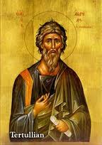
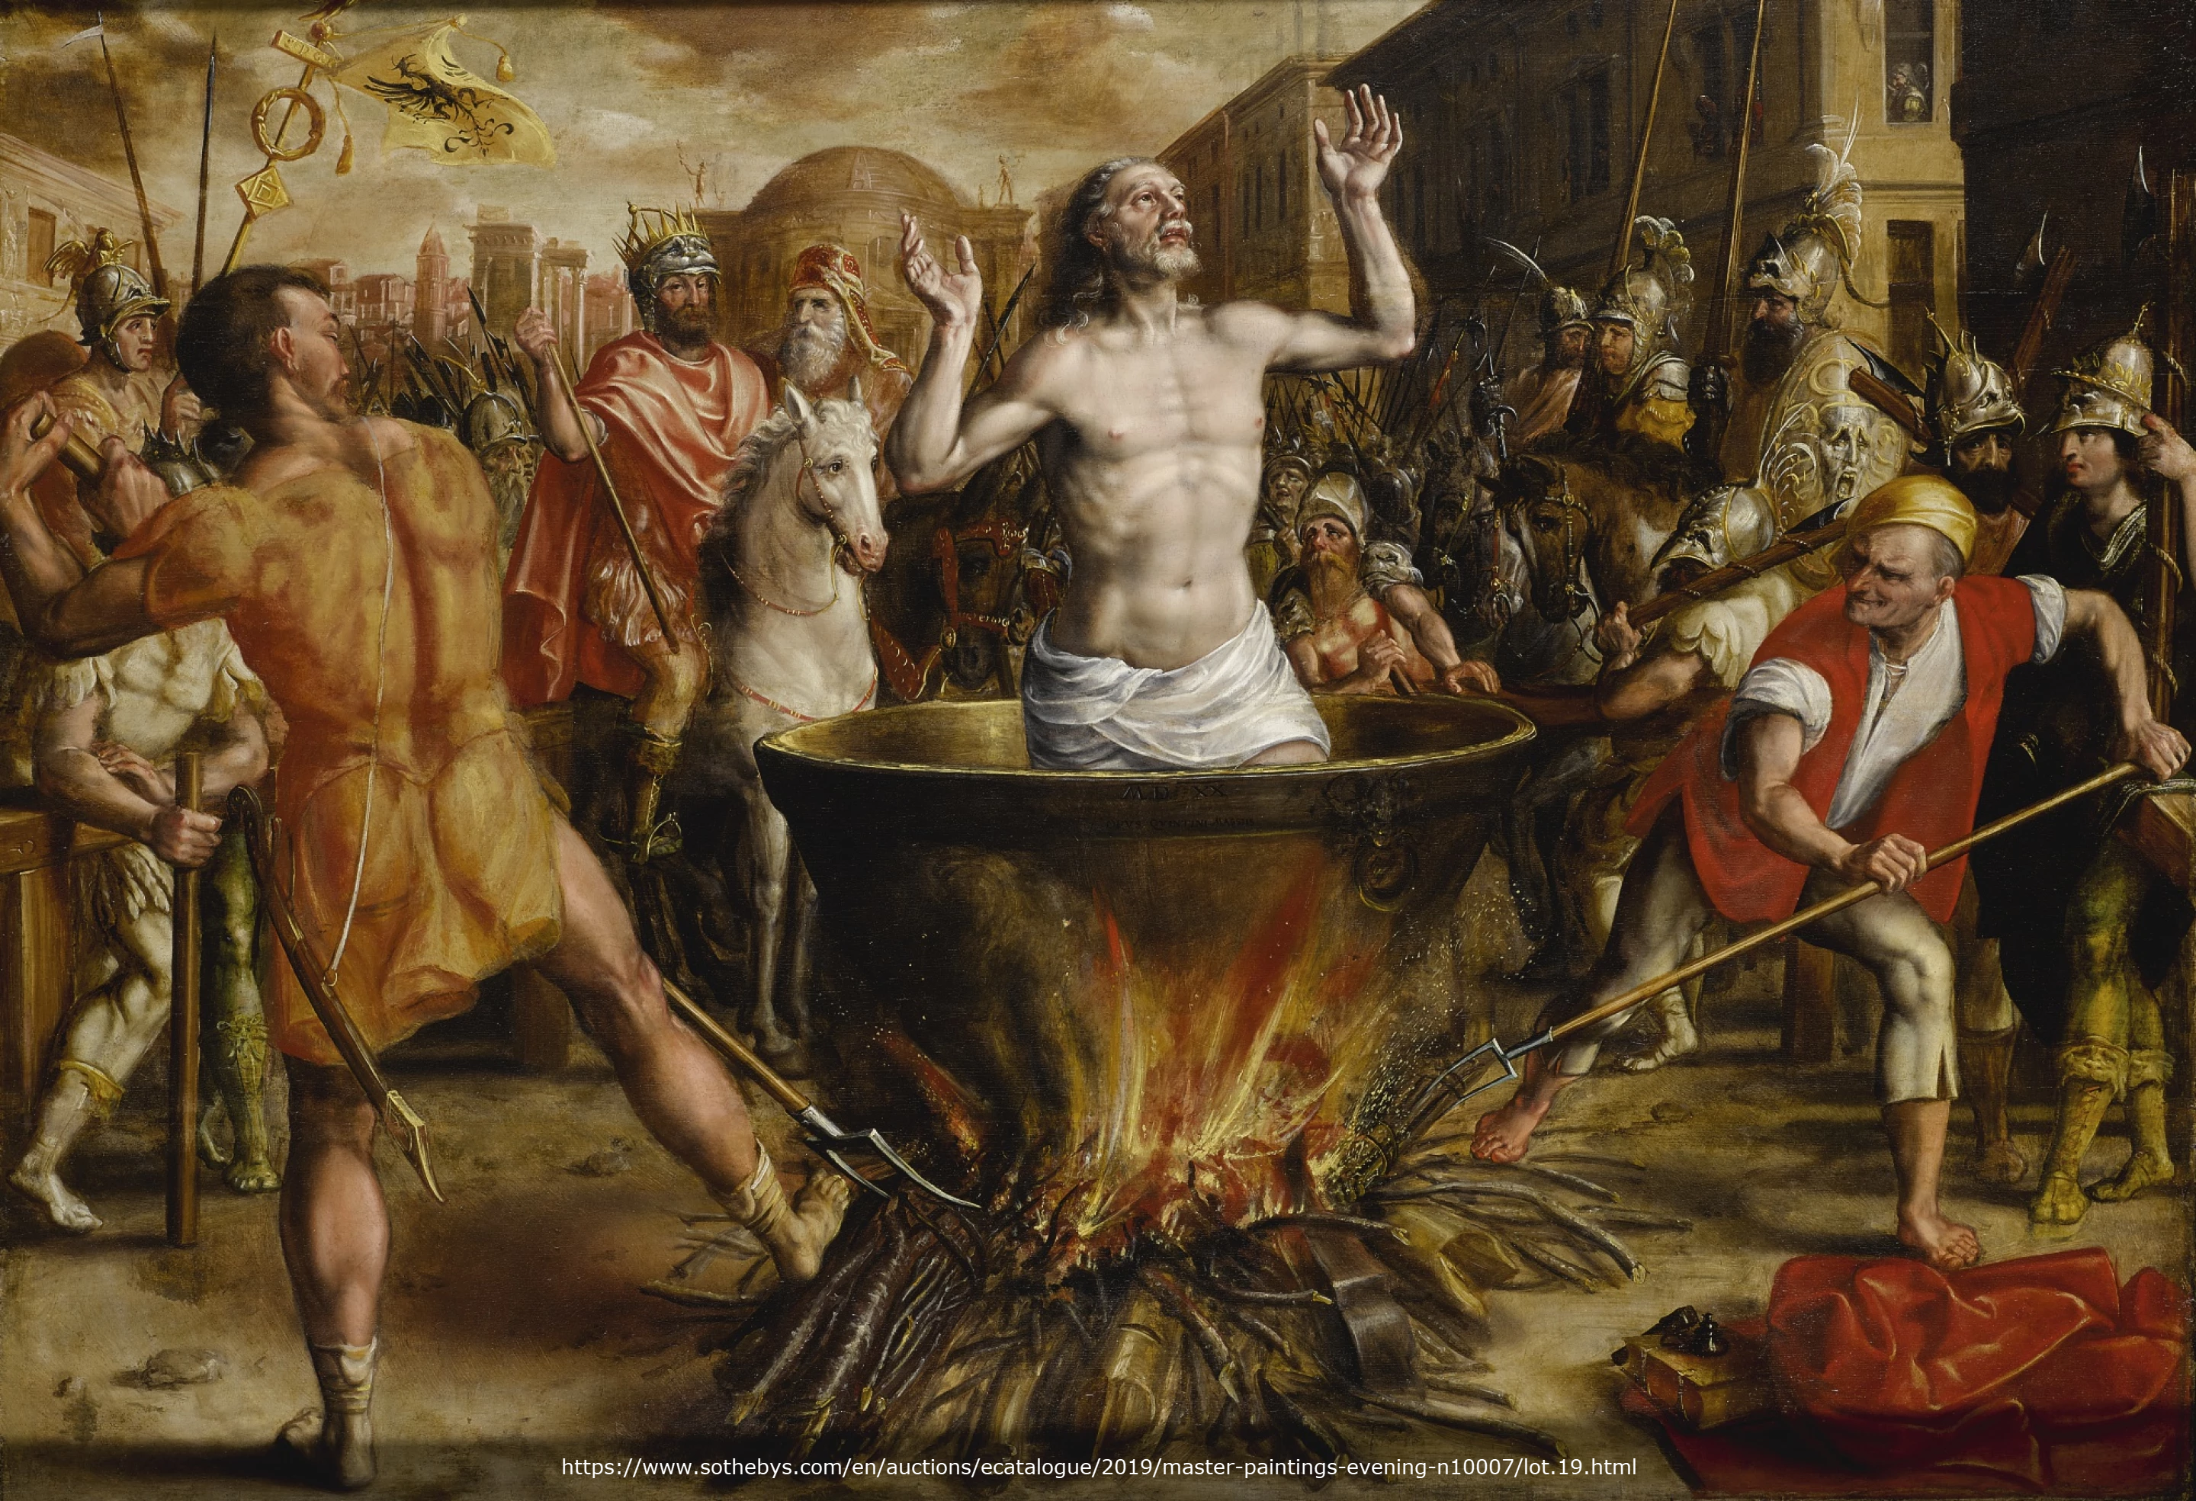
Tertullian Prescription Against Heretics, 36
“…where the Apostle John was first plunged, unhurt, into boiling oil, and thence remitted to his island-exile!”

Slide 34
Genuine Conversion? (2:13-16)
2:13 – Changed lives
2:14-15 – Part of an elite group (Judean believers, Christ, apostles, and Paul)
2:16 – Wrath stored up against enemies (Rom 2:5; Gen 15:16)

Slide 35
Genesis 15:16
“Then in the fourth generation they will return here, for the wrongdoing of the Amorite is not yet complete.”

Slide 36
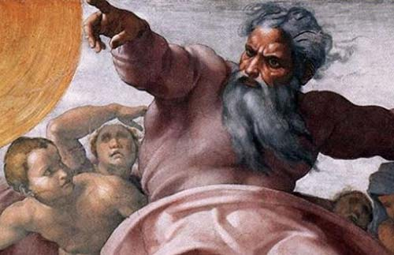
Romans 2:5
“But because of your stubbornness and unrepentant heart you are storing up wrath for yourself in the day of wrath and revelation of the righteous judgment of God.”

Slide 37
Genesis 6:1-3
“¹ Now it came about, when men began to multiply on the face of the land, and daughters were born to them, ² that the sons of God saw that the daughters of men were beautiful; and they took wives for themselves, whomever they chose. ³ Then the Lord said, “My Spirit shall not strive with man forever, because he also is flesh; nevertheless his days shall be one hundred and twenty years.”

Slide 38
Matthew 24:36-39
³⁶ “But of that day and hour no one knows, not even the angels of heaven, nor the Son, but the Father alone. ³⁷ For the coming of the Son of Man will be just like the days of Noah. ³⁸ For as in those days before the flood they were eating and drinking, marrying and giving in marriage, until the day that Noah entered the ark, ³⁹ and they did not understand until the flood came and took them all away; so will the coming of the Son of Man be.”

Slide 39
Conclusion

Slide 40
Genuine Conversion? (2:13-16)
2:13 – Changed lives
2:14-15 – Part of an elite group (Judean believers, Christ, apostles, and Paul)
2:16 – Wrath stored up against enemies (Rom 2:5; Gen 15:16)

Slide 41
Structure
Personal (1–3)
Genuine conversion (1)
Impure motives (2:1-16)
Lack of concern (2:17–3:13)
Practical (4–5)
Immorality (4:1-8)
Laziness (4:9-12)
Eschatology (4:13–5:11)
Ministry imbalances (5:12-15)
Progressive sanctification (5:16-28)

Slide 42
Lack of Concern? (2:17–3:13)
Paul’s plan to visit (2:17-18)
Paul’s concern for their glorification (2:19-20)
Timothy’s visit (3:1-5)
Relief at Timothy’s report (3:6-10)
Paul’s prayer (3:11-13)

