Slide 1
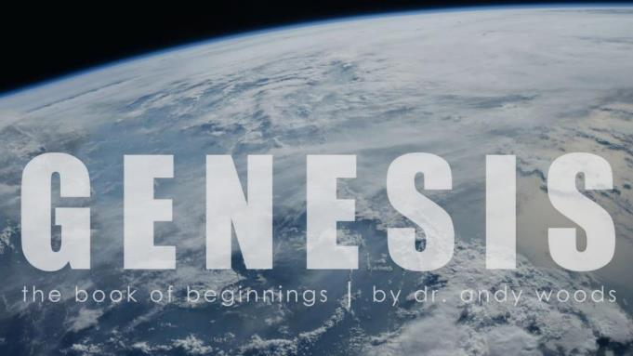
Genesis 12‒50
Israel’s Birth & Preservation

Slide 2
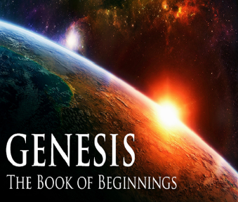
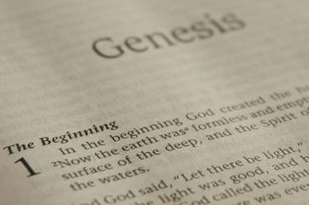
GENESIS STRUCTURE
Beginning of the Human race (Gen. 1‒11)
Beginning of the Hebrew race (Gen. 12‒50)

Slide 3
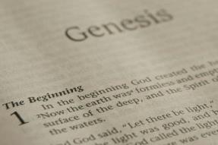
GENESIS STRUCTURE
Genesis 1-11 (four events)
Creation (1-2)
Fall (3-5)
Flood (6-9)
National dispersion (10-11)

Slide 4
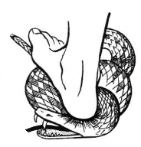
Genesis 3:15
“And I will put enmity Between you and the woman, And between your seed and her seed; He shall bruise you on the head, And you shall bruise him on the heel.”

Slide 5
GENESIS STRUCTURE
Beginning of the Human race (Gen. 1‒11)
Beginning of the Hebrew race (Gen. 12‒50)

Slide 6
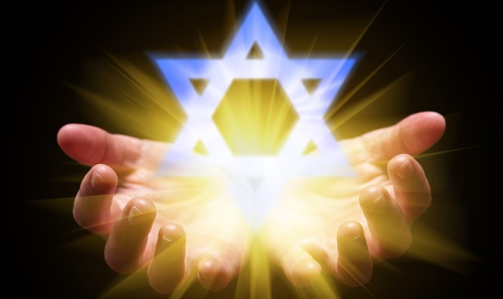
Isaiah 43:1
“But now, thus says the Lord, your Creator, O Jacob, And He who formed you, O Israel, 'Do not fear, for I have redeemed you; I have called you by name; you are Mine!'”

Slide 7
GENESIS STRUCTURE
Genesis 12-50 (four people)
Abraham (12:1–25:11)
Isaac (25:12–26:35)
Jacob (27–36)
Joseph (37–50)

Slide 8
Genesis 25 Chapter Summary
Abraham & Keturah (1-6)
Abraham’s death (8-11)
Ishmael’s Toledoth (12-18)
Birth of Jacob & Esau (19-26)
Selling of the birthright (27-34)

Slide 9
V. Genesis 25:27-34 Selling of the Birthright
Development of the boys (27)
Parental preferences (28)
Jacob purchases the birthright (29-34)

Slide 10
V. Genesis 25:27-34 Selling of the Birthright
Development of the boys (27)
Parental preferences (28)
Jacob purchases the birthright (29-34)

Slide 11
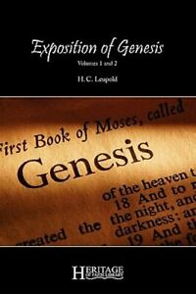
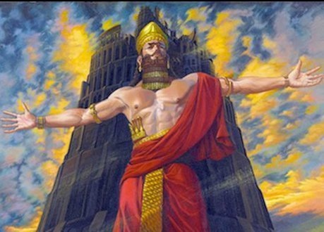
H. C. Leupold
H.C. Leupold, Exposition of Genesis, 1:366.
“For the meaning of the verb form nimrodh, without a doubt, is ‘let us revolt’.”

Slide 12
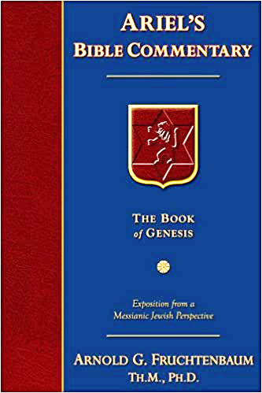
Dr. Arnold G. Fruchtenbaum
The Book of Genesis, 213
“Verse 9 deals with Nimrod’s relationship to God: He was a mighty hunter before Jehovah. The terminology implies antagonism; antagonism against and in opposition to God.”

Slide 13
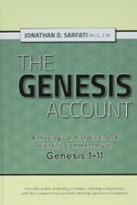
The Jerusalem Targum
Jonathan D. Sarfati, The Genesis Account: A Theological, Historical, and Scientific Commentary on Genesis 1‒11 (Powder Springs, GA: Creation Book Publishers, 2015), 642.
The Jerusalem Targum paraphrases this passage as follows: “He was powerful in hunting and in wickedness before the Lord for he was a hunter of the sons of men, as he said to them, ‘Depart from the judgment of the Lord and hear the judgement of Nimrod.’ Therefore, it is said as Nimrod the strong one, strong in hunting, and wickedness before the Lord.”

Slide 14
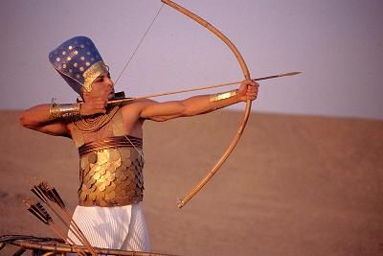
Dr. Arnold G. Fruchtenbaum
The Book of Genesis, 346
“He now became a hunter. In the context of Genesis, this is not a positive but a negative, as already indicated with Nimrod; for he, too, was a mighty hunter before the Lord.”

Slide 15
Dr. Arnold G. Fruchtenbaum
The Book of Genesis, 402
“Esau was a skillful hunter, just as Nimrod was a skillful hunter (10:8–12). In the context of Genesis, being a skillful hunter is not a positive statement, but a negative one. This is important because throughout church history, Jacob has received a lot of bad press. In most sermons, especially in Christian circles, Jacob is painted very negatively, and attributes are ascribed to Jacob that are not true to the Word of God and certainly do not correspond with God’s own evaluation of Jacob.”

Slide 16
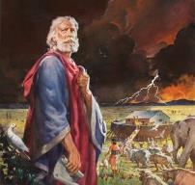
Genesis 6:8-9
“⁸ But Noah found favor in the eyes of the Lord. ⁹ These are the records of the generations of Noah. Noah was a righteous man, blameless in his time; Noah walked with God.”

Slide 17
Dr. Arnold G. Fruchtenbaum
The Book of Genesis, 403
“In other words, this word does not mean quiet, but perfect. Why is it not translated that way? The reason is not because it does not make sense in the text, but rather because it does not fit people’s preconceived notions about Jacob. This is the first of several examples where the biblical view of Jacob is opposite from the portrayal of all too many commentators and preachers.”

Slide 18
V. Genesis 25:27-34 Selling of the Birthright
Development of the boys (27)
Parental preferences (28)
Jacob purchases the birthright (29-34)

Slide 19
V. Genesis 25:27-34 Selling of the Birthright
Development of the boys (27)
Parental preferences (28)
Jacob purchases the birthright (29-34)

Slide 20
Genesis 25:29-34 Jacob Purchases the Birthright
Occasion (29)
Request (30)
Counter-offer (31)
Esau’s agreement (32)
Selling (33)
Payment (34a)
Conclusion (34b)

Slide 21
Genesis 25:29-34 Jacob Purchases the Birthright
Occasion (29)
Request (30)
Counter-offer (31)
Esau’s agreement (32)
Selling (33)
Payment (34a)
Conclusion (34b)

Slide 22
Genesis 25:29-34 Jacob Purchases the Birthright
Occasion (29)
Request (30)
Counter-offer (31)
Esau’s agreement (32)
Selling (33)
Payment (34a)
Conclusion (34b)

Slide 23
Genesis 25:29-34 Jacob Purchases the Birthright
Occasion (29)
Request (30)
Counter-offer (31)
Esau’s agreement (32)
Selling (33)
Payment (34a)
Conclusion (34b)

Slide 24
Dr. Arnold G. Fruchtenbaum
The Book of Genesis, 404
“In the Nuzi Tablets, the birthright was salable; the firstborn had the right to sell his birthright. Esau’s birthright included four elements: physical benefits (Deut. 21:17); spiritual benefits (I Chron. 5:1–2); being in the Messianic line, because this is the birthright of the Abrahamic Covenant; and the possession of the Land. Esau did not care anything about the spiritual benefits. Because the spiritual benefits were in the forefront, he did not particularly care to hang on to his birthright.”

Slide 25
Genesis 25:29-34 Jacob Purchases the Birthright
Occasion (29)
Request (30)
Counter-offer (31)
Esau’s agreement (32)
Selling (33)
Payment (34a)
Conclusion (34b)

Slide 26
Genesis 25:29-34 Jacob Purchases the Birthright
Occasion (29)
Request (30)
Counter-offer (31)
Esau’s agreement (32)
Selling (33)
Payment (34a)
Conclusion (34b)

Slide 27
Genesis 25:29-34 Jacob Purchases the Birthright
Occasion (29)
Request (30)
Counter-offer (31)
Esau’s agreement (32)
Selling (33)
Payment (34a)
Conclusion (34b)

Slide 28
Genesis 25:29-34 Jacob Purchases the Birthright
Occasion (29)
Request (30)
Counter-offer (31)
Esau’s agreement (32)
Selling (33)
Payment (34a)
Conclusion (34b)

Slide 29
2 Cor. 4:18
¹⁸ while we look not at the things which are seen, but at the things which are not seen; for the things which are seen are temporal, but the things which are not seen are eternal.

Slide 30
Conclusion

Slide 31
Genesis 25 Chapter Summary
Abraham & Keturah (1-6)
Abraham’s death (8-11)
Ishmael’s Toledoth (12-18)
Birth of Jacob & Esau (19-26)
Selling of the birthright (27-34)

Slide 32
V. Genesis 25:27-34 Selling of the Birthright
Development of the boys (27)
Parental preferences (28)
Jacob purchases the birthright (29-34)

Slide 33
Genesis 25:29-34 Jacob Purchases the Birthright
Occasion (29)
Request (30)
Counter-offer (31)
Esau’s agreement (32)
Selling (33)
Payment (34a)
Conclusion (34b)

Slide 34
²⁴ The Lord bless you, and keep you; ²⁵ The Lord make His face shine on you, And be gracious to you; ²⁶ The Lord lift up His countenance on you, And give you peace.
Numbers 6:24–26 (NASB95)

