Slide 1
Dr. Andy Woods
Senior Pastor – Sugar Land Bible Church
President – Chafer Theological Seminary

Slide 2
Introductory Matters
Authorship |  | Occasion
Recipients |  | Structure
Place of writing |  | Unique characteristics
Date |  | Purpose
Audience |  | Message

Slide 3
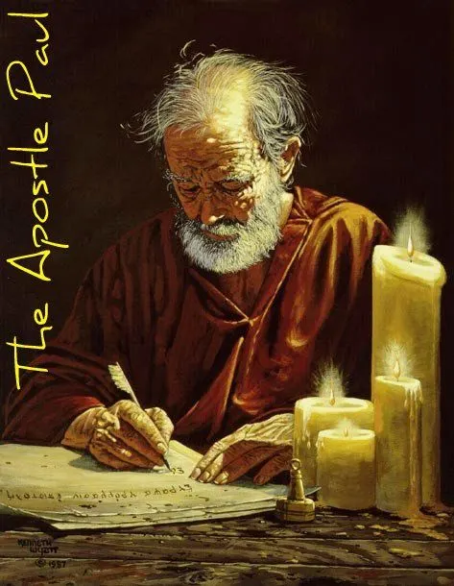
Structure
1 THESSALONIANS 1-3 | 1 THESSALONIANS 4-5
Personal Experience | Practical Exhortation
Looking Back | Looking Forward

Slide 4
Structure
Personal (1–3)
Genuine conversion (1)
Impure motives (2:1-16)
Lack of concern (2:17–3:13)
Practical (4–5)
Immorality (4:1-8)
Laziness (4:9-12)
Eschatology (4:13–5:11)
Ministry imbalances (5:12-15)
Progressive sanctification (5:16-28)

Slide 5
Structure
Personal (1–3)
Genuine conversion (1)
Impure motives (2:1-16)
Lack of concern (2:17–3:13)
Practical (4–5)
Immorality (4:1-8)
Laziness (4:9-12)
Eschatology (4:13–5:11)
Ministry imbalances (5:12-15)
Progressive sanctification (5:16-28)

Slide 6
Structure
Personal (1–3)
Genuine conversion (1)
Impure motives (2:1-16)
Lack of concern (2:17–3:13)
Practical (4–5)
Immorality (4:1-8)
Laziness (4:9-12)
Eschatology (4:13–5:11)
Ministry imbalances (5:12-15)
Progressive sanctification (5:16-28)

Slide 7
Genuine Conversion? (1 Thess 1)
Greeting (1:1)
Faith, hope, and love in Christ (1:2-3)
Response to the Gospel (1:4-5)
Joy in the midst of tribulation (1:6)
Example to those in Macedonia and Achaia (1:7)
No formal missionary endeavor (1:8-9a)
Turned from idols (1:9b)
Eschatological hope (1:10)

Slide 8
Structure
Personal (1–3)
Genuine conversion (1)
Impure motives (2:1-16)
Lack of concern (2:17–3:13)
Practical (4–5)
Immorality (4:1-8)
Laziness (4:9-12)
Eschatology (4:13–5:11)
Ministry imbalances (5:12-15)
Progressive sanctification (5:16-28)

Slide 9
Pauline Motives? (2:1-12)
2:1-2-Message, motives, and method
2:3-12-Elaboration
Message (2:3-4)
Motives (2:5-8)
Method (2:9-12)

Slide 10
Pauline Motives? (2:1-12)
2:1-2-Message, motives, and method
2:3-12-Elaboration
Message (2:3-4)
Motives (2:5-8)
Method (2:9-12)

Slide 11
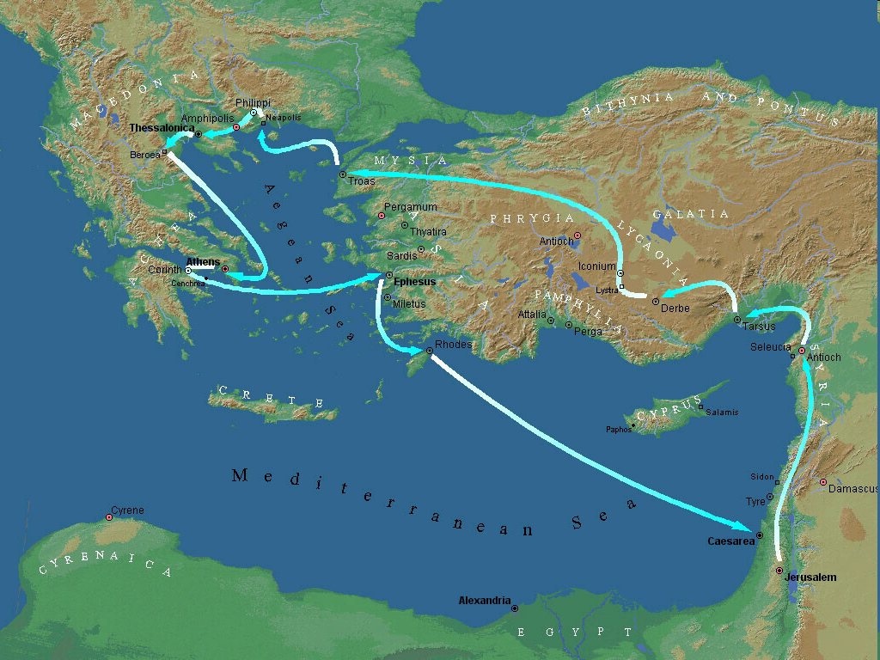
Second Missionary Journey

Slide 12
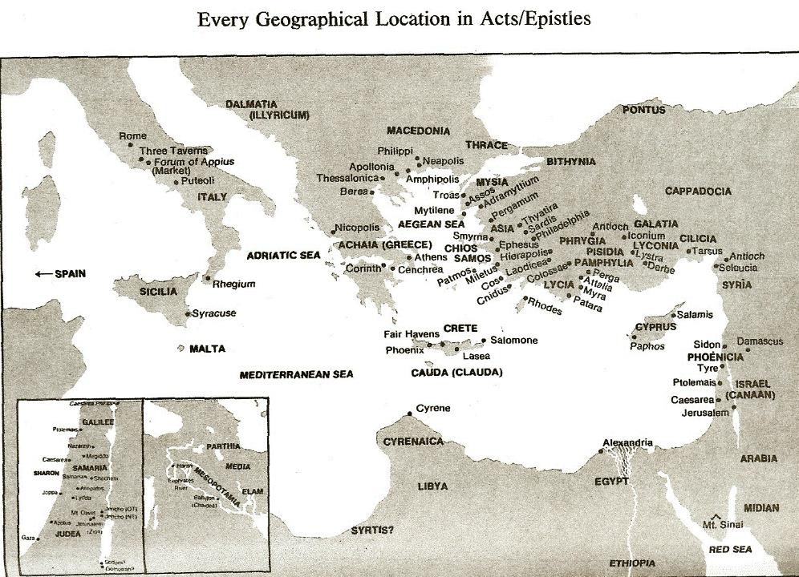

Slide 13
Pauline Motives? (2:1-12)
2:1-2 – Message, motives, and method
2:3-12 – Elaboration
Message (2:3-4)
Motives (2:5-8)
Method (2:9-12)

Slide 14
Pauline Motives? (2:1-12)
2:1-2 – Message, motives, and method
2:3-12 – Elaboration
Message (2:3-4)
Motives (2:5-8)
Method (2:9-12)

Slide 15
1 Corinthians 4:2
“In this case, moreover, it is required of stewards that one be found trustworthy.”

Slide 16
Pauline Motives? (2:1-12)
2:1-2 – Message, motives, and method
2:3-12 – Elaboration
Message (2:3-4)
Motives (2:5-8)
Method (2:9-12)

Slide 17
Pauline Motives? (2:1-12)
2:1-2 – Message, motives, and method
2:3-12 – Elaboration
Message (2:3-4)
Motives (2:5-8)
Method (2:9-12)

Slide 18
1 Thessalonians 2:12
“So that you would walk in a manner worthy of the God who calls you into [eis] His own kingdom and glory.”

Slide 19
1 Thessalonians 2:12
“So that you would walk in a manner worthy of the God who calls you into [eis] His own kingdom and glory.”

Slide 20
1 Thessalonians 2:12
“So that you would walk in a manner worthy of the God who calls you into [eis] His own kingdom and glory.”

Slide 21
Three Tenses of Salvation
Phase | Justification | Sanctification | Glorification
Tense | Past | Present | Future
Saved from sin’s: | Penalty | Power | Presence
Scripture | Eph 2:8-9; Titus 3:5 | Philip 2:12 | Rom 5:10

Slide 22
E.R. Craven “Excursus on the Basileia,” in Revelation of John, J. P. Lange (New York: Scribner, 1874), 97.
“The preposition in the Greek is εἰς. But since believers on earth are not yet in glory, the whole expression is manifestly *proleptical, and the E. V. gives the translation, unto.”
*proleptical – the representation of something in the future as if it already existed or had occurred.

Slide 24
2 Peter 3:10-11
“¹⁰ But the day of the Lord will come like a thief, in which the heavens will pass away with a roar and the elements will be destroyed with intense heat, and the earth and its works will be burned up. ¹¹ Since all these things are to be destroyed in this way, what sort of people ought you to be in holy conduct and godliness.”

Slide 25
J. Dwight Pentecost
Prophecy For Today, Page 20
“A short time ago, I took occasion to go through the New Testament to mark each reference to the coming of the Lord Jesus Christ and to observe the use made of that teaching about His coming. I was struck a new with the fact that almost without exception, when the coming of Christ is mentioned in the New Testament, it is followed by an exhortation to godliness and holy living.”

Slide 26
Conclusion

Slide 27
Pauline Motives? (2:1-12)
2:1-2 – Message, motives, and method
2:3-12 – Elaboration
Message (2:3-4)
Motives (2:5-8)
Method (2:9-12)

Slide 28
Structure
Personal (1–3)
Genuine conversion (1)
Impure motives (2:1-16)
Lack of concern (2:17–3:13)
Practical (4–5)
Immorality (4:1-8)
Laziness (4:9-12)
Eschatology (4:13–5:11)
Ministry imbalances (5:12-15)
Progressive sanctification (5:16-28)

