Slide 1
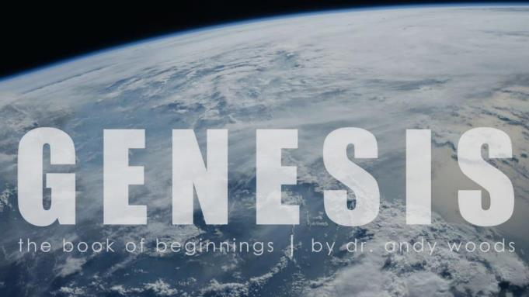
Genesis 12‒50
Israel’s Birth & Preservation

Slide 2
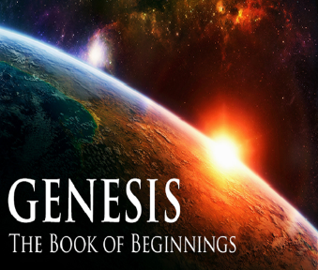
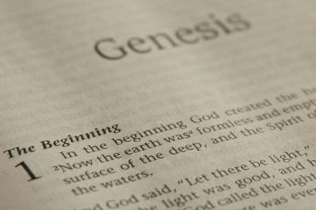
GENESIS STRUCTURE
Beginning of the Human race (Gen. 1‒11)
Beginning of the Hebrew race (Gen. 12‒50)

Slide 3
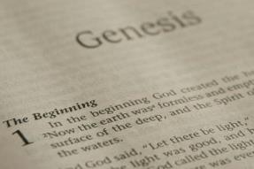
GENESIS STRUCTURE
Genesis 1-11 (four events)
Creation (1-2)
Fall (3-5)
Flood (6-9)
National dispersion (10-11)

Slide 4
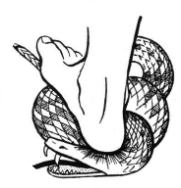
Genesis 3:15
“And I will put enmity Between you and the woman, And between your seed and her seed; He shall bruise you on the head, And you shall bruise him on the heel.”

Slide 5
GENESIS STRUCTURE
Beginning of the Human race (Gen. 1‒11)
Beginning of the Hebrew race (Gen. 12‒50)

Slide 6
GENESIS STRUCTURE
Genesis 12-50 (four people)
Abraham (12:1–25:11)
Isaac (25:12–26:35)
Jacob (27–36)
Joseph (37–50)

Slide 7
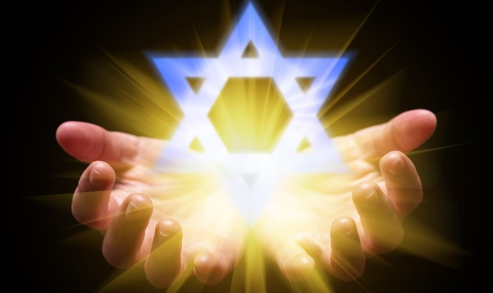
Isaiah 43:1
“But now, thus says the Lord, your Creator, O Jacob, And He who formed you, O Israel, 'Do not fear, for I have redeemed you; I have called you by name; you are Mine!'”

Slide 8
GENESIS STRUCTURE
Genesis 12-50 (four people)
Abraham (12:1–25:11)
Isaac (25:12–26:35)
Jacob (27–36)
Joseph (37–50)

Slide 9
Genesis 12‒25 Abraham’s Early Journeys
Unconditional promises (Gen. 12:1-3) From Haran to Canaan (Gen. 12:4-5) In Canaan (Gen. 12:6-9) In Egypt (Gen. 12:10-20) Abram and Lot Separate (Gen. 13:1-13) Reaffirmation of Abram’s promises (Gen. 13:14-18) Abram Rescues Lot (14:1-24) Abrahamic Covenant (15:1-21) Hagar & Ishmael (16:1-16) Circumcision (Gen. 17:1-27) | Sodom & Gomorrah (Gen. 18‒19) Abraham & Abimelech (Gen. 20) Isaac’s birth (Gen. 21:1-7) Ishmael’s expulsion (21:8-21) Abraham & Abimelech’s covenant (21:22-34) Abraham sacrifices Isaac (22) Sarah’s death (23) Isaac’s marriage (24) Abraham & Keturah (25:1-6) Abraham’s death (25:7-11)

Slide 10
Genesis 25 Chapter Summary
Abraham & Keturah (1-6)
Abraham’s death (8-11)
Ishmael’s Toledoth (12-18)
Birth of Jacob & Esau (19-26)
Selling of the birthright (27-34)

Slide 11
Genesis 25 Chapter Summary
Abraham & Keturah (1-6)
Abraham’s death (8-11)
Ishmael’s Toledoth (12-18)
Birth of Jacob & Esau (19-26)
Selling of the birthright (27-34)

Slide 12
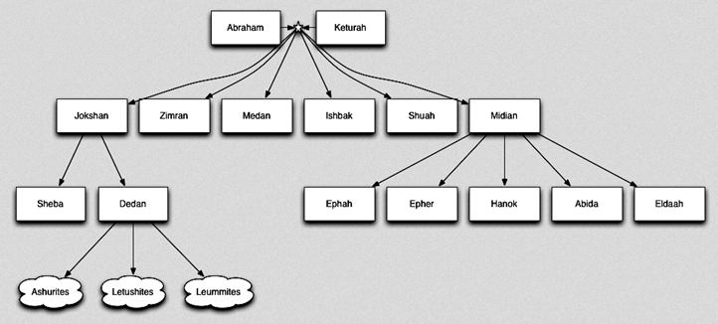

Slide 13
Genesis 25 Chapter Summary
Abraham & Keturah (1-6)
Abraham’s death (8-11)
Ishmael’s Toledoth (12-18)
Birth of Jacob & Esau (19-26)
Selling of the birthright (27-34)

Slide 14
II. Genesis 25:7-11 Abraham’s Death
Abraham’s age (7)
Abraham’s death (8)
Abraham’s burial (9-10)
Isaac’s blessing (11)

Slide 15
Genesis 25 Chapter Summary
Abraham & Keturah (1-6)
Abraham’s death (8-11)
Ishmael’s Toledoth (12-18)
Birth of Jacob & Esau (19-26)
Selling of the birthright (27-34)

Slide 16
III. Genesis 25:12-18 The Generations of Ishmael
Ishmael’s toledoth (12a)
Ishmael’s identification (12b)
Ishmael’s 12 sons (13-16)
Ishmael’s death (17)
Ishmael’s territory (18)

Slide 17
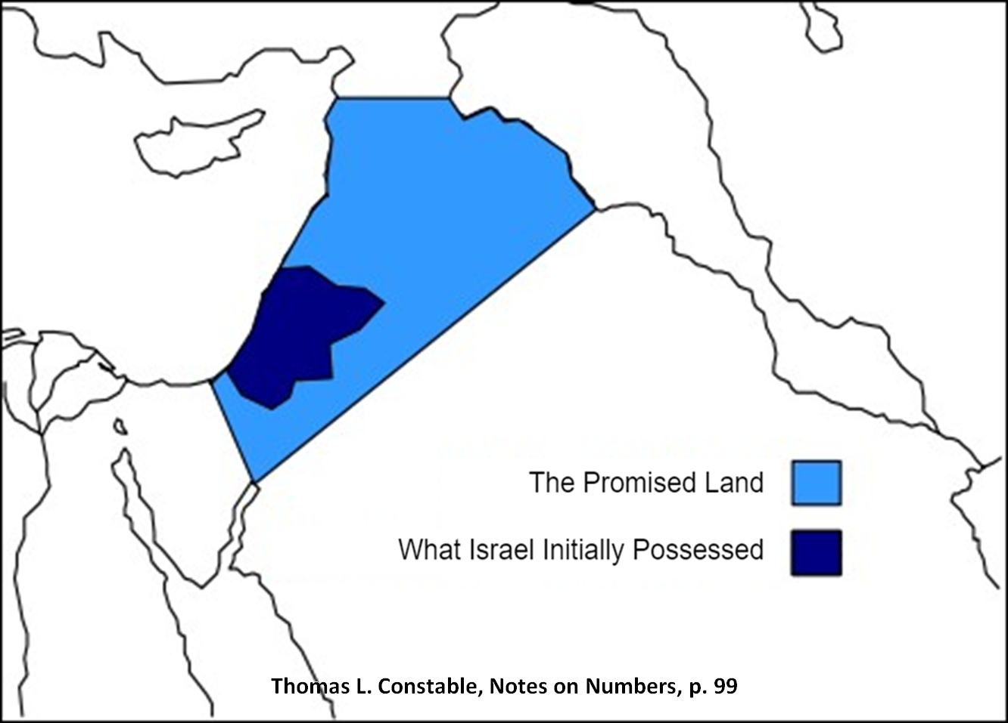
Assyria
Havilah (?)
Egypt
Shur

Slide 18
GENESIS STRUCTURE
Genesis 12-50 (four people)
Abraham (12:1–25:11)
Isaac (25:12–26:35)
Jacob (27–36)
Joseph (37–50)

Slide 19
Genesis 25 Chapter Summary
Abraham & Keturah (1-6)
Abraham’s death (8-11)
Ishmael’s Toledoth (12-18)
Birth of Jacob & Esau (19-26)
Selling of the birthright (27-34)

Slide 20
IV. Genesis 25:19-26 Birth of Jacob & Esau
Isaac’s toledoth (19a)
Hebrew line (19b)
Isaac’s age (20a)
Rebekah’s lineage (20b)
Isaac’s intercession (21a)
Rebekah’s conception (21b)
Struggle in Rebekah’s womb (22a)
Rebekah’s prayer (22b)
God’s prophecy (23)
Birth of the twins (24-26)

Slide 21
IV. Genesis 25:19-26 Birth of Jacob & Esau
Isaac’s toledoth (19a)
Hebrew line (19b)
Isaac’s age (20a)
Rebekah’s lineage (20b)
Isaac’s intercession (21a)
Rebekah’s conception (21b)
Struggle in Rebekah’s womb (22a)
Rebekah’s prayer (22b)
God’s prophecy (23)
Birth of the twins (24-26)

Slide 22
Toledoth “And These Are the Generations of…”
Introduction to the generations (1:1–2:3)
Generations of the heaven and earth (2:4–4:26)
Generations of Adam (5:1–6:8)
Generations of Noah (6:9–9:29)
Generations of the sons of Noah (10:1–11:9)
Generations of Shem (11:10–26)
Generations of Terah (11:27–25:11)
Generations of Ishmael (25:12-18)
Generations of Isaac (25:19–35:29)
Generations of Esau (36:1–37:1)
Generations of Jacob (37:2–50:26)

Slide 24
Luke 1:1–4
¹ Inasmuch as many have undertaken to compile an account of the things accomplished among us, ² just as they were handed down to us by those who from the beginning were eyewitnesses and servants of the word, ³ it seemed fitting for me as well, having investigated everything carefully from the beginning, to write it out for you in consecutive order, most excellent Theophilus; ⁴ so that you may know the exact truth about the things you have been taught.

Slide 25
IV. Genesis 25:19-26 Birth of Jacob & Esau
Isaac’s toledoth (19a)
Hebrew line (19b)
Isaac’s age (20a)
Rebekah’s lineage (20b)
Isaac’s intercession (21a)
Rebekah’s conception (21b)
Struggle in Rebekah’s womb (22a)
Rebekah’s prayer (22b)
God’s prophecy (23)
Birth of the twins (24-26)

Slide 26
IV. Genesis 25:19-26 Birth of Jacob & Esau
Isaac’s toledoth (19a)
Hebrew line (19b)
Isaac’s age (20a)
Rebekah’s lineage (20b)
Isaac’s intercession (21a)
Rebekah’s conception (21b)
Struggle in Rebekah’s womb (22a)
Rebekah’s prayer (22b)
God’s prophecy (23)
Birth of the twins (24-26)

Slide 27
IV. Genesis 25:19-26 Birth of Jacob & Esau
Isaac’s toledoth (19a)
Hebrew line (19b)
Isaac’s age (20a)
Rebekah’s lineage (20b)
Isaac’s intercession (21a)
Rebekah’s conception (21b)
Struggle in Rebekah’s womb (22a)
Rebekah’s prayer (22b)
God’s prophecy (23)
Birth of the twins (24-26)

Slide 28
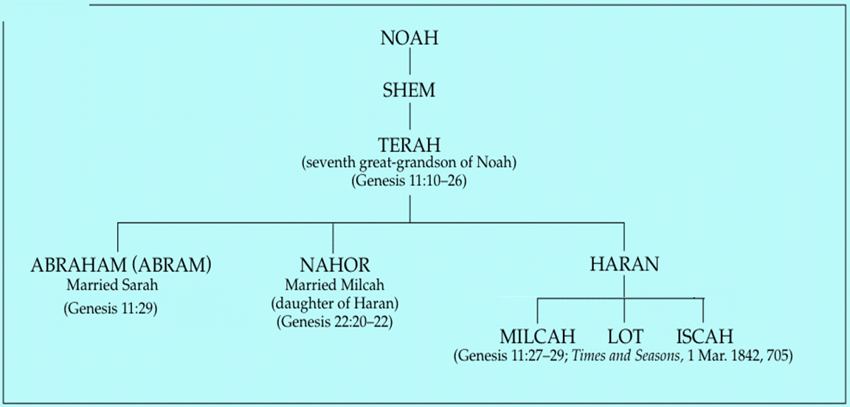

Slide 29
Genesis 22:20-24 Rebekah’s Lineage
Timing (20a)
Nahor’s children (20b-24)
From Milcah (20b-23)
From Reumah (24)

Slide 30
Nahor’s children through Milcah (Gen. 22:20b-23)
1. Uz (Job 1:1) | 5. Hazo
2. Buz | 6. Pildash
3. Aram | 7. Jidlaph
4. Chesed | 8. Bethuel (Gen. 24)

Slide 31
IV. Genesis 25:19-26 Birth of Jacob & Esau
Isaac’s toledoth (19a)
Hebrew line (19b)
Isaac’s age (20a)
Rebekah’s lineage (20b)
Isaac’s intercession (21a)
Rebekah’s conception (21b)
Struggle in Rebekah’s womb (22a)
Rebekah’s prayer (22b)
God’s prophecy (23)
Birth of the twins (24-26)

Slide 32
IV. Genesis 25:19-26 Birth of Jacob & Esau
Isaac’s toledoth (19a)
Hebrew line (19b)
Isaac’s age (20a)
Rebekah’s lineage (20b)
Isaac’s intercession (21a)
Rebekah’s conception (21b)
Struggle in Rebekah’s womb (22a)
Rebekah’s prayer (22b)
God’s prophecy (23)
Birth of the twins (24-26)

Slide 33
Genesis 3:15
“And I will put enmity Between you and the woman, And between your seed and her seed; He shall bruise you on the head, And you shall bruise him on the heel.”

Slide 34
Genesis 12‒24 Abraham’s Early Journeys
Unconditional promises (Gen. 12:1-3) From Haran to Canaan (Gen. 12:4-5) In Canaan (Gen. 12:6-9) In Egypt (Gen. 12:10-20) Abram and Lot Separate (Gen. 13:1-13) Reaffirmation of Abram’s promises (Gen. 13:14-18) Abram Rescues Lot (14:1-24) Abrahamic Covenant (15:1-21) Hagar & Ishmael (16:1-16) Circumcision (Gen. 17:1-27) | Sodom & Gomorrah (Gen. 18‒19) Abraham & Abimelech (Gen. 20) Isaac’s birth (Gen. 21:1-7) Ishmael’s expulsion (21:8-21) Abraham & Abimelech’s covenant (21:22-34) Abraham sacrifices Isaac (22) Sarah’s death (23) Isaac’s marriage (24) Abraham’s death (25)

Slide 35
IV. Genesis 25:19-26 Birth of Jacob & Esau
Isaac’s toledoth (19a)
Hebrew line (19b)
Isaac’s age (20a)
Rebekah’s lineage (20b)
Isaac’s intercession (21a)
Rebekah’s conception (21b)
Struggle in Rebekah’s womb (22a)
Rebekah’s prayer (22b)
God’s prophecy (23)
Birth of the twins (24-26)

Slide 36
IV. Genesis 25:19-26 Birth of Jacob & Esau
Isaac’s toledoth (19a)
Hebrew line (19b)
Isaac’s age (20a)
Rebekah’s lineage (20b)
Isaac’s intercession (21a)
Rebekah’s conception (21b)
Struggle in Rebekah’s womb (22a)
Rebekah’s prayer (22b)
God’s prophecy (23)
Birth of the twins (24-26)

Slide 37
IV. Genesis 25:19-26 Birth of Jacob & Esau
Isaac’s toledoth (19a)
Hebrew line (19b)
Isaac’s age (20a)
Rebekah’s lineage (20b)
Isaac’s intercession (21a)
Rebekah’s conception (21b)
Struggle in Rebekah’s womb (22a)
Rebekah’s prayer (22b)
God’s prophecy (23)
Birth of the twins (24-26)

Slide 38
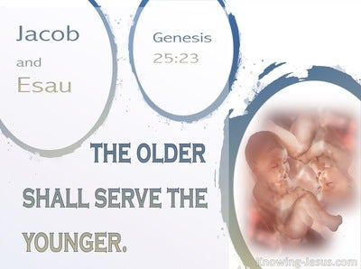
Genesis 25:23
“The Lord said to her, ‘Two nations are in your womb; And two peoples will be separated from your body; And one people shall be stronger than the other; And the older shall serve the younger.’”

Slide 39
Genesis 25:23
“The Lord said to her, ‘Two nations are in your womb; And two peoples will be separated from your body; And one people shall be stronger than the other; And the older shall serve the younger.’”

Slide 40
Genesis 25:23
“The Lord said to her, ‘Two nations are in your womb; And two peoples will be separated from your body; And one people shall be stronger than the other; And the older shall serve the younger.’”

Slide 41
Genesis 25:23
“The Lord said to her, ‘Two nations are in your womb; And two peoples will be separated from your body; And one people shall be stronger than the other; And the older shall serve the younger.’”

Slide 42
Genesis 25:23
“The Lord said to her, ‘Two nations are in your womb; And two peoples will be separated from your body; And one people shall be stronger than the other; And the older shall serve the younger.’”

Slide 43
Cain Murders Abel (4:3-8)
4:3-5a
Messianic line through Abel (Gen 3:21; Heb 11:4) contrary to Eve’s false expectation (4:1)
Begins selection of younger over older pattern (Abel over Cain, Seth over Cain, Shem over Japheth, Isaac over Ishmael, Jacob over Esau, Judah and Joseph over their brothers, and Ephraim over Manasseh)

Slide 44
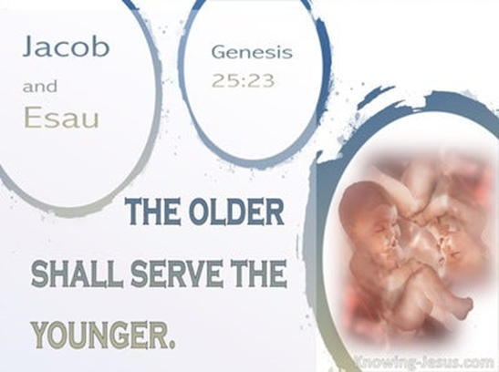
Charles Ryrie Ryrie Study Bible, page 33
Genesis 25:22-23: “The struggle within Rebekah’s womb foreshadowed the struggle between the two peoples (the Edomites and the Israelites) of which Esau and Jacob were the progenitors.”﻿

Slide 45
John 13:19; 14:29
“^{13:19} From now on I am telling you before it comes to pass, so that when it does occur, you may believe that I am He… ^{14:29} Now I have told you before it happens, so that when it happens, you may believe.”

Slide 47
IV. Genesis 25:19-26 Birth of Jacob & Esau
Isaac’s toledoth (19a)
Hebrew line (19b)
Isaac’s age (20a)
Rebekah’s lineage (20b)
Isaac’s intercession (21a)
Rebekah’s conception (21b)
Struggle in Rebekah’s womb (22a)
Rebekah’s prayer (22b)
God’s prophecy (23)
Birth of the twins (24-26)

Slide 48
Genesis 25:24-26 Birth of the Twins
Births (24)
Esau (25)
Jacob (26a)
Isaac’s age (26b)

Slide 49
Genesis 25:24-26 Birth of the Twins
Births (24)
Esau (25)
Jacob (26a)
Isaac’s age (26b)

Slide 50
Genesis 25:24-26 Birth of the Twins
Births (24)
Esau (25)
Jacob (26a)
Isaac’s age (26b)

Slide 51
Genesis 25:24-26 Birth of the Twins
Births (24)
Esau (25)
Jacob (26a)
Isaac’s age (26b)

Slide 52
Genesis 25:23
“The Lord said to her, ‘Two nations are in your womb; And two peoples will be separated from your body; And one people shall be stronger than the other; And the older shall serve the younger.’”

Slide 53
Luke 19:41-44
“⁴¹ When He approached Jerusalem, He saw the city and wept over it, ⁴² saying, ‘If you had known in this day, even you, the things which make for peace! But now they have been hidden from your eyes. ⁴³ For the days will come upon you when your enemies will throw up a barricade against you, and surround you and hem you in on every side, ⁴⁴ and they will level you to the ground and your children within you, and they will not leave in you one stone upon another, because you did not recognize the time of your visitation.’”

Slide 54
SLBC Position Statements # 1
SANCTITY OF LIFE – We believe that the fetus, from the moment of conception, is a person (Psalm 139:13-18). We also believe that all persons are created in the image of God regardless of age, health, function and/or condition of dependency.

Slide 55
Genesis 25:24-26 Birth of the Twins
Births (24)
Esau (25)
Jacob (26a)
Isaac’s age (26b)

Slide 56
Conclusion

Slide 57
IV. Genesis 25:19-26 Birth of Jacob & Esau
Isaac’s toledoth (19a)
Hebrew line (19b)
Isaac’s age (20a)
Rebekah’s lineage (20b)
Isaac’s intercession (21a)
Rebekah’s conception (21b)
Struggle in Rebekah’s womb (22a)
Rebekah’s prayer (22b)
God’s prophecy (23)
Birth of the twins (24-26)

Slide 58
Genesis 25 Chapter Summary
Abraham & Keturah (1-6)
Abraham’s death (8-11)
Ishmael’s Toledoth (12-18)
Birth of Jacob & Esau (19-26)
Selling of the birthright (27-34)

Slide 59
²⁴ The Lord bless you, and keep you; ²⁵ The Lord make His face shine on you, And be gracious to you; ²⁶ The Lord lift up His countenance on you, And give you peace.
Numbers 6:24–26 (NASB95)

