Slide 1
Dr. Andy Woods
Senior Pastor – Sugar Land Bible Church
President – Chafer Theological Seminary

Slide 2
Introductory Matters
Authorship |  | Occasion
Recipients |  | Structure
Place of writing |  | Unique characteristics
Date |  | Purpose
Audience |  | Message

Slide 3
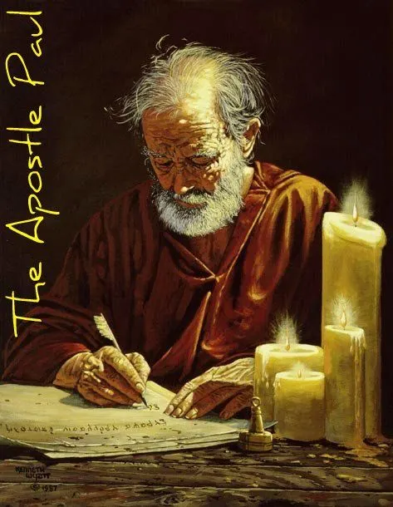
Structure
1 THESSALONIANS 1-3 | 1 THESSALONIANS 4-5
Personal Experience | Practical Exhortation
Looking Back | Looking Forward

Slide 4
Structure
Personal (1–3)
Genuine conversion (1)
Impure motives (2:1-16)
Lack of concern (2:17–3:13)
Practical (4–5)
Immorality (4:1-8)
Laziness (4:9-12)
Eschatology (4:13–5:11)
Ministry imbalances (5:12-15)
Progressive sanctification (5:16-28)

Slide 5
Structure
Personal (1–3)
Genuine conversion (1)
Impure motives (2:1-16)
Lack of concern (2:17–3:13)
Practical (4–5)
Immorality (4:1-8)
Laziness (4:9-12)
Eschatology (4:13–5:11)
Ministry imbalances (5:12-15)
Progressive sanctification (5:16-28)

Slide 6
Structure
Personal (1–3)
Genuine conversion (1)
Impure motives (2:1-16)
Lack of concern (2:17–3:13)
Practical (4–5)
Immorality (4:1-8)
Laziness (4:9-12)
Eschatology (4:13–5:11)
Ministry imbalances (5:12-15)
Progressive sanctification (5:16-28)

Slide 7
Genuine Conversion? (1 Thess 1)
Greeting (1:1)
Faith, hope, and love in Christ (1:2-3)
Response to the Gospel (1:4-5)
Joy in the midst of tribulation (1:6)
Example to those in Macedonia and Achaia (1:7)
No formal missionary endeavor (1:8-9a)
Turned from idols (1:9b)
Eschatological hope (1:10)

Slide 8
Unique Characteristics
Every chapter ends with a reference to the Second Advent
Small amount of time in between planting of the church and the first letter to the church

Slide 9
1 Thessalonians 4:13-18
¹³ "But we do not want you to be uninformed, brethren, about those who are asleep, so that you will not grieve as do the rest who have no hope. ¹⁴ For if we believe that Jesus died and rose again, even so God will bring with Him those who have fallen asleep in Jesus. ¹⁵ For this we say to you by the word of the Lord, that we who are alive and remain until the coming of the Lord, will not precede those who have fallen asleep. ¹⁶ For the Lord Himself will descend from . . .

Slide 10
1 Thessalonians 4:13-18
. . .heaven with a shout, with the voice of the archangel and with the trumpet of God, and the dead in Christ will rise first. ¹⁷ Then we who are alive and remain will be caught up together with them in the clouds to meet the Lord in the air, and so we shall always be with the Lord. ¹⁸ Therefore comfort one another with these words."

Slide 11
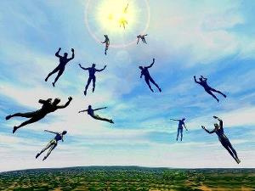
Imminent (1 Cor 15:51; 1 Thess 4:15)
Imminency definition
James 5:8; 1 Thess 1:10; 1 Cor 1:7; Philip 3:20
We are to be looking for Jesus Christ and not the Antichrist!
Motivator (Holiness, Evangelism)

Slide 12
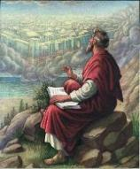
John 14:1–4
¹ “Do not let your heart be troubled; believe in God, believe also in Me. ² In My Father’s house are many dwelling places; if it were not so, I would have told you; for I go to prepare a place for you. ³ If I go and prepare a place for you, I will come again and receive you to Myself, that where I am, there you may be also. ⁴ And you know the way where I am going.”

Slide 13
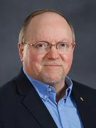
Wayne Brindle
"Biblical Evidence for the Imminence of the Rapture," Bibliotheca Sacra 158, no. 630 (April-June 2001): 138-51.
“Four criteria may be suggested, any one of which indicates imminence: (1) The passage speaks of Christ’s return as at any moment. (2) The passage speaks of Christ’s return as ‘near,’ without stating any signs that must precede His coming. (3) The passage speaks of Christ’s return as something that gives believers hope and encouragement, without indicating that these believers will suffer tribulation. (4) The passage speaks of Christ’s return as giving hope without relating it to God’s judgment of unbelievers.”

Slide 16
Lewis Sperry Chafer
Systematic Theology, Vol. 4, p. 367
“THE IMMINENT RETURN OF CHRIST. Whether it be that coming of Christ to the earth in glory when Israel is to be delivered or that coming into the air to receive His Bride, the coming is imminent. Scripture which directs Israel in the tribulation, which time is terminated by the glorious return of Christ as their judge and Deliverer, warns her to watch, for He will then come ‘as a thief in the night’ (cf. Matt. 24:32–25:13; 1 Thess. 5:1–8; 2 Pet. 3:8, 10). Over against this, the Church is instructed to wait and to look for His return for her (1 Thess. 1:9–10; Titus 2:13; Heb. 9:28). In both instances the return of Christ is . . .

Slide 17
Lewis Sperry Chafer
Systematic Theology, Vol. 4, p. 367
. . . unannounced and therefore impending, within the period to which each event belongs. The return of Christ for His Church was not impending in Old Testament days; nor is the glorious appearing impending until the tribulation (2 Thess. 2:3).”

Slide 18
Dr. John Walvoord
The Thessalonian Epistles, 17
“It is significant that Paul in such a brief period of ministry not only led them out of darkness into the light in the gospel, but also faithfully preached to them the truth of the coming of the Lord. By contrast today, some folks who go to church year after year never hear the precious truth that Christ who came to Bethlehem so long ago is coming again and that we can be looking for that wonderful return of the Lord for His own. So, in verse 10 he reminds the believers in Thessalonica that they not only have turned to God from idols to serve the living and true God—a present work—but they also have a new hope for . . .

Slide 19
Dr. John Walvoord
The Thessalonian Epistles, 17
. . .the future: ‘And to wait for His Son from heaven. The word ‘wait’ is in the present tense. They had turned to God in one act, but there remained the constant, day by day expectation. In other words, they were constantly looking for the return of the Lord, the coming of the Lord for His saints.”

Slide 20
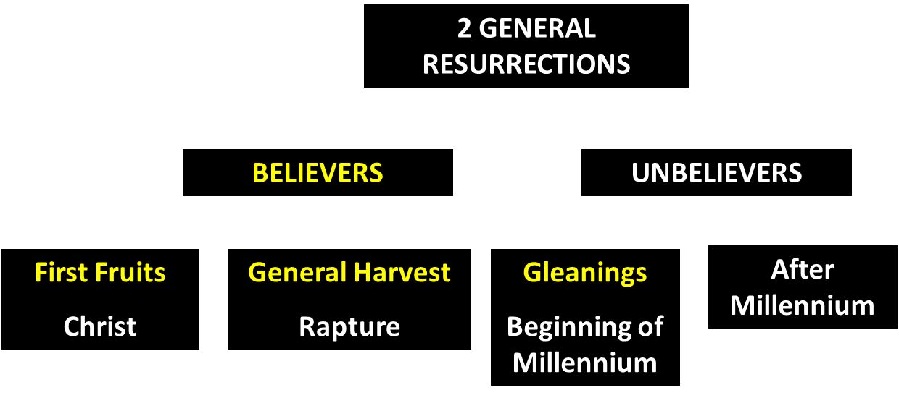
God’s Resurrection Program

Slide 22
Promised Exemption from Divine Wrath
The promise (1 Thess 1:10; 5:9; Rom 5:9; 8:1; Rev 3:10)
Tribulation = divine wrath (Rev 6:16-17; 11:18; 15:1, 7; 16:1, 19)

Slide 24
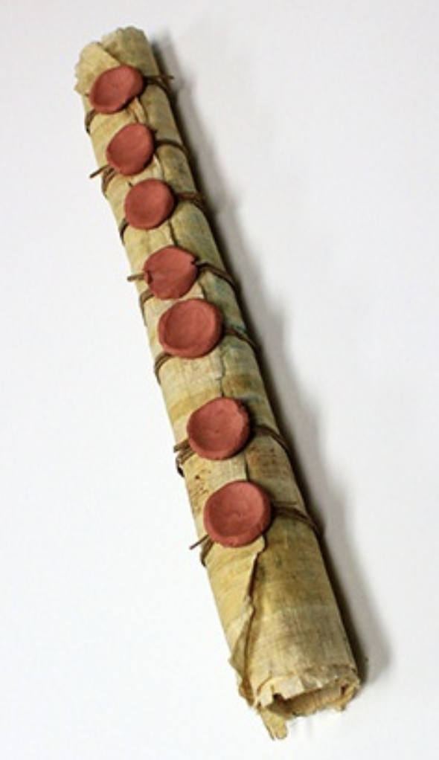
1st Six Seals (Revelation 6)
6:1-2 – Advent of antichrist
6:3-4 – War
6:5-6 – Famine
6:7-8 – Death
6:9-11 – Martyrdoms
6:12-17 – Cosmic disturbances

Slide 25
Revelation 6:16-17
^{“16} and they said to the mountains and the rocks, ‘Fall on us and hide us from the sight of Him who sits on the throne, and from the wrath [orgḗ] of the Lamb; ¹⁷ for the great day of Their wrath [orgḗ] has come, and who is able to stand?’”

Slide 26
Rev. 6:16-17 Robert L. Thomas, Revelation 1–7: An Exegetical Commentary, ed. Kenneth Barker (Chicago: Moody, 1992), 457-58.
"Mankind in his rebellion correctly analyzes the cosmic and terrestrial disturbances as a part of the great end-time day of wrath from the one sitting on the throne and from the Lamb. The verb ēlethen ("has come") is aorist indicative, referring to a previous arrival of wrath, not something that is about to take place. Men see the arrival of this day at least as early as the cosmic upheavals that characterize the sixth seal (6:12-14), but upon reflection they probably recognize that it was already in effect with the death of one-fourth of the population (6:7-8), the worldwide famine (6:5-6), and the global warfare (6:3-4). . . .

Slide 27
Rev. 6:16-17 Robert L. Thomas, Revelation 1–7: An Exegetical Commentary, ed. Kenneth Barker (Chicago: Moody, 1992), 457-58.
. . . rapid sequence of all of these events could not escape notice, but the light of their true explanation does not dawn upon human consciousness until the severe phenomena of the sixth seal arrive."

Slide 28
First Thessalonians 1:10 and the Pre-Tribulational Rapture
Ek vs. para/en
Imminency
Prepare for the Tribulation?
Rescues/from (2 Cor 1:10)

Slide 29
1 Thessalonians 1:10
“and to wait for His Son from heaven, whom He raised from the dead, that is Jesus, who rescues (rhyomai) us from (ek) the wrath (orgē) to come..”

Slide 30
2 Corinthians 1:10
“who delivered (rhyomai) us from (ek) so great a peril of death (thanatos), and will deliver us, He on whom we have set our hope. And He will yet deliver us.”

Slide 31
Structure
Personal (1–3)
Genuine conversion (1)
Impure motives (2:1-16)
Lack of concern (2:17–3:13)
Practical (4–5)
Immorality (4:1-8)
Laziness (4:9-12)
Eschatology (4:13–5:11)
Ministry imbalances (5:12-15)
Progressive sanctification (5:16-28)

Slide 32
Pauline Motives? (2:1-12)
2:1-2-Message, motives, and method
2:3-12-Elaboration
Message (2:3-4)
Motives (2:5-8)
Method (2:9-12)

Slide 33
Pauline Motives? (2:1-12)
2:1-2-Message, motives, and method
2:3-12-Elaboration
Message (2:3-4)
Motives (2:5-8)
Method (2:9-12)

Slide 34
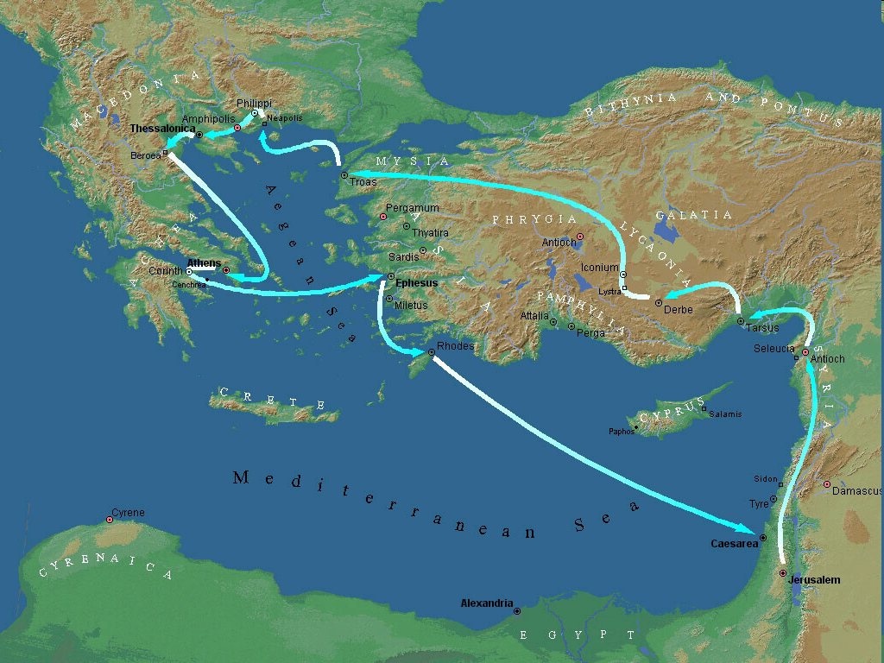
Second Missionary Journey

Slide 35
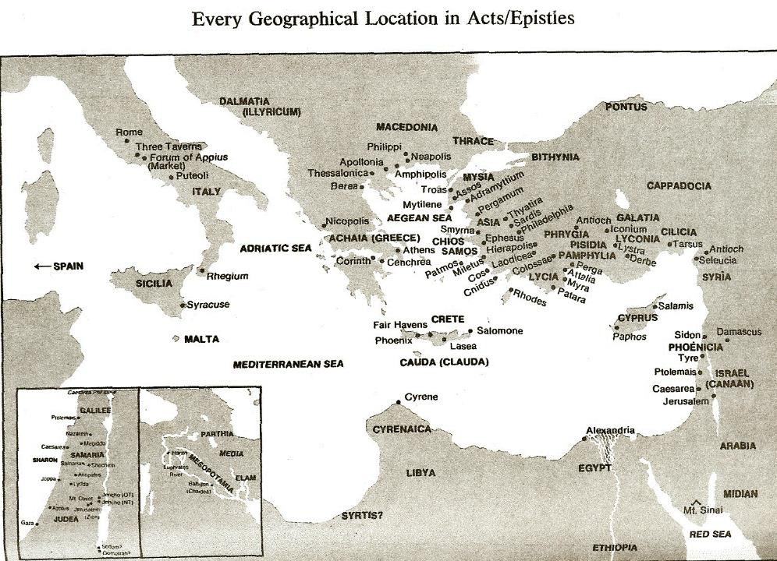

Slide 36
Pauline Motives? (2:1-12)
2:1-2-Message, motives, and method
2:3-12-Elaboration
Message (2:3-4)
Motives (2:5-8)
Method (2:9-12)

Slide 37
Pauline Motives? (2:1-12)
2:1-2-Message, motives, and method
2:3-12-Elaboration
Message (2:3-4)
Motives (2:5-8)
Method (2:9-12)

Slide 38
Pauline Motives? (2:1-12)
2:1-2-Message, motives, and method
2:3-12-Elaboration
Message (2:3-4)
Motives (2:5-8)
Method (2:9-12)

Slide 39
Pauline Motives? (2:1-12)
2:1-2-Message, motives, and method
2:3-12-Elaboration
Message (2:3-4)
Motives (2:5-8)
Method (2:9-12)

Slide 40
1 Thessalonians 2:12
“So that you would walk in a manner worthy of the God who calls you into [eis] His own kingdom and glory.”

Slide 41
1 Thessalonians 2:12
“So that you would walk in a manner worthy of the God who calls you into [eis] His own kingdom and glory.”

Slide 42
1 Thessalonians 2:12
“So that you would walk in a manner worthy of the God who calls you into [eis] His own kingdom and glory.”

Slide 43
E.R. Craven “Excursus on the Basileia,” in Revelation of John, J. P. Lange (New York: Scribner, 1874), 97.
“The preposition in the Greek is εἰς. But since believers on earth are not yet in glory, the whole expression is manifestly proleptical, and the E. V. gives the translation, unto.”
proleptical – the representation of something in the future as if it already existed or had occurred.

Slide 45
2 Peter 3:10-11
“¹⁰ But the day of the Lord will come like a thief, in which the heavens will pass away with a roar and the elements will be destroyed with intense heat, and the earth and its works will be burned up. ¹¹ Since all these things are to be destroyed in this way, what sort of people ought you to be in holy conduct and godliness.”

Slide 46
Conclusion

Slide 47
Pauline Motives? (2:1-12)
2:1-2-Message, motives, and method
2:3-12-Elaboration
Message (2:3-4)
Motives (2:5-8)
Method (2:9-12)

Slide 48
Structure
Personal (1–3)
Genuine conversion (1)
Impure motives (2:1-16)
Lack of concern (2:17–3:13)
Practical (4–5)
Immorality (4:1-8)
Laziness (4:9-12)
Eschatology (4:13–5:11)
Ministry imbalances (5:12-15)
Progressive sanctification (5:16-28)

