Slide 1
Genesis 12‒50
Israel’s Birth & Preservation

Slide 2
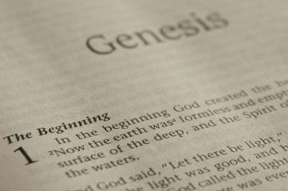
GENESIS STRUCTURE
Beginning of the Human race (Gen. 1‒11)
Beginning of the Hebrew race (Gen. 12‒50)

Slide 3
GENESIS STRUCTURE
Genesis 1-11 (four events)
Creation (1-2)
Fall (3-5)
Flood (6-9)
National dispersion (10-11)

Slide 4
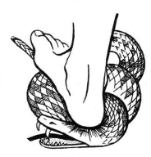
Genesis 3:15
“And I will put enmity Between you and the woman, And between your seed and her seed; He shall bruise you on the head, And you shall bruise him on the heel.”

Slide 5
GENESIS STRUCTURE
Beginning of the Human race (Gen. 1‒11)
Beginning of the Hebrew race (Gen. 12‒50)

Slide 6
GENESIS STRUCTURE
Genesis 12-50 (four people)
Abraham (12:1–25:11)
Isaac (25:12–26:35)
Jacob (27–36)
Joseph (37–50)

Slide 7
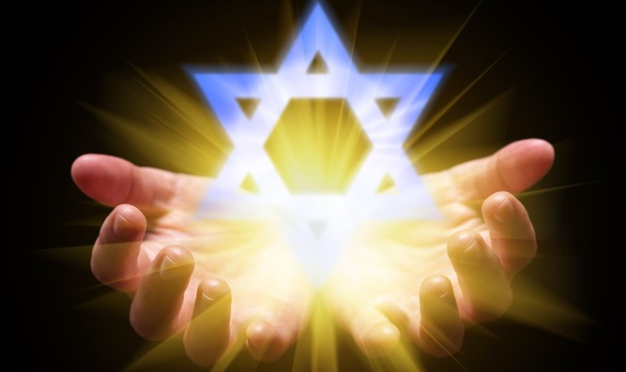
Isaiah 43:1
“But now, thus says the Lord, your Creator, O Jacob, And He who formed you, O Israel, 'Do not fear, for I have redeemed you; I have called you by name; you are Mine!'”

Slide 8
GENESIS STRUCTURE
Genesis 12-50 (four people)
Abraham (12:1–25:11)
Isaac (25:12–26:35)
Jacob (27–36)
Joseph (37–50)

Slide 9
Genesis 12‒25 Abraham’s Early Journeys
Unconditional promises (Gen. 12:1-3) From Haran to Canaan (Gen. 12:4-5) In Canaan (Gen. 12:6-9) In Egypt (Gen. 12:10-20) Abram and Lot Separate (Gen. 13:1-13) Reaffirmation of Abram’s promises (Gen. 13:14-18) Abram Rescues Lot (14:1-24) Abrahamic Covenant (15:1-21) Hagar & Ishmael (16:1-16) Circumcision (Gen. 17:1-27) | Sodom & Gomorrah (Gen. 18‒19) Abraham & Abimelech (Gen. 20) Isaac’s birth (Gen. 21:1-7) Ishmael’s expulsion (21:8-21) Abraham & Abimelech’s covenant (21:22-34) Abraham sacrifices Isaac (22) Sarah’s death (23) Isaac’s marriage (24) Abraham & Keturah (25:1-6) Abraham’s death (25:7-11)

Slide 10
Genesis 25 Chapter Summary
Abraham & Keturah (1-6)
Abraham’s death (8-11)
Ishmael’s Toledoth (12-18)
Birth of Jacob & Esau (19-26)
Selling of the birthright (27-34)

Slide 11
Genesis 25 Chapter Summary
Abraham & Keturah (1-6)
Abraham’s death (8-11)
Ishmael’s Toledoth (12-18)
Birth of Jacob & Esau (19-26)
Selling of the birthright (27-34)

Slide 12
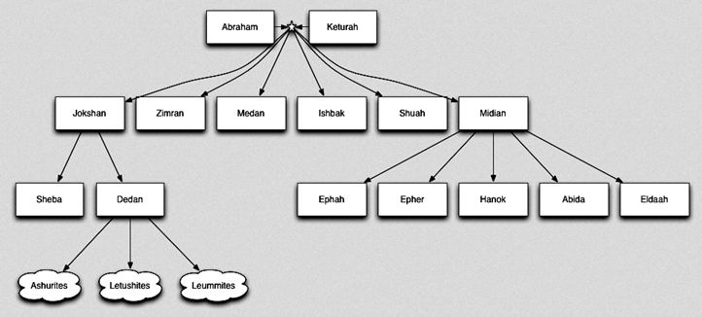

Slide 13
Genesis 25 Chapter Summary
Abraham & Keturah (1-6)
Abraham’s death (8-11)
Ishmael’s Toledoth (12-18)
Birth of Jacob & Esau (19-26)
Selling of the birthright (27-34)

Slide 14
II. Genesis 25:7-11 Abraham’s Death
Abraham’s age (7)
Abraham’s death (8)
Abraham’s burial (9-10)
Isaac’s blessing (11)

Slide 15
Genesis 25 Chapter Summary
Abraham & Keturah (1-6)
Abraham’s death (8-11)
Ishmael’s Toledoth (12-18)
Birth of Jacob & Esau (19-26)
Selling of the birthright (27-34)

Slide 16
III. Genesis 25:12-18 The Generations of Ishmael
Ishmael’s toledoth (12a)
Ishmael’s identification (12b)
Ishmael’s 12 sons (13-16)
Ishmael’s death (17)
Ishmael’s territory (18)

Slide 17
III. Genesis 25:12-18 The Generations of Ishmael
Ishmael’s toledoth (12a)
Ishmael’s identification (12b)
Ishmael’s 12 sons (13-16)
Ishmael’s death (17)
Ishmael’s territory (18)

Slide 18
Toledoth “And These Are the Generations of…”
Introduction to the generations (1:1–2:3)
Generations of the heaven and earth (2:4–4:26)
Generations of Adam (5:1–6:8)
Generations of Noah (6:9–9:29)
Generations of the sons of Noah (10:1–11:9)
Generations of Shem (11:10–26)
Generations of Terah (11:27–25:11)
Generations of Ishmael (25:12-18)
Generations of Isaac (25:19–35:29)
Generations of Esau (36:1–37:1)
Generations of Jacob (37:2–50:26)

Slide 20
Luke 1:1–4
¹ Inasmuch as many have undertaken to compile an account of the things accomplished among us, ² just as they were handed down to us by those who from the beginning were eyewitnesses and servants of the word, ³ it seemed fitting for me as well, having investigated everything carefully from the beginning, to write it out for you in consecutive order, most excellent Theophilus; ⁴ so that you may know the exact truth about the things you have been taught.

Slide 21
Dr. Arnold G. Fruchtenbaum
The Book of Genesis, 397
“The purpose of recording the death of Ishmael here, which is not a strict chronological sequence, is to continue the author’s pattern in the book, which is to dispense with the non-seed line before dealing with the main seed line, in this case Ishmael’s half-brother Isaac.”

Slide 22
III. Genesis 25:12-18 The Generations of Ishmael
Ishmael’s toledoth (12a)
Ishmael’s identification (12b)
Ishmael’s 12 sons (13-16)
Ishmael’s death (17)
Ishmael’s territory (18)

Slide 23
Genesis 12‒24 Abraham’s Early Journeys
Unconditional promises (Gen. 12:1-3) From Haran to Canaan (Gen. 12:4-5) In Canaan (Gen. 12:6-9) In Egypt (Gen. 12:10-20) Abram and Lot Separate (Gen. 13:1-13) Reaffirmation of Abram’s promises (Gen. 13:14-18) Abram Rescues Lot (14:1-24) Abrahamic Covenant (15:1-21) Hagar & Ishmael (16:1-16) Circumcision (Gen. 17:1-27) | Sodom & Gomorrah (Gen. 18‒19) Abraham & Abimelech (Gen. 20) Isaac’s birth (Gen. 21:1-7) Ishmael’s expulsion (21:8-21) Abraham & Abimelech’s covenant (21:22-34) Abraham sacrifices Isaac (22) Sarah’s death (23) Isaac’s marriage (24) Abraham’s death (25)

Slide 24
III. Genesis 25:12-18 The Generations of Ishmael
Ishmael’s toledoth (12a)
Ishmael’s identification (12b)
Ishmael’s 12 sons (13-16)
Ishmael’s death (17)
Ishmael’s territory (18)

Slide 25
Genesis 25:13-16 Ishmael’s 12 sons
Introduction (13a)
Names (13b-15)
Divisions (16)

Slide 26
Genesis 25:13-16 Ishmael’s 12 sons
Introduction (13a)
Names (13b-15)
Divisions (16)

Slide 27
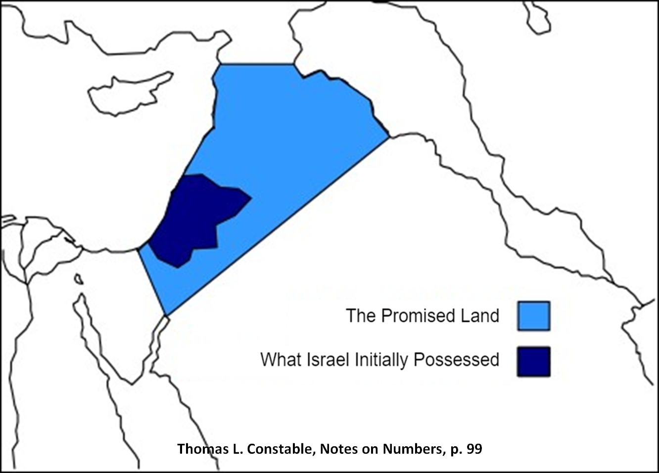

Slide 28
Genesis 25:13-16 Ishmael’s 12 sons
Introduction (13a)
Names (13b-15)
Divisions (16)

Slide 29
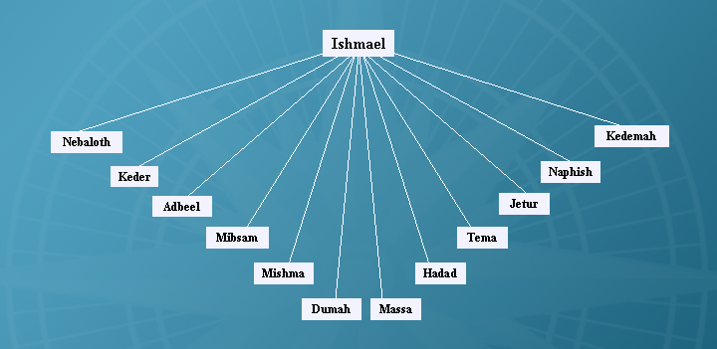

Slide 30
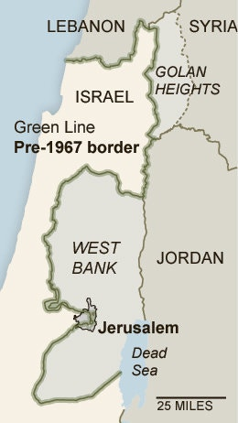

Slide 33
Genesis 25:13-16 Ishmael’s 12 sons
Introduction (13a)
Names (13b-15)
Divisions (16)

Slide 34
John 13:19; 14:29
“^{13:19} From now on I am telling you before it comes to pass, so that when it does occur, you may believe that I am He… ^{14:29} Now I have told you before it happens, so that when it happens, you may believe.”

Slide 35
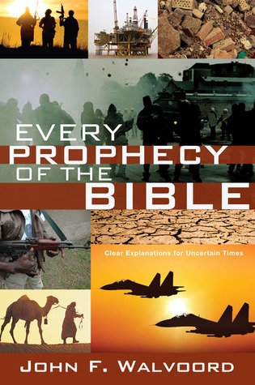

Slide 36
III. Genesis 25:12-18 The Generations of Ishmael
Ishmael’s toledoth (12a)
Ishmael’s identification (12b)
Ishmael’s 12 sons (13-16)
Ishmael’s death (17)
Ishmael’s territory (18)

Slide 37
Genesis 25:17 Ishmael’s Death
Age (17a)
Death (17b)
Afterlife (17c)

Slide 38
Genesis 25:17 Ishmael’s Death
Age (17a)
Death (17b)
Afterlife (17c)

Slide 39
Genesis 25:17 Ishmael’s Death
Age (17a)
Death (17b)
Afterlife (17c)

Slide 40
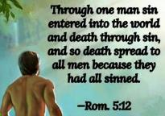
Genesis 2:16-17
“¹⁶ The Lord God commanded the man, saying, ‘From any tree of the garden you may eat freely; ¹⁷ but from the tree of the knowledge of good and evil you shall not eat, for in the day that you eat from it you will surely die (muwth).’”

Slide 41
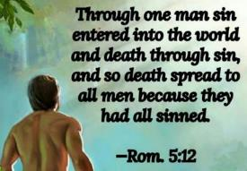
Genesis 3:19
“By the sweat of your face You will eat bread, Till you return to the ground, Because from it you were taken; For you are dust, And to dust you shall return.”

Slide 42
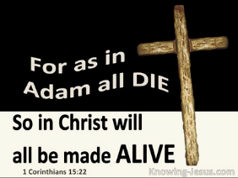
1 Corinthians 15:21-22
“²¹ For since by a man came death, by a man also came the resurrection of the dead. ²² For as in Adam all die, so also in Christ all will be made alive.”

Slide 43
Romans 5:12
“Therefore, just as through one man sin entered into the world, and death through sin, and so death spread to all men, because all sinned—.”

Slide 44
2 Cor. 4:16
Therefore we do not lose heart, but though our outer man is decaying, yet our inner man is being renewed day by day.

Slide 46
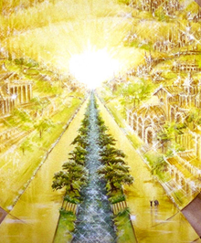
Eternal State is Future
No Satan (Rev 20:10)
No sea (Rev 21:1)
No death, crying, or pain (Rev 21:4)
No Sun (Rev 22:5)
No Moon (Rev 21:23)
No temple (Rev. 21:22)
No night (Rev 21:25)
No evil (Rev 21:27)
No curse (Rev 22:3)

Slide 47
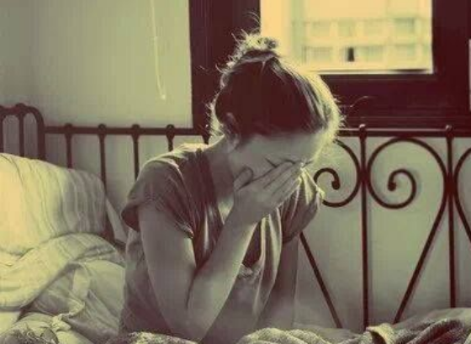
Revelation 21:4
“and He will wipe away every tear from their eyes; and there will no longer be any death; there will no longer be any mourning, or crying, or pain; the first things have passed away.”

Slide 48
Genesis 25:17 Ishmael’s Death
Age (17a)
Death (17b)
Afterlife (17c)

Slide 49
Daniel 12:1-2
“¹ Now at that time Michael, the great prince who stands guard over the sons of your people, will arise. And there will be a time of distress such as never occurred since there was a nation until that time; and at that time your people, everyone who is found written in the book, will be rescued. ² Many of those who sleep in the dust of the ground will awake, these to everlasting life, but the others to disgrace and everlasting contempt.”

Slide 50
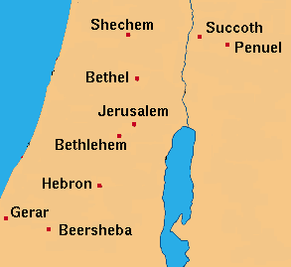

Slide 51
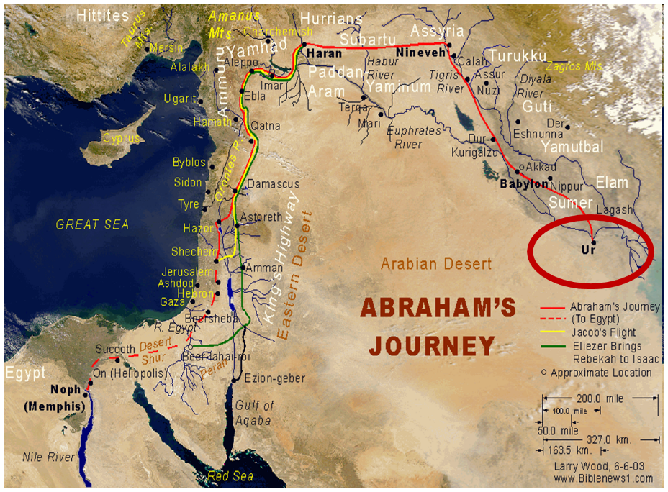

Slide 52
III. Genesis 25:12-18 The Generations of Ishmael
Ishmael’s toledoth (12a)
Ishmael’s identification (12b)
Ishmael’s 12 sons (13-16)
Ishmael’s death (17)
Ishmael’s territory (18)

Slide 53
Dr. Arnold G. Fruchtenbaum
The Book of Genesis, 397
“This toldot concludes by describing Ishmael’s territory and descendants: And they dwelled from Havilah unto Shur that is before Egypt, as you go toward Assyria. That means the territory extended from the Euphrates River in the north to the Red Sea in the south, and from the Northern Sinai to the western border of Babylonia. Havilah was the southeast border of his territory, located in Northeast Arabia. Shur was the southwest border toward Assyria, giving the northern border. Basically, this was the Arabian Peninsula that is described.”

Slide 54
Assyria
Havilah (?)
Egypt
Shur

Slide 56
John 13:19; 14:29
“^{13:19} From now on I am telling you before it comes to pass, so that when it does occur, you may believe that I am He… ^{14:29} Now I have told you before it happens, so that when it happens, you may believe.”

Slide 58
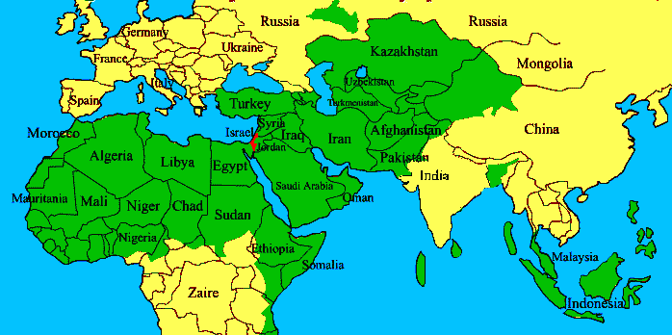
ISRAEL

Slide 59
Conclusion

Slide 60
III. Genesis 25:12-18 The Generations of Ishmael
Ishmael’s toledoth (12a)
Ishmael’s identification (12b)
Ishmael’s 12 sons (13-16)
Ishmael’s death (17)
Ishmael’s territory (18)

Slide 61
Genesis 25 Chapter Summary
Abraham & Keturah (1-6)
Abraham’s death (8-11)
Ishmael’s Toledoth (12-18)
Birth of Jacob & Esau (19-26)
Selling of the birthright (27-34)

Slide 62
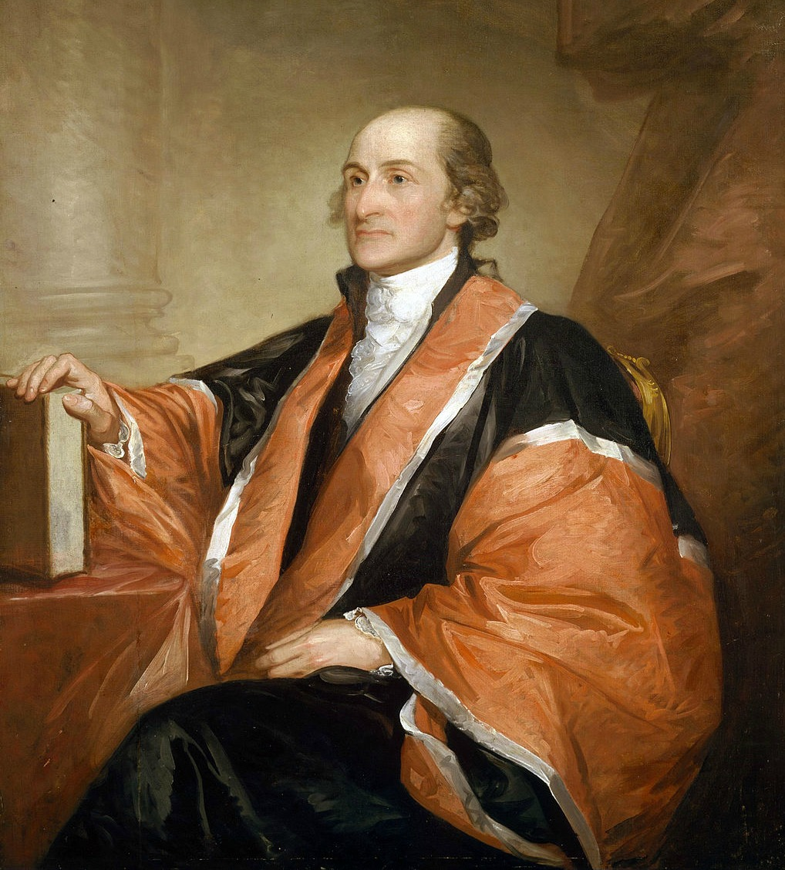
John Jay
President of Congress; Diplomat; Author of the Federalist Papers; Original Chief Justice of the U.S. Supreme Court; Governor of New York.
“Providence has given to our people the choice of their rulers, and it is the duty as well as the privilege and interest of our Christian nation, to select and prefer Christians for their rulers.”
Source: William Jay, The Life of John Jay (New York: J. & J. Harper, 1833), Vol. II, p. 376, to John Murray Jr. on October 12, 1816.

Slide 63
²⁴ The Lord bless you, and keep you; ²⁵ The Lord make His face shine on you, And be gracious to you; ²⁶ The Lord lift up His countenance on you, And give you peace.
Numbers 6:24–26 (NASB95)

