Slide 2
Introductory Matters
Title
Authorship
Biography
Place of writing
Recipient
Purpose
Message
Method
Sources
Date
Structure
Scope
Themes
Unique characteristics

Slide 3
Introductory Matters
Title
Authorship
Biography
Place of writing
Recipient
Purpose
Message
Method
Sources
Date
Structure
Scope
Themes
Unique characteristics

Slide 4
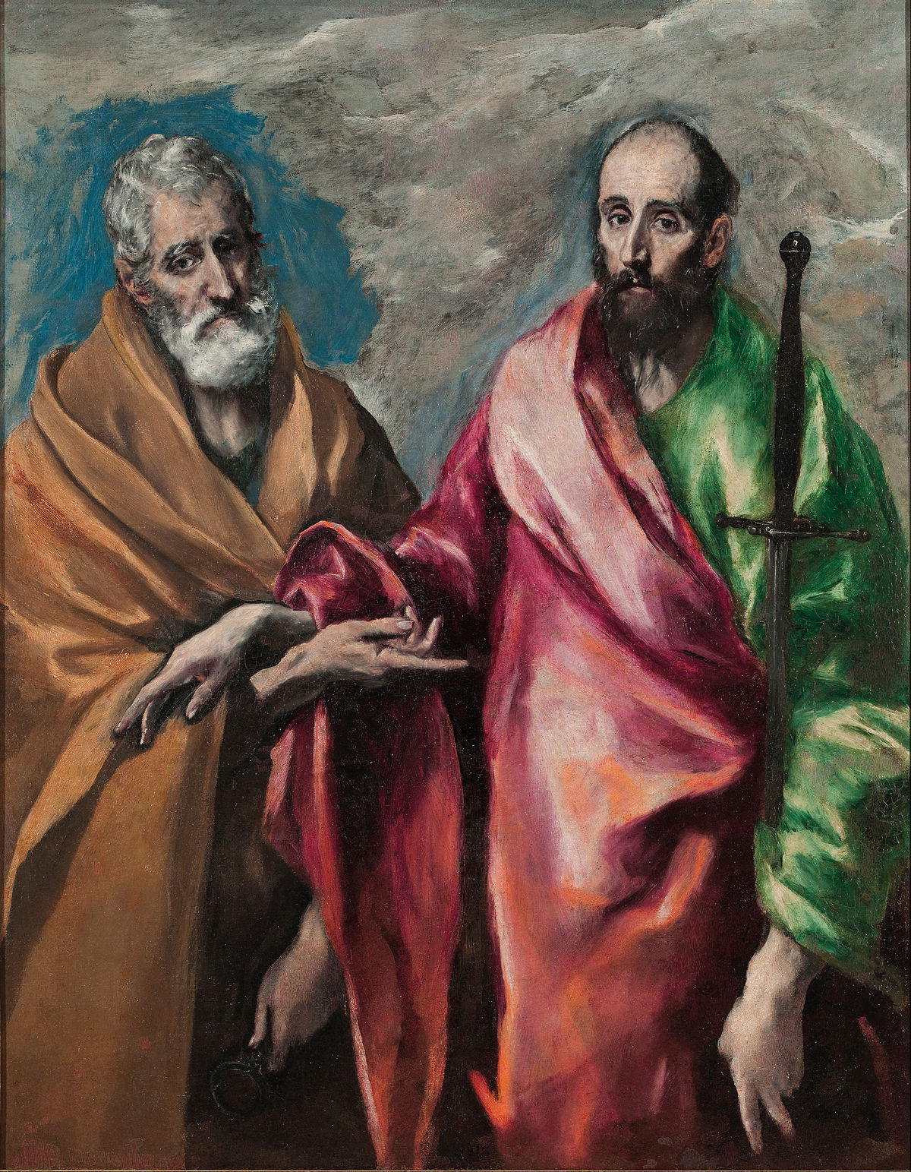
Title
Acts of the Apostles
Misleading?
Acts of the Holy Spirit
Geographical expansion
Two apostles: Peter and Paul

Slide 5
Introductory Matters
Title
Authorship
Biography
Place of writing
Recipient
Purpose
Message
Method
Sources
Date
Structure
Scope
Themes
Unique characteristics

Slide 6
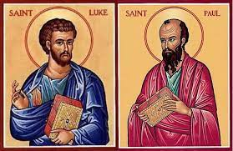
Authorship
External: many early church fathers
Internal
“We” (Acts 28:16)
Similarities with the Gospel of Luke
Literary ability (Col 4:14)
Affiliation with Paul (2 Tim 4:11)

Slide 7
Luke 1:1–4
¹ Inasmuch as many have undertaken to compile an account of the things accomplished among us, ² just as they were handed down to us by those who from the beginning were eyewitnesses and servants of the word, ³ it seemed fitting for me as well, having investigated everything carefully from the beginning, to write it out for you in consecutive order, most excellent Theophilus; ⁴ so that you may know the exact truth about the things you have been taught.

Slide 8
Introductory Matters
Title
Authorship
Biography
Place of writing
Recipient
Purpose
Message
Method
Sources
Date
Structure
Scope
Themes
Unique characteristics

Slide 9
Biography
Paul’s companion (2 Tim 4:11)
Physician (Col 4:14)
Gentile
Col 4:11
Acts 1:19

Slide 10
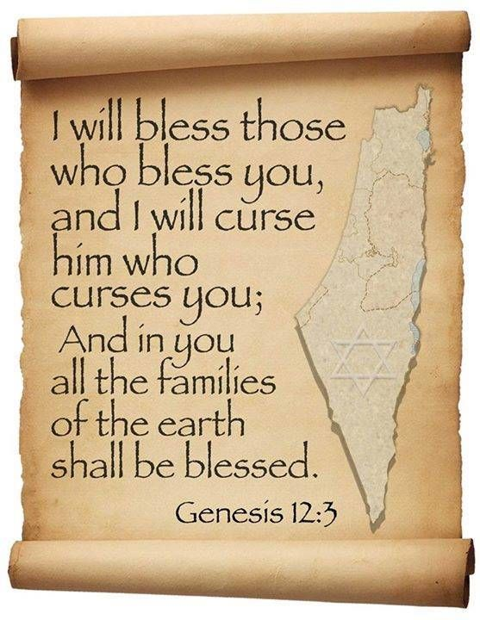
Genesis 12:3
“And I will bless those who bless you, And the one who curses you I will curse. And in you all the families of the earth will be blessed.”

Slide 11
Israel’s Three Blessings to the World (Gen 12:3b)
Scripture (Rom 3:2)
Savior (John 4:22)
Kingdom (Isa 2:2-3)

Slide 12
Introductory Matters
Title
Authorship
Biography
Place of writing
Recipient
Purpose
Message
Method
Sources
Date
Structure
Scope
Themes
Unique characteristics

Slide 13
Place of Writing
“We” sections (Acts 16:10-40; 20:5–21:18; 27:1–28:16)
From Paul
Cesarean imprisonment (Acts 24:27)
Voyage to Rome (Acts 27)
First Roman imprisonment (Acts 28:16)
Combination

Slide 14
Introductory Matters
Title
Authorship
Biography
Place of writing
Recipient
Purpose
Message
Method
Sources
Date
Structure
Scope
Themes
Unique characteristics

Slide 15
Recipient
Theophilus (Acts 1:1)
Luke 1:3-4
Roman official
Gentile
Believer
Need of confirmation in what he had already believed

Slide 16
Luke 1:1–4
¹ Inasmuch as many have undertaken to compile an account of the things accomplished among us, ² just as they were handed down to us by those who from the beginning were eyewitnesses and servants of the word, ³ it seemed fitting for me as well, having investigated everything carefully from the beginning, to write it out for you in consecutive order, most excellent Theophilus; ⁴ so that you may know the exact truth about the things you have been taught.

Slide 17
Luke 1:1–4
¹ Inasmuch as many have undertaken to compile an account of the things accomplished among us, ² just as they were handed down to us by those who from the beginning were eyewitnesses and servants of the word, ³ it seemed fitting for me as well, having investigated everything carefully from the beginning, to write it out for you in consecutive order, most excellent Theophilus; ⁴ so that you may know the exact truth about the things you have been taught.

Slide 18
Luke 1:1–4
¹ Inasmuch as many have undertaken to compile an account of the things accomplished among us, ² just as they were handed down to us by those who from the beginning were eyewitnesses and servants of the word, ³ it seemed fitting for me as well, having investigated everything carefully from the beginning, to write it out for you in consecutive order, most excellent Theophilus; ⁴ so that you may know the exact truth about the things you have been taught.

Slide 19
Introductory Matters
Title
Authorship
Biography
Place of writing
Recipient
Purpose
Message
Method
Sources
Date
Structure
Scope
Themes
Unique characteristics

Slide 20
Purpose
To present Theophilus with an orderly account of the birth and growth of the church so as to affirm him in what he has believed

Slide 21
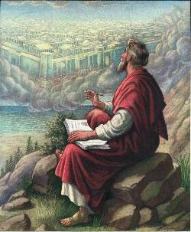
John 20:30-31
“Therefore many other signs Jesus also performed in the presence of the disciples, which are not written in this book; but these have been written so that you may believe that Jesus is the Christ, the Son of God; and that believing you may have life in His name.”

Slide 22
Introductory Matters
Title
Authorship
Biography
Place of writing
Recipient
Purpose
Message
Method
Sources
Date
Structure
Scope
Themes
Unique characteristics

Slide 23
Message
Birth and growth of the church numerically, geographically, ethnically
Components
Numerically (progress reports)
Geographically (From Jerusalem to Rome)
Ethnically (From Judaism to Gentile domination)

Slide 24
Progress Reports
Clearest: Acts 2:47; 6:7; 9:31; 12:24; 16:5; 19:20; 28:30-31
Less clear: Acts 1:15; 2:41; 4:4, 31; 5:14, 42; 8:25, 40; 11:21; 13:49; 17:6

Slide 25
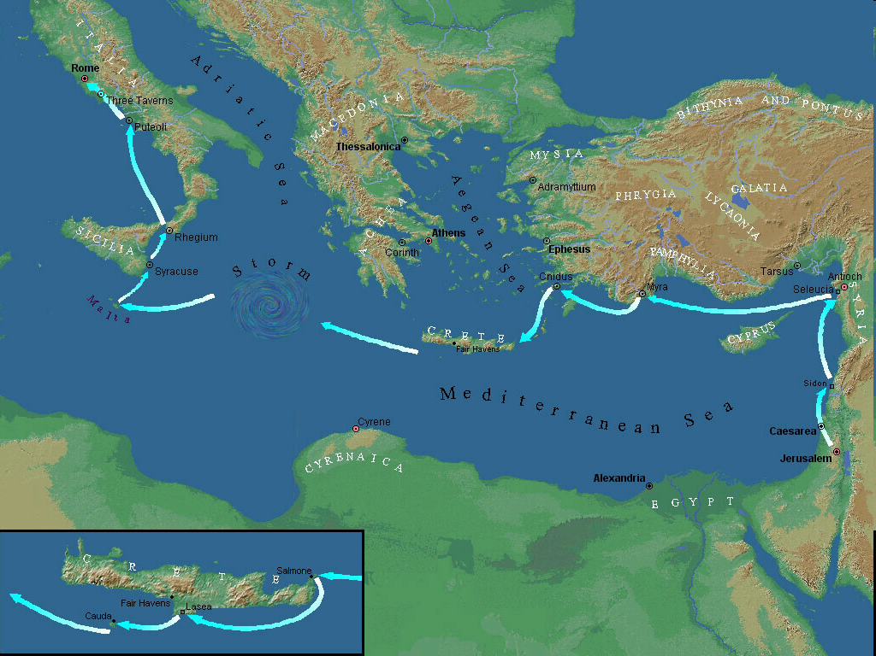

Slide 26
Introductory Matters
Title
Authorship
Biography
Place of writing
Recipient
Purpose
Message
Method
Sources
Date
Structure
Scope
Themes
Unique characteristics

Slide 27
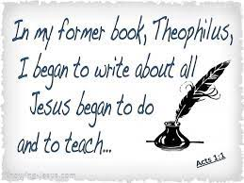
Method
Record history (Luke 1:1-4; Acts 1:1)
Selective rather than comprehensive
Shaped around his purpose

Slide 28
Luke 1:1–4
¹ Inasmuch as many have undertaken to compile an account of the things accomplished among us, ² just as they were handed down to us by those who from the beginning were eyewitnesses and servants of the word, ³ it seemed fitting for me as well, having investigated everything carefully from the beginning, to write it out for you in consecutive order, most excellent Theophilus; ⁴ so that you may know the exact truth about the things you have been taught.

Slide 29
John 20:30-31
“Therefore many other signs Jesus also performed in the presence of the disciples, which are not written in this book; but these have been written so that you may believe that Jesus is the Christ, the Son of God; and that believing you may have life in His name.”

Slide 30
John 21:25
“And there are also many other things which Jesus did, which if they were written in detail, I suppose that even the world itself would not contain the books that would be written.”

Slide 31
Introductory Matters
Title
Authorship
Biography
Place of writing
Recipient
Purpose
Message
Method
Sources
Date
Structure
Scope
Themes
Unique characteristics

Slide 32
Sources
“We” sections
Himself
Paul
Cesarean witnesses
Others mentioned in Acts
Those interviewed in his prequel (Luke 1:2)
Written records (Acts 15:23-29; 23:26-30)

Slide 33
Luke 1:1–4
¹ Inasmuch as many have undertaken to compile an account of the things accomplished among us, ² just as they were handed down to us by those who from the beginning were eyewitnesses and servants of the word, ³ it seemed fitting for me as well, having investigated everything carefully from the beginning, to write it out for you in consecutive order, most excellent Theophilus; ⁴ so that you may know the exact truth about the things you have been taught.

Slide 34
Introductory Matters
Title
Authorship
Biography
Place of writing
Recipient
Purpose
Message
Method
Sources
Date
Structure
Scope
Themes
Unique characteristics

Slide 35
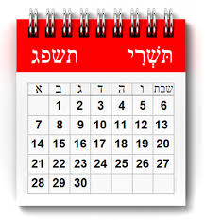
Date: A.D. 60-62
Israel’s judgment (A.D. 66–70)
First Roman Persecution (A.D. 64–67)
Paul’s latter life
Martyrdom (A.D. 68)
2nd imprisonment (A.D. 66)
Activity between imprisonment (A.D. 62–66)
Outcome of trial (A.D. 62)

Slide 36
Introductory Matters
Title
Authorship
Biography
Place of writing
Recipient
Purpose
Message
Method
Sources
Date
Structure
Scope
Themes
Unique characteristics

Slide 37
Revelation 1:19
“Therefore write the things which you have seen, and the things which are, and the things which will take place after these things [meta tauta].”

Slide 38
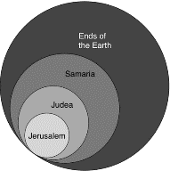
Acts 1:8
“but you will receive power when the Holy Spirit has come upon you; and you shall be My witnesses both in Jerusalem, and in all Judea and Samaria, and even to the remotest part of the earth.”

Slide 39
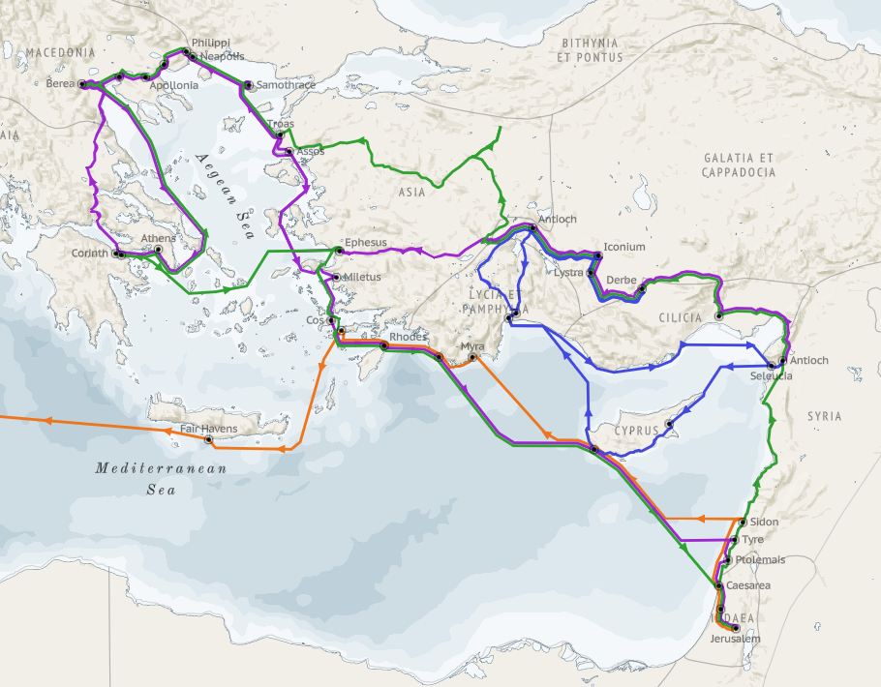
Structure (Acts 1:8)
Jerusalem (Acts 1–7)
Judea and Samaria (Acts 8–12)
Remotest part of the earth (Acts 13–28)
1st missionary journey (Acts 13–14)
Jerusalem council (Acts 15:1-35)
2nd missionary journey (Acts 15:36 –18:22)
3rd missionary journey (Acts 18:23–21:17)
Trip to Rome (Acts 21:18–28:31)

Slide 40
Introductory Matters
Title
Authorship
Biography
Place of writing
Recipient
Purpose
Message
Method
Sources
Date
Structure
Scope
Themes
Unique characteristics

Slide 41
Scope = 29 years
Jerusalem (Acts 1–7): A.D. 33–34 or 2 years
Judea and Samaria (Acts 8–12): A.D. 35–48 or 13 years
Remotest part of the earth (Acts 13–28): A.D. 48– 62 or 14 years

Slide 42
Introductory Matters
Title
Authorship
Biography
Place of writing
Recipient
Purpose
Message
Method
Sources
Date
Structure
Scope
Themes
Unique characteristics

Slide 43
Themes
From Peter to Paul (Gal 2:7-8)
Universality of the Gospel
Transitions
Sovereignty of God (Acts 2:23; 13:48)
Soteriology (Acts 16:31)

Slide 44
Galatians 2:7-8
“⁷ But on the contrary, seeing that I had been entrusted with the gospel to the uncircumcised, just as Peter had been to the circumcised ⁸ (for He who effectually worked for Peter in his apostleship to the circumcised effectually worked for me also to the Gentiles).”

Slide 45
From Peter to Paul
Reference | Center | Person | Place | Outreach
Acts 1–12 | Jerusalem | Peter | Jerusalem, Judea, Samaria | Jewish
Acts 13–28 | Antioch | Paul | Uttermost parts | Gentiles

Slide 46
From Peter to Paul
Peter | Paul
Heals a man lame from birth (3:1-11) | Heals a man lame from birth (14:8-18)
Heals by shadow (3:15-16) | Heals by handkerchief (19:11-12)
Success is a cause of jealousy (5:17) | Success is a cause of jealousy (13:45)
Confronts a sorcerer (8:9-24) | Confronts a sorcerer (13:6-11)
Raises Dorcas (9:36-41) | Raises Eutychus (20:9-12)
Jailed and miraculously freed (12:3-19) | Jailed and miraculously freed (16:25-34)

Slide 47
TRANSITIONS
Historical: from gospels to epistles
Religious: from Judaism to Christianity
Divine: from Law to grace
People of God: from Jews to Gentiles
Program of God: from kingdom (Israel) to church
Leadership: from Christ to apostles

Slide 48
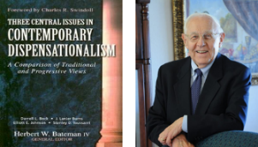
Stanley D. Toussaint
“Israel and the Church of a Traditional Dispensationalist,” in Three Central Issues in Contemporary Dispensationalism, ed. Herbert W. Bateman (Grand Rapids: Kregel, 1999), 242.
“It is difficult to explain why Luke does not use the term if the kingdom is being inaugurated. He employs it forty-five times in the gospel. . . . [O]ne would expect Luke to use the word if such a startling thing as the inauguration of the kingdom had taken place. The fact that Luke uses kingdom only eight times in Acts after such heavy usage in his gospel implies that the kingdom had not begun but was in fact, postponed.”

Slide 50
Introductory Matters
Title
Authorship
Biography
Place of writing
Recipient
Purpose
Message
Method
Sources
Date
Structure
Scope
Themes
Unique characteristics

Slide 51
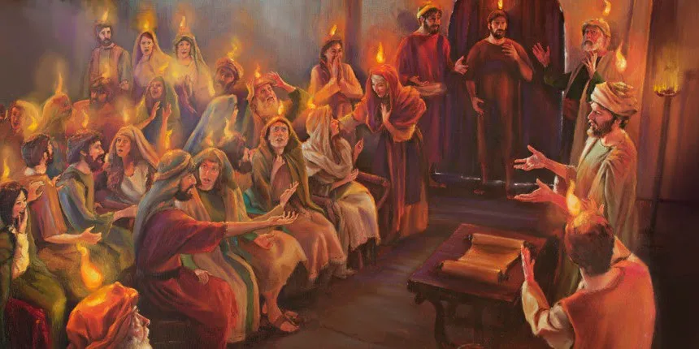
Unique Characteristics
Sermons
Miracles wrought by the Holy Spirit
Background for Pauline letters
Accurate history
Places and names
Volume
Gentile

Slide 52
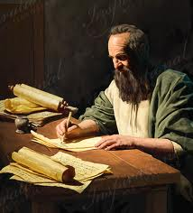
Order of Paul’s Letters
Galatians (A.D. 49)
1‒2 Thessalonians (A.D. 51)
1‒2 Corinthians (A.D. 56)
Romans (A.D. 57)
Ephesians, Colossians, Philemon, Philippians (A.D. 60‒62)
1 Timothy, Titus (A.D. 62‒66)
2 Timothy (A.D. 67)

Slide 53
Paul’s Ministry Chronology
# of books | Journey | Acts | Date | Books
1 | 1 | 13–14 | 48–49 | Gal
2 | 2 | 15:36–18:22 | 50–52 | 1–2 Thess
3 | 3 | 18:23–21:17 | 53–57 | 1–2 Cor, Rom
4 | 4 | 28:16-31 | 60–62 | Eph, Col, Phlm, Phlp
2 | Between Imprisonments | Post Acts | 62–66 | 1 Tim, Titus
1 | 2nd Imprisonment | Post Acts | 67 | 2 Tim

Slide 54
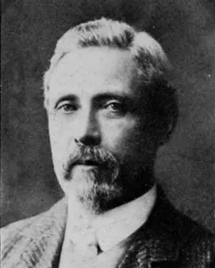
Sir William Ramsay
The Bearing of Recent Discovery on the Trustworthiness of the New Testament, pp. 37-38, 81.
“I had read a good deal of modern criticism about the book, and dutifully accepted the current opinion that it was written during the second half of the second century by an author who wished to influence the minds of people in his own time by a highly wrought and imaginative description of the early Church. His object was not to present a trustworthy picture of facts in the period about A.D. 50, but to produce a certain effect on his own time by setting forth a carefully coloured account of events and persons of that older period. He wrote for his contemporaries, not for truth…The present writer takes the view that Luke’s history is unsurpassed in respect of its trustworthiness. At this point we are describing what reasons and arguments changed the mind of one who began under the impression that the history was written long after the events and that it was untrustworthy as a whole.”

Slide 55
Conclusion

Slide 56
Introductory Matters
Title
Authorship
Biography
Place of writing
Recipient
Purpose
Message
Method
Sources
Date
Structure
Scope
Themes
Unique characteristics

