Slide 1
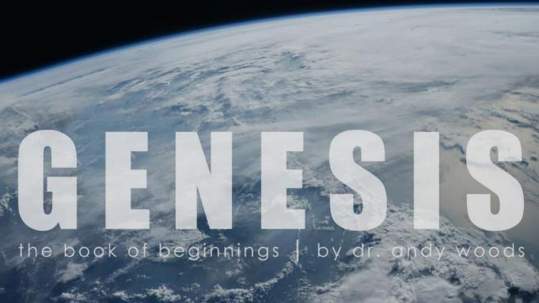

Genesis 12‒50
Israel’s Birth & Preservation

Slide 2
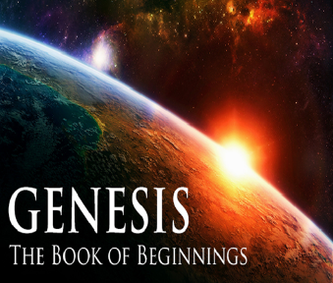
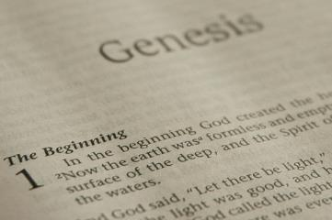
GENESIS STRUCTURE
  Beginning of the Human race (Gen. 1‒11)
  Beginning of the Hebrew race (Gen. 12‒50)

Slide 3
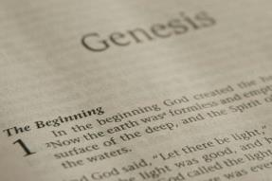
GENESIS STRUCTURE
  Genesis 1-11 (four events)
    Creation (1-2)
    Fall (3-5)
    Flood (6-9)
    National dispersion (10-11)

Slide 4
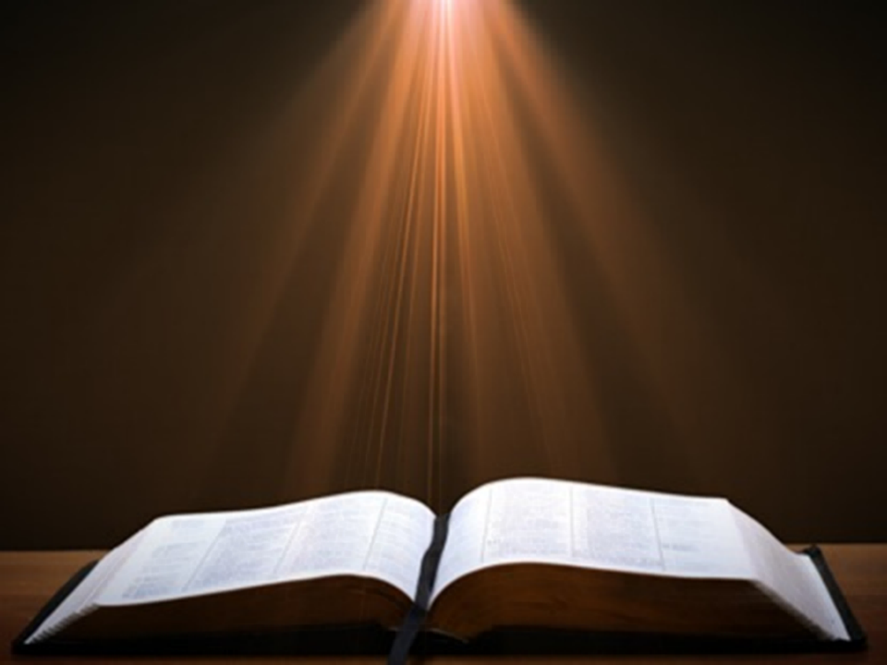
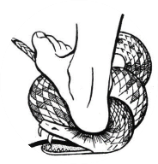
Genesis 3:15
“And I will put enmity Between you and the woman, And between your seed and her seed; He shall bruise you on the head, And you shall bruise him on the heel.”

Slide 5
GENESIS STRUCTURE
  Beginning of the Human race (Gen. 1‒11)
  Beginning of the Hebrew race (Gen. 12‒50)

Slide 6

GENESIS STRUCTURE
  Genesis 12-50 (four people)
    Abraham (12:1–25:11)
    Isaac (25:12–26:35)
    Jacob (27–36)
    Joseph (37–50)

Slide 7

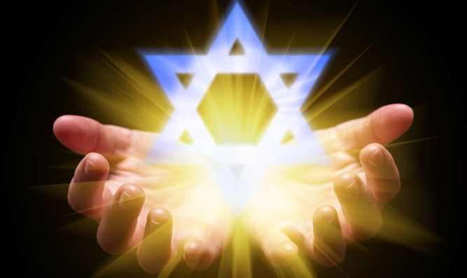
Isaiah 43:1
“But now, thus says the Lord, your Creator, O Jacob, And He who formed you, O Israel, 'Do not fear, for I have redeemed you; I have called you by name; you are Mine!'”

Slide 8
GENESIS STRUCTURE
  Genesis 12-50 (four people)
    Abraham (12:1–25:11)
    Isaac (25:12–26:35)
    Jacob (27–36)
    Joseph (37–50)

Slide 9
Genesis 12‒25
Abraham’s Early Journeys
Unconditional promises (Gen. 12:1-3) From Haran to Canaan (Gen. 12:4-5) In Canaan (Gen. 12:6-9) In Egypt (Gen. 12:10-20) Abram and Lot Separate (Gen. 13:1-13) Reaffirmation of Abram’s promises (Gen. 13:14-18) Abram Rescues Lot (14:1-24) Abrahamic Covenant (15:1-21) Hagar & Ishmael (16:1-16) Circumcision (Gen. 17:1-27) | Sodom & Gomorrah (Gen. 18‒19) Abraham & Abimelech (Gen. 20) Isaac’s birth (Gen. 21:1-7) Ishmael’s expulsion (21:8-21) Abraham & Abimelech’s covenant (21:22-34) Abraham sacrifices Isaac (22) Sarah’s death (23) Isaac’s marriage (24) Abraham & Keturah (25:1-6) Abraham’s death (25:7-11)

Slide 10
Genesis 25
Chapter Summary
  Abraham & Keturah (1-6)
  Abraham’s death (8-11)
  Ishmael’s Toledoth (12-18)
  Birth of Jacob & Esau (19-26)
  Selling of the birthright (27-34)

Slide 11
Genesis 25
Chapter Summary
  Abraham & Keturah (1-6)
  Abraham’s death (8-11)
  Ishmael’s Toledoth (12-18)
  Birth of Jacob & Esau (19-26)
  Selling of the birthright (27-34)

Slide 12
I. Genesis 25:1-6
Abraham & Keturah
    Abraham’s marriage to Keturah (1)
    Keturah’s sons (2)
    Jokshan’s sons (3a)
    Dedan’s sons (3b)
    Median’s sons (4a)
    Summary (4b)
    Contrast (5-6a)
    Distance from Isaac (6b)

Slide 13
I. Genesis 25:1-6
Abraham & Keturah
    Abraham’s marriage to Keturah (1)
    Keturah’s sons (2)
    Jokshan’s sons (3a)
    Dedan’s sons (3b)
    Median’s sons (4a)
    Summary (4b)
    Contrast (5-6a)
    Distance from Isaac (6b)

Slide 14
I. Genesis 25:1-6
Abraham & Keturah
    Abraham’s marriage to Keturah (1)
    Keturah’s sons (2)
    Jokshan’s sons (3a)
    Dedan’s sons (3b)
    Median’s sons (4a)
    Summary (4b)
    Contrast (5-6a)
    Distance from Isaac (6b)

Slide 15
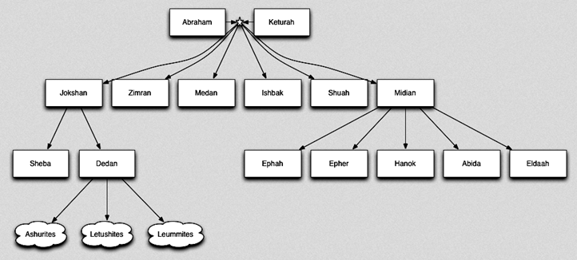

Slide 16
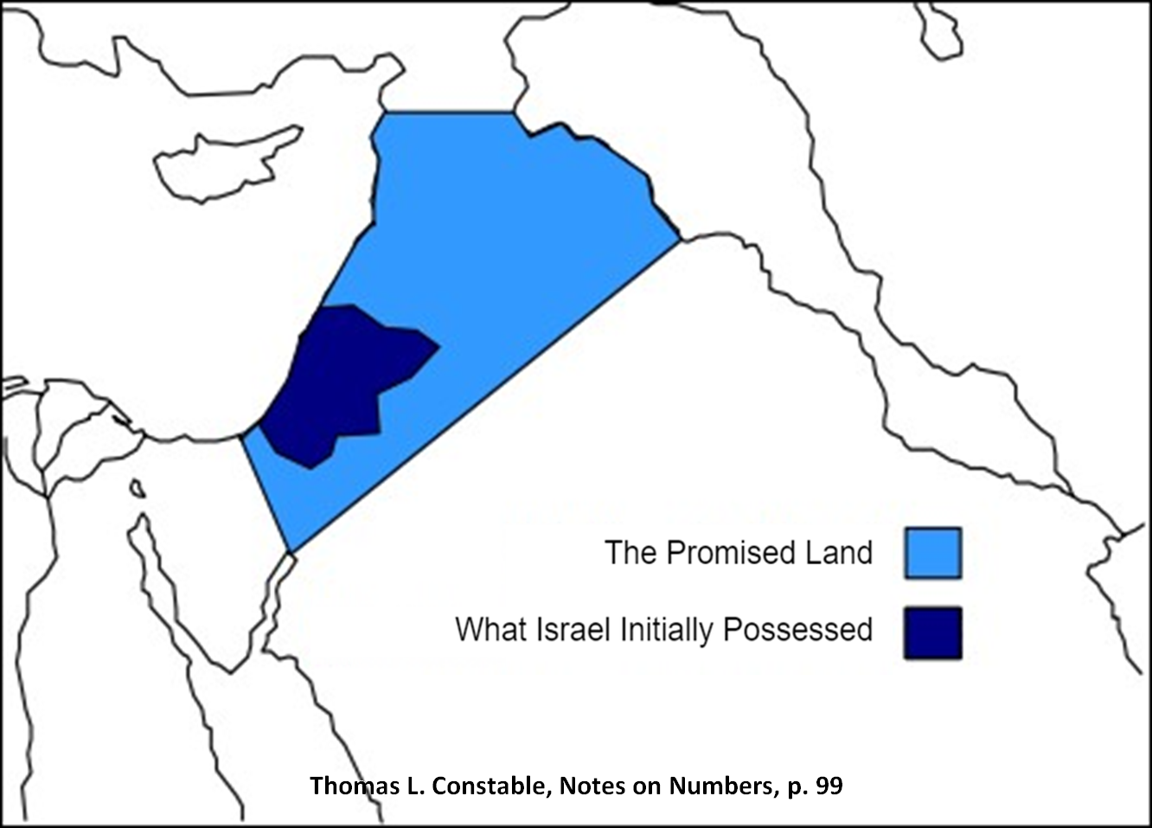

Slide 17
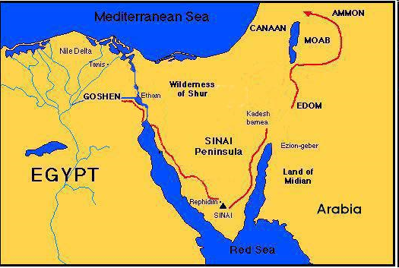

Slide 18
THREE PHASES OF MOSES’ 120 YEAR LIFE
LIFE PHASE | SCRIPTURE | YEARS | AGE | ACTIVITY
Natural Training | Acts 7:23 | 1526–1486 B.C. | 1-40 | Egyptian Education
Spiritual Training | Exod. 7:7 | 1486–1446 B.C. | 40-80 | Midian Shepherding
Ministry | Deut. 31:2; 34:7; Acts 7:36 | 1446–1406 B.C. | 80-120 | Exodus, Law, Wilderness Preservation, Pentateuch Authorship

Slide 19
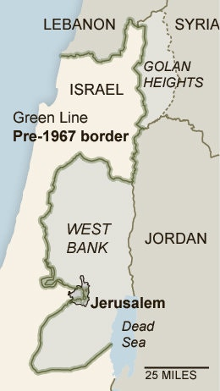

Slide 20
I. Genesis 25:1-6
Abraham & Keturah
    Abraham’s marriage to Keturah (1)
    Keturah’s sons (2)
    Jokshan’s sons (3a)
    Dedan’s sons (3b)
    Median’s sons (4a)
    Summary (4b)
    Contrast (5-6a)
    Distance from Isaac (6b)

Slide 22
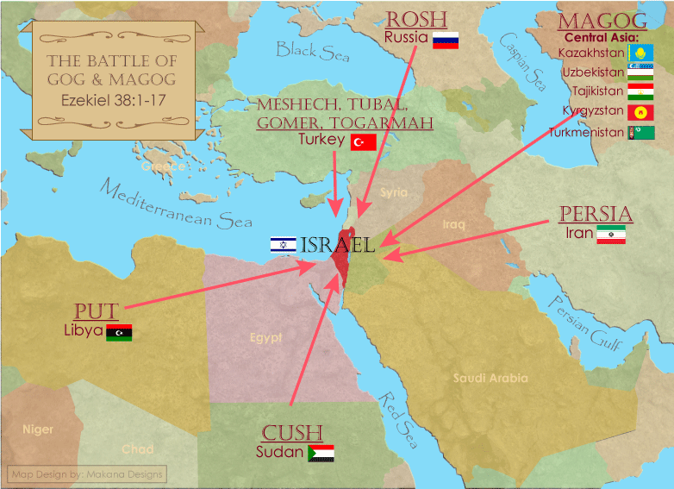
Saudi Arabia

Slide 23
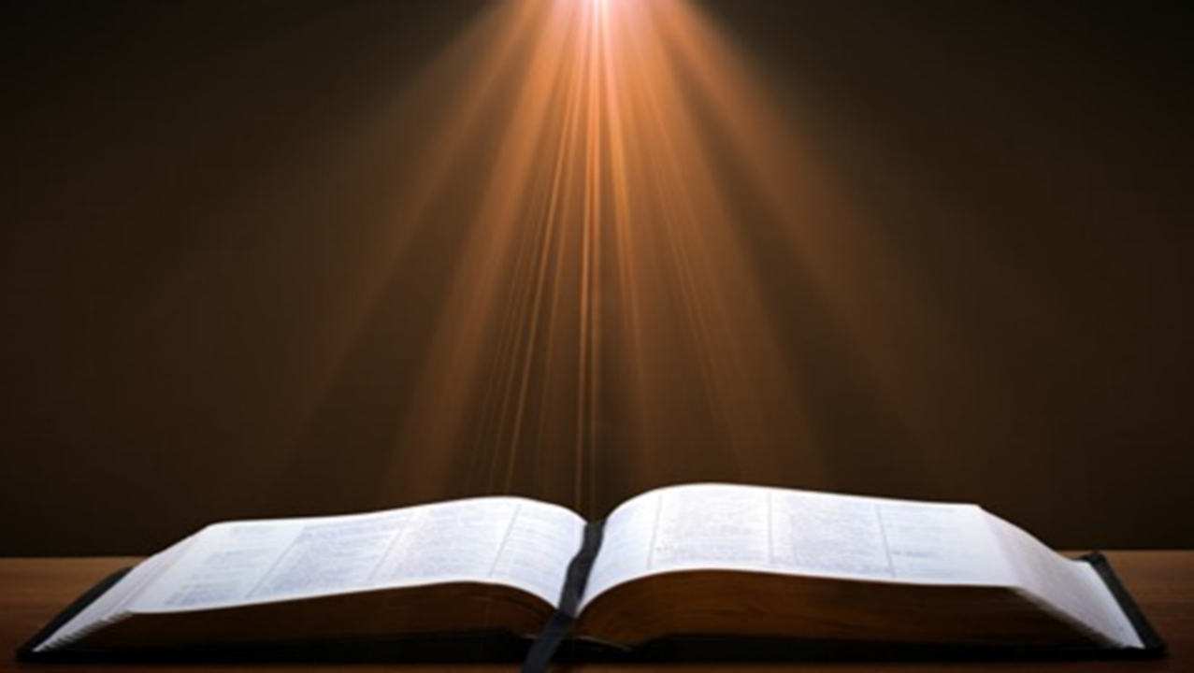
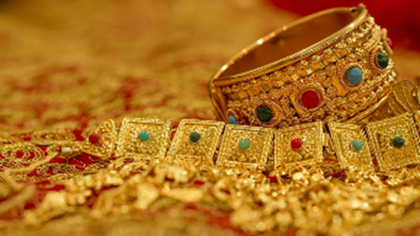
Ezekiel 38:13
“Sheba and Dedan and the merchants of Tarshish with all its villages will say to you, ‘Have you come to capture spoil? Have you assembled your company to seize plunder, to carry away silver and gold, to take away cattle and goods, to capture great spoil?’”

Slide 24
I. Genesis 25:1-6
Abraham & Keturah
    Abraham’s marriage to Keturah (1)
    Keturah’s sons (2)
    Jokshan’s sons (3a)
    Dedan’s sons (3b)
    Median’s sons (4a)
    Summary (4b)
    Contrast (5-6a)
    Distance from Isaac (6b)

Slide 27
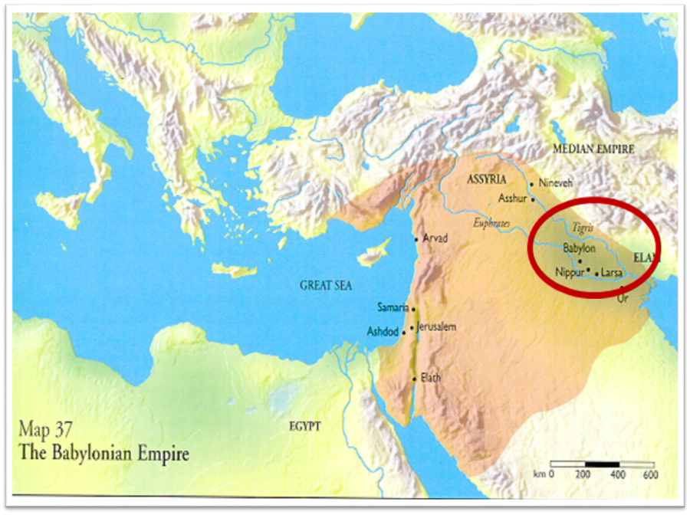

Slide 28
I. Genesis 25:1-6
Abraham & Keturah
    Abraham’s marriage to Keturah (1)
    Keturah’s sons (2)
    Jokshan’s sons (3a)
    Dedan’s sons (3b)
    Median’s sons (4a)
    Summary (4b)
    Contrast (5-6a)
    Distance from Isaac (6b)

Slide 30
I. Genesis 25:1-6
Abraham & Keturah
    Abraham’s marriage to Keturah (1)
    Keturah’s sons (2)
    Jokshan’s sons (3a)
    Dedan’s sons (3b)
    Median’s sons (4a)
    Summary (4b)
    Contrast (5-6a)
    Distance from Isaac (6b)

Slide 31


John 13:19; 14:29
“^{13:19} From now on I am telling you before it comes to pass, so that when it does occur, you may believe that I am He… ^{14:29} Now I have told you before it happens, so that when it happens, you may believe.”

Slide 32
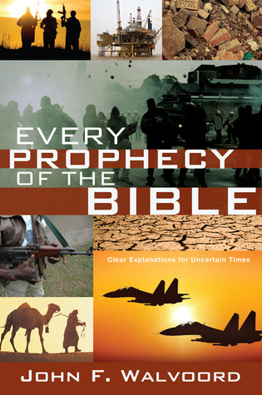

Slide 33
I. Genesis 25:1-6
Abraham & Keturah
    Abraham’s marriage to Keturah (1)
    Keturah’s sons (2)
    Jokshan’s sons (3a)
    Dedan’s sons (3b)
    Median’s sons (4a)
    Summary (4b)
    Contrast (5-6a)
    Distance from Isaac (6b)

Slide 34
Genesis 25:5-6a
Contrast
      Isaac (5)
      Seven others (6a)

Slide 35
Genesis 25:5-6a
Contrast
      Isaac (5)
      Seven others (6a)

Slide 36
Genesis 25:5-6a
Contrast
      Isaac (5)
      Seven others (6a)

Slide 37
I. Genesis 25:1-6
Abraham & Keturah
    Abraham’s marriage to Keturah (1)
    Keturah’s sons (2)
    Jokshan’s sons (3a)
    Dedan’s sons (3b)
    Median’s sons (4a)
    Summary (4b)
    Contrast (5-6a)
    Distance from Isaac (6b)

Slide 40
Saudi Arabia

Slide 41

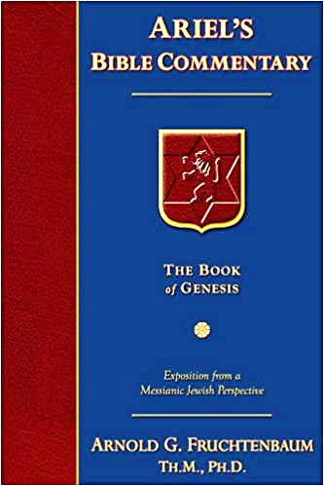
Dr. Arnold G. Fruchtenbaum
The Book of Genesis, 391
“Then the text states: He sent them away from Isaac his son. He made sure that there was a distance between Isaac and his other sons, for Isaac was to inherit the Land. The Hebrew word means it was a deliberate sending away from his son and from the Promised Land because they were not part of the covenant; the Abrahamic Covenant was sustained only through Isaac. This he did while he yet lived. He did not wait until he died for things to be worked out; in order that there be no disputes after his death whatsoever as to what was to go to Isaac and what was to go to his other sons, he divided his inheritance while he yet lived. He gave the others gifts and then sent them all away; he sent them eastward, east of the Promised Land: unto the east country; he sent them into the Trans-Jordan area and the Saudi Arabian area.”

Slide 42
Genesis 12‒25
Abraham’s Early Journeys
Unconditional promises (Gen. 12:1-3) From Haran to Canaan (Gen. 12:4-5) In Canaan (Gen. 12:6-9) In Egypt (Gen. 12:10-20) Abram and Lot Separate (Gen. 13:1-13) Reaffirmation of Abram’s promises (Gen. 13:14-18) Abram Rescues Lot (14:1-24) Abrahamic Covenant (15:1-21) Hagar & Ishmael (16:1-16) Circumcision (Gen. 17:1-27) | Sodom & Gomorrah (Gen. 18‒19) Abraham & Abimelech (Gen. 20) Isaac’s birth (Gen. 21:1-7) Ishmael’s expulsion (21:8-21) Abraham & Abimelech’s covenant (21:22-34) Abraham sacrifices Isaac (22) Sarah’s death (23) Isaac’s marriage (24) Abraham & Keturah (25:1-6) Abraham’s death (25:7-11)

Slide 43
Genesis 25
Chapter Summary
  Abraham & Keturah (1-6)
  Abraham’s death (8-11)
  Ishmael’s Toledoth (12-18)
  Birth of Jacob & Esau (19-26)
  Selling of the birthright (27-34)

Slide 44
II. Genesis 25:7-11
Abraham’s Death
    Abraham’s age (7)
    Abraham’s death (8)
    Abraham’s burial (9-10)
    Isaac’s blessing (11)

Slide 45
II. Genesis 25:7-11
Abraham’s Death
    Abraham’s age (7)
    Abraham’s death (8)
    Abraham’s burial (9-10)
    Isaac’s blessing (11)

Slide 46
John 13:19; 14:29
“^{13:19} From now on I am telling you before it comes to pass, so that when it does occur, you may believe that I am He… ^{14:29} Now I have told you before it happens, so that when it happens, you may believe.”

Slide 48
II. Genesis 25:7-11
Abraham’s Death
    Abraham’s age (7)
    Abraham’s death (8)
    Abraham’s burial (9-10)
    Isaac’s blessing (11)

Slide 49
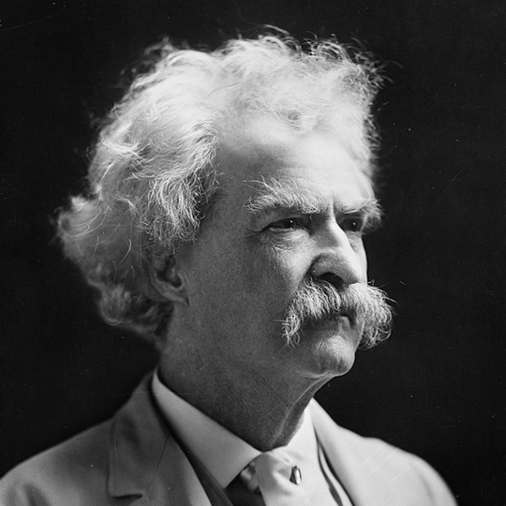
Mark Twain
Autobiography, 2:37
“A myriad of men are born; they labor and sweat and struggle for bread; they squabble and scold and fight; they scramble for little mean advantages over each other. Age creeps upon them and infirmities follow; shames and humiliations bring down their prides and their vanities. Those they love are taken from them, and the joy of life is turned to aching grief. The burden of pain, care, and misery grows heavier year by year. At length ambition is dead, pride is dead, vanity is dead; longing for release is in their place. It comes at last-the only un-poisoned gift earth ever had for them-and they vanish from a world where they were of no consequence; where they achieved nothing, where they were a mistake and a failure and a foolishness; where they left no sign that they have existed-a world that will lament them a day and forget them forever.”

Slide 50
2 Timothy 4:7-8
“⁷ I have fought the good fight, I have finished the course, I have kept the faith; ⁸ in the future there is reserved for me the crown of righteousness, which the Lord, the righteous Judge, will award to me on that day; and not only to me, but also to all who have loved His appearing.”

Slide 51

Daniel 12:1-2
“¹ Now at that time Michael, the great prince who stands guard over the sons of your people, will arise. And there will be a time of distress such as never occurred since there was a nation until that time; and at that time your people, everyone who is found written in the book, will be rescued. ² Many of those who sleep in the dust of the ground will awake, these to everlasting life, but the others to disgrace and everlasting contempt.”

Slide 52
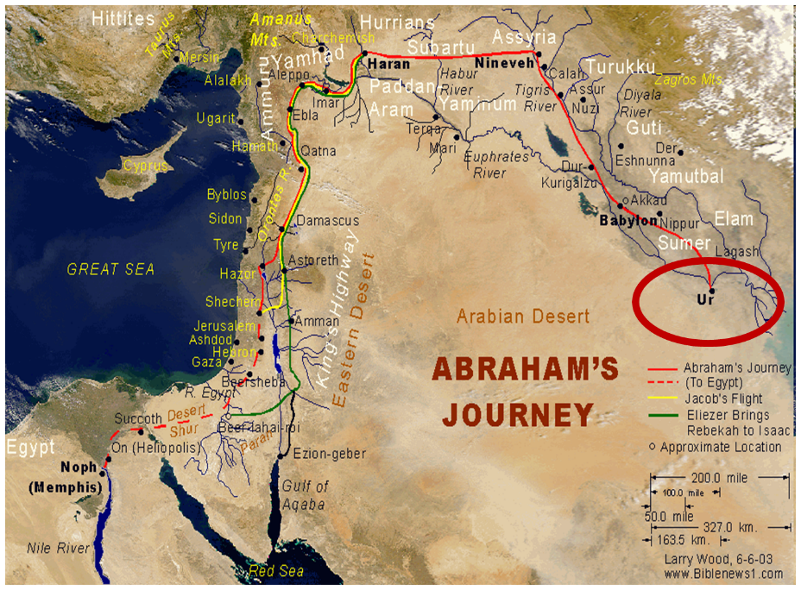

Slide 53
Dr. Arnold G. Fruchtenbaum
The Book of Genesis, 392
“This phrase ‘gathered to his people’ is used ten times, and only in the Pentateuch: Genesis 25:8, of Abraham; 25:17, of Ishmael; 35:29, of Isaac; 49:29, of Jacob; 49:33, of Jacob; Numbers 20:24, of Aaron; 20:26, of Aaron; 27:13, of Moses; 31:2, of Moses; and Deuteronomy 32:50, of Aaron and Moses. A parallel phrase is gathered to his fathers in Genesis 15:15 and 47:30.”

Slide 54
II. Genesis 25:7-11
Abraham’s Death
    Abraham’s age (7)
    Abraham’s death (8)
    Abraham’s burial (9-10)
    Isaac’s blessing (11)

Slide 55
Genesis 12‒25
Abraham’s Early Journeys
Unconditional promises (Gen. 12:1-3) From Haran to Canaan (Gen. 12:4-5) In Canaan (Gen. 12:6-9) In Egypt (Gen. 12:10-20) Abram and Lot Separate (Gen. 13:1-13) Reaffirmation of Abram’s promises (Gen. 13:14-18) Abram Rescues Lot (14:1-24) Abrahamic Covenant (15:1-21) Hagar & Ishmael (16:1-16) Circumcision (Gen. 17:1-27) | Sodom & Gomorrah (Gen. 18‒19) Abraham & Abimelech (Gen. 20) Isaac’s birth (Gen. 21:1-7) Ishmael’s expulsion (21:8-21) Abraham & Abimelech’s covenant (21:22-34) Abraham sacrifices Isaac (22) Sarah’s death (23) Isaac’s marriage (24) Abraham’s death (25)

Slide 56
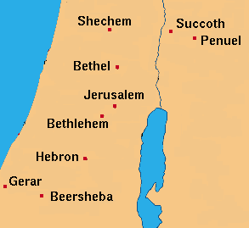

Slide 57
II. Genesis 25:7-11
Abraham’s Death
    Abraham’s age (7)
    Abraham’s death (8)
    Abraham’s burial (9-10)
    Isaac’s blessing (11)

Slide 58
John 13:19; 14:29
“^{13:19} From now on I am telling you before it comes to pass, so that when it does occur, you may believe that I am He… ^{14:29} Now I have told you before it happens, so that when it happens, you may believe.”

Slide 60

Charles Ryrie
The Ryrie Study Bible
“Genesis 16:14 (RSB:NASB1995U): 16:14 Beer-lahai-roi means ‘a well of the Living One who sees me.’ The exact location is unknown, though possibly it was SW of Beersheba.”

Slide 62
Genesis 12‒24
Abraham’s Early Journeys
Unconditional promises (Gen. 12:1-3) From Haran to Canaan (Gen. 12:4-5) In Canaan (Gen. 12:6-9) In Egypt (Gen. 12:10-20) Abram and Lot Separate (Gen. 13:1-13) Reaffirmation of Abram’s promises (Gen. 13:14-18) Abram Rescues Lot (14:1-24) Abrahamic Covenant (15:1-21) Hagar & Ishmael (16:1-16) Circumcision (Gen. 17:1-27) | Sodom & Gomorrah (Gen. 18‒19) Abraham & Abimelech (Gen. 20) Isaac’s birth (Gen. 21:1-7) Ishmael’s expulsion (21:8-21) Abraham & Abimelech’s covenant (21:22-34) Abraham sacrifices Isaac (22) Sarah’s death (23) Isaac’s marriage (24) Abraham’s death (25)

Slide 64
Genesis 25
Chapter Summary
  Abraham & Keturah (1-6)
  Abraham’s death (8-11)
  Ishmael’s Toledoth (12-18)
  Birth of Jacob & Esau (19-26)
  Selling of the birthright (27-34)

Slide 65
Toledoth
“And These Are the Generations of…”
Introduction to the generations (1:1–2:3)
Generations of the heaven and earth (2:4–4:26)
Generations of Adam (5:1–6:8)
Generations of Noah (6:9–9:29)
Generations of the sons of Noah (10:1–11:9)
Generations of Shem (11:10–26)
Generations of Terah (11:27–25:11)
Generations of Ishmael (25:12-18)
Generations of Isaac (25:19–35:29)
Generations of Esau (36:1–37:1)
Generations of Jacob (37:2–50:26)

Slide 66
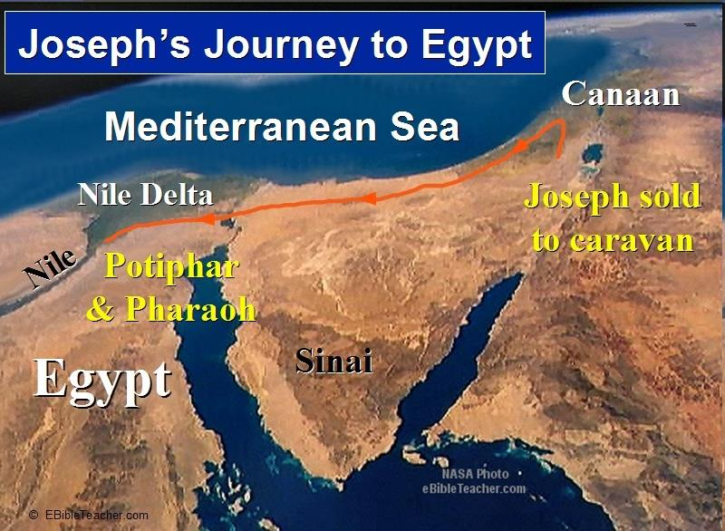

Slide 67

Luke 1:1–4
¹ Inasmuch as many have undertaken to compile an account of the things accomplished among us, ² just as they were handed down to us by those who from the beginning were eyewitnesses and servants of the word, ³ it seemed fitting for me as well, having investigated everything carefully from the beginning, to write it out for you in consecutive order, most excellent Theophilus; ⁴ so that you may know the exact truth about the things you have been taught.

Slide 68
III. Genesis 25:12-18
The Generations of Ishmael
    Ishmael’s toledoth (12a)
    Ishmael’s identification (12b)
    Ishmael’s 12 sons (13-16)
    Ishmael’s death (17)
    Ishmael’s territory (18)

Slide 69
III. Genesis 25:12-18
The Generations of Ishmael
    Ishmael’s toledoth (12a)
    Ishmael’s identification (12b)
    Ishmael’s 12 sons (13-16)
    Ishmael’s death (17)
    Ishmael’s territory (18)

Slide 70
Dr. Arnold G. Fruchtenbaum
The Book of Genesis, 397
“The purpose of recording the death of Ishmael here, which is not a strict chronological sequence, is to continue the author’s pattern in the book, which is to dispense with the non-seed line before dealing with the main seed line, in this case Ishmael’s half-brother Isaac.”

Slide 71
III. Genesis 25:12-18
The Generations of Ishmael
    Ishmael’s toledoth (12a)
    Ishmael’s identification (12b)
    Ishmael’s 12 sons (13-16)
    Ishmael’s death (17)
    Ishmael’s territory (18)

Slide 72
Genesis 12‒24
Abraham’s Early Journeys
Unconditional promises (Gen. 12:1-3) From Haran to Canaan (Gen. 12:4-5) In Canaan (Gen. 12:6-9) In Egypt (Gen. 12:10-20) Abram and Lot Separate (Gen. 13:1-13) Reaffirmation of Abram’s promises (Gen. 13:14-18) Abram Rescues Lot (14:1-24) Abrahamic Covenant (15:1-21) Hagar & Ishmael (16:1-16) Circumcision (Gen. 17:1-27) | Sodom & Gomorrah (Gen. 18‒19) Abraham & Abimelech (Gen. 20) Isaac’s birth (Gen. 21:1-7) Ishmael’s expulsion (21:8-21) Abraham & Abimelech’s covenant (21:22-34) Abraham sacrifices Isaac (22) Sarah’s death (23) Isaac’s marriage (24) Abraham’s death (25)

Slide 73
III. Genesis 25:12-18
The Generations of Ishmael
    Ishmael’s toledoth (12a)
    Ishmael’s identification (12b)
    Ishmael’s 12 sons (13-16)
    Ishmael’s death (17)
    Ishmael’s territory (18)

Slide 74
Genesis 25:13-16
Ishmael’s 12 sons
      Introduction (13a)
      Names (13b-15)
      Divisions (16)

Slide 75
Genesis 25:13-16
Ishmael’s 12 sons
      Introduction (13a)
      Names (13b-15)
      Divisions (16)

Slide 76
Genesis 25:13-16
Ishmael’s 12 sons
      Introduction (13a)
      Names (13b-15)
      Divisions (16)

Slide 77
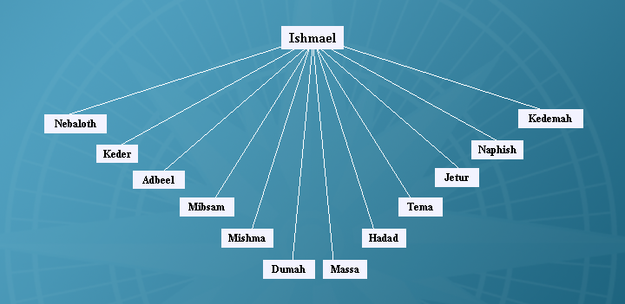

Slide 81
Genesis 25:13-16
Ishmael’s 12 sons
      Introduction (13a)
      Names (13b-15)
      Divisions (16)

Slide 82
John 13:19; 14:29
“^{13:19} From now on I am telling you before it comes to pass, so that when it does occur, you may believe that I am He… ^{14:29} Now I have told you before it happens, so that when it happens, you may believe.”

Slide 84
III. Genesis 25:12-18
The Generations of Ishmael
    Ishmael’s toledoth (12a)
    Ishmael’s identification (12b)
    Ishmael’s 12 sons (13-16)
    Ishmael’s death (17)
    Ishmael’s territory (18)

Slide 85
Genesis 25:17
Ishmael’s Death
      Age (17a)
      Death (17b)
      Afterlife (17c)

Slide 86
Genesis 25:17
Ishmael’s Death
      Age (17a)
      Death (17b)
      Afterlife (17c)

Slide 87
Genesis 25:17
Ishmael’s Death
      Age (17a)
      Death (17b)
      Afterlife (17c)

Slide 88
Genesis 25:17
Ishmael’s Death
      Age (17a)
      Death (17b)
      Afterlife (17c)

Slide 89
Daniel 12:1-2
“¹ Now at that time Michael, the great prince who stands guard over the sons of your people, will arise. And there will be a time of distress such as never occurred since there was a nation until that time; and at that time your people, everyone who is found written in the book, will be rescued. ² Many of those who sleep in the dust of the ground will awake, these to everlasting life, but the others to disgrace and everlasting contempt.”

Slide 90
III. Genesis 25:12-18
The Generations of Ishmael
    Ishmael’s toledoth (12a)
    Ishmael’s identification (12b)
    Ishmael’s 12 sons (13-16)
    Ishmael’s death (17)
    Ishmael’s territory (18)

Slide 91
Dr. Arnold G. Fruchtenbaum
The Book of Genesis, 397
“This toldot concludes by describing Ishmael’s territory and descendants: And they dwelled from Havilah unto Shur that is before Egypt, as you go toward Assyria. That means the territory extended from the Euphrates River in the north to the Red Sea in the south, and from the Northern Sinai to the western border of Babylonia. Havilah was the southeast border of his territory, located in Northeast Arabia. Shur was the southwest border toward Assyria, giving the northern border. Basically, this was the Arabian Peninsula that is described.”

Slide 93
John 13:19; 14:29
“^{13:19} From now on I am telling you before it comes to pass, so that when it does occur, you may believe that I am He… ^{14:29} Now I have told you before it happens, so that when it happens, you may believe.”

Slide 95
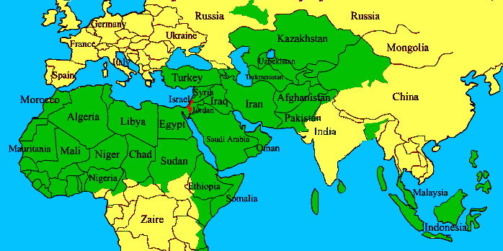
ISRAEL

Slide 96
Toledoth
“And These Are the Generations of…”
Introduction to the generations (1:1–2:3)
Generations of the heaven and earth (2:4–4:26)
Generations of Adam (5:1–6:8)
Generations of Noah (6:9–9:29)
Generations of the sons of Noah (10:1–11:9)
Generations of Shem (11:10–26)
Generations of Terah (11:27–25:11)
Generations of Ishmael (25:12-18)
Generations of Isaac (25:19–35:29)
Generations of Esau (36:1–37:1)
Generations of Jacob (37:2–50:26)

Slide 98
Luke 1:1–4
¹ Inasmuch as many have undertaken to compile an account of the things accomplished among us, ² just as they were handed down to us by those who from the beginning were eyewitnesses and servants of the word, ³ it seemed fitting for me as well, having investigated everything carefully from the beginning, to write it out for you in consecutive order, most excellent Theophilus; ⁴ so that you may know the exact truth about the things you have been taught.

Slide 99
GENESIS STRUCTURE
  Genesis 12-50 (four people)
    Abraham (12:1–25:11)
    Isaac (25:12–26:35)
    Jacob (27–36)
    Joseph (37–50)

Slide 100
Genesis 25
Chapter Summary
  Abraham & Keturah (1-6)
  Abraham’s death (8-11)
  Ishmael’s Toledoth (12-18)
  Birth of Jacob & Esau (19-26)
  Selling of the birthright (27-34)

Slide 101
IV. Genesis 25:19-26
Birth of Jacob & Esau
    Isaac’s toledoth (19a)
    Hebrew line (19b)
    Isaac’s age (20a)
    Rebekah’s lineage (20b)
    Isaac’s intercession (21a)
    Rebekah’s conception (21b)
    Struggle in Rebekah’s womb (22a)
    Rebekah’s prayer (22b)
    God’s prophecy (23)
    Birth of the twins (24-26)

Slide 102
IV. Genesis 25:19-26
Birth of Jacob & Esau
    Isaac’s toledoth (19a)
    Hebrew line (19b)
    Isaac’s age (20a)
    Rebekah’s lineage (20b)
    Isaac’s intercession (21a)
    Rebekah’s conception (21b)
    Struggle in Rebekah’s womb (22a)
    Rebekah’s prayer (22b)
    God’s prophecy (23)
    Birth of the twins (24-26)

Slide 103
Toledoth
“And These Are the Generations of…”
Introduction to the generations (1:1–2:3)
Generations of the heaven and earth (2:4–4:26)
Generations of Adam (5:1–6:8)
Generations of Noah (6:9–9:29)
Generations of the sons of Noah (10:1–11:9)
Generations of Shem (11:10–26)
Generations of Terah (11:27–25:11)
Generations of Ishmael (25:12-18)
Generations of Isaac (25:19–35:29)
Generations of Esau (36:1–37:1)
Generations of Jacob (37:2–50:26)

Slide 105
Luke 1:1–4
¹ Inasmuch as many have undertaken to compile an account of the things accomplished among us, ² just as they were handed down to us by those who from the beginning were eyewitnesses and servants of the word, ³ it seemed fitting for me as well, having investigated everything carefully from the beginning, to write it out for you in consecutive order, most excellent Theophilus; ⁴ so that you may know the exact truth about the things you have been taught.

Slide 106
IV. Genesis 25:19-26
Birth of Jacob & Esau
    Isaac’s toledoth (19a)
    Hebrew line (19b)
    Isaac’s age (20a)
    Rebekah’s lineage (20b)
    Isaac’s intercession (21a)
    Rebekah’s conception (21b)
    Struggle in Rebekah’s womb (22a)
    Rebekah’s prayer (22b)
    God’s prophecy (23)
    Birth of the twins (24-26)

Slide 107
IV. Genesis 25:19-26
Birth of Jacob & Esau
    Isaac’s toledoth (19a)
    Hebrew line (19b)
    Isaac’s age (20a)
    Rebekah’s lineage (20b)
    Isaac’s intercession (21a)
    Rebekah’s conception (21b)
    Struggle in Rebekah’s womb (22a)
    Rebekah’s prayer (22b)
    God’s prophecy (23)
    Birth of the twins (24-26)

Slide 108
IV. Genesis 25:19-26
Birth of Jacob & Esau
    Isaac’s toledoth (19a)
    Hebrew line (19b)
    Isaac’s age (20a)
    Rebekah’s lineage (20b)
    Isaac’s intercession (21a)
    Rebekah’s conception (21b)
    Struggle in Rebekah’s womb (22a)
    Rebekah’s prayer (22b)
    God’s prophecy (23)
    Birth of the twins (24-26)

Slide 109
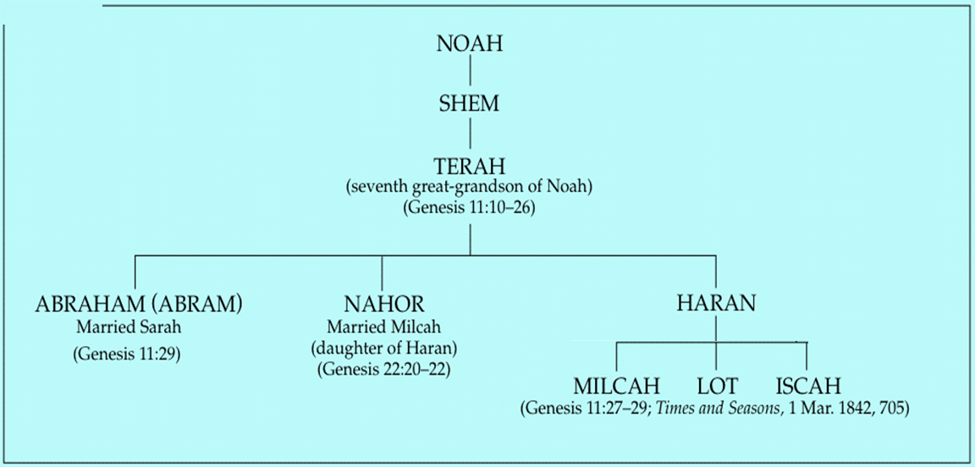

Slide 110
Genesis 22:20-24
Rebekah’s Lineage
    Timing (20a)
    Nahor’s children (20b-24)
      From Milcah (20b-23)
      From Reumah (24)

Slide 111

Nahor’s children through Milcah (Gen. 22:20b-23)
1. Uz (Job 1:1) | 5. Hazo
2. Buz | 6. Pildash
3. Aram | 7. Jidlaph
4. Chesed | 8. Bethuel (Gen. 24)

Slide 112
IV. Genesis 25:19-26
Birth of Jacob & Esau
    Isaac’s toledoth (19a)
    Hebrew line (19b)
    Isaac’s age (20a)
    Rebekah’s lineage (20b)
    Isaac’s intercession (21a)
    Rebekah’s conception (21b)
    Struggle in Rebekah’s womb (22a)
    Rebekah’s prayer (22b)
    God’s prophecy (23)
    Birth of the twins (24-26)

Slide 113
IV. Genesis 25:19-26
Birth of Jacob & Esau
    Isaac’s toledoth (19a)
    Hebrew line (19b)
    Isaac’s age (20a)
    Rebekah’s lineage (20b)
    Isaac’s intercession (21a)
    Rebekah’s conception (21b)
    Struggle in Rebekah’s womb (22a)
    Rebekah’s prayer (22b)
    God’s prophecy (23)
    Birth of the twins (24-26)

Slide 114
Genesis 12‒24
Abraham’s Early Journeys
Unconditional promises (Gen. 12:1-3) From Haran to Canaan (Gen. 12:4-5) In Canaan (Gen. 12:6-9) In Egypt (Gen. 12:10-20) Abram and Lot Separate (Gen. 13:1-13) Reaffirmation of Abram’s promises (Gen. 13:14-18) Abram Rescues Lot (14:1-24) Abrahamic Covenant (15:1-21) Hagar & Ishmael (16:1-16) Circumcision (Gen. 17:1-27) | Sodom & Gomorrah (Gen. 18‒19) Abraham & Abimelech (Gen. 20) Isaac’s birth (Gen. 21:1-7) Ishmael’s expulsion (21:8-21) Abraham & Abimelech’s covenant (21:22-34) Abraham sacrifices Isaac (22) Sarah’s death (23) Isaac’s marriage (24) Abraham’s death (25)

Slide 115
IV. Genesis 25:19-26
Birth of Jacob & Esau
    Isaac’s toledoth (19a)
    Hebrew line (19b)
    Isaac’s age (20a)
    Rebekah’s lineage (20b)
    Isaac’s intercession (21a)
    Rebekah’s conception (21b)
    Struggle in Rebekah’s womb (22a)
    Rebekah’s prayer (22b)
    God’s prophecy (23)
    Birth of the twins (24-26)

Slide 116
IV. Genesis 25:19-26
Birth of Jacob & Esau
    Isaac’s toledoth (19a)
    Hebrew line (19b)
    Isaac’s age (20a)
    Rebekah’s lineage (20b)
    Isaac’s intercession (21a)
    Rebekah’s conception (21b)
    Struggle in Rebekah’s womb (22a)
    Rebekah’s prayer (22b)
    God’s prophecy (23)
    Birth of the twins (24-26)

Slide 117
IV. Genesis 25:19-26
Birth of Jacob & Esau
    Isaac’s toledoth (19a)
    Hebrew line (19b)
    Isaac’s age (20a)
    Rebekah’s lineage (20b)
    Isaac’s intercession (21a)
    Rebekah’s conception (21b)
    Struggle in Rebekah’s womb (22a)
    Rebekah’s prayer (22b)
    God’s prophecy (23)
    Birth of the twins (24-26)

Slide 118
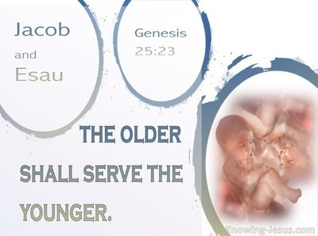
Genesis 25:23
“The Lord said to her, ‘Two nations are in your womb; And two peoples will be separated from your body; And one people shall be stronger than the other; And the older shall serve the younger.’”

Slide 119
Genesis 25:23
“The Lord said to her, ‘Two nations are in your womb; And two peoples will be separated from your body; And one people shall be stronger than the other; And the older shall serve the younger.’”

Slide 120
Genesis 25:23
“The Lord said to her, ‘Two nations are in your womb; And two peoples will be separated from your body; And one people shall be stronger than the other; And the older shall serve the younger.’”

Slide 121
Genesis 25:23
“The Lord said to her, ‘Two nations are in your womb; And two peoples will be separated from your body; And one people shall be stronger than the other; And the older shall serve the younger.’”

Slide 122
Genesis 25:23
“The Lord said to her, ‘Two nations are in your womb; And two peoples will be separated from your body; And one people shall be stronger than the other; And the older shall serve the younger.’”

Slide 123

Cain Murders Abel
(4:3-8)
  4:3-5a
  Messianic line through Abel (Gen 3:21; Heb 11:4) contrary to Eve’s false expectation (4:1)
  Begins selection of younger over older pattern (Abel over Cain, Seth over Cain, Shem over Japheth, Isaac over Ishmael, Jacob over Esau, Judah and Joseph over their brothers, and Ephraim over Manasseh)

Slide 124
IV. Genesis 25:19-26
Birth of Jacob & Esau
    Isaac’s toledoth (19a)
    Hebrew line (19b)
    Isaac’s age (20a)
    Rebekah’s lineage (20b)
    Isaac’s intercession (21a)
    Rebekah’s conception (21b)
    Struggle in Rebekah’s womb (22a)
    Rebekah’s prayer (22b)
    God’s prophecy (23)
    Birth of the twins (24-26)

Slide 125
Genesis 25:24-26
Birth of the Twins
      Births (24)
      Esau (25)
      Jacob (26a)
      Isaac’s age (26b)

Slide 126
Genesis 25:24-26
Birth of the Twins
      Births (24)
      Esau (25)
      Jacob (26a)
      Isaac’s age (26b)

Slide 127
Genesis 25:24-26
Birth of the Twins
      Births (24)
      Esau (25)
      Jacob (26a)
      Isaac’s age (26b)

Slide 128
Genesis 25:24-26
Birth of the Twins
      Births (24)
      Esau (25)
      Jacob (26a)
      Isaac’s age (26b)

Slide 129
Luke 19:41-44
“⁴¹ When He approached Jerusalem, He saw the city and wept over it, ⁴² saying, ‘If you had known in this day, even you, the things which make for peace! But now they have been hidden from your eyes. ⁴³ For the days will come upon you when your enemies will throw up a barricade against you, and surround you and hem you in on every side, ⁴⁴ and they will level you to the ground and your children within you, and they will not leave in you one stone upon another, because you did not recognize the time of your visitation.’”

Slide 130


SLBC Position Statements # 1
SANCTITY OF LIFE – We believe that the fetus, from the moment of conception, is a person (Psalm 139:13-18). We also believe that all persons are created in the image of God regardless of age, health, function and/or condition of dependency.

Slide 131
Genesis 25:24-26
Birth of the Twins
      Births (24)
      Esau (25)
      Jacob (26a)
      Isaac’s age (26b)

Slide 132
Genesis 25
Chapter Summary
  Abraham & Keturah (1-6)
  Abraham’s death (8-11)
  Ishmael’s Toledoth (12-18)
  Birth of Jacob & Esau (19-26)
  Selling of the birthright (27-34)

Slide 133
V. Genesis 25:27-34
Selling of the Birthright
    Development of the boys (27)
    Parental preferences (28)
    Jacob purchases the birthright (29-34)

Slide 134
V. Genesis 25:27-34
Selling of the Birthright
    Development of the boys (27)
    Parental preferences (28)
    Jacob purchases the birthright (29-34)

Slide 135
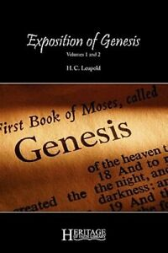
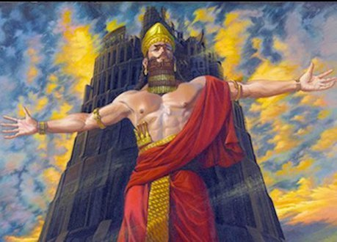
H. C. Leupold
H.C. Leupold, Exposition of Genesis, 1:366.
“For the meaning of the verb form nimrodh, without a doubt, is ‘let us revolt’.”

Slide 136
Dr. Arnold G. Fruchtenbaum
The Book of Genesis, 213
“Verse 9 deals with Nimrod’s relationship to God: He was a mighty hunter before Jehovah. The terminology implies antagonism; antagonism against and in opposition to God.”

Slide 137

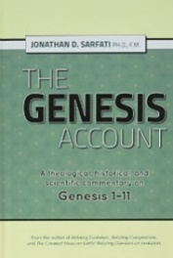
The Jerusalem Targum
Jonathan D. Sarfati, The Genesis Account: A Theological, Historical, and Scientific Commentary on Genesis 1‒11 (Powder Springs, GA: Creation Book Publishers, 2015), 642.
The Jerusalem Targum paraphrases this passage as follows: “He was powerful in hunting and in wickedness before the Lord for he was a hunter of the sons of men, as he said to them, ‘Depart from the judgment of the Lord and hear the judgement of Nimrod.’ Therefore, it is said as Nimrod the strong one, strong in hunting, and wickedness before the Lord.”

Slide 138
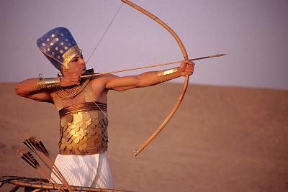
Dr. Arnold G. Fruchtenbaum
The Book of Genesis, 346
“He now became a hunter. In the context of Genesis, this is not a positive but a negative, as already indicated with Nimrod; for he, too, was a mighty hunter before the Lord.”

Slide 139
Dr. Arnold G. Fruchtenbaum
The Book of Genesis, 402
“Esau was a skillful hunter, just as Nimrod was a skillful hunter (10:8–12). In the context of Genesis, being a skillful hunter is not a positive statement, but a negative one. This is important because throughout church history, Jacob has received a lot of bad press. In most sermons, especially in Christian circles, Jacob is painted very negatively, and attributes are ascribed to Jacob that are not true to the Word of God and certainly do not correspond with God’s own evaluation of Jacob.”

Slide 140

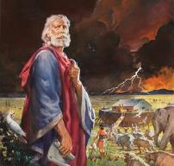
Genesis 6:8-9
“⁸ But Noah found favor in the eyes of the Lord. ⁹ These are the records of the generations of Noah. Noah was a righteous man, blameless in his time; Noah walked with God.”

Slide 141
Dr. Arnold G. Fruchtenbaum
The Book of Genesis, 403
“In other words, this word does not mean quiet, but perfect. Why is it not translated that way? The reason is not because it does not make sense in the text, but rather because it does not fit people’s preconceived notions about Jacob. This is the first of several examples where the biblical view of Jacob is opposite from the portrayal of all too many commentators and preachers.”

Slide 142
V. Genesis 25:27-34
Selling of the Birthright
    Development of the boys (27)
    Parental preferences (28)
    Jacob purchases the birthright (29-34)

Slide 143
V. Genesis 25:27-34
Selling of the Birthright
    Development of the boys (27)
    Parental preferences (28)
    Jacob purchases the birthright (29-34)

Slide 144
Genesis 25:29-34
Jacob Purchases the Birthright
      Occasion (29)
      Request (30)
      Counter-offer (31)
      Esau’s agreement (32)
      Selling (33)
      Payment (34a)
      Conclusion (34b)

Slide 145
Genesis 25:29-34
Jacob Purchases the Birthright
      Occasion (29)
      Request (30)
      Counter-offer (31)
      Esau’s agreement (32)
      Selling (33)
      Payment (34a)
      Conclusion (34b)

Slide 146
Genesis 25:29-34
Jacob Purchases the Birthright
      Occasion (29)
      Request (30)
      Counter-offer (31)
      Esau’s agreement (32)
      Selling (33)
      Payment (34a)
      Conclusion (34b)

Slide 147
Genesis 25:29-34
Jacob Purchases the Birthright
      Occasion (29)
      Request (30)
      Counter-offer (31)
      Esau’s agreement (32)
      Selling (33)
      Payment (34a)
      Conclusion (34b)

Slide 148
Dr. Arnold G. Fruchtenbaum
The Book of Genesis, 404
“In the Nuzi Tablets, the birthright was salable; the firstborn had the right to sell his birthright. Esau’s birthright included four elements: physical benefits (Deut. 21:17); spiritual benefits (I Chron. 5:1–2); being in the Messianic line, because this is the birthright of the Abrahamic Covenant; and the possession of the Land. Esau did not care anything about the spiritual benefits. Because the spiritual benefits were in the forefront, he did not particularly care to hang on to his birthright.”

Slide 149
Genesis 25:29-34
Jacob Purchases the Birthright
      Occasion (29)
      Request (30)
      Counter-offer (31)
      Esau’s agreement (32)
      Selling (33)
      Payment (34a)
      Conclusion (34b)

Slide 150
Genesis 25:29-34
Jacob Purchases the Birthright
      Occasion (29)
      Request (30)
      Counter-offer (31)
      Esau’s agreement (32)
      Selling (33)
      Payment (34a)
      Conclusion (34b)

Slide 151
Genesis 25:29-34
Jacob Purchases the Birthright
      Occasion (29)
      Request (30)
      Counter-offer (31)
      Esau’s agreement (32)
      Selling (33)
      Payment (34a)
      Conclusion (34b)

Slide 152
Genesis 25:29-34
Jacob Purchases the Birthright
      Occasion (29)
      Request (30)
      Counter-offer (31)
      Esau’s agreement (32)
      Selling (33)
      Payment (34a)
      Conclusion (34b)

Slide 153
Conclusion

Slide 154
Genesis 25
Chapter Summary
  Abraham & Keturah (1-6)
  Abraham’s death (8-11)
  Ishmael’s Toledoth (12-18)
  Birth of Jacob & Esau (19-26)
  Selling of the birthright (27-34)

Slide 155
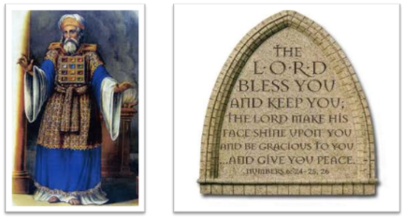
²⁴ The Lord bless you, and keep you; ²⁵ The Lord make His face shine on you, And be gracious to you; ²⁶ The Lord lift up His countenance on you, And give you peace.
Numbers 6:24–26 (NASB95)

