Slide 1
Dr. Andy Woods
Senior Pastor – Sugar Land Bible Church
President – Chafer Theological Seminary

Slide 2
Introductory Matters
Authorship |  | Occasion
Recipients |  | Structure
Place of writing |  | Unique characteristics
Date |  | Purpose
Audience |  | Message

Slide 3
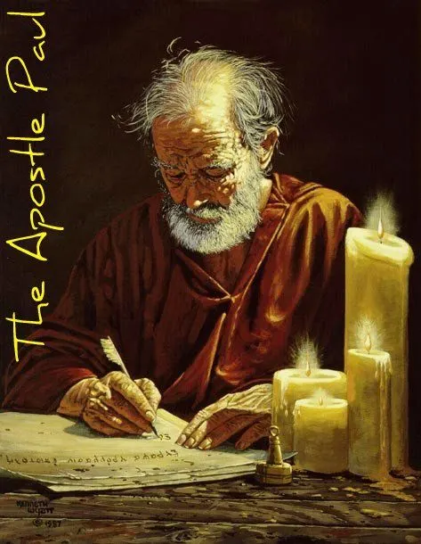
Structure
1 THESSALONIANS 1-3 | 1 THESSALONIANS 4-5
Personal Experience | Practical Exhortation
Looking Back | Looking Forward

Slide 4
Structure
Personal (1–3)
Genuine conversion (1)
Impure motives (2:1-16)
Lack of concern (2:17–3:13)
Practical (4–5)
Immorality (4:1-8)
Laziness (4:9-12)
Eschatology (4:13–5:11)
Ministry imbalances (5:12-15)
Progressive sanctification (5:16-28)

Slide 5
Structure
Personal (1–3)
Genuine conversion (1)
Impure motives (2:1-16)
Lack of concern (2:17–3:13)
Practical (4–5)
Immorality (4:1-8)
Laziness (4:9-12)
Eschatology (4:13–5:11)
Ministry imbalances (5:12-15)
Progressive sanctification (5:16-28)

Slide 6
Structure
Personal (1–3)
Genuine conversion (1)
Impure motives (2:1-16)
Lack of concern (2:17–3:13)
Practical (4–5)
Immorality (4:1-8)
Laziness (4:9-12)
Eschatology (4:13–5:11)
Ministry imbalances (5:12-15)
Progressive sanctification (5:16-28)

Slide 7
Genuine Conversion? (1 Thess 1)
Greeting (1:1)
Faith, hope, and love in Christ (1:2-3)
Response to the Gospel (1:4-5)
Joy in the midst of tribulation (1:6)
Example to those in Macedonia and Achaia (1:7)
No formal missionary endeavor (1:8-9a)
Turned from idols (1:9b)
Eschatological hope (1:10)

Slide 8
Chafer Theological Seminary Statement of Faith:
ELECTION
"We believe Scripture reveals two clear and indisputable lines of evidence. One line shows God sovereignly choosing His own in Christ; the other shows man possessing the function of volition, able to receive or reject God's uniquely born Son (regarding sovereignty, see Job 42:2; Psalm 135:6; Isaiah 46:9–10; Jeremiah 1:5; Matthew 24:22, 24, 31; Luke 18:7; Romans 8:29–33; Galatians 1:15; 2 Timothy 2:10; 1 Peter 1:1–2; regarding human volition, see John 1:9–13; 3:16, 36; 6:47; 20:30–31; Acts 16:30–31; Romans 10:11–13; 1 John 5:9–13, as well as every command in the epistles).”
https://www.chafer.edu/soteriology

Slide 9
Genuine Conversion? (1 Thess 1)
Greeting (1:1)
Faith, hope, and love in Christ (1:2-3)
Response to the Gospel (1:4-5)
Joy in the midst of tribulation (1:6)
Example to those in Macedonia and Achaia (1:7)
No formal missionary endeavor (1:8-9a)
Turned from idols (1:9b)
Eschatological hope (1:10)

Slide 10
John 5:24
“Truly, truly, I say to you, he who hears My word, and believes Him who sent Me, has eternal life, and does not come into judgment, but has passed out of death into life.”

Slide 11
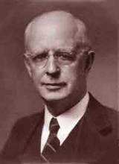
Lewis Sperry Chafer, Salvation: A Clear Doctrinal Analysis (Grand Rapids: Zondervan, 1977), 60. Italics added
Lewis Sperry Chafer
“There is a normal Christian experience. There are new and blessed emotions and desires. Old things do pass away; and behold all things do become new; but all such experiences are but secondary evidences, as to the fact of salvation, in that they grow out of that positive repose of faith which is the primary evidence.”

Slide 12
Genuine Conversion? (1 Thess 1)
Greeting (1:1)
Faith, hope, and love in Christ (1:2-3)
Response to the Gospel (1:4-5)
Joy in the midst of tribulation (1:6)
Example to those in Macedonia and Achaia (1:7)
No formal missionary endeavor (1:8-9a)
Turned from idols (1:9b)
Eschatological hope (1:10)

Slide 13
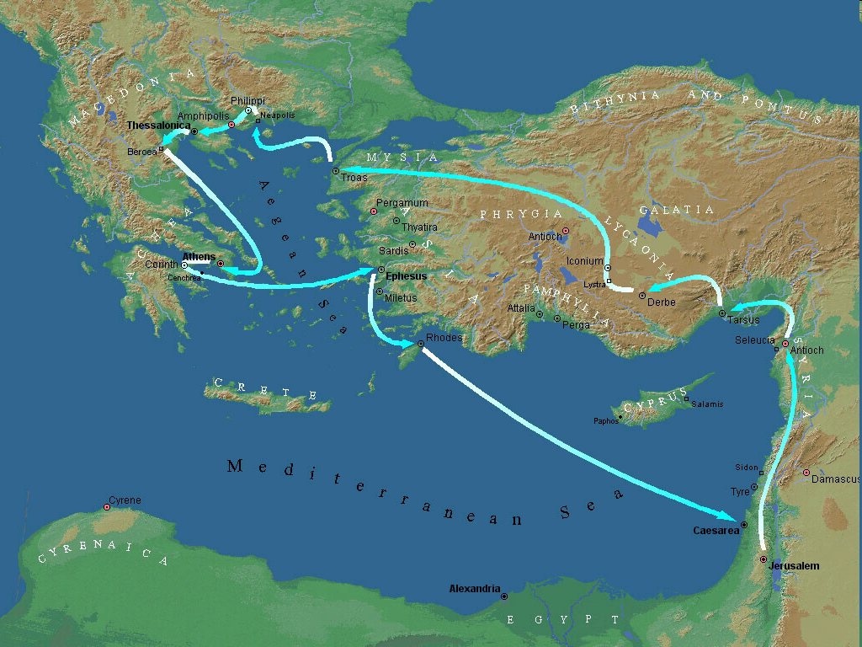
Second Missionary Journey

Slide 14
Second Missionary Journey

Slide 15
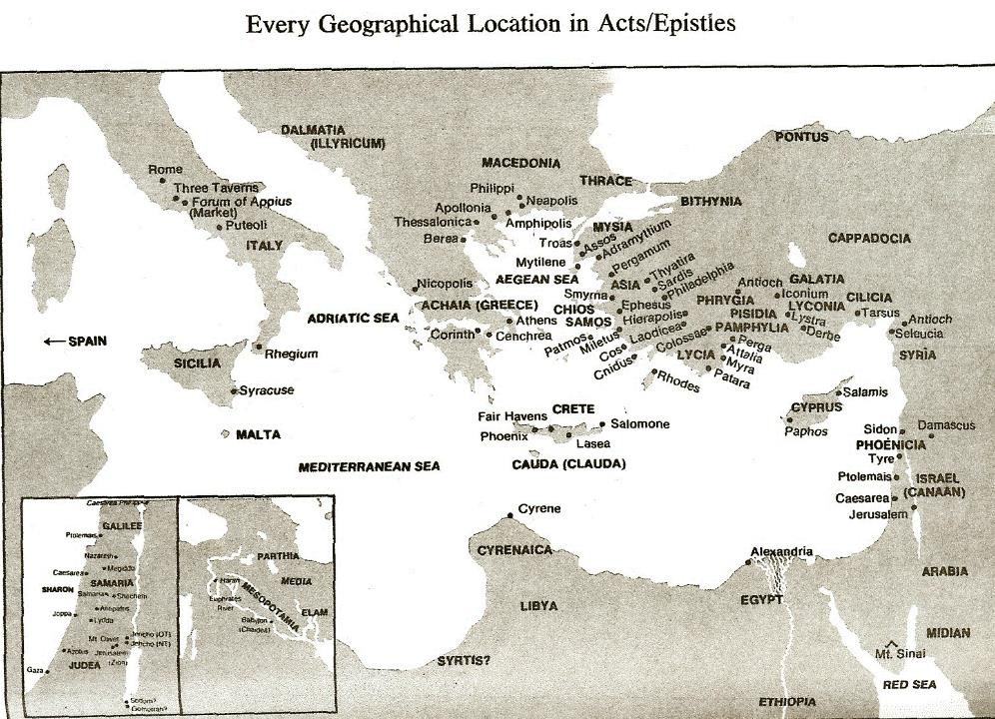

Slide 16
Genuine Conversion? (1 Thess 1)
Greeting (1:1)
Faith, hope, and love in Christ (1:2-3)
Response to the Gospel (1:4-5)
Joy in the midst of tribulation (1:6)
Example to those in Macedonia and Achaia (1:7)
No formal missionary endeavor (1:8-9a)
Turned from idols (1:9b)
Eschatological hope (1:10)

Slide 17
Second Missionary Journey

Slide 18
Second Missionary Journey

Slide 20
Lewis Sperry Chafer, vol. 7, Systematic Theology^{b} (Grand Rapids, MI: Kregel Publications, 1993), 265-66.
Belief-God’s One Condition for Justification
“…because upwards of 150 passages of Scripture condition salvation upon believing only (cf. John 3:16; Acts 16:31).

Slide 21
Genuine Conversion? (1 Thess 1)
Greeting (1:1)
Faith, hope, and love in Christ (1:2-3)
Response to the Gospel (1:4-5)
Joy in the midst of tribulation (1:6)
Example to those in Macedonia and Achaia (1:7)
No formal missionary endeavor (1:8-9a)
Turned from idols (1:9b)
Eschatological hope (1:10)

Slide 23
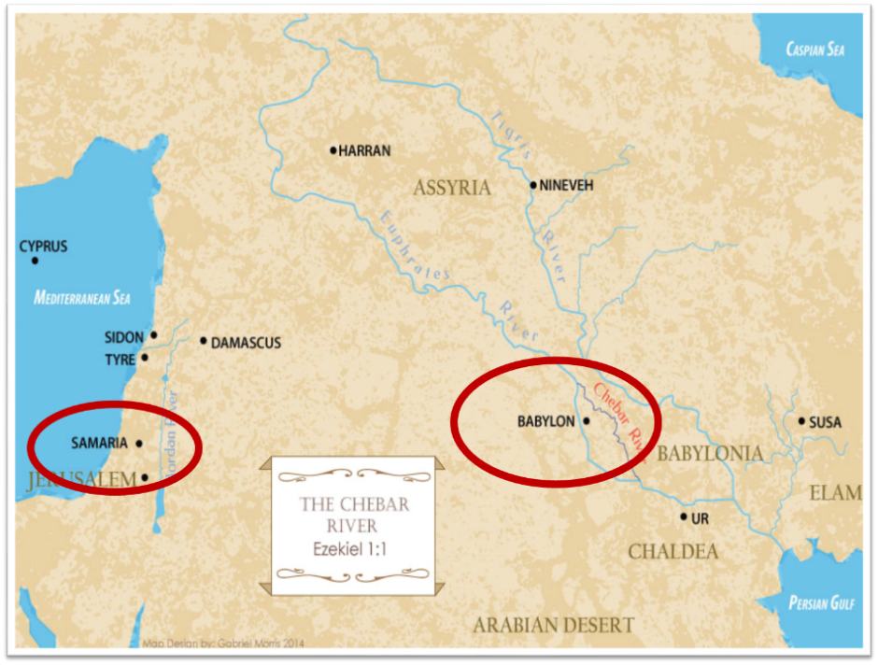

Slide 24
Three Tenses of Salvation
Phase | Justification | Sanctification | Glorification
Tense | Past | Present | Future
Saved from sin’s: | Penalty | Power | Presence
Scripture | Eph 2:8-9; Titus 3:5 | Philip 2:12 | Rom 5:10

Slide 25
Revelation 9:20-21
“The rest of mankind, who were not killed by these plagues, did not repent of the works of their hands, so as not to worship demons, and the idols of gold and of silver and of brass and of stone and of wood, which can neither see nor hear nor walk; ²¹ and they did not repent of their murders nor of their sorceries (pharmakov) nor of their immorality nor of their thefts.”

Slide 26
Genuine Conversion? (1 Thess 1)
Greeting (1:1)
Faith, hope, and love in Christ (1:2-3)
Response to the Gospel (1:4-5)
Joy in the midst of tribulation (1:6)
Example to those in Macedonia and Achaia (1:7)
No formal missionary endeavor (1:8-9a)
Turned from idols (1:9b)
Eschatological hope (1:10)

Slide 27
1 Thessalonians 4:13-18
¹³ "But we do not want you to be uninformed, brethren, about those who are asleep, so that you will not grieve as do the rest who have no hope. ¹⁴ For if we believe that Jesus died and rose again, even so God will bring with Him those who have fallen asleep in Jesus. ¹⁵ For this we say to you by the word of the Lord, that we who are alive and remain until the coming of the Lord, will not precede those who have fallen asleep. ¹⁶ For the Lord Himself will descend from . . .

Slide 28
1 Thessalonians 4:13-18
. . .heaven with a shout, with the voice of the archangel and with the trumpet of God, and the dead in Christ will rise first. ¹⁷ Then we who are alive and remain will be caught up together with them in the clouds to meet the Lord in the air, and so we shall always be with the Lord. ¹⁸ Therefore comfort one another with these words."

Slide 29
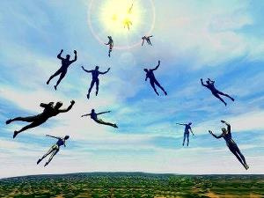
Imminent (1 Cor 15:51; 1 Thess 4:15)
Imminency definition
James 5:8; 1 Thess 1:10; 1 Cor 1:7; Philip 3:20
We are to be looking for Jesus Christ and not the Antichrist!
Motivator (Holiness, Evangelism)

Slide 30
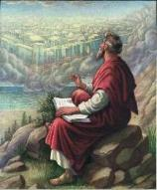
John 14:1–4
¹ “Do not let your heart be troubled; believe in God, believe also in Me. ² In My Father’s house are many dwelling places; if it were not so, I would have told you; for I go to prepare a place for you. ³ If I go and prepare a place for you, I will come again and receive you to Myself, that where I am, there you may be also. ⁴ And you know the way where I am going.”

Slide 31
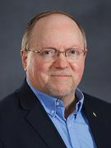
Wayne Brindle
"Biblical Evidence for the Imminence of the Rapture," Bibliotheca Sacra 158, no. 630 (April-June 2001): 138-51.
“Four criteria may be suggested, any one of which indicates imminence: (1) The passage speaks of Christ’s return as at any moment. (2) The passage speaks of Christ’s return as ‘near,’ without stating any signs that must precede His coming. (3) The passage speaks of Christ’s return as something that gives believers hope and encouragement, without indicating that these believers will suffer tribulation. (4) The passage speaks of Christ’s return as giving hope without relating it to God’s judgment of unbelievers.”

Slide 33
Lewis Sperry Chafer
Systematic Theology, Vol. 4, p. 367
“THE IMMINENT RETURN OF CHRIST. Whether it be that coming of Christ to the earth in glory when Israel is to be delivered or that coming into the air to receive His Bride, the coming is imminent. Scripture which directs Israel in the tribulation, which time is terminated by the glorious return of Christ as their judge and Deliverer, warns her to watch, for He will then come ‘as a thief in the night’ (cf. Matt. 24:32–25:13; 1 Thess. 5:1–8; 2 Pet. 3:8, 10). Over against this, the Church is instructed to wait and to look for His return for her (1 Thess. 1:9–10; Titus 2:13; Heb. 9:28). In both instances the return of Christ is unannounced . . .

Slide 34
Lewis Sperry Chafer
Systematic Theology, Vol. 4, p. 367
. . . and therefore impending, within the period to which each event belongs. The return of Christ for His Church was not impending in Old Testament days; nor is the glorious appearing impending until the tribulation (2 Thess. 2:3).”

Slide 35
Dr. John Walvoord
The Thessalonian Epistles, 17
“It is significant that Paul in such a brief period of ministry not only led them out of darkness into the light in the gospel, but also faithfully preached to them the truth of the coming of the Lord. By contrast today, some folks who go to church year after year never hear the precious truth that Christ who came to Bethlehem so long ago is coming again and that we can be looking for that wonderful return of the Lord for His own. So, in verse 10 he reminds the believers in Thessalonica that they not only have turned to God from idols to serve the living and true God—a present work—but they also have a new hope for . . .

Slide 36
Dr. John Walvoord
The Thessalonian Epistles, 17
. . .the future: ‘And to wait for His Son from heaven. The word ‘wait’ is in the present tense. They had turned to God in one act, but there remained the constant, day by day expectation. In other words, they were constantly looking for the return of the Lord, the coming of the Lord for His saints.”

Slide 37
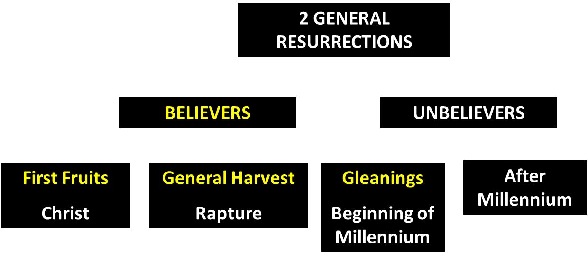
God’s Resurrection Program

Slide 39
Promised Exemption from Divine Wrath
The promise (1 Thess 1:10; 5:9; Rom 5:9; 8:1; Rev 3:10)
Tribulation = divine wrath (Rev 6:16-17; 11:18; 15:1, 7; 16:1, 19)

Slide 41
1st Six Seals (Revelation 6)
6:1-2 – Advent of antichrist
6:3-4 – War
6:5-6 – Famine
6:7-8 – Death
6:9-11 – Martyrdoms
6:12-17 – Cosmic disturbances

Slide 42
Revelation 6:16-17
^{“16} and they said to the mountains and the rocks, ‘Fall on us and hide us from the sight of Him who sits on the throne, and from the wrath [orgḗ] of the Lamb; ¹⁷ for the great day of Their wrath [orgḗ] has come, and who is able to stand?’”

Slide 43
Rev. 6:16-17 Robert L. Thomas, Revelation 1–7: An Exegetical Commentary, ed. Kenneth Barker (Chicago: Moody, 1992), 457-58.
"Mankind in his rebellion correctly analyzes the cosmic and terrestrial disturbances as a part of the great end-time day of wrath from the one sitting on the throne and from the Lamb. The verb ēlethen ("has come") is aorist indicative, referring to a previous arrival of wrath, not something that is about to take place. Men see the arrival of this day at least as early as the cosmic upheavals that characterize the sixth seal (6:12-14), but upon reflection they probably recognize that it was already in effect with the death of one-fourth of the population (6:7-8), the worldwide famine (6:5-6), and the global warfare (6:3-4). . . .

Slide 44
Rev. 6:16-17 Robert L. Thomas, Revelation 1–7: An Exegetical Commentary, ed. Kenneth Barker (Chicago: Moody, 1992), 457-58.
. . . rapid sequence of all of these events could not escape notice, but the light of their true explanation does not dawn upon human consciousness until the severe phenomena of the sixth seal arrive."

Slide 45
First Thessalonians 1:10 and the Pre-Tribulational Rapture
Ek vs. para/en
Rescues/from (2 Cor 1:10)
Imminency
Prepare for the Tribulation?

Slide 46
1 Thessalonians 1:10
“and to wait for His Son from heaven, whom He raised from the dead, that is Jesus, who rescues (rhyomai) us from (ek) the wrath (orgē) to come..”

Slide 47
2 Corinthians 1:10
“who delivered (rhyomai) us from (ek) so great a peril of death (thanatos), and will deliver us, He on whom we have set our hope. And He will yet deliver us.”

Slide 48
Conclusion

Slide 49
Genuine Conversion? (1 Thess 1)
Greeting (1:1)
Faith, hope, and love in Christ (1:2-3)
Response to the Gospel (1:4-5)
Joy in the midst of tribulation (1:6)
Example to those in Macedonia and Achaia (1:7)
No formal missionary endeavor (1:8-9a)
Turned from idols (1:9b)
Eschatological hope (1:10)

Slide 50
Structure
Personal (1–3)
Genuine conversion (1)
Impure motives (2:1-16)
Lack of concern (2:17–3:13)
Practical (4–5)
Immorality (4:1-8)
Laziness (4:9-12)
Eschatology (4:13–5:11)
Ministry imbalances (5:12-15)
Progressive sanctification (5:16-28)

