Slide 1
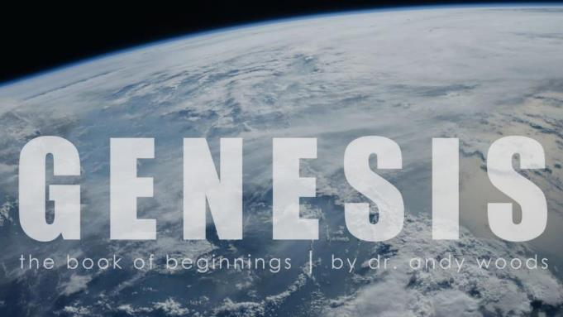
Genesis 12‒50
Israel’s Birth & Preservation

Slide 2
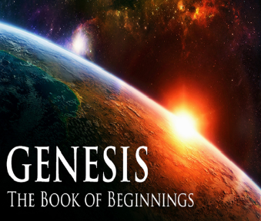
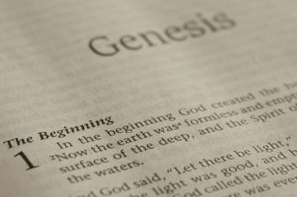
GENESIS STRUCTURE
Beginning of the Human race (Gen. 1‒11)
Beginning of the Hebrew race (Gen. 12‒50)

Slide 3
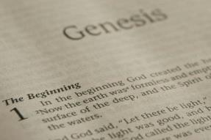
GENESIS STRUCTURE
Genesis 1-11 (four events)
Creation (1-2)
Fall (3-5)
Flood (6-9)
National dispersion (10-11)

Slide 4
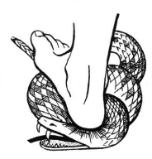
Genesis 3:15
“And I will put enmity Between you and the woman, And between your seed and her seed; He shall bruise you on the head, And you shall bruise him on the heel.”

Slide 5
GENESIS STRUCTURE
Beginning of the Human race (Gen. 1‒11)
Beginning of the Hebrew race (Gen. 12‒50)

Slide 6
GENESIS STRUCTURE
Genesis 12-50 (four people)
Abraham (12:1–25:11)
Isaac (25:12–26:35)
Jacob (27–36)
Joseph (37–50)

Slide 7
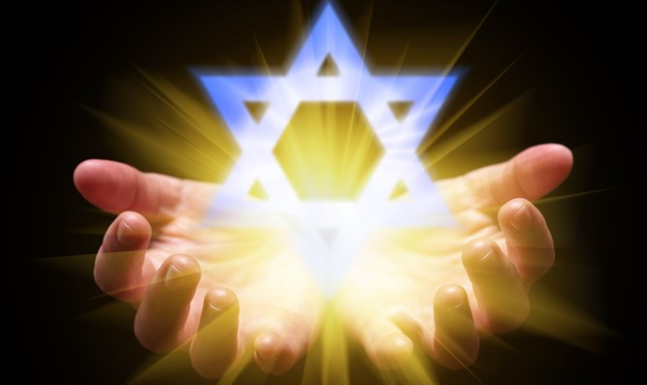
Isaiah 43:1
“But now, thus says the Lord, your Creator, O Jacob, And He who formed you, O Israel, 'Do not fear, for I have redeemed you; I have called you by name; you are Mine!'”

Slide 8
GENESIS STRUCTURE
Genesis 12-50 (four people)
Abraham (12:1–25:11)
Isaac (25:12–26:35)
Jacob (27–36)
Joseph (37–50)

Slide 9
Genesis 12‒24 Abraham’s Early Journeys
Unconditional promises (Gen. 12:1-3) From Haran to Canaan (Gen. 12:4-5) In Canaan (Gen. 12:6-9) In Egypt (Gen. 12:10-20) Abram and Lot Separate (Gen. 13:1-13) Reaffirmation of Abram’s promises (Gen. 13:14-18) Abram Rescues Lot (14:1-24) Abrahamic Covenant (15:1-21) Hagar & Ishmael (16:1-16) Circumcision (Gen. 17:1-27) | Sodom & Gomorrah (Gen. 18‒19) Abraham & Abimelech (Gen. 20) Isaac’s birth (Gen. 21:1-7) Ishmael’s expulsion (21:8-21) Abraham & Abimelech’s covenant (21:22-34) Abraham sacrifices Isaac (22) Sarah’s death (23) Isaac’s marriage (24)

Slide 10
Genesis 24 Isaac’s Marriage
Abraham’s instructions (1-9)
Servant prays (10-14)
Servant meets Rebekah (15-27)
Servant and Laban (28-49)
Betrothal of Isaac & Rebekah (50-60)
Marriage of Isaac & Rebekah (61-67)

Slide 11
Genesis 24 Isaac’s Marriage
Abraham’s instructions (1-9)
Servant prays (10-14)
Servant meets Rebekah (15-27)
Servant and Laban (28-49)
Betrothal of Isaac & Rebekah (50-60)
Marriage of Isaac & Rebekah (61-67)

Slide 12
Genesis 24:61-67 Isaac & Rebekah’s marriage
Journey & arrival (61)
Isaac’s encounter (62-63)
Rebekah’s encounter (64-65)
Servant reports to Isaac (66)
Marriage (67)

Slide 13
Genesis 24:61-67 Isaac & Rebekah’s marriage
Journey & arrival (61)
Isaac’s encounter (62-63)
Rebekah’s encounter (64-65)
Servant reports to Isaac (66)
Marriage (67)

Slide 14
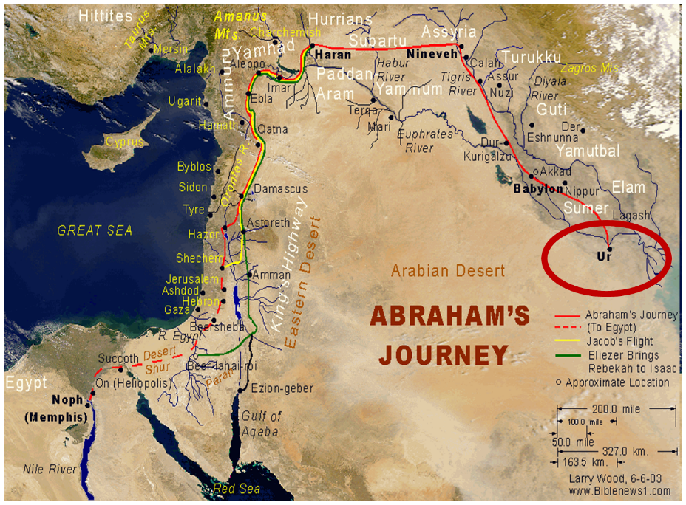

Slide 15
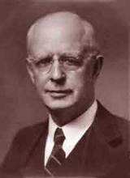
Lewis Sperry Chafer, vol. 7, Systematic Theology^{b} (Grand Rapids, MI: Kregel Publications, 1993), 265-66.
Belief-God’s One Condition for Justification
“…because upwards of 150 passages of Scripture condition salvation upon believing only (cf. John 3:16; Acts 16:31).

Slide 16
Genesis 24:61-67 Isaac & Rebekah’s marriage
Journey & arrival (61)
Isaac’s encounter (62-63)
Rebekah’s encounter (64-65)
Servant reports to Isaac (66)
Marriage (67)

Slide 17
Charles Ryrie
The Ryrie Study Bible
“Genesis 16:14 (RSB:NASB1995U): 16:14 Beer-lahai-roi means ‘a well of the Living One who sees me.’ The exact location is unknown, though possibly it was SW of Beersheba.”

Slide 18
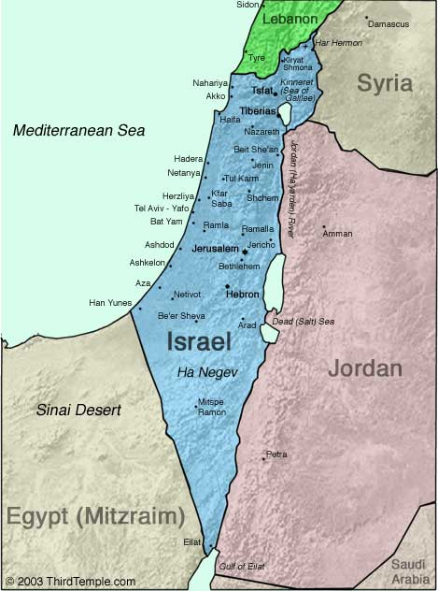
Negev

Slide 19
Genesis 12‒24 Abraham’s Early Journeys
Unconditional promises (Gen. 12:1-3) From Haran to Canaan (Gen. 12:4-5) In Canaan (Gen. 12:6-9) In Egypt (Gen. 12:10-20) Abram and Lot Separate (Gen. 13:1-13) Reaffirmation of Abram’s promises (Gen. 13:14-18) Abram Rescues Lot (14:1-24) Abrahamic Covenant (15:1-21) Hagar & Ishmael (16:1-16) Circumcision (Gen. 17:1-27) | Sodom & Gomorrah (Gen. 18‒19) Abraham & Abimelech (Gen. 20) Isaac’s birth (Gen. 21:1-7) Ishmael’s expulsion (21:8-21) Abraham & Abimelech’s covenant (21:22-34) Abraham sacrifices Isaac (22) Sarah’s death (23) Isaac’s marriage (24)

Slide 20
Genesis 24:61-67 Isaac & Rebekah’s marriage
Journey & arrival (61)
Isaac’s encounter (62-63)
Rebekah’s encounter (64-65)
Servant reports to Isaac (66)
Marriage (67)

Slide 21
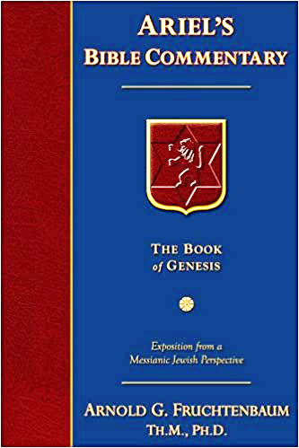
Dr. Arnold G. Fruchtenbaum
The Book of Genesis, 387
“Genesis 24:64–65 records Rebekah’s encounter, with verse 64 giving the occasion: And Rebekah lifted up her eyes, and when she saw Isaac, she alighted from the camel. The Hebrew word for alighted is naphal, which normally means ‘to fall.’ The picture being conveyed is that when she saw Isaac, she ‘fell off’ her camel. This did not happen because she knew who he was, because the event happened before she knew who he was. Therefore, when she saw Isaac, something about Isaac’s demeanor or looks or whatever caused her to fall off her camel. If ever there was any implication of love at first sight, this may very well be it. Again, this was before she knew who he was; because only in verse 65 is Isaac identified to her.”

Slide 22
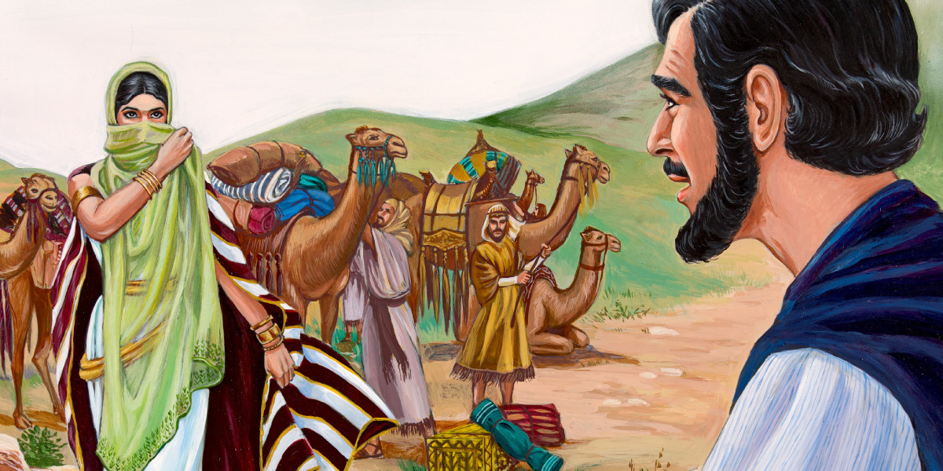
Dr. Arnold G. Fruchtenbaum
The Book of Genesis, 388
“That was in keeping with the custom of those days in that the bride’s face was veiled on the wedding night…Nevertheless, realizing that Isaac is the one she is going to marry, in keeping with the tradition of a bride veiling her face on the wedding night, she veiled herself.”

Slide 23
Charles Ryrie
The Ryrie Study Bible
“Genesis 24:65 (RSB:NASB1995U): The veil, a sign of modesty and respect, was large enough to wrap around both face and body.”

Slide 24
Genesis 24:61-67 Isaac & Rebekah’s marriage
Journey & arrival (61)
Isaac’s encounter (62-63)
Rebekah’s encounter (64-65)
Servant reports to Isaac (66)
Marriage (67)

Slide 25
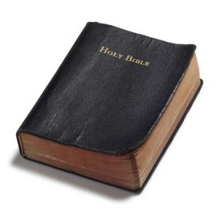
1 Corinthians 4:2
“In this case, moreover, it is required of stewards that one be found trustworthy.”
25

Slide 26
2 Corinthians 5:10
“For we must all appear before the judgment seat of Christ, so that each one may be recompensed for his deeds in the body, according to what he has done, whether good or bad.”

Slide 27
Genesis 24:61-67 Isaac & Rebekah’s marriage
Journey & arrival (61)
Isaac’s encounter (62-63)
Rebekah’s encounter (64-65)
Servant reports to Isaac (66)
Marriage (67)

Slide 28
Dr. Arnold G. Fruchtenbaum
The Book of Genesis, 388-89
“This helps to clarify exactly what a biblical marriage is and is not. A biblical marriage is not merely living together; nor is a biblical marriage merely sexual union. It was possible to have sexual union without marriage even within the biblical context. However, there were three elements in a biblical marriage. First, there had to be a commitment to one another; she was committed to Isaac, and Isaac was committed to her. There may not have been any love at this point because, as in the case here, they had only just met. This shows it is possible to make a commitment without the feeling of love per se, but the commitment to love the one you marry.”

Slide 29
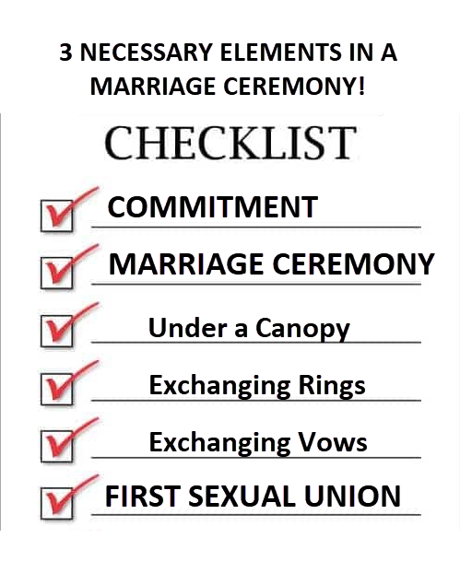
Dr. Arnold G. Fruchtenbaum
The Book of Genesis, 388-89
“The second necessary element is the marriage ceremony, a ceremony recognized by society to be a marriage ceremony. With different societies there are different customs, but every society has a ceremony for marriage, such as marrying under a canopy or the custom of exchanging rings and exchanging vows. The third element for a biblical marriage is the first sexual union by which the couple becomes one.”

Slide 30
Conclusion

Slide 31
Genesis 12‒24 Abraham’s Early Journeys
Unconditional promises (Gen. 12:1-3) From Haran to Canaan (Gen. 12:4-5) In Canaan (Gen. 12:6-9) In Egypt (Gen. 12:10-20) Abram and Lot Separate (Gen. 13:1-13) Reaffirmation of Abram’s promises (Gen. 13:14-18) Abram Rescues Lot (14:1-24) Abrahamic Covenant (15:1-21) Hagar & Ishmael (16:1-16) Circumcision (Gen. 17:1-27) | Sodom & Gomorrah (Gen. 18‒19) Abraham & Abimelech (Gen. 20) Isaac’s birth (Gen. 21:1-7) Ishmael’s expulsion (21:8-21) Abraham & Abimelech’s covenant (21:22-34) Abraham sacrifices Isaac (22) Sarah’s death (23) Isaac’s marriage (24)

Slide 32
Genesis 24 Isaac’s Marriage
Abraham’s instructions (1-9)
Servant prays (10-14)
Servant meets Rebekah (15-27)
Servant and Laban (28-49)
Betrothal of Isaac & Rebekah (50-60)
Marriage of Isaac & Rebekah (61-67)

Slide 33
Genesis 24:61-67 Isaac & Rebekah’s marriage
Journey & arrival (61)
Isaac’s encounter (62-63)
Rebekah’s encounter (64-65)
Servant reports to Isaac (66)
Marriage (67)

Slide 34
Genesis 12‒25 Abraham’s Early Journeys
Unconditional promises (Gen. 12:1-3) From Haran to Canaan (Gen. 12:4-5) In Canaan (Gen. 12:6-9) In Egypt (Gen. 12:10-20) Abram and Lot Separate (Gen. 13:1-13) Reaffirmation of Abram’s promises (Gen. 13:14-18) Abram Rescues Lot (14:1-24) Abrahamic Covenant (15:1-21) Hagar & Ishmael (16:1-16) Circumcision (Gen. 17:1-27) | Sodom & Gomorrah (Gen. 18‒19) Abraham & Abimelech (Gen. 20) Isaac’s birth (Gen. 21:1-7) Ishmael’s expulsion (21:8-21) Abraham & Abimelech’s covenant (21:22-34) Abraham sacrifices Isaac (22) Sarah’s death (23) Isaac’s marriage (24) Abraham’s death (25)

Slide 35
²⁴ The Lord bless you, and keep you; ²⁵ The Lord make His face shine on you, And be gracious to you; ²⁶ The Lord lift up His countenance on you, And give you peace.
Numbers 6:24–26 (NASB95)

