Slide 1


Zechariah
God Remembers!

Slide 2

Occasion
538 B.C. ‒ Cyrus’ decree
536 B.C. ‒ Temple foundation laid
534 B.C. ‒ Temple building interrupted
Temple project stalled for 15 years
520‒518 B.C. ‒ Ministries of Zechariah & Haggai
519 B.C. ‒ Darius confirmation of Cyrus’ decree
Resumption of Temple building
516 B.C. ‒ Temple completed

Slide 3
Purposes
  To encourage the returnees to rebuild the Temple
  To provide eschatological hope in the challenging post-exilic world
  To prepare the returnees for Temple worship
  To exhort the returnees toward covenant obedience

Slide 4

Structure
Introductory call to repentance (1:1-6)
Eight-night visions (1:7–6:15)
Question and answers about fasting (7–8)
Two burdens (9–14)

Slide 5
Structure
Introductory call to repentance (1:1-6)
Eight-night visions (1:7–6:15)
Question and answers about fasting (7–8)
Two burdens (9–14)

Slide 6
Structure
Introductory call to repentance (1:1-6)
Eight-night visions (1:7–6:15)
Question and answers about fasting (7–8)
Two burdens (9–14)

Slide 7
ZECHARIAH’S EIGHT NIGHT VISIONS
Vision | Reference | Meaning
The Red-horse Rider among the Myrtles | 1:7-17 | God’s anger against the nations & blessing on restored Israel.
The Four Horns & the Four Craftsmen | 1:18-21 | God’s judgment on the nations that afflict Israel.
The Surveyor with a Measuring Line | Chapter 2 | God’s future blessing on restored Israel.
The Cleansing & Crowning of Joshua the Hight Priest. | Chapter 3 | Israel’s future cleansing from sin & reinstatement as a priestly nation.
The Golden Lampstand & the Two Olive Trees | Chapter 4 | Israel as the light to the nations under Messiah, the King-Priest.
The Flying Scroll | 5:1-4 | The severity & totality of divine judgment on individual Israelites.
The Woman in the Ephah | 5:5-11 | The removal of national Israel’s sin of rebellion against God.
The Four Chariots | 6:1-8 | Divine judgment on Gentile nations.

Slide 8
II. Eight Night Visions
(1:7‒6:15)
  Riders & horses among the myrtle trees (1:7-17)
  Four horns & four craftsmen (1:18-21)
  Man with the measuring line (2)
  Cleansing of the High Priest Joshua (3)
  Lampstand & olive tree (4)
  Flying scroll (5:1-4)
  Woman in the basket (5:5-11)
  Four chariots (6:1-8)
  Conclusion: crowning of Joshua (6:9-15)

Slide 9
Structure
Introductory call to repentance (1:1-6)
Eight-night visions (1:7–6:15)
Question and answers about fasting (7–8)
Two burdens (9–14)

Slide 10
III. Questions & Answers Concerning Fasting
(7‒8)
  Question (7:1-3)
  Four divine answers (7:4‒8:23)
    Condemnation of empty ritualism (7:4-7)
    Condemnation of past covenant failure (7:8-14)
    Prediction of Jerusalem’s restoration (8:1-17)
    Prediction of future blessing (8:18-23)

Slide 11
Structure
Introductory call to repentance (1:1-6)
Eight-night visions (1:7–6:15)
Question and answers about fasting (7–8)
Two burdens (9–14)

Slide 12
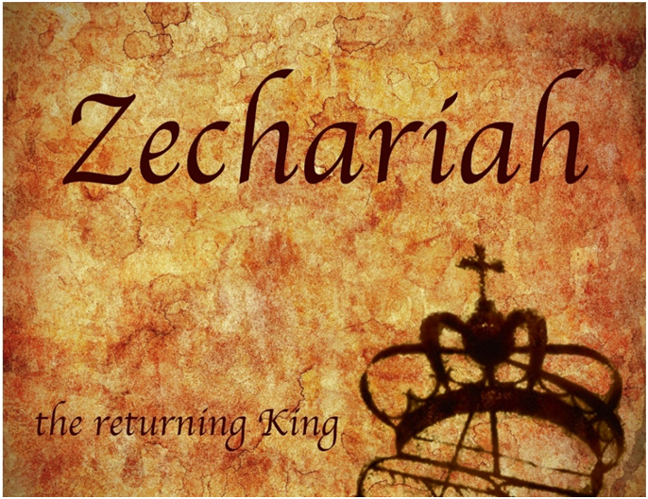
IV. Two Burdens
(9‒14)
  Israel’s postponed deliverance due to her rejection of her Messiah (9‒11)
  Israel’s future deliverance due to her acceptance of her Messiah (12‒14)

Slide 13
IV. Two Burdens
(9‒14)
  Israel’s postponed deliverance due to her rejection of her Messiah (9‒11)
  Israel’s future deliverance due to her acceptance of her Messiah (12‒14)

Slide 14

First Burden Outline
(9‒11)
    Divine warrior hymn (9)
    True shepherd (10)
    False shepherd (11)

Slide 15
IV. Two Burdens
(9‒14)
  Israel’s postponed deliverance due to her rejection of her Messiah (9‒11)
  Israel’s future deliverance due to her acceptance of her Messiah (12‒14)

Slide 16
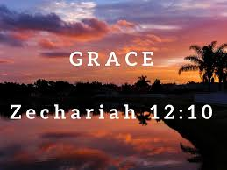
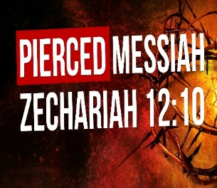
Zechariah 12
(Israel’s Physical & Spiritual Salvation)
Israel’s physical deliverance (12:1-9)
  The nations that will attack Israel (1-3)
  The God who will protect Israel (4-9)
Israel’s spiritual deliverance (12:10-14)
  God’s Spirit: the cause of revival (10a)
  Israel’s remorse: the result of revival (11-14)

Slide 17
Zechariah 13
(Israel’s Physical & Spiritual Salvation)
Spiritual cleansing (13:1-5)
Comprehensive deliverance (13:6-9)

Slide 18
Zechariah 14
(Israel’s Kingdom)
Jerusalem’s deliverance (14:1-7)
Kingdom conditions (14:8-11)
Enemies’ judgment (12-15)
Kingdom worship (16-21)

Slide 19
Zechariah 14
(Israel’s Kingdom)
Jerusalem’s deliverance (14:1-7)
Kingdom conditions (14:8-11)
Enemies’ judgment (12-15)
Kingdom worship (16-21)

Slide 20
I. Jerusalem’s Deliverance
(Zechariah 14:1-7)
  The theme (1)
  The crisis (2)
  The warrior (3)
  The return (4)
  The remnant (5)
  The darkness (6)
  The Uniqueness (7)

Slide 21
Zechariah 14
(Israel’s Kingdom)
Jerusalem’s deliverance (14:1-7)
Kingdom conditions (14:8-11)
Enemies’ judgment (12-15)
Kingdom worship (16-21)

Slide 22


Slide 23
II. Kingdom Conditions
(Zechariah 14:8-11)
  Jerusalem’s waters (8)
  Earthly reign (9)
  Topographical changes (10)
  Millennial Jerusalem (11)

Slide 24
Zechariah 14
(Israel’s Kingdom)
Jerusalem’s deliverance (14:1-7)
Kingdom conditions (14:8-11)
Enemies’ judgment (12-15)
Kingdom worship (16-21)

Slide 25
III. Enemies’ Judgment
(Zechariah 14:12-15)
  Plague (12)
  Panic (13)
  Plunder (14)
  Pets (15)

Slide 26
III. Enemies’ Judgment
(Zechariah 14:12-15)
  Plague (12)
  Panic (13)
  Plunder (14)
  Pets (15)

Slide 27


Genesis 12:3
“And I will bless those who bless you, And the one who curses [kalal] you I will curse [aor]. And in you all the families of the earth will be blessed.”

Slide 28
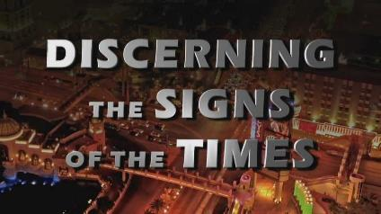
Signs of the Second Coming
Israel
International Politics
Economics
Technology
Spirituality
Society
Understanding Bible Prophecy

Slide 29
Signs of the Second Coming
Israel
International Politics
Economics
Technology
Spirituality
Society
Understanding Bible Prophecy

Slide 30

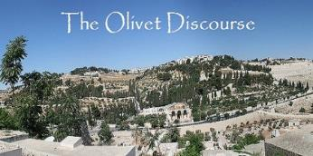
Matthew 24:21-22
“²¹ For then there will be a great tribulation, such as has not occurred since the beginning of the world until now, nor ever will. ²² Unless those days had been cut short, no life would have been saved; but for the sake of the elect those days will be cut short.”

Slide 31
III. Enemies’ Judgment
(Zechariah 14:12-15)
  Plague (12)
  Panic (13)
  Plunder (14)
  Pets (15)

Slide 32


Slide 33
III. Enemies’ Judgment
(Zechariah 14:12-15)
  Plague (12)
  Panic (13)
  Plunder (14)
  Pets (15)

Slide 34
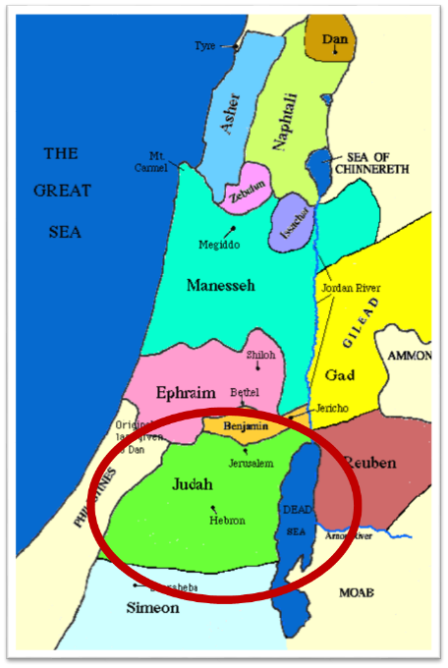

Slide 35

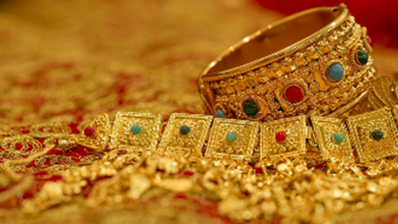
Ezekiel 38:12
“to capture spoil and to seize plunder, to turn your hand against the waste places which are now inhabited, and against the people who are gathered from the nations, who have acquired cattle and goods, who live at the center of the world.”

Slide 36
Ezekiel 38:13
“Sheba and Dedan and the merchants of Tarshish with all its villages will say to you, ‘Have you come to capture spoil? Have you assembled your company to seize plunder, to carry away silver and gold, to take away cattle and goods, to capture great spoil?’”

Slide 37
III. Enemies’ Judgment
(Zechariah 14:12-15)
  Plague (12)
  Panic (13)
  Plunder (14)
  Pets (15)

Slide 39
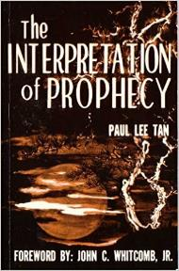
Paul Lee Tan
The Interpretation of Prophecy, 223-24
“Interestingly, these prophesied military instruments though centuries old have not been made obsolete. The horse, for instance, is still used in warfare on certain kinds of terrain.”

Slide 40
Zechariah 14
(Israel’s Kingdom)
Jerusalem’s deliverance (14:1-7)
Kingdom conditions (14:8-11)
Enemies’ judgment (12-15)
Kingdom worship (16-21)

Slide 41
IV. Kingdom Worship
(Zechariah 14:16-21)
  The pilgrimage (16)
  The punishment (17-19)
  The purity (20-21)

Slide 42
IV. Kingdom Worship
(Zechariah 14:16-21)
  The pilgrimage (16)
  The punishment (17-19)
  The purity (20-21)

Slide 43

Zechariah 14:16-18
“Then it will come about that any who are left of all the nations that went against Jerusalem will go up from year to year to worship the King, the Lord of hosts, and to celebrate the Feast of Booths. ¹⁷ And it will be that whichever of the families of the earth does not go up to Jerusalem to worship the King, the Lord of hosts, there will be no rain on them. ¹⁸ If the family of Egypt does not go up or enter, then no rain will fall on them; it will be the plague with which the Lord smites the nations who do not go up to celebrate the Feast of Booths.”

Slide 44
Scripture’s Four Judgments
NAME | SHEEP AND GOAT | JUDGMENT OF THE JEWS | BEMA SEAT | GREAT WHITE THRONE
SCRIPTURE | Matt 25:31-46 | Ezek 20:33-44 | 1 Cor 3:10-15 | Rev 20:11-15
PLACE | Earth, Jerusalem | Earth, wilderness | Heaven | Earth
AUDIENCE | Gentile Tribulation survivors | Jewish Tribulation survivors | Church Age believers | All unsaved
WHEN | After Tribulation | After Tribulation | After rapture | After Millennium
PURPOSE | Saved Gentiles enter kingdom | Saved Jews enter kingdom | Reward believers | Degree of punishment in hell
EVALUATION | Treatment of Christ’s brethren | Passing under shepherd’s rod | Works taken through fire | Not in the book; judged by books

Slide 45
Christ’s Three Offices
Prophet (First Coming)
Priest (Present Session)
King (Second Coming)

Slide 46

Isaiah 2:1-4
¹ “The word which Isaiah the son of Amoz saw concerning Judah and Jerusalem.² Now it will come about that In the last days The mountain of the house of the Lord Will be established as the chief of the mountains, And will be raised above the hills; And all the nations will stream to it.³ And many peoples will come and say, “Come, let us go up to the mountain of the Lord, To the house of the God of Jacob; That He may teach us concerning His ways And that we may . . .

Slide 47

Isaiah 2:1-4
. . . walk in His paths.” For the law will go forth from Zion And the word of the Lord from Jerusalem.⁴ And He will judge between the nations, And will render decisions for many peoples; And they will hammer their swords into plowshares and their spears into pruning hooks. Nation will not lift up sword against nation, And never again will they learn war.”

Slide 48

Revelation 20:7-9
“⁷ When the thousand years are completed [teleō], Satan will be released from his prison, ⁸ and will come out to deceive the nations which are in the four corners of the earth, Gog and Magog, to gather them together for the war; the number of them is like the sand of the seashore. ⁹ And they came up on the broad plain of the earth and surrounded the camp of the saints and the beloved city, and fire came down from heaven and devoured them.”

Slide 49
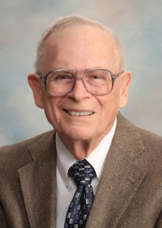
Robert Thomas
Four Views on the Book of Revelation, page 207.
“At the end of the Millennium that city will be Satan’s prime objective with his rebel army, because Israel will be a leader among the nations.”

Slide 50
Levitical Feasts (Leviticus 23)
Feast | Season | Purpose | Type
Passover | Spring | Redemption | 1 Cor 5:7
Unleavened Bread | Spring | Separation | John 6:35
1st Fruits | Spring | Praise | 1 Cor 15:20
Pentecost | Spring | Praise | Acts 2:1-4
Trumpets | Fall | New Year | Matt 24:31
Atonement | Fall | Lev 16 | Zech 12:10
Booths | Fall | Wilderness provision | Zech 14:16-18

Slide 51


Dr. Arnold G. Fruchtenbaum
Footsteps of the Messiah, 456-57
“There are usually. . . objections to taking these sacrifices literally. First objection: This would mean a return to the sacrificial system of the Mosaic Law which ended when Messiah died and therefore violates all that the New Testament teaches about the termination of the Law as a rule of life. Answer: While there are many similarities with the sacrifices of the Mosaic Law, as there are between the sacrifices of Noah and Moses, the differences show they are not the same. It was these very differences that kept the rabbis from accepting Ezekiel into the Hebrew Canon for some time. These differences include . . .

Slide 52
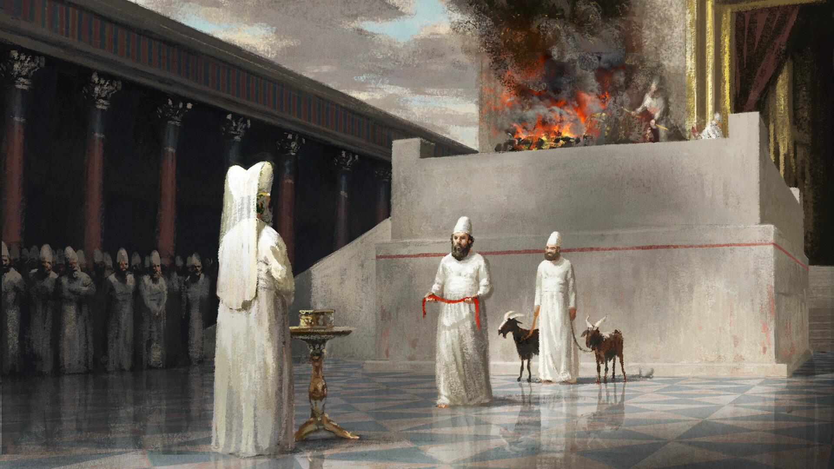
Dr. Arnold G. Fruchtenbaum
Footsteps of the Messiah, 456-57
. . . the following…All these differences show that this is not a return to the Law of Moses, but it is a new system under Kingdom Law and so it does not violate what the New Testament teaches concerning the termination of the Law with Messiah’s death.”

Slide 53
IV. Kingdom Worship
(Zechariah 14:16-21)
  The pilgrimage (16)
  The punishment (17-19)
  The purity (20-21)

Slide 55
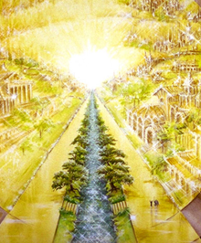
Eternal State is Future
No Satan (Rev 20:10)
No sea (Rev 21:1)
No death, crying, or pain (Rev 21:4)
No Sun (Rev 22:5)
No Moon (Rev 21:23)
No temple (Rev. 21:22)
No night (Rev 21:25)
No evil (Rev 21:27)
No curse (Rev 22:3)

Slide 56
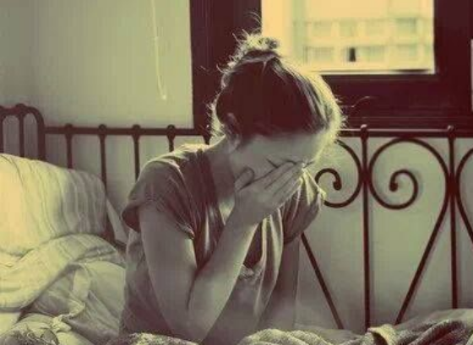
Revelation 21:4
“and He will wipe away every tear from their eyes; and there will no longer be any death; there will no longer be any mourning, or crying, or pain; the first things have passed away.”

Slide 57
Millennium Rev.20 | Eternal State Rev.21-22
Sin restrained | Sin removed
Curse restrained | Curse removed
Death | No death
Mortals / resurrected | Resurrected only
Mortals Destinies undecided | All Destinies sealed
Renovation | Recreation
Temporary | Eternal
Transitional | Non-transitional

Slide 58
Millennium and Eternal State
 | Rev 20:1-10 | Rev 21–22
Time | 20:4 | 22:5
Luminaries | Isa 30:26 | 21:23; 22:5
Temple | Ezek 40–48 | 21:22
Death | Isa 65:20 | 21:4
Satanic activity | 20:7 | 20:10
Rebellion | 20:8-9 | 21:27

Slide 59
Ezekiel 20:33-38
³³ “As I live,” declares the Lord God, “surely with a mighty hand and with an outstretched arm and with wrath poured out, I shall be king over you. ³⁴ I will bring you out from the peoples and gather you from the lands where you are scattered, with a mighty hand and with an outstretched arm and with wrath poured out; ³⁵ and I will bring you into the wilderness of the peoples, and there I will enter into judgment with you face to face. ³⁶ As I entered into . . .

Slide 60
Ezekiel 20:33-38
. . . judgment with your fathers in the in the wilderness of the land of Egypt, so I will enter into judgment with you,” declares the Lord God. ³⁷ “I will make you pass under the rod, and I will bring you into the bond of the covenant; ³⁸ and I will purge from you the rebels and those who transgress against Me; I will bring them out of the land where they sojourn, but they will not enter the land of Israel. Thus you will know that I am the Lord.

Slide 61
Christ’s Three Offices
Prophet (First Coming)
Priest (Present Session)
King (Second Coming)

Slide 62
Zechariah 14:16-18
“Then it will come about that any who are left of all the nations that went against Jerusalem will go up from year to year to worship the King, the Lord of hosts, and to celebrate the Feast of Booths. ¹⁷ And it will be that whichever of the families of the earth does not go up to Jerusalem to worship the King, the Lord of hosts, there will be no rain on them. ¹⁸ If the family of Egypt does not go up or enter, then no rain will fall on them; it will be the plague with which the Lord smites the nations who do not go up to celebrate the Feast of Booths.”

Slide 63
Revelation 20:7-9
“⁷ When the thousand years are completed [teleō], Satan will be released from his prison, ⁸ and will come out to deceive the nations which are in the four corners of the earth, Gog and Magog, to gather them together for the war; the number of them is like the sand of the seashore. ⁹ And they came up on the broad plain of the earth and surrounded the camp of the saints and the beloved city, and fire came down from heaven and devoured them.”

Slide 64


Slide 65
IV. Kingdom Worship
(Zechariah 14:16-21)
  The pilgrimage (16)
  The punishment (17-19)
  The purity (20-21)

Slide 67
Eternal State is Future
No Satan (Rev 20:10)
No sea (Rev 21:1)
No death, crying, or pain (Rev 21:4)
No Sun (Rev 22:5)
No Moon (Rev 21:23)
No temple (Rev. 21:22)
No night (Rev 21:25)
No evil (Rev 21:27)
No curse (Rev 22:3)

Slide 68
ISRAEL’S FOUR TEMPLES
Solomon’s pre-exilic temple (Kings and Chronicles)
Zerubbabel’s post exilic temple (Ezra 1-6; John 2:20)
Antichrist's temple (Dan. 9:27; Matt. 24:15; 2 Thess. 2:4; Rev. 11:1-2)
Millennial temple (Ezek. 40-48)

Slide 69


Slide 70


Slide 71
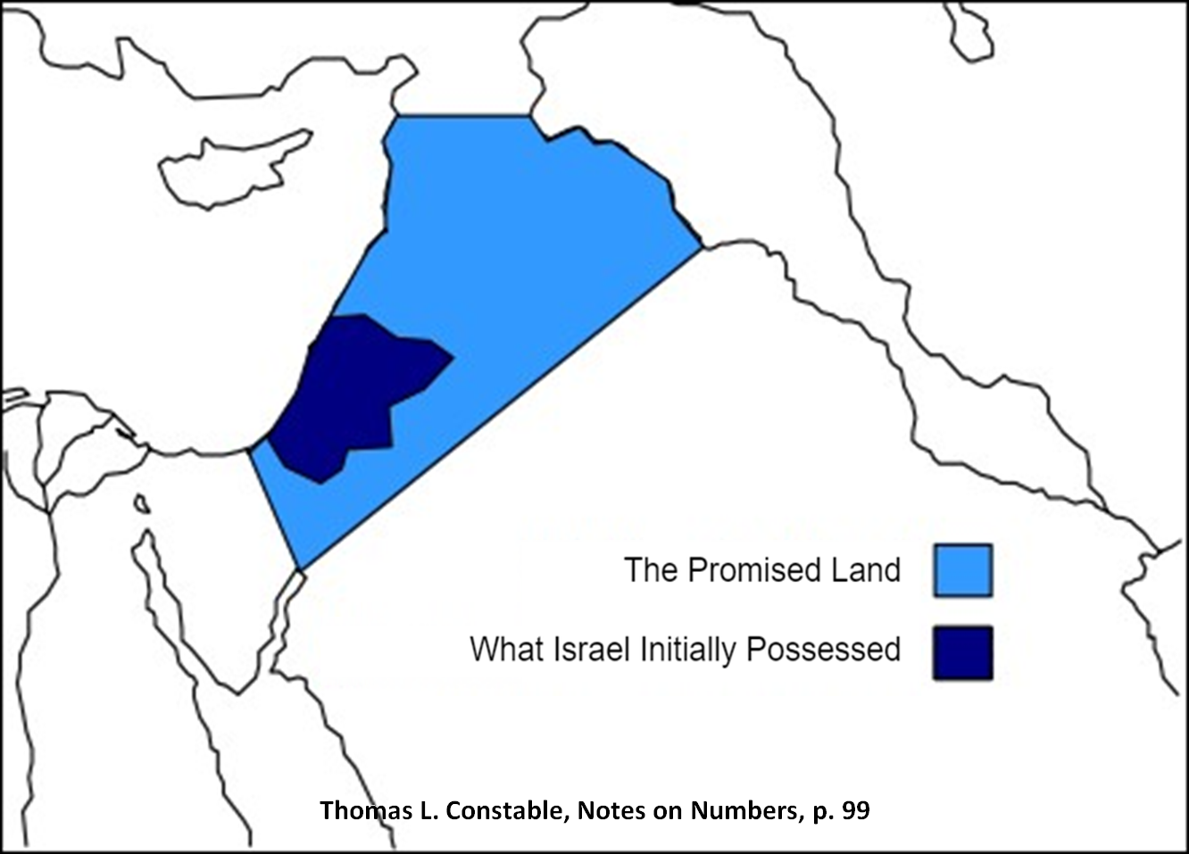

Slide 72
Conclusion

Slide 73
Zechariah 14
(Israel’s Kingdom)
Jerusalem’s deliverance (14:1-7)
Kingdom conditions (14:8-11)
Enemies’ judgment (12-15)
Kingdom worship (16-21)

